Slide 1


12th Annual South-East Asia Red Cross Red Crescent Leadership Meeting 2015 Post-2015 Sustainable Development Goals
Cambodia 25-27 February 2015

Slide 2

Post-2015 Sustainable Development Goals
SDGs will be the new MDGs.
Will be adopted in a summit in New York in Sept 2015.
Wide ranging agenda covering all aspects of sustainable development.
Consistent IFRC and NS engagement through the process
Cambodia 25-27 February 2015

Slide 3
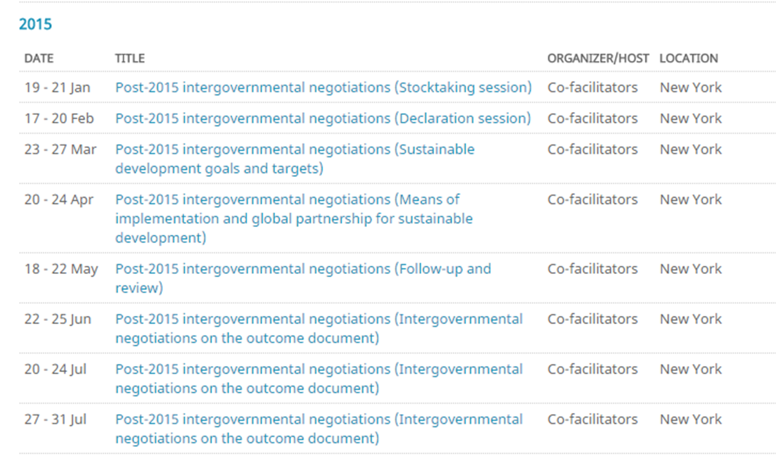
Post 2015 Development Agenda Final Phase (Jan-July 2015)
Cambodia 25-27 February 2015

Slide 4
Synthesis Report of UN Secretary-General on the Post-2015 Agenda
Cambodia 25-27 February 2015

Slide 5
Post 2015 Development Agenda: Some Key Messages
Resilience and disaster risk reduction:
It is critical that resilience and disaster risk reduction be mainstreamed in the new agenda, in order for development gains to be sustainable and protected.
The OWG report mainstreamed these issues into the SDG goals and targets, these should be maintained in the final outcome.
Prioritize the poorest and most vulnerable:
Development action must prioritize addressing the needs of the poorest and most vulnerable.
The SDGs have integrated this concern in a number of ways: 1) through “getting to zero” targets on hunger, malnutrition and communicable diseases, 2) through the universal provision of basic services such as health, education, and water and sanitation, 3) through a focus on inequality, which is a standalone goal.
These targets must remain and this should be prioritized in implementation.
Financing must trickle down to the local level:
Adequate resources for the post-2015 agenda must be mobilized, and these resources have to be allocated at the local and community levels, where development impacts are most felt.
Cambodia 25-27 February 2015

Slide 6
Post 2015 Development Agenda
3 sets of activities to ensure optimal outcomes in the post-2015 process:
IFRC New York office to continue to influence negotiations in New York to ensure that the outcomes of the post-2015 processes reflect RCRC interests and areas of concern
National Societies should engage with their governments to ensure that national positions on the post-2015 process reflect RCRC interests
Position RCRC National Societies and the IFRC, as implementers of choice for the post-2015 framework/SDGs
Cambodia 25-27 February 2015

Slide 7

Thank you

