Slide 1



12th Annual South-East Asia Red Cross Red Crescent Leadership Meeting 2015
Cambodia 25-27 February 2015

Slide 2

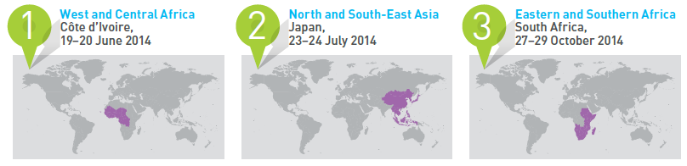
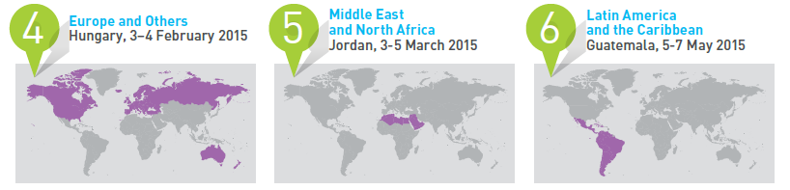
WHS Regional Consultations
Cambodia 25-27 February 2015

Slide 3
WHAT: Four Themes
Cambodia 25-27 February 2015

Slide 4
Two Main Expected Outcomes
Outcome 1: Build consensus and ownership of the process and establish/ reinforce networks that will take summit recommendations forward.
Outcome 2: Agree upon a future agenda for humanitarian action and the modalities to execute summit recommendations.
Cambodia 25-27 February 2015

Slide 5
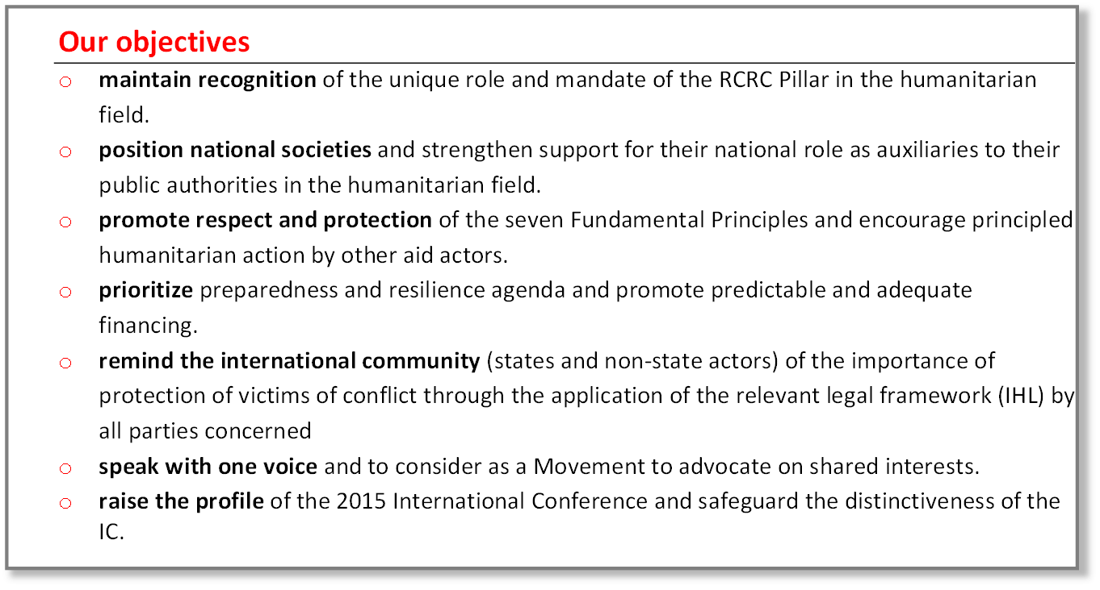
Why should we engage?
Cambodia 25-27 February 2015

Slide 6
RCRC engagement in WHS
National Societies are engaging with their Governments in discussions & consultations on WHS.
RCRC participation in regional consultations and in the Regional Steering Committees that organize these consultations.
RCRC participation in each of the global thematic task teams on the four WHS themes.
Task Team of NS, IFRC, ICRC is helping to coordinate ourselves and develop positions
The Task Team has developed a joint concept paper that provides overall guidance. The Task Team is also working on producing thematic papers on the four WHS themes, going into greater detail / substance.
Cambodia 25-27 February 2015

Slide 7
How can National Societies participate?
Engage in the Task Team of NS, IFRC, ICRC.
Promote national dialogue with partners and relevant government entities to support RCRC priorities and key messages.
Secure broad participation of member NS in the regional consultations, including participation in the regional steering groups and preparatory processes.
Encourage consultation and coordination among NS at the regional level.
Provide input / engage in preparations of RCRC thematic papers, sharing insight and experiences from the region.
Encourage and support NS staff and volunteers to participate in the online consultation platform.
Cambodia 25-27 February 2015

Slide 8
Some key messages
Promote local actors’ role in preparedness and response
Promote and enhance legislations and policies that support the auxiliary role of NS and their capacity building and resourcing
Promote legislations and policies that provide and safe and enabling environment for volunteers
Promote legal preparedness, IDRL, IHL
Accelerate progress in strengthening domestic legal/procedural preparedness for humanitarian assistance
Developed countries should meet their commitments on financing risk reduction
At the 2nd GPDRR (2009) developed countries pledged to allocated 1% of ODA for DRR. 5 years later, this commitment has not even been half met. Today, only 0.4% of ODA is allocated for DRR.
Cambodia 25-27 February 2015

Slide 9

Thank you

