Slide 1
Rights of Migrants in Action Benefits for National Society

Slide 2
Overall objective
RIGHTS OF MIGRANTS IN ACTION To promote and protect the human rights of migrants in targeted countries, migration corridors and regions through a globally coordinated civil society action, with a specific focus on migrant domestic workers and victims of human trafficking
IFRC
Positioning as Development actor
New contractual opportunities
People-centred approach
Accountability to EU
15 Involved NSs
Driving role (Focal point,
Independent Evaluation Committee)
Auxiliary role strengthened
Positioning towards society/stakeholders
Coordination of CSOs
New skills acquired
Partner NSs
Support to the process
Coaching role
Sharing of capacities
provision of know-how (technical/thematic)
NSs in selected neighbouring countries (Cluster NSs)
Use of produced material
Participation in trainings and regional meetings
Roles and responsibilities
Direct Cooperation agreement with DG DEVCO
Building blocks
General Assembly 2013 (IFRC Budget 2013 – 2015)
S2020; IFRC Migration Policy, 2009; International Conference, 2007, 2011

Slide 3
Relevance of the Project
Migration: an issue of growing attention and concern – estimated 232 million international migrants
Working with and for vulnerable migrants is one of the long standing tradition of the RCRC Movement. It is rooted in its FP and universal character as well as in is volunteer and community basis
The project supports the RCRC mission to reduce risk, to build community and individual resilience, and improve the lives of vulnerable migrants throughout their journey
Project in accordance with IFRC Policy on Migration (Principle 4: Recognizing the right of the migrants; Principle 5: Linking Assistance, Protection and Humanitarian Advocacy for Migrants) and Resolution 3 adopted at the 31st IC «Migration: ensuring Access, Dignity, Respect for Diversity and Social inclusion»

Slide 4
Protection in Action
We can work together to change perceptions of migrant workers;
There is a need to present the human story rather than faceless statistics. Terminology is important; we need to get it right;
Ensuring migrant voices are heard by involving migrant workers in migration programmes and initiatives;
Positive engagement with Media, including encouraging timely publication of accurate data and use of data;
Linking government and civil society actions in sending and receiving countries
Improving inks between local communities, migrant worker and other partners).

Slide 5
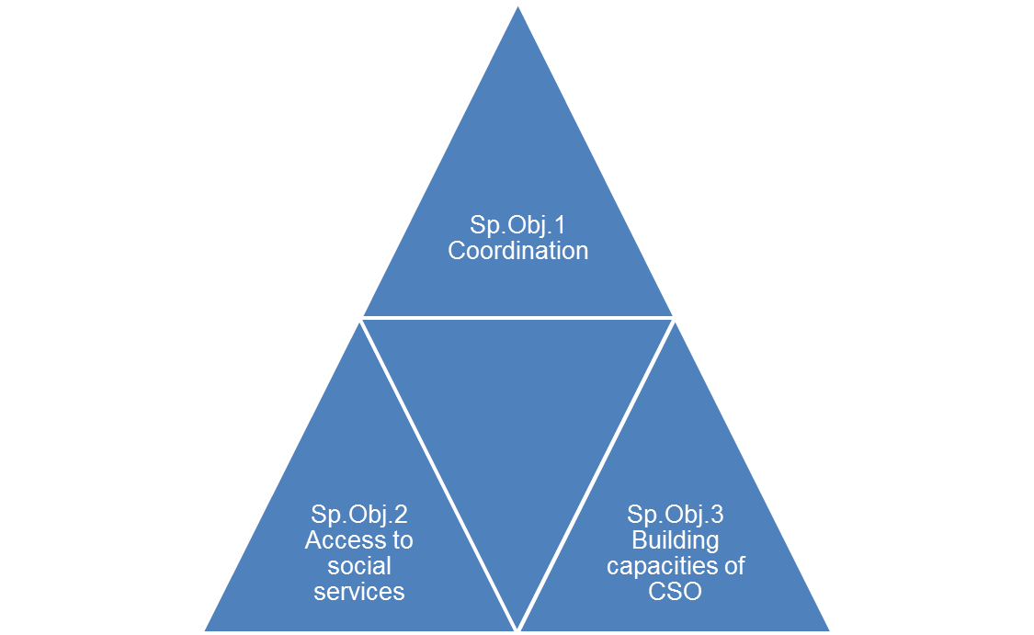

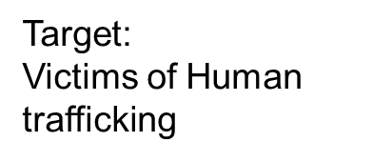

Specific objectives and target
Notes:
Sp. Obj. 1: To foster a harmonised and coordinated approach to civil society organisations toward the protection of human rights of migrants, in particular regarding migrant domestic workers and victims of human trafficking
Sp. Obj. 2: Migrants’ access to social services of the targeted countries, and provision of services, is enhanced through small scale CSO projects.
Sp. Obj. 3: To build and strengthen the capacities of civil society organisations to support the improvements of human rights of migrants, in particular regarding migrant domestic workers and victims of human trafficking

Slide 6
How Will We Do It ?
Under Component 1(Coordination)
Baseline will be established (desk studies and country specific surveys).
Exchange of good practices and networking between CSOs (group meetings, a community of practise and regional and global events).
Engagement in dialogue with public authorities(launch of advocacy campaigns, information sessions).
Under Component 2 (Access to social services)
Launching Calls for Proposals and evaluating, selecting and contracting the projects.
Enhancing migrant’s access to social and other services (small scale CSO projects).
Notes:
Under Component 1
Baseline will be established ,(desk studies and surveys).
Exchange of good practices and networking between CSO (group meetings, and regional and global events).
Engagement in dialogue with public authorities(launch of advocacy campaigns).
Under Component 2
Enhancing migrant’s access to social services (small scale CSO projects).
Launching Calls for Proposals and evaluating, selecting and contracting the projects.

Slide 7
How Will We Do It ?
Under Component 3 (Building capacities of CSO)
CSO capacities will be enhanced (training, development of coaching and monitoring mechanism for the selected small-scale projects)
Development of e learning tools
Peer to peer learning and share of experiences though different forums /platform
Notes:
Under Component 3, CSO capacities will be enhanced through provision of technical assistance and training sessions prior to the launch of the Call for Proposals. Continued technical assistance to civil society organisations throughout the implementation period of the selected projects will be provided, touching upon both knowledge/substance and competences/skills aspects. This component will also include developing and applying coaching and monitoring mechanisms enabling a close and regular follow-up of the implementation of the selected small-scale projects.

Slide 8
Cluster Approach
Introduction of a cluster approach (group of the countries) to be involved in the project implementation.
There will be several invited countries attached to the centre country considered as cluster countries.
e.g Thailand (centre of the cluster ), Myanmar, Cambodia, Vietnam and Lao (invited countries).

Slide 9
Benefits for the National Society
Convenor role of NS, profiling and positioning NS
Develop a sense of ownership by having appointed focal points, trained and supported by IFRC.
Take part in the committee members responsible for the selection of the small scale grants
Strengthen their auxiliary role to their respective governments.

Slide 10
Benefits for the National Society
Increase capacity in the human rights areas related to migration.
Engage in joint capacity building with Civil Societies Organizations (CSOs) through the organization of trainings (e.g. programme management, financial and narrative reporting, M&E and migration).
Dialogue with public authorities and other stakeholders in the selected countries and in launching coordinated advocacy campaigns aimed at promoting migrant’s rights and influencing policy development.

Slide 11
Benefits for the National Society
Work with new partnerships (national societies will work with DG DEVCO in joint management mode).
Working with civil society organizations, other relevant stakeholders (ILO and NGOs),
Academia
EU delegations at country level,
To leverage the efforts carried out at government level by several development actors in addressing migrants vulnerabilities.

Slide 12
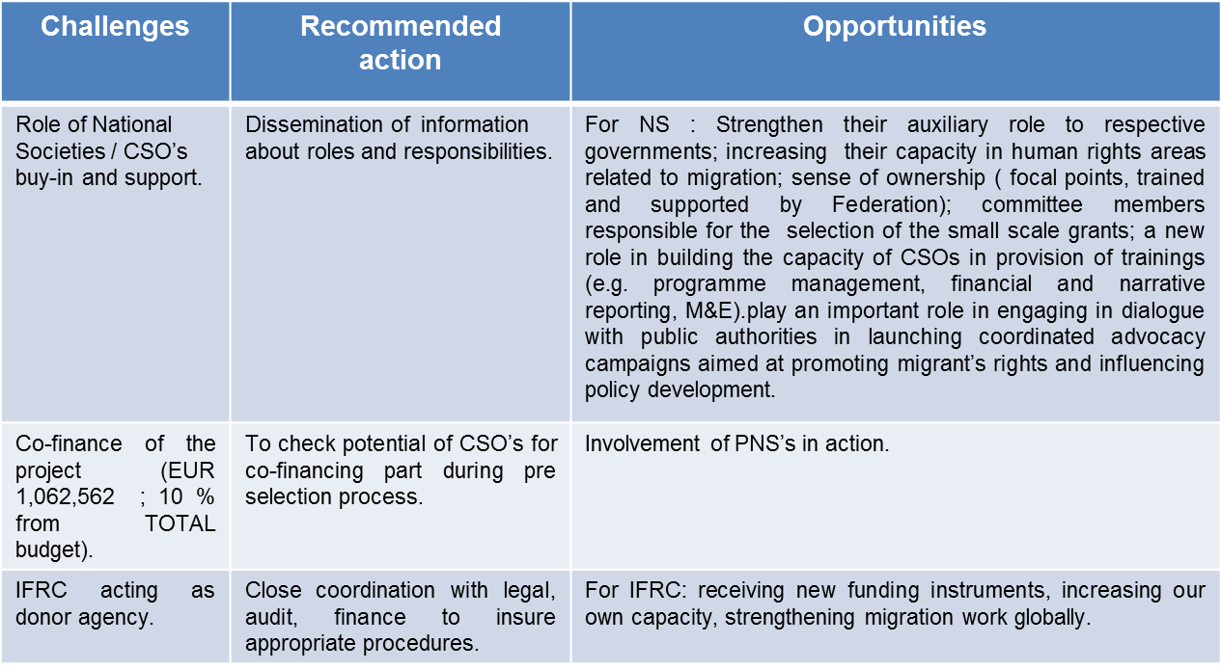
Challenges, Recommended action and opportunities

Slide 13
Thank you
© International Federation of Red Cross and Red Crescent Societies, Geneva, 2014.
Any part of this presentation may be cited, copied, translated into other languages or adapted to meet local needs without prior permission from the International Federation of Red Cross and Red Crescent Societies, provided that the source is clearly stated. Requests for commercial reproduction should be directed to the IFRC Secretariat at secretariat@ifrc.org
All photos used in this presentation are copyright of the IFRC unless otherwise indicated.

