Slide 1

CRC Auxiliary Role to Public Authorities
Relationship with Private and Public sectors
and OD Progress Update
Phnom Penh, 25-27 February 2015

Slide 2
Presentation Outline
Auxiliary role to public authorities
Relationship with Private and Public Sector
CRC OD Progress Update
  Governance and Management
  Branch/Sub-Branch Development
  Human Resource Management and Development
  Resource Development
  Communication and Cooperation
  Administration and Finance Development
  Planning, Monitoring, Evaluation and Reporting
  Steps to be taken;

Slide 3
I- Auxiliary role to public authorities
The Cambodian Red Cross (CRC) was established on 18 February 1955, was recognized by the Royal Government (Royal Decree No. 378/NS) on the 16 June 1958 as the Khmer Red Cross Society;
CRC officially recognized as auxiliary to the public authorities in humanitarian field by Royal Decree (No. NS/RKT/113 dated 06 May 2002);
Royal Government of Cambodia respect CRC adherence to the Seven Fundamental Principles;
CRC has close coordination and cooperation with, and received great support from the government, especially in fund-raising;

Slide 4
I- Auxiliary role to public authorities
In national contingency plan, CRC was assigned a main role for provision of humanitarian relief assistance in collaboration with Ministry of Commerce, and as secondary role for shelter/camp management in collaboration with Ministry of National Defense and other relevant ministries;
The government recognizes CRC involvement in drafting Law on Road Trafficking (the law was adopted recently); and drafting Disaster Law which endorsed by the Council of Ministers and submitted to the National Assembly for adoption;
All CRC activities have been recognized by the government. Hence it has been invited to be a member of many national inter-ministerial committees dealing with humanitarian matters;

Slide 5
II- Relationship with private and public sector
Some members of Central Committee are from businessmen; they are involving in fundraising especially in WRCRC Day, May 8;
Private sector provides support during fundraising events, emergencies and project activities;
Public sector provides support during fundraising events, emergencies and project activities, and has a close coordination and cooperation with CRC;

Slide 6
1. Governance &Management
2. Branch Development
3. Human Resource Manag. & Dev.
4. Resource Development
5. Admin/Finance Dev.
6. Communication &Cooperation
7. PMER

Slide 7
III- CRC OD Progress Update
Governance and Management
  Statutory texts including Statutes, Rule of Procedures and Financial regulations;
  6th General Assembly (6-7 August 2014);
  Ext.-ordinary GA (6 August 2014);
  RCY Assembly (5 August 2014);
  Strategy 2011-2020; 4YDP→6YDP
  Decentralization and de-concentration directions;
  Policies and guidelines:
    RCY policy, RCVs policy, Child Protection policy and others;
    Guideline on the Project and Programme Implementation under the Decentralization and de-concentration directions; and other guidelines;
Notes:
Governance and Management
6th General Assembly (6-7 August 2014)
Elected dedicated and committed Central Committee members (29 members including 3 substitute members); show in CRC Newsletter;
Appointed 1 Secretary General and 2 Deputy Secretaries General;
Adopted activity and financial reports of 5th Term of office;
Adopted objectives and budget for 6th Term of office;
Ext.-ordinary GA (6 August 2014):
Adopted amendment Statutes, rules of procedures and financial regulations;
Note: The Statutory text will be uploaded on CRC website;

Slide 8
III- CRC OD Progress Update (cont.)
  Constituency, Structure, Roles & Responsibilities
    Decision on ‘the CRC Organization and Functioning’ approved;
    CRC works throughout the country;
    NHQ: Five Departments (AFD, COD, DMD, HED, HRD);
    25 Branches at provincial level with 3 categories of structures;
    184 Sub-Branches at district level; 1302 Red Cross groups at commune level and RCVs at village level;
Notes:
The Central Committee adopts the decision on “The Organization and Functioning of the Cambodian Red Cross” ; delegating the role and responsibility; establishing a Special Advisory Committee and other committees which will include high ranking officials from relevant Ministries that work together with the Cambodian Red Cross, if needed .

Slide 9
III- CRC OD Progress Update (cont.)
Branch/Sub-Branch Development
  Branch capacity is improved as its development is in compliance with decentralization and
  de-concentration directions;
  All 25 branches organized their branch assemblies;
  Reviewing branch structure & staffing accordingly;
  Conducted BOCA induction to 5 branches—2 year commitment;
Notes:
All 25 branches organized their branch assemblies;
elected committed Branch Committee members;
Adopted activity and financial reports of the 3rd Term of office;
Adopted objectives and budget for the 4th Term of office;
Conducted BOCA induction to 5 branches—2 year commitment in ongoing process (have completed BOCA exercise with Characteristics of Well-Functioning Branch and will conduct next BOCA in the next 2 years);

Slide 10
III- CRC OD Progress Update (cont.)
  24 branches issued its Decisions on the Organization and Function (Role and Responsibility)
  Branch Structures:
    minimum level: 8 branches;
    level 1 of development: 14 branches;
    level 2 of development: 4 branches
  Sub-branch committee members of 83 Sub-branches are appointed and recognized by CRC-NHQ; 2 staff are stand-by at each Sub-branch office;
  83 Sub-branches have its own offices across 194 districts of country-wide;
  Red Cross groups established in 1302 communes among 1633 communes across country wide;
  At least 2 RCVs in one village (targeting 2020);

Slide 11
III- CRC OD Progress Update (cont.)
Human Resource Management and Development
  Staff: 424 (F: 109)
    NHQ: 123 (F: 34)
    Branch : 301(F: 75)
  RCY: 29,099 (F: 15,789); Youth Advisor: 970 (F:264);
  RCVs: 20,456 (F: 7,821)
  RCY Policy is finalized and published
  Child Protection Policy is finalized and published
  CRC conducted YABC training in 2014;
Notes:
Youth and volunteers are the key active forces of the CRC.
CRC established working group to support Youth and RCV Activities led by by Samdech Kittipritthbindit Bun Rany HunSen, President of CRC.
During the last 4 years of Fifth Term under the wise leadership of Samdech Kittipritthbindit, President of CRC, the organization and the management of CRC youth and volunteers achieved remarkable results as follows:
^{1). CRC Youth Development}
The total number of youth is 29,099, of whom 15,789 are female, whereas in the Fourth Term the total number was 14,676 of which 6,675 were female. The number of youth advisors is 970, of whom 264 are female, from 11 elementary schools, 71 Secondary Schools, 332 High schools, 1 Pedagogical school, 27 Universities (18 in Phnom Penh while 9 in provinces). There were only 13 universities in the 4th Term.
In 2014, CRC chaired the RCRC South East Asia Youth Network (SEAYN) and as Vice-Chairman of the Asia Pacific Youth Network (APYN).
Road Safety Awareness, relief distribution and packaging, peer-to-peer health/hygiene education in school, and during relief distribution,
^{2). CRC Volunteer Development}
As well as the volunteers in the range of governing boards and in the offices, the total of RCVs 20,456 in villages were trained on awareness of the Movement, Fundamental Principles, International Humanitarian Law, First Aid, and skilled tasks related to woman and child health care programme, water and sanitation, and dissemination about danger of landmine, road accident, disaster management, etc...

Slide 12
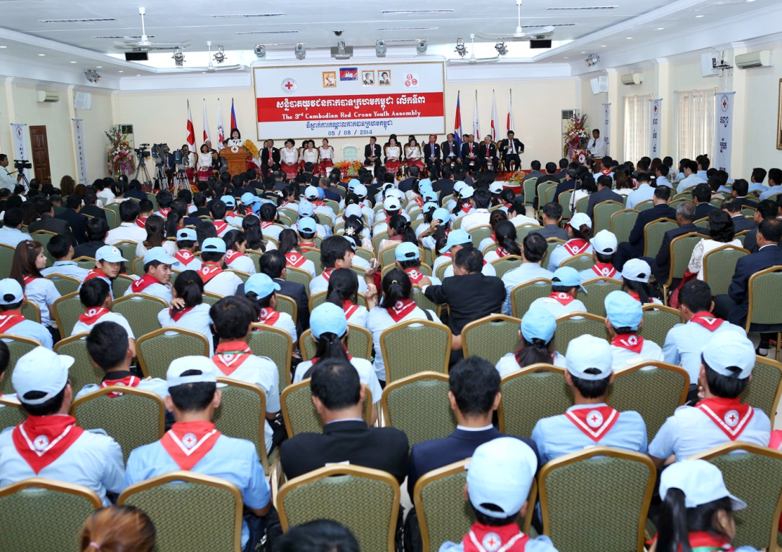
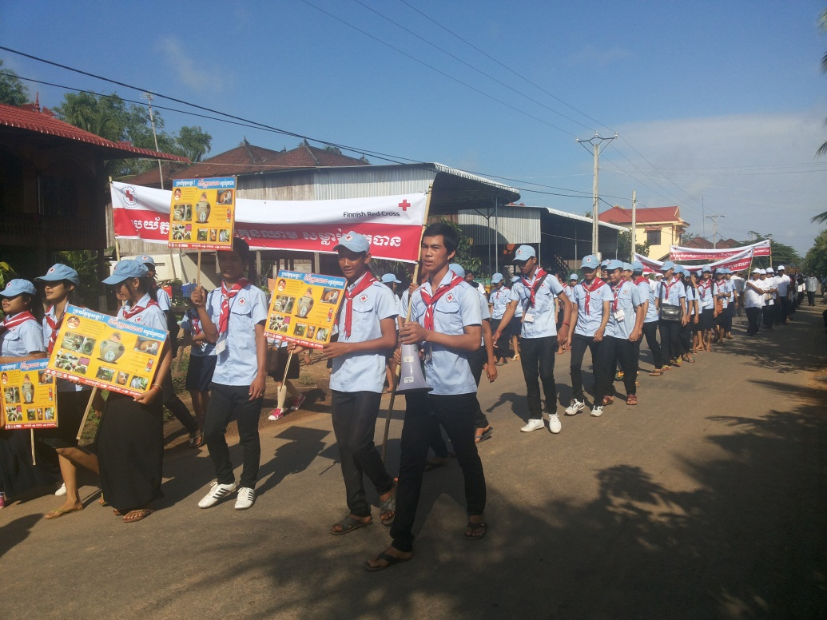
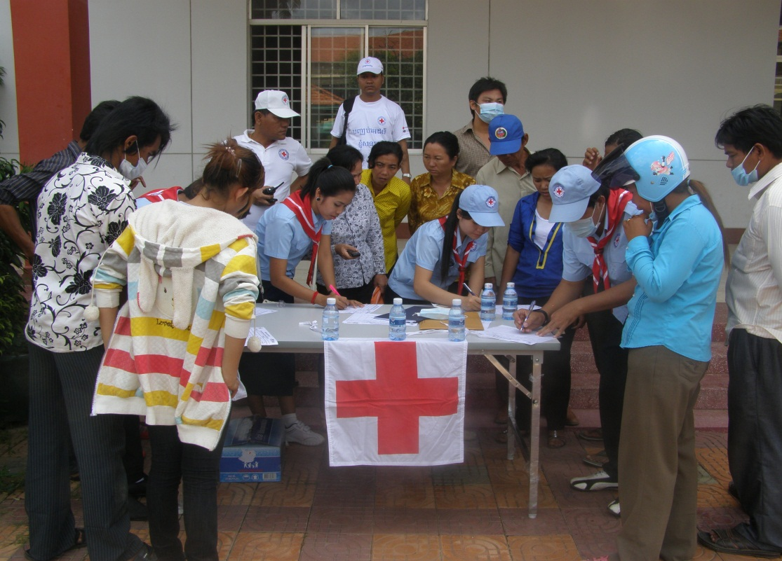
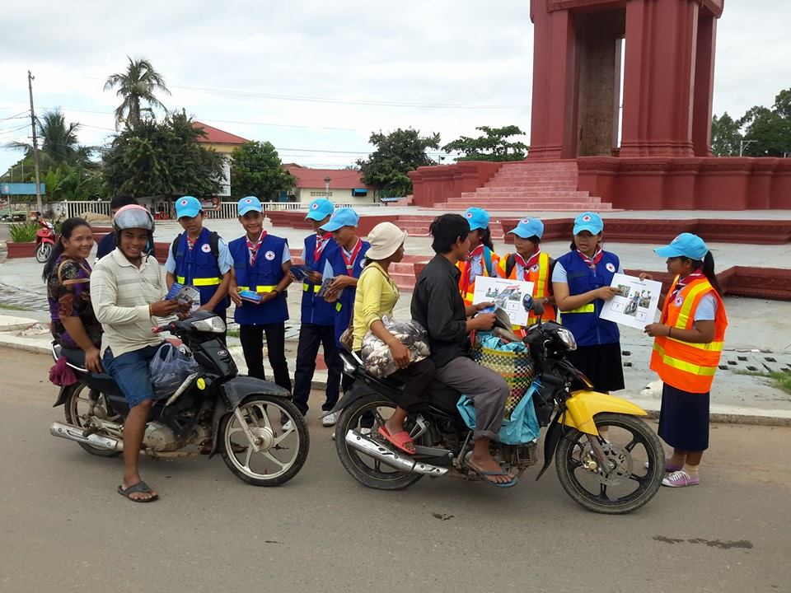

Slide 13
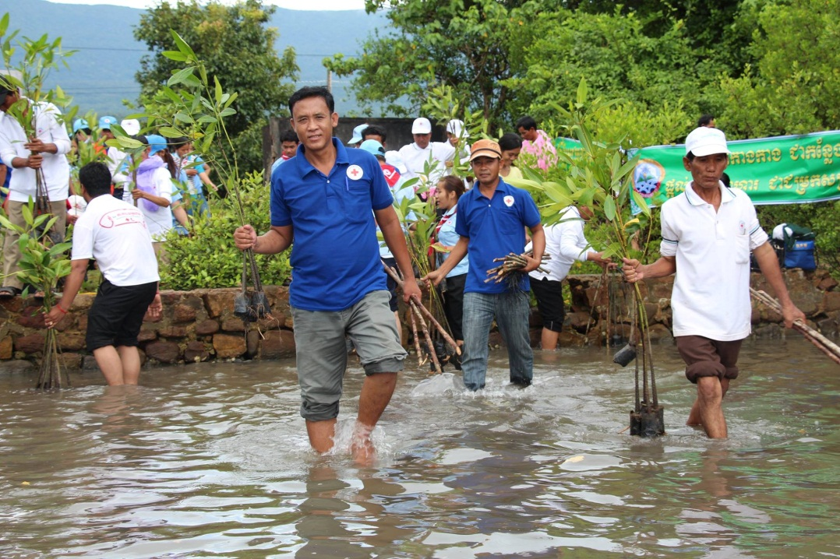
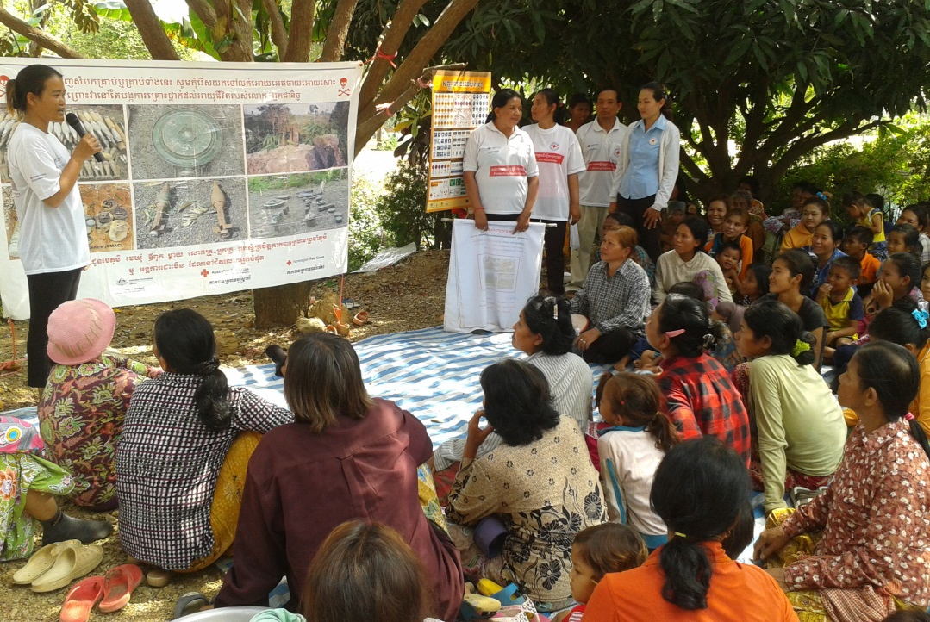
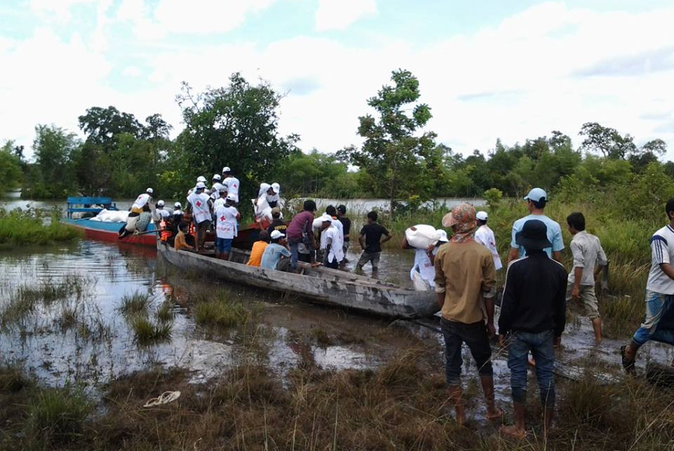
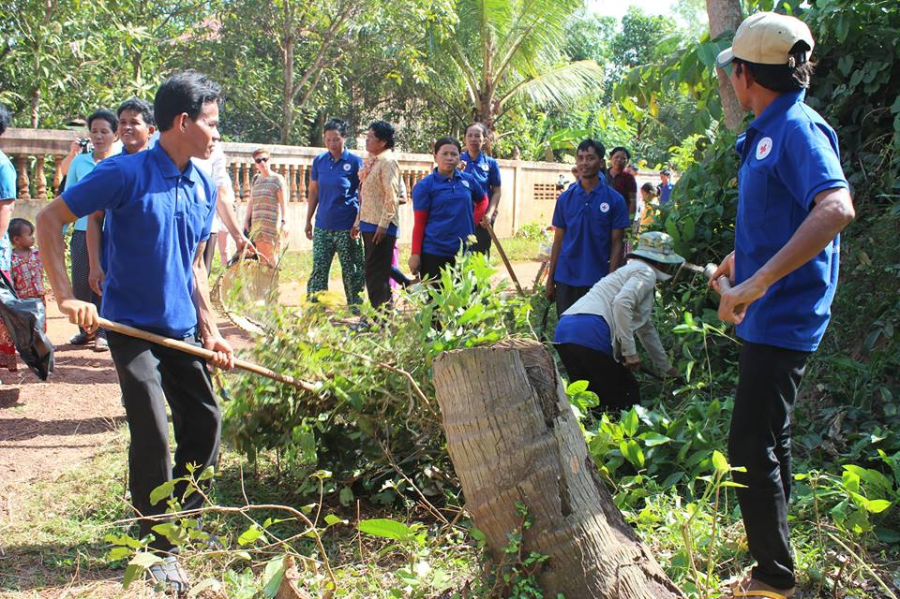

Slide 14
III- CRC OD Progress Update (cont.)
Resource (Finance) Development
  8 May is the main event that CRC both at NHQ and branch level raise funds; and
  Other including commercial first aid, membership fee, donation from generous people, postage stamps, charity boxes etc.
  CRC aims to have a minimum membership of 1% of the registered population in capital or provinces;
  Income generation:
    Phnom Penh Municipality RC Branch run drinking water factory and medical waste management; collaborate with Preah Vihear RC Branch build a new hotel;
    Guesthouse: Svay Rieng, Sihanouk Ville RC and Kep branches;
    Building leasing: Svay Rieng and Battambang branches;
    Raffle: Svay Rieng and Kampong Thom branches;
Notes:
Branches shall aim to have a minimum membership of 1% (one percent) of the registered population in their capital or province

Slide 15
III- CRC OD Progress Update (cont.)
Communication and Cooperation
  National
    As auxiliary to the public authorities in the humanitarian field, CRC is a dynamic partner in coordination and cooperation with:
    Ministry of Health, Ministry of Posts and Tele-communication, Ministry of Education, Ministry of Foreign Affairs and Int. Cooperation, Ministry of Social Affairs, Veterans and Youth Rehabilitation, Ministry of Interior, Ministry of Labor, National Committee for Disaster Management (NCDM), Cambodian Mine Action and Victim Assistance Authority (CMAA), National AID Authority of Cambodia (NAA), National Road Safety Committee, local authorities at all levels etc.;
    Media: local media including national and private radio, TVs for broadcasting CRC activities; and but not limited to international media during disaster;

Slide 16
III- CRC OD Progress Update (cont.)
Communication and Cooperation (cont.)
  International
    CRC has co-operational partners including Red Cross family, non-Red Cross and UN partners:
      IFRC, ICRC, ARC, Red Cross Society of China (RCSC), DRC, FRC, FinRC, German RC, JRCS, SRC, Italian RC and others support during disaster;
      World Mate, DFID, Global Fund, Family Health International etc.
      WHO, UNICEF, UNAIDS etc.
    Quarterly Movement Coordination meeting on progress update, challenges etc.
    Twining branch: CRC and VNRC especially branches situate along border, for disaster response, health in emergency;
    CRC is Acting Chair of Regional Health Technical Working Group;
    CRC is the first ever chair of Southeast Asia Youth Network (SEAYN) in 2014, and Deputy Chair Asia Pacific Youth Network (APYN) in 2014;
    CRC is a member of Regional Disaster Management Committee;
Notes:
Under the RDMC, CRC leads DP, DRR and CSR (Community Safer Resilience);

Slide 17
III- CRC OD Progress Update (cont.)
Admin. and Financial Management
  Develop and implement standardized administrative and financial system, policy and procedures at headquarters and branch levels;
  Strengthen admin. and finance systems, and ensure transparency and accountability to donors and beneficiaries through internal control and external audit;
  Build capacity of branch and sub-branch staff through trainings on admin. and financial management;

Slide 18
III- CRC OD Progress Update (cont.)
PMER
  CRC has strengthen PMER process through establishment of PMER Unit under the Admin. & Finance Department, tasking to:
    advice and help departments and branches in developing operational and long-term plans; producing reports based on M&E and in compliance with CRC standard;
    Produce overall monthly, quarterly and annually reports;
    take part in conducting M&E of projects/programmes;
    train NHQ and branch staff on M&E;

Slide 19
III- CRC OD Progress Update (cont.)
Steps to be taken
  Review CRC decentralization and
  de-concentration directions;
  Disseminate new Statutory Text (Statutes, Rules of Procedures, Financial Regulations);
  CRC Strategy 2011-2020 mid-term review ;
  Revise CRC 6YDP (2015-2020) with above Strategy mid-term review recommendations;
  Revise branch 6YDP (2014-2019) with BOCA findings;
  Conduct BOCA in other 20 branches;

Slide 20
III- CRC OD Progress Update (cont.)
Steps to be taken
  Review HR Development Strategy;
  Submit for approval and print RCV Policy and its guideline;
  Conduct mid-term review on Condition of services ;
  Upgrade PMIS as web-based database;
  Encourage 25 branches to prepare for internal audit;

