Slide 1
Introduction

Slide 2
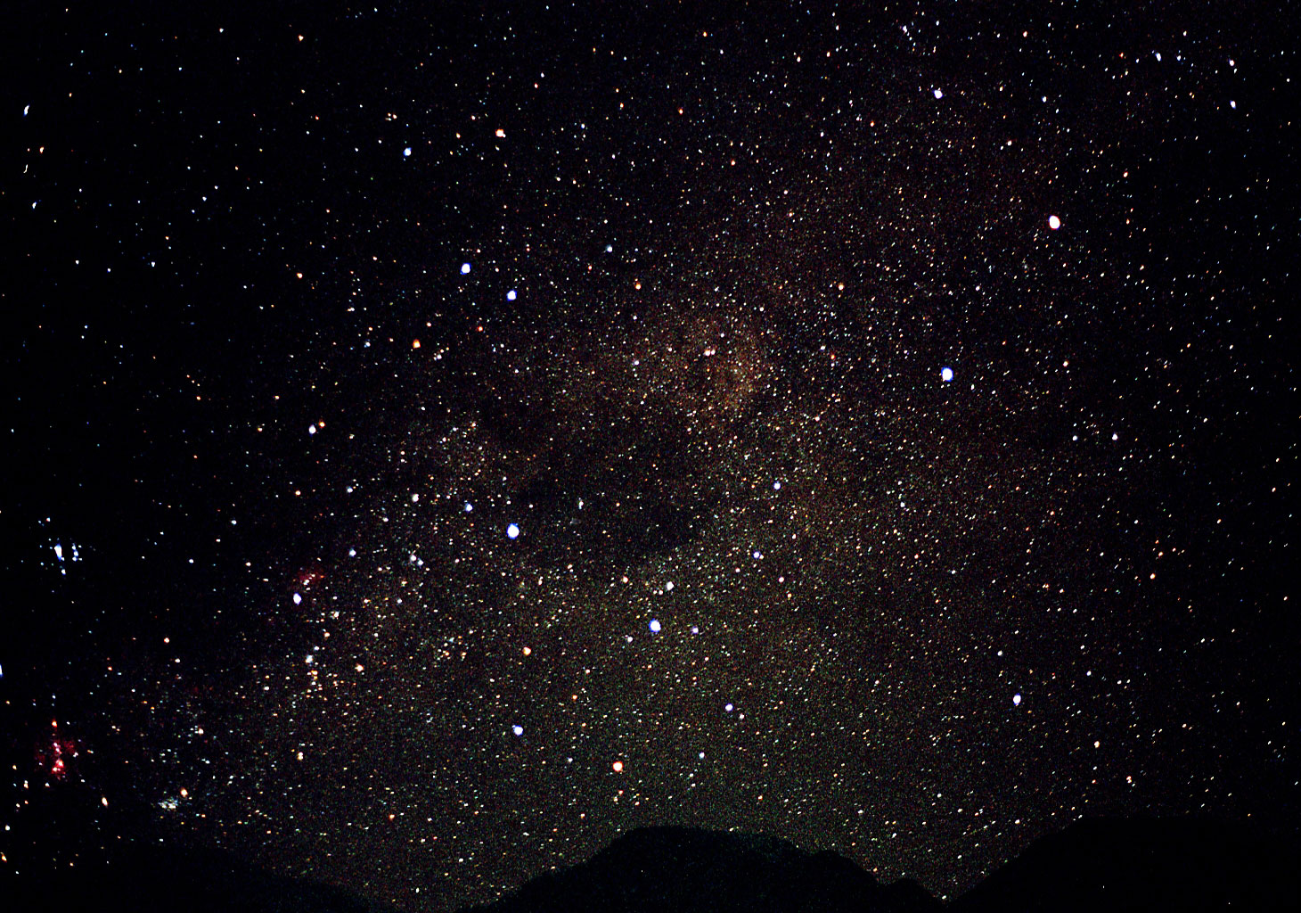
WELCOME
Notes:
This training is a joint effort by IFRC SEARD and the Red Cross/ Red Crescent Climate Centre
Local host:
Welcome + house rules / practical logistics etc.:
Facilitor(s)
Welcome – team introduction:
3 “coordinating facilitators” – Bec, ANM, KF – come to us for suggesting changes / clarifications
+ “special guest stars” from DRC/IFRC: Lasse, Hans, Patrick Sam Ban, Cecilia
yourself: experienced crowd – share your observations and ideas – this is new to all of us. You’ll get a chance to introduce yourself in just a minute.

Slide 3
Key objectives of this session
Know the participants of the activity
Establish rapport among fellow participants and facilitators
Share their expectations
Form host teams and establish ground rules
Explain the training purpose and contents

Slide 4
Where do you feel you belong to?
Health
Disaster Risk Reduction
Disaster
response/ relief
Other
Notes:
4
“Pick a corner”
Description:
Make all participants stand up – and choose a corner in the room where you feel you most “belong”
Facilitator: invite each participant to present him/herself [name, main experience (why in this corner), current position]

Slide 5
Introduction
Name with climate related prefix.
Position
National Society/ IFRC Office
Hobbies

Slide 6
Perception of Climate Change (CC)
“I feel fairly well informed on topics of CC and can conduct national training and actively involve in discussions with stakeholders ”
“I see all the hype about CC; but I struggle to see the relevance for the RCRC
“I understand the relevance of CC for RCRC, but struggle to find the practical ways to move forward”
“I admit have no clue on several topics of CC”
Notes:
6
Let participants distribute themselves into corners according to their general understanding of CC issues and implications in general
[note: count the distribution for comparison at end-of-training (“evaluation”)]
Invite a few people from each corner to argue/explain why they have chosen to stand it that corner, and give examples
Facilitators' objective: more people in upper left corner by the end of the training! We will repeat this at the evaluation/debriefing at the last day

Slide 7
Expectations
Content
Methodology
Facilitators
Participants
Logistical arrangements

Slide 8
Objective
The overall purpose of this workshop is to develop a core group of climate change experts amongst SEA National Societies who can provide technical support to plan and implement climate smart program activities at national, sub national and community level.
Notes:
Specific:
To promote a better understanding of climate change and the challenges it poses amongst NSs.
To better understand scientific climate information and the role of different agencies that can support National Societies to plan and implement climate smart project activities.
To understand how to effectively mainstream climate change concerns into programming and identify the opportunities it brings.
To introduce existing tools available for mainstreaming climate change and disaster risk reduction.
To create the confidence amongst NSs to engage in climate change related discussions/dialogue with their Governments and engage in national level policy processes
To enable NSs to raise awareness at national, sub national and community level.
To have a better understanding of climate change policy and financing mechanisms at both the global and national levels, and to stimulate RC NS engagement in these policy dialogues with national government (in particular in the context of the development of National Adaptation Plans (NAPs).

Slide 9
Expected Outcome
Participants gain adequate knowledge in order to appropriately and adequately mainstream climate change in to programming.
Participants have the knowledge and the confidence to engage in national level CC dialogue and planning process.
Participants have the knowledge and confidence to initiate national level training programmes in their respective local language.
Contribute to developing pool of experts at regional and national levels.
Define potential partnerships at national and global levels.

Slide 10
Methodology
Planning and Preparation
Post training PoA
Technical support and Feedback
Climate Change ToT
National level Climate change engagement
Notes:
The capacity development process will have five key interlinked stages

Slide 11
Agenda
Day 1: Climate Science
Day 2 : CCA Mainstreaming / Risk
Assessment
Day 3: Con’t Risk Assessment, Early
Warning Early Action, Public
Awareness and Education
Day 4 : Field Visit
Day 5: CC Mitigation, Finance and Health
Day 6: Gender, NAPA and Plan of Action

Slide 12
Host Teams

Slide 13
Host Team Function
A host team is a group of participants that assumes responsibility in helping the facilitator/s in the daily management of the training-workshop, its tasks are to:
Get people started
Assist the facilitator in pasting newsprint on the wall or blackboard
Ensure marking pens and materials needed for the day are available
Give feedback to facilitators problems encountered by participants
Review previous days activities and link them with the next days activities
Make administrative announcements
Manage the daily schedules
Act as timekeepers
Provide icebreakers

Slide 14
Responsibility – As per Group – Mock Session
Day 2:
Day 3:
Day 4:
Day 5:
Day 6:
Notes:
Session Plan
Key messages
Content for National level training

Slide 16
Parking Section

Slide 17
Logistics

Slide 18
Joining the Online Conversation…

Slide 19
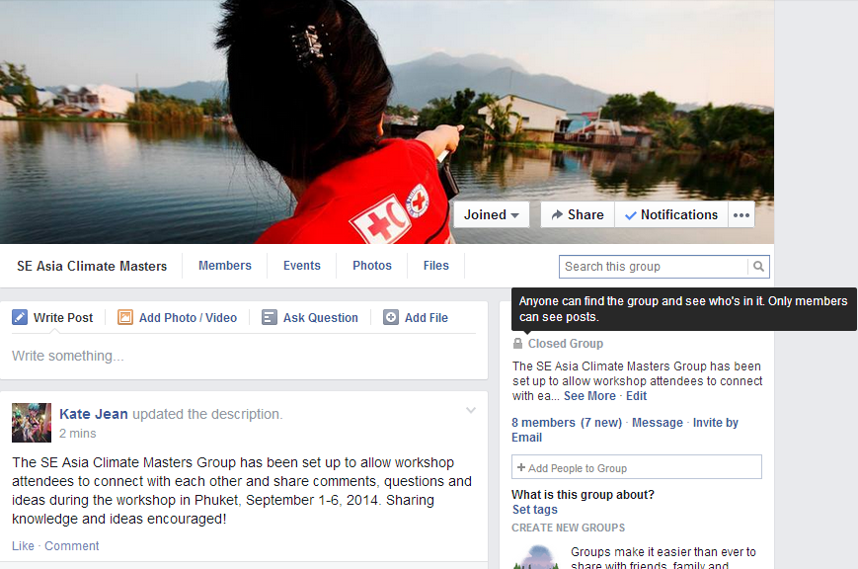
Notes:
Ways you can get involved/contribute #1… FACEBOOK
As you will have seen, we have set up a private Facebook group for this event. To the group you can post comments or pose questions, share photos and also upload documents.
If you haven’t already, please join the Facebook group https://www.facebook.com/groups/1501584126755564/ - connect with your colleagues, and start engaging in conversation. ***Please take a minute to join the group now***

Slide 20
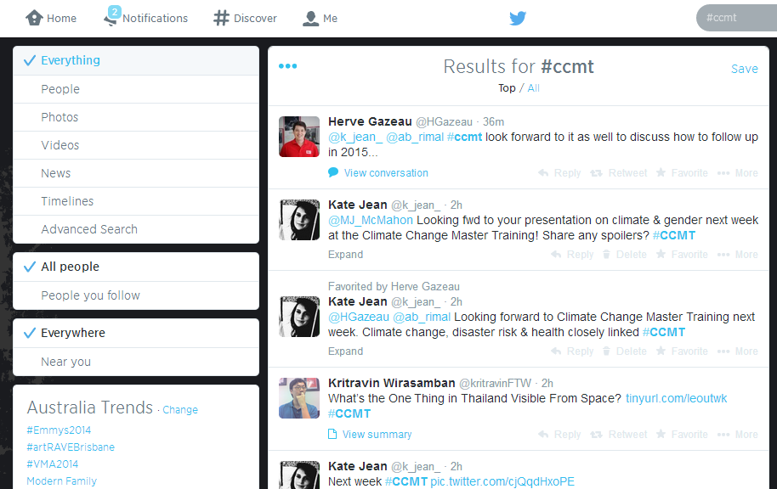
#CCMT
Notes:
Ways you can get involved #2… TWITTER
If you are on Twitter (check show of hands), we also encourage you to tweet and connect with your colleagues there.
We will be watching the #CCMT feed for your comments and questions.
Simply use the workshop hashtag #CCMT – don’t forget to @mention your colleagues or the facilitators if you want to get their attention

Slide 21
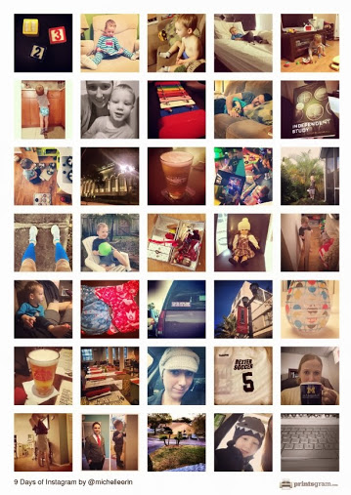
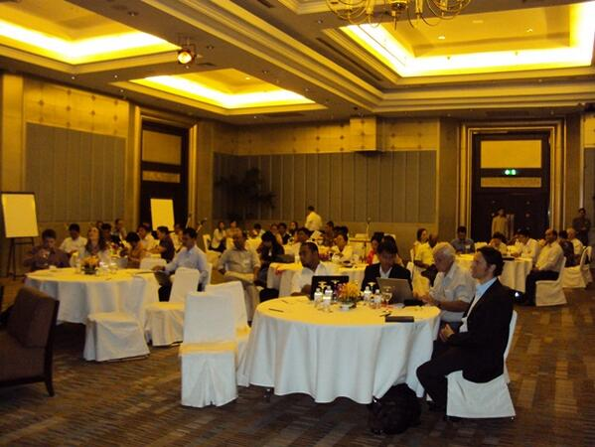
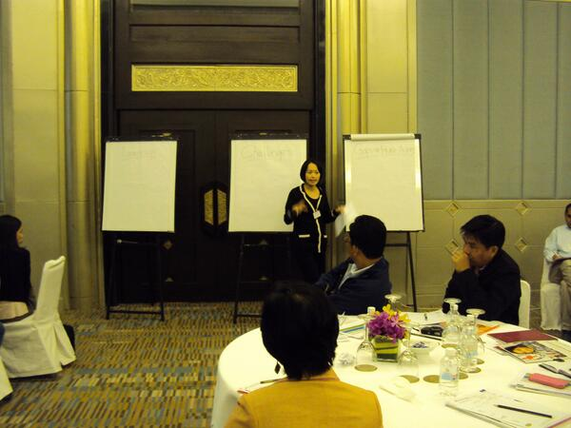
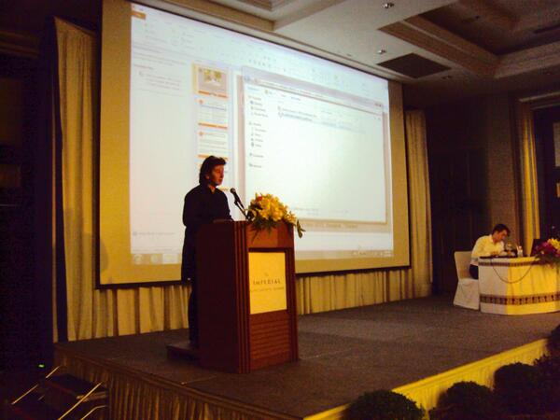
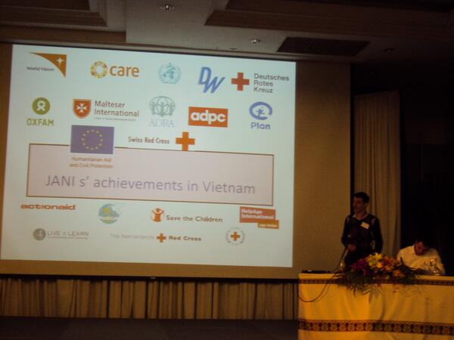
#CCMT
Notes:
Ways you can get involved/contribute #3… INSTAGRAM

Slide 22
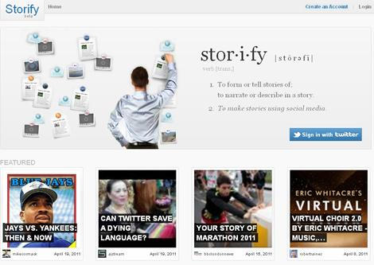
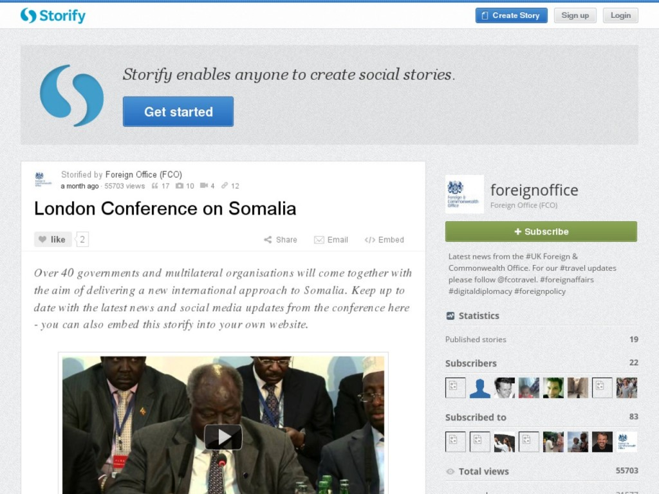
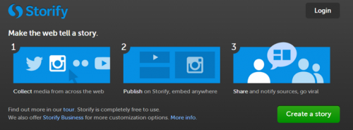
Notes:
Bring it all together into one story, we will be using STORIFY…
* Outline what Storify is
* Outline why and how we will be using it over the coming days
The why: To create a record the workshop, to make it more interactive for workshop participants, to make it it accessible online to people outside the workshop (and allowing them to contribute), to create a ‘selling tool’ for you to take back to your NS and promote to senior people what can be done and the resources available. Environmentally friendly.
The how: I will be observing and building ‘the story’ as the workshop goes – taking photos, tweeting questions and comments, and adding notes. I will also be watching for tweets using the hashtag #.... and will add these to the ‘Story’
* Ask how many people in the room use Facebook? Twitter? Instagram

Slide 23
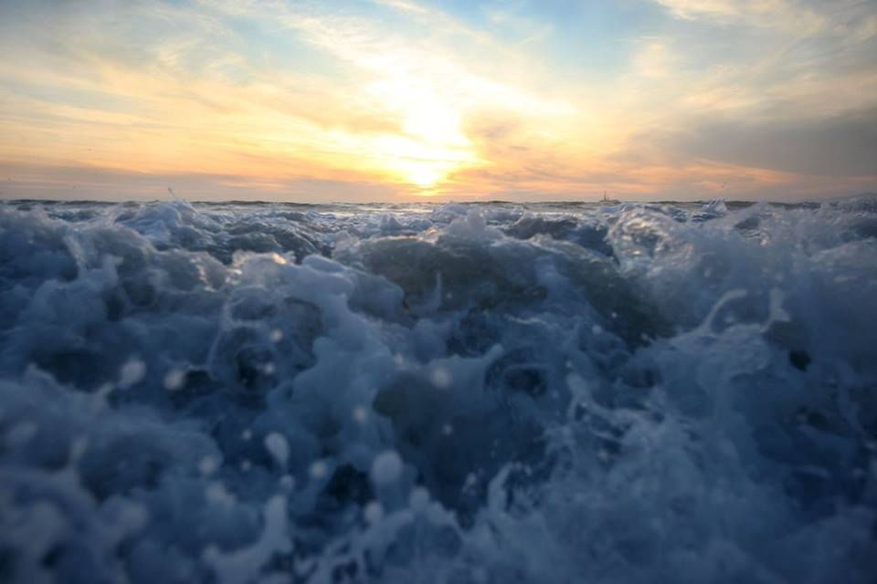
Notes:
You will have seen we sent you an email last week, encouraging you to use social media – particularly Facebook, Twitter or Instagram - during the training workshop this week.
The purpose is three-fold:
1) To enhance your involvement, by giving you a means be which to share feedback during the event and discuss ideas
2) To allow us to collect your feedback (comments, questions, ideas) and photos so we can use it in our reporting
3) To allow you to connect with your colleagues online as well as offline
This event is about two-way knowledge sharing, with the facilitators but also with each other.
We hope social media will enhance this.

Slide 24
THANK YOU

