Slide 1
Notes:
HISTORY:
Now in 150 countries, 7000 cities, it is a huge global, public-facing environmental sustainability campaign lead by WWF – World Wildlife Fund
Started in Sydney, Australia in 2007, when 2 million homes mobilized to switch off their lights as a symbolic action that care about climate change … (has developed into footprint etc)
The visible, symbolic action of switching of the lights (at 8:30pm local time on the last Saturday of March each year) unites people behind the campaign, but the real message and goal of the campaign is to raise awareness of environmental issues, particularly climate change, and move people to action. It is not just about saving energy for that one hour.
Starts in Samoa, sweeps around through to Cook Islands
Today, Earth Hour engages a massive mainstream community on a broad range of environmental issues. The one-hour event continues to remain the key driver of the now larger movement.

Slide 2
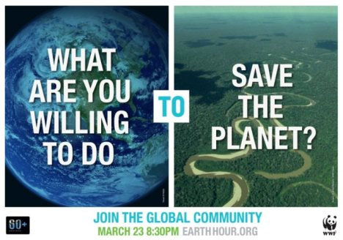
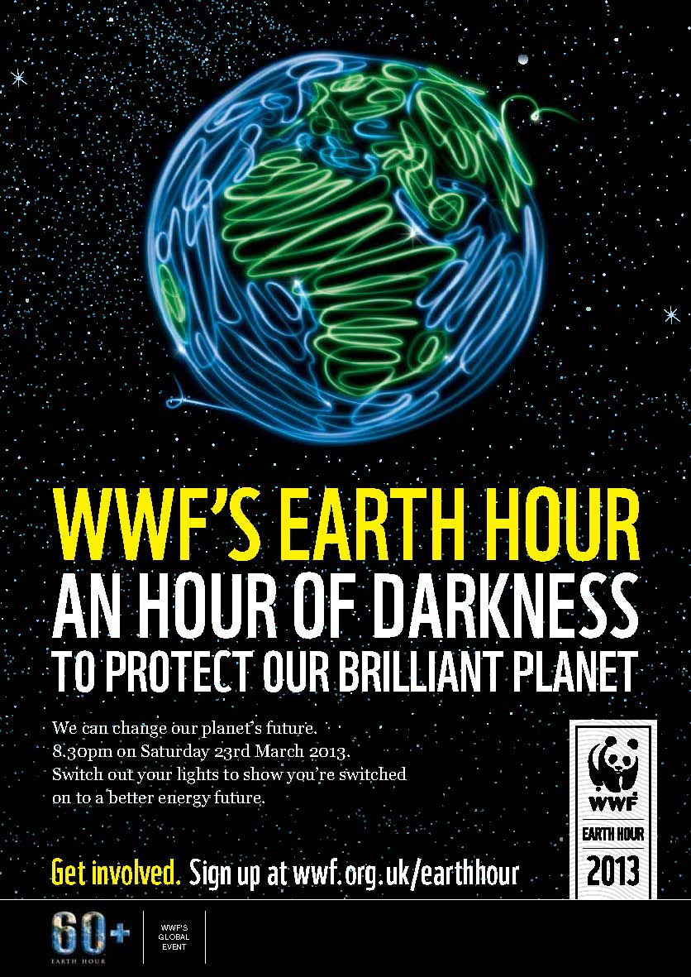
Notes:
How it works
Each year, a theme/concept plus messages and communications toolkits are developed by the global campaign team in Singapore and provided to country offices
2012: Go Beyond the Hour (to highlight more than just one hour)
2013: I will if you will (created a game out of encouraging sustainable action)
2014: Earth Hour Blue (aimed to mobilise crowdfunding/sourcing to support conservation sustainable development initiatives around the world)
The country office adapt according to their own priorities/initiatives and roll out in their communities (e.g. see http://www.earthhour.org/2014-outcomes)
Toolkits: Key messages, logos, suggested activities, posters, online resources (eg banners, code formwebsites)
*Earth Hour is a multipronged campaign, targeting a range of groups at different levels…. So, Messages are tailored for range of target audiences: Individuals/families, business, schools, community groups

Slide 3
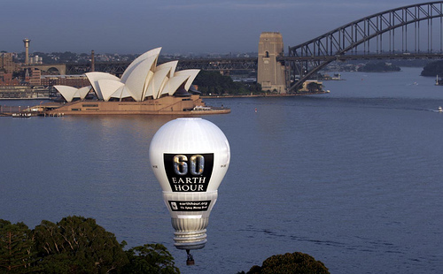
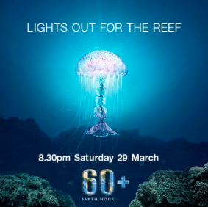
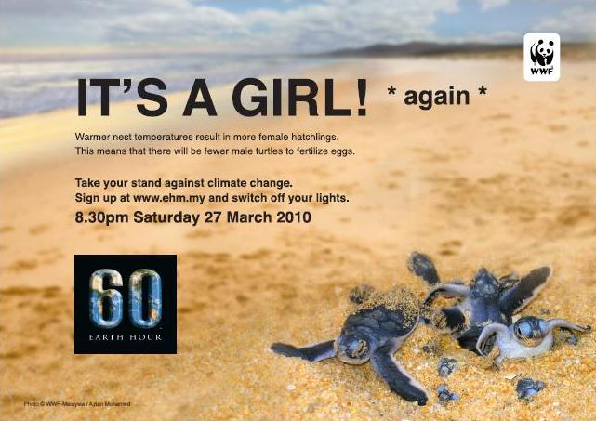
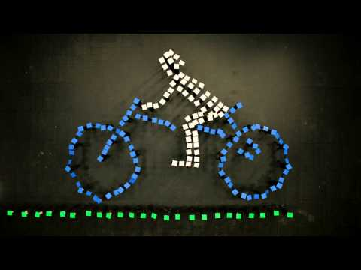
Notes:
Australia
Each year WWF-Australia receives global, top-level key messages
The Australian WWF team adapts according to priority for that year (public support for action on climate change 2007, environmental footprint in 2012, Switch off and switch on to solar/renewable energy 2013, impact of climate on GBR 2014)
They launch the campaign by reaching out to schools, community groups, business, local councils via a huge communications strategy (letters, meetings, email), using media partnerships and partnerships with government to promote
Over time have built relationships with councils – share the toolkits with councils who use campaign to promote their own campaigns and initiatives
Community groups organise events, individuals organise events
Schools really drive the initiative. Students take information home and share with their families

Slide 4
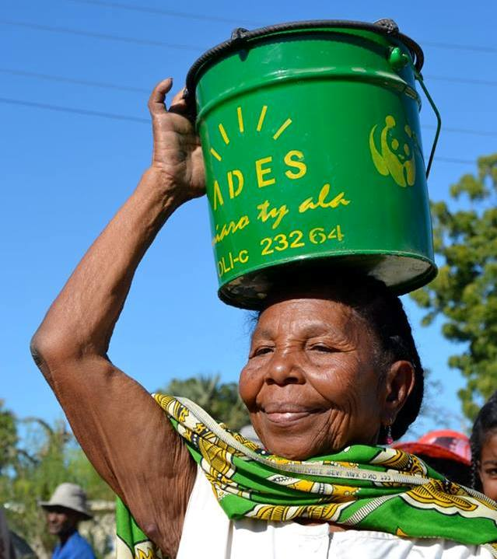
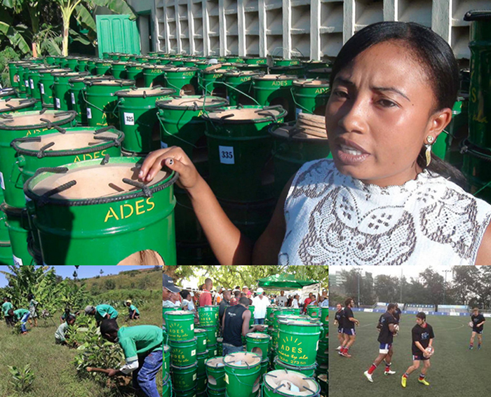
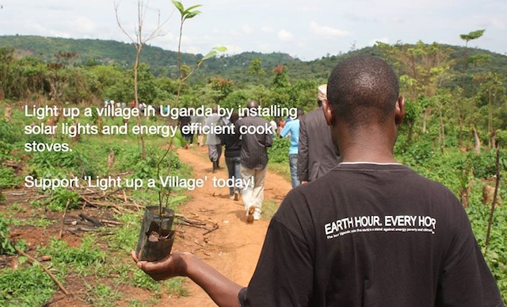
Notes:
Madagascar
2014
Assistance of WWF-France, who helped with PR, social media and ambassador support
he project raised US $4,419 on the Earth Hour Blue global crowdfunding platform, delivering 519 highly efﬁcient cook stoves to families in Madagascar.
The stoves cut a families wood reliance by half and help prevent deforestation.
WWF and Earth Hour partners in Madagascar handed out 1000 wood saving stoves to victims of February’s cyclone Haruna, passing significant savings on to families while reducing charcoal producing and wood gathering impacts on forests.
instead of asking people to switch off lights they don’t have.

Slide 5
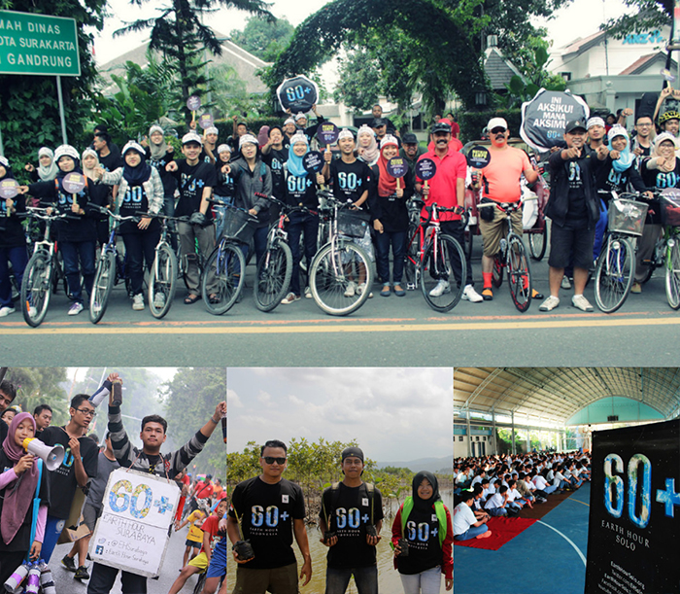
Notes:
Indonesia
WWF Indonesia hosts an annual Earth Hour Schools event (Kumbang) where the key participants from each city join to help decide the annual focus of Earth Hour.
Very much youth led – promote public transport, reduction in paper and tissue, reduction in use of plastic, tree planting and energy saving.
Movement’s most active global participant in social media. The social media call to action #IniAksiku! Mana Aksimu? has helped propel the country to having one of the biggest digital footprints for Earth Hour globally.

Slide 6
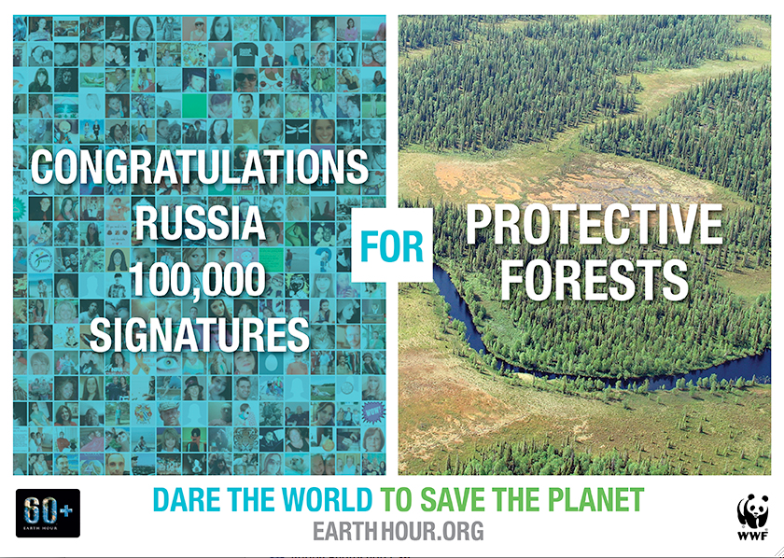
Notes:
Russia
In 2012, the WWF-Russia’s Earth Hour team built a petition base of more than 120,000 people to support legislative change on marine protection against oil spills. It was passed within nine months after seven years of trying.
In 2013, WWF’s Earth Hour in Russia successfully secured more than 127,000 signatures from Russian citizens to petition for amendments to the current forest legislation with the aim of returning a ban on industrial logging in an area of land equal to twice the size of France.
Toolkits: Key messages, logos, suggested activities, posters, online resources (eg banners, code for websites)
2013 campaign aiming to secure more than 100,000 signatures from Russian citizens to petition for amendments to the current forest legislation.calling for forest protection; while

Slide 7
Notes:
Philippines
In 2014, 18 ﬁshermen affected by Typhoon Haiyan received climate-smart ﬁberglass boats crowdfunded by Earth Hour Blue backers

Slide 8
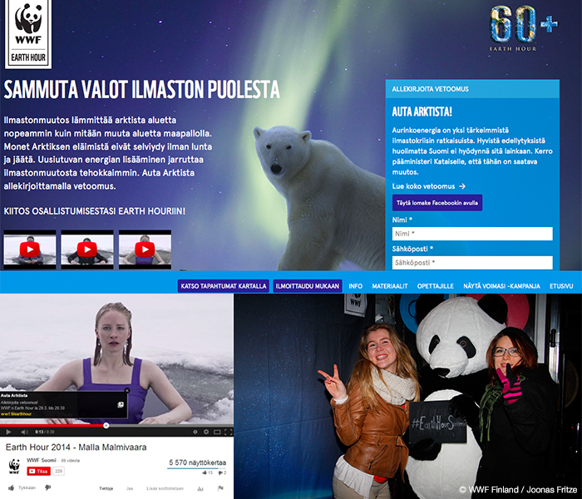
Notes:
Finland
A stand to protect the Arctic with 20,000 signatures for the solar pledge
The place on Earth most affected by climate change is the Arctic.
The Arctic focused Earth Hour 2014 campaign collected more than 20,000 signatures for a Solar Arctic Pledge.

Slide 9
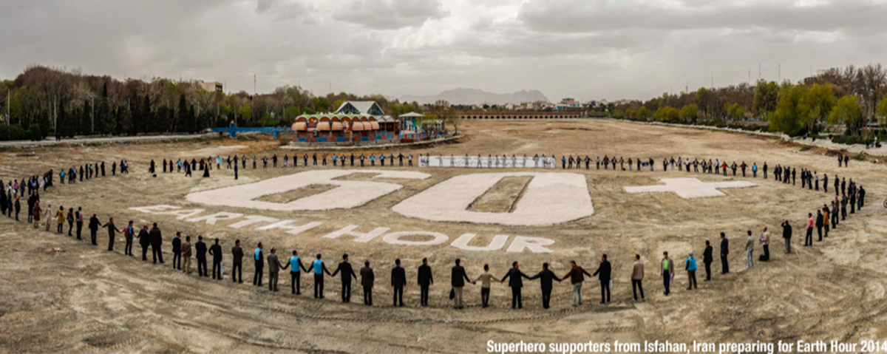
Notes:
Iran
Earth Hour has been organised in Iran since 2012 through the Municipality of Tehran.
A major focus in 2014 was in the city of Isfahan, where an Earth Hour celebration was held in front of Khaju Bridge to raise awareness about the plight of the famous Zayanderud River. The river has had no continuous water ﬂow for the past few years, due to climate change and other factors, including poor water management. A petition was launched for Earth Hour in Isfahan about the river.
The people of Isfahan also made a 2800 square meter Earth Hour logo in the dried out river bed.
Another gathering took place close to the only large scale wind turbine in Iran, organized by the Isfahan Municipality Climbing Team.
An educational campaign was launched in kindergartens and schools in Isfahan regarding environmental protection.
In Tehran, awareness about Earth Hour was created via city billboards, advertisements on TV, Metro mobitors, and through SMS messages sent to phone subscribers.

Slide 10
Notes:
A couple of quick points:
* Point was made on Wednesday by Donna when talking about early warning, that sometimes as urgency of risk increases, it can become more challenging to communicate that risk and move people to act…In climate change communication, this is playing out.
The point is to make action on climate change and reducing your personal footprint possible and achievable. Individuals and communities can all take climate change action.
* Research is important – on the audiences (phone surveys) and also of the stakeholders post-campaign (how the campaign went, did key messages resonate with their communities, outcomes etc etc). Research is continuous throughout – before, during, after (every year)
Questions?

