Slide 1
Dignity, Access, Participation and Safety
Operationalising Gender and Diversity in disasters
IFRC, 28 January 2016
May Maloney and Christina Haneef

Slide 2

That’s just so typical!
A way of behaving, an attitude or a characteristic that would be considered typical (from where you are from) based on your sex or gender.
Notes:
Overgeneralisation of the characteristics of one group of people. Often polarising in that it attributes +ve characteristics to one group and –ve attributes to another.

Slide 3
Objectives
To understand importance of mainstreaming gender and diversity in different sectors throughout programme cycle
Feel confident to articulate the reasons that we should implement gender- and diversity-sensitive programming and some practical ways to achieve it
Confident in the practical use of tools (IFRC Minimum Standard Commitments to Gender and Diversity) for reducing risks to disasters, conducting assessments, programming, and beneficiary selection

Slide 4
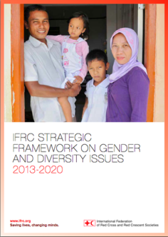
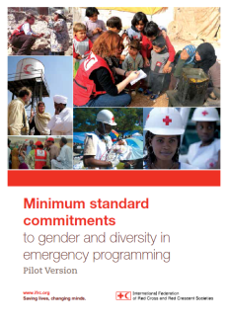

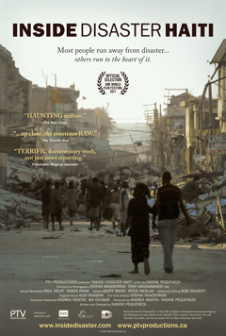
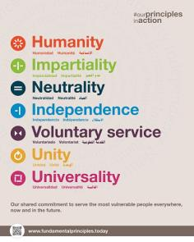
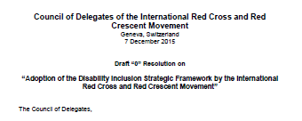
Agenda and Structure
Notes:
This training is structured around the following resources, and is based on the following priorities:
The IFRC Strategic Framework
The Fundamental Principles of the Red Cross Red Crescent
Case studies will include:
Mexican red cross and Haiti examples (because there is a great resource that is called Inside Disasters, which follows a Red Cross FACT Team)
The experiences of the group
You will learn to use this key PRACTICAL resource:
The IFRC Minimum Standard Commitments to Gender and Diversity in Emergency Programming

Slide 5
DIGNITY
Notes:
At the beginning of each session, you will ask the group to brainstorm the meaning of the word for that session (Dignity, Access, Participation and Safety).
Ensure that you discuss: what is means; what it means to you as a Red Cross workers; what obligations you have to do this; a practical place they can find out more (the MSC guide) and also why it is about the workplace obligation not the personal interpretation.
Ideas to draw out about DIGNITY:
Respect, promote and safeguard human dignity in extreme situations of vulnerability
Not limited to personally engaging an individual in a respectful matter
Planning, asking, understanding needs
Protecting people’s psychosocial wellbeing
Ensuring privacy, and specific cultural needs are met

Slide 6
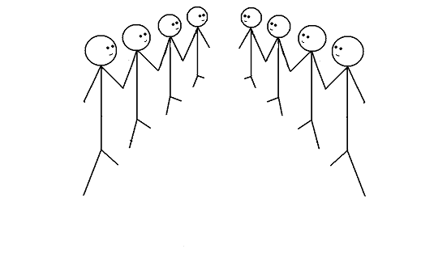
Group exercise
Speed debating

Slide 7
Discuss…
In disaster response we are so busy. Addressing gender and diversity must wait.
Notes:
This exercise if called SPEED DEBATING:
On this slide and the following slides you will find a series of ‘Black and White’ or ‘Blanket’ statements
You ask the group to stand in two lines facing each other, ensure that each person has a ‘partner’ in front of them (even numbers of people facing each other)
Then you will ask one side to take the ‘affirmative’ side of the statement; the other side argues that the statement is not true.
Give 3 minutes to debate each slide
Between slides, have a short debrief about the topic
KEY THEMES TO DRAW OUT:
It is not as simple as any of these statements
You often cannot view vulnerability only in terms of ‘gender’ or ‘diversity’ – you need to overlay them with each other

Slide 8
Discuss…
Trying to meet the distinct needs of people with a disability represents a waste of limited resources.

Slide 9
Discuss…
It makes no difference if we categorise an adolescent girl as an adult or a child?

Slide 10
Discuss…
As Red Cross Red Crescent we do not pay enough attention to the needs of older people during disasters

Slide 11
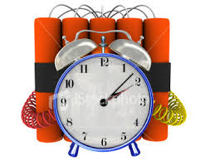
What do we hear about gender and diversity?
COMMON CHALLENGES
Too busy
No resources
Not a priority
I do not know how to do it
It is for someone else to do

Slide 12
Core Concepts
Sex | Gender
Biological differences | Social differences
Male, female | Masculine, feminine
Born male or female; difficult to change | We become masculine or feminine. Changes across the life-cycle, within and between cultures, traditions, beliefs
Binary opposites | Degrees of masculinity and femininity – society sets the bar, on attitudes, behaviours etc.
Notes:
Male and female – binary opposites
Masculine and feminine – degrees of masculinity and femininity set against a bar set by society.
Feminine – girly-girl, princess, tomboy, butch, androgynous, bitch, whore, madonna
Masculine – hyper masculine, ‘a bit of a woman’, ‘a girl’s blouse’, ‘feminine’

Slide 13
Sex or Gender?
Females can get pregnant A higher percentage of American doctors are women, compared to Egypt Males have testicles, females have ovaries In some countries, women have to cover their heads when they go outside the house New Zealand was the first country in the world to give women the vote. | Males have deeper voices after puberty Women tend to do more of the housework than men Male new-borns tend to weigh more than female new-borns Nursing is often seen as a woman's job, although many men enter the profession Females breastfeed Women are the main care-givers (for children, aging parents, sick and disabled)
Notes:
•1893 New Zealand gave women the vote
•1902 Australia - Australian women, with the exception of aboriginal women. Aborigines, male and female, did not have the right to vote until 1962.
•1906 Finland
•1913 Norway
•1915 Denmark
•1917 Canada - Canadian women, except Canadian Indian women, won the vote in 1917. Canadian Indians, male and female, did not win the vote until 1960.
•1918 Austria, Germany, Poland, Russia
•1919 Netherlands
•1920 United States
•1921 Sweden
•1928 Britain, Ireland
•1931 Spain
•1934 Turkey
•1944 France
•1945 Italy
•1947 Argentina, Japan, Mexico, Pakistan
•1949 China
•1950 India
•1954 Colombia
•1957 Malaysia, Zimbabwe
•1962 Algeria
•1963 Iran, Morocco
•1964 Libya
•1967 Ecuador
•1971 Switzerland
•1972 Bangladesh
•1974 Jordan
•1976 Portugal
•1989 Namibia
•1990 Western Samoa
•1993 Kazakhstan, Moldova
•1994 South Africa
•2005 Kuwait
•2006 United Arab Emirates
•2011 Saudi Arabia – but can’t vote until 2015

Slide 14


Male and female/masculine and feminine?
Notes:
One dimensional – there’s a bit more to us than whether we are male or female, isn’t there?

Slide 15
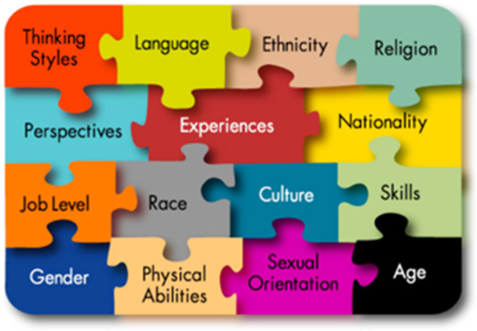
Diversity
…The respect and acceptance of the differences between people
Notes:
Diversity is so important

Slide 16
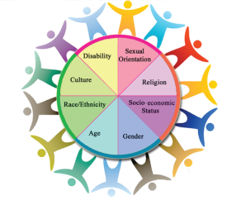











Gender and Diversity

Slide 17
Why it matters in our approach to disasters?
Women, girls and boys are 14 times more likely to die during a disaster than are men
Indian Ocean Tsunami, 2004 +80% fatalities women
Japan earthquake 65% of casualties 60+
Cyclone Nargis, 2008 61% deaths women & children
Accountability
Do no harm
Quality
Address vulnerability
Fundamental Principles
Cost effective
Notes:
These are some examples of WHY it matters to analyse WHAT ALREADY EXISTS
Evidence:
More than 70% of those that died in the 2004 Asia Tsunami were women (it was 80+% females in some areas affected by the Tsunami)
News Article: http://www.theguardian.com/society/2005/mar/26/internationalaidanddevelopment.indianoceantsunamidecember2004
Oxfam Report: Women and the Tsunami http://www.preventionweb.net/files/1502_bn050326tsunamiwomen.pdf
In three of the affected areas of the 2011 Japan earthquake/ tsunami, 65% of casualties were over the age of 60

Slide 18

Sexual and Gender-based Violence (S/GBV)
An umbrella term for any harmful act that results in, or is likely to result in, physical, sexual or psychological harm or suffering to a person on the basis of their gender.
A result of gender inequality and abuse of power.
Includes but not limited to: sexual violence, domestic violence, trafficking, forced/early marriage, forced prostitution, sexual exploitation and abuse, and denial of resources, opportunities and services.
Another confusing and contested term: sexual violence, sexual and gender-based violence, violence against women and girls

Slide 19
SGBV: Joint action on prevention and response
Call to look at existing research and to continue research to enable guidance and tools to be developed for preventing and responding to disasters
Call upon states to look at their laws, plans and procedures to asses if they adequately prevent and respond to SGBV
Call upon states to engage community members in particular women, in decision making about DRR and
Ensure appropriate efforts to integrate GBV into DRR and response activities
Notes:
SGBV resolution?

Slide 20
IFRC’s approach
The IFRC’s gender and diversity work is not a separate or new component
It is rooted in its humanitarian mandate to prevent and alleviate human suffering without discrimination and to protect human dignity.
The RCRC recognizes that women and men have different capacities, strengths, needs and vulnerabilities which can impact their resilience to disasters

Slide 21
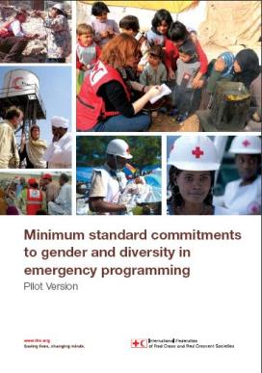
Minimum Standard Commitments to Gender and Diversity in Emergency Programming
Relevant to entire full spectrum of the emergency programme cycle
Dignity
Access
Participation
Safety
Emergency Health
Food Security
WASH
Emergency Shelter Livelihoods
Non-food Items
Disaster Risk Reduction
Notes:
Take out framework?

Slide 22
ACCESS
Notes:
Have a short discussion about Access – what it means
Key points:
- Emphasise that is it not about making the person the problem, but rather about making the service the problem (if people are absent)

Slide 23
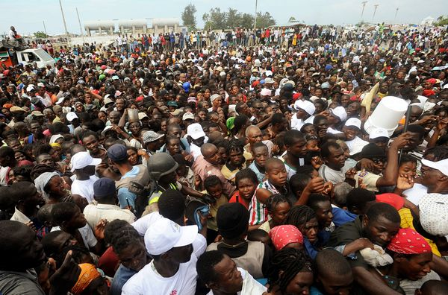
Notes:
Ask participants if they can describe this crowd?

Slide 24
Quiz Time!
Notes:
There is another slideshow that contains answers to the Quiz questions.

Slide 25
Notes:
As again: knowing what you now know about general characteristics, and general population data, what can you say about this crowd of people?
Talk about rapid gender analysis in emergencies:
You can do it before you get on the plane (a Google search of relevant secondary data)
You can have the gender and diversity analysis already ready to go

Slide 26
Impartiality, non-discrimination
2 videos
Notes:
In the next section we are going to look at relevant skills: both internal and external, for doing a good and rapid vulnerability analysis
Show films:
Trailer of Inside Disaster: https://www.youtube.com/results?search_query=inside+disaster+haiti
Show the film about how difficult it is to given aid quickly based on vulnerability critera

Slide 27
Disaster and DRR- Knowing who is most affected?
“Everything needs to be done at once but we just can’t”
Jean-Pierre Taschereau, IFRC Team Leader

Slide 28
Needs Assessments – Gender & Diversity Analysis
Who is affected? Why and how are they affected? What are their distinct needs, protection concerns and priorities?
Sex- and age-disaggregated data (SADD) – data broken out by sex and age (or age group)
Gender analysis examines relationships between females and males; their roles, responsibilities, access to and control of resources and constraints they face relative to each other.
Diversity analysis – examines the distinct reality of being a particular age/age group, disabled and other contextual factors (e.g. minority group, ethnicity, etc.)

Slide 29
Challenges in collecting and analysing SADD
No harmonised way to collect SADD
Different people in chain of collection, analysis and design
If collected, who does the analysis? (Who has capacity?)
If collected and analysed, who feeds/how is this fed into project design?
M | F | M | F | M | F | etc
0-5 | 0-5 | 6-12 | 6-12 | 13-18 | 13-18 | etc
2 | 1 | 4

Slide 30

Needs Assessments – Gender & Diversity Analysis
Price of not including a gender and diversity analysis
We limit the effectiveness of humanitarian operations
Humanitarian operations do not reach the most vulnerable
Potential to deepen pre-crisis inequalities
We do not meet donor requirements

Slide 31
Prioritisation
If you’re not counted, then your needs don’t count
Due to funding limitations ,it is not always possible to reach everyone.
Indeed, not everyone is in need.
RCRC needs to transparently target and prioritise those most at risk to meet immediate and long term needs
Develop beneficiary selection and prioritisation criteria in consultation with affected community
Simple or more comprehensive

Slide 32
Beneficiary Registration
Basis for planning programmes
Population’s assistance and protection needs are determined and documented
Individual registration – especially protection needs
Where individual registration not feasible, ensure individual registration of persons with specific needs.

Slide 33
Equal Access: Considering our teams
Team composition doing assessments is important, we risk not allowing people to truly tell us about their needs
We also need to consider practical ways in emergencies to transform our teams to meet needs – volunteerism and leveraging all capacities in the community
Tabasco floods video
Notes:
At the end of this, show the film about Tabasco floods:
https://www.youtube.com/watch?v=3d-Yu8Dh1LY
This film shows how important it is to be:
Inclusive in our teams
Consider local knowledge, vulnerability and who is missing out
Use simple measures such as wrist bands, and outreach to deliver aid to the most vulnerable

Slide 34
Exercise: Beneficiary Selection/Registration
Spontaneous camp of 10,000, one month after disaster in Myanmar
Camp will remain for at least 12 months
Some cursory multisector rapid assessments and distributions carried out – indicating shelter is a need
Beneficiary registration desk to be established, and you need to establish who in the community has protection risks, needs and capacities
Comment on team composition.
What information is missing?
What are challenges in collecting each piece of information?
Notes:
This is an exercise that the teams will do, using the templates and guides.
DO WE HAVE THESE GUIDES?
What handouts are needed?

Slide 35
PARTICIPATION
Notes:
Ask questions about what Participation is, and WHY it matters
Show that we don’t just do PARTICIPATION for the sake of it, we actually do it for an outcome (which is to get information that will help us to assess: needs, quality of what we are doing, anything that we need to approve, our relationships with the community

Slide 36
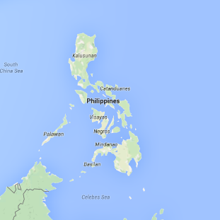
Inside Disaster Risk Reduction
Typhoon Hazard
Notes:
This is an exercise about people’s individual or specific needs (based on their situation)
How can we ensure we best prepare people for disasters
What are each of their needs/risks/priorities – one group rotating looking at this. The other group what can we do in our DRR activities to mitigate these risks

Slide 37

Exercise
Minimum Standard Commitments to Gender and Diversity in Emergency Programming
Seven sectors – health, food, WASH, shelter (and settlements), livelihoods, NFIs
Four Commitments (with corresponding standards)
D – dignity
A – access
P – participation
S - safety

Slide 38
Exercise
Each person’s distinct needs – health, food, WASH, shelter (and settlements), livelihoods, NFIs
Each person’s protection risks and capacities
10 minutes with ‘your’ person; rotate for three minutes with each person in the gallery; stop when back where you started.
Does each point noted address the survivor’s dignity (D), access to assistance (A), participation (P) and/or safety (S)? (place letter)
Notes:
Place the survivors profiles on a sheet of paper and place them around the room as a gallery. Now split the group into teams of 2. they can either be sector teams doing a rapid needs assessment with beneficiaries, or they can be doing a multisectoral analysis of the person’s individual needs.
Ask them to refer to the MSCs and have it in hand.
Remind then that you do not want to hear that they have WASH needs. All of the survivors have WASH needs – you want to know the SPECIFIC needs and SPECIFIC adaptations that would need to take place.
Place emphasis on: the person’s strengths, their protection risks and the fact that the humanitarian system is just that – a system, so you can partner and refer people to other agencies if you and your team cannot meet their needs, but to do this, you need to understand that other agencies are in the area and they are asking similar questions.
If you wish to add complexity to this exercise, you can have a team from ‘another agency’ arrive to assess the needs of the same individuals mid way through the RC team doing their assessments.

Slide 39
SAFETY
Notes:
Our safety commitments are about:
Sector specific safety
Gender based violence response
Internal protection systems

Slide 40
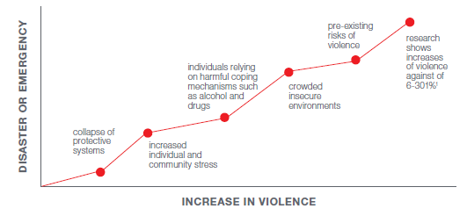
VIOLENCE INCREASES IN DISASTERS

Slide 41

To Serve with Pride
To Serve with Pride: Zero tolerance for sexual exploitation and abuse by our own staff
Notes:
We are going to start by talking about our Internal Processes for Safety
This is about out staff code of conduct which dictates our behaviours
Here is the film link for To Serve With Pride:
http://www.pseataskforce.org/
Please warn people prior to viewing this, that it may be distressing, that they can come and talk to the facilitators afterwards about any issues or that they can leave the room at any point

Slide 42
Six Core Principles
Sexual exploitation and sexual abuse constitute acts of serious misconduct and are therefore grounds for disciplinary measures, including summary dismissal
Sexual activity with children (persons under the age of 18) is prohibited regardless of the age of majority or age of consent locally. Mistaken belief in the age of a child is not a defence
Exchange of money, employment, goods or services for sex, including sexual favours or other forms of humiliating, degrading or exploitative behaviour, is prohibited. This includes any exchange of assistance that is due to beneficiaries

Slide 43
Six Core Principles
Sexual relationships between staff and beneficiaries of assistance, since they are based on inherently unequal power dynamics, undermine credibility and integrity and are strongly discouraged;
Where a staff member develops concerns or suspicions regarding sexual exploitation or sexual abuse by a fellow worker, whether in the same agency or not, he or she must report such concerns via established reporting mechanisms;
Staff are obliged to create and maintain an environment that prevents sexual exploitation and sexual abuse. Managers at all levels have a particular responsibility to support and develop systems that maintain this environment.

Slide 44
IFRC’s reporting mechanism
Main documents include:
  Anti harassment guidelines
  Child protection policy
  Code of Conduct
Reporting mechanism (All 3 avenues have a duty of confidentiality)
Line manager
Head of HR
Safe number – call center based in UK.
Investigation: It is not our job as individuals to investigate

Slide 45
Prevention first!
Response is important but it is fundamental to raise awareness before an incident occurs especially for staff who work directly with beneficiaries
Sexual exploitation and abuse can have long term impacts on all areas of a person’s life – including their health (physical or mental), shame, exclusion or stigmatization
Youth and volunteers can be key advocates within the community
We do not investigate, there is a formal HR process.

Slide 46
Setting up referral pathways!
Is essential to your planning
Health care
Support groups
Legal services
Counselling or psychological supports
Networks and friends
Safe spaces
Alternative housing/shelters
Help to leave town/travel to somewhere safe

Slide 47
Some volunteers from the crowd?
A girl/survivor
Her mother
A CBHFA volunteer
A local leader
His wife
A local healer
A male RCRC Health Unit volunteer
A female RCRC Health Unit volunteer
A doctor
A policemen
A taxi driver

Slide 48
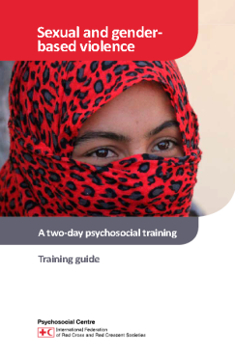
Case study
A 13 year-old girl tells her mother and a RC volunteer that her neighbour has raped her.
Neither the mother nor volunteer know what to do. So she goes to the wife of a local community leader, and tells her what has happened. The wife tells her to take her daughter to the local healer. She goes to the healer and repeats the story of the abuse by the neighbour.
The healer examines the girl, gives her some medicine and tells the mother to go to the local RCRC community centre. The male field officer is at the centre, so the mother tells him the story. He says she should go to the female field officer. They go to her and tell her the story again and ask for advice.
She then says they must go to the doctor to get an examination. They get in a taxi, and on their way to the doctor, the mother explains that that are going to the doctor for an examination and that her daughter is unwell. The doctor examines the girl and tells them to go to the police. The police officer tells her they need a certificate from the doctor. They go back to the doctor, who gives the certificate. They go back to the police, the mother hands over the certificate to the police. The police interview the girl, ask her what she was wearing, what happened, what does she expect them to do?
Some days later, the mother is very worried because the neighbour has been threatening the family. He has heard about her going to the authorities, and others in town also know.
Notes:
Do we need this printed??

Slide 49
First principles
Volunteers are not counsellors nor are they trained to be
In delivering the Violence Prevention module, volunteers will need to have some skills that can be referred to as ‘incidental’ counselling skills, this means the skills needed to respond adequately, appropriately and within the limits of someone’s ability.

Slide 50
HANDLING DISCOSURES OF VIOLENCE
Action 1: Acknowledge the person’s situation and feelings. Listen carefully to what they say. (“Remain calm, stay close”)
Action 2: Comfort the person (say something empathic) and ensure they are safe. If you are in a group, contain the situation. You do not want people sharing things when it may be harmful to them.
Action 3: If it is a child disclosing, you need to report immediately to the appropriate agencies. If it is an adult, it is their choice if they will seek help or not. (Keep the info safe)
Action 4: For adults, equip the person with information so that they can seek help when they want it, such as information about formal or informal referral they can seek.

Slide 51
SURVIVOR CENTERED APPROACH
Begin with the experiences of the survivor. These experiences determine the need and the needs determine the services required.
Four principles:
Safety
Confidentiality
Respect
Non-discrimination

Slide 52
Summary considerations
Do listen
Do be compassionate
Do offer the person the information they need or help them find it
But you cannot make promises to children or some adults
No secrets
No surprises
No promises
No interviews
No assumptions

Slide 53
STORYBOARDS
Notes:
Our safety commitments are about:
Sector specific safety
Gender based violence response
Internal protection systems

Slide 54
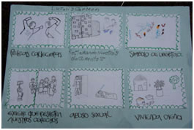
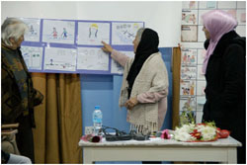
Storyboard
“A picture is worth more than a thousand words”
Universal planning method – no matter level of education, literacy
Notes:
Explain that it is a principles of film making
Easily adapted to any context
Have worked with people of all levels of education – and it about seeing the change
Examples: Iraqi doctors (pen is mightier than the sword, and a picture tells a thousand words); illiterate women in Ethiopia who have never held a pencil;
it gets us away from the log frame for a moment to think about how our behaviour and the challenges we face has an impact on individuals and what we can do to change it.

Slide 55
Storyboard your plan of action
Separately. A4 paper. No words allowed.
What is a key challenge you face in integrating gender and diversity into emergency work?
What impact does that challenge have on communities/individuals you work with (communities/staff)?
What do you do (already) to address this challenge? (existing)
What would you do if you had a ‘free hand’? (could change)
What supports are needed to make that happen and who provides it?
What would be the outcome of that change for individuals/communities?

