Slide 1
Climate Change and
Nepal Initiatives

Slide 2
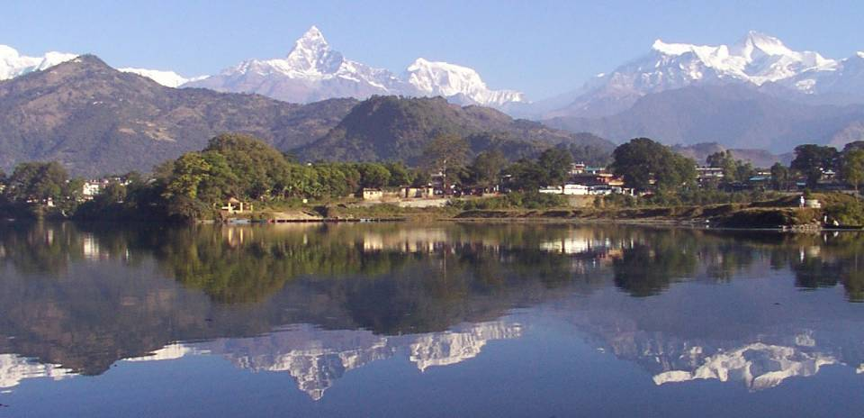
Climate Change and Nepal Initiatives

Slide 3
When was NAPA/LAPA initiated in Nepal and how?
The NAPA development process was initiated in May 2009 and it was completed in 2010
It took around 15 months going through consultative process
Around people were participated at different levels
Six thematic working groups were formed:
  Agriculture and food security
  Climate induced disaster
  Urban settlement and infrastructure
  Public health
  Forest and biodiversity
  Water resources and energy

Slide 4
When NAPA/LAPA was initiated and how?
Concerned ministries joint secretaries were assigned as the thematic coordinator
Thematic facilitators were identified as per their specialty
Livelihoods and governance, gender and social inclusion were identified as the cross cutting themes
Wider reference groups were formed on each TWG

Slide 5
Objectives
Assess and prioritize climate change vulnerabilities and identify adaptation measures
Develop proposals for priorities activities
Prepare, review and finalize the NAPA document
Develop and maintain a knowledge management and learning platform and
Develop a multi-stakeholder framework of action on climate change

Slide 6
NAPA finalization and Approval
National and regional level workshops and transect appraisal in 3 river basin
Climatic vulnerability assessment
Inception workshop
Formation of thematic working groups and desk review
NAPA drafting Consultation with wider reference group
Consultation on draft NAPA
National, regional and stakeholders and donors

Slide 7
NRCS Engagement in NAPA Process
NRCS was being involved at TWG as well as local level consultative workshops/meetings
Each sectorial focal point of NRCS were assigned at Headquarters to attend these consultative meetings
Our inputs have been included in assessment and adaptation measures
We could contribute in developing the NAPA however getting resource didn’t work

Slide 8
NRCS Engagement in NAPA Process
Government couldn’t get external support except a small project
The plan was short term and looks vertical though different line ministries are also part of this
Government hasn’t initiated the NAP development process
We need to be part of development committee and clarify NRCS contribution in entire development process

Slide 9
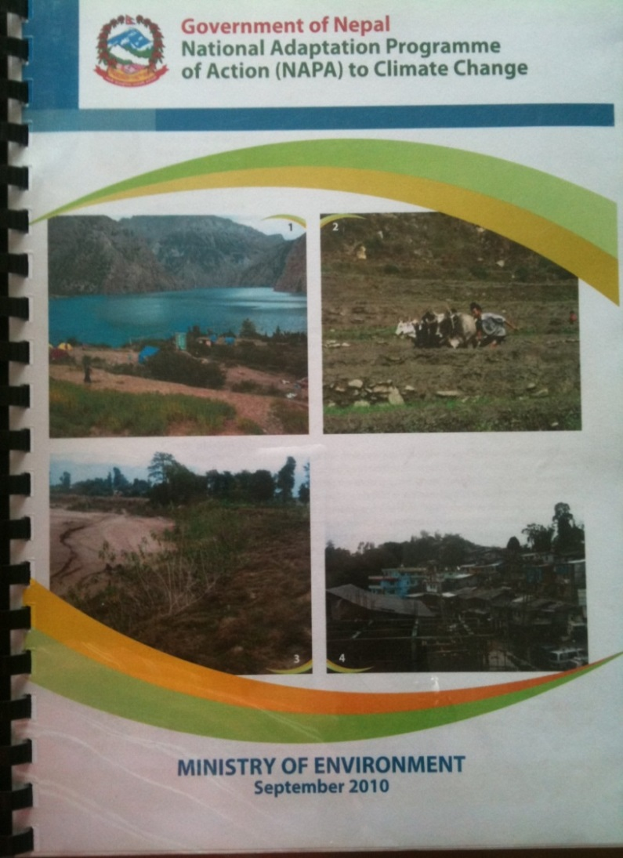
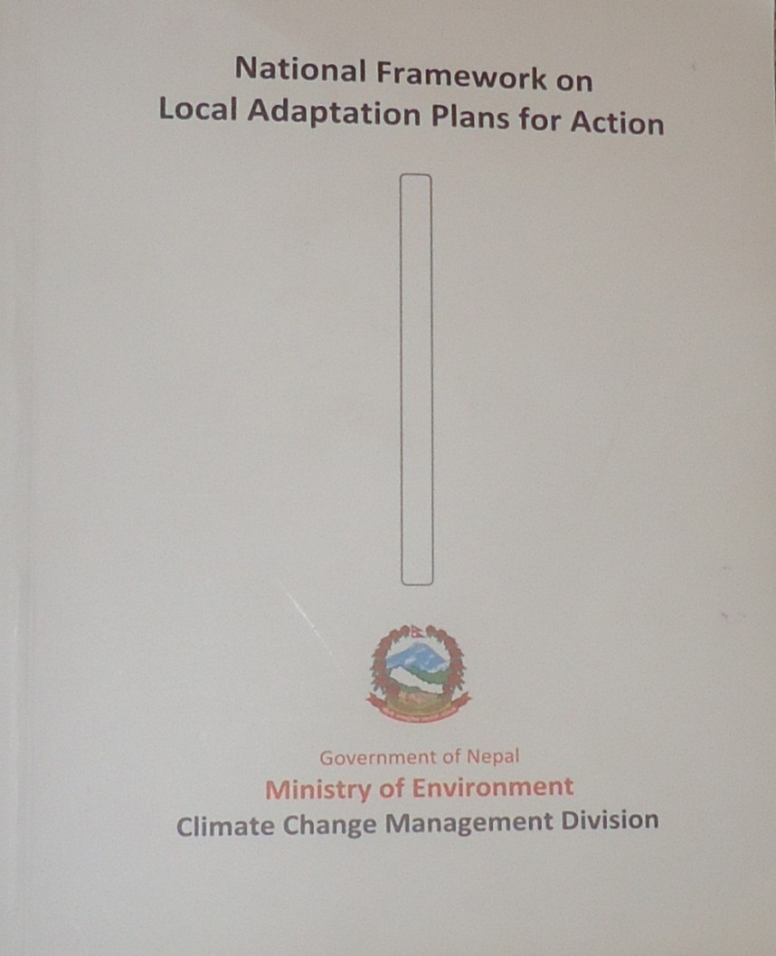
National Adaptation Program of Action (NAPA):
Local Adaptation Program
of Action (LAPA):

Slide 10
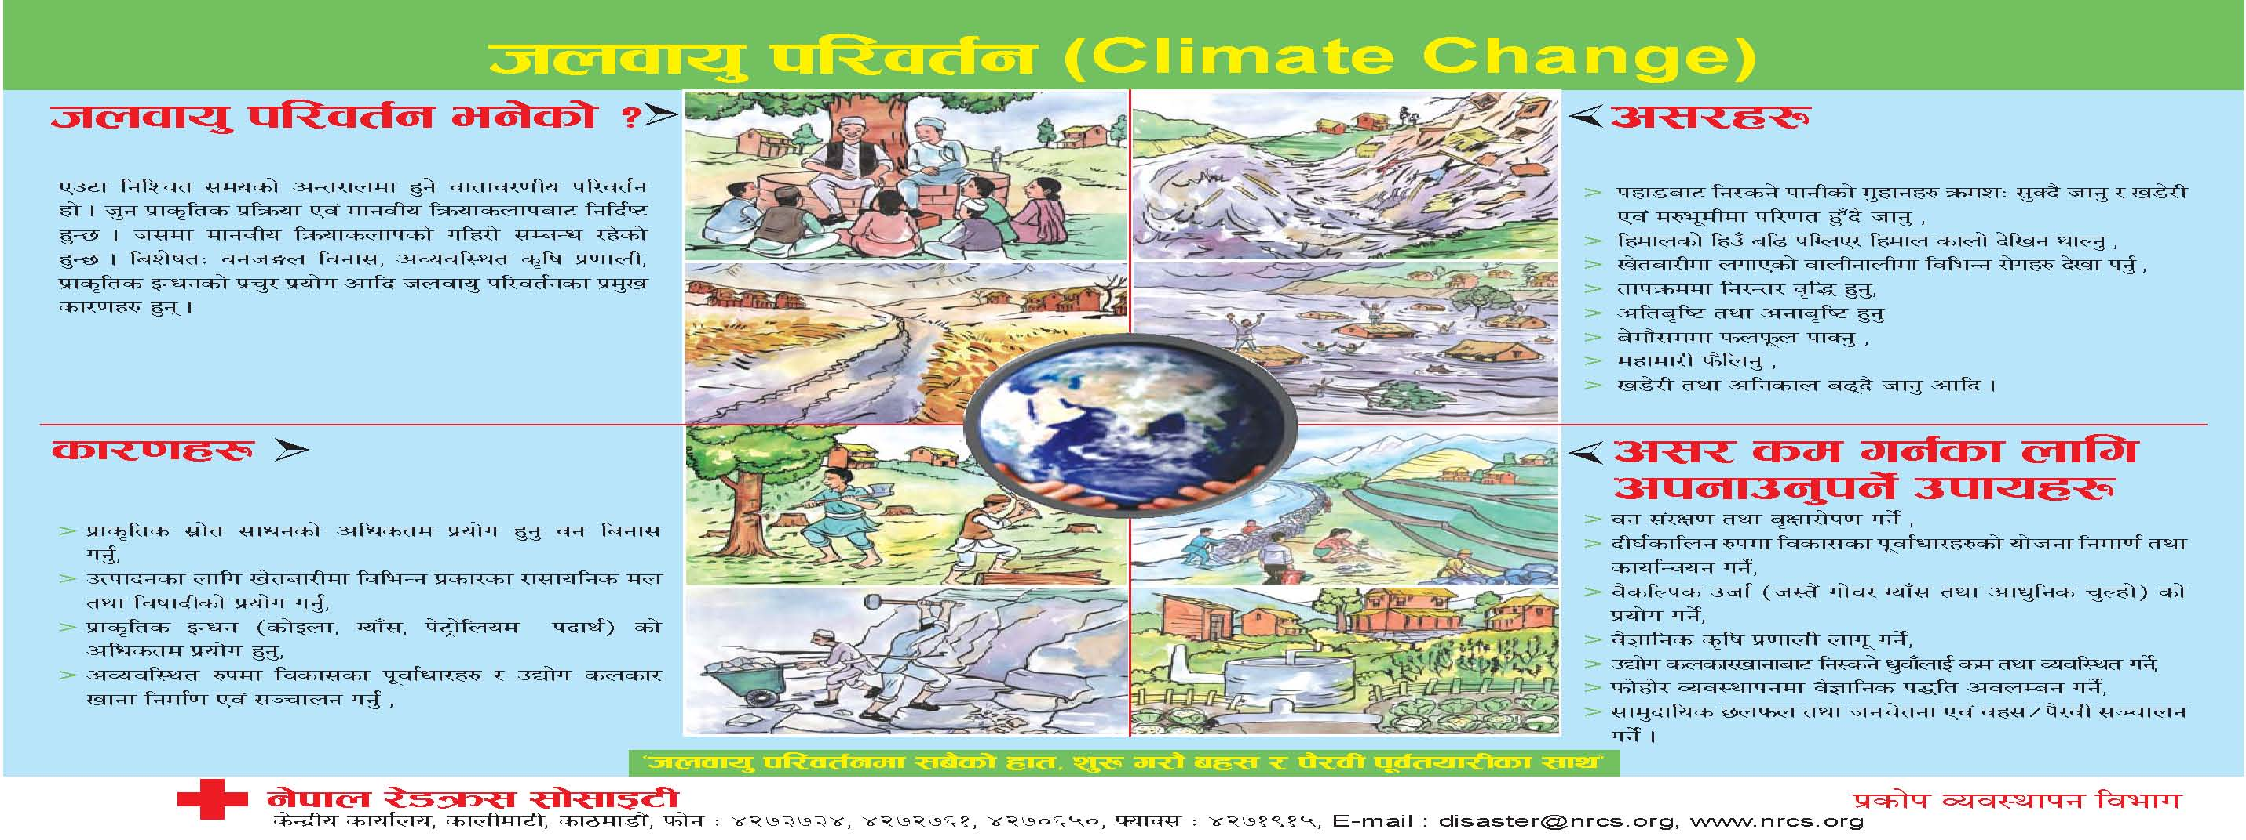

Slide 11
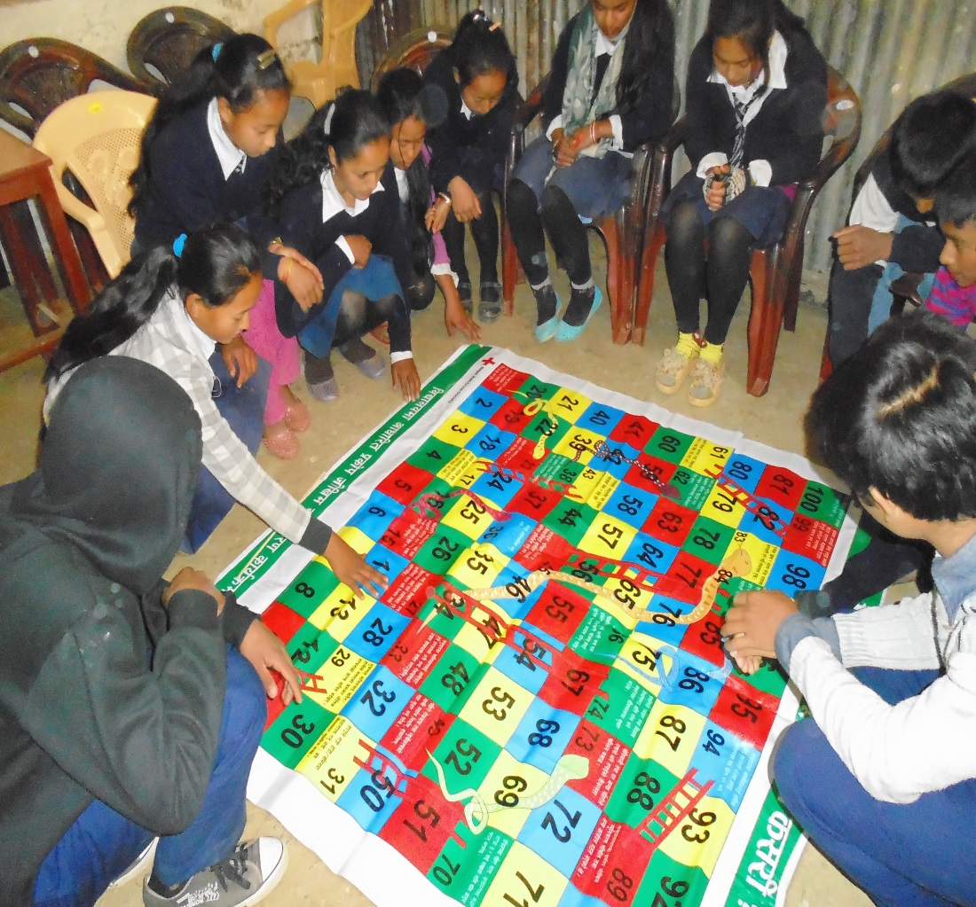

Slide 12
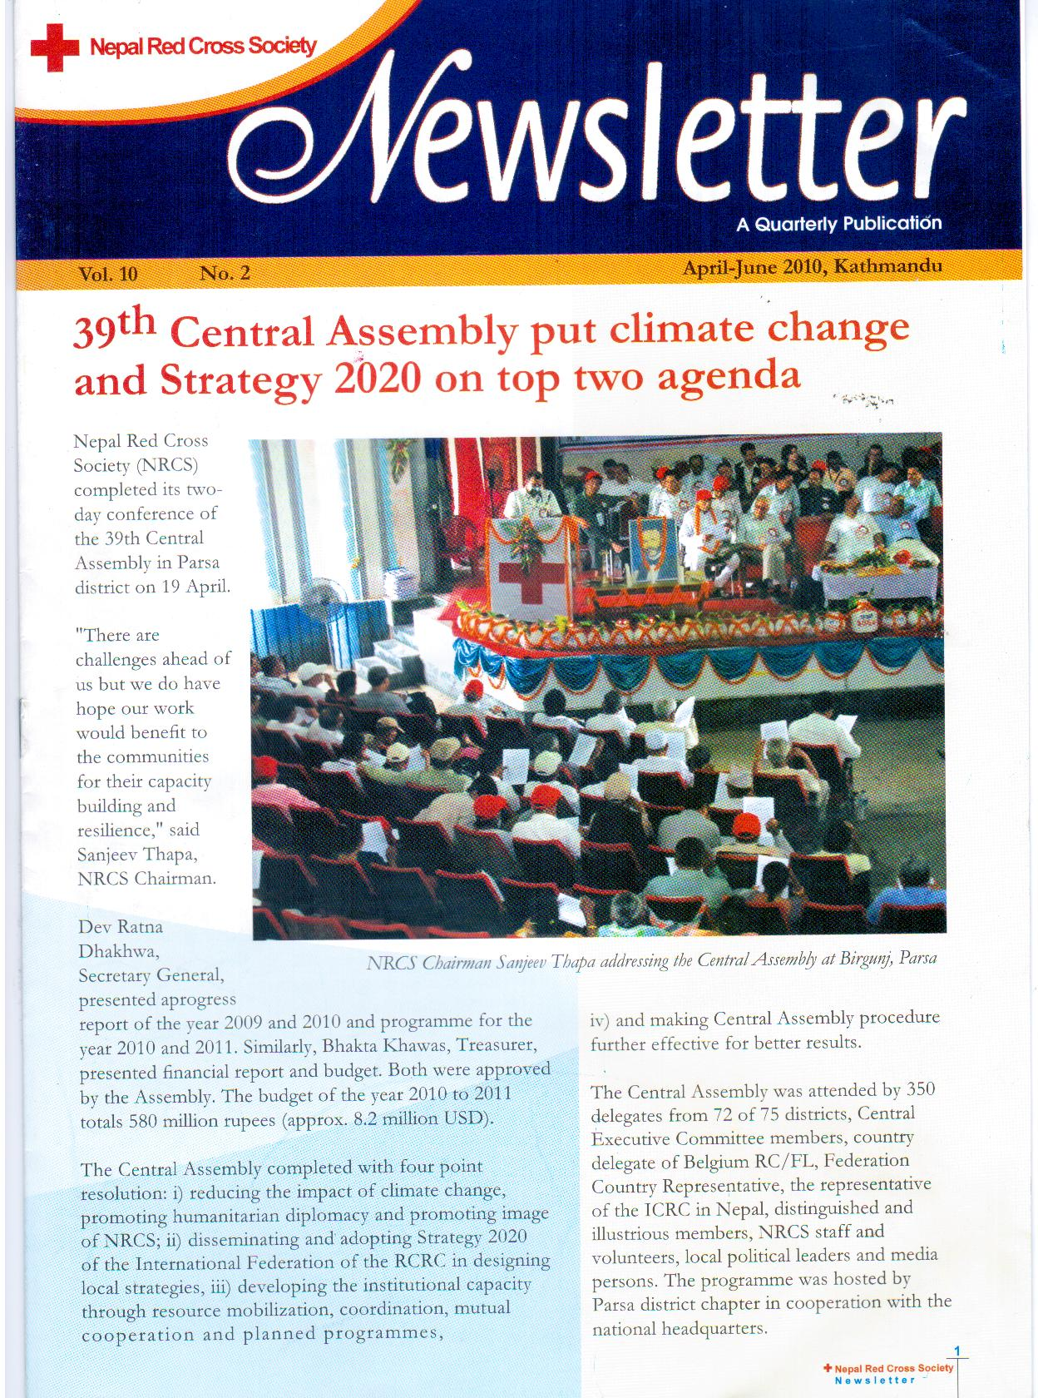

Slide 13
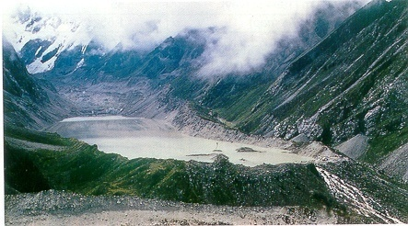
Tsho Rolpa Glacial Lake

Slide 14
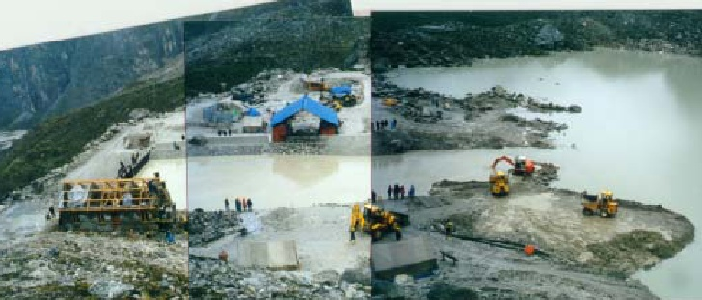

Slide 15
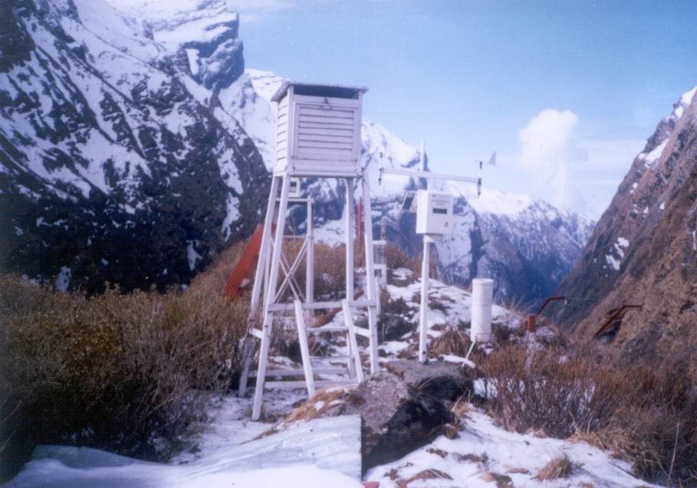
Tsho Rolpa Glacial Lake and Applied Risk Reduction Measures

Slide 16
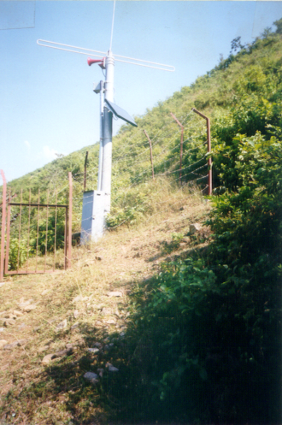

Slide 17
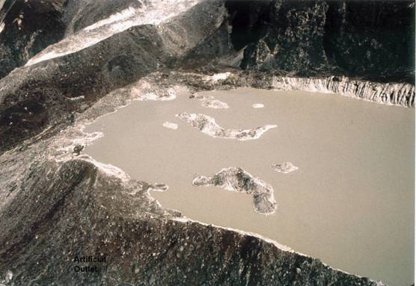
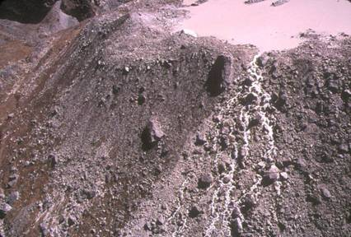
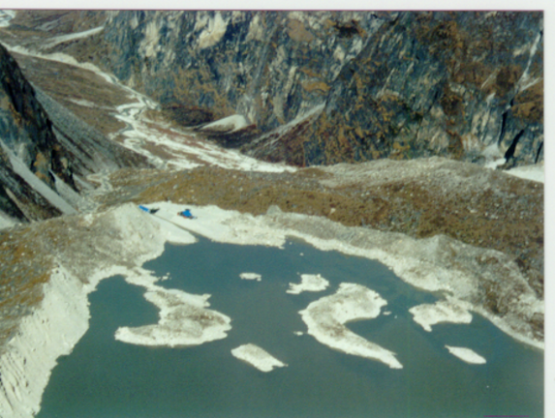
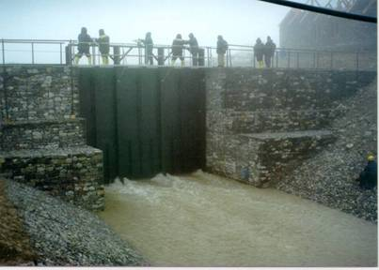

Slide 18
Thank you

