Slide 1
CRC in Asia
RRI Project Steering Committee Meeting
Bangkok
April 26, 2016

Slide 2
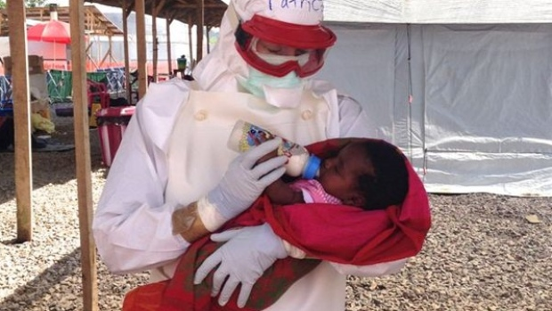
In 2015, Canadian red cross international operations Reached out to the world with 236 missions in 51 countries

Slide 3
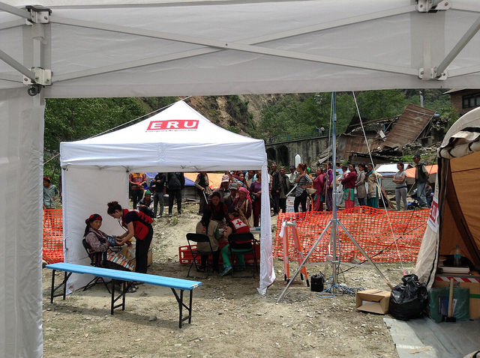
The Canadian Red Cross supported 68 Emergency response operations THROUGHOUT THE WORLD

Slide 4
And through programmes that focused on WOMEN’S AND CHILDREN’S HEALTH, violence prevention, DRR and strengthening capacities for emergency response...

Slide 5
WE Reached more than seven million people in 30 countries

Slide 6
CRC Strategy 2020:
DISASTERS AND EMERGENCIES
KEY AREAS OF EXCELLENCE
COMMUNITY HEALTH AND WELLNESS
PREVENTION AND SAFETY
Notes:
Disasters and Emergencies: We help people affected by disaster and conflict build their resiliency and help communities prepare for future crisis
Community health and wellness in Canada: We improve peoples’ health and independence by providing community-based programs, education and training
Community health and wellness around the world: We improve health and reduce the mortality of mothers, newborns and children in countries around the world
Through education we improve peoples’ health, safety and prevent harm.

Slide 7
Development programs Mandate
CRC’s long-term programs in Asia focus on:
Capacity Building & Organizational Development
Health (particular focus on mother, newborn, and child health)
Disaster Risk Reduction
Violence Prevention
Notes:
The Development Unit has been in existence formally since 2006. The mandate of the Unit is the management of CRC’s international long-term programs in the areas of:
Capacity Building & Organizational Development
Health (especially Mother, Newborn, and Child Health)
Disaster Risk Reduction
Violence Prevention
The Unit is organized into two geographic teams: Africa and Asia. The mode of programming is primarily bilateral, working in partnership with sister national societies in developing countries, while respecting and promoting Movement coherence. While the primary modality is bilateral, the team has substantial experience and capability with various approaches, including multilateral and consortium modalities.

Slide 8
CRC asia Development Programs in fy16-17
ASIA
Afghanistan
Bangladesh
China
DPRK
Indonesia
Maldives
Myanmar
Nepal
Pakistan
Philippines
Thailand-RRI (11 SEAsian countries)

Slide 9
Development Programs FY 16-17 - ASIA
Myanmar
DM/OD (2015-2017)
Technical Support (2016-2017)
$178,930
China
Health (2016-2017)
OD (2016-2019)
Provincial DM and OD (2015-2017)
$468,671
Afghanistan
DM, Health/ OD/ PMER (2013-2019)
$2,995,163
Pakistan
OD/DM (2015-2018)
Health (2016-2018)
$1,144,926
RRI- C3R
DRR/Gender/OD (2013-2018) $2,207,610
Indonesia
OD/DM/VP
(2015- 2017) $698,193
Philippines
Haiyan Recovery (2014-2017)
Branch Development (2016-2017)
$3,562,636
Maldives
OD/DM (2016-2017)
$349,099
$11,877,328
4 delegates
8 NO Staff

Slide 10
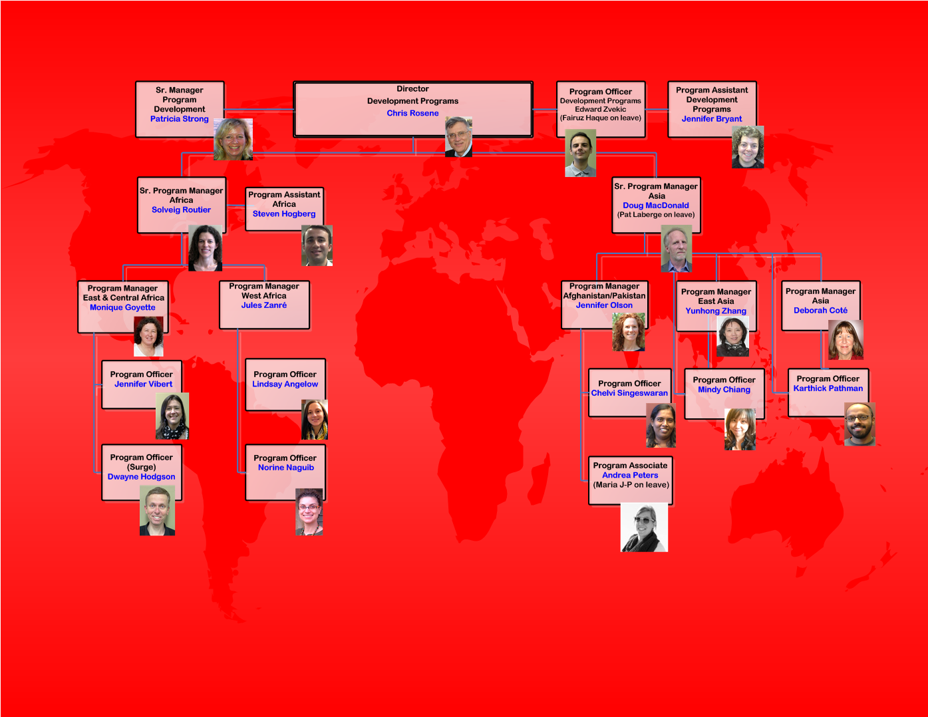
Notes:
The DEV Team welcomes Pieterjan Wouda , who will be covering Solveig Routier (SPM) will she is on maternal leave.
In December, our team will be joined by Violette Pedneault to take over for Jule Zanres as PM W. Africa.

Slide 11
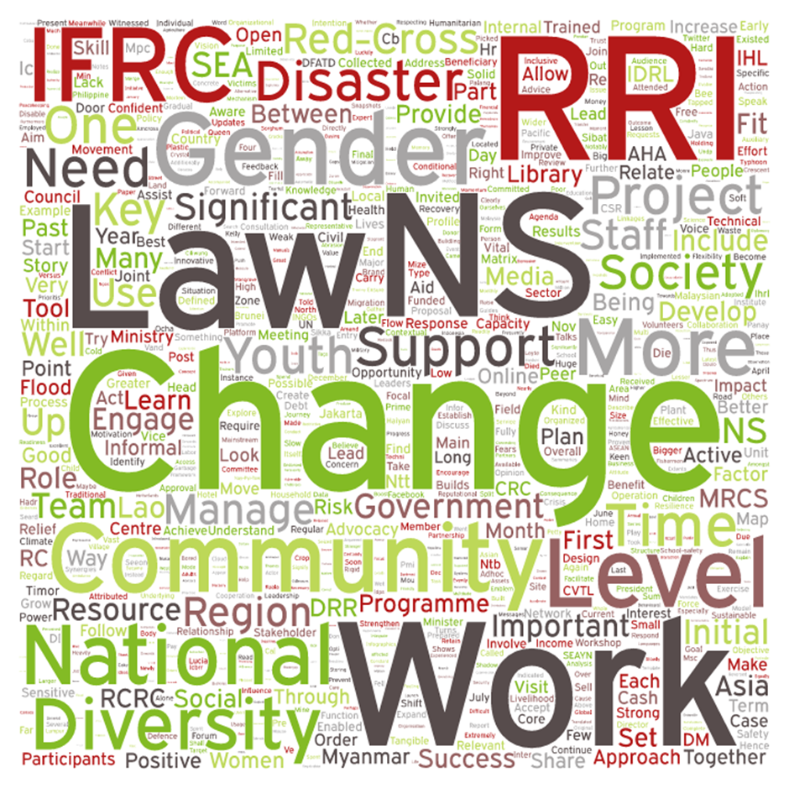
RRI alignment to CRC io strategy and Priorities
improved representation of community Disaster Risk Reduction issues in national policies, plans and programs
increased effectiveness of SEA regional DRR cooperation mechanisms that address the needs of vulnerable communities
Notes:
CRC sees RRI directly supporting our International Operations 5 year strategy, and the priorities of our Canadian government to address vulnerabilities to natural disasters through mainstreaming disaster risk reduction with policies and planning at the national and regional levels; and aligning with ASEAN priorities.
We are interested in RRI’s ability to strengthen our partnerships with IFRC and other Movement partners and with Global Affairs Canada.

Slide 12
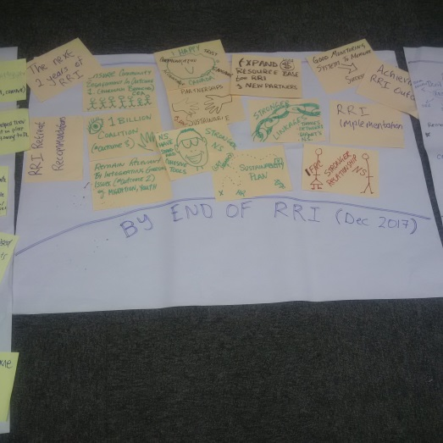
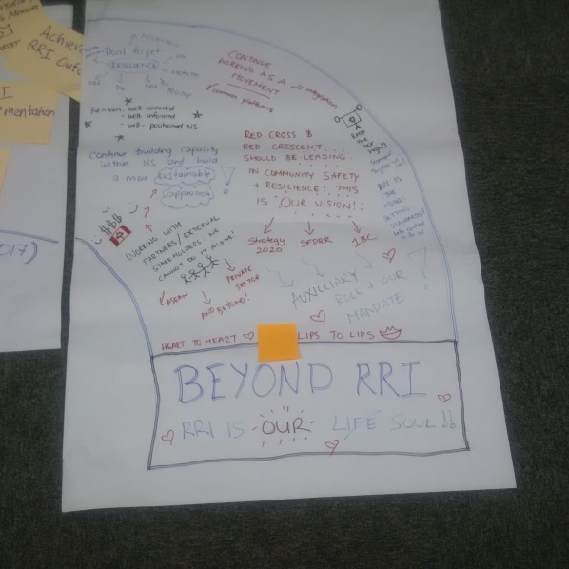
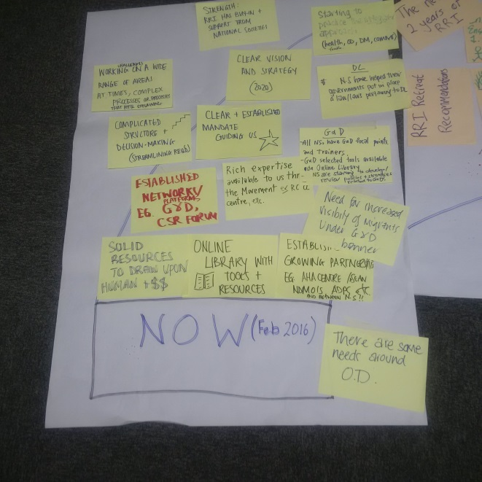
Where is RRI now;
where do we want it to be by end of initiative;
how do we position for beyond RRI?
Notes:
CRC is also interested in looking at future plans and collaborations, as well as the on-going RRI implementation.

Slide 13
Thank You
Notes:
IMPACT Course – January 2012

