Slide 1
STEERING COMMITTEE MEETING
– 26 April 2016
Building Regional Capacity & Collaboration for Community Resilience in Southeast Asia
Overview of the Third Annual Work Plan (AWP3)
April 2016 to March 2017

Slide 2
Key project facts
Location: Southeast Asia – or 11 countries
Duration: 2014-2017
Project value: CAD 6,290,802
Donor: Canadian Government (GAC) and Canadian Red Cross
Beneficiaries: Direct - 11NSs & governments, ASEAN and regional organizations
Indirect - 10m people

Slide 3
Planning process for AWP3
At the regional level, based on and contributing to:
The Community Safety and Resilience Roadmap 2016-2020, including components of regional cooperation, HD, Gender and Diversity as well as Disaster Law.
The IFRC Operational Plan 2016 for the Bangkok CCST
Recommendations from the RRI mid-term retreat (February 2016)
At national-level, a planning process
Initiated in January 2015
9 countries submitted their plans after discussion with IFRC country offices (when existing)
Four work plans (HD/COM, DL, G&D, CSR) contributing to 3 outcomes
First draft submitted to CRC on 18 March 2016, then to GAC on 5 April 2016.

Slide 4
No cost extension
The plan was prepared based on the assumption that the no cost extension was approved
It is not the final year of the project
The full project team is maintained for the whole year
Comparative financial volume with AWP2
Increased focus on sustainability of the activities to transition into a smaller and final AWP4

Slide 5
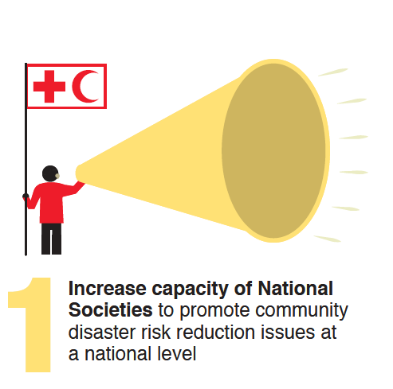
Humanitarian Diplomacy / Communications
Ongoing support to publications from NSs to profile their work
Continuation of the investments in Social media, in particular through peer to peer support
Community engagement, maximizing opportunities with radios and TVs
Communications for advocacy in programming
Support to HD/advocacy for regional events such as the Hanoi conference on gender and DRR or AMCDRR in India

Slide 6
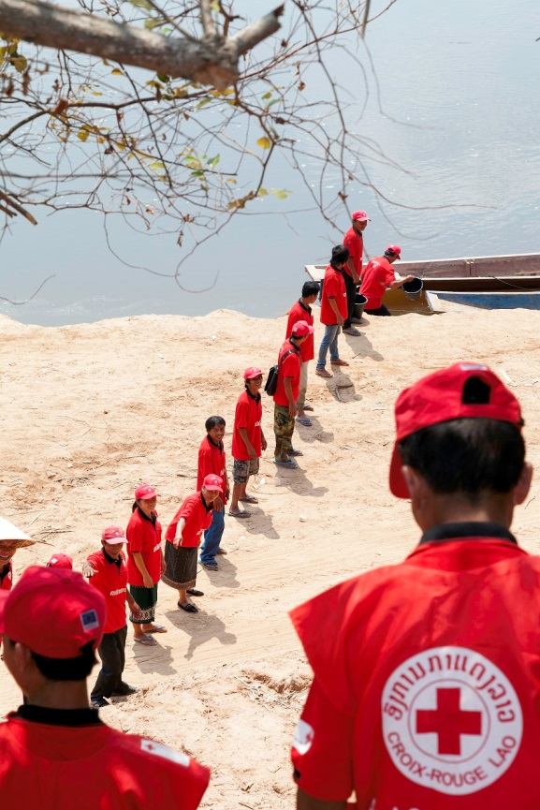
Disaster Law
Finalization of research projects in Indonesia and Myanmar (with potential continuation)
Dissemination activities in Cambodia and Viet Nam at the request of the governments
Law process in Lao PDR
Disaster Law bootcamp (October)
Regional DL network

Slide 7
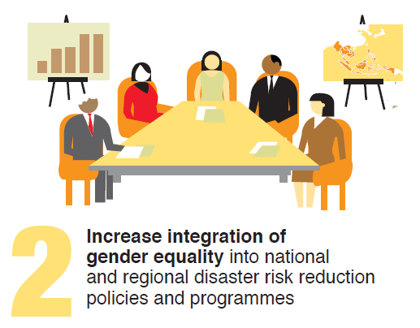
Gender and Diversity
Hanoi Gender and DRR Conference
Network meeting / refresher training for focal points
G&D self assessments in Philippines and Viet Nam
Policy work in Philippines and Cambodia
Gender in DRR tools such as VCA and NDRT assessment templates
Resource library

Slide 8
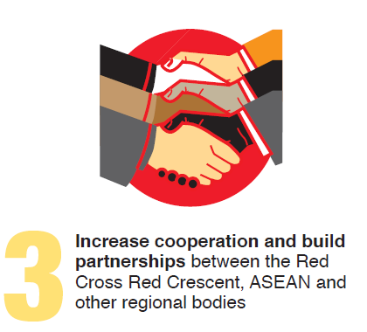
Community Safety and Resilience / Regional cooperation / internal
Continue supporting the CSRF and the SEAYN
Invest more in the Mekong sub-region with peer to peer potential
Support NS positioning with NDMOs through targeted joint activities
Finalize 5 HFA reports as baselines for Sendai implementation plans in the countries
Launch the new online library platform and sustain the gains of this knowledge management hub

Slide 9
Community Safety and Resilience / Regional cooperation / external
ASEAN
  ACE programme
  Simulation Exercises
  Technical dialogue (DRR, school safety, DL, SGBV, etc.)
Other actors
  AMCDRR
  ADPC

Slide 10
SEA-Canada exchanges
First opportunity in November 2015 as part of the 6th National Roundtabble on DRR in Calgary and following CRHNet annual simposium
Areas discussed were DRR and National Society relationships with governments as part of National Platforms, humanitarian diplomacy and community engagement, disaster law as well as gender and diversity.
Potential for next visit for the next annual roundtable as well as Canadian visits to project activities in SEA throughout AWP3

Slide 13
Project management tools
PMF reviewed and updated in March 2016 / no major change
Indicator tracking table updated in March 2016 (AWP3 targets) and April 2016 (AWP2 progress)
Risk Matrix updated / no major change

