Slide 1
STEERING COMMITTEE MEETING
– 25 April 2016
Building Regional Capacity & Collaboration for Community Resilience in Southeast Asia
Overview of project achievements (AWP2)
April 2015 to March 2016

Slide 2
Key project facts
Location: Southeast Asia – or 11 countries
Duration: 2014-2017
Project value: CAD 6,290,802
Donor: Canadian Government (GAC) and Canadian Red Cross
Beneficiaries: Direct - 11NSs & governments, ASEAN and regional organizations
Indirect - 10m people

Slide 3
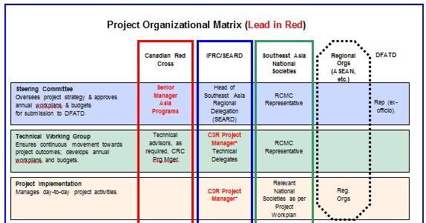
Roles and responsibilities (1)

Slide 4
Overall aim of the Regional Resilience Initiative
Rather than a new project, this initiative is building on current programme and strategy for the region
It aims at strengthening communication and advocacy, humanitarian diplomacy, disaster law and gender / diversity inclusion…
… to enhance capacities and partnerships and thus be able to better advocate for the needs of the most vulnerable, both at national and regional levels.

Slide 5
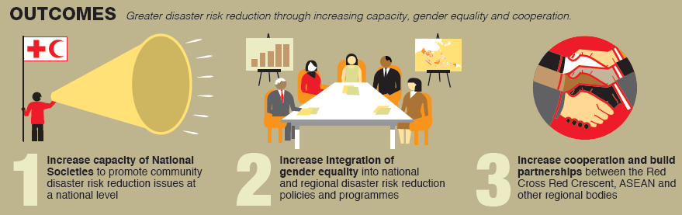

Slide 6
3 outcomes, 4 inter-related work plans, 2 levels of engagement…
Four work plans contributing to 3 outcomes
  Humanitarian Diplomacy / communications
  Disaster Law
  Gender and Diversity
  Community Safety and Resilience / Regional Cooperation
Regional cooperation
  Support of existing networks (CSRF, SEAYN, G&D…)
  Partnerships enhancement (ASEAN, ADPC, UN…)
Tailored support to National Societies

Slide 7
Planning for AWP2
November 2014 – January 2015 | In-country planning process
February 2015 | Drafting of the plan – discussion within the team
2 March 2015 | Steering Committee – initial review and approval in principle
March-April 2015 | Finalization of the plan
15 May 2015 | Submission to GAC (then DFATD)

Slide 8
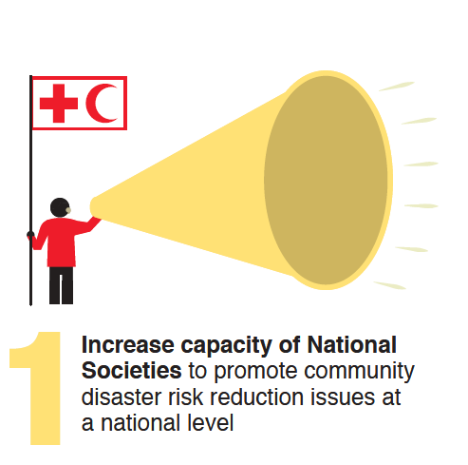
Building evidence for effective DRR advocacy
Promoting community voices
and NS DRR programming
(documentation of best practices)
177 staffs trained (77 female),
Incl. 54 (18 female) managers
Use of social media for community engagement

Slide 9
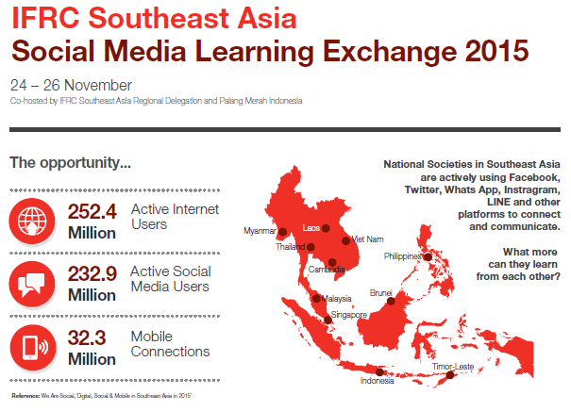

Slide 10
Growing interest for Disaster Law
Regional Disaster Law Forum in Bangkok, June 2015
Commitment from the region to continue strengthening disaster laws and the role of National Societies as a bridge between the community/local level and high level law and policy making processes.

Slide 11
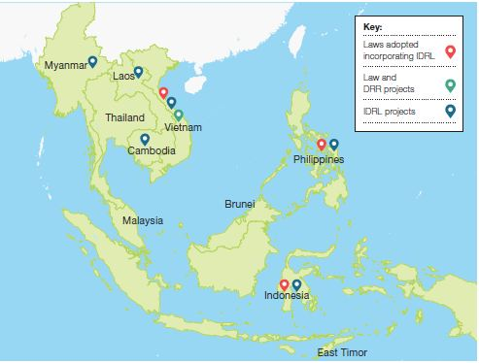
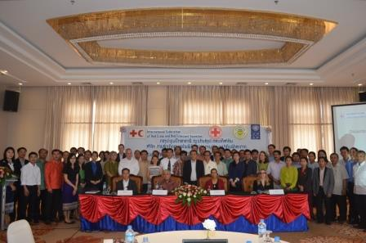
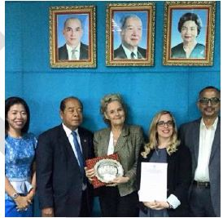
Disaster Law at national level

Slide 12
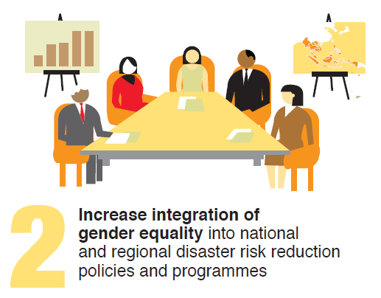
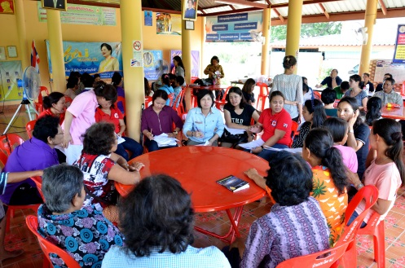
Growing interest in Gender and Diversity
Plans in countries
  Strategic / policy support
  Development of tools
  Review of good practices
Regional network launched
Regional TOT last October
Online resource library
Partnership with Australian, Canadian, French, German and Norwegian RC

Slide 13
G&D - Progress in countries
Awareness-raising in Timor Leste for 76 staffs in three batches (August 2016)
Training on Gender in DRR for Thai Red Cross (November 2015)
New Strategy for Women’s Advancement (2016-2020) of the Lao Red Cross (March 2016)
National self-assessment of the Viet Nam Red Cross
Sensitization session with Malaysian military on SGBV
Philippine and Cambodian RC produced a first draft of Gender and Diversity policy

Slide 14
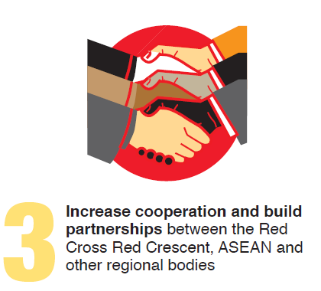
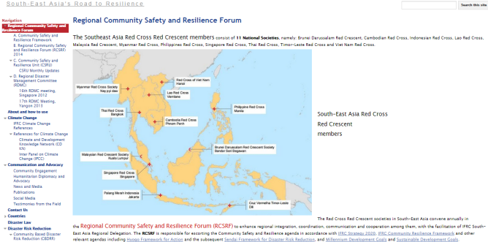
Regional cooperation – among National Societies
Peer-to-peer exchanges
Online library
Joint emergency response
Community Safety and Resilience Forum

Slide 15
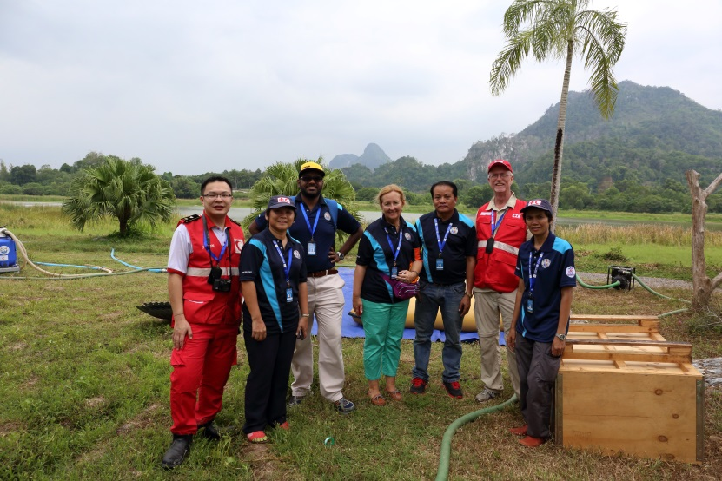
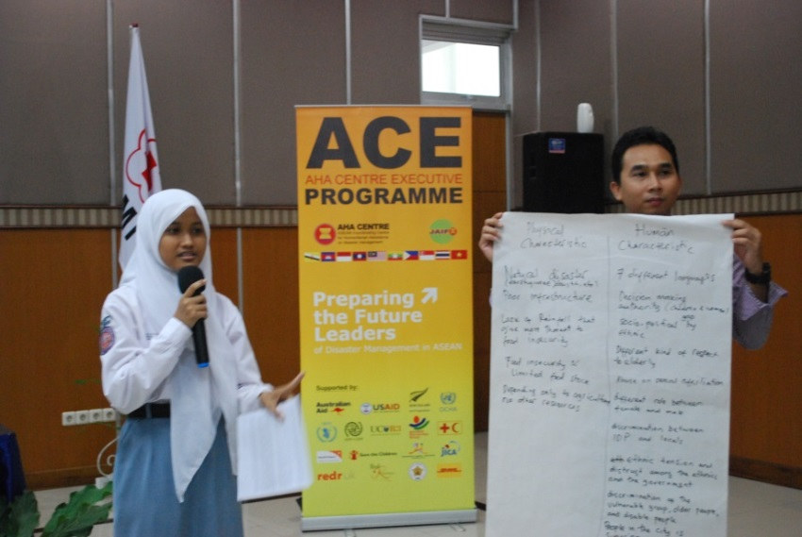
Cooperation with ASEAN
Technical cooperation with AHA Centre based on our Joint Action Plan: ACE Programme, DiREx Malaysia, ASEAN Joint Disaster Response Plan
Technical dialogue with ASEAN Secretariat at the time Member States draft the post-2015 AADMER Work Programme (2016-2020)
Contribution to the ASEAN Safe Schools Initiative under the AADMER

Slide 16
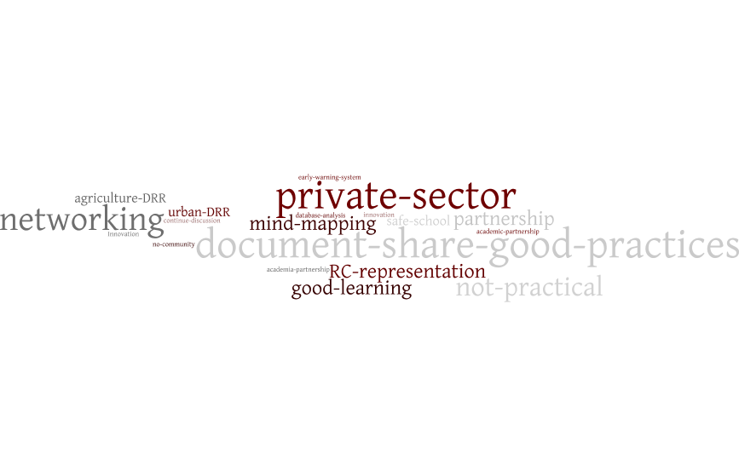
Regional cooperation with other partners
Participation in the Asia-Pacific Coalition on School Safety
Co-organization of the 8th DRR Practitioner Workshop with UNDP, FAO, ECHO and ADPC
Partnership with UNDP and UNOCHA on Disaster Law

Slide 17
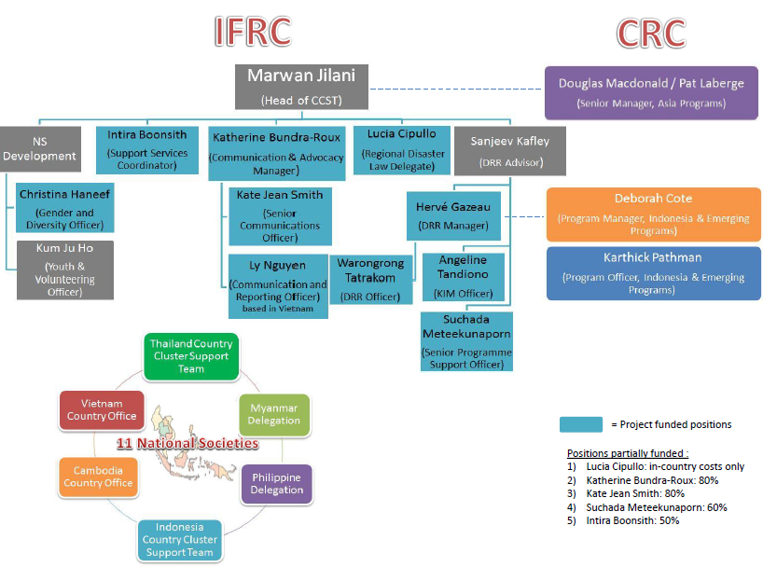

Slide 18
Expenditures (IFRC only)

Slide 19
Variances in AWP1 expenditures vs. budget
HD/COM: delay of a regional training for senior management as well as transfer of some activities to ICRC (Cambodia)
Disaster Law: government approvals for research projects (Indonesia and Myanmar) and floods in Myanmar
Gender & Diversity: decision to postpone some national level activities after the regional TOT
Other costs : mid-term retreat supported by CRC budget of RRI

Slide 20
Challenges
Monitoring, complexity of tracking the impact
A wide range of stakeholders / information-sharing and coordination
Prioritization of opportunities – multiple linkages and collaborations
Coordination among component vs. workload and travels

Slide 21
Thank you

Slide 22

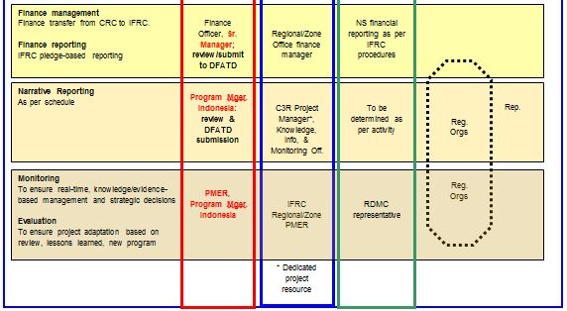
Roles and responsibilities (2)

