Slide 1
Overview of Red Cross Red Crescent in South-East Asia
Presentation to
Participants to 3rd batch of ACE training
by AHA Centre
Giorgio Ferrario, Head of CCST Jakarta

Slide 2
South-East Asia context and emerging humanitarian challenges
Accelerated vulnerability to disasters
Rapid urbanisation
Community adaptation to climate change including Emerging Health threats (Pandemic, Malaria, Dengue, etc.)
Significant flows of migration (legal and irregular/internal and external flows)

Slide 3

Red Cross Red Crescent National Society context
10 Red Cross or Red Crescent National Societies, one in each ASEAN country, sharing a common global strategy (S2020) with another 180 NSs in the world
Auxiliary to public authorities, but independent
Not NGOs, not Government – recognised by law
NS are becoming stronger, growing in competencies, in confidence both at domestic level but increasingly at regional and international level.

Slide 4
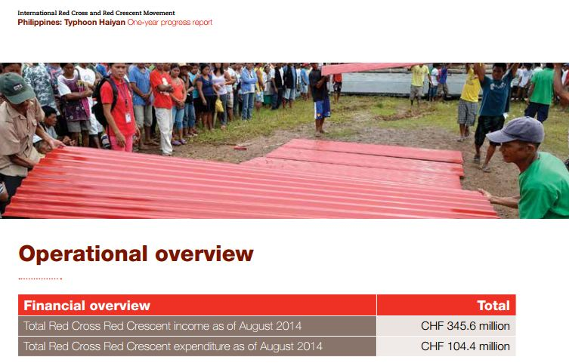
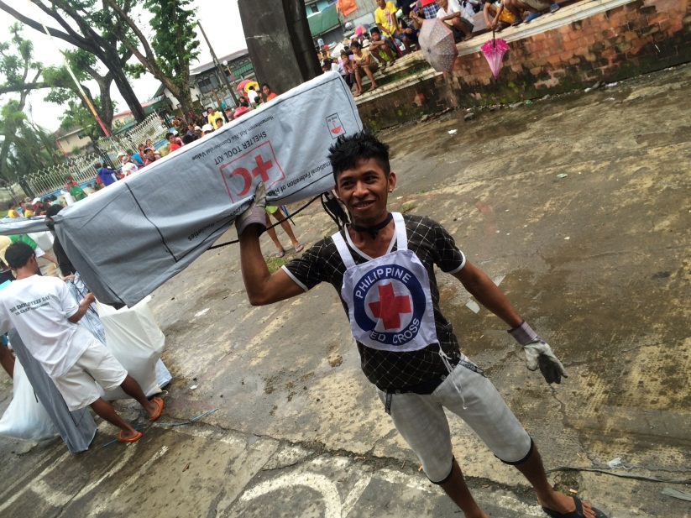
Our Red Cross Red Crescent National Societies are best known for disaster management activities

Slide 5
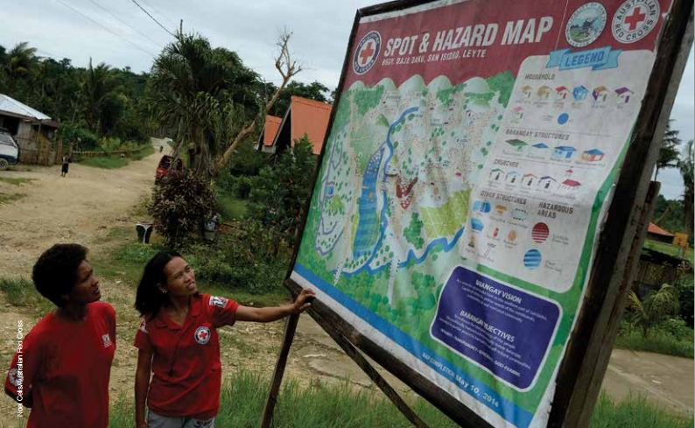
From initial response to recovery, rebuilding lives

Slide 6
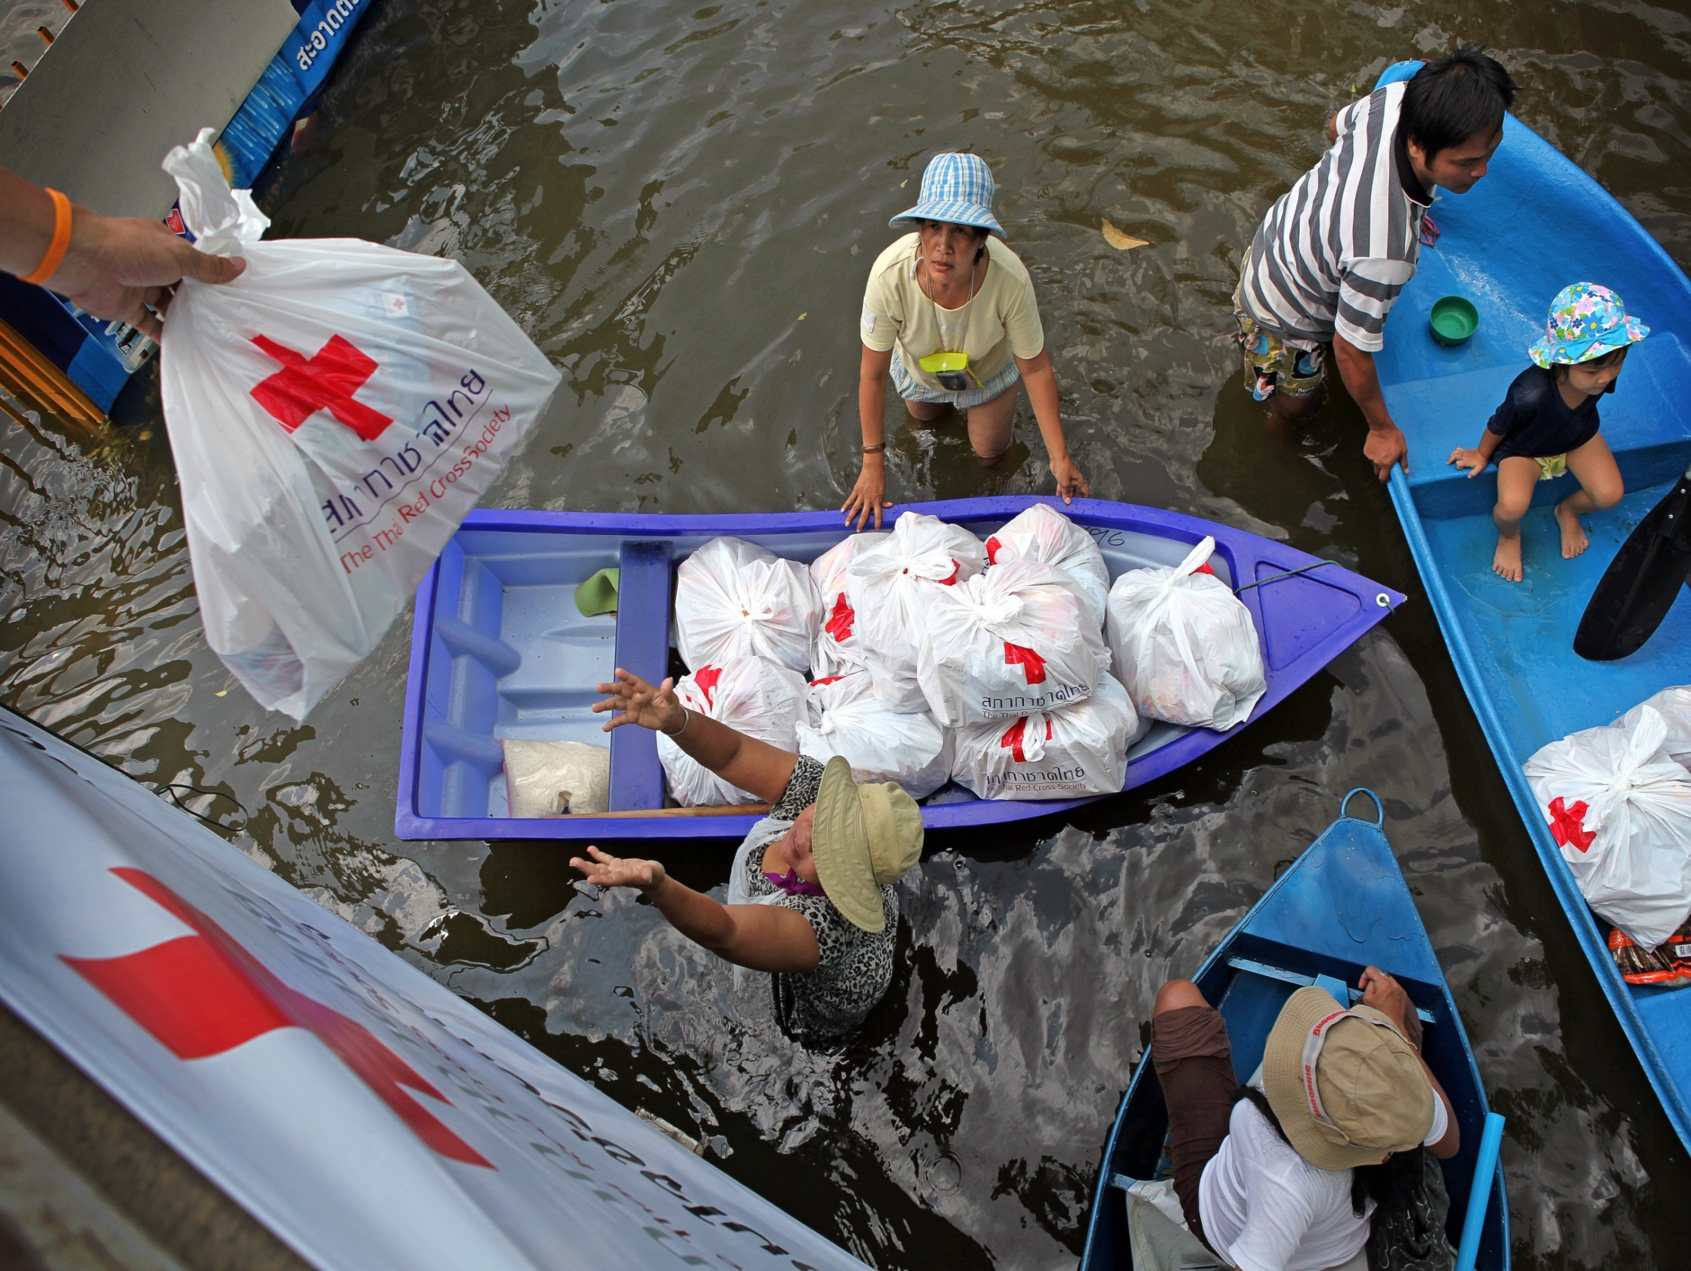

Slide 7

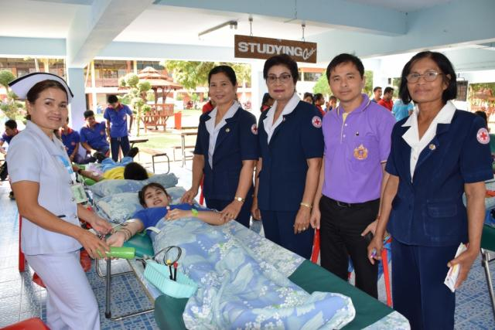
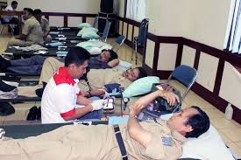

Blood services with health ministries

Slide 8
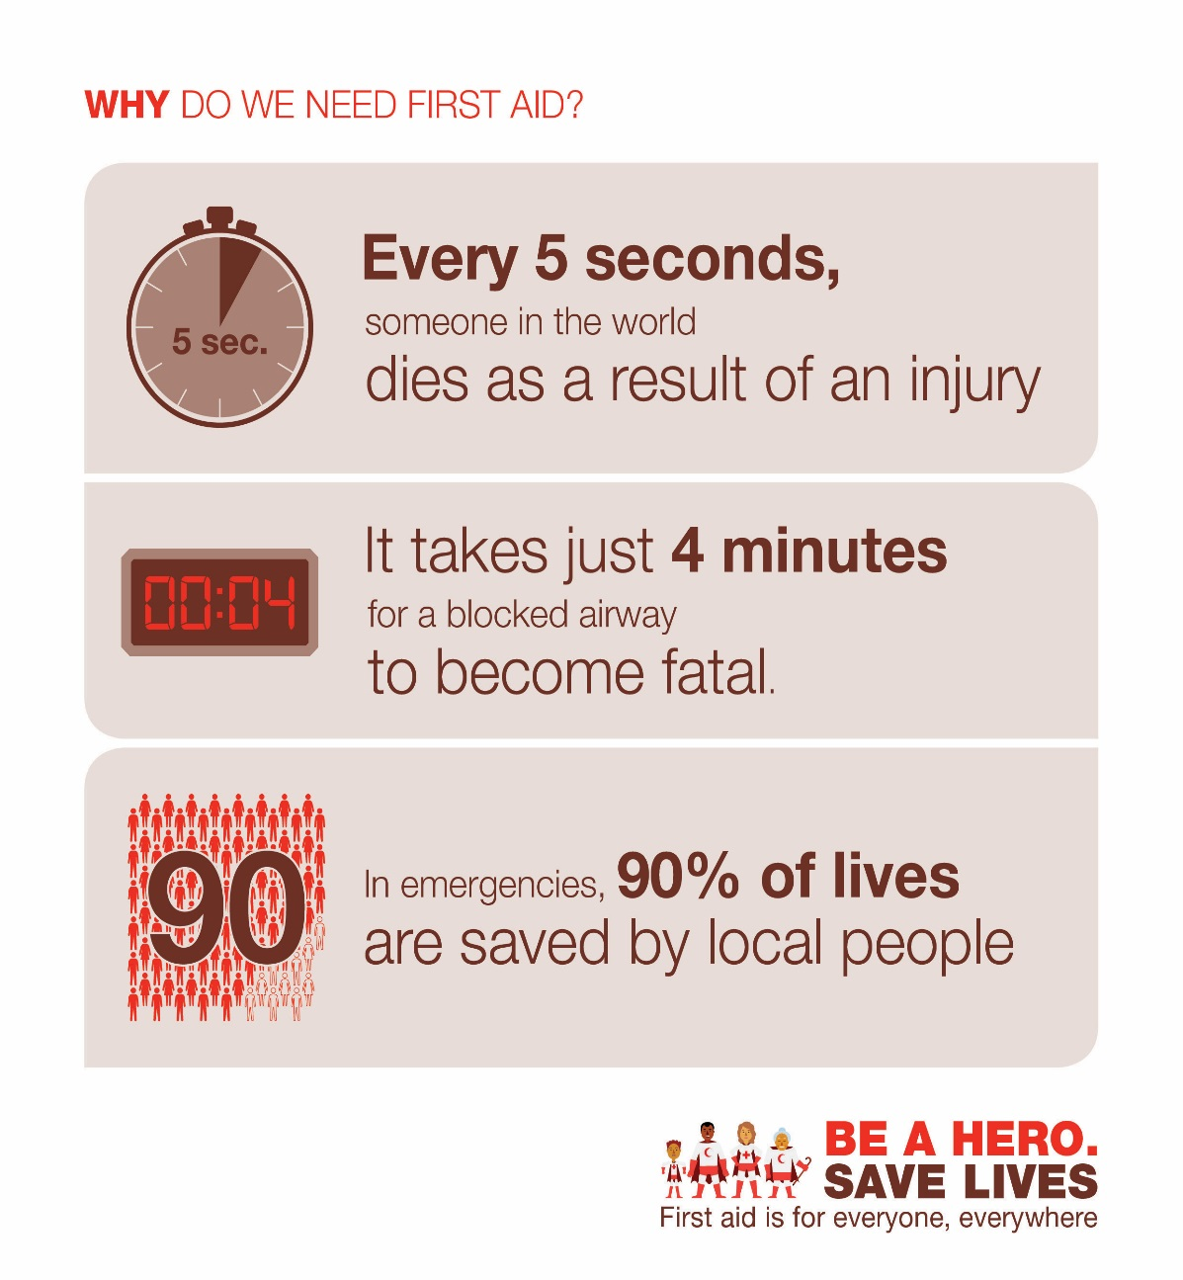
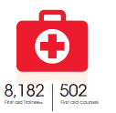

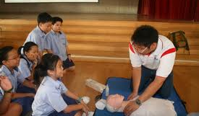
First aid, a core activity in all countries
Singapore, in 2013…

Slide 9
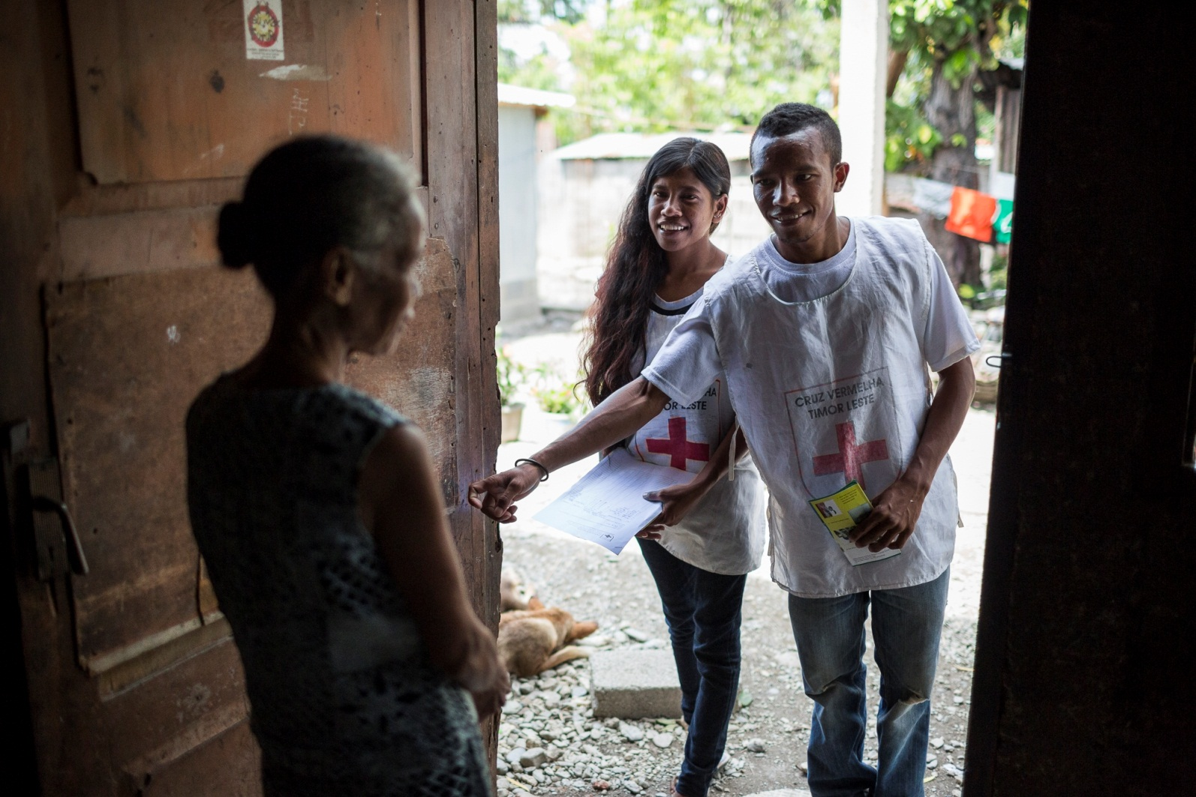
Our NSs action reaches communities all over the country

Slide 10
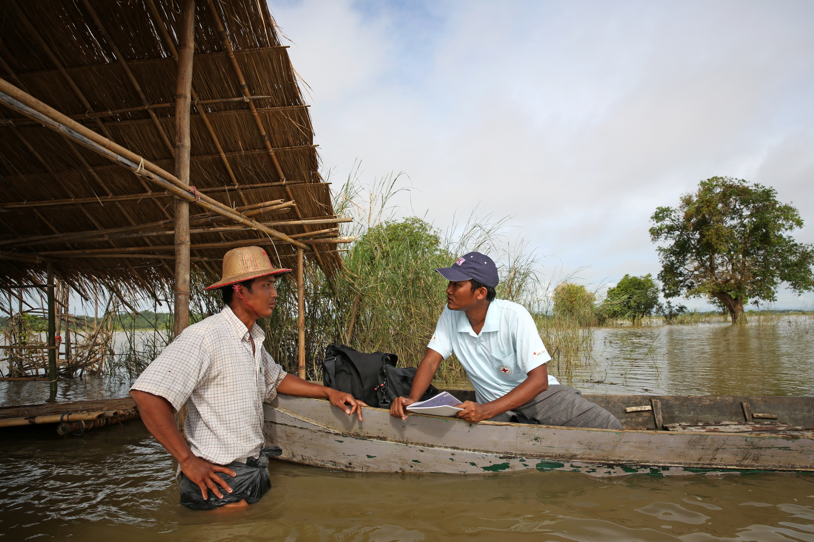
Myanmar

Slide 11
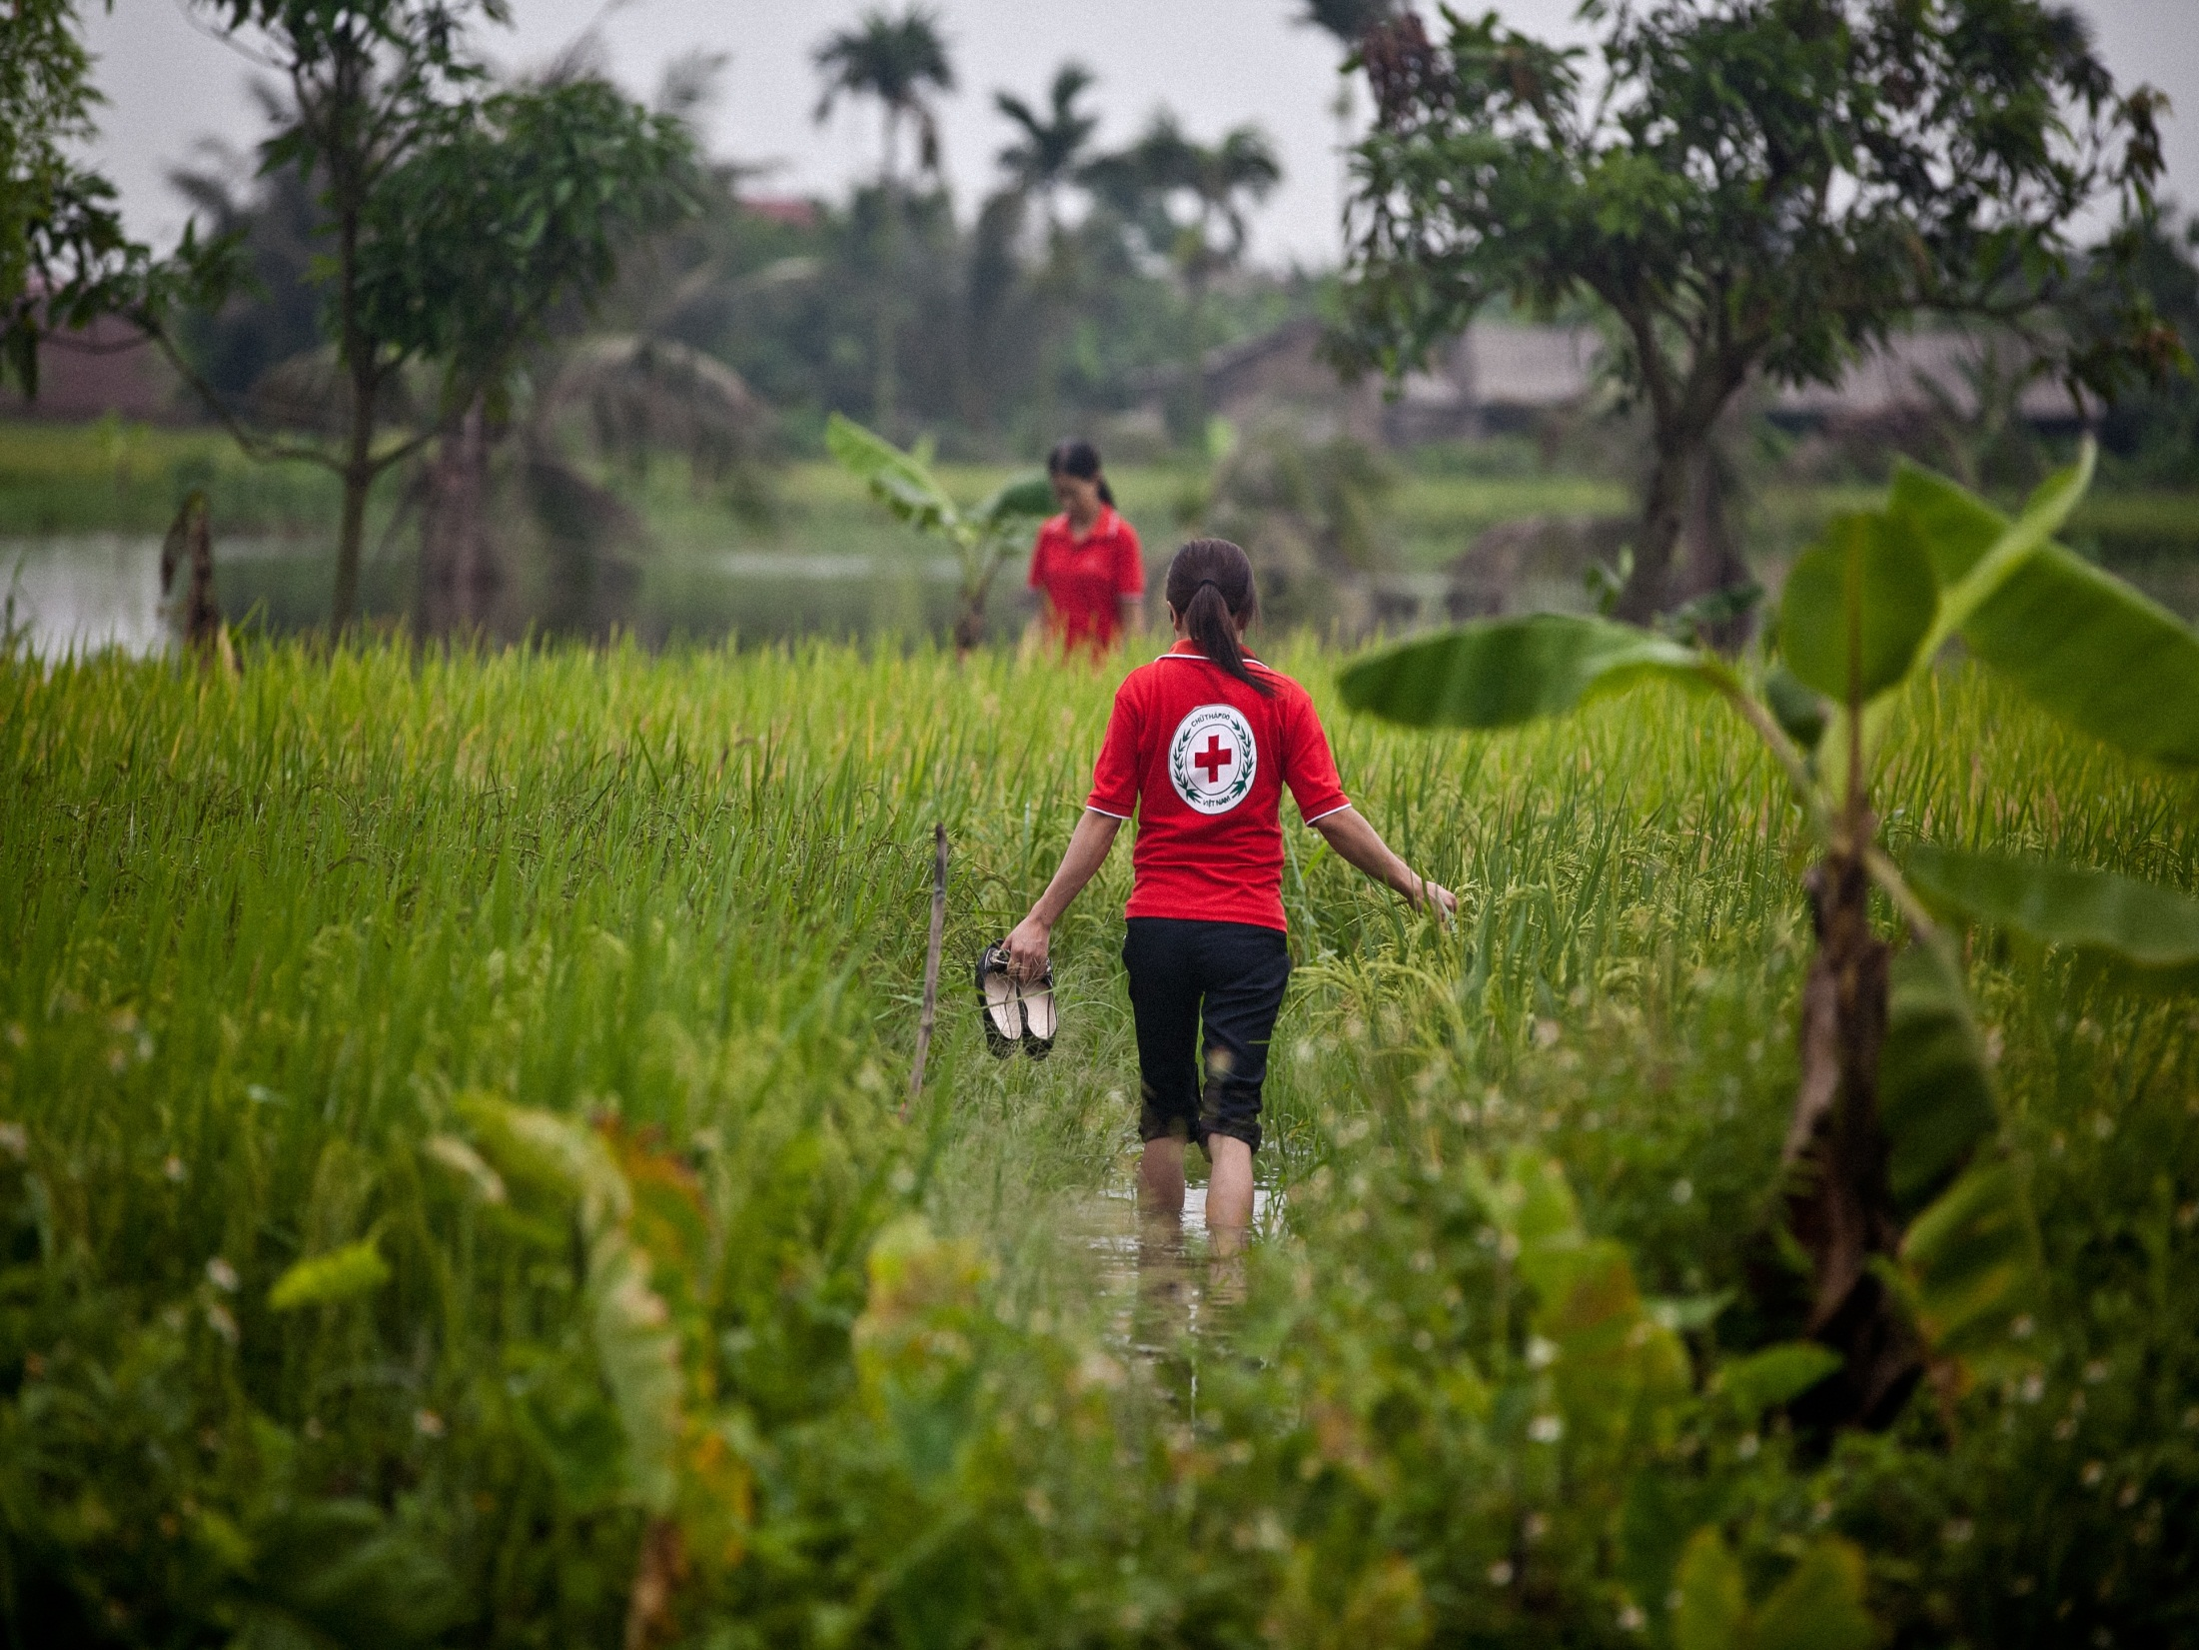
Vietnam

Slide 12
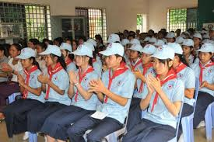
Youth and volunteers
Cambodia

Slide 13


Slide 14
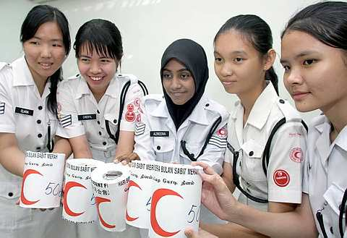

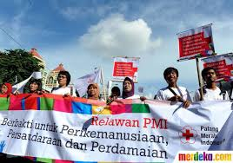

Malaysia
Brunei

Slide 15
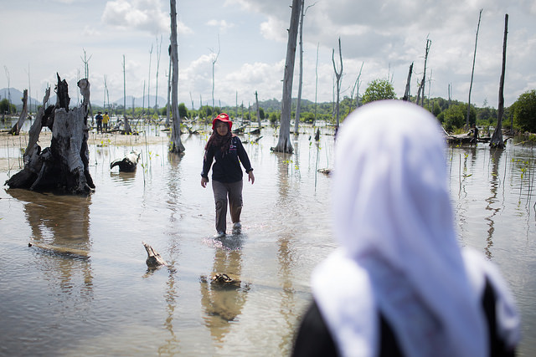
Engagement in communities and schools
Planting mangrove in Indonesia

Slide 16
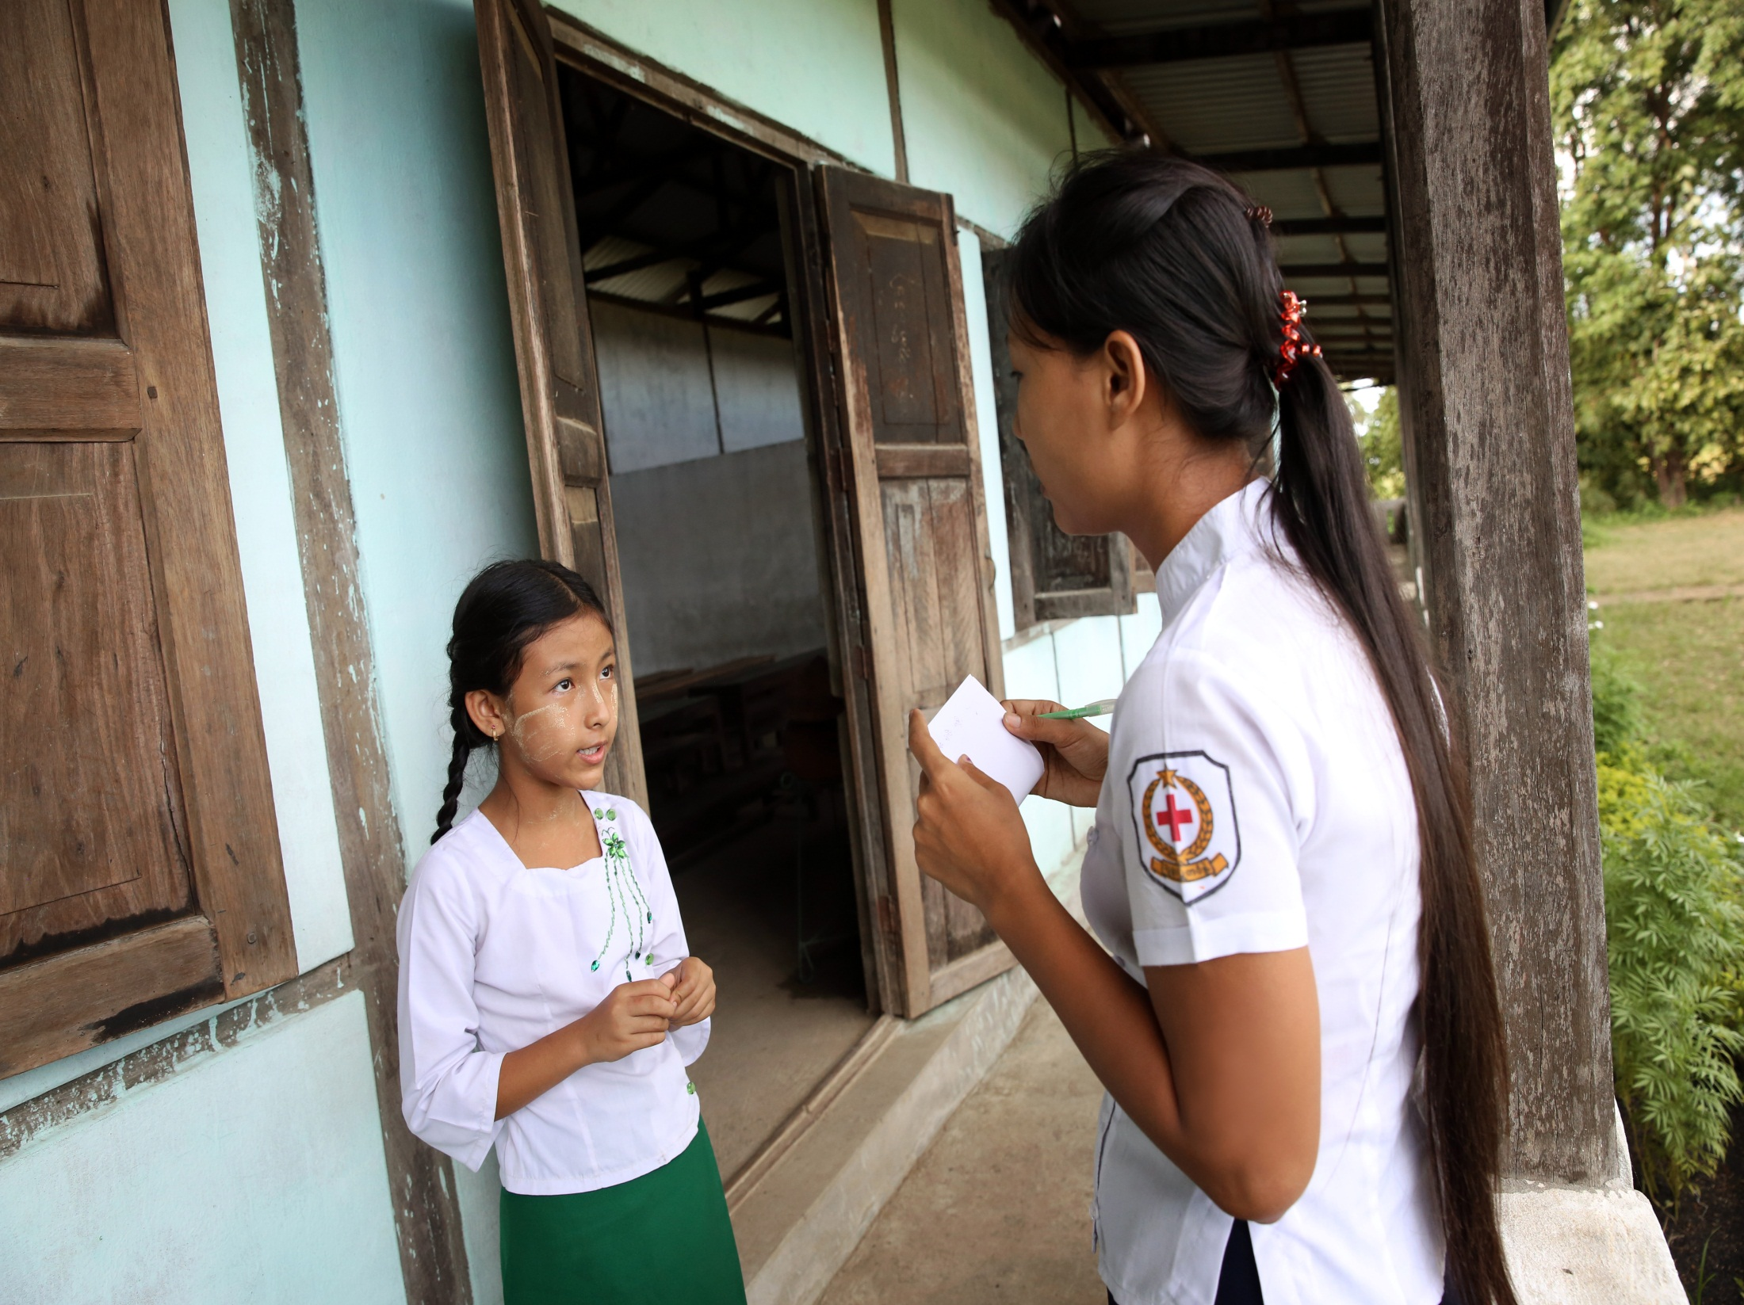
School awareness, Myanmar

Slide 17
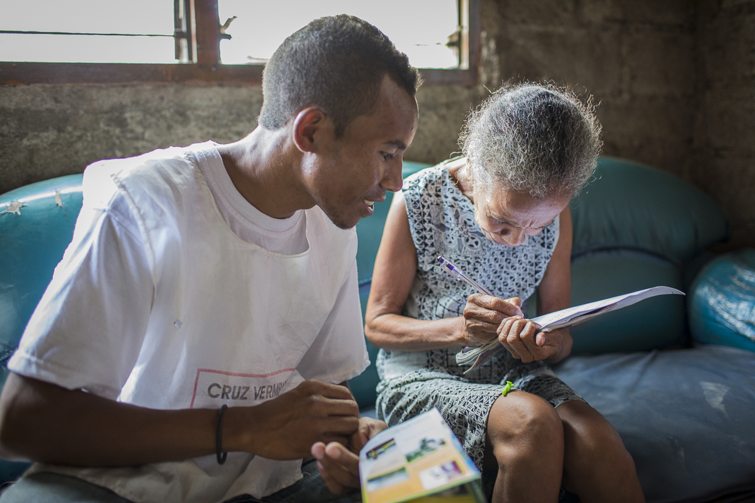
Dengue prevention, Timor Leste

Slide 18
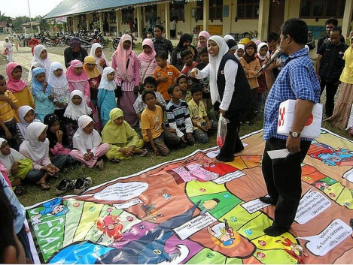
Disaster Preparedness in Indonesia

Slide 19
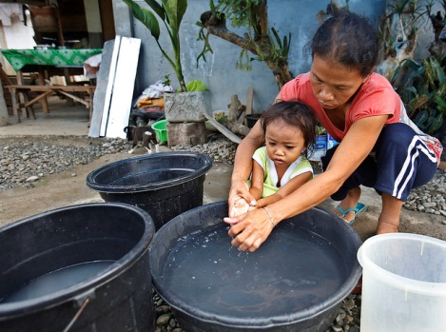
Hygiene promotion in the Philippines

Slide 20
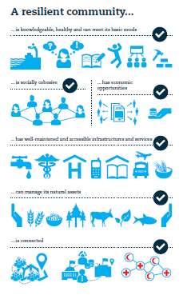
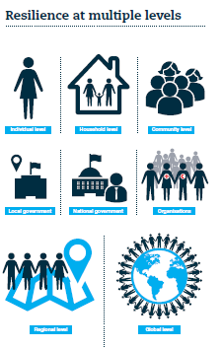
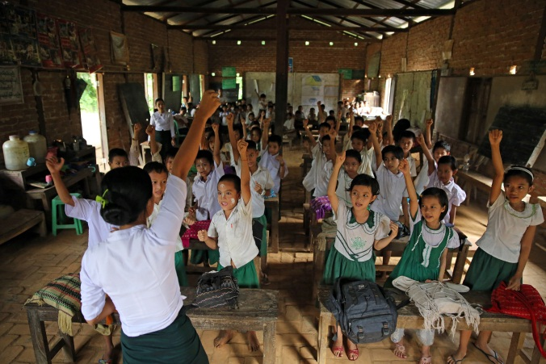
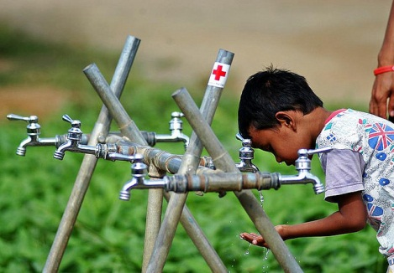
Community resilience

Slide 21
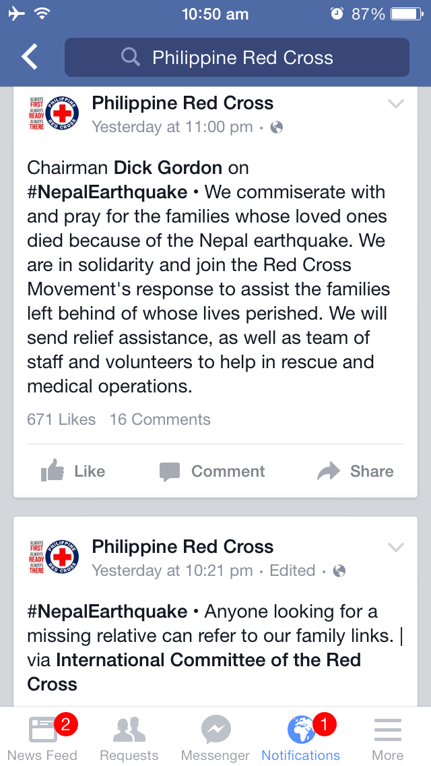
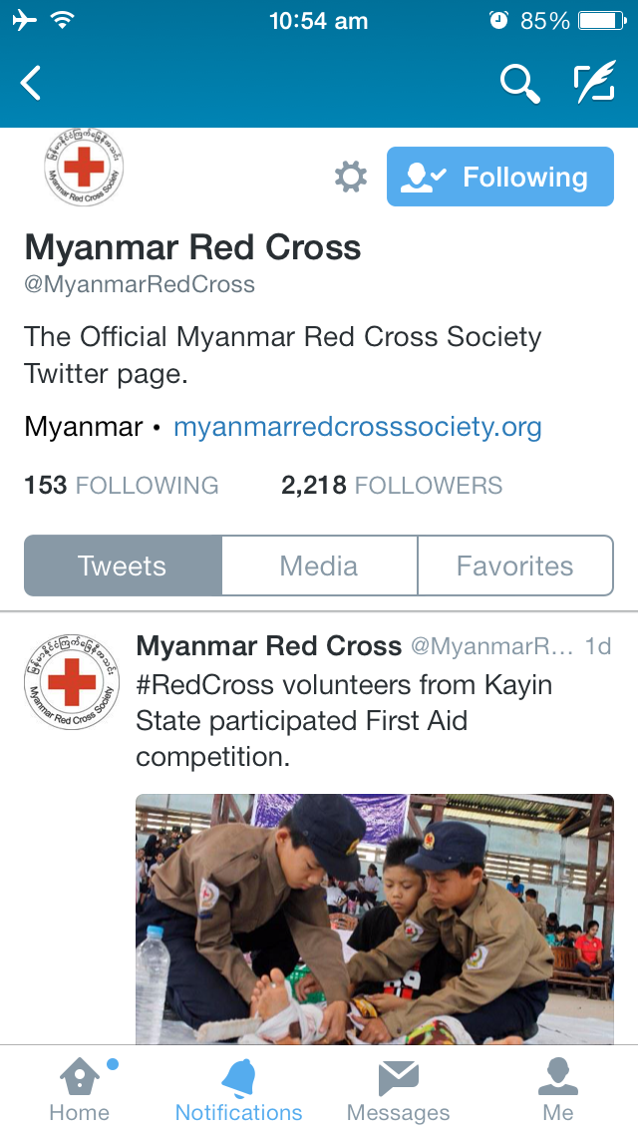
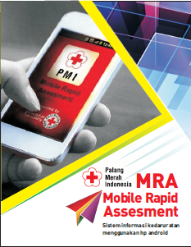
Community Engagement and Accountability - Beneficiary communications
Notes:
PMI on Facebook: another roles (building community, emergency request from public, etc.)

Slide 22
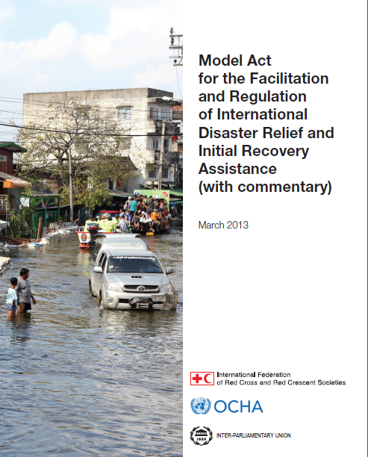
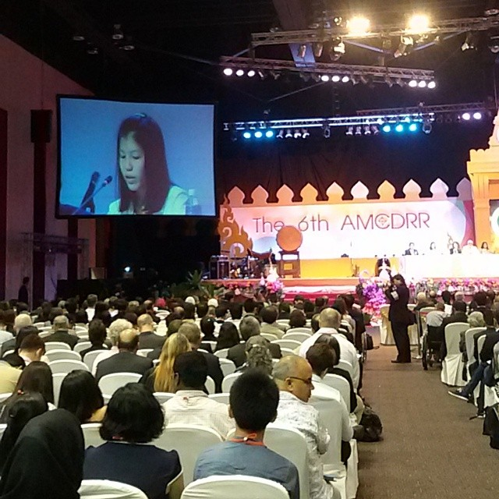
Humanitarian Diplomacy

Slide 23
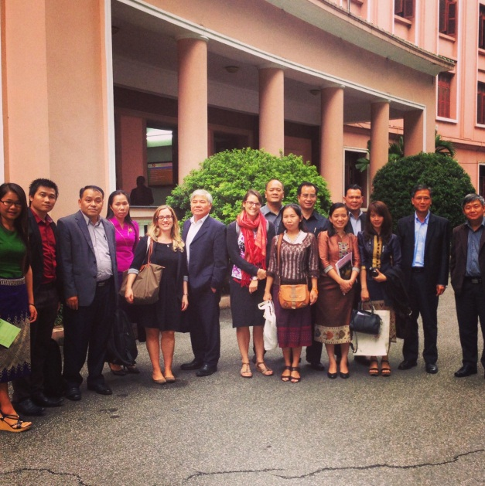
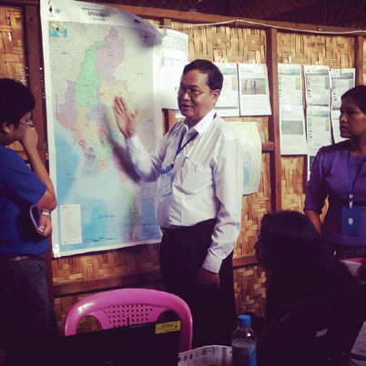
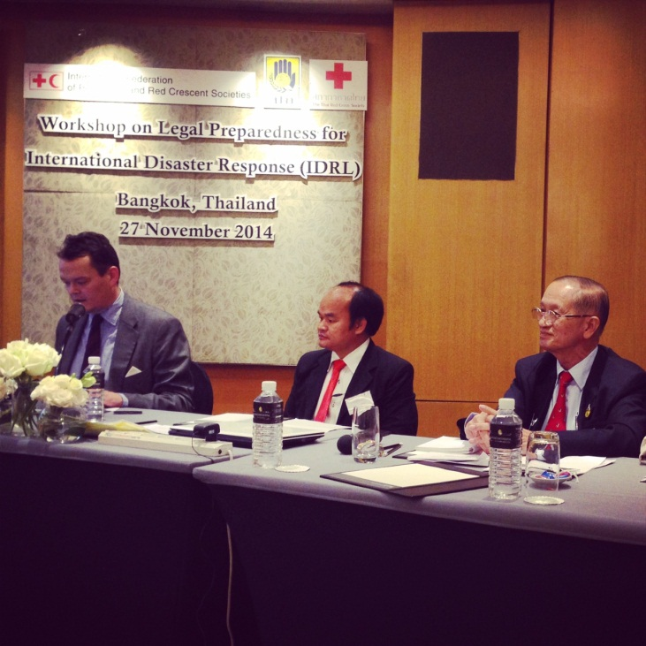
Working with governments on Disaster Law Initiative
Disaster Law workshop, Thailand
Vietnam – Lao exchange on Disaster Law
Simulation exercise in Myanmar

Slide 24
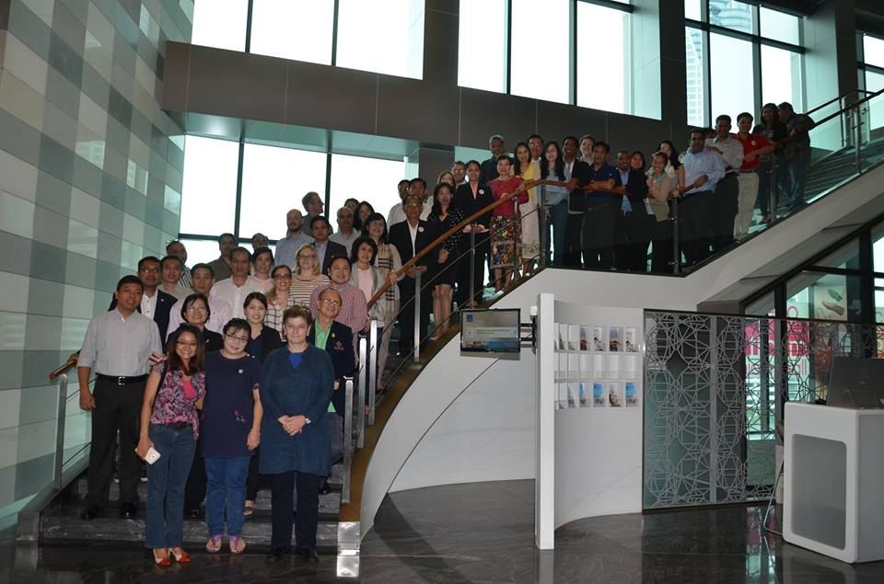
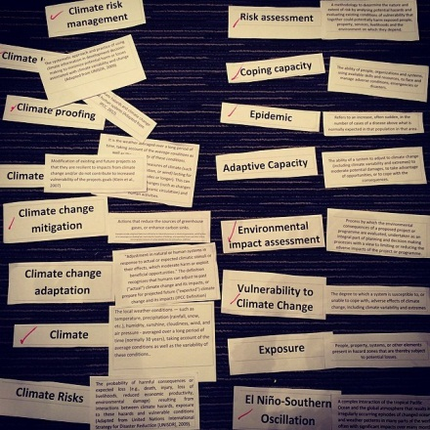
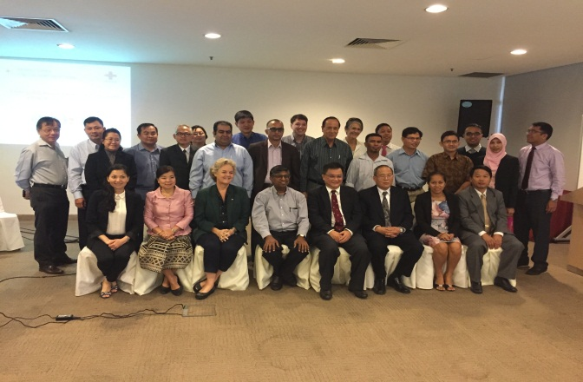
Regional cooperation – among NSs
Community Safety and Resilience Forum
Pandemic Preparedness and Public Health Emergency
Climate Masters Training
Notes:
CSR Forum
Climate Change
Pandemics / 17-20 Nov / DFATD / Jacob at last day
RDRT technical meeting (October)
Peer to peer (PMI-CVTL, TRCS-LRC…)

Slide 25
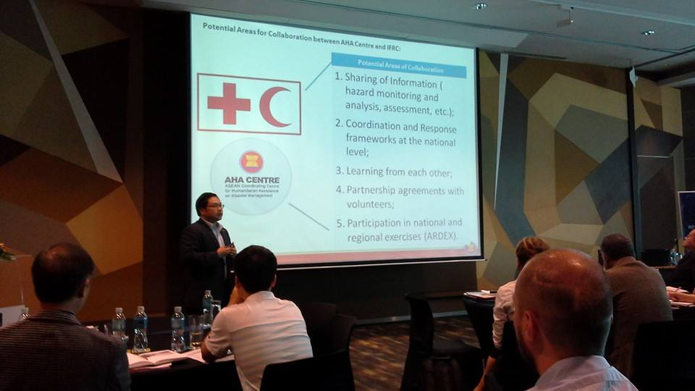
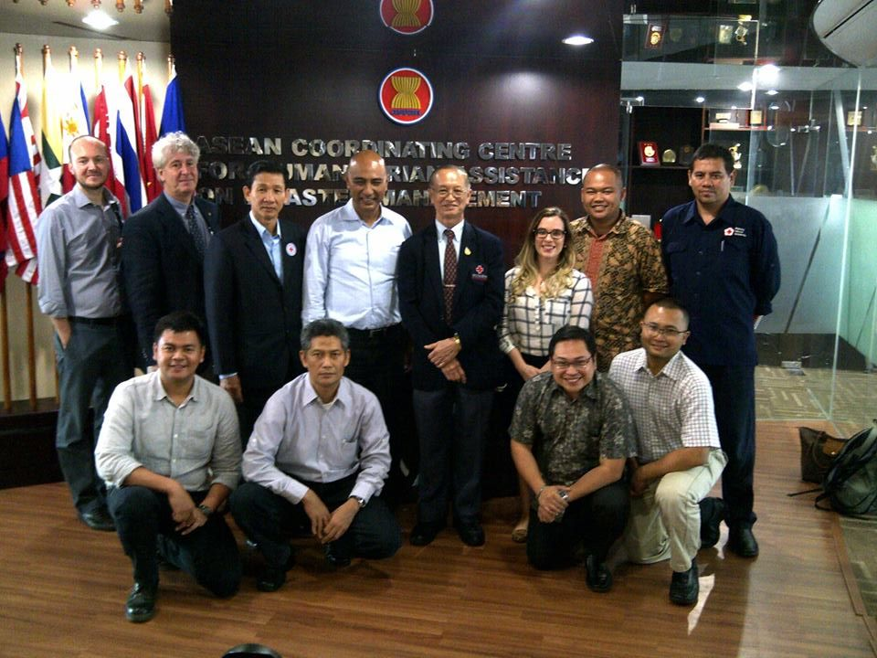
Regional cooperation with ASEAN
Joint Action Plan with AHA Centre – ACE Programme
Alignment of School Safety activities with ASSI
Contribution to AADMER reporting and future planning
Health: potential joint efforts in pandemic preparedness and NCD
Notes:
AHA Centre / Joint action plan / ACE
ASSI / APCSS
AADMER / mapping initiated
ASEAN / pandemics
ASEAN / NCD / Dengue (RRI)

Slide 26

www.ifrc.org giorgio.ferrario@ifrc.org
If you want to know more:

Slide 27
Thank you
© International Federation of Red Cross and Red Crescent Societies, Geneva, 2016.
Any part of this presentation may be cited, copied, translated into other languages or adapted to meet local needs without prior permission from the International Federation of Red Cross and Red Crescent Societies, provided that the source is clearly stated. Requests for commercial reproduction should be directed to the IFRC Secretariat at secretariat@ifrc.org
All photos used in this presentation are copyright of the IFRC unless otherwise indicated.
This presentation was written and developed by Giorgio Ferrario and produced in May 2016
Relevant resources are available on FedNet at fednet.ifrc.org
For further information, please contact giorgio.ferrario@ifrc.org

