Slide 1
Disaster Law: An Asia Pacific Perspective
Introduction to Disaster Law – Part 2
ACE Programme 2016

Slide 2
Overview of the session: Part 2
Theme 2: Law and DRR
Disaster Law developments in South East Asia and role of RCRC
Country case study: Indonesia
Background, multi-country study, DRR checklist
Wrap up, questions, comments
Notes:
I hope you all enjoyed the IDRL scenario exercise. We will now be moving on to the second main disaster law theme, and that is about ‘law and disaster risk reduction’. During this session I will also give you a brief overview of some of the key progress made in Southeast Asia. We will then hear from Pak Arifin from PMI about the disaster law developments in Indonesia, which is a country that has taken great strides when it comes to disaster law.

Slide 3
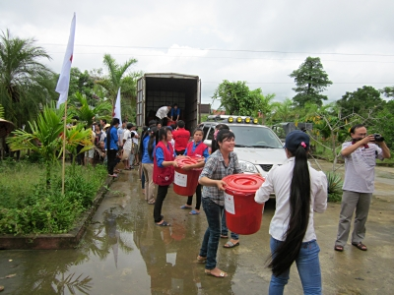
Why law and DRR? Experience highlights the importance of legal frameworks for DRR
Vietnam:
Seen the benefits of having strong laws / regulations for DRR in terms of saving lives.
Legislation on early warning, the establishment of dykes, drains (prevent flooding) and safe shelters and community awareness activities = a substantial reduction in lives lost from flooding and storms.
The flood level in the Mekong Delta in 2011 was similar to 2000 BUT the number of deaths from floods dropped from 600 down to 60.
Notes:
Now, some of you might be wondering why law and DRR is important? Well, experience highlights that legal frameworks for DRR, if implemented well, can and DO save lives. This example from Vietnam is quite significant, so I’d like to share it with you.
Vietnam:
Vietnam is a country which has really seen the benefits of having strong laws / regulations for DRR in terms of saving lives. They have a comprehensive flagship disaster management law in place, as well as relevant sectoral laws.
For example, they have legislation on early warning, the establishment of dykes, drains (to prevent flooding) and safe shelters. Their laws also provide for community awareness activities, which has resulted in a substantial reduction in lives lost from flooding and storms.
To give you some figures: the flood level in the Mekong Delta in 2011 was similar to 2000, BUT the number of deaths from floods dropped from 600 down to 60. This is a dramatic drop in the loss of lives!! So this just goes to show that is you have relevant laws in place which are implemented well, they can actually contribute to saving lives.

Slide 4
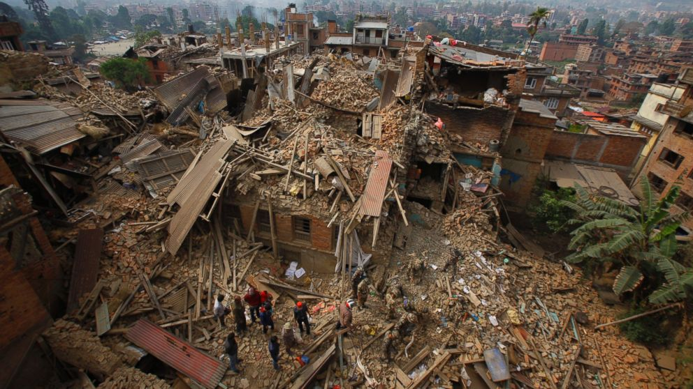
Notes:
Can anyone take a guess where this picture is from? (ask the group). Some of you may have even been deployed to this emergency.
It is Nepal, and the collapse of many buildings like this really demonstrated the need to not only have sectoral laws, like building codes, in place – but to make sure they are IMPLEMENTED and ENFORCED. Your country could have the greatest building codes and building plans in place, but if they are not practical, understood and implemented well, then you can end up in a situation like this. I’m sharing this picture to highlight my point that it is not just about having the right laws in place, but making sure they are IMPLEMENTED.

Slide 5
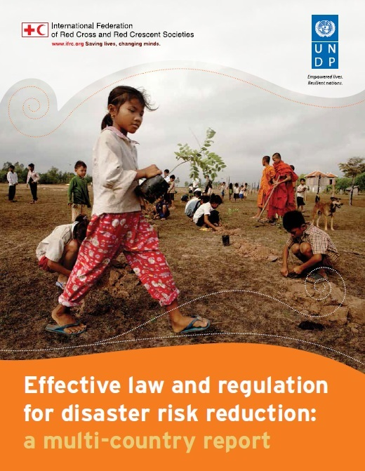
What has IFRC been doing to address this? Multi-Country Report
IFRC and UNDP launched a global study in 2014 looking at 31 countries:
Examples of good practice legal provisions
What helps or hinders implementation
Recommendations for reviewing or drafting laws
Aim to support legislators, public administrators and development practitioners to prepare and implement legal frameworks for DRR
Notes:
So the IFRC has been working closely with UNDP for a number of years to highlight the role of law and regulations for DRR. This has become increasingly important as we see a shift from response-focused laws and policies, to more focus on risk reduction and risk management.
IFRC and UNDP launched a global study in 2014 looking at 31 countries. The study highlighted the following areas:
Examples of good practice legal provisions
What helps or hinders implementation
Recommendations for reviewing or drafting laws
The aim of the study is to support legislators, public administrators and development practitioners to prepare and implement legal frameworks for DRR

Slide 6
Findings: Role of Disaster Risk Management laws
DRM law
DRR as a priority in law and policies
Support DRR education and awareness
Provide budget allocation for DRR
Define roles and responsibilities at different levels
Notes:
When it comes to the key findings of the report, what we identified was that having a good DRM law in place can do the following things to ensure effective DRR:
1: mandate DRR as a national and local priority in law and policy
2: clearly define roles and responsibilities for DRR at different levels
3: provide adequate budget allocation for DRR from government
4: and last but not least, support DRR education and awareness (e.g. by mandating the teaching of DRR as part of school curriculum).

Slide 7
Findings: sectoral laws are equally important!
Building codes
Land Use planning
Environment
Education
Climate change adaptation
Mainstreaming DRR
Notes:
Our research also demonstrated that when it comes to DRR, it is not just about having a good DM law. Sectoral laws are equally important, especially building codes, land use planning laws and policy, environmental protection laws, laws for climate change, and even laws relating to education.
These are all important areas to consider when it comes to mainstreaming DRR in your national legal frameworks.

Slide 8
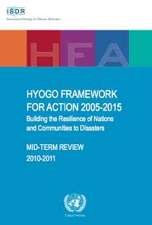
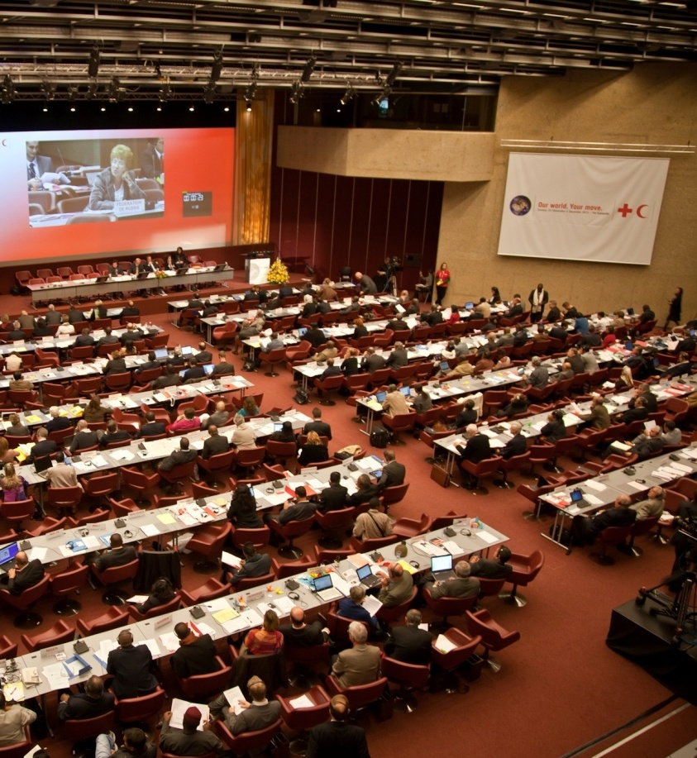
Background: where did this idea come from?
HFA Priority 1 – DRR – a national and local priority through: “policy, legislative and institutional frameworks for disaster risk reduction”
Resolution 7 - International Conference of the Red Cross and Red Crescent in 2011 – calls on states to review existing legal frameworks for DRR
Notes:
The thinking around the role of law in DRR has emerged from key global commitments, including the HFA and Resolutions from the International RCRC conference, as mentioned earlier in the session today (See slide).

Slide 9
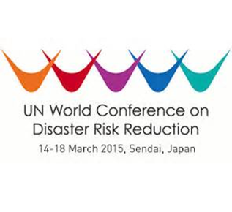
Disaster Law: International Commitments
Sendai Framework for DRR: focus on DRR legislation and IDRL Guidelines
Resolution 6 on Disaster Law, 2015
Notes:
More recently, the role of law for DRR was emphasised throughout the Sendai Framework for DRR, specifically under Priority on risk governance. It is worth noting here that the SFDRR also calls on states to use the IDRL Guidelines when preparing national laws for disaster preparedness and response.
As mentioned earlier today, a new resolution was adopted at the 32nd IC of the RCRC in December 2015, which calls upon states to take measures to strengthen their national legal frameworks for DRR, with support from the Red Cross and other partners.

Slide 10
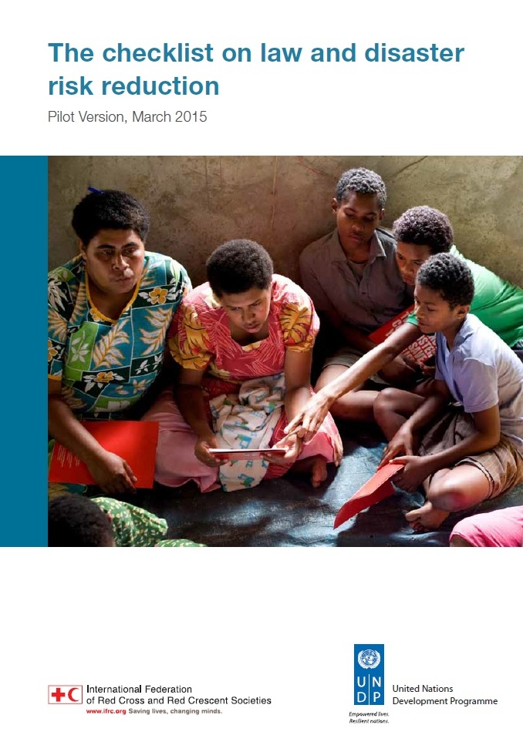
New tools: The Checklist on Law and DRR
A succinct and easy to use tool to support the strengthening of legal frameworks for DRR by:
Drawing on key findings of the multi-country study
To help guide a review and revision process of laws and regulations for DRR
For use by lawmakers, NDMOs, RCRC Societies, other DRR advocates
Handbook also prepared to guide implementation of the checklist
Notes:
In 2015, a new tool was adopted which is designed to help law makers, NDMOS, the RCRC and DRR practitioners ensure that their national legal frameworks adequately address DRR considerations, including issues around the engagement of different actors (e.g. from communities to the private sector); ensuring that budget and resources are allocated for DRR within the relevant financing mechanisms; and ensuring that laws for DRR address gender and diversity considerations and that this is mainstreamed through the relevant sectoral laws. See other key points on the slide.

Slide 11
True or False?
If you have a good disaster management law, your legal framework for DRR is complete
Answer: False
Notes:
Now, just to make sure everyone is still awake, I have a quick true or false question for you!!
If you have a good disaster management law, your legal framework for DRR is complete??
FALSE!! As I was just explaining, when it comes to DRR, it goes beyond having a good disaster management law. DRR is much broader in scope, and we must also consider the relevant sectoral laws to make sure we have a good framework for DRR in place at the national level.

Slide 12
Key points to remember!
Disaster management laws are important: BUT other sectoral laws are equally as important for risk reduction
Effective laws and regulations serve as a foundation for building community resilience and making people safer
The Checklist on Law and Disaster Risk Reduction provides guidance for reviewing and improving legal frameworks for DRR – so please go ahead and use it! ☺
Notes:
Before moving on to the final part of the disaster law session, I’d like to leave you with some key points to remember about law and DRR (see slide!).

Slide 13
What is the role of the IFRC’s Disaster Law Programme?
Technical assistance
Advocacy
Research and capacity building
Notes:
Now, if you and your NDMOS are looking at revising or drafting a new law or policy relevant to DRM than the IFRC and our national society’s are ready to help! We have been working very actively in South East Asia and Asia Pacific for over 10 years and provide technical assistance, advocacy support as well as research and capacity building to governments, RCRC Societies and key partners including UN Agencies and regional organizations like ASEAN.

Slide 14
Disaster Law Progress in Southeast Asia
PRC and Govt working on review of DM law and DL trainings
Philippines
Cambodia
Indonesia
Thailand
Vietnam
Myanmar
Lao PDR
IDRL study, Adopted new DM law in 2015
IDRL Study, DRR study, DM law review in 2017
IDRL workshop – Int. Asst. Guideline
IDRL and DRR study, adopted DM law in 2013
IDRL Study,
Developing new disaster AND climate change law
IDRL deployment to support floods in 2015
New DM law and rules, conducting IDRL workshop this week!
Notes:
We have seen A LOT of progress in SEA in particular. Here is a diagram to give you some key examples from the most active countries in SEA. More and more countries are also looking to SEA as an exemplar in disaster law developments, and we have facilitated learning exchanges between ASEAN member states (e.g. Laos and Vietnam) and even further abroad (e.g. Vietnam and DPRK).
Please read examples from the slide. In many of these countries, the NS and IFRC have been actively involved in the development of disaster law and associated rules and regulations, many of which have adopted recommendations from the DL tools mentioned today (e.g. IDRL Guidelines, Model Act, DRR checklist etc.).

Slide 15
What disaster law work have SEA National Societies been doing?
Malaysia
Singapore
Brunei Darusslam
National workshop on (legal) preparedness with govt and OCHA, considering development of new DM law
Contributing to regional initiatives
Sensitization and enhancing relations with government
Notes:
While these countries have been less active in DL, they have still made progress and take part in regional initiatives (read examples on slide).

Slide 16
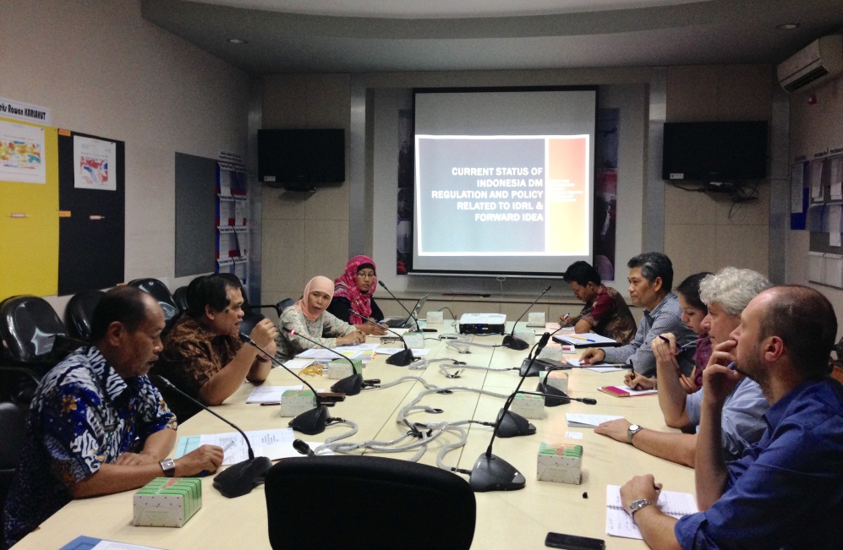
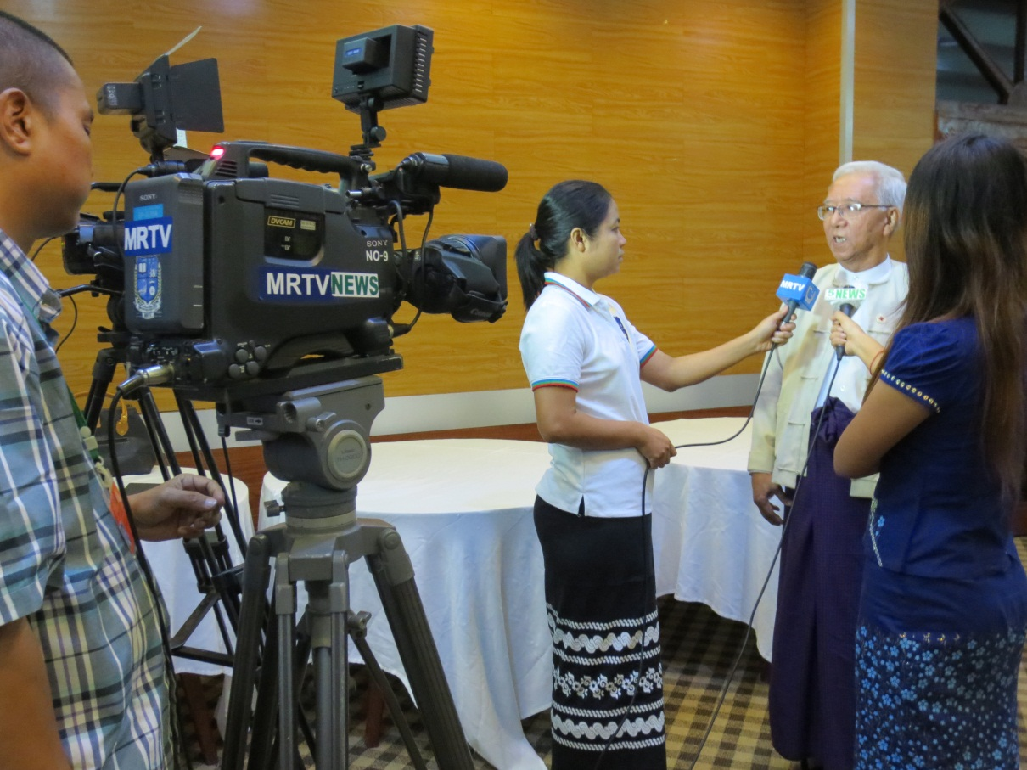
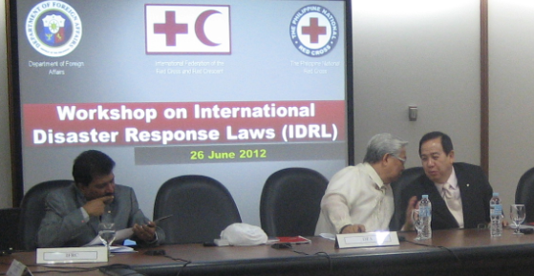
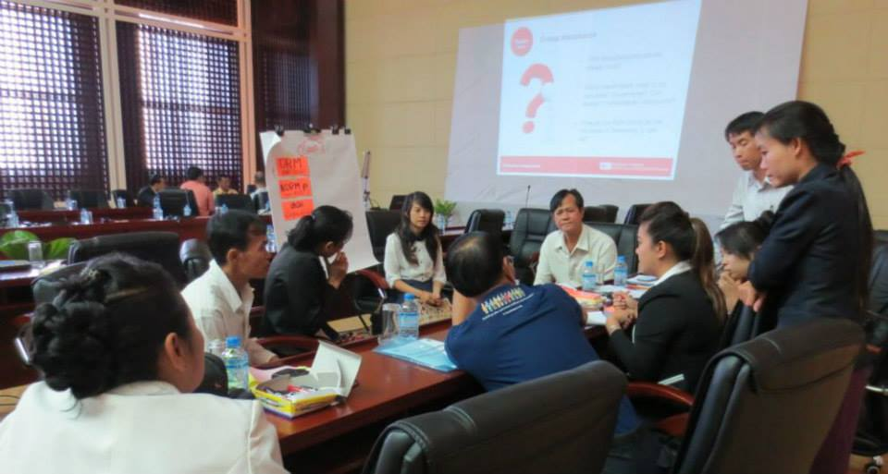
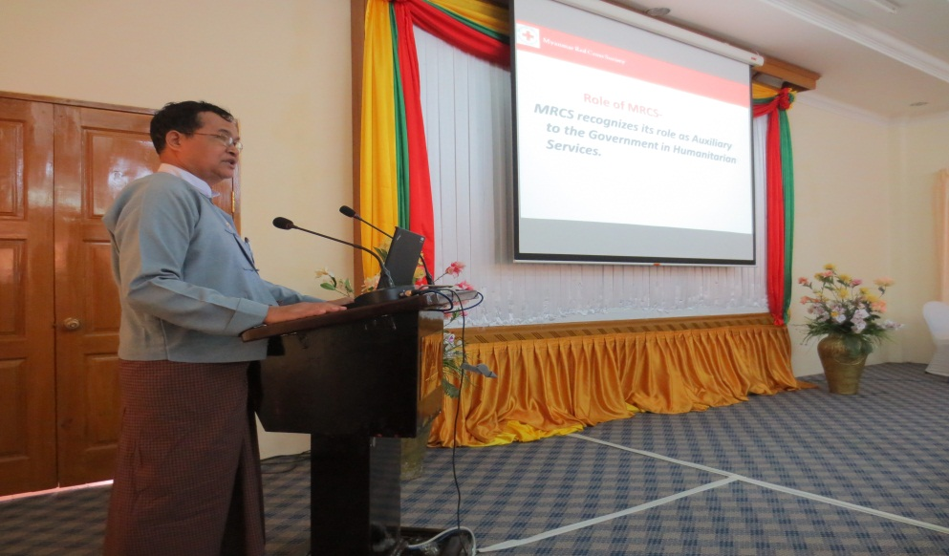
South East Asia: Leaders in Disaster Law!
Notes:
Before I finish I just want to highlight again how much SEA is a leader when it comes to disaster law! A lot of progress is being made in this region, both at the national and regional level! So I hope all of you have learnt something today, and let’s keep going!!

Slide 17
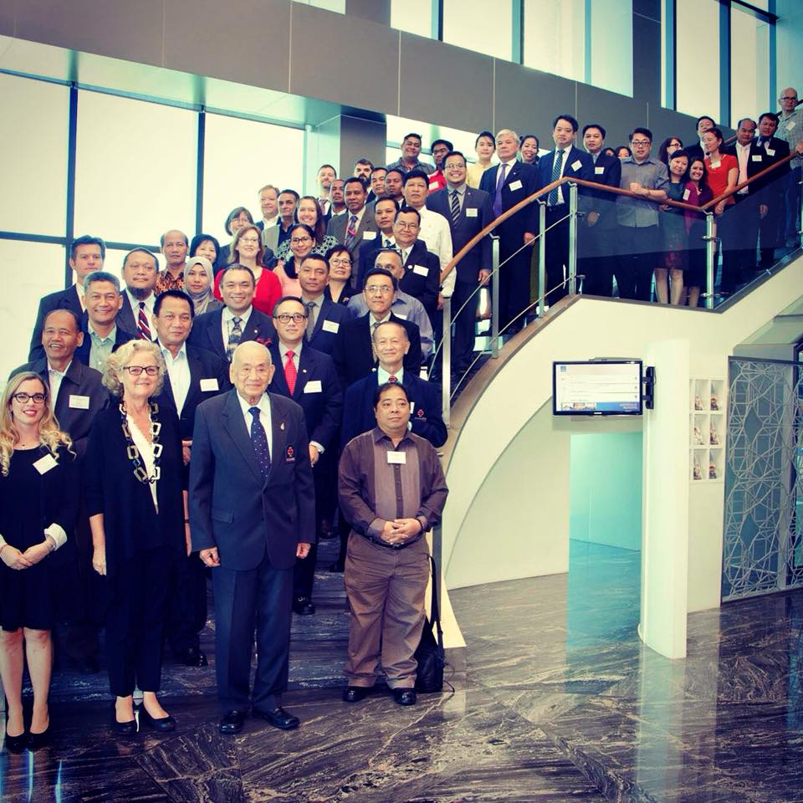
Thank you!
Comments?
Regional Disaster Law Forum, June 2015, Bangkok
Questions?
Ask me if you have questions! ☺

