Slide 1
Disaster Law: An Asia Pacific Perspective
Introduction to Disaster Law – Part 1
ACE Programme 2016

Slide 2
Overview of the session: Part 1
Introduction to Disaster Law
What is IDRL? Background, tools, commitments
IDRL scenario exercise
Theme 1: IDRL
Part 2: Law and DRR, regional developments, Indonesia experience
Notes:
Introduce yourself and go through the overview of the programme (see slide, self explanatory)

Slide 3
What is disaster law?
Key
Disaster law
Notes:
Ask participants: how many of you have heard or disaster law? Or International Disaster Response Law? Does anyone want to take a guess what it is? We are often met with these sorts of faces when we mention disaster law, but many states are actively involved in disaster law processes, sometimes without even realising it!

Slide 4
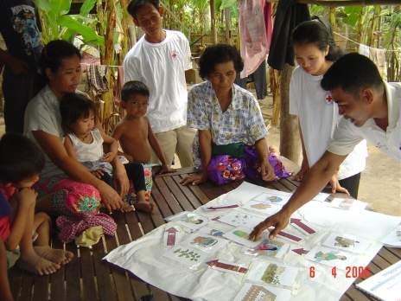
Disaster Law is…
The laws and regulations which:
address the roles and responsibilities to manage and respond to disasters
minimise impact of disasters
reduce disaster risks
Notes:
So when we talk about disaster law, we are taking about the laws and regulations which address three key areas:
The roles and responsibilities to manage and respond to disasters
The laws which minimise impact of disasters
The laws which help reduce disaster risks

Slide 5
Disaster Law themes
Law and Disaster Risk Reduction (Law and DRR)
International Disaster Response Law (IDRL)
Notes:
The IFRC and our National Societies have been undertaking work for over a decade in two key disaster areas or ‘themes’.
International Disaster Response Law (or IDRL, as it is commonly referred to)
Law and Disaster Risk Reduction.
We have been working on IDRL for well over 10 years now, and are internationally recognized as a leader in this field. More recently, over the past 4-5 years, we have also been examining the role the law and regulation can play in disaster risk reduction.

Slide 6
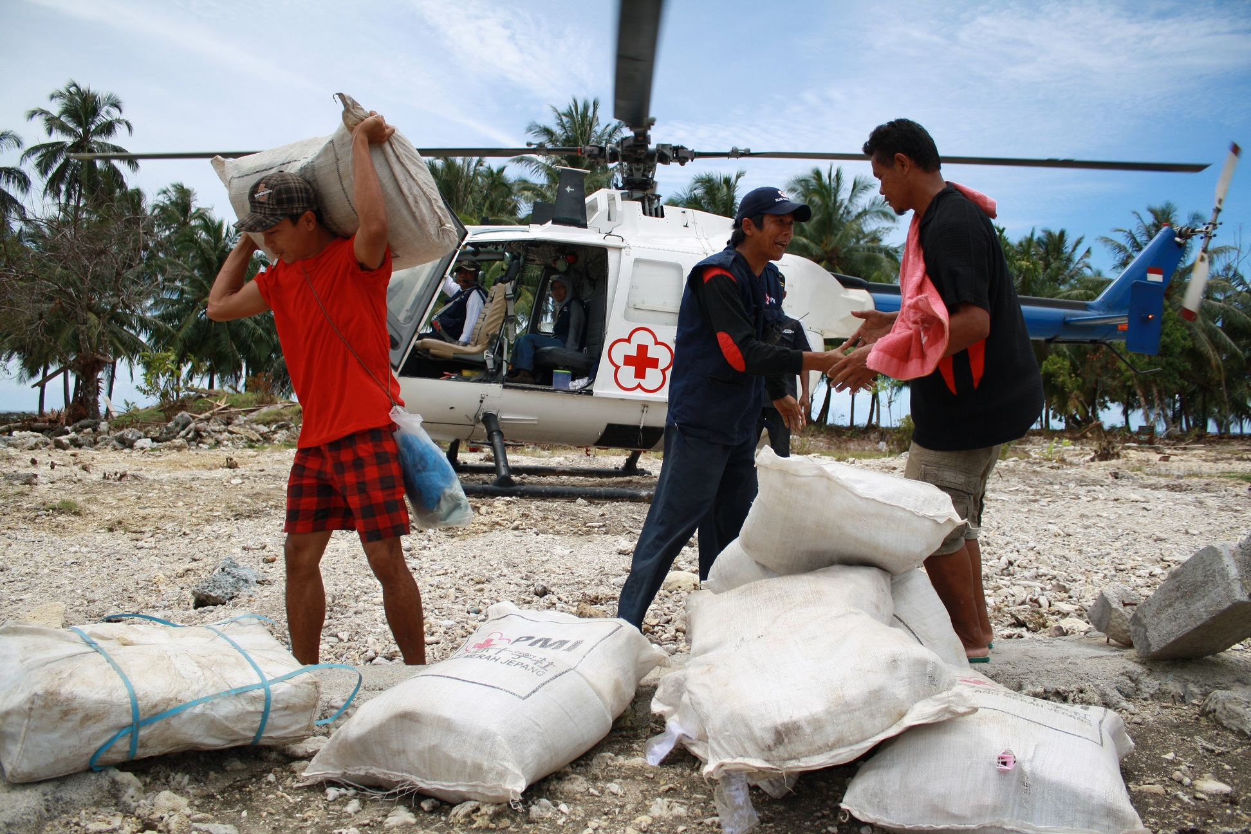
Theme 1: International Disaster Response Law (IDRL)
Theme 1: International Disaster Response Law (IDRL): the laws and regulations to handle incoming international assistance
Notes:
So now we will move on to our first theme of the session, and that is international disaster response law (IDRL). This is all about the laws and regulations that are designed to handle incoming international disaster assistance, often in a large-scale emergency.
Can I get a show of hands as to who is already familiar with IDRL? Has anybody heard of it? (see what audience’s response is…)
Ok, well we are going to put you to the test! (move on to true and false questions – see next slide).

Slide 7
True or False?
Disasters = chaos, confusion, there are no rules, law doesn’t apply.
Answer: False
Notes:
To get everybody warmed up, we have a few true and false questions for you! Don’t be shy!
Question 1: what do you this about this statement, is it true or false? “Disasters + chaos, confusion, there are no rules, law doesn’t apply”.
It is FALSE. If anything, law is even MORE IMPORTANT in a disaster situation, because you need rules to regulate the activities that are happening on the ground. You also need rules to help facilitate the response, so people receive the right kind of aid, as quickly as possible.

Slide 8
True or False?
IDRL is international humanitarian law
Answer: False
Notes:
Next question:
What do you think about this statement, is it true or false? “IDRL is international humanitarian law”
FALSE: IDRL and IHL are two different bodies of law. IHL refers to the laws of war and armed conflict, whereas IDRL is all about natural disasters.

Slide 9
True or False?
International humanitarian workers should abide by all national laws when working in disaster affected countries.
Answer: True
Notes:
What do you think about this statement? Is it true or false? “International humanitarian workers should abide by all national laws when working disaster affected countries”.
TRUE: international actors cannot just enter a country and do as they please! If their assistance is welcomed or requested by the affected state, they must respect all national laws of that country. This is in line with fundamental principles of international law, such as state sovereignty and territorial integrity.

Slide 10
True or False?
International relief teams need the permission of the affected state to provide humanitarian assistance.
Answer: True
Notes:
Next question:
“International relief teams need the permission of the affected state to provide humanitarian assistance” – true or false?
TRUE: international assisting actors MUST have the permission of the affected state to enter their country and provide relief. They should not enter without prior authorization and activities must be conducted in accordance with the needs of the affected state and affected communities.

Slide 11
True or False?
After requesting international assistance, the affected state must allow foreign governments to bring in any type of aid.
Answer: False
Notes:
“After requesting international assistance, the affected state MUST allow foreign governments to bring in ANY type of aid”. True or false?
FALSE: the affected state will determine what kind of assistance is required and when. Foreign governments cannot bring in ANY type of aid. It should be in line with the type of assistance requested by the affected state, which should ideally be based on an assessment of the needs of the affected communities.

Slide 12
Why legal preparedness for international disaster response?
More and different international responders
More frequent and larger natural disasters
Absence of laws and procedures to regulate an increasingly complex context
Notes:
So, having considered all of those questions, why do you think legal preparedness for international disaster response is important? Why do we need laws and regulations for this?
Well, I think everyone in this room knows that we are witnessing more frequent and large scale disasters than ever before – especially in Southeast Asia and the Asia Pacific more broadly. In addition to this, we are seeing many more (and different!) international responders.
At the same time, we have seen an absence of laws and procedures to regulate what is becoming an increasingly complex context.

Slide 13
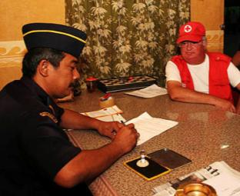
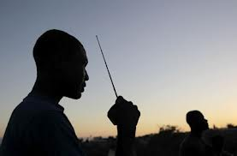
Research shows that a lack of legal preparedness hampers international relief
Barriers
Initiation, visas, customs, radio use, taxes, professional qualifications, registration, transport, liability
Oversight gaps
Inappropriate items, ignoring standards, poor coordination, corruption
Bottom line
Aid is slower, more expensive, less effective, sometimes counter-productive
Notes:
The IFRC has been conducted research in the area of international disaster response law (IDRL) for well over ten years now, and research has shown that a lack of legal preparedness seriously hampers international relief. We have seen significant barriers to the initiation of international assistance; problems around the rapid issuing of visas and expedited customs clearance; use of radios and specialized telecommunications equipment etc (see areas outlined on the slide).
We have also seen significant gaps in oversight, leading to the delivery of inappropriate items, ignoring minimum standards, and poor coordination among actors, sometimes even cases of corruption.
What is this means is, at the bottom line, aid is slower, more expensive, less effective, and sometimes counter productive to the relief operation as a whole.

Slide 14
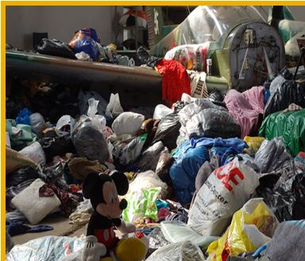
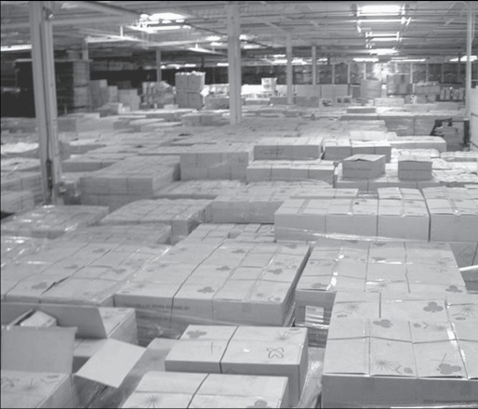
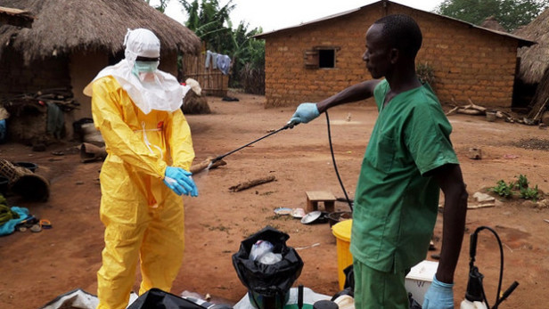
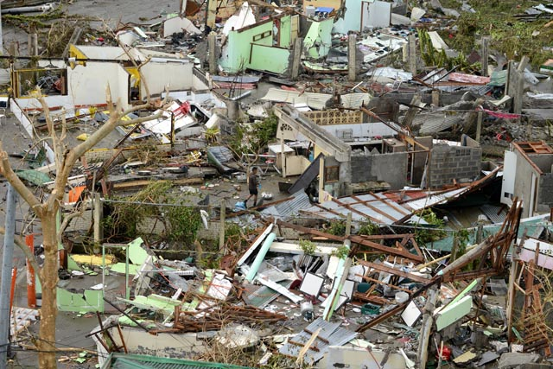
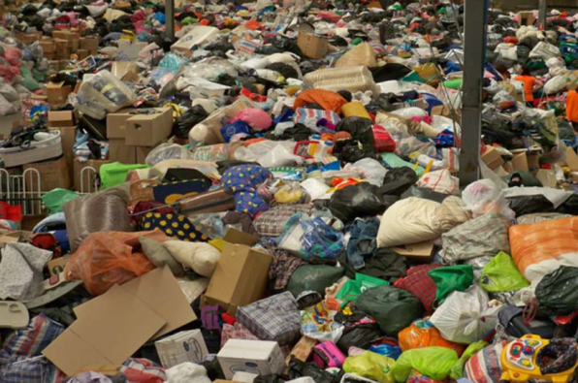
A few anecdotes…
Notes:
Now, just to highlight the issues, I’d like to share a few anecdotes with you, and play a little guessing game?
Can anyone guess what these pictures are, or where they are from?
This picture depicts the so called ‘tsunami of misguided will’ which arrived in Thailand and Indonesia following the indian ocean tsunami. Their borders were completely inundated with bags of used clothing, expired medications and culturally unacceptable food were donated to the major relief operations. All of these unwanted goods ended up then blocking the entry of the relief that was actually needed.
A warehouse full of boxes of military rations. In the days after hurricane Katrina, the US government circulated a list of relief items needed, including ‘meals ready to eat’. So the British government sent over 500,000 MREs. When they reached New Orleans, the US Government realised that they couldn’t be distributed because they contained British beef, which had been banned by American law years before because of mad cow disease. The authorities didn’t know what to do with them, and the British didn’t want them back, so they sat in storage for over a year (at significant expense to the US govt) until they finally found foreign recipients willing to accept them (border guards in Georgia).
3) The third picture shows the devastation caused by typhoon haiyan, and the rubble and mess that needed to be sifted through in the early days of the response by search and rescue teams.. Unfortunately, there were reports of an Urban Search and Rescue team turning up with no food, water or tents etc. and were caught stealing relief goods meant for distribution. Reports also that some medical teams came ill-equipped or without their own equipment, looking to use local resources (even though there weren’t any!) because they didn’t have their own
4) The fourth picture in the centre refers to the Ebola crisis in West Africa. Legal issues in disaster response are not unique to disasters such as earthquakes, floods, tsunami, hurricanes – they can also occur during health emergencies. A report from New York Times was published which claimed shipping containers contained medicines and medical equipment were stuck on the docks for 2 months in Sierra Leone because it took so long to process the clearance of goods. There were also claims of goods being sent without authorization from national authorities.
5) The final picture in the bottom corner is actually from Australia after severe bushfires took place in 2009. Authorities were completely overwhelmed with relief goods and donations, some were useful, others were not. But the bottom line is that even the most developed countries can be overwhelmed with relief in the midst of large scale disaster response. This can create significant delays, often because there is so much to sort thought, much of which can be inappropriate and not useful. This why all states, regardless of whether they are developed or developing, should have solid laws and procedures to not only facilitate, but REGULATE, a disaster response.

Slide 15
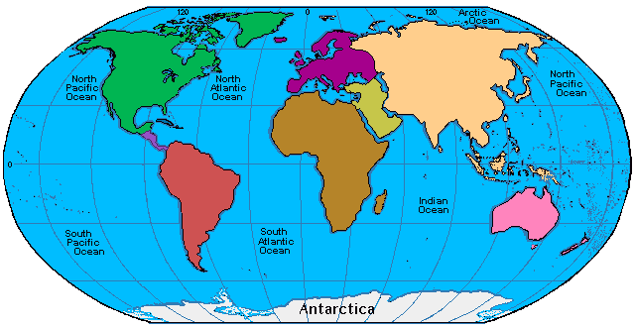
Global & Regional Institutions
RC /RC (Soft) Law
No Comprehensive Legal Regime
3
Soft Law
IHL, HRL and Refugee Law
Sectoral Law
Regional Law
Bilateral Agreements
Notes:
So over the years we have seen many different areas of sectoral law (e.g. for customs, immigration, telecommunications etc) emerge; there are also significant regional laws (e.g. the AADMER); bilateral agreements between states; what we ‘soft’ law in the form of guidelines and resolutions; there are elements of human rights law which are applicable etc.
But there has not been one comrpehensive legal regime to address issues in disaster response. There have only been these bits and pieces, many of which states don’t even know about!

Slide 16
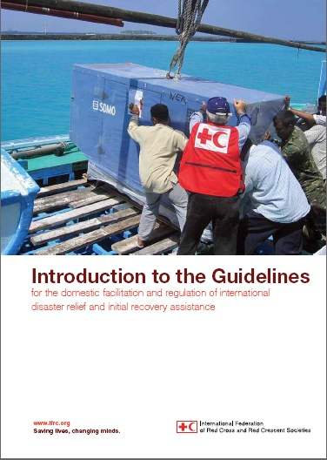
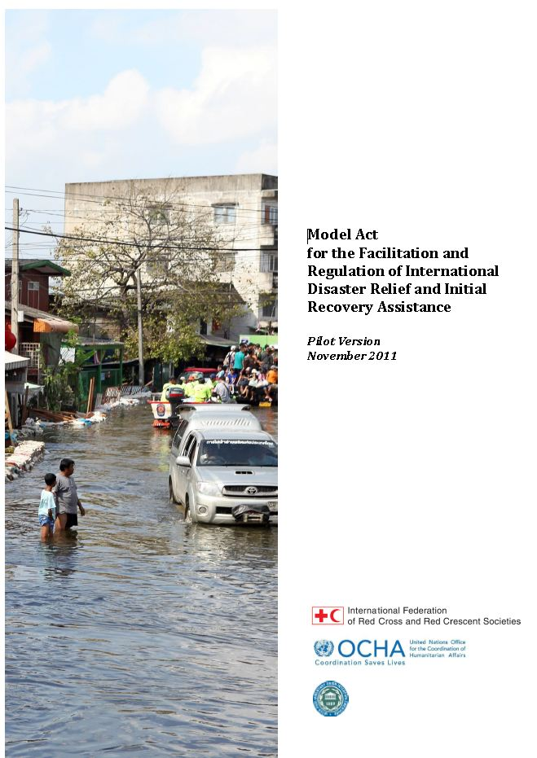
IFRC tools: IDRL Guidelines & Model Act
Draw upon existing international norms and best practice
Recommendations to governments on how to prepare domestic laws and procedures for international assistance
Requests for ‘legislative language’ to implement the Guidelines = Model Act
Translated into different languages
Notes:
So the IFRC worked closely with governments, NS, international organizations, parliamentarians, civil society, etc, to consolidate all of this good practice in one clear document: “The Guidelines for the Domestic Facilitation and Regulation of International Disaster Relief and Initial Recovery Assistance” – also known as the IDRL Guidelines.
These guidelines draw upon existing international norms and best practice to provide recommendations to governments on how to prepare domestic laws and procedures for international assistance. They were adopted at the International Conference of the Red Cross Red Crescent in 2007, and since that time we have seen many states utilize these to develop their domestic legal frameworks for disaster management and reponse.
In the years following the adoption of the IDRL Guidelines, the IFRC received increasing requests from states for ‘legislative language’ to help implement the Guidelines. As such we worked closely with UN OCHA and the Inter-Parliamentary Union to develop a model law, the ‘Model Act on International Disaster Assistance’. This tool was developed through research and consultations across the world, and is now available in different languages including in Myanmar, Lao, Thai and Vietnamese.

Slide 17
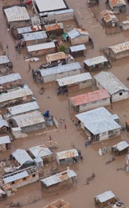
The core ideas of the IDRL Guidelines
Domestic actors have the primary role
International relief providers have responsibilities
International actors need certain legal facilities (e.g. expedited visa and customs processing, exemptions from taxes duties and fees, priority customs clearance)
Some legal facilities should be conditional upon compliance with humanitarian principles and national law
Notes:
There are four core ideas behind the IDRL Guidelines:
Domestic actors have the primary role. We have to respect state sovereignty and territorial integrity, and it is the affected states primary responsibility to respond – and whether to request or welcome international assistance if their capacity is overwhelmed.
International relief providers have responsibilities: International actors cannot just come into an affected state and do as they please. They must provide assistance in accordance with minimum standards, and according to the needs of the government and affected population.
In addition, International actors need certain legal facilities (e.g. expedited visa and customs processing, exemptions from taxes duties and fees, priority customs clearance) in order to be able to carry out their activities efficiently and effectively. Therefore affected states are encouraged to put in place legal or policy procedures to help facilitate this.
Last but not least, the legal facilities should be conditional upon compliance with humanitarian principles and national law. They should not just be given to any international organization that wants to help, but those who are formally recognized and comply with humanitarian principles. This helps to give the state control of the type, amount and quality of assistance being provided.

Slide 18
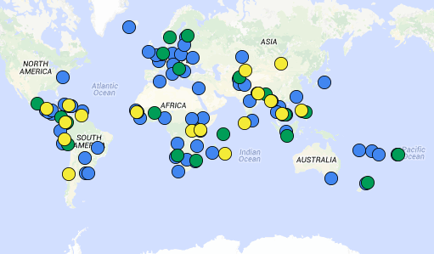
Progress to date: implementing the IDRL Guidelines at the national level
Key:
Blue: # of disaster law projects (50+)
Green: # of new laws/regulations adopted (+18)
Yellow: # of new laws/regulations pending (+17)
Notes:
We have seen a lot of progress globally in the uptake and use of the IDRL Guidelines (explain colours and numbers on the map).

Slide 19
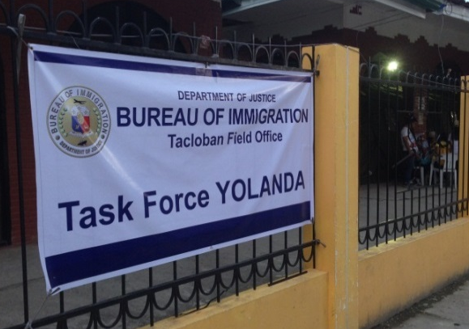
IDRL in action: The experience of the Philippines
Republic Act 10121 on National Disaster Risk Reduction and Management (section 16 and 18) and IRR (rule 14) refers to international assistance and IDRL
‘Welcomed’ international support soon after Typhoon Haiyan / Yolanda
Established a “One-Stop-Shop” to expedite clearance of relief goods and equipment through customs; Established new immigration procedures and a Task Force
RA10121 However, not detailed enough: many different orders and guidelines = ad hoc response
The Philippines has been reviewing its disaster management law, implementing rules and regulations AND developing a new guideline
Notes:
We’d like to give you an example of IDRL in action, to demonstrate the operational relevance of this work. I am sure many of you in this room are familiar with Typhoon Haiyan and the devastating affects it had on the Philippines. Some of you may have even been involved in the response.
At the time, the Philippines already had a very comprehensive disaster management law: “Republic Act 10121 on National Disaster Risk Reduction and Management”. Some sections of the law (section 16 and 18) and the implementing rules and regulations (rule 14) even refer to international assistance and IDRL. However these parts are quite brief and not very detailed in their scope.
We saw good practice as the government ‘Welcomed’ international support soon after Typhoon Haiyan / Yolanda and Established a “One-Stop-Shop” to expedite clearance of relief goods and equipment through customs.
They also Eestablished new immigration procedures and a Task Force to help process the renewal of visas for relief personnel.
However, it became clear that the law (RA10121) was not detailed enough, and these procedures were done through many different orders and guidelines . This created a somewhat rushed and ad hoc response.
The Philippines recognized this, and has since been reviewing its disaster management law, implementing rules and regulations AND developing a new guideline on the Philippines International Humanitarian Assistance Cluster, which seeks to better address IDRL issues.
So we can see that, unfortunately, it often takes a large scale response for governments to recognise the need to have detailed procedures on international assistance in place, PRIOR to an emergency.

Slide 20
International Commitments
States adopted a resolution at the 31st International RCRC Conference in 2011 which:
Reiterated the urgency to be prepared to facilitate international assistance
Renewed its call on states to use the IDRL Guidelines to examine and strengthen their laws
Called on regional and international organizations to use the IDRL Guidelines as well.
A new resolution was adopted at the 32nd international conference in 2015 which states the need for states to ‘accelerate progress’ in developing procedures in line with the IDRL Guidelines and Model Act.
Notes:
Now, just to highlight that there are INTERNATIONAL COMMITMENTS to do this disaster law work, and it is not coming out of nowhere! For example:
States adopted a resolution at the 31st International RCRC Conference in 2011 which:
Reiterated the urgency to be prepared to facilitate international assistance
Renewed its call on states to use the IDRL Guidelines to examine and strengthen their laws
Called on regional and international organizations to use the IDRL Guidelines as well.
A new resolution was adopted at the 32nd international conference in 2015 which states the need for states to ‘accelerate progress’ in developing procedures in line with the IDRL Guidelines and Model Act.

Slide 21
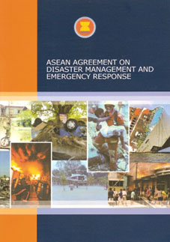
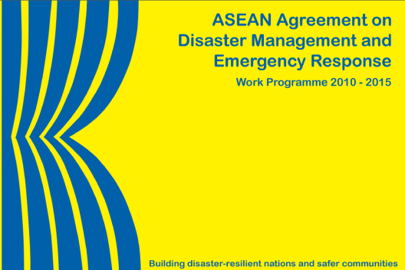
Regional Commitments
AADMER Agreement: a binding agreement that provides a regional cooperation mechanism for disaster response
Governments in SEA must take legislative measures to implement the AADMER e.g.:
To provide assisting states with exemptions from taxation, duties and other charges of a similar nature, and facilitate entry and stay of personnel and equipment (art 14)
Previous AADMER work programme 2010 – 2015 references the IDRL Guidelines as a key tool for developing national legal frameworks for international assistance
Notes:
There are also significant commitments at the regional level here in ASEAN, which I am sure many of you are familiar with. These include, most importantly, the ASEAN Agreement on Disaster Management and Emergency Response (or the ‘AADMER’), which I am sure you all know inside out!
The AADMER is the first regional legally binding agreement to comprehensively address disaster management and emergency response.
It calls upons governments in SEA must take legislative measures to implement the AADMER e.g.:
To provide assisting states with exemptions from taxation, duties and other charges of a similar nature, and facilitate entry and stay of personnel and equipment (art 14)
The previous AADMER work programme 2010 – 2015 references the IDRL Guidelines as a key tool for developing national legal frameworks for international assistance.
As many of you will know, a new AADMER work programme has recently been adopted, and highlights the importance of putting legislation in place. It recognizes the progress that has already been made by many of the Member States, but also highlights the need for further work on this, in line with several of the 8 priority areas, including in relation to both response and risk reduction.

Slide 22
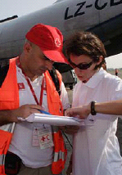
Why is IDRL important?
1. For governments:
Sets out procedures, roles and responsibilities
Controls the type of incoming assistance
Regulates the actions of international actors
2. For International assisting actors:
Facilitates response operations
Provides ‘legal facilities’ to operate in country
Notes:
So before we finish up on this first theme, I want to summarize for you WHY IDRL is important. It is something that works two-ways:
1. For governments:
It helps to clearly set out procedures, roles and responsibilities;
It controls the type and amount of incoming assistance;
And Regulates the actions of international actors
2. For International assisting actors:
It facilitates their response operations by giving them the quick access they need;
It provides them with the necessary ‘legal facilities’ to operate in country so that they can ensure a rapid and effective response in line with the needs of affected communities.

Slide 23
Challenges
Law development is a long-term process: changes do not happen overnight!
Dissemination
Implementation
Notes:
It is also important to note here that we do face some challenges in this work.
Law development is a long-term process: it does not happen overnight! That is why, sometimes, we see the development of guidelines, SOPs, regulations or policies because they are easy to put in place. But ultimately, a state should have a strong, solid law as a foundation for effective disaster response.
In addition, and in some ways more importantly, states needs to ensure that there is effective IMPLEMENTATION and DISSEMINATION of the relevant laws. Otherwise they just get left on the shelf and nobody knows about them!

Slide 24
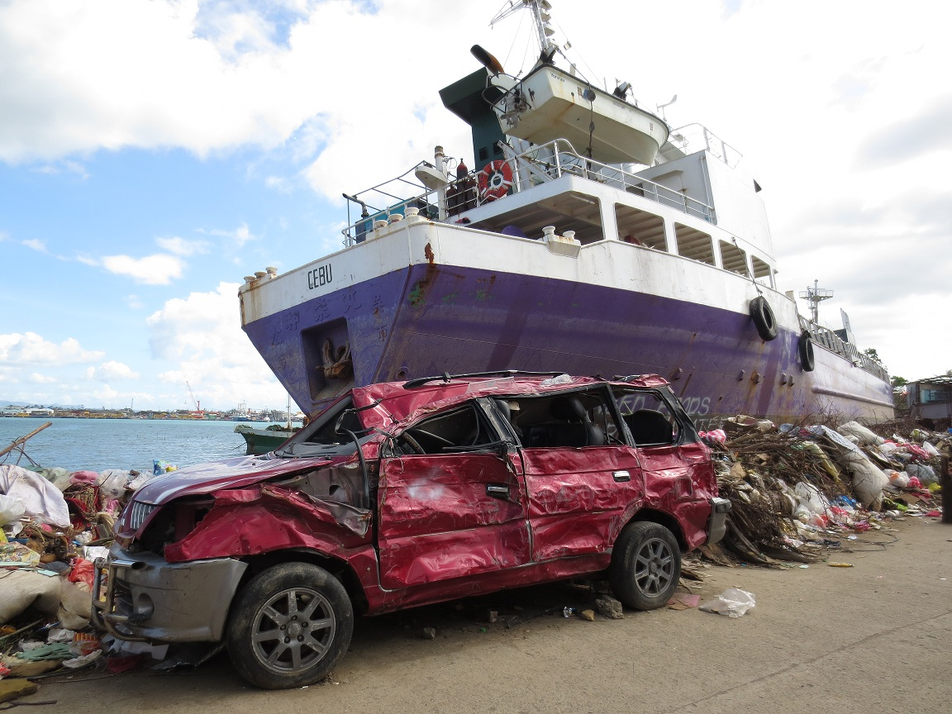
Legal preparedness is important….
…to provide the right aid, at the right time!
Notes:
To leave you with one final message:
At the end of the day, legal preparedness is important to make sure that people get the right aid, at the right time, in line with international and humanitarian standards!

Slide 25
Questions? Comments?
Which IDRL issues have you come across in your experience?
Which challenges might be most relevant in your country context?
What procedures do you know of that are already in place in your country? e.g. DM law? customs laws? Immigration laws?
Notes:
Here are some questions to get you thinking. Please feel free to share your thoughts and experiences with the group before we move into the IDRL scenario exercise!!

