Slide 1
The IFRC

Slide 2
Video We are the Federation.mp4

Slide 3
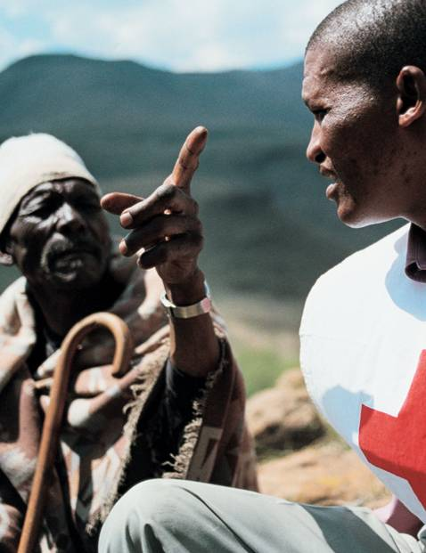
A membership organisation
190 Red Cross or Red Crescent National Societies
A secretariat that provides support to and linkages between our 189 member National Societies
International coordination services in response to large-scale disasters and health emergencies
International representation, resource mobilization and humanitarian diplomacy

Slide 4
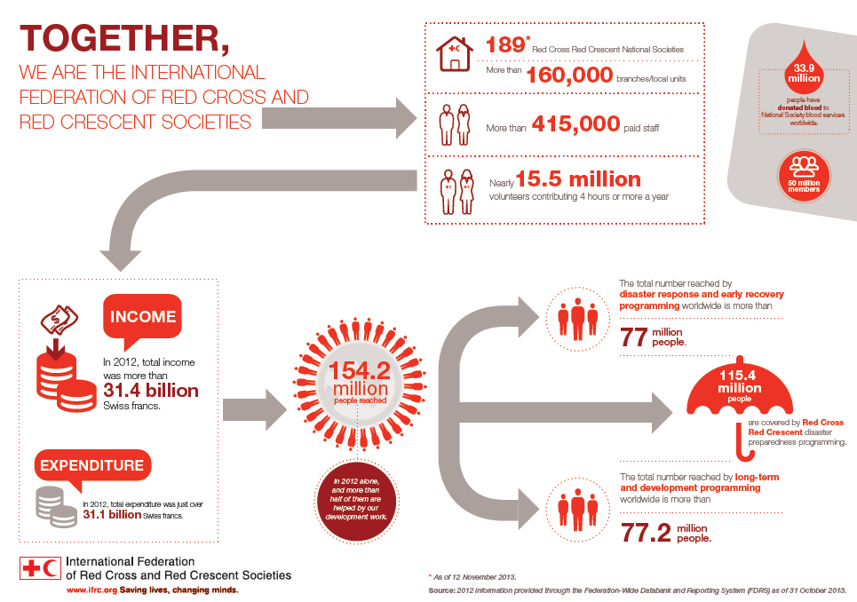
The International Federation of Red Cross and Red Crescent Societies (IFRC)

Slide 5
IFRC Governance
Sets direction, decides strategy and policy, supervises management
IFRC Management
Translates strategy and policy into cost-effective results, decides use of resources, reports to governance
President
Secretary General
Governing Board (20 members, 4 Vice Presidents,1 ex-officio)
Elect
Decide, approve
Africa
Asia Pacific
MENA
Europe
Americas
Geneva Team
General Assembly of the IFRC
190 NSs
Country Cluster Support Team
NSS
…
NSS
Supports a group of NS

Slide 6
Notes:
4. About our vision
We think that the IFRC, as a whole, should set our common vision – this is taken straight from the Constitution adopted in 2007, while each National Society or RCRC centre should set its specific mission within its own context and selected priorities.

Slide 7
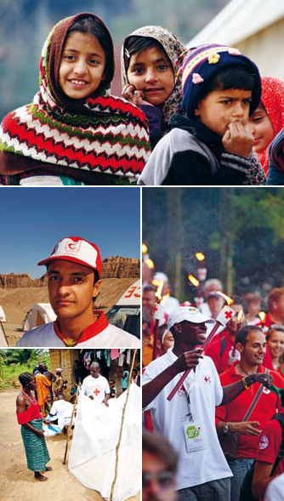
Vision 2020
To inspire, encourage, facilitate, and promote at all times all forms of humanitarian activities by National Societies, with a view to preventing and alleviating human suffering, and thereby contributing to the maintenance and promotion of human dignity and peace in the world.
(Article 4, IFRC Constitution)
Notes:
4. About our vision
We think that the IFRC, as a whole, should set our common vision – this is taken straight from the Constitution adopted in 2007, while each National Society or RCRC centre should set its specific mission within its own context and selected priorities.

Slide 8
Strategy 2020
Vision 2020
Strategic Aim 1
Save lives, protect livelihoods, and strengthen recovery from disasters and crises
Strategic Aim 2
Enable healthy and safe living
Strategic Aim 3
Promote social inclusion and a culture of non-violence and peace
Enabling Action 2
Pursue humanitarian diplomacy to prevent and reduce vulnerability in a globalised world
Enabling Action 3
Function effectively as the IFRC
Enabling Action 1
Build strong National Red Cross and Red Crescent Societies

Slide 9
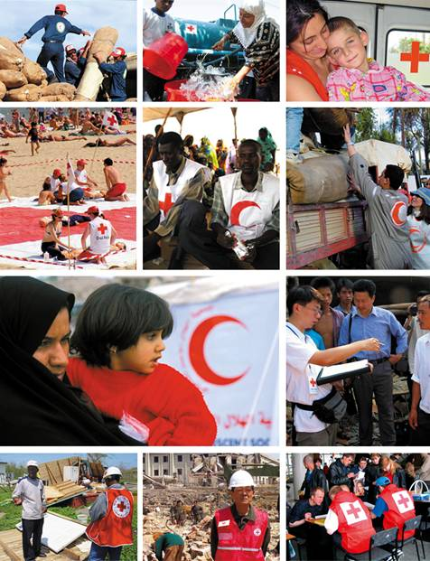
National Societies
National Societies act as auxiliaries to the public authorities of their own countries in the humanitarian field.
They provide a range of services including disaster relief, health and social programmes, and assistance to people affected by war.
Notes:
The promotion of humanitarian values is an intrinsic part of all Red Cross and Red Crescent activities. National Societies conduct campaigns and speak on behalf of vulnerable people in their own countries. They also promote awareness of international humanitarian law and advocate internationally through the Federation and with the International Committee of the Red Cross.
National Societies build and mobilize their network of volunteers through a nationwide branch structure, which can reach communities at greatest risk. Their programmes and services address both immediate and long-term needs of the beneficiaries and include:
• emergency shelter, food and medicine
• water and sanitation
• restoring family contact for disaster victims
• disaster preparedness
• community-based health and care
• first aid training and activities
• control and prevention of diseases
• HIV/AIDS prevention and awareness
• blood donor recruitment, collection and supply
• youth and volunteer activities

Slide 10
A NS structure

Slide 11
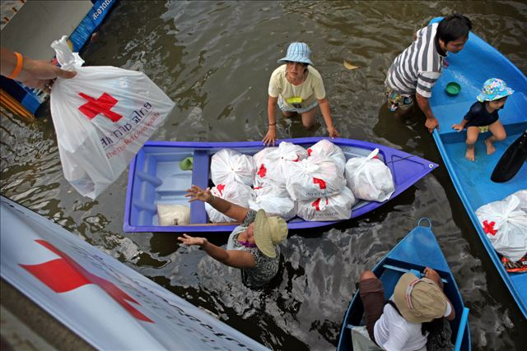
National Societies provide services like:
Disaster response and recovery –
to save lives and protect
livelihoods
Emergency shelter
Food, relief supplies and clean water
Restoring family links

Slide 12
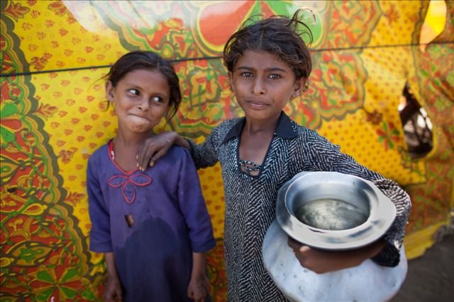
National Societies provide services like:
Enabling healthy and
safe living
Disaster risk reduction and resilience building
Community-based health
and care
First aid training
Water, sanitation and hygiene
promotion
Climate change adaptation

Slide 13
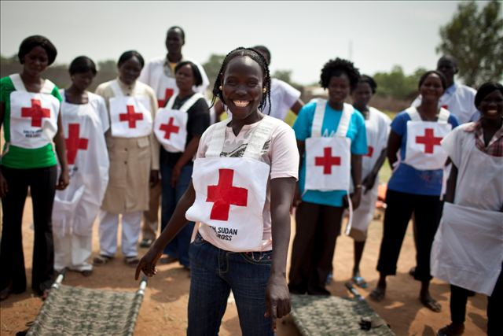
National Societies provide services like:
Promoting social inclusion
and peace
Promotion of the practical application of the Fundamental Principles
Integration of disadvantaged people into their communities
Migrant and refugee services

Slide 14
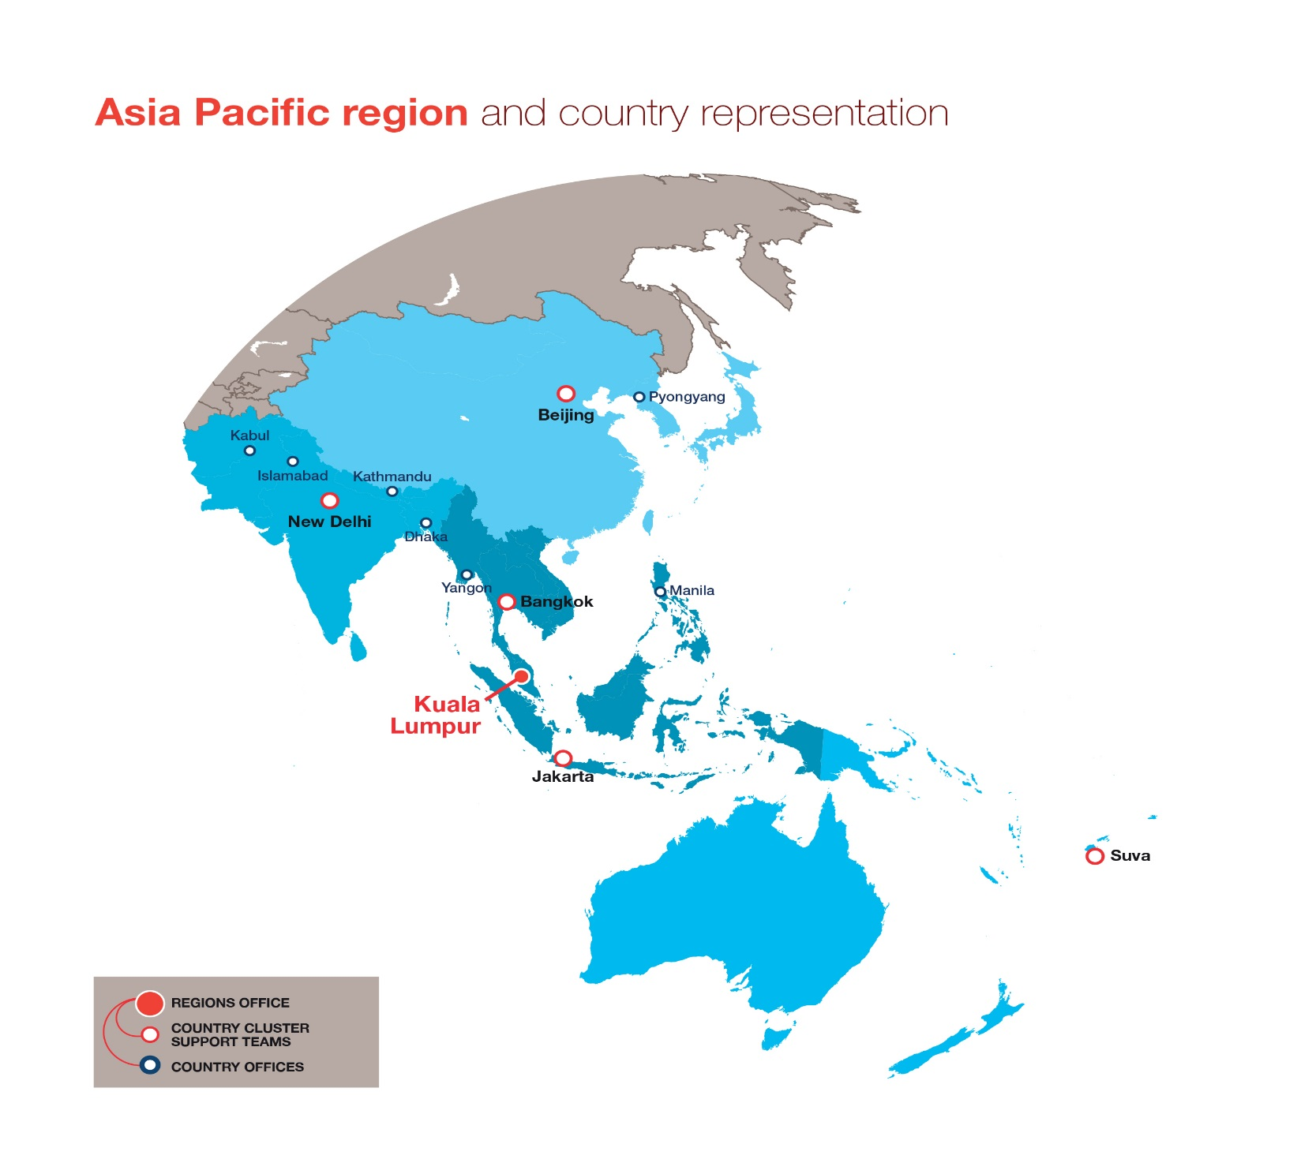

Slide 15
Video where the streets have no name

Slide 16
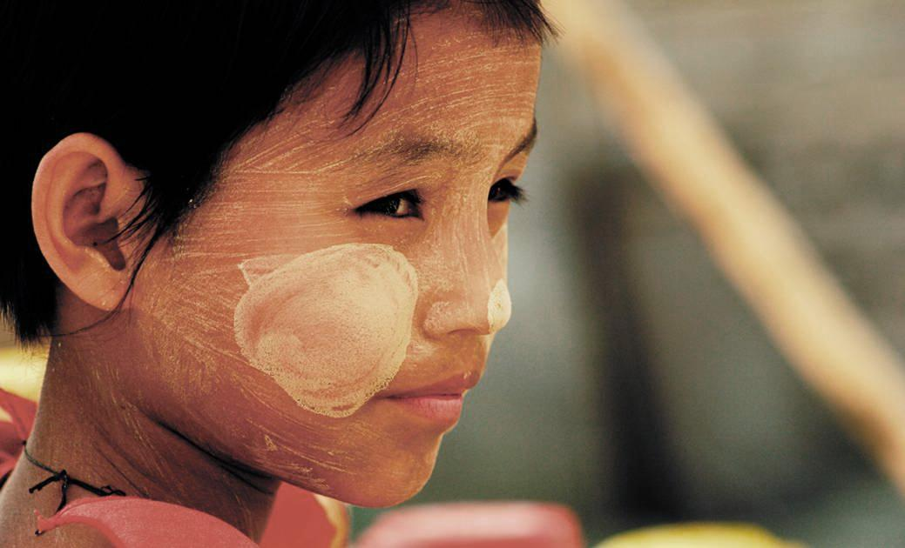
www.ifrc.org www.icrc.org www.pmi.or.id www.standcom.ch giorgio.ferrario@ifrc.org
If you want to know more:

Slide 17
Thank you
© International Federation of Red Cross and Red Crescent Societies, Geneva, 2016.
Any part of this presentation may be cited, copied, translated into other languages or adapted to meet local needs without prior permission from the International Federation of Red Cross and Red Crescent Societies, provided that the source is clearly stated. Requests for commercial reproduction should be directed to the IFRC Secretariat at secretariat@ifrc.org
All photos used in this presentation are copyright of the IFRC unless otherwise indicated.
This presentation was written and developed by Giorgio Ferrario and produced in May 2016
Relevant resources are available on FedNet at fednet.ifrc.org
For further information, please contact giorgio.ferrario@ifrc.org

