Slide 1
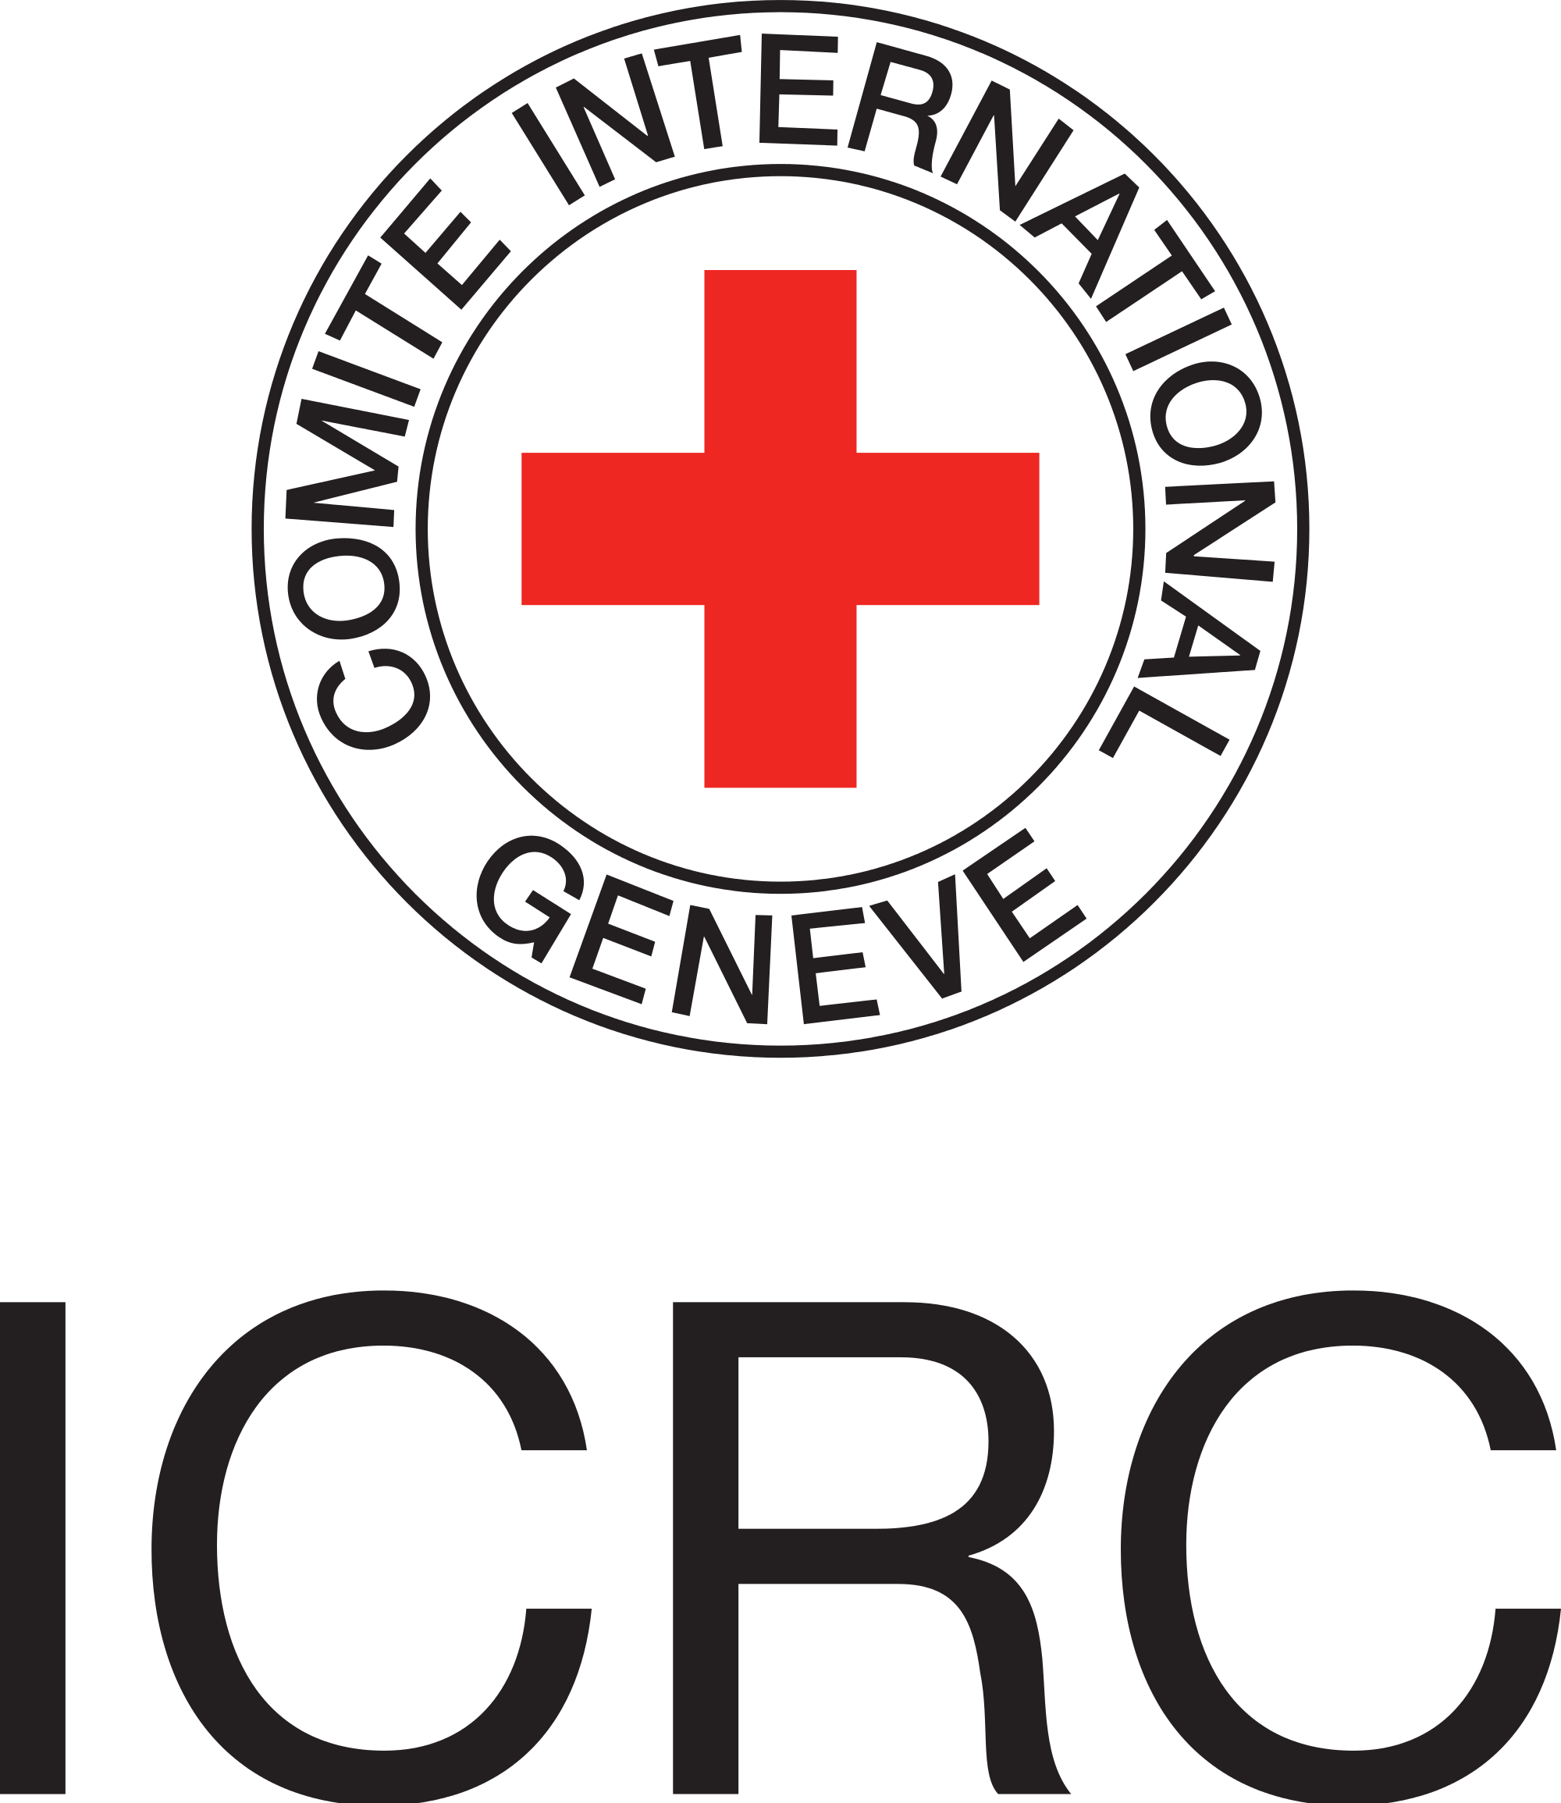
INTERNATIONAL COMMITTEE OF THE RED CROSS
Annisa Marezqa
Cooperation Department
ICRC Regional Delegation for Indonesia and Timor Leste
amarezqa@icrc.org

Slide 2
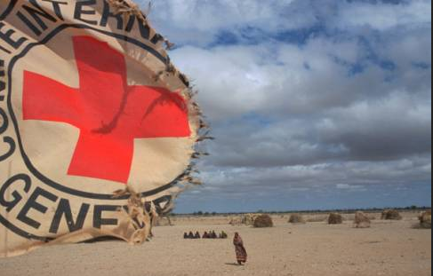
INTERNATIONAL COMMITTEE
OF THE RED CROSS
(ICRC)
Notes:
Rubah gambar minta sonny =D yang menceritakan operasi ICRC, child or women sensitivity picture =)

Slide 3
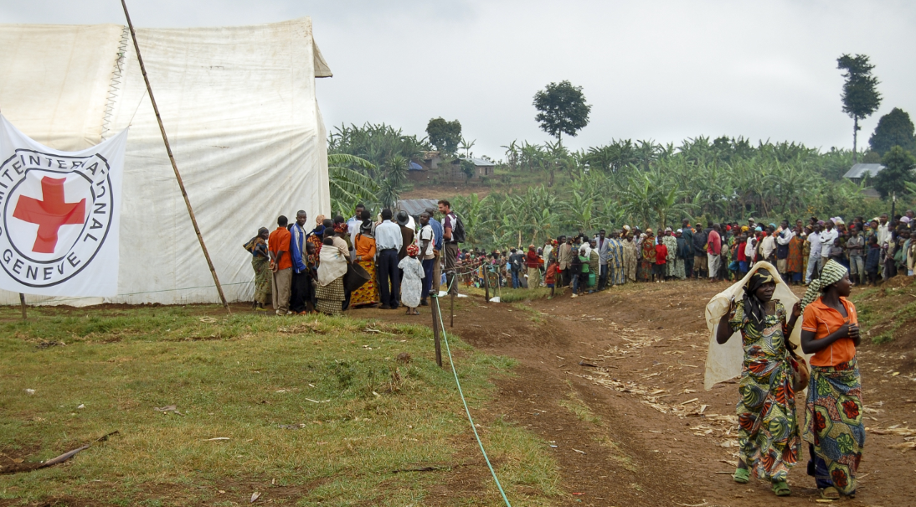
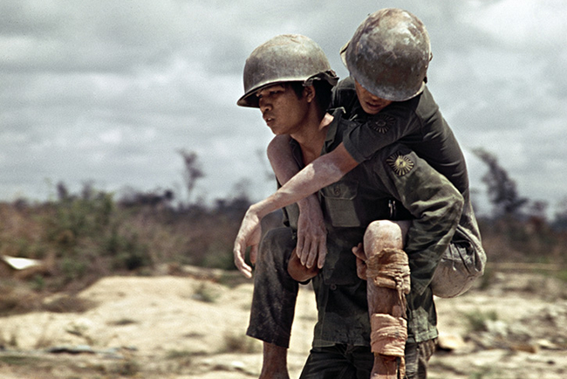
ICRC MANDATE
To Protect and Assist victims of armed conflict
COMBATANTS
CIVILIANS
Notes:
The legal bases of any action undertaken by the ICRC are as follows:
The four Geneva Conventions and Additional Protocol I confer on the ICRC a specific mandate to act in the event of international armed conflict. In particular, the ICRC has the right to visit prisoners of war and civilian internees. The Conventions also give the ICRC a broad right of initiative.
In non-international armed conflicts, the ICRC enjoys a right of humanitarian initiative recognized by the international community and enshrined in Article 3 common to the four Geneva Conventions.
In the event of internal disturbances and tensions, and in any other situation that warrants humanitarian action, the ICRC also enjoys a right of initiative, which is recognized in the Statutes of the International Red Cross and Red Crescent Movement. Thus, wherever international humanitarian law does not apply, the ICRC may offer its services to governments without that offer constituting interference in the internal affairs of the State concerned.

Slide 4
ICRC MISSION
To protect the lives and dignity of victims of armed conflict and other situations of violence and to provide them with assistance
The ICRC also endeavours to prevent suffering by promoting and strengthening humanitarian law and universal humanitarian principles
It directs and coordinates the international activities conducted by the Movement in armed conflicts and other situations of violence.
Notes:
The ICRC's mission statement
The International Committee of the Red Cross (ICRC) is an impartial, neutral and independent organization whose exclusively humanitarian mission is to protect the lives and dignity of victims of armed conflict and other situations of violence and to provide them with assistance.
The ICRC also endeavours to prevent suffering by promoting and strengthening humanitarian law and universal humanitarian principles.
Established in 1863, the ICRC is at the origin of the Geneva Conventions and the International Red Cross and Red Crescent Movement. It directs and coordinates the international activities conducted by the Movement in armed conflicts and other situations of violence.

Slide 5
ICRC IS NOT.....
United Nation
NGO
Group of Activist
Political Organization
Part of any government
Taking side in politics
Notes:
'sui generis' international organisation → unique organization
- Headquarters Agreement with over 70 countries
Mandate in the Geneva Conventions
Exemption of testimony granted by the ICTY (International Criminal Tribunal for former Yugoslavia), ICC
Observatory status at UN
ICTY (International Criminal Tribunal for former Yugoslavia)
The Court was established by Resolution 827 of the United Nations Security Council, which was passed on 25 May 1993. It has jurisdiction over four clusters of crimes committed on the territory of the former Yugoslavia since 1991: grave breaches of the Geneva Conventions, violations of the laws or customs of war, genocide, and crimes against humanity. The maximum sentence it can impose is life imprisonment. Various countries have signed agreements with the UN to carry out custodial sentences.
ICC
The International Criminal Court (ICC) investigates and, where warranted, tries individuals charged with the gravest crimes of concern to the international community: genocide, war crimes and crimes against humanity
The ICRC is often considered to be sui generis: legally, it is neither an
intergovernmental nor a non-governmental organization. It is a private association
under Swiss law with international mandates under public international law.
Established in 1863, the ICRC operates worldwide, helping people affected by conflict and armed violence and promoting the laws that protect victims of war. An independent and neutral organization, its mandate stems essentially from the Geneva Conventions of 1949. We are based in Geneva, Switzerland, and employ some 14,500 people in more than 80 countries. The ICRC is funded mainly by voluntary donations from governments and from national Red Cross and Red Crescent Societies.

Slide 6
ACCEPTANCE BASED ACCESS
PERCEPTION
action
ACCEPTANCE
Programmes
Authorities, Arms Carriers
Beneficiaries
access
Reaching Beneficiaries

Slide 7
FUNDING and EXPANDITURE 2015
HQ
FIELD
SOURCE of FUND 2015
(in million)

Slide 8
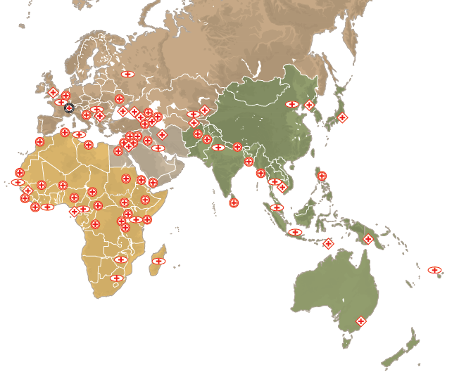
ICRC in the WORLD
around 60 delegations
in 80 countries

Slide 9
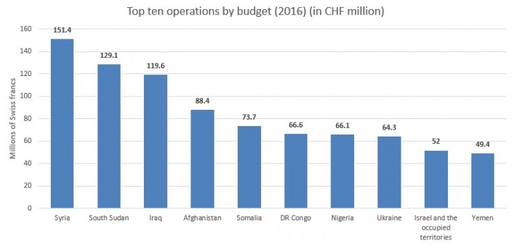
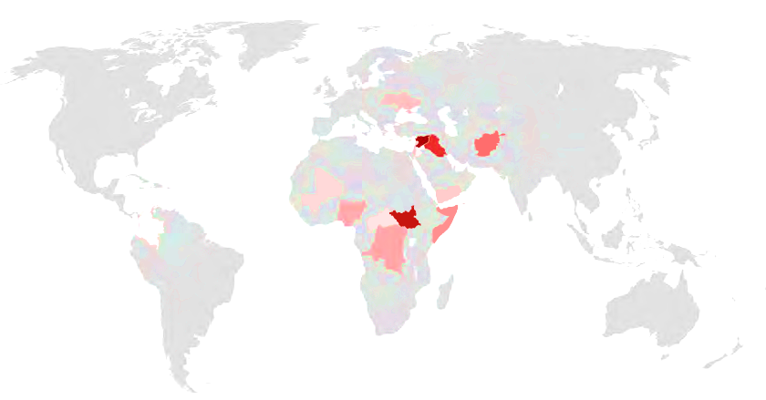
10 LARGEST OPERATIONS
Notes:
Di revise…. Ganti layout

Slide 10
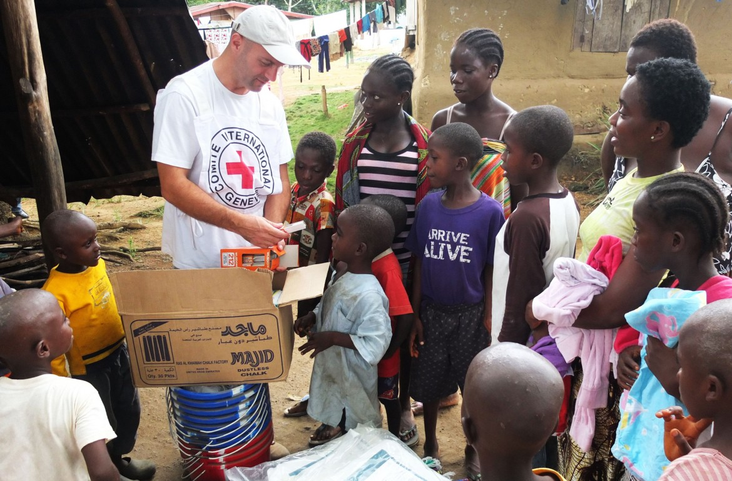
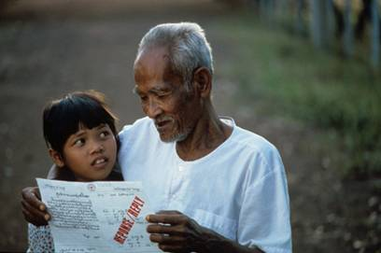
PROTECTION
ICRC
Activities
Protect Civilians
Visiting Detainees
Re-establishing Family Links
Notes:
PROTECT
"…the lives and dignity of victims of armed conflict and other situations of violence…"
In order to preserve the lives, security, dignity, and physical and mental well-being of victims of armed conflict and other situations of violence, the "protection" approach aims to ensure that authorities and other actors fulfil their obligations and uphold the rights of individuals.
It also tries to prevent or put an end to actual or probable violations of international humanitarian law or other bodies of law or fundamental rules protecting people in these situations. It focuses first on the causes or circumstances of violations, addressing those responsible and those who can influence them, and second on the consequences of violations.
Decline protection:
Protection of civilians
Protection for the civilian population is a basic element of humanitarian law: civilians and all those not taking part to hostilities must be spared and protected. Such rules stems from the Geneva Conventions and Additional Protocols. In situations other than armed conflict (e.g. internal disturbances) civilians are protected by other international bodies of law (notably IHRL, especially inalienable rights )
The ICRC protection activities aim at addressing the causes and of the violations and circumstances leading to them by collecting relevant reliable information and addressing those responsible of the violation on a confidential basis.
Restoring family links
Each year, hundreds of thousands of new cases of people being sought by their relatives are opened, whether they concern displaced people, refugees, detainees, unaccompanied children or missing persons. The ICRC works with National Red Cross and Red Crescent Societies or together with other humanitarian agencies, distributing Red Cross messages, organizing family reunifications, issuing temporary travel documents and capture cards, visiting persons deprived of their freedom, drawing up certificates of captivity and death certificates, and so on.
Visiting people deprived of freedom
It is up to the detaining authorities to ensure the protection of the people they take into custody and they can be held accountable if they fail to do so. The aim of ICRC visits is to take preventive action and initiate a dialogue with the detaining authorities with a view to ensuring that people, both military and civilians (prisoners of war, civilian internees and any other individuals imprisoned on security grounds) they hold are treated humanely. The purpose of ICRC visits is purely humanitarian: it is to preserve the physical and moral integrity of detainees, to prevent any abuse to which they may be subjected and to make certain that they enjoy decent material conditions of detention. The ICRC never questions the reason for a person's arrest.
ICRC visiting modalities:
to see all prisoners who come within its mandate and to have access to all places at which they are held;
to speak with prisoners in private, without any third parties being present;
to draw up a list of prisoners during its visit whom it considers to come within its mandate, or to receive such a list from the authorities and to check and supplement it if necessary;
to repeat its visits to all prisoners of its choice if it considers that the situation so warrants, and to do so as often as it wishes.
The ICRC regularly provides the national authorities with a summary report – confidential – on its findings over a given period or in a specific category of places of detention, which covers not only the problems identified but also any improvements observed or steps taken. Dialogue with the authorities, and not the systematic denunciation of violations of international law and the humanitarian principles, is the course of action adopted by the ICRC.

Slide 11
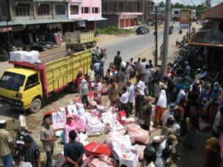
ASSISTANCE
ICRC
Activities
Economic Security
Water and Habitat
Healthcare
Notes:
ASSISTANCE
ASSIST
"…victims of armed conflict and other situations of violence…"
Draw inspiration from the photos to highlight that while providing emergency assistance, the ICRC tries to keep sight of the ultimate aim of restoring people's ability to provide for themselves (link with the concept of protecting their dignity).
While emergency assistance saves lives and mitigates the worst effects of conflict, sometimes other kinds of assistance are chosen (importance of field evaluation-proximity to the victims-access).
The aim of assistance is to preserve life and/or restore the dignity of individuals or communities
adversely affected by armed conflict or other situations of violence.
Assistance activities principally address the consequences of violations of international humanitarian law and other relevant bodies of law. They may also tackle the causes and circumstances of these violations by reducing exposure to risk.
Assistance covers the unmet essential needs of individuals and/or communities as determined by the social and cultural environment. These needs vary, but responses mainly address issues relating to health, water, sanitation, shelter and economic security by providing goods and services, supporting existing facilities and services and encouraging the authorities and others to assume their responsibilities.
The primary aim is to protect victims' lives and health, to ease their plight and to ensure that the consequences of conflict — disease, injury, hunger or exposure to the elements — do not jeopardize their future. While emergency assistance saves lives and mitigates the worst effects of conflict, the ICRC tries always to keep sight of the ultimate aim of restoring people's ability to provide for themselves. Assistance may take a variety of forms, depending on the region and the nature of the crisis. It may include the provision of food and/or medicine, but usually builds on the capacity to deliver essential services, such as the construction or repair of water-supply systems or medical facilities and the training of primary health care staff, surgeons and orthopaedic technicians.

Slide 12
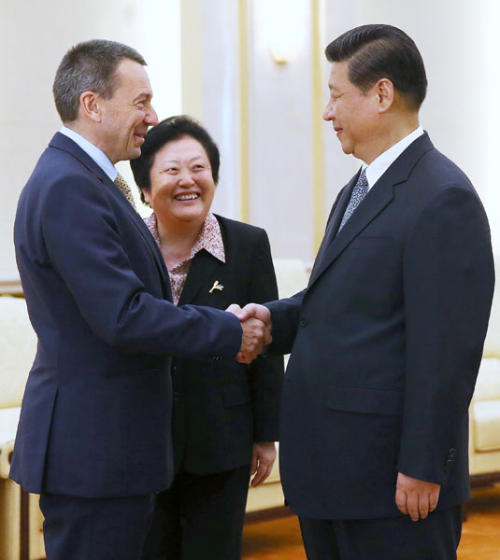
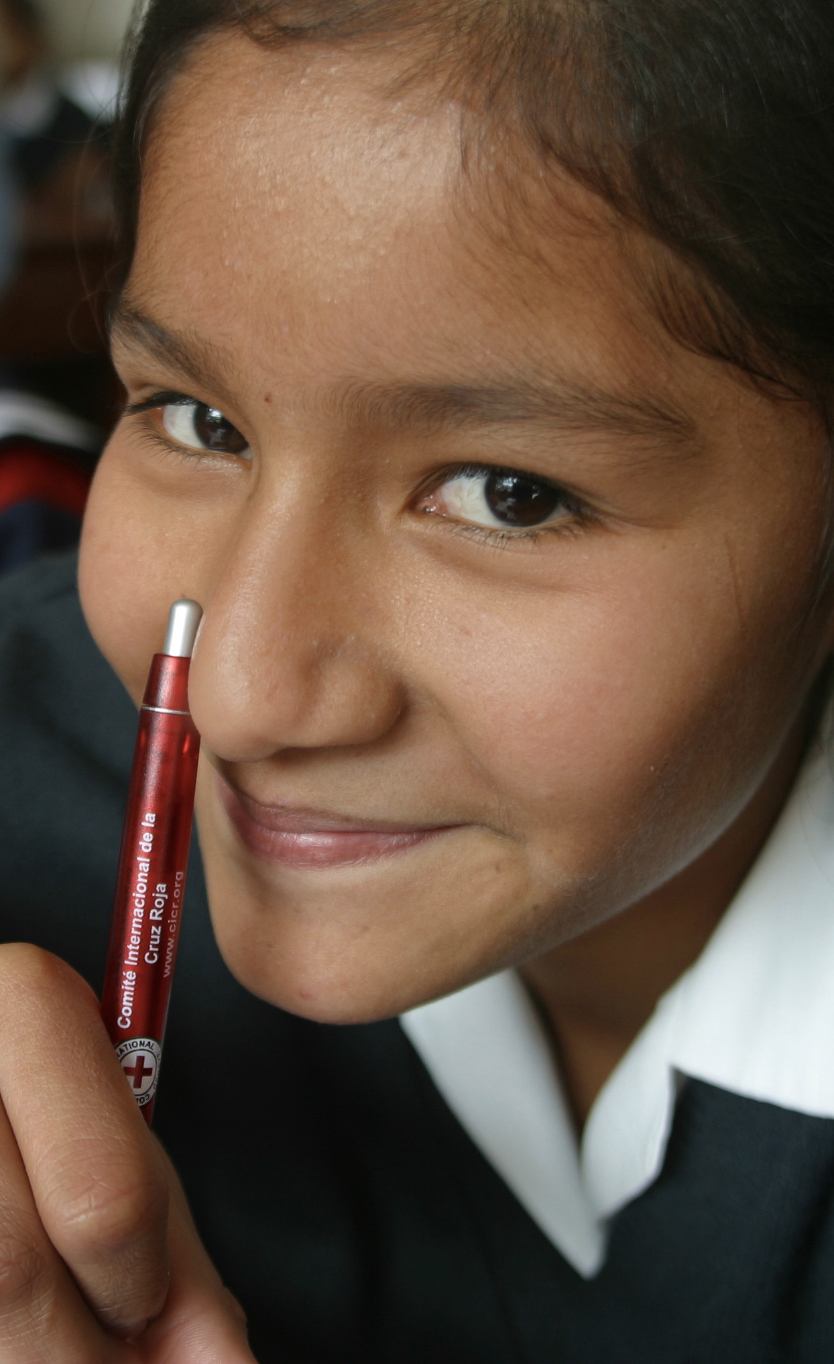
PREVENTION
ICRC
Activities
Arms Carriers
Authorities
Civil Society
Notes:
PREVENT
"…suffering by promoting and strengthening humanitarian law and universal
humanitarian principles…"
The aim of prevention is to foster an environment that is conducive to respect for the lives
and dignity of those who may be adversely affected by armed conflict and other situations
of violence, and that favours the work of the ICRC.
This approach aims to prevent suffering by influencing those who have a direct or indirect impact on the fate of people affected by these situations. This generally implies a medium- or long-term perspective.
In particular, the prevention approach involves communicating, developing, clarifying and promoting the implementation of international humanitarian law and other applicable bodies of law, and promoting acceptance of the ICRC’s work.
PREVENTION
The ICRC seeks to prevent human suffering by fostering an environment conducive to respect for:
the life and dignity of persons affected by armed conflict and other situations of violence;
the ICRC’s work
This approach entails influencing those who can determine – directly or indirectly – the fate of people affected and generally implies a medium- or long-term perspective. Wherever they operate, ICRC's personnel explain who they are and what they do in order to get acceptance, security for its operations and thus access to the victims. They recall parties that rules remain applicable in time of armed conflict or armed violence. Accordingly, the ICRC targets in particular those people and groups who determine the fate of victims or who can obstruct or facilitate ICRC action (i.e. armed forces, police, security forces and other weapons bearers, decision-makers and opinion-leaders at local and international level and, with an eye to the future, teenagers, students and their teachers).
Dissemination and integration
One set of activities aims at fostering understanding and acceptance of the ICRC's work and/or IHL and other relevant bodies of law. Within protection and assistance approaches, they play a particularly important role (e.g. supporting the organization in guaranteeing security and access to victims of armed conflict and other situations of violence). The ICRC also supports arms carriers in their efforts to meet their obligations in dissemination of the law (i.e. spreading knowledge) or its integration (translating the law into concrete measures, means and mechanisms – at doctrine, education, training and equipment and/or sanctions levels – allowing thus compliance therewith). This top-down approach presupposes a certain degree of organization, capacity and will to respect the law. Commitment – if not present at the outset – needs to be secured early if these activities are to have a lasting effect.
MINUNI and EHL
The ICRC also endeavors to promote IHL among young people and students at all levels of education from secondary schools to universities. The aim is to ensure that future leaders and opinion makers understand the practical relevance of IHL and have a thorough knowledge of its basic principles.
Development of the the law
Another set of activities focuses on the development of IHL and other rules of international law applicable in armed conflict or in other situations of violence. This work aims to strengthen the legal protection afforded to persons affected by armed conflict or other situations of violence. This work may entail the preparation of new treaty law, the identification of customary rules of IHL, the clarification of legal notions and the development of guidelines for their interpretation (e.g. clarification of the notion of direct participation in hostilities), and activities aimed at defending the integrity of the law (e.g. IHL and terrorism).
Stress the direct link between humanitarian problems observed in the field and this activity (e.g. antipersonnel landmines, cluster ammunitions or additional emblem). This may entail either proposing new or additional laws or a clarification process (e.g. customary law study, direct participation in hostilities)
Humanitarian diplomacy
The ICRC works to raise awareness of humanitarian issues with States and in various international and regional fora including the United Nations.

Slide 13
COOPERATION
ICRC
Activities
Capacity Building
Operational Partnership
Notes:
COORDINATE
"… the international activities conducted by the Movement in armed conflicts and other situations of violence…"
The aim of cooperation is to increase the operational capacities of National Societies, above all in countries affected or likely to be affected by armed conflict or other situations of violence. A further aim is to increase the ICRC’s capacity to interact with National Societies and work in partnership with them.
The cooperation approach aims to optimize the humanitarian work of Movement components by making the best use of complementary mandates and skills in operational matters such as protection, assistance and prevention.
It involves drawing up and implementing the policies of the Movement that are adopted during its statutory meetings and strengthening the capacities of the National Societies, helping them to adhere at all times to the Fundamental Principles.
In particular, international activities of the components of the Movement are organized in accordance with the Agreement on the Organization of the International Activities of the Components of the International Red Cross and Red Crescent Movement ("Seville Agreement", 1997).
The Seville Agreement clearly designates the ICRC as lead agency in situations of armed conflict, internal strife and their direct results
COOPERATION
The ICRC and the National Societies derive many advantages from their mutually supportive relationship. Victims of conflict receive wider and more efficient services through the coordinated capacities of the various components of the Movement. It is ICRC responsibility to coordinate the efforts of the Movement components in armed conflict or armed violence situation.
National Society capacity-building
Thanks to its operational know-how, the ICRC passes on its expertise to the National Societies, and more specifically in the fields of promoting international humanitarian law and the Movement’s Fundamental Principles, emergency aid and health care for those affected by conflict, and RFL. As well as preparing the National Society to work in sensitive and insecure situation, by supporting the NS on increasing their acceptance, perception, access and safety.
Operational cooperation: assistance and tracing
In accordance with the distribution of roles within the Movement that has been agreed to by all components, the ICRC is the lead agency in situations of conflict or internal violence. This means that in addition to organizing its own operations the ICRC coordinates the activities of other components operating in the country, thereby maximizing complementarity of mandates and skills.
In a country affected by armed conflict, the ICRC and that country’s National Society pool their operational resources. This type of cooperation covers various activities such as first aid and health care, distributing food, taking war casualties to hospital and restoring family links.
Legal advise
RC knowledge
Emergency preparedness for response
- Logistics support
- Emergency Water & sanitation teams
- Restoring of Family links
- Livelihood support
- Camp management
- Management of Dead

Slide 14
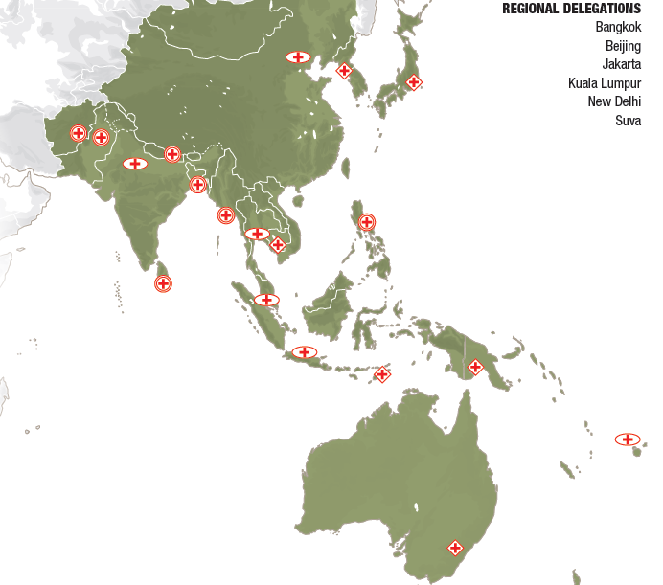
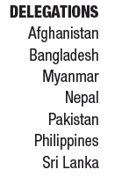
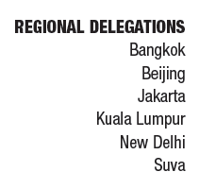
ICRC in Asia and Pacific
Notes:
Afghanistan :
Having assisted victims of the Afghan armed conflict for six years in Pakistan, the ICRC opened a delegation in Kabul in 1987. Its current operations aim at: visiting detainees,
monitoring their treatment and living conditions, and helping them keep in contact with their families; monitoring the conduct of hostilities and working to prevent IHL violations; assisting the wounded and the disabled; supporting health and hospital care; improving water and sanitation services; promoting accession to and national implementation of IHL treaties and compliance with IHL by military forces; and helping the Afghan Red Crescent Society strengthen its capacities.
XXDespite insecurity sometimes hampering the ICRC’s access,
some conflict-affected people received provisions of food/
household essentials. Some made use of livelihood support to
restore their self-sufficiency.
XXWeapon-wounded people received life-saving care from
emergency responders and were taken to hospital by means of
an ICRC-funded transport system, as the number of casualties
increased.
XXDisabled people improved their mobility at ICRC-run physical
rehabilitation centres, managed by ICRC-trained disabled
employees. Some regained a measure of self-sufficiency with
ICRC financial assistance.
XXMore detainees, held far from their homes following their transfer
to the Afghan-run Parwan detention facility, maintained/restored
contact with relatives via the Movement’s family-links services.
XXParties to the conflict continued their dialogue with the ICRC
amid worsening security conditions. Directives from some
of them facilitated the transfer of human remains and safe
passage for the wounded/sick.
XXThe armed forces assumed greater responsibility for IHL training:
they appointed an IHL-training coordinator and created a mobile
training team to conduct courses for operational troops.
Myanmar :
Victims of Cyclone Komen in Rakhine state and clashes in Kachin and Shan states covered their urgent food, water and household needs with the aid of the Myanmar Red Cross
Society and the ICRC.
Breadwinners in Kachin and Shan states, and heads of cyclone affected households in Rakhine state, used conditional cash grants and supplies/equipment to earn money or produce food
for their families.
Health facilities improved their services with comprehensive ICRC support. Disabled persons obtained rehabilitative care at ICRC-supported centres, a mobile workshop or communitybased
technicians.
With ICRC input, the authorities improved detainees’ treatment and living conditions. Over 26,000 inmates benefited from upgrades to water, sanitation and other facilities that
helped reduce their health risks.
At National Society/ICRC education sessions, around 700 people in Kachin state learnt how to minimize the risks they faced from the presence of mines or explosive remnants of war.
The armed forces, police and armed groups deepened their knowledge of the application of IHL or internationally recognized policing standards, during ICRC workshops/
training courses.
Phillipines
Nearly 98,000 people displaced by intensified fighting in central Mindanao dealt with their urgent needs using food, water and household items distributed by the Philippine Red
Cross and the ICRC.
The weapon-wounded received good-quality treatment at ICRC-supported hospitals in Mindanao. In Zamboanga, malnourished IDPs recovered their health via National
Society/ICRC nutrition projects.
Conflict-affected households and victims of past typhoons restored/reinforced their livelihoods with ICRC-provided agricultural supplies/equipment, training and cash grants.
The authorities sought, with ICRC support, to address the effects of prison overcrowding, notably by introducing annual TB screening for all detainees. Taskforces began work to
expedite detainees’ cases.
Weapon bearers learnt more about their responsibilities under IHL and other applicable bodies of law during dissemination sessions. The national police academy incorporated IHL
training in its curriculum.
With Movement support, the National Society trained and equipped members of 22 Red Cross Action Teams, boosting their capacities in areas such as restoring family links and first aid.
Cambodia, Lao, Vietnam, Thailand
Detainees in Cambodia and Thailand benefited from the authorities’ improvements to prison management, following ICRC recommendations/support: more regular access to health
care and open air, for example.
The authorities, supported by the ICRC, expedited the resolution of some cases pending for several years in Cambodia; 174 detainees thus had their sentences finalized.
Vulnerable households in southern Thailand and some disabled people in Cambodia made themselves more selfsufficient by starting small businesses with ICRC livelihood
assistance.
In Cambodia and the Lao People’s Democratic Republic, disabled people received physical rehabilitation services at ICRC-supported centres; support for centres in the latter
country began in 2015.
Naval officers from 14 countries in the Asia-Pacific region added to their knowledge of the application of IHL in naval warfare at a workshop organized jointly by the Royal Thai
Navy and the ICRC.
Indonesia, Timor Leste and ASEAN
Members of families dispersed by detention or migration communicated via the Movement’s family-links services.
In Indonesia, people in Papua continued to benefit from ophthalmological care provided by the Indonesian Red Cross Society and the ICRC, and people in Maluku began to receive
similar services.
With the ICRC’s guidance, Indonesian military and police instructors became more adept in providing advice on IHL compliance and instruction in internationally recognized
policing standards, respectively.
In Timor-Leste, it supports training for the authorities and other relevant actors in the management of human remains following disasters
Supporting NS on increasing their safety while working in sensitive and insecure situation.
Brunei Darusalam, Malaysia, Singapore
People in immigration detention centres in Malaysia had better access to health care following ICRC-supported initiatives by authorities to deploy medical staff and establish a clinic
on-site.
Residents in Sabah, Malaysia, learnt to cope with basic health issues after attending Malaysian Red Crescent Society and/or ICRC sessions on good hygiene practices and first aid.
Members of dispersed families contacted relatives through Movement family-links services. Movement partners, responding to recent migration and other events in the region,
sought to improve these services.
Authorities and other influential actors in Japan drew attention to key humanitarian issues, notably at events on the Arms Trade Treaty and through films and publications.
At an ICRC workshop, military officers from Brunei Darussalam, Malaysia, Singapore and 7 other countries learnt more about the norms governing military operations in
support of law enforcement.

Slide 15
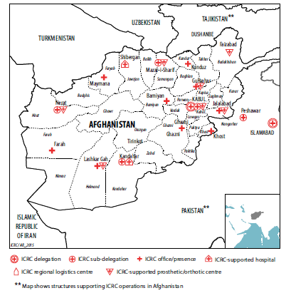
ICRC in Asia and Pacific
Afghanistan
Assistance (food/house hold/livelihood to support self-sufficiency)
Medical assistant for weapon - wounded
Improve mobility of people with disabilities (physical rehabilitation centre)
Maintaining/Restoring family links
Continue dialogue on humanitarian assistance
IHL dissemination
Notes:
Cambodia, Lao, Vietnam, Thailand
Detainees in Cambodia and Thailand benefited from the authorities’ improvements to prison management, following ICRC recommendations/support: more regular access to health
care and open air, for example.
The authorities, supported by the ICRC, expedited the resolution of some cases pending for several years in Cambodia; 174 detainees thus had their sentences finalized.
Vulnerable households in southern Thailand and some disabled people in Cambodia made themselves more selfsufficient by starting small businesses with ICRC livelihood
assistance.
In Cambodia and the Lao People’s Democratic Republic, disabled people received physical rehabilitation services at ICRC-supported centres; support for centres in the latter
country began in 2015.
Naval officers from 14 countries in the Asia-Pacific region added to their knowledge of the application of IHL in naval warfare at a workshop organized jointly by the Royal Thai
Navy and the ICRC.
Indonesia, Timor Leste and ASEAN
Members of families dispersed by detention or migration communicated via the Movement’s family-links services.
In Indonesia, people in Papua continued to benefit from ophthalmological care provided by the Indonesian Red Cross Society and the ICRC, and people in Maluku began to receive
similar services.
With the ICRC’s guidance, Indonesian military and police instructors became more adept in providing advice on IHL compliance and instruction in internationally recognized
policing standards, respectively.
In Timor-Leste, it supports training for the authorities and other relevant actors in the management of human remains following disasters
Supporting NS on increasing their safety while working in sensitive and insecure situation.
Brunei Darusalam, Malaysia, Singapore
People in immigration detention centres in Malaysia had better access to health care following ICRC-supported initiatives by authorities to deploy medical staff and establish a clinic
on-site.
Residents in Sabah, Malaysia, learnt to cope with basic health issues after attending Malaysian Red Crescent Society and/or ICRC sessions on good hygiene practices and first aid.
Members of dispersed families contacted relatives through Movement family-links services. Movement partners, responding to recent migration and other events in the region,
sought to improve these services.
Authorities and other influential actors in Japan drew attention to key humanitarian issues, notably at events on the Arms Trade Treaty and through films and publications.
At an ICRC workshop, military officers from Brunei Darussalam, Malaysia, Singapore and 7 other countries learnt more about the norms governing military operations in
support of law enforcement.

Slide 16
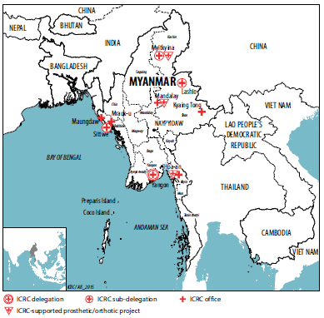
ICRC in Asia and Pacific
Myanmar
Assistance together with Myanmar RC (food, water, house hold needs) –
Cyclone Komen in Rakhine state, clashes in Kachin and Shan states
Cash Grant and providing supplies/equipment for livelihood in Kachin and Shan
Improving Health Facilities. People with disabilities obtain rehabilitative care
Support the authorities to improve living condition in the detention places.
IHL dissemination to armed forces, police and armed group
Notes:
Cambodia, Lao, Vietnam, Thailand
Detainees in Cambodia and Thailand benefited from the authorities’ improvements to prison management, following ICRC recommendations/support: more regular access to health
care and open air, for example.
The authorities, supported by the ICRC, expedited the resolution of some cases pending for several years in Cambodia; 174 detainees thus had their sentences finalized.
Vulnerable households in southern Thailand and some disabled people in Cambodia made themselves more selfsufficient by starting small businesses with ICRC livelihood
assistance.
In Cambodia and the Lao People’s Democratic Republic, disabled people received physical rehabilitation services at ICRC-supported centres; support for centres in the latter
country began in 2015.
Naval officers from 14 countries in the Asia-Pacific region added to their knowledge of the application of IHL in naval warfare at a workshop organized jointly by the Royal Thai
Navy and the ICRC.
Indonesia, Timor Leste and ASEAN
Members of families dispersed by detention or migration communicated via the Movement’s family-links services.
In Indonesia, people in Papua continued to benefit from ophthalmological care provided by the Indonesian Red Cross Society and the ICRC, and people in Maluku began to receive
similar services.
With the ICRC’s guidance, Indonesian military and police instructors became more adept in providing advice on IHL compliance and instruction in internationally recognized
policing standards, respectively.
In Timor-Leste, it supports training for the authorities and other relevant actors in the management of human remains following disasters
Supporting NS on increasing their safety while working in sensitive and insecure situation.
Brunei Darusalam, Malaysia, Singapore
People in immigration detention centres in Malaysia had better access to health care following ICRC-supported initiatives by authorities to deploy medical staff and establish a clinic
on-site.
Residents in Sabah, Malaysia, learnt to cope with basic health issues after attending Malaysian Red Crescent Society and/or ICRC sessions on good hygiene practices and first aid.
Members of dispersed families contacted relatives through Movement family-links services. Movement partners, responding to recent migration and other events in the region,
sought to improve these services.
Authorities and other influential actors in Japan drew attention to key humanitarian issues, notably at events on the Arms Trade Treaty and through films and publications.
At an ICRC workshop, military officers from Brunei Darussalam, Malaysia, Singapore and 7 other countries learnt more about the norms governing military operations in
support of law enforcement.

Slide 17
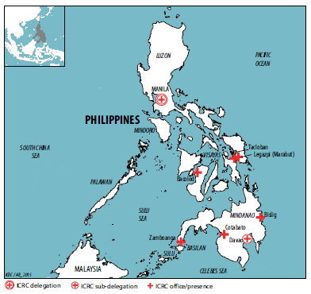
ICRC in Asia and Pacific
Philippines
Assistance at Central Mindanao together with Philippines RC (food, water, household items)
Weapon-wounded – health treatment at ICRC supported hospitals in Mindanao
Malnourish IDPs recover health in Zamboanga
Agriculture supplies/equipment, training and cash grant to restore livelihood
Supporting the authorities addressing overcrowding in detention places.
Dissemination of IHL to weapon bearers. IHL incorporated in National Police training curriculum
Supporting (together with Movement partners) the NS capacity development on RFL and first aid.
Notes:
Cambodia, Lao, Vietnam, Thailand
Detainees in Cambodia and Thailand benefited from the authorities’ improvements to prison management, following ICRC recommendations/support: more regular access to health
care and open air, for example.
The authorities, supported by the ICRC, expedited the resolution of some cases pending for several years in Cambodia; 174 detainees thus had their sentences finalized.
Vulnerable households in southern Thailand and some disabled people in Cambodia made themselves more selfsufficient by starting small businesses with ICRC livelihood
assistance.
In Cambodia and the Lao People’s Democratic Republic, disabled people received physical rehabilitation services at ICRC-supported centres; support for centres in the latter
country began in 2015.
Naval officers from 14 countries in the Asia-Pacific region added to their knowledge of the application of IHL in naval warfare at a workshop organized jointly by the Royal Thai
Navy and the ICRC.
Indonesia, Timor Leste and ASEAN
Members of families dispersed by detention or migration communicated via the Movement’s family-links services.
In Indonesia, people in Papua continued to benefit from ophthalmological care provided by the Indonesian Red Cross Society and the ICRC, and people in Maluku began to receive
similar services.
With the ICRC’s guidance, Indonesian military and police instructors became more adept in providing advice on IHL compliance and instruction in internationally recognized
policing standards, respectively.
In Timor-Leste, it supports training for the authorities and other relevant actors in the management of human remains following disasters
Supporting NS on increasing their safety while working in sensitive and insecure situation.
Brunei Darusalam, Malaysia, Singapore
People in immigration detention centres in Malaysia had better access to health care following ICRC-supported initiatives by authorities to deploy medical staff and establish a clinic
on-site.
Residents in Sabah, Malaysia, learnt to cope with basic health issues after attending Malaysian Red Crescent Society and/or ICRC sessions on good hygiene practices and first aid.
Members of dispersed families contacted relatives through Movement family-links services. Movement partners, responding to recent migration and other events in the region,
sought to improve these services.
Authorities and other influential actors in Japan drew attention to key humanitarian issues, notably at events on the Arms Trade Treaty and through films and publications.
At an ICRC workshop, military officers from Brunei Darussalam, Malaysia, Singapore and 7 other countries learnt more about the norms governing military operations in
support of law enforcement.

Slide 18
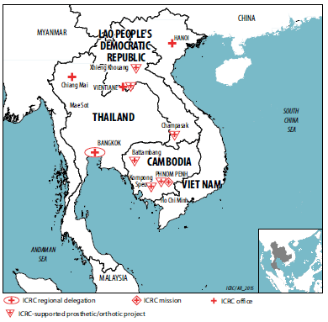
ICRC in Asia and Pacific
Bangkok regional
(Cambodia, Lao, Vietnam, Thailand)
Cambodia and Thailand – continue dialogue with authorities on prison management
Vulnerable households Southern Thailand and people with disabilities in Cambodia – livelihood (small business)
Cambodia and Lao People’s Democratic Republic, people with disabilities – physical rehibilitations
IHL dissemination to Naval officers from 14 countries of Asia – Pacific (application of IHL at naval warfare workshop – Royal Thai Navy and ICRC)
Notes:
Indonesia, Timor Leste and ASEAN
Members of families dispersed by detention or migration communicated via the Movement’s family-links services.
In Indonesia, people in Papua continued to benefit from ophthalmological care provided by the Indonesian Red Cross Society and the ICRC, and people in Maluku began to receive
similar services.
With the ICRC’s guidance, Indonesian military and police instructors became more adept in providing advice on IHL compliance and instruction in internationally recognized
policing standards, respectively.
In Timor-Leste, it supports training for the authorities and other relevant actors in the management of human remains following disasters
Supporting NS on increasing their safety while working in sensitive and insecure situation.
Brunei Darusalam, Malaysia, Singapore
People in immigration detention centres in Malaysia had better access to health care following ICRC-supported initiatives by authorities to deploy medical staff and establish a clinic
on-site.
Residents in Sabah, Malaysia, learnt to cope with basic health issues after attending Malaysian Red Crescent Society and/or ICRC sessions on good hygiene practices and first aid.
Members of dispersed families contacted relatives through Movement family-links services. Movement partners, responding to recent migration and other events in the region,
sought to improve these services.
Authorities and other influential actors in Japan drew attention to key humanitarian issues, notably at events on the Arms Trade Treaty and through films and publications.
At an ICRC workshop, military officers from Brunei Darussalam, Malaysia, Singapore and 7 other countries learnt more about the norms governing military operations in
support of law enforcement.

Slide 19
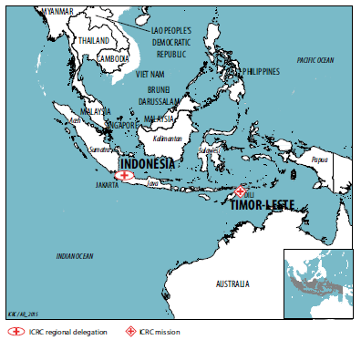
ICRC in Asia and Pacific
Jakarta regional
(Indonesia, Timor Leste and ASEAN)
Continue with RFL services
Ophthalmological care for the communities (PMI and ICRC) in Papua and Maluku
Supporting PMI on increasing their safety while working in sensitive and insecure situation
IHL dissemination – Indonesian military and police
Maintain regular dialogue with ASEAN
In Timor Leste - management of human remains
In Timore Leste - IHL dissemination TL military and police
Supporting CVTL in increasing their safety while working in sensitive and insecure situation
Notes:
policing standards, respectively.
In Timor-Leste, it supports training for the authorities and other relevant actors in the management of human remains following disasters
Supporting NS on increasing their safety while working in sensitive and insecure situation.
Brunei Darusalam, Malaysia, Singapore
People in immigration detention centres in Malaysia had better access to health care following ICRC-supported initiatives by authorities to deploy medical staff and establish a clinic
on-site.
Residents in Sabah, Malaysia, learnt to cope with basic health issues after attending Malaysian Red Crescent Society and/or ICRC sessions on good hygiene practices and first aid.
Members of dispersed families contacted relatives through Movement family-links services. Movement partners, responding to recent migration and other events in the region,
sought to improve these services.
Authorities and other influential actors in Japan drew attention to key humanitarian issues, notably at events on the Arms Trade Treaty and through films and publications.
At an ICRC workshop, military officers from Brunei Darussalam, Malaysia, Singapore and 7 other countries learnt more about the norms governing military operations in
support of law enforcement.

Slide 20
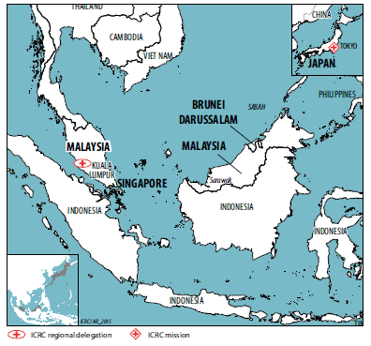
ICRC in Asia and Pacific
Kuala Lumpur regional
(Brunei Darussalam, Malaysia, Singapore)
Health care in immigration detention centres – Malaysia (on site clinic)
Basic Health Care promotion together with Malaysian RC – Sabah, Malaysia
Restoring Family Links services
IHL dissemination – military officers from Brunei Darussalam, Malaysia, Singapore and 7 other countries
Notes:
Members of dispersed families contacted relatives through Movement family-links services. Movement partners, responding to recent migration and other events in the region,
sought to improve these services.
Authorities and other influential actors in Japan drew attention to key humanitarian issues, notably at events on the Arms Trade Treaty and through films and publications.
At an ICRC workshop, military officers from Brunei Darussalam, Malaysia, Singapore and 7 other countries learnt more about the norms governing military operations in
support of law enforcement.

Slide 21
http://blogs.icrc.org/indonesia
www.icrc.org
www.facebook.com/icrcfans
Twitter: @icrc
@icrc_id

