Slide 1
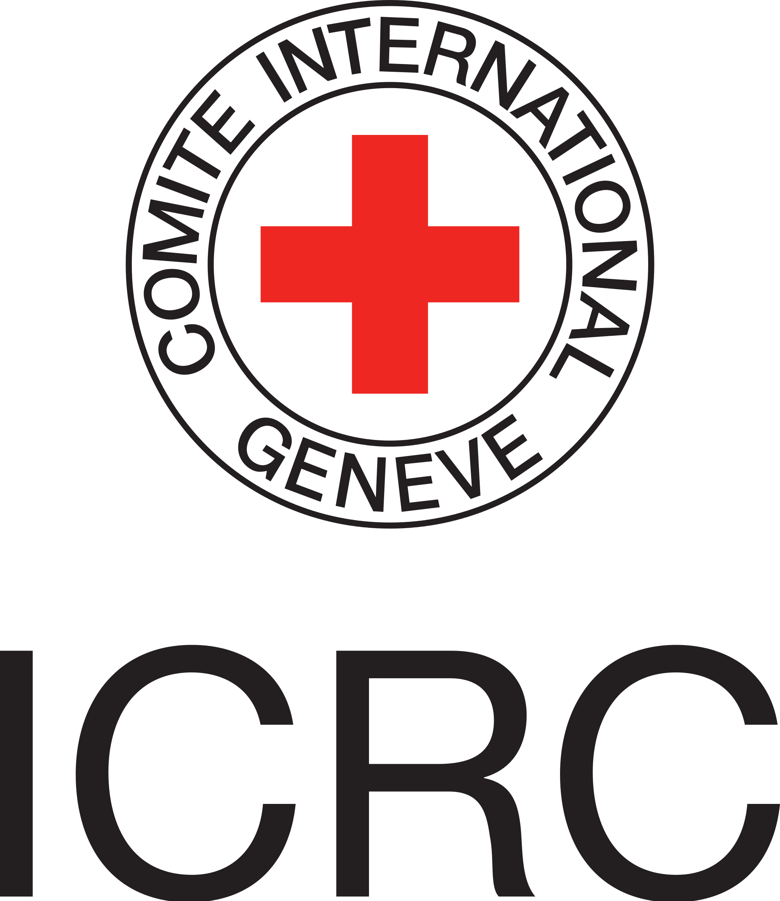
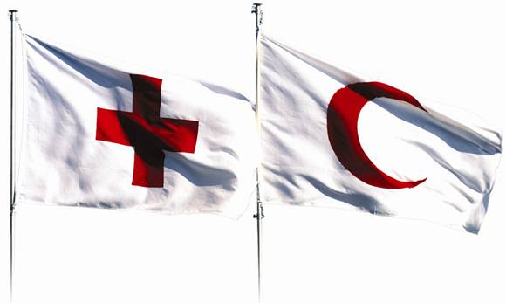
The International Red Cross and Red Crescent Movement Presentation to Participants to 3rd batch of ACE training by AHA Centre

Slide 2
Video imagine

Slide 3
Video Story of an Idea

Slide 4
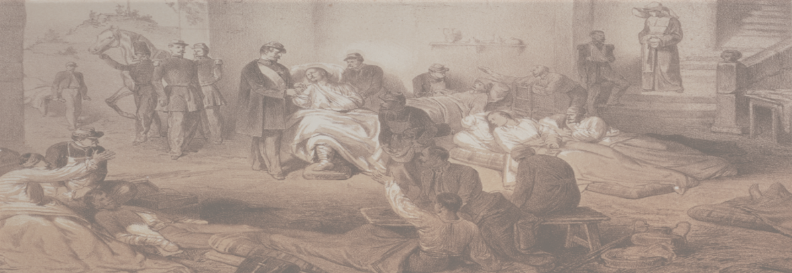
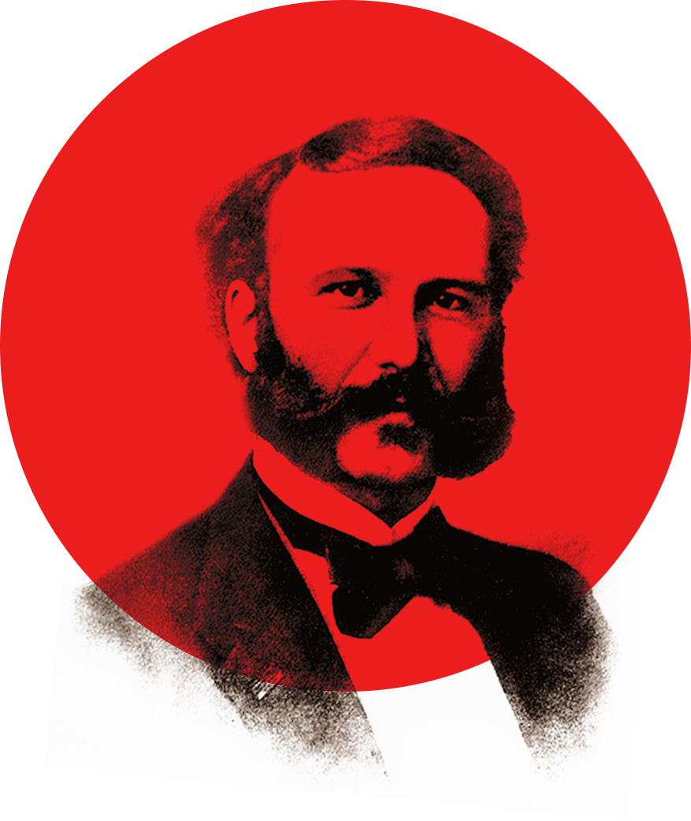
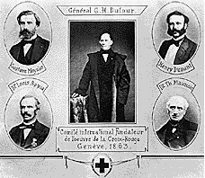
ORIGIN OF THE MOVEMENT
24 Jun 1859: Battle of Solferino, Battle between Austrian and French army
1862
“ A Memory of Solferino” - Henry Dunant
Voluntary Organization
International Agreement
1863
Creation of International Committee for Relief to the wounded
(1876 became ICRC)

Slide 5
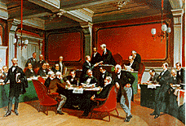
ORIGIN OF THE MOVEMENT
1864
1st International Conference
1st Geneva Convention
1863/1864
establishment of the first National Societies
(Germany, Spanish, Italian, French)

Slide 6
The International Red Cross and Red Crescent Movement
INTERNATIONAL COMMITTEE OF THE RED CROSS (ICRC)
(1863)
190 NATIONAL SOCIETIES
(SINCE 1863)
INTERNATIONAL FEDERATION OF RED CROSS AND RED CRESCENT SOCIETIES (IFRC) (1919)

Slide 7
INTERNATIONAL COMMITTEE OF THE RED CROSS
(ICRC)
Provide protection and assistance for civilian and victims of international, non-international armed conflict, violence, internal disturbances
IHL development, promotion and dissemination
It directs and coordinates the international activities conducted by the Movement in armed conflicts and other situations of violence
Notes:
To assist victims of conflict :
international, non-international, violence and internal disturbances, OSV and coordinating humanitarian assistance
IHL development, promotion and dissemination
- provide protection and assistance for civilian and military victims of armed conflicts and internal violence,
- promote International Humanitarian Law

Slide 8
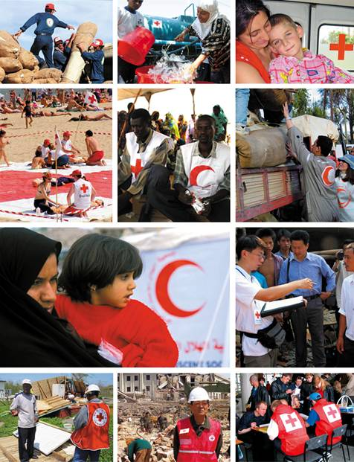
National Societies
National Societies act as auxiliaries to the public authorities of their own countries in the humanitarian field.
They provide a range of services including disaster relief, health and social programmes, and assistance to people affected by war.
Promote awareness of IHL
Other activities mandated by the government
Notes:
The promotion of humanitarian values is an intrinsic part of all Red Cross and Red Crescent activities. National Societies conduct campaigns and speak on behalf of vulnerable people in their own countries. They also promote awareness of international humanitarian law and advocate internationally through the Federation and with the International Committee of the Red Cross.
National Societies build and mobilize their network of volunteers through a nationwide branch structure, which can reach communities at greatest risk. Their programmes and services address both immediate and long-term needs of the beneficiaries and include:
• emergency shelter, food and medicine
• water and sanitation
• restoring family contact for disaster victims
• disaster preparedness
• community-based health and care
• first aid training and activities
• control and prevention of diseases
• HIV/AIDS prevention and awareness
• blood donor recruitment, collection and supply
• youth and volunteer activities

Slide 9
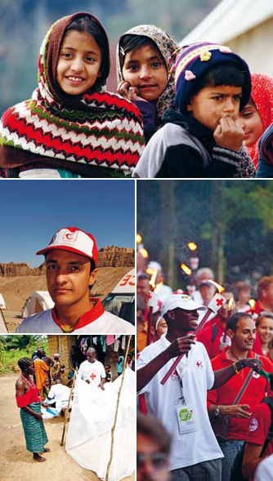
(IFRC)
International membership organization
Inspires, encourages, facilitates and promotes NS's humanitarian activities, strengthening NS
When required, it directs and coordinates the international activities conducted by the Movement for international emergencies (natural disaster or technological disaster)
Promotes Cooperation among National Societies
Notes:
IFRC vision: To inspire, encourage, facilitate and promote at all times all forms of humanitarian activities by National Societies, with a view to preventing and alleviating human suffering, and thereby contributing to the maintenance and promotion of human dignity and peace in the world.
The IFRC carries out relief operations to assist victims of disasters, and combines this with development work to strengthen the capacities of its member National Societies. The IFRC's work focuses on four core areas: promoting humanitarian values, disaster response, disaster preparedness, and health and community care
The role of the secretariat in Geneva is to coordinate and mobilize relief assistance for international emergencies, promote cooperation between National Societies and represent these National Societies in the international field. The role of the field delegations is to assist and advise National Societies with relief operations and development programmes, and encourage regional cooperation.

Slide 10
Video the Movement

Slide 11
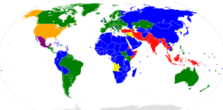
MOVEMENT and STATES
INTERNATIONAL CONFRENCE of RED CROSS and RED CRESCENT
190 National Societies
196 States party to Geneva Conventions
Notes:
The International Conference is a unique forum bringing together the world's largest humanitarian network and nearly every government. It is a major event on the humanitarian calendar and the premier global forum to enhance and inspire humanitarian debates among governments, policy makers and the components of the International Red Cross and Red Crescent Movement.
Through the Conference, states, as parties to the Geneva Conventions and partners in humanitarian action, undertake joint commitments with the Movement to advance humanitarian action.
The Conference also serves an important function in nurturing the auxiliary role of Red Cross and Red Crescent National Societies to their public authorities in the humanitarian field.
A range of other humanitarian and development actors also participate as observers – including regional and international organizations, the United Nations and several of its specialized agencies, non-governmental organizations, academic institutions and others.
In addition to formal decisions (resolutions) of the Conference, participants also make commitments in the form of pledges. These pledges, which may be made individually or jointly by several participants, are an important tool for translating the Conference outcomes into action at the country level.

Slide 12
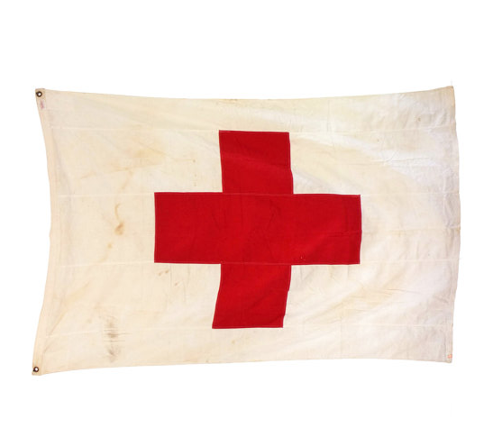
THE RED CROSS EMBLEM
Signs of the medical services of armed forces after 1863
Signs of the medical services of armed forces before 1863
Notes:
During the Geneva conferences of 1863 and 1864, which established the rules that have now become the Geneva Conventions, a red cross on a white background was adopted as a neutral emblem. It was intended to be universal and easily recognized in order to protect medical personnel and facilities from attack during armed conflicts. This was not a religious symbol; it was simply the reversal of the colours of the Swiss flag. As such, it was felt it would embody the fundamental requirement of neutrality.

Slide 13
GENEVA CONVENTION EMBLEMS
1863 - Z
1876 - Z
1929 - 1980
2005 - Z
Each state party of GC must use one emblem only

Slide 14
The Fundamental Principles
Humanity
Impartiality
Neutrality
Independence
Voluntary service
Unity
Universality

Slide 15
The Fundamental Principles
Humanity
The International Red Cross and Red Crescent Movement, born of a desire to bring assistance without discrimination to the wounded on the battlefield, endeavours, in its international and national capacity, to prevent and alleviate human suffering wherever it may be found. Its purpose is to protect life and health and to ensure respect for the human being. It promotes mutual understanding, friendship, cooperation and lasting peace amongst all peoples.
Impartiality
It makes no discrimination as to nationality, race, religious beliefs, class or political opinions. It endeavours to relieve the suffering of individuals, being guided solely by their needs, and to give priority to the most urgent cases of distress.
Neutrality
In order to enjoy the confidence of all, the Movement may not take sides in hostilities or engage at any time in controversies of a political, racial, religious or ideological nature.
Independence
The Movement is independent. The National Societies, while auxiliaries in the humanitarian services of their governments and subject to the laws of their respective countries, must always maintain their autonomy so that they may be able at all times to act in accordance with the principles of the Movement.
Voluntary service
It is a voluntary relief movement not prompted in any manner by desire for gain.
Unity
There can be only one Red Cross or Red Crescent Society in any one country. It must be open to all. It must carry on its humanitarian work throughout its territory.
Universality
The International Red Cross and Red Crescent Movement, in which all societies have equal status and share equal responsibilities and duties in helping each other, is worldwide.

