Slide 1
Dignity, Access, Participation and Safety Operationalizing Gender and Diversity in Disaster Management
AHA Centre Executive (ACE) Programme
26 May 2016
Christina Haneef

Slide 2
Objectives
To understand importance of mainstreaming gender and diversity in different sectors within disaster management
Introduction to IFRC’s approach and guiding frameworks
To feel confident to articulate the reasons that we should implement gender- and diversity-sensitive programming and some practical ways to achieve it
Confident in the practical use of tools - IFRC Minimum Standard Commitments to Gender and Diversity

Slide 3
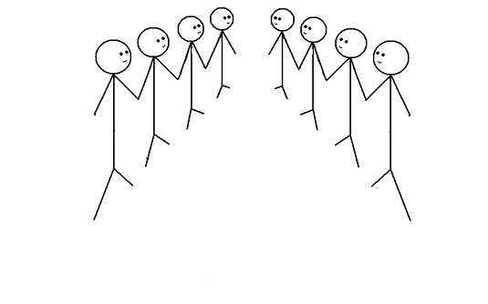
Speed debating

Slide 4
Group exercise
In disaster response we are so busy. Addressing gender and diversity must wait.

Slide 5
Group exercise
In a disaster response, trying to meet the distinct needs of people with a disability represents an unacceptable burden on limited resources.

Slide 6
Group exercise
In disasters the elderly are dependent and always need help

Slide 7
Group exercise
Adolescent/teenage girls; woman or child?
In our emergency programmes, it makes no difference as long as they are included in the overall number.

Slide 8
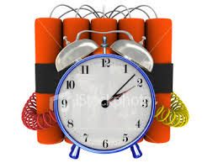
What do we hear about gender and diversity?
COMMON CHALLENGES
Too busy
No resources
Not a priority
I do not know how to do it
It is for someone else to do

Slide 9
Why does it matters in our approach to disasters?
Women, girls and boys are 14 times more likely to die during a disaster than are men
Indian Ocean Tsunami, 2004 +80% fatalities women
Japan earthquake 65% of casualties 60+
Cyclone Nargis, 2008 61% deaths women & children
Accountability
Cost effective
Do no harm
Quality
Address vulnerability
Fundamental Principles
Notes:
These are some examples of WHY it matters to analyse WHAT ALREADY EXISTS
Evidence:
More than 70% of those that died in the 2004 Asia Tsunami were women (it was 80+% females in some areas affected by the Tsunami)
News Article: http://www.theguardian.com/society/2005/mar/26/internationalaidanddevelopment.indianoceantsunamidecember2004
Oxfam Report: Women and the Tsunami http://www.preventionweb.net/files/1502_bn050326tsunamiwomen.pdf
In three of the affected areas of the 2011 Japan earthquake/ tsunami, 65% of casualties were over the age of 60

Slide 10
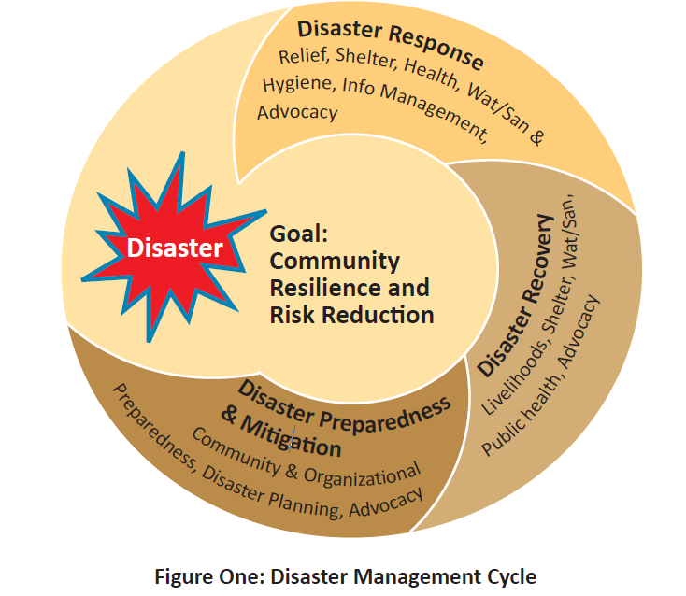
Gender- and diversity- sensitive risk factors
Social expectations / Caring roles / risk taking
Access to information /
preparedness programmes / EWS (G&D)
Livelihoods development / participation
Opportunities for skill development
Beneficiary registration –
relief distribution

Slide 11
IFRC’s approach
The IFRC’s gender and diversity work is not a separate or new component
It is rooted in its humanitarian mandate & fundamental principles, to prevent and alleviate human suffering without discrimination and to protect human dignity.
The RCRC recognizes that women and men have different capacities, strengths, needs and vulnerabilities which can impact their resilience to disasters

Slide 12
Sex or Gender?
Females can get pregnant New Zealand was the first country in the world to give women the vote. Males have testicles, females have ovaries | Women are the main care-givers (for children, aging parents, sick and disabled) Males have deeper voices after puberty
Notes:
•1893 New Zealand gave women the vote
•1902 Australia - Australian women, with the exception of aboriginal women. Aborigines, male and female, did not have the right to vote until 1962.
•1906 Finland
•1913 Norway
•1915 Denmark
•1917 Canada - Canadian women, except Canadian Indian women, won the vote in 1917. Canadian Indians, male and female, did not win the vote until 1960.
•1918 Austria, Germany, Poland, Russia
•1919 Netherlands
•1920 United States
•1921 Sweden
•1928 Britain, Ireland
•1931 Spain
•1934 Turkey
•1944 France
•1945 Italy
•1947 Argentina, Japan, Mexico, Pakistan
•1949 China
•1950 India
•1954 Colombia
•1957 Malaysia, Zimbabwe
•1962 Algeria
•1963 Iran, Morocco
•1964 Libya
•1967 Ecuador
•1971 Switzerland
•1972 Bangladesh
•1974 Jordan
•1976 Portugal
•1989 Namibia
•1990 Western Samoa
•1993 Kazakhstan, Moldova
•1994 South Africa
•2005 Kuwait
•2006 United Arab Emirates
•2011 Saudi Arabia – but can’t vote until 2015

Slide 13
Diversity
…The respect and acceptance of the differences between people
Notes:
Diversity is so important

Slide 14
Sexual and Gender-based Violence (S/GBV)
An umbrella term for any harmful act that results in, or is likely to result in, physical, sexual or psychological harm or suffering to a person on the basis of their gender.
A result of gender inequality and abuse of power.
Includes but not limited to: sexual violence, domestic violence, trafficking, forced/early marriage, forced prostitution, sexual exploitation and abuse, and denial of resources, opportunities and services.

Slide 15
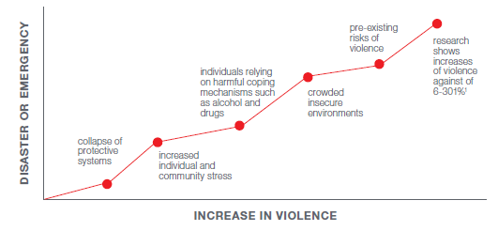
VIOLENCE INCREASES IN DISASTERS
Notes:
Violence must also be recognised as a cross cutting issue throughout DRR and DM activities. Violence can affect women, men, boys and girls, however women and girls and men who do not conform to society’s concepts of masculinity are usually more at risk of violence as a result of their gender (gender-based violence). Gender inequality is the root cause of vulnerabilities to violence.
Following a disaster, sexual, physical and gender-based violence (GBV) is known to increase, and this can happen for a number of reasons….

Slide 16
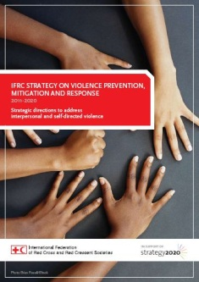
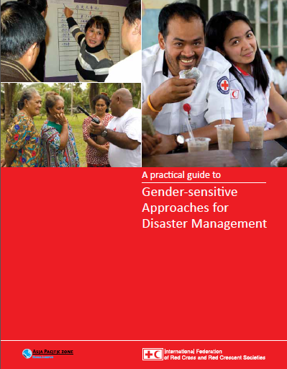
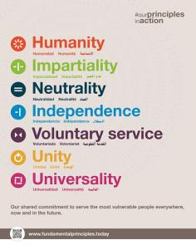
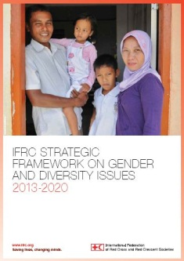
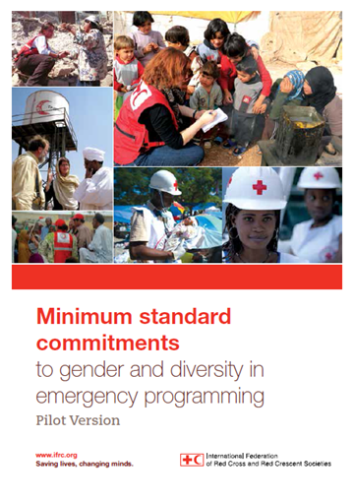
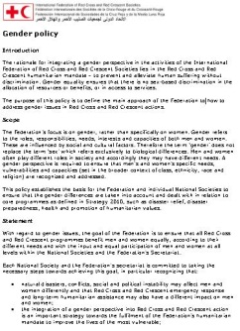
Organisational Policies and Tools

Slide 17
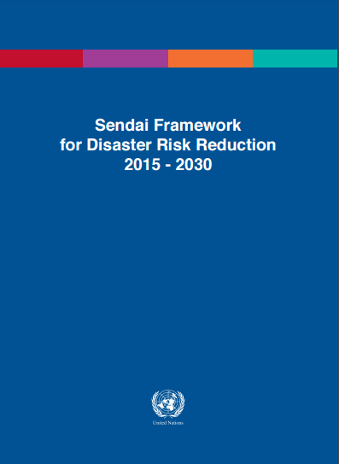
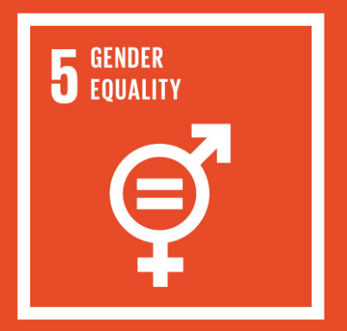
Organisational Policies and Tools
Sexual and gender-based violence: joint action on prevention and response (IFRC-ICRC)
Strategic framework on disability inclusion

Slide 19
Dignity
How can we apply this?
Safety
Access
Participation

Slide 20
Notes:
Ask participants if they can describe this crowd?

Slide 21
The Gender, Diversity and Gender-based Violence
Quiz

Slide 22
Sex
While approximately 50% of the world’s population is female, it is estimated that in most refugee populations, _____ are women and children.
Is it 60%, 70%, 80% or 85%?
80%
Notes:
1. While approximately 50% of the world’s population is female, it is estimated that in most refugee populations, _____ are women and children. Is it 60%, 70%, 80% or 85%?
“80 percent of the world’s 51 million people displaced by conflict are women, children and youth.” (Women's Refugee Commission Fact Sheet 2013)
“Women and girls comprise about half of any refugee, internally displaced or stateless population.” (UNCHR)
“Refugee women and girls accounted for 48 per cent of the refugee population in
2012, a proportion that has remained constant over the past decade”
“Children below 18 years constituted 46 per cent of the refugee population in
2012. This was in line with 2011but higher than a few years ago.” (UNHCR Global Trends report 2012)

Slide 23
Age
% of world’s population aged between 0 and 14 years
% of world’s population aged between 15 and 24 years
% of world’s population aged between 25 and 54 years
% of world’s population aged between 55 and 64 years
% of world’s population aged over 65 years

Slide 24
Age
% of world’s population aged between 0 and 14 years | 26%
% of world’s population aged between 15 and 24 years | 17%
% of world’s population aged between 25 and 54 years | 41%
% of world’s population aged between 55 and 64 years | 8%
% of world’s population aged over 65 years | 8%
Notes:
World’s Age Structure 2015
0-14 years: 25.79% (male 956,360,171/female 893,629,520)
15-24 years: 16.61% (male 613,806,639/female 577,904,561)
25-54 years: 40.78% (male 1,478,739,525/female 1,447,244,791)
55-64 years: 8.51% (male 298,092,946/female 312,206,795)
65 years and over: 8.32% (male 265,453,689/female 331,172,947) (2014 est.)
Source: CIA https://www.cia.gov/library/publications/resources/the-world-factbook/geos/xx.html
There are some 33 million international migrants under the age of 20, who represent around 16 per cent of the total
migrant population (232 million)
Source: UNICEF 2013 http://www.unicef.org/socialpolicy/files/Population_Dynamics_and_Migration%281%29.pdf

Slide 25
Pregnancy
___% of women of reproductive age (i.e. 15 - 45 years), including refugees and IDPs, are pregnant at any given time.
Is it 7%, 10%, 20% or 25%?
20%
Notes:
Source: Cooperative for Assistance and Relief Everywhere Inc. (2002) Moving from Emergency Response to Comprehensive Reproductive Health Programs: A Modular Training Series.
Washington, DC: CARE.

Slide 26
Disability
Around % of the total world's population live with a disability
% of the world's poorest people with some kind of disability
15%, 20%, 2%

Slide 27
Disability
Around % of the total world's population live with a disability | 15%
% of the world's poorest people with some kind of disability | 20%
Notes:
1. 15% of the world's population, have some form of disability.
Source: WHO Disability and health Fact sheet N°352 Reviewed December 2014
2. 20% of the world's poorest people with some kind of disability
Source: UN Enable Factsheet on Persons with Disabilities
http://www.un.org/disabilities/default.asp?id=18
Original source World Bank
3. In countries with life expectancies over 70 years, individuals spend on average about 8 years, or 11.5 per cent of their life span, living with disabilities.
Source: WHO / UN
http://www.un.org/disabilities/convention/facts.shtml
4. UNESCO estimates that 98% of children with disabilities in developing countries do not attend school, and that 99% of girls with disabilities are illiterate.
Source: United Nations (2007) From Exclusion to Equality: Realizing the rights of persons with disabilities
–Handbook for Parliamentarians on the Convention on the Rights of Persons with Disabilities and its Optional Protocol,

Slide 28
LGBTI
Being lesbian, gay, bisexual, transgender or intersex is illegal in how many countries?
Is it 25, 47 or 76?
76 countries (or 78 depending ‘countries’)
Notes:
1. 76 countries retain laws that are used to criminalize people on the basis of sexual orientation or gender identity.
Source: “State-sponsored homophobia: a world survey of laws criminalising same-sex sexual acts between consenting adults”, International Lesbian, Gay, Bisexual, Transgender and Intersex Association (ILGA), Brussels, May 2011, p. 9
See the countries here http://76crimes.com/76-countries-where-homosexuality-is-illegal/
2. Five countries put people to death for their sexual orientation: Iran, Mauritania, Saudi Arabia, Sudan and Yemen [plus some parts of Nigeria and Somalia]
Source: ILGA 2010 Read more: http://deathpenaltynews.blogspot.com/2010/06/ilga-76-countries-ban-gay-sex-7-have.html#ixzz3e5E2Fper

Slide 29
Violence
What % of women have reported experiencing physical violence by either an intimate and/or non-intimate partner in their lifetime?
In Cambodia?
In Vietnam?
Is it 5%, 13%, 22%, 35% or 50%
Notes:
Source: http://www.endvawnow.org/uploads/browser/files/vawprevalence_matrix_june2013.pdf

Slide 30
Violence
What % of women have reported experiencing physical violence by either an intimate and/or non intimate partner in their lifetime?
In Cambodia? 22%
In Vietnam? 35%
Notes:
Source: http://www.endvawnow.org/uploads/browser/files/vawprevalence_matrix_june2013.pdf

Slide 31
Violence
What % of the 4.5 million people forced into sexual exploitation are women and girls?
Is it 75, 88 or 98%
98%
Notes:
1. What % of the 4.5 million people forced into sexual exploitation are women and girls? 98%
Source: UN Women Facts and Figures on Violence Against Women and Girls
http://www.unwomen.org/en/what-we-do/ending-violence-against-women/facts-and-figures
2. Every 10 minutes, somewhere in the world, an adolescent girl dies as a result of violence
Source: UNICEF 2014
http://www.unicef.org/publications/files/A_Statistical_Snapshot_of_Violence_Against_Adolescent_Girls.pdf

Slide 32
Violence
How often does an adolescent girl die as a result of violence in the world?
Is it every 30, 20 or 10 minutes?
Every 10 minutes
Notes:
1. What % of the 4.5 million people forced into sexual exploitation are women and girls? 98%
Source: UN Women Facts and Figures on Violence Against Women and Girls
http://www.unwomen.org/en/what-we-do/ending-violence-against-women/facts-and-figures
2. Every 10 minutes, somewhere in the world, an adolescent girl dies as a result of violence
Source: UNICEF 2014
http://www.unicef.org/publications/files/A_Statistical_Snapshot_of_Violence_Against_Adolescent_Girls.pdf

Slide 33
Violence
How many countries only recognise female victims of rape? 42, 62 or 82
62
Notes:
Retrieved from: INTO THE MAINSTREAM: ADDRESSING SEXUAL VIOLENCE AGAINST MEN AND BOYS IN CONFLICT
A briefing paper prepared for the workshop held at the Overseas Development
Institute, London, 14 May 2014
Dr Chris Dolan (funded by Plan, Refugee Law Project, War Child)
http://www.plan-uk.org/assets/Documents/pdf/26374/Into-the-Mainstream
This survey, relying on web-searches to locate the relevant penal codes or equivalent legislation, reviewed 189 codes. Legislation for 4 countries could not be found.
Legal regimes were placed in four categories, and combined with population statistics from the World Bank. This was combined with current characterisations of countries at conflict, sourced from the International Institute of Security Studies database. (Doan C and Luedke A, forthcoming)

Slide 34
Notes:
Rapid gender analysis in emergencies:
You can do it before you get on the plane (a Google search of relevant secondary data)
You can have the gender and diversity analysis already ready to go

Slide 35
Disasters - Knowing who is most affected!
“Everything needs to be done at once but we just can’t”
Jean-Pierre Taschereau, IFRC Team Leader

Slide 36
Needs Assessments – Gender & Diversity Analysis
Who is affected? Why and how are they affected? What are their distinct needs, protection concerns and priorities?
Sex- and age-disaggregated data (SADD) – data broken out by sex and age (or age group)
Gender analysis examines relationships between females and males; their roles, responsibilities, access to and control of resources and constraints they face relative to each other.
Diversity analysis – examines the distinct reality of being a particular age/age group, disabled and other contextual factors (e.g. minority group, ethnicity, etc.)

Slide 37
Challenges in collecting and analysing SADD
No harmonised way to collect SADD
Different people in chain of collection, analysis and design
If collected, who does the analysis? (Who has capacity?)
If collected and analysed, who feeds/how is this fed into project design?
M | F | M | F | M | F | etc
0-5 | 0-5 | 6-12 | 6-12 | 13-18 | 13-18 | etc
2 | 1 | 4

Slide 38
Needs Assessments – Gender & Diversity Analysis
Price of not including a gender and diversity analysis
We limit the effectiveness of humanitarian operations
Humanitarian operations do not reach the most vulnerable
Potential to deepen pre-crisis inequalities
We do not meet donor requirements

Slide 39
Beneficiary selection & Prioritisation
Due to funding limitations, it is not always possible to reach everyone.
Indeed, not everyone is in need.
RCRC needs to transparently target and prioritise those most at risk to meet immediate and long term needs
Develop beneficiary selection and prioritisation criteria in consultation with affected community – focus on individual not HH

Slide 40
Equal Access: Considering our teams
Team composition doing assessments is important, we risk not allowing people to truly tell us about their needs
We also need to consider practical ways in emergencies to transform our teams to meet needs – volunteerism and leveraging all capacities in the community
Tabasco floods (2007, Mexico)
https://www.youtube.com/watch?v=3d-Yu8Dh1LY
Notes:
This film shows how important it is to be:
Inclusive in our teams
Consider local knowledge, vulnerability and who is missing out
Use simple measures such as wrist bands, and outreach to deliver aid to the most vulnerable

Slide 41
Thank you!
Any questions?

Slide 42
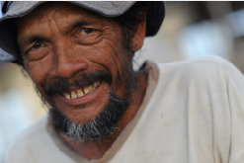
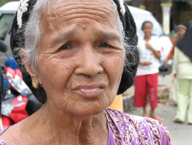
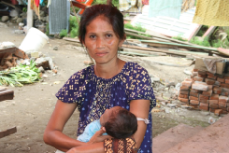
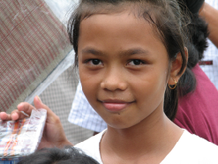
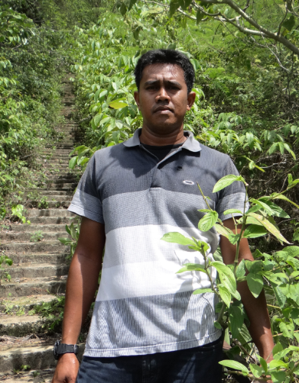
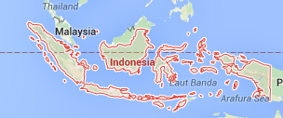
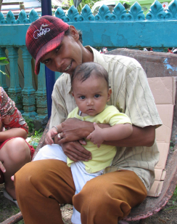
Inside the disaster – survivors

Slide 43
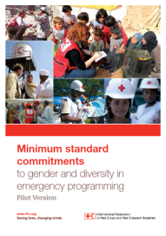
Exercise
Minimum Standard Commitments to Gender and Diversity in Emergency Programming
Seven sectors – health, food, WASH, shelter (and settlements), livelihoods, NFIs
Four Commitments (with corresponding standards)
D – dignity
A – access
P – participation
S - safety

Slide 44
Exercise
Each person’s distinct needs – health, food, WASH, shelter (and settlements), livelihoods, NFIs
Each person’s protection risks and capacities
Consider issues such as referrals and partnerships
10 minutes with ‘your’ person; rotate for three minutes with each person in the gallery; stop when back where you started.
Does each point noted address the survivor’s dignity (D), access to assistance (A), participation (P) and/or safety (S)? (place letter)

