Slide 1
Task Forces
Roles and Responsibilities

Slide 2
Functions of Task Force
Non-Disaster
Before Disaster
During Disaster
After Disaster

Slide 3
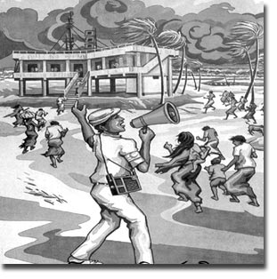
Search & Rescue Task Force
First Aid Task Force
Fire Safety Task Force
Warning & Awareness Task Force
Evacuation Task Force

