Slide 1
Structural Safety
&
Non-Structural Safety

Slide 2
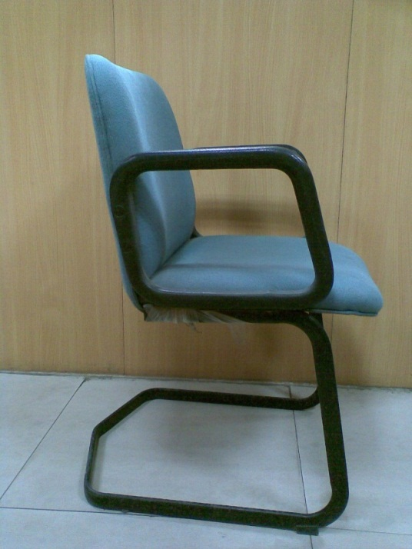
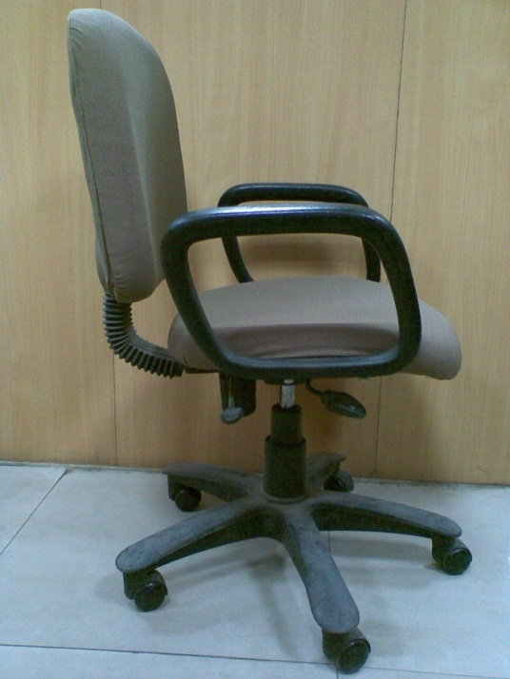
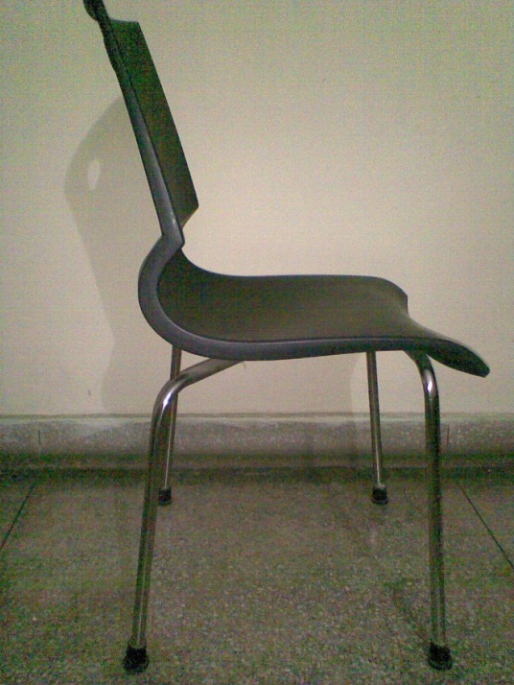
Which Chair will you prefer ?

Slide 3
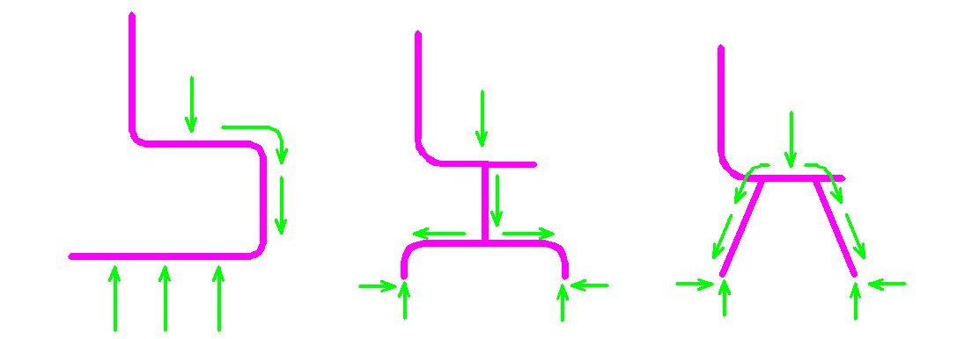
…. how a force flows ?

Slide 4
Why structures fail?
Many buildings are very old & weak
Old buildings were constructed when Design Codes did NOT exist
Codes not strictly followed in new buildings
Engineers unaware of earthquake resistant designs
Poor quality of materials
Poor construction
Untrained masons

Slide 5
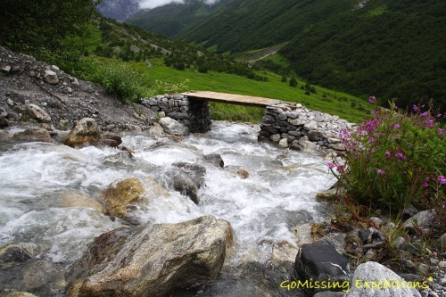
Background
Structural engineering is surely one of the oldest – a plank across a stream!

Slide 6
disaster resistant construction
principles

Slide 7
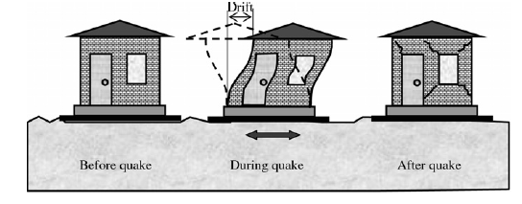

Slide 8
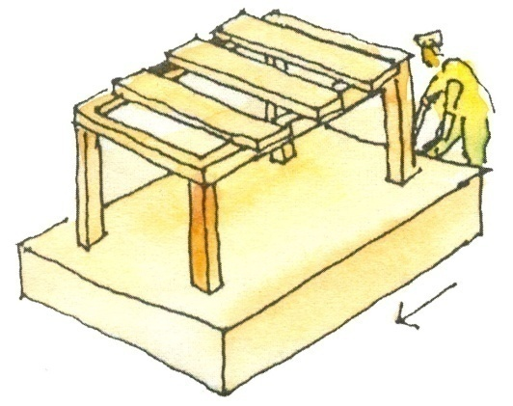
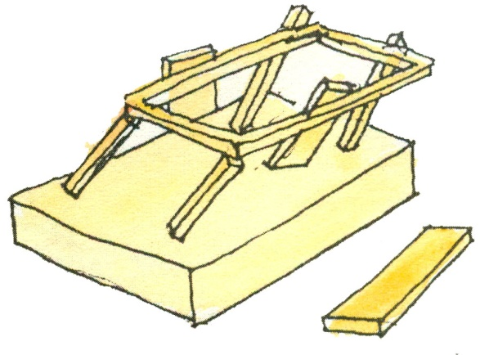
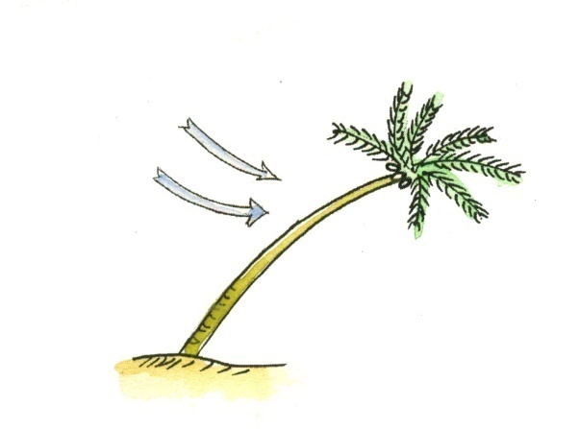
Disaster resistant construction principles
If a table, with a heavy top is poorly attached to its supports, is shaken violently can break off and collapse. A building with heavy roof can collapse in an earthquake if roof is not properly attached to its supports
In an earthquake or cyclone , a tree bends and comes back to its original position because it is elastic and strong. Masonry wall bend and crack. A building needs to be ductile/elastic

Slide 9
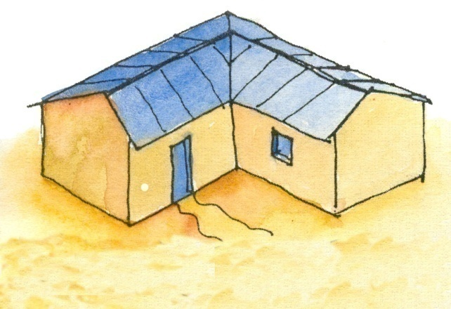
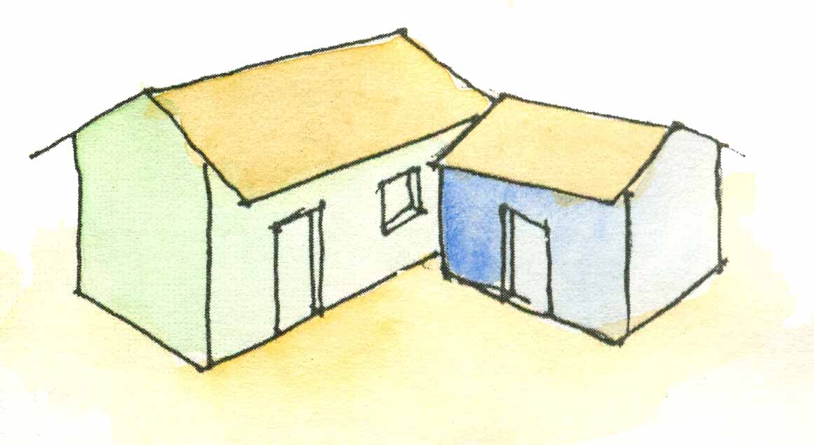
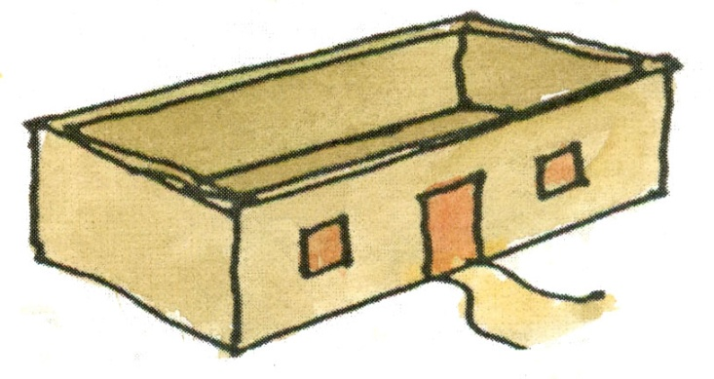
General rules of building plan and form
Building with asymmetrical plan is not safe
Divide the building in a number of symmetrical units
Avoid rectangular plan having walls longer than 3 times its width

Slide 10
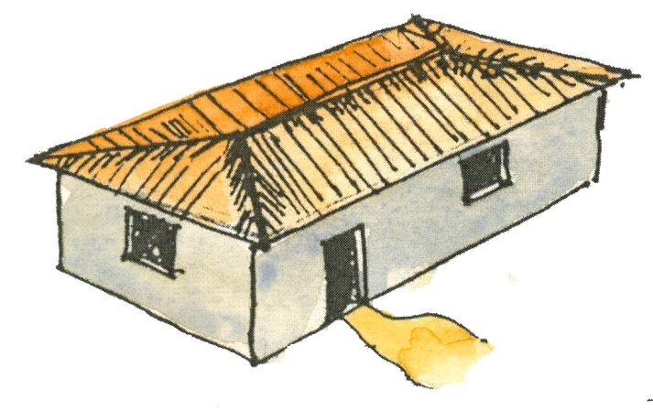
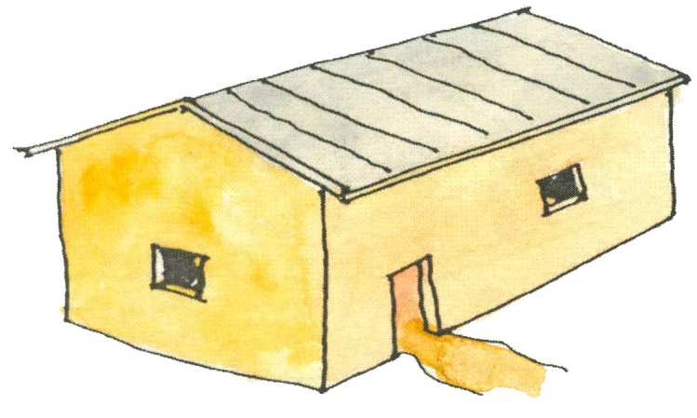
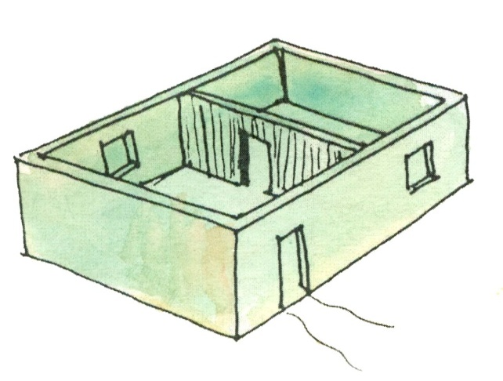
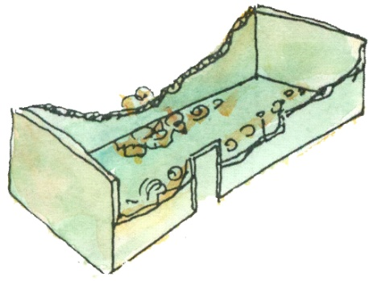
General rules of roof and walls
Build divider wall simultaneously and properly connected to the outer long walls, and make it 230mm thick to prevent collapse or cracking
Four sided sloping roof is better than the two sided roof, since the gable wall can easily crack at its base
Walls can collapse if they are…
Too long

Slide 11
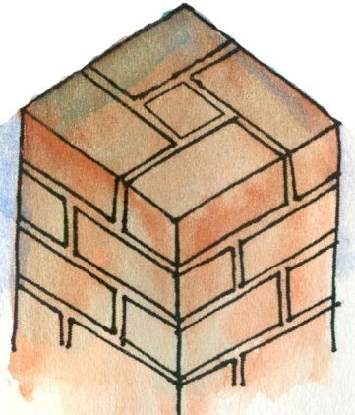
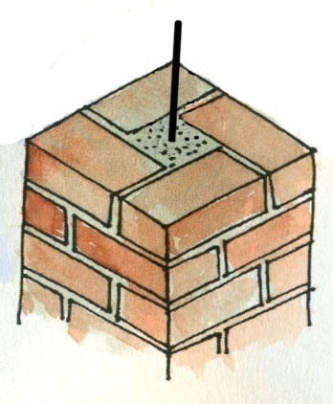
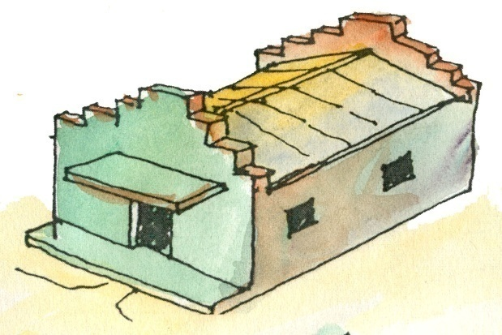
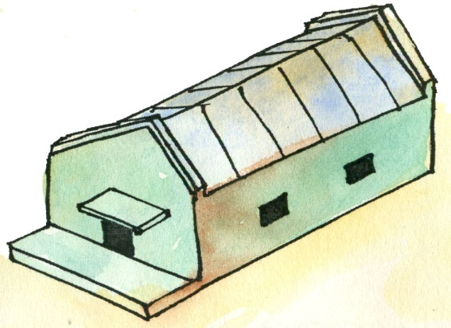
General rules for walls
Avoid un-reinforced masonry columns. Build with 1-12mm TOR bar fully encased in concrete. Anchor it at top and bottom.
Avoid high load walls. Build 230mm high load walls with reinforcement bar.

Slide 12
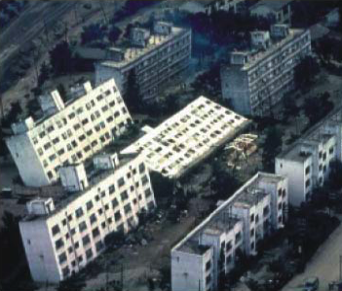
Earthquake

Slide 13
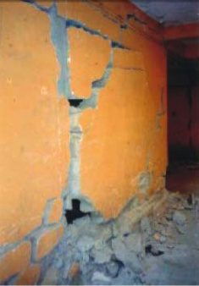
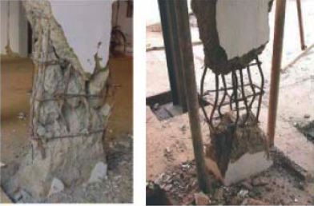
Earthquake

Slide 14
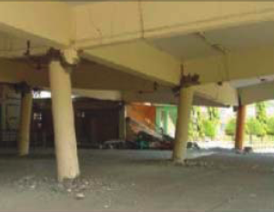
Earthquake

Slide 15
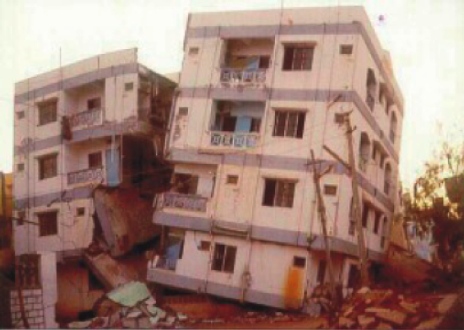
Earthquake

Slide 16
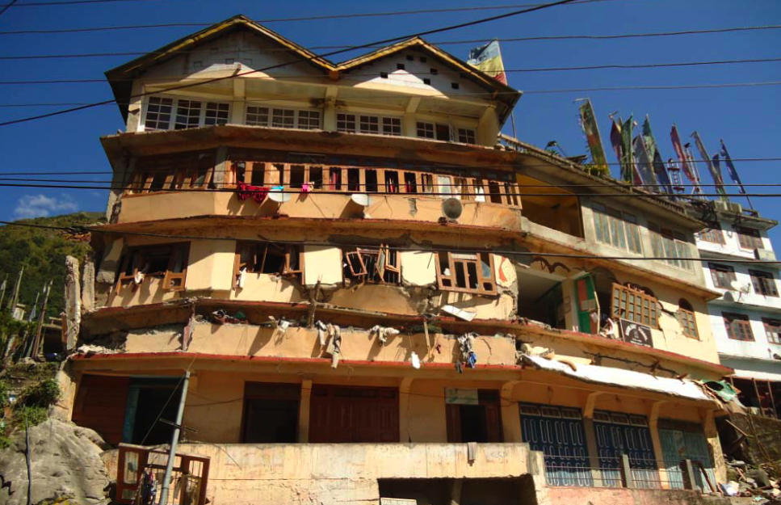
Earthquake

Slide 17
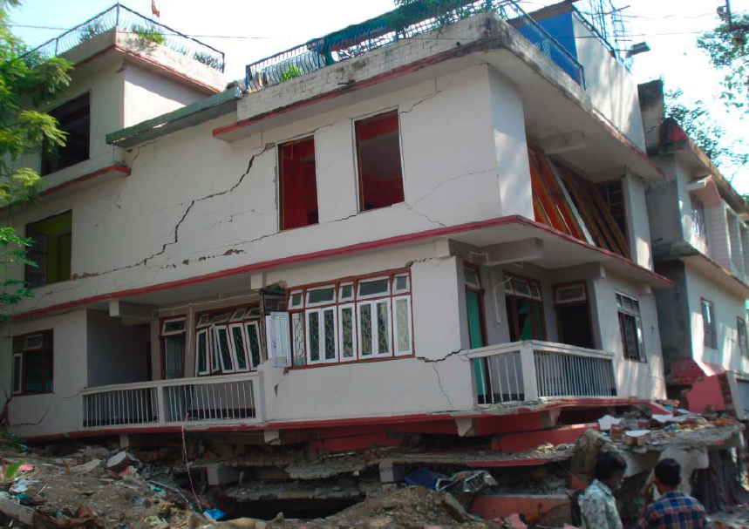
Earthquake

Slide 18
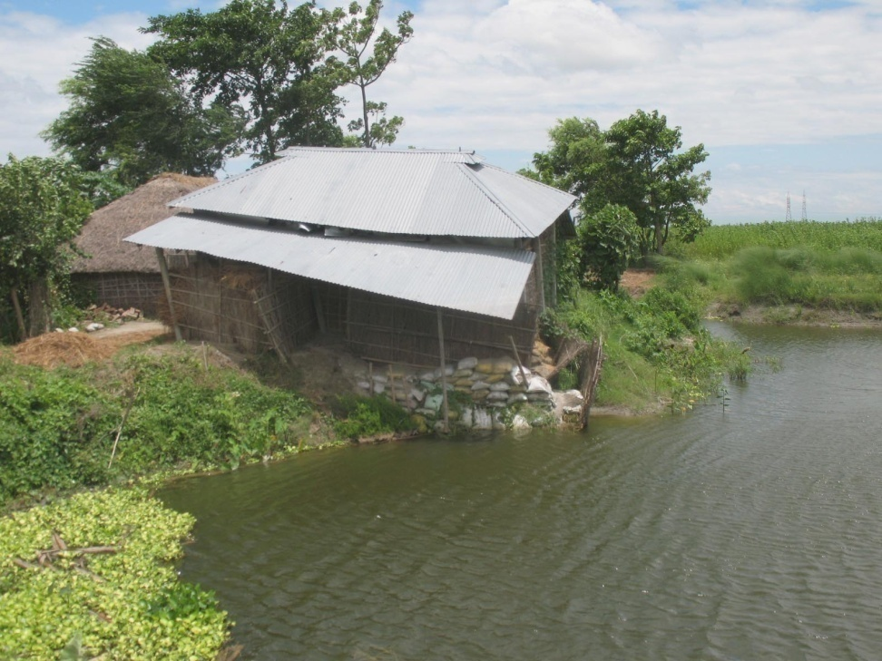
Floods

Slide 19
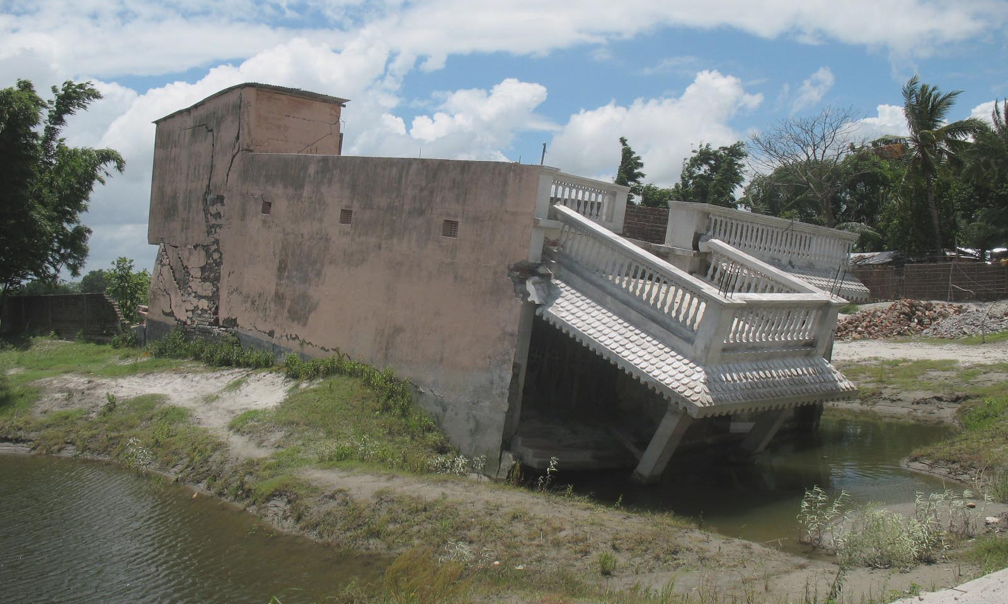
Floods

Slide 20
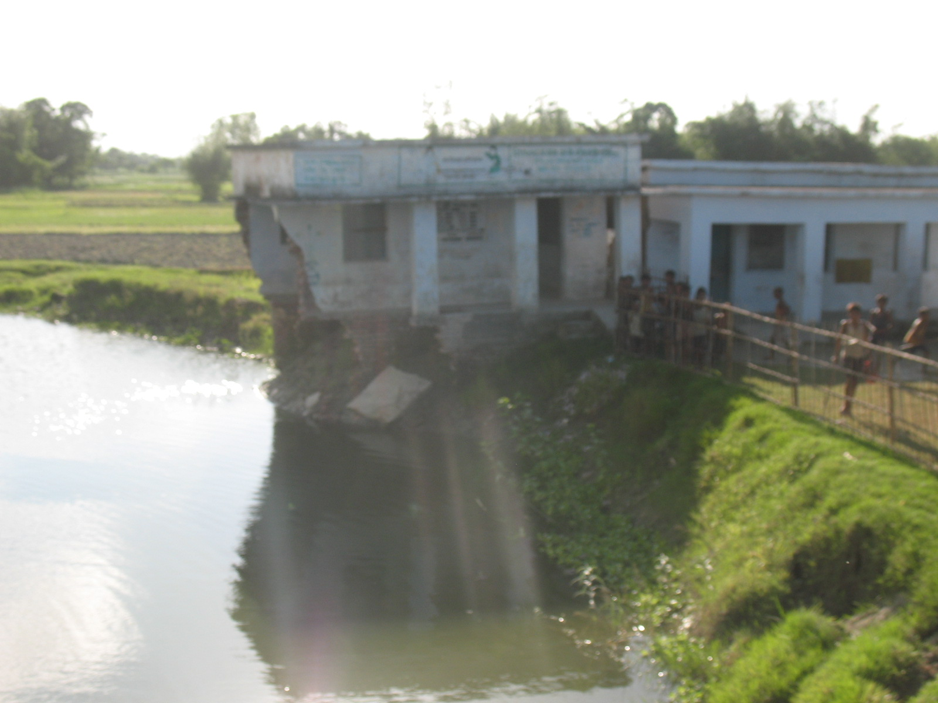
Floods

Slide 21
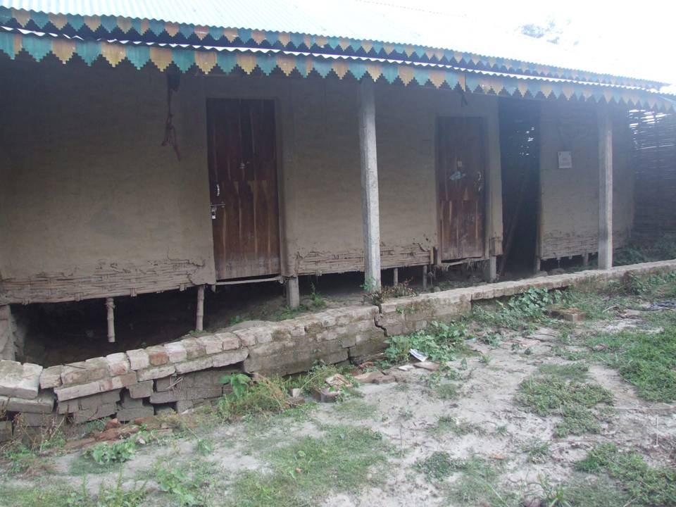
Floods

Slide 22
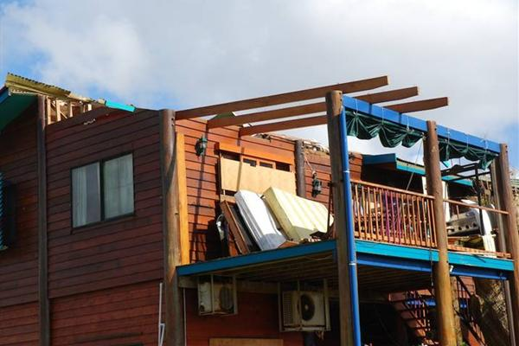
High Wind

Slide 23
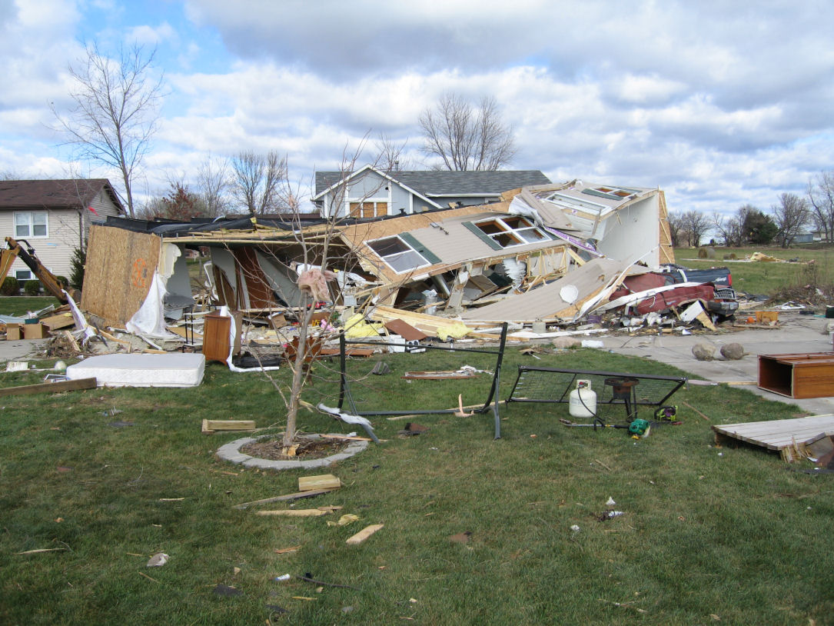
High Wind

Slide 24
NON-STRUCTURAL SAFETY

Slide 25
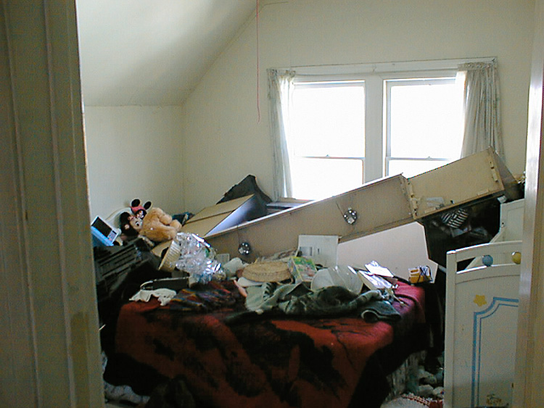

Slide 26
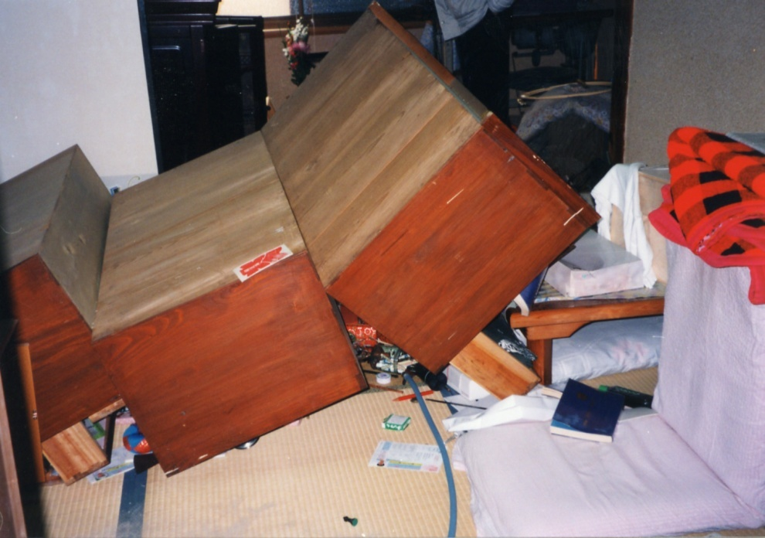

Slide 27
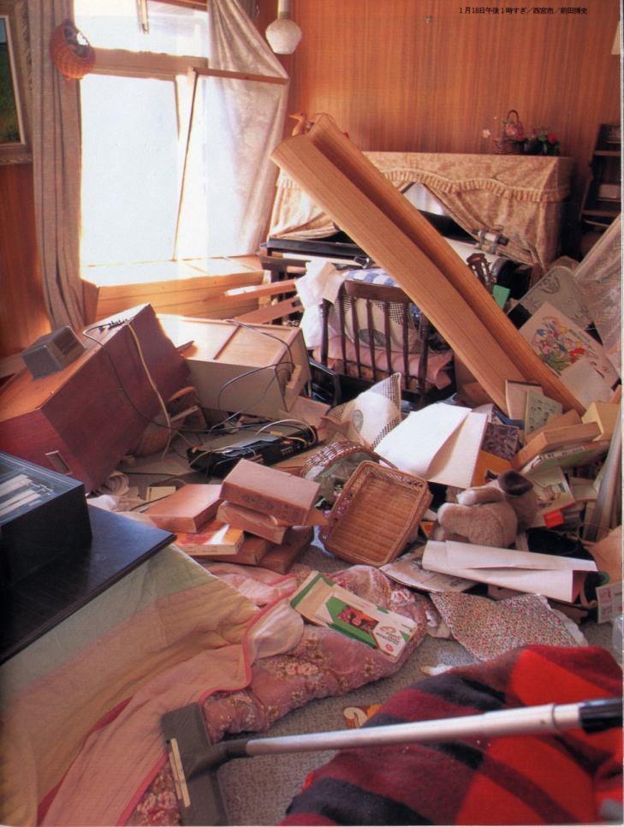
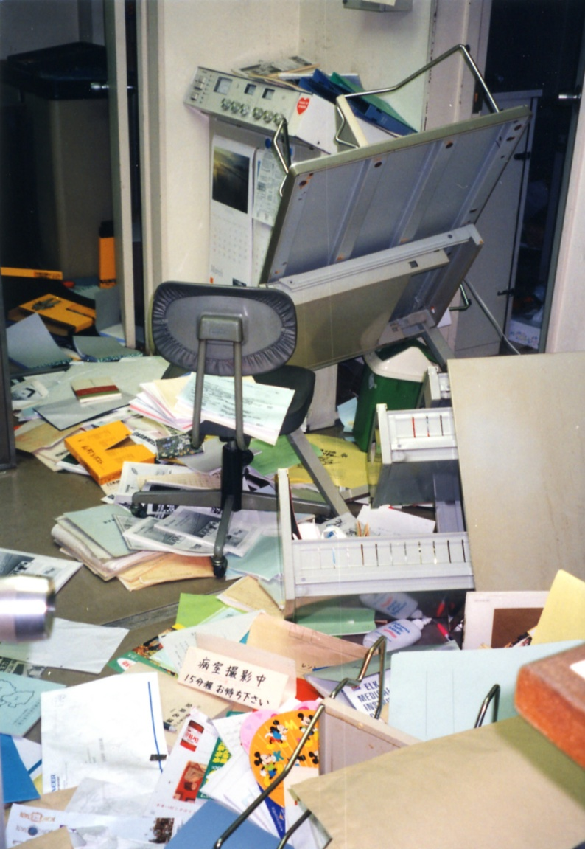

Slide 28
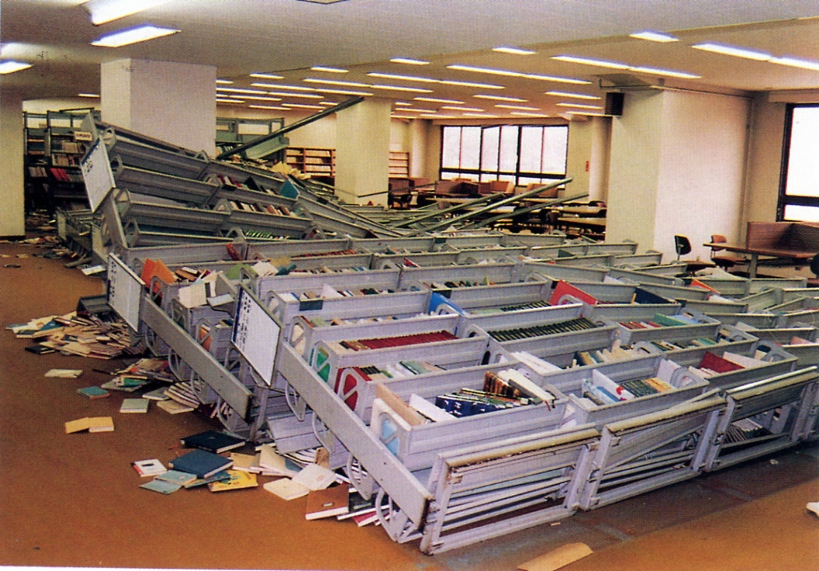

Slide 29
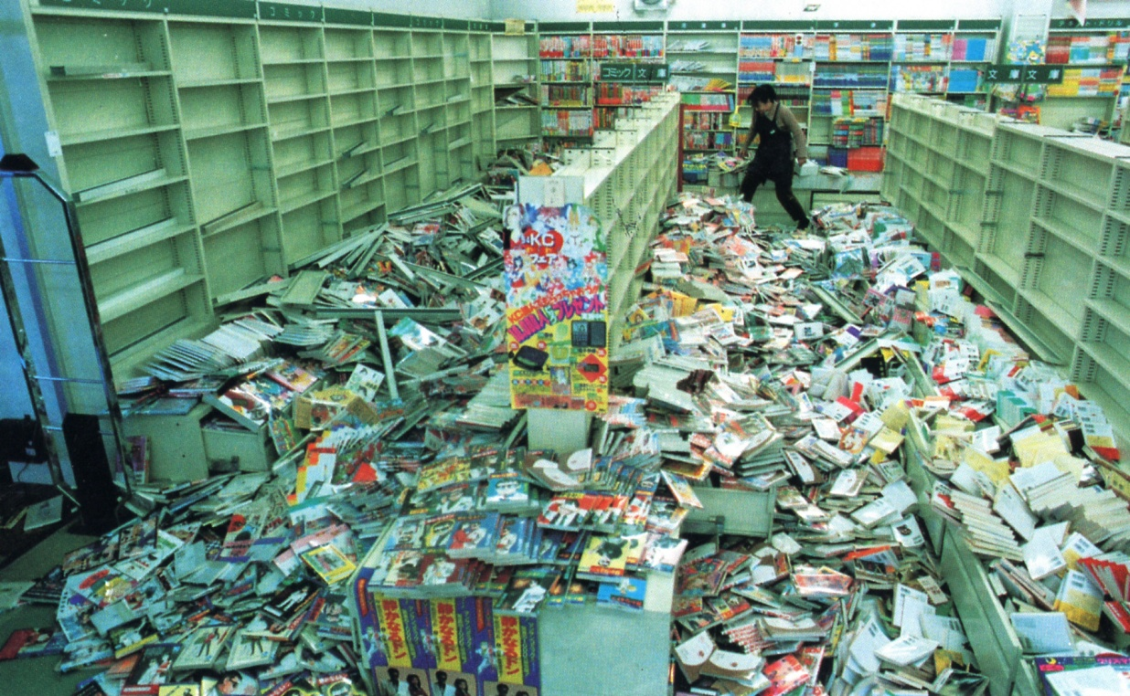

Slide 30
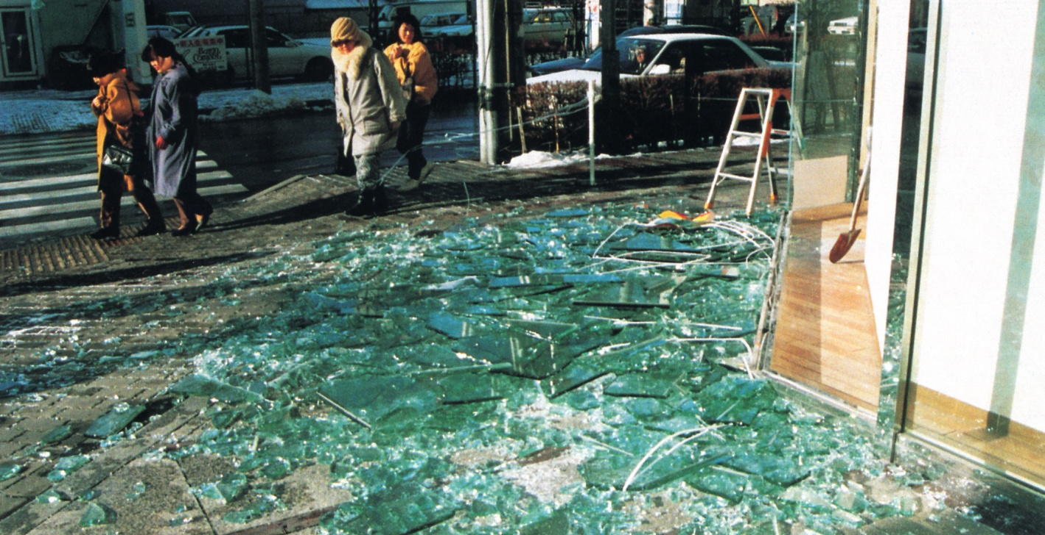

Slide 31
What is Non-Structural Elements?
those which are attached to or housed in
a building or building system, but are not
part of the main load-resisting structural
system of the building.

Slide 32
Architectural elements, for example, parapets, penthouses, appendages and ornamentations,veneer, cladding systems, suspended ceiling, sign boards, etc.,
mechanical components, for example, boilers, storage tanks, piping systems, fire protection systems, and
electrical components, for example, electric motors, light fixtures, computers and data acquisition systems, etc.
Furnitures and content, for example, almirah, sofa, computer, etc.

Slide 33
Risk Associated
loss of life or injury to building occupants
loss of property especially in commercial buildings (high as 75% of total cost of building)
impairment or loss of function of an important building or lifeline structure, for example, fire resisting system, communication facilities, telecom centre

Slide 34
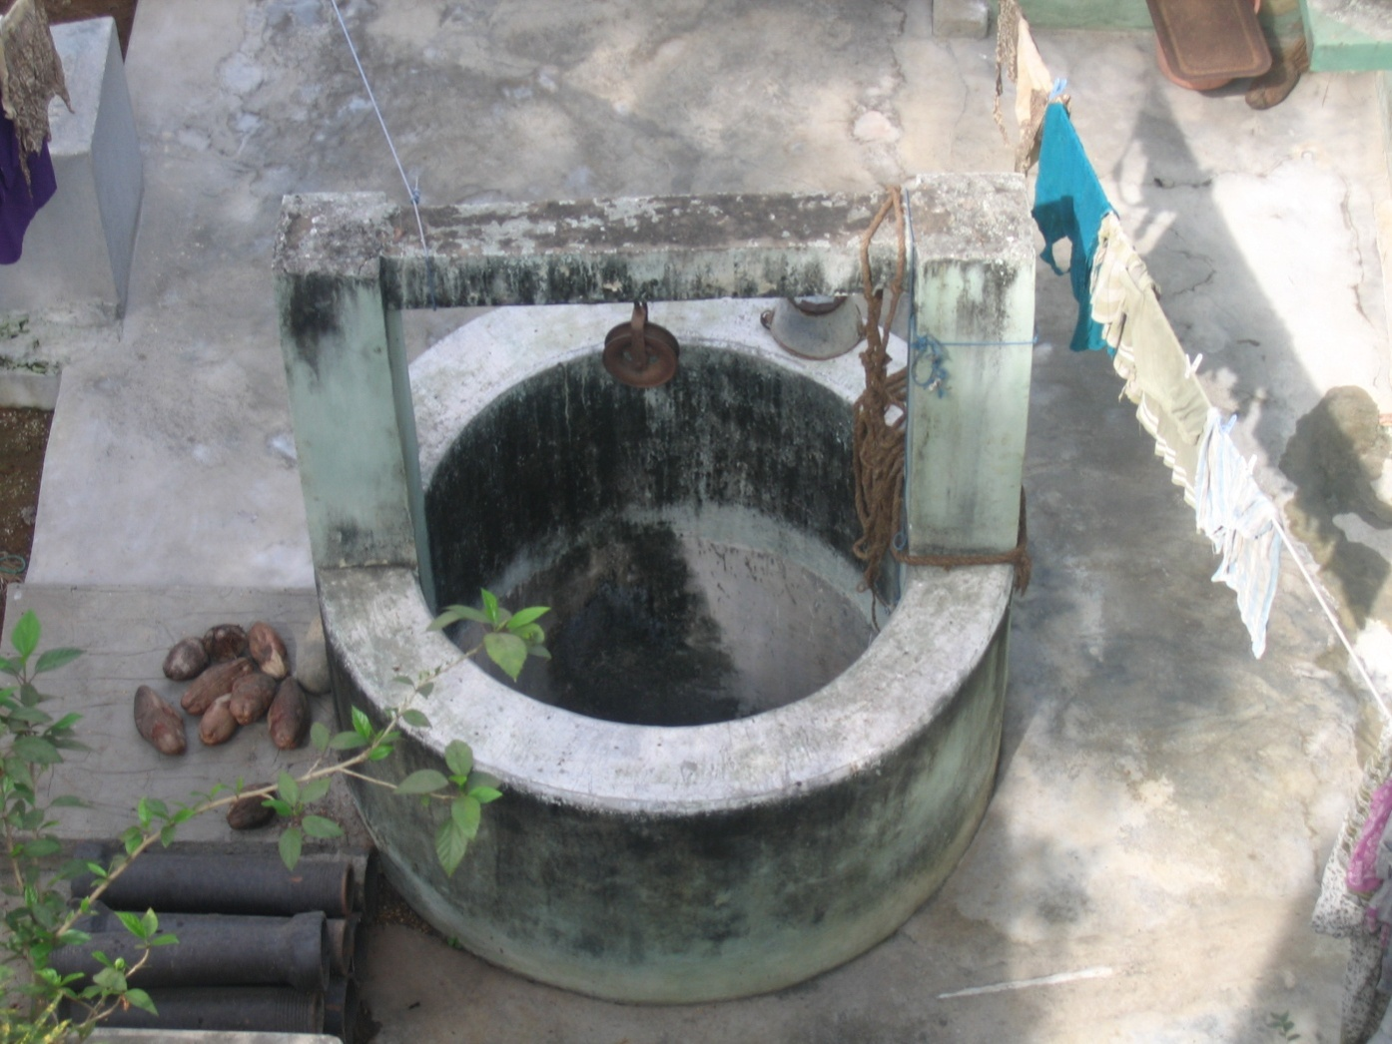
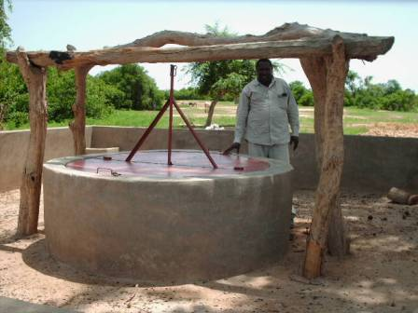
NSM – Day to Day Risk

Slide 35
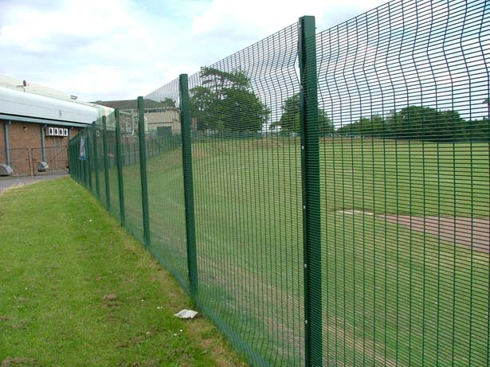

Slide 36
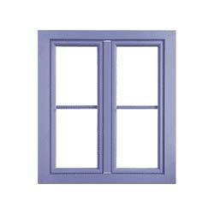
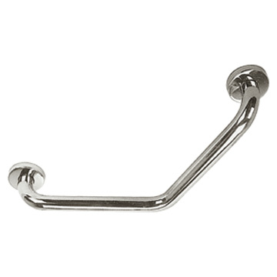
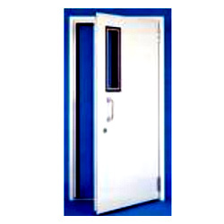


Slide 37
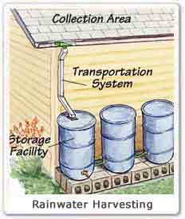

Slide 38
Non-Structural Hazard Hunt
Group Exercise

Slide 39
Non Structural Mitigation Itemized Inventory Form
Area / Location | Item (Full Description) | Risk Type |  |  | Priority H/M/L or 1,2,3 | Weight (including contents) in KG | Mitigation Measure
 |  | Life Safety | Property Safety | Operational Continuity
Room No 1 | Computer | ✓ | ✓ | ✓ | H | 3 kgs | Fixing by Hook and loop (velcro)
 | Glass window pane | ✓ | ✓ |  | H |  | Filming
Room No 2 | Door opening inward | ✓ |  |  | H | 8 kgs | Outward opening/ double hinge
 | Sharp Edge on exit door | ✓ |  |  | H |  | Sloping
Lobby – 1st Floor | Copier Machine with roller |  | ✓ | ✓ | M | 15 Kgs | Fixing /locking
 | Telephone Exchange Board |  |  | ✓ | L | 7 kgs | Relocate/fixing

Slide 40
Thank you
www.seedsindia.org

