Slide 1
School Disaster Management Plan

Slide 2
SDMP Template
Dangers threatening the school
Facilities outside school
Problems outside school
Facilities inside school
Evacuation area, route
Equipment & Tools
Awareness material
Task Force Members
Skilled Man Power
Disaster Management Planning for School
Problems inside school (structural)
Problems inside school (non-structural)
Activities for reducing disaster effects
Preparations for disaster
Actions to take when disaster happens
Review of Disaster Management Plan

Slide 3
SDMP governed by DM Cycle
Non-disaster-time To take up activities for reducing disaster effects. To increase disaster management skills, Plan, to regularly carry out drills in schools, to raise awareness of Students and staff | Before Disaster To check readiness of facilities for quick response. To take decisions to minimize losses. Early Warning Bringing your plan into action.
After Disaster To manage the safety and care of evacuees, sending students back to their homes in safe manner. | During Disaster To quickly respond to a disaster situation, record damage, mobilization of task forces

Slide 4

Key stakeholders of School Safety
School Management
Teaching & Non Teaching Staff
Students
Stakeholders
Parents
Community
Local business owners
Local Leaders
Volunteers
CBOs
Youth organisations
Media
Corporates
Civil Societies
Administration
Local administration
Education Department
Government [Province/National]

Slide 5
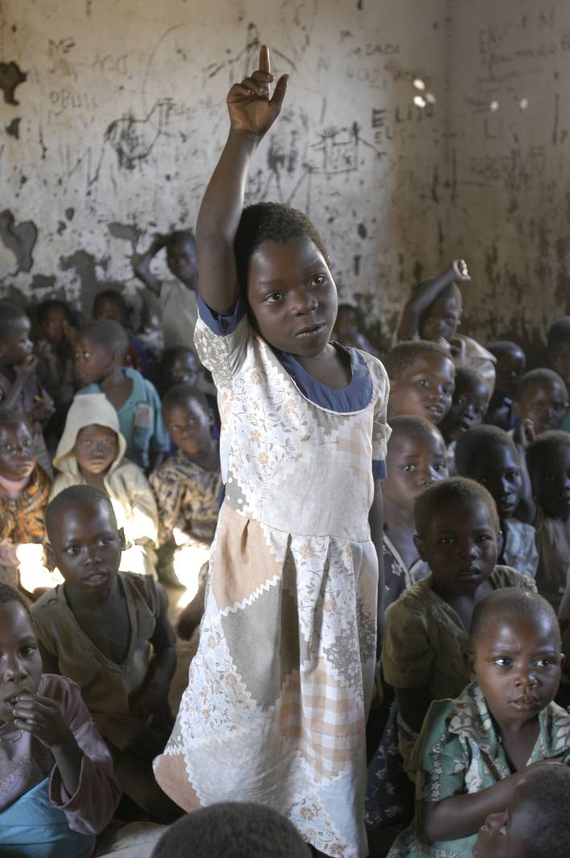
Education in Emergency
Fundamental Right & Continuity of Education
Healthy Development
Health and Nutrition
Protection
Life saving knowledge and skill
Support to children with special need

Slide 6


