Slide 1
MALAYSIAN RED CRESCENT
RDMC MEETING
SINGAPORE 2012
MEMBER OF THE INTERNATIONAL FEDERATION OF RED CROSS AND RED CRESCENT SOCIETIES

Slide 2
THE MYRC STRUCTURE
NATIONAL COUNCIL
NATIONAL SECRETARIAT
NATIONAL EXECUTIVE BOARD
BRANCH ( 15 )
BRANCH SECRETARIAT
CHAPTER SECRETARIAT
CHAPTER ( 149 )
WELFARE
&
SERVICE GROUPS
VOLUNTARY
AID
DETACHMENTS
RED CRESCENT
LINKS
JUNIOR
RED CRESCENT
MEMBER OF THE INTERNATIONAL FEDERATION OF RED CROSS AND RED CRESCENT SOCIETIES

Slide 3
NATIONAL EXECUTIVE BOARD & COMMITTEE
MEMBER OF THE INTERNATIONAL FEDERATION OF RED CROSS AND RED CRESCENT SOCIETIES

Slide 4
DM MANAGEMENT FLOW
DIRECTOR DISASTER MANAGEMENT AND RC SERVICES
DISASTER MANAGEMENT & LOGISTIC DEPT
AMBULANCE SERVICES DEPT
AMBULANCE SERVICES MANAGER
RESPONSE OFFICER
DM & PEPAREDNESS OFFICER
AMBULANCE SERVICE OFFICER
LOGISTIC OFFICER
TRANSPORT OFFICER
ESO
AMA / PARAMEDICS
MEMBER OF THE INTERNATIONAL FEDERATION OF RED CROSS AND RED CRESCENT SOCIETIES

Slide 5
EARLY WARNING IN MALAYSIA USED BY MYRC
MEMBER OF THE INTERNATIONAL FEDERATION OF RED CROSS AND RED CRESCENT SOCIETIES

Slide 6
EARLY WARNING SYSTEM IN MALAYSIA
GOVT DISASTER EARLY WARNING SYSTEM
TSUNAMI AND EARTHQUAKE
National Tsunami Early Waning System (SAATNM)
17 Seismological station in Malaysia ( 7 short period sensor and 10 broadband sensor.
2 deep ocean buoy equipped with tsunameter instrument
Data transmitted to Malaysia Meteorological Dept HQ in PJ via VSAT satellite
Shared with other agencies
LANDSLIDE AND EROSION HAZARD
Surface Monitoring Technique at hill slope
System monitored by JKR Dept
Shared with other agencies
FLOOD
River water level Indicator and gauge
Monitored by JKR Dept
Shared with other agencies
MEMBER OF THE INTERNATIONAL FEDERATION OF RED CROSS AND RED CRESCENT SOCIETIES

Slide 7
(CONTINUED)
INFORMATION OBTAINED FROM GOVERNMENT EWS
MALAYSIAN RED CRESCENT
PREPAREDNESS AND PLANNING
RESPONSE AND MOBILIZATION OF RESOURCES
MEMBER OF THE INTERNATIONAL FEDERATION OF RED CROSS AND RED CRESCENT SOCIETIES

Slide 8
DOMESTIC REPORTING AND SUPPORTING LINE
AS AN AUXILIARY BODY TO MALAYSIAN GOVERNMENT,
MALAYSIAN RED CRESCENT ALSO
INVOLVED AND REPORTED TO THE GOVERNMENT
NATIONAL SECURITY COUNCIL (MKN)
BASED ON DIRECTIVE 18,20 AND 21
MEMBER OF THE INTERNATIONAL FEDERATION OF RED CROSS AND RED CRESCENT SOCIETIES

Slide 9
3 MAIN MINISTRY WHICH MALAYSIAN RED CRESCENT DIRECTLY
INVOLVED WITH:
MINISTRY OF HEALTH
MINISTRY OF SOCIAL WELFARE
FIRE AND RESCUE DEPARTMENT

Slide 10
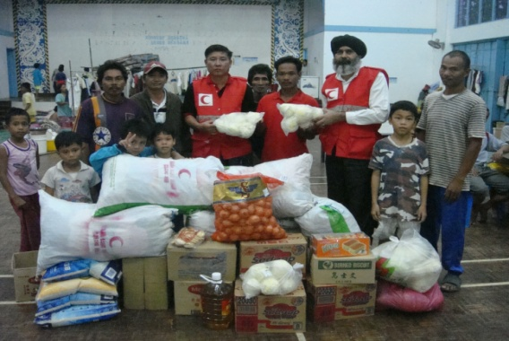
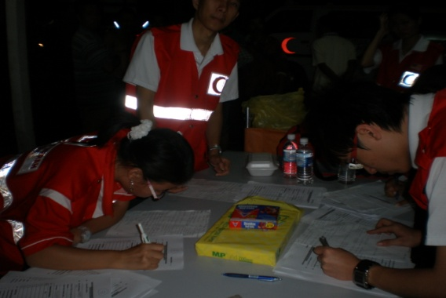
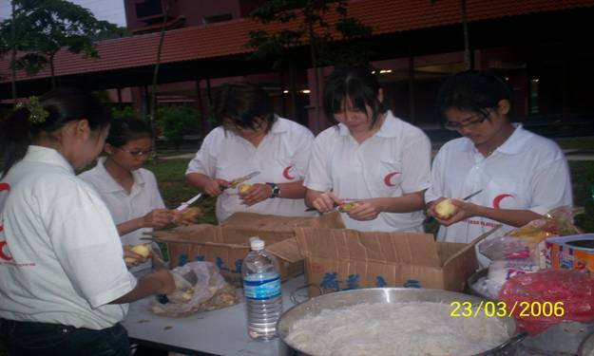
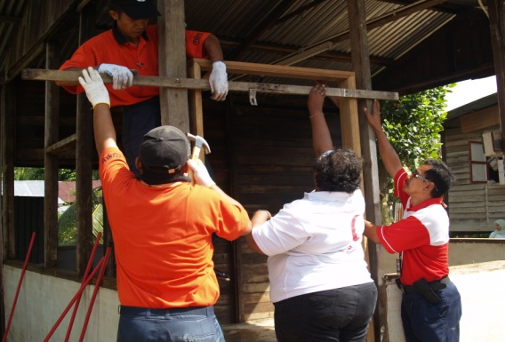
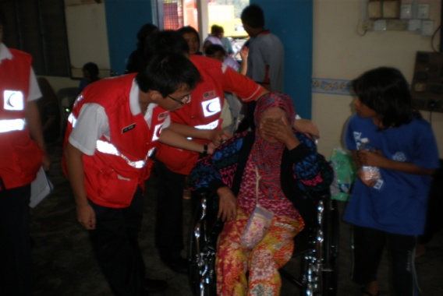
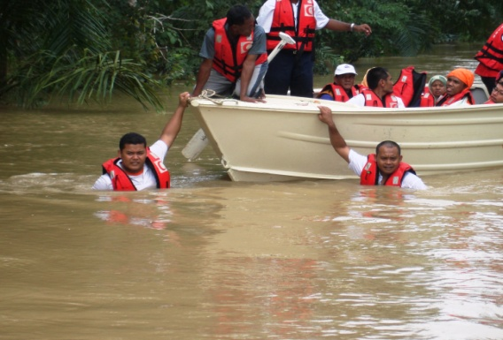
Ministry Of Welfare
Relief Distribution
Registration
Food preparation
Shelter
Psychosocial Support
(PsP)
Transportation
MEMBER OF THE INTERNATIONAL FEDERATION OF RED CROSS AND RED CRESCENT SOCIETIES

Slide 11
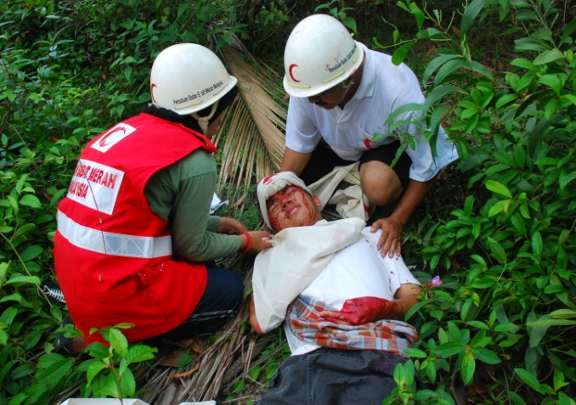
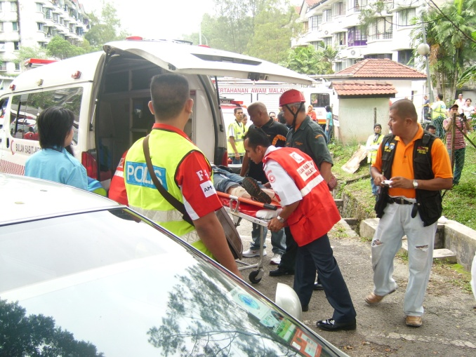
Ministry Of Health
First Aid / Health
Ambulance –Transportation of casualties
MEMBER OF THE INTERNATIONAL FEDERATION OF RED CROSS AND RED CRESCENT SOCIETIES

Slide 12
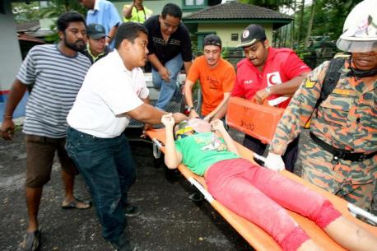
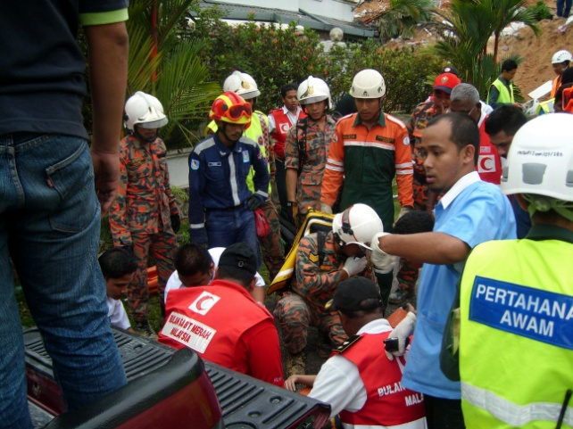
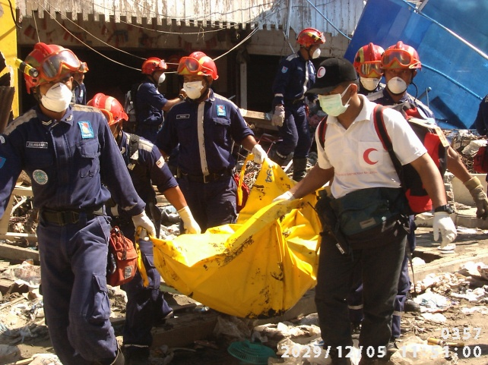
Fire and Rescue Department
Search, Rescue and Evacuation
MEMBER OF THE INTERNATIONAL FEDERATION OF RED CROSS AND RED CRESCENT SOCIETIES

Slide 13
INTERNATIONAL REPORTING LINE
AP ZONE
OVERWHELM DISASTER SITUATION WHICH MAY REQUIRED INTERNATIONAL RC ASSISTANCE
REGIONAL DELEGATION
MALAYSIAN RED CRESCENT
MEMBER OF THE INTERNATIONAL FEDERATION OF RED CROSS AND RED CRESCENT SOCIETIES

Slide 14
MALAYSIAN RED CRESCENT RESPONSE TOOL
Rapid Deployment Squad (RDS)
Well trained unit in disaster management and response
Unit were trained with the coordination from various main government agencies
Based on the Malaysian Red Crescent supporting roles to the government in Malaysian Security Council Directive 20
Strategy to establish atleast 20 trained RDS member in every branch
MEMBER OF THE INTERNATIONAL FEDERATION OF RED CROSS AND RED CRESCENT SOCIETIES

Slide 15
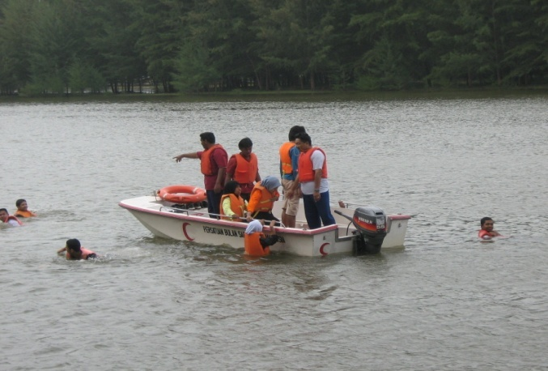
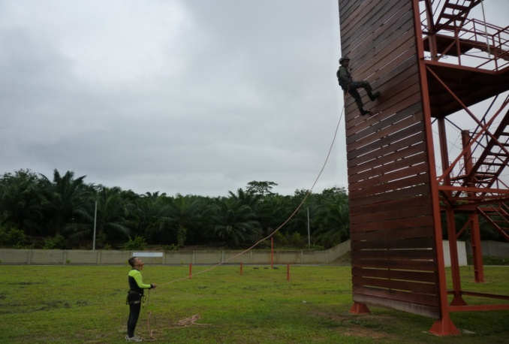
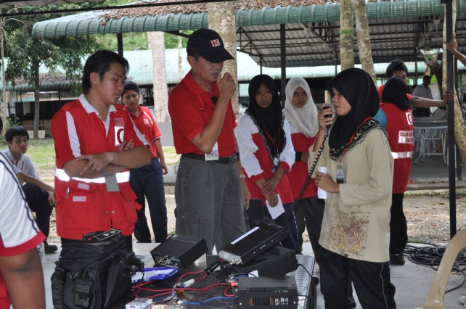
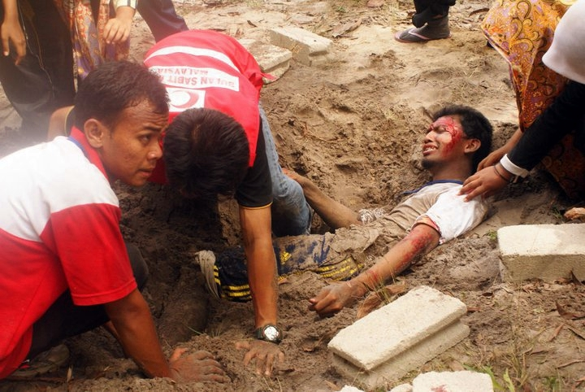
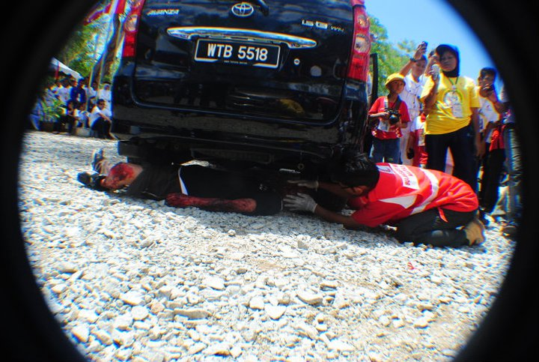
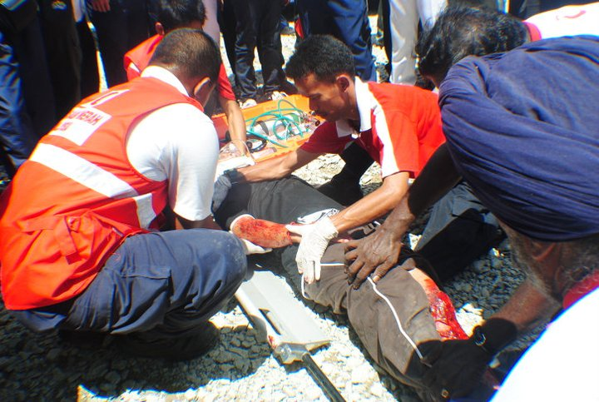
Rapid Deployment Squad (RDS) Training Component
WATER CONFIDENT AND RESCUE
ROPE RESCUE TECHNIQUE
COMMUNICATION
OBSTACLE EVACUATION
OBSTACLE RESCUE
MEDICAL RESCUE
MEMBER OF THE INTERNATIONAL FEDERATION OF RED CROSS AND RED CRESCENT SOCIETIES

Slide 16
THANK YOU
QUESTION
MEMBER OF THE INTERNATIONAL FEDERATION OF RED CROSS AND RED CRESCENT SOCIETIES

