Slide 1
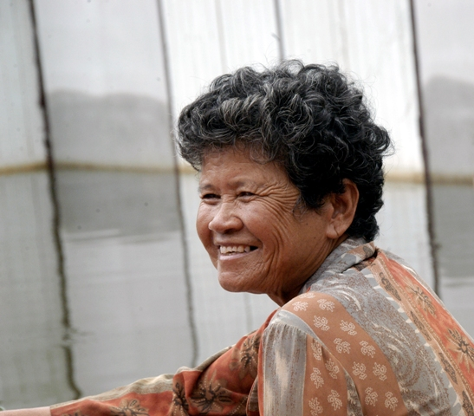
Building Safer and More Resilient Communities in South-East Asia
Regional Community Safety and Resilience Unit – CSRU,
South-East Asia Regional Delegation
Bangkok

Slide 2
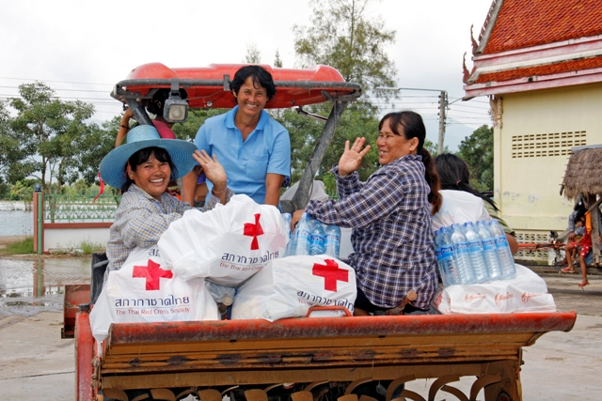
Why Resilience Approach?

Slide 3

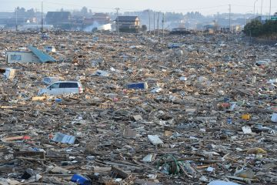
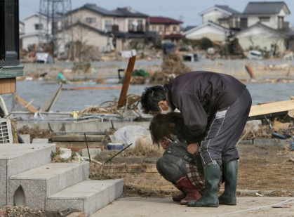
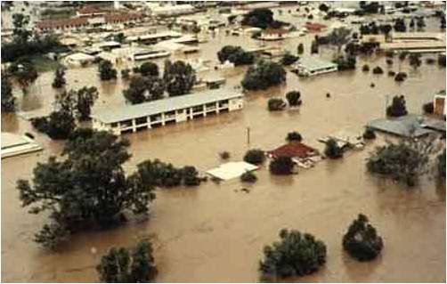
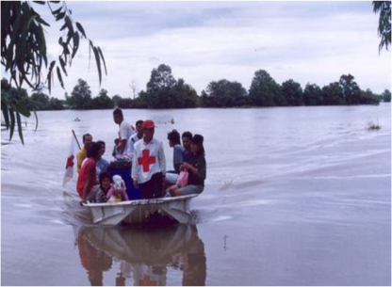
Considering the scale and impacts of natural hazards that are continuing to cause enormous human and material damages – much remains to be done to make communities safer and more resilient.
In 2011 only….

Slide 4
Japan EQ/T 260 B $ and Thai F 40 B$

Slide 5
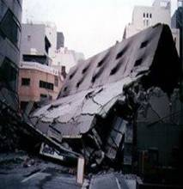
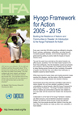
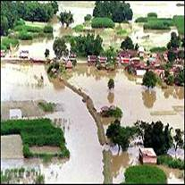
Is the resilience approach something new?
Millennium Development Goals - MDG
Hyogo Framework for Action
“Building the resilience of nations and
communities to disasters”
Strategic Goals
More effective integration of Disaster Risk consideration into sustainable development policies, planning and programming at all levels – with emphasis on disaster prevention, mitigation, preparedness and vulnerability reduction
Development/Strengthening of institutions (especially at community level) to build resilience to hazards .
Systematic incorporation of RR approaches into design and implementation of emergency preparedness, response and recovery programs
Notes:
The Yokohama Strategy for Safer World: Guidelines for Natural Disaster Prevention, Preparedness and Mitigation and its PoA (Yokohama Strategy) adopted in 1994 provides landmark guidance on reducing disaster risk and the impact of disasters
De facto ECHO-DIPECHO approach/orientation in DRR is in line with Strategic Goals 2 and 3

Slide 6
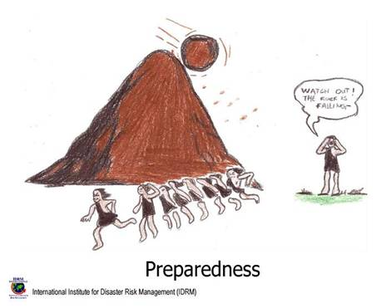
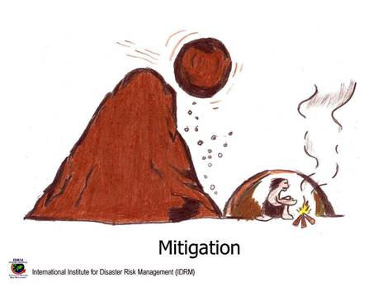
RCRC Complementarities with
Hyogo Framework for Action
Five Priority Areas for Action
DRR - a national and local priority
Identify, assess and monitor disaster risk and enhance early warning
Use knowledge, innovation and education to build a culture of safety and resilience at all levels
Reducing underlying risk factors.
Strengthen disaster preparedness for effective response
Notes:
Training: first aid, search and rescue teams, provision of equipment, drills, …
Awareness campaigns with the population (i.e: at schools) to recognise disaster risks & necessary measures.
Early warning systems (hydrological studies, communication systems, awareness signs, etc…),
Risk mapping (mapping of villages/risks/existing structures,…).
Institutional strengthening : training of institutions, facilitation of coordination, information sharing networks
Mitigation - To limit/minimise the averse impact of natural, environmental, technological hazards by reducing the physical vulnerability of the existing sites / infrastructures. : costal reforestation, construction of protection walls along water streams, building of elevated platforms for key village assets (i.e: water points) to face flooding, reinforcement of bridges to allow quick evacuation of people, …
Prevention- : Includes: planning (i.e site planning) legal measures (i.e : construction
codes) infrastructure works (i.e: dams, retrofitting,…), etc.

Slide 7
Background: What has been done so far?
WDR focusing on community resilience in 2004 (other resilience related approaches even before this)
Community Safety and Resilience Framework, focus on DRR in 2007-2008
Strategy 2020 references to resilience
Health Strategic Operational Framework 2011-2015 – resilience approach
“Characteristics of Resilient Communities” – DRR study 2011
Development and Disaster and Crisis Management Position Papers 2011
Workshop on Community Resilience at the GA 2011
Resilience teams/units – e.g. Bangkok Regional Delegation preparedness and resilience unit
NS work on resilience programmes
One integrated and articulated approach still missing.

Slide 8
Rationale: Why resilience concept?
Purpose: to consolidate various Federation approaches to resilience and to establish the Federation’s definition and common understanding on resilience.
This common understanding should help us to improve:
Coherence and integration: provides a more unified and coherent way of working across sectors
Linking relief, recovery and development: helps to identify better linkages between our longer term developmental work and disaster/crises response
Funding: improves our ability to attract funding, possibility to tap into development funding

Slide 9
Beliefs towards concept
No communities with Zero resilience / No communities with absolute resilience.
Need to focus on collective and integrated planning with communities at the forefront (DM and Health).
We have experiences and we need to build on it.
Resilience is an integrated concept that allows multiple risks and their impacts on vulnerable people to be considered together. Integrating various approaches to development work with humanitarian work.
Notes:
Comprehensive risks assessment, Coping capacity, Risks Reduction, and recovery capacity are the major components of CSR.

Slide 10

What are the characteristics of resilient
communities which we would like to contribute to?
A resilient community is one that can prepare for, adapt to, withstand and recover from external and internal shocks as well as have the capacity to cope with social, political and economic disparities that contribute to vulnerability.
To do this a community should:
Be aware of their own risks, vulnerabilities and capacities and be able to plan for and implement initiatives to address these.
Be able to cope with impacts of various shocks / adversities and bounce back immediately.
Be able to respond to a lack of required services and inequitable access to existing services .
Respect the different roles of men and women and enable each to contribute and reach their potential. Provide a safety net for the most vulnerable members of that community when they need it.
Recognise and promote volunteerism as a key way of contributing to the community and building resilience.
Develop the skills to participate in the decision making processes and influence the decisions that affect it.
Develop links with other communities and institutions to overcome social isolation.
Notes:
What do communities look like when strong?
What do you to think about these as you read them
Of course characteristics may be unique to each community context
This is an ideal or vision but something to aim for
Understanding this is key to any bottom up approach – this is the reason why we are in the room together
This approach is strong on values
What are strengths and gaps in communities?
This is a multi-sector holistic approach to development
Some people have defined point 1 as the definition of resilience and the other items are the how.

Slide 11

A strong NS listens to the voice of volunteers who themselves come from vulnerable communities and asks them to give ideas for programmes that communities need
Resilient
communities
Local Branch
Supporting Branch
National Headquarters
Volunteers
These ideas are turned into national programmes
and services that benefit vulnerable people
OD + DM + Health
Notes:
If volunteers are coming from communities, allow NS to listen to voice of volunteers.
This is a very different way of planning than the way we usually plan which usually revolves around partners coming along and planning with HQ and then HQ planning with branches based on their programmes available, top down process.
This approach does not start with what people and branches really want.

Slide 12
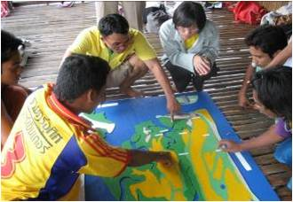
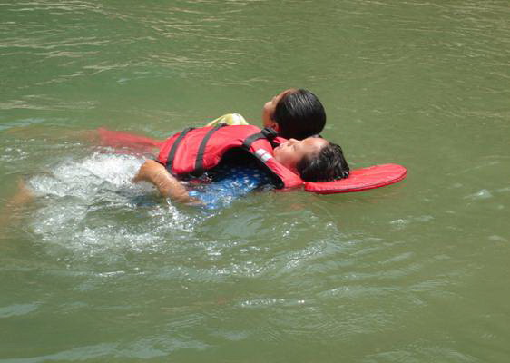
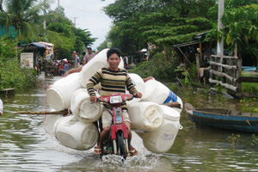
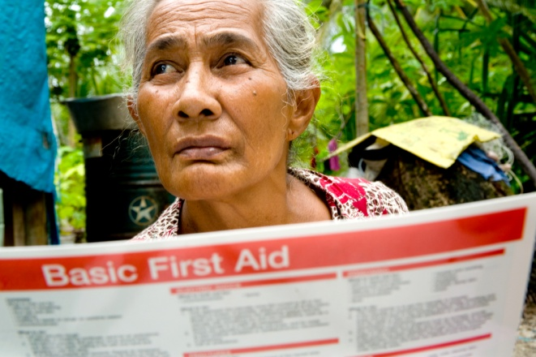
How to strengthen resilience?
PEOPLE FIRST: A people and community centred approach understands that resilience is not something we can do or bring to individuals or communities. Rather we can facilitate and assist individuals and their households and communities in their own efforts to strengthening their resilience.
LOCAL OWNERSHIP: Focus on building local ownership, assets and capacity, do not foster dependency or substitution.
COMPREHENSIVE APPROACH: Understand the diverse underlying causes of vulnerability and disaster and crisis risks simultaneously. This requires holistic assessments and interventions which take into account a variety of shocks and underlying causes of vulnerability. This doesn’t necessarily fit with a standardised sectoral way of working but requires increased cross-sectoral cooperation and partnerships in programme implementation as well as integration and openness to more tailor-made programming.
ACKNOWLEDGING INTERDEPENDENCIES: address underlying causes of vulnerability and prepare for and respond to disasters and crises throughout the overlapping phases of disaster management and linking closely to developmental programming.

Slide 13
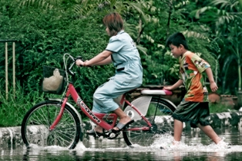
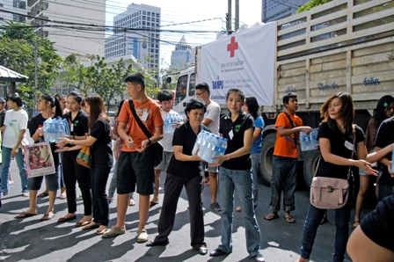
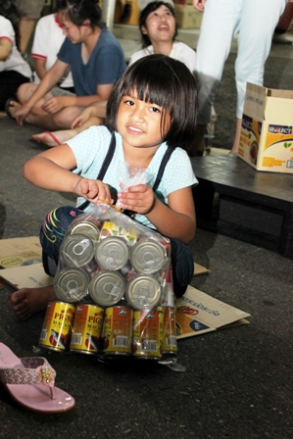
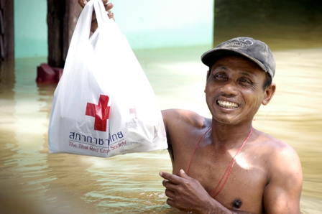
How to strengthen Resilience? Cont.…
LONG TERM PERSPECTIVE: Engage and invest in the long term.
WORKING IN PARTNERSHIP: Create and broker relevant partnerships or advocate for support especially in areas which are not in the core of Red Cross and Red Crescent expertise or mandate but relevant to the individuals and communities we work with. Resilient communities cannot be achieved solely with IFRC support. The Red Cross and Red Crescent needs to facilitate support from a range of stakeholders who contribute to strengthening and sustaining resilience.
KNOW THE LIMITS: Acknowledge that strengthening and sustaining resilience is not possible in all contexts at all times (e.g. due to access or resource issues). Even in these contexts ensure that the intervention is not undermining resilience and rather contributes (even if at small scale) towards resilience. Tools such as the Better Programming Initiative (BPI) may be useful in insecure context to facilitate resilience strengthening.

Slide 14
Regional Community Safety and Resilience Unit
Health
Disaster Management
Strenghtening Resilience
Through comprehensive and integrated approach mainly focusing on planning to reduce risks and strengthen capacities - development programs

Slide 15
Components for consideration
CBDRR
Risk Assessment, identification and establishment of CBEW and prediction
Advocacy, education and awareness raising
Strong auxiliary relationship with national and local government
Partnership with international, governmental, NGO and CBOs

Slide 16
Some practical ideas for Integrated programming….
Multi-sectoral assessments and community planning – Community Assessment Field School, use of participatory techniques/tools for community assessments and planning
Understand mutual interests and priorities; identify areas for integration in planning and implementation;
Agree on conceptual, operational models, share models/tools whenever applicable/possible
Joint action: planning, implementation, review and evaluation of activities/initiatives
Assembling indicators from both DM and Health that will translate the needs of communities and be easily measurable
Disaster
Management
Health

Slide 17
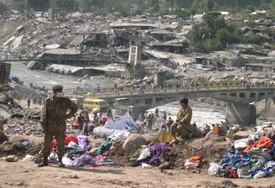
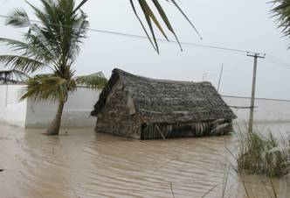
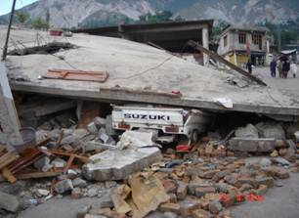
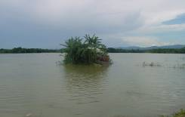
Community Focus – Issues for planning consideration
Local Ownership – involve communities, participatory approach
Replicability (within financial reach of local communities)
Maintenance (availability of materials, skills of beneficiaries to maintain/repair)
Replenishment (locally available and affordable)
Indigenous Knowledge (build on existing , add value on it)
Training (using qualified trainers, systematic training tools, manuals, refreshers, transferred and hosted knowledge )
Linkages with local Authorities/Auxiliary role (sustainability)

Slide 18

The importance of using the VCA as a process and starting point to identify which other complementary tools should then be used:
Use/adapt/integrate existing tools – Avoid re-inventing the wheel…..
CBHFA | CBDRR |  | PHAST
PASSA | Violence Prevention |  | PSP
Community Development |  | Livelihoods
with CCA integrated
NS relationship / dialogue
Building on existing capacities
Step by step and replication at scale –
Notes:
No particular order
1. Uses in-country adaptation of the tools
Generally, we work with the NS to understand what will better
enable and support them to see the communities they work with
stronger, healthier, more resilient – this includes promoting more
technically integrated programming – it’s a dialogue out of relationship
A recognition that perfection is difficult to attain across the whole
range of a NS’ branches but that need to move step by step in
helping them improve conceptual understanding and related practical
implementation processes and doing so across the whole of the NS
organisation

Slide 19
Integrated planning: DM and HEALTH – more suggestion for further discussion…..
  Strengthening the emergency preparedness, planning capacities and response to disasters/shocks
  Identification of risks from hazards and assessment of community vulnerabilities
  Improving preparedness for response such as development of evacuation plans or improving epidemic preparedness and response mechanisms at community levels
  Promoting better integration of risk reduction activities across health and other sectors – strengthening coordination mechanisms (both preparedness and response)

Slide 20
Thank
You!

