Slide 1

ASEAN Regional Mechanism for Disaster Management
Said Faisal
Executive Director
ASEAN Coordinating Centre for Humanitarian Assistance on disaster management (AHA Centre )

Slide 2
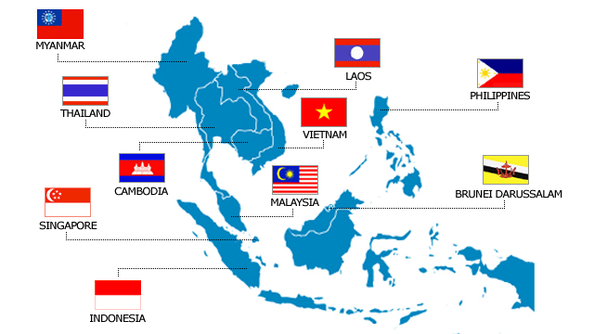


The Association of Southeast Asian Nations (ASEAN) consists of 10 countries with nearly 600 million people . Every year, on average, the ASEAN region experiences losses related to natural disasters estimated at US$ 4.6 billion *
59,534,300 people
676,577km2
5,922,100 people
236,800km2
92,226,600 people
300,000 km2
LAO PDR
66,903,000 people
513,120km2
86,024,600 people
331,051km2
14,957,800 people
181,035km2
406,200 people
5.765km2
28,3006,700 people
330,252km2
4,987,600 people
710km2
231,369,500 people
1,860,360km2
* Source: Advancing Disaster Risk Financing and Insurance in ASEAN Countries, World Bank, GFDRR, ASEAN , and UNIISDR
Connecting ASEAN for Disaster Readiness

Slide 3
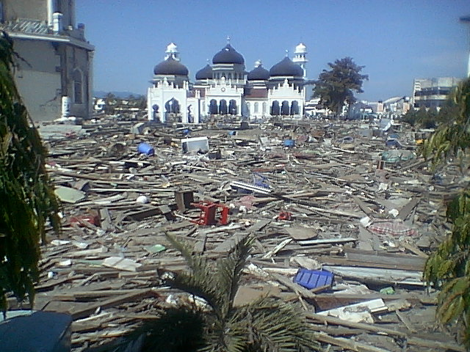
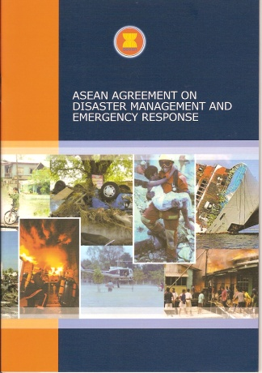
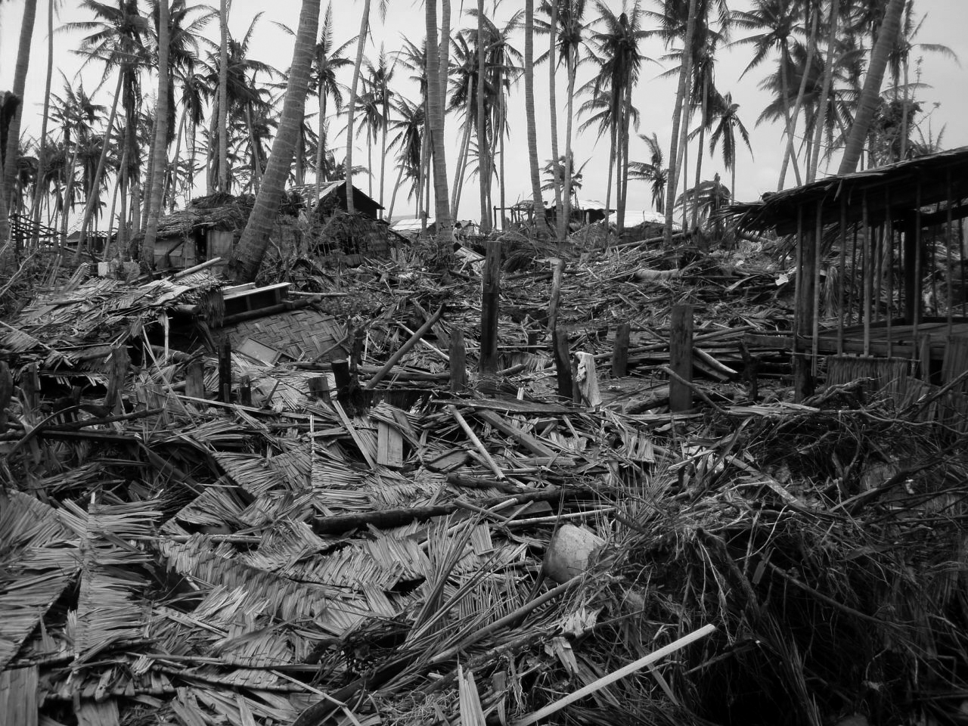
The two MEGA DISASTERS in ASEAN …
Providing the momentum for the development of an ASEAN Agreement on Disaster Management and Emergency Response (AADMER)
2004 Indian Ocean Tsunami
Testing ASEAN’s solidarity and relevance as a regional grouping
2008 Cyclone Nargis

Slide 4

To have a more united and coordinated responses toward disaster within the region , ASEAN FOREIGN MINISTERS signed AADMER on 26 July 2005
A legal framework for all ASEAN member states and serves as a common platform in responding to disasters within the ASEAN
Objective: Reducing disaster losses in ASEAN countries, and jointly respond to disaster emergencies
A comprehensive agreement that covers various aspects of Disaster Management such as Disaster Risk Identification, Assessment, Prevention, Mitigation, Preparedness, Emergency Response, Rehabilitation, Scientific Research, Coordination and others .
Entered into force in December 2009
Connecting ASEAN for Disaster Readiness

Slide 5
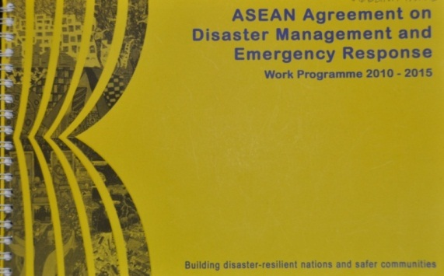
To translates the intent and spirit of AADMER into a comprehensive and holistic action plan for the period 2010 to 2015, a Work Programme was developed
Aims of AADMER Work Programme
Improve the capacities of ASEAN for effective and efficient regional early warning and monitoring, preparedness, emergency response, and disaster risk reduction in the region
Enhance humanitarian and emergency response
Strengthen technical and institutional capacity of member states
Assist Member States and promote regional collaboration in mainstreaming, formulating and implementing disaster risk reduction
Foster closer partnerships and more collaborative initiatives with relevant partners
Support community –based approaches in disaster management and enhance disaster consciousness of the peoples of ASEAN
Components of AADMER Work Programme 22010-2015
Introduction and Guiding Principle
Risk Assessment,
Monitoring and
Early Warning
Prevention
and Mitigation
Thematic Pillars/
strategic
components
Preparedness and
Response
Recovery and
Rehabilitation
Institutionalization of AADMER
Partnership
CROSS-CUTTING
ELEMENTS
Resource Mobilisation
Information Management and Comm. Tech.
Outreach and mainstreaming
Training and Knowledge Management
Monitoring and Evaluation
Connecting ASEAN for Disaster Readiness

Slide 6
For the past 2 years, ASEAN Member States have made a lot of effort for the Establishment of ASEAN Coordinating Centre for humanitarian assistance on disaster management (AHA CENTRE) as the operational engine of AADMER
The AHA centre shall be established for the purpose of facilitating co-operation and co-ordination among the parties, and with relevant United Nations and international organizations, in promoting regional collaboration
(AADMER article 20.1)
The AHA Centre shall work on the basis that the Party will act first to manage and respond to disasters. In the event that the Party requires assistance to cope with such situation, in addition to direct request to any Assisting Entity, it may seek assistance from the AHA centre to facilitate such request (AADMER article 20.2)
Connecting ASEAN for Disaster Readiness

Slide 7
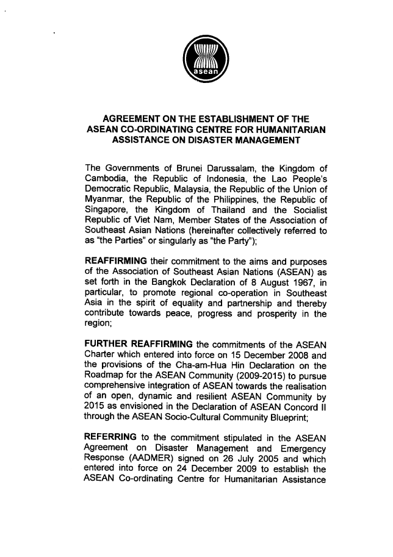
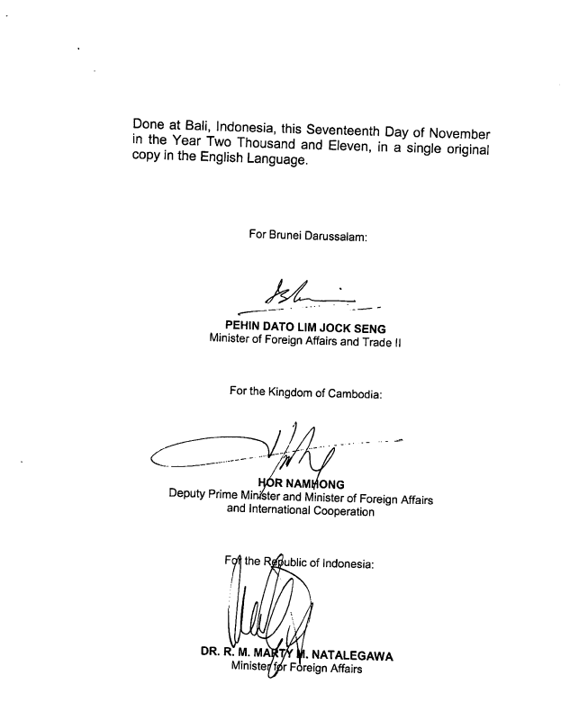
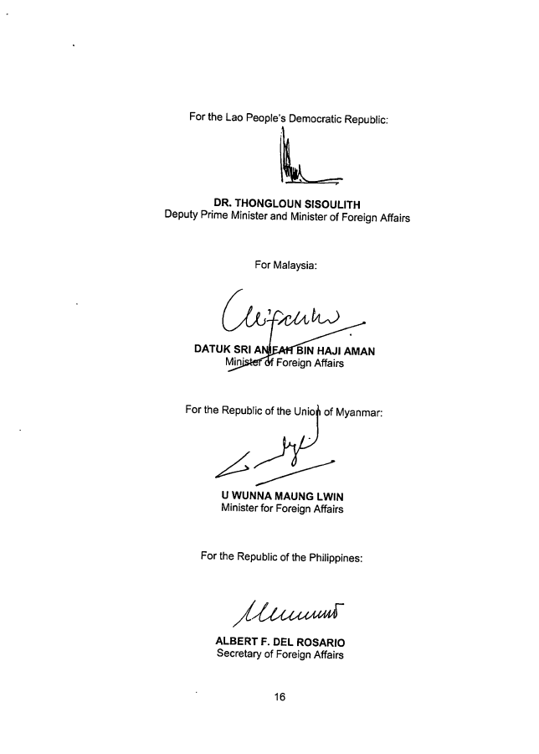
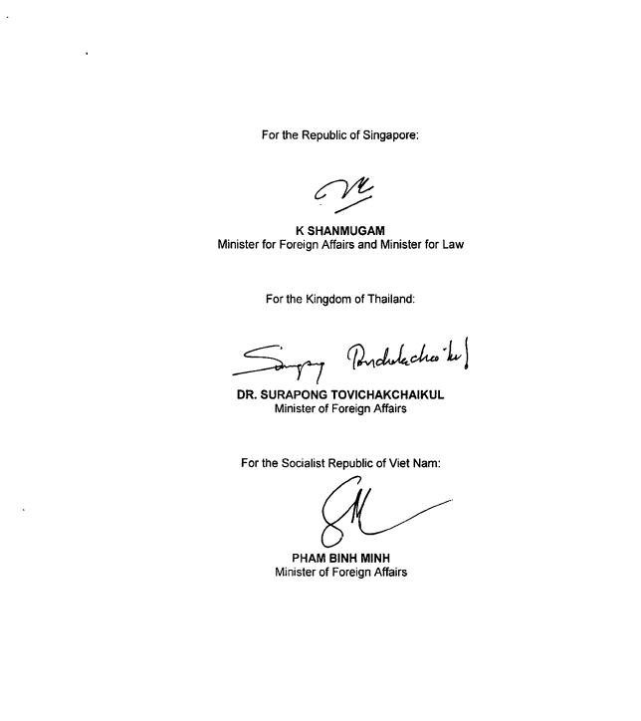
At the 19th of ASEAN Summit, witnessed by all of ASEAN Head of States, the agreement on the establishment of AHA Centre was signed by ASEAN Foreign Ministers on 17 November 2011, in Bali Indonesia

Slide 8

and also officially launched at the 19th ASEAN SUMMIT…
“We welcome with satisfaction the signing of the Agreement on the Establishment of the ASEAN Coordinating Centre for Humanitarian Assistance on disaster management (AHA Centre) by our Foreign Ministers on the sidelines of the 19th ASEAN Summit. We further welcome the official launch of the AHA Centre on 17 November 2011 as a mechanism in facilitating cooperation and coordination among the ASEAN Member States and with relevant United Nations agencies and international organizations to promote regional collaboration.
(Chairman’s statement of the 19th ASEAN summit, Bali, Indonesia 17 November 2011)

Slide 9
...And appreciate the support from asean Dialogue partners as well as encourage the commitment and contribution from ASEAN Member States as well as our Dialogue Partners to ensure the full operationalisation of the AHA Centre
We appreciate the contribution by the Indonesian Government as well as our Dialogue Partners, including Australia, Japan, New Zealand and the United States of America, and welcome the incoming support from the European and other dialogue and external partners in the establishment of the AHA Centre. We encourage the commitment and contribution from ASEAN Member States as well as our Dialogue Partners to ensure the full operationalisation and to strengthen the capacity of the AHA Centre
(Chairman’s statement of the 19th ASEAN summit, Bali, Indonesia 17 November 2011)

Slide 10
THE FUNCTIONS OF THE AHA CENTRE IN GENERAL ARE MANAGING INFORMATION/DATA AND FACILITATING COOPERATION AND COORDINATION AMONG RELEVANT PARTIES
Receive and consolidate data as analyzed by and recommendation on risk level from National Focal point
Disseminate to each party through it through its National Focal Point, the analysed data and risk level arising from the identified hazards
Conduct analysis on possible regional-level implications
Risk Identification and Monitoring
Receive information regarding available resources for the regional standby arrangements for disaster relief and emergency response.
Facilitate the establishment, maintenance and periodical review of regional standby arrangements for disaster relief and emergency response
Facilitate periodic review of regional standard operating procedures
Receive data on earmarked assets and capacities which may be available for the regional standby arrangements for disaster relief and emergency response as communicated by each Party, and their updates
Consolidate, update and disseminate the data on such earmarked assets and capacities, and communicate with the Parties for their utilisation
ASEAN Standby Arrangement

Slide 11
THE FUNCTIONS OF THE AHA CENTRE IN GENERAL ARE MANAGING INFORMATION/DATA AND FACILITATING COOPERATION AND COORDINATION AMONG RELEVANT PARTIES
Receive information on measures taken by the Parties to mobilise equipment, facilities, materials, human and financial resources required to respond to disasters
Facilitate joint emergency response
Where appropriate, facilitate the processing of exemptions and facilities in respect of the provision of assistance
Where possible and appropriate, facilitate the processing of transit of personnel, equipment, facilities and materials in respect of the provisions of assistance
Emergency Response
Facilitate activities for technical co-operation
Facilitate activities for scientific and technical research
Receive from each Party information on designated NFP and Competent Authorities and any subsequent changes in their designations
Regularly and expeditiously provide to the Parties and, as necessary, to relevant international organisations, information about NFPs and CAs
Cooperation and collaboration

Slide 12
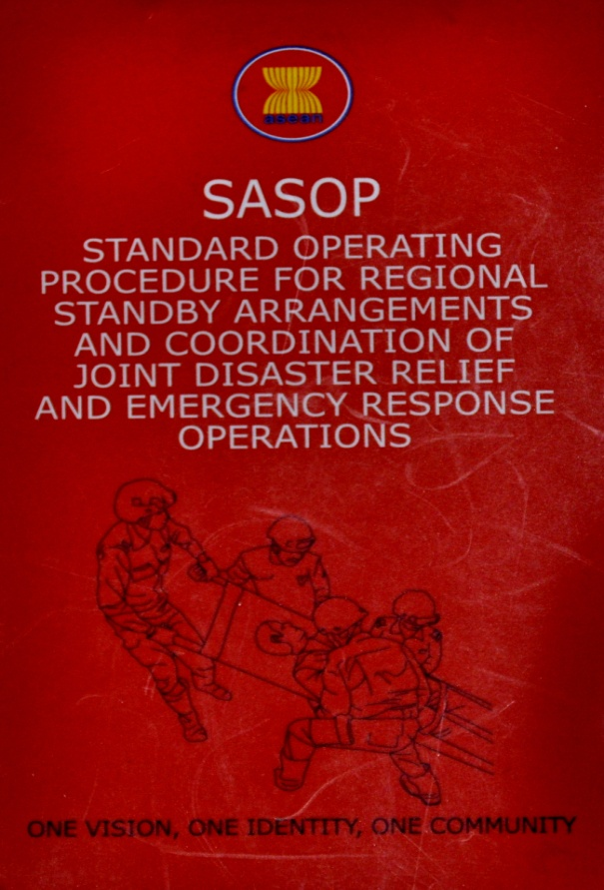
AADMER also requires the preparation on effective Standard Operating Procedure for Regional Standby Arrangements and coordination of joint disaster relief and emergency response operation (SASOP)
Guides and templates to initiate the establishment of the ASEAN Standby Arrangements for Disaster Relief and Emergency Response,
Procedures for joint disaster relief and emergency response operations
Procedures for the facilitation and utilization of military and civilian assets and capacities, (personnel, transportation and communication equipment, facilities, good and services, and the facilitation of their trans-boundary movement)
Methodology for the periodic conduct of the ASEAN regional disaster emergency response simulation exercises (ARDEX) which shall test the effectiveness of this procedures
Connecting ASEAN for Disaster Readiness

Slide 13
And.. The AHA CENTRE IS ALSO TASKED TO PERFORM MOST OF THE ASPECTS UNDER SASOP
REQUEST FOR ASSISTANCE
The AHA Centre to forward the request to other party/entity
The AHA Centre will explore other possible assistance
DISASTER SITUATION UPDATE
The AHA Centre to receive report within 24 to 48 hours of arrival of assistance at disaster site
DEMOBILISATION OF ASSISTANCE AND REPORTING
The AHA Centre to receive and update of this development
The AHA Centre to be received within 2 weeks of departure from the affected country
NOTIFICATION OF DISASTER AND SITUATION UPDATE
The AHA Centre to analyze the initial report and notify other Party/Entity of the disaster
The AHA Centre to analyze each situation Report and immediately notify the other party /entity of the significant developments (a) periodically or (b) by 10:00 am (Jakarta time)
OFFER OF ASSISTANCE
The AHA centre to forward the offer to the receiving Party
AHA
Centre
Joint Assessment of required Assistance
The AHA Centre to facilitate mobilization of ERAT
The AHA Centre to receive updates on any plans and findings of joint assessment
The AHA Centre to receive copy of the Contractual Agreement for Assistance
MOBILISATION OF ASSETS AND CAPACITIES
The AHA Centre to facilitate the processing of exemption for provision of assistance and facilities , transit of personnel and equipment
Connecting ASEAN for Disaster Readiness

Slide 14
TOGEtHER.. WE HAVE Achieved SIGINIFICANT progress IN 2011
1
Agreement on the Establishment of AHA Centre signed by ASEAN Ministers and witnessed by all of ASEAN Head of States, 17th November 2011, Bali.
Office and operation Centre of AHA Centre fully renovated
ICT infrastructure ( Hardware and Software) for operation centre fully installed and operational
AHA Centre Strategic Work Plan available and adopted by ACDM
Mechanism to address financial and operational gap has been addressed by ACDM including decision for ACDM to be the Governing Board of AHA Centre Organizational structure and number of key personnel approved by ACDM
Ability to operate disaster monitoring function for several disaster situations in the region.
And continued support from Dialogue Partners such as Government of Japan, New Zealand, USA, Australia, and European Union
2
3
Milestones
2011
Thanks for your great support !!
4
5
6
7

Slide 15
organizational structure of AHA Centre
Conference of Parties of AADMER
Secretary General of ASEAN as Humanitarian Assistance Coordinator
Governing Board
Executive Director
Consultant, Advisor, Technical Assistant
Head Of
Operations Division
Head of
Corporate & Program
Preparedness & Response
Disaster Monitoring & Analysis
Administration and Finance
Information, Communication & Technology
Program Officer(s)

Slide 16
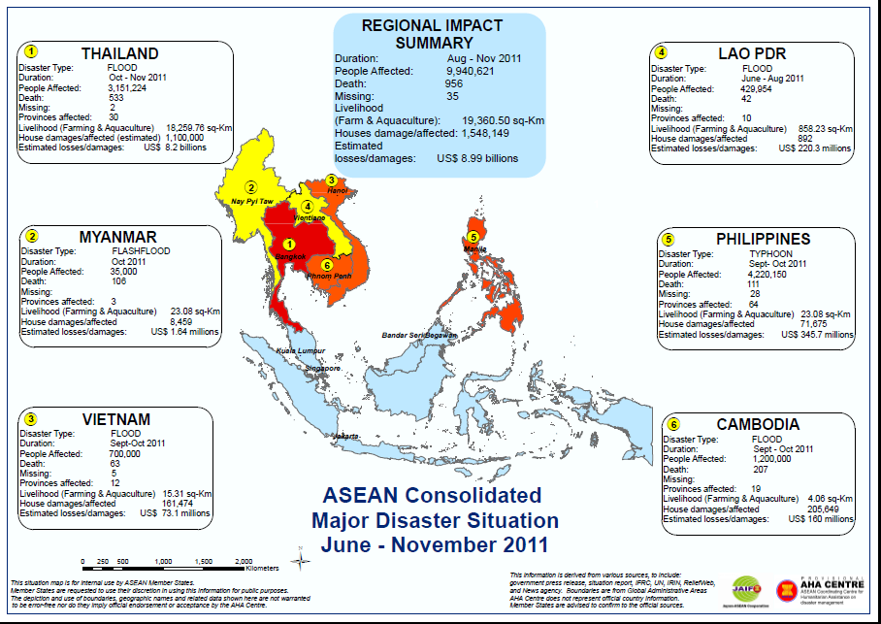
Disaster risk monitoring

Slide 17
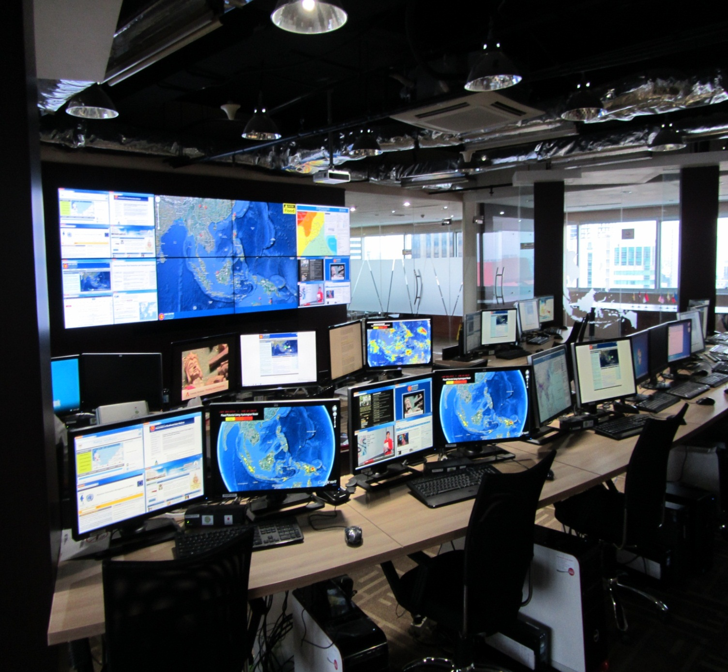
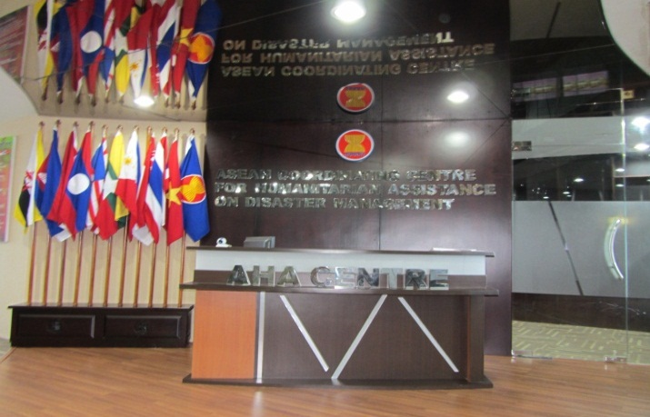
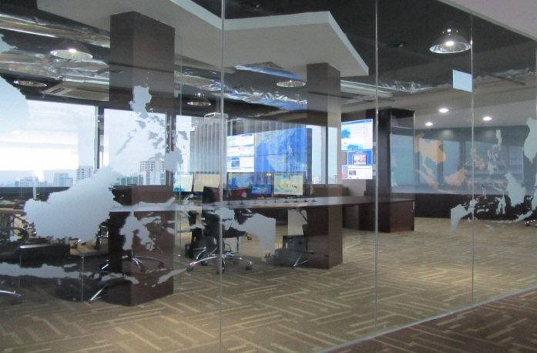
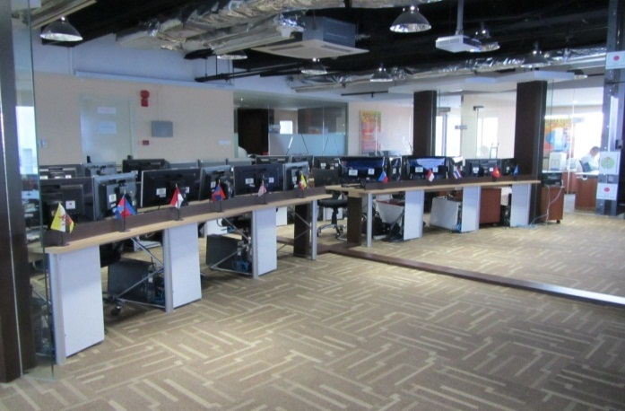
Current Office and Operation Centre of AHA Centre

Slide 18
But… challenges remain…
1
2
3
Limited personnel to implement Strategic Work Plan
Budget for AHA Centre is still work in progress
Limited capacity on the area of Preparedness and Response
4
5
Awareness of AHA Centre is still considered low for ASEAN as well as for international community
As a new organization.. all necessary rules, procedures, regulations, SOP, manuals .. need to be developed
Limited connectivity with ASEAN Member States

Slide 19
Moving forward.. AHA Centre will focus on the following
1
Recruitment of personnel/Expert/ consultants with operational and technical capacity
Finalizing organizational rules, regulations ( Admin, finance , staff ) and operational Standard Operating Procedures
Establishing connection with ASEAN Member States
Working closely with ASEAN Secretariat in the delivery and implementation of key projects:
    JAIF -ICT Phase 2-Connevtivity
    JAIF – Stockpile
    US-TATF - Disaster Monitoring Response System, and Standby Arrangement database
    AUSAID support to AHA Centre
    ASEAN-EU Partnership – Knowledge sharing, capacity building
    New Zealand support to AHA Centre
Awareness building of AHA Centre to ASEAN Member States, Dialogue partners and International Organizations
Exploring possibilities for additional support from existing and new Dialogue Partners
Implementation of other activities as stated in the AHA Centre Strategic Work Plan particularly in the area of preparedness and response
2
3
4
5
6
7

Slide 20

In the long run.. more things are need to done and more cooperation and partnerships will need to be established
Institutional Set Up
Institutional Strengthening
Institutional Stability
Up to 2011-2012
2012 to 2015 and possibly beyond
Review performance, functions and operation
Set new vision for the next level
Agreement signed
Governing board is in place
Agreed contribution released and made available by Member States to AHA Centre
Staff of AHA centre recruited and in place
Office and Supporting facilities are available
Work Plan,Procedures, Manual, Guidelines are available
Capacity building for AHA centre
Strengthening connection with Member States
Establishing partnership with similar regional organization to shorten learning curve
Awareness building at regional and international level
Continuous partnership with donors and partners
Testing procedures and improve accordingly

Slide 21
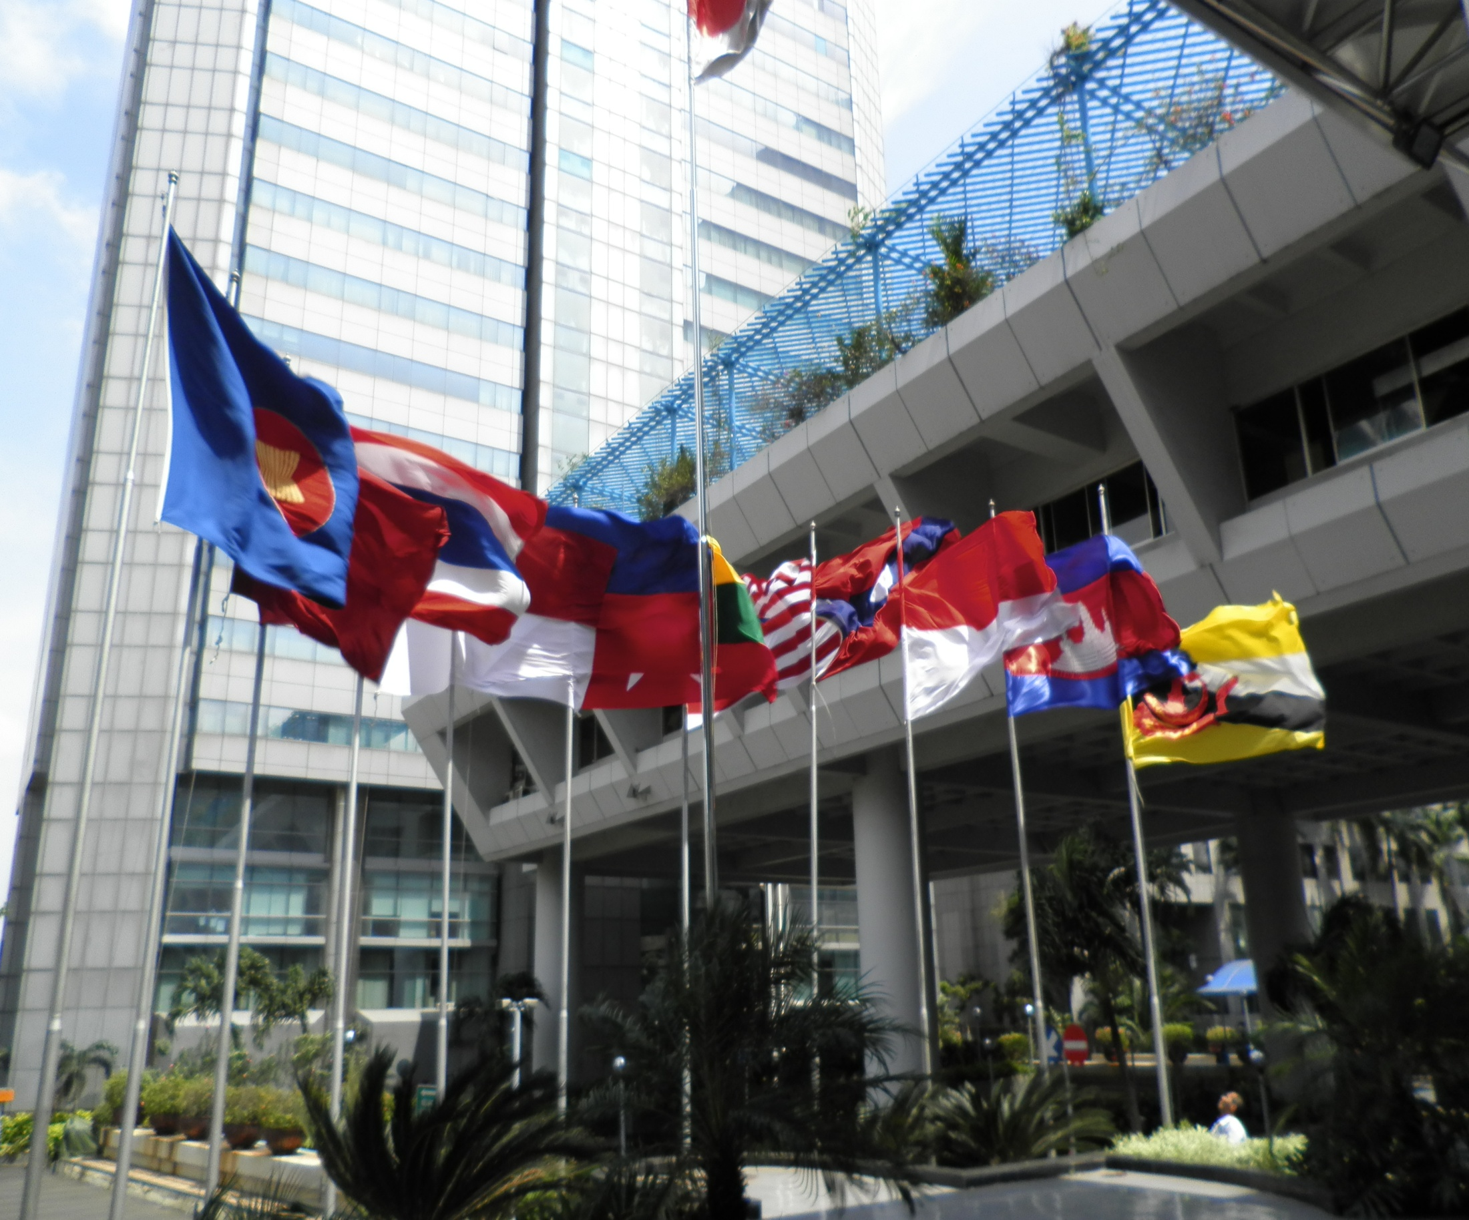
AHA CENTRE
Gedung I BPPT, LT17,
JL MH Thamrin No 8 Jakarta 10340, Indonesia
www.ahacentre.org
THANK YOU

