Slide 1
SEA Regional Community Safety and Resilience Forum Sept 2014
Asia Pacific Zone Disaster Management

Slide 2
DM Agenda 2014
October Beijing AP Regional Conference
Regional Cooperation .
SEA Leaders
New ”DM/Resilience”Strategy 2015/2018
January 2014
February
March
April
May
June
July
August
September
2013
December
DM Reference Group Meeting in KL
Civil Military Forum - KL
6th AM CDRR Bangkok
Urban DM
Workshop Maniia
DM and Innovation
Forum
DM Reference Group Concept Note
Regional DRR meeting Pacific-
IFRC Resilinece Forum -Colombia...
3rd IC SIDS - Samoa
World Urban Forum UN Habitat - Colombia
AP RDRT Field School
Iran - TBC
OCHA
CM Coord Course
Asia TBD
Second
DM Reference Group Meeting
OCHA
CM Coord Course Suva - Fiji
Activity organized by DMU
Activity Organized by SEA RD
Activity organized by IFRC/GVA
Activity organized by UN System
Activity IFRC is Co-Organizer.

Slide 3
The DM Reference Group Identified the following strategic priorities
Civil and Military Relations
The 6th Asia Ministerial Conference on DRR - Work with regional DRR and resilience
Urban Risks
Innovative approaches to DM
(RMS, TERA system, Mega 5 and ODK)

Slide 4
Civil Military Relations (CMR)
Civil Military Relations forum in KL in May 2014 with:
16 National Societies from Asia Pacific Zone, 3 PNS, 4 HoRD, 2 IFRC CMR FC, ICRC, Armed forces (New Zealand, Royal Thai and Malaysian), OCHA, the Australian Civil Military Centre and World Vision International.
Forum report includes road map recommendations of the National Societies
Workshop at the AP Regional conference in Beijing: Understand Civil Military Relations during Natural Disasters

Slide 5
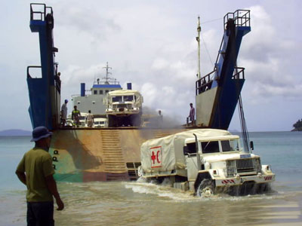
Scenarios with the military and IFRC
Under certain circumstances, due to the scale and the complexity of disasters in country, involvement of military (and/or civil defence) forces in humanitarian operations becomes inevitable.
Natural disaster (counterparts within the Movement: IFRC, NS)
Nepal floods
Complex emergency (counterparts within the Movement: ICRC, IFRC, NS)
- Haiti earthquake, Pakistan floods and Philippines typhoon
Armed conflict (counterparts within the Movement: IFRC, ICRC, NS)
- Afghanistan floods
Notes:
Dependent on the LEVEL of the disaster the national government may request additional support from regional partners or the wider international community. In such cases this may result in the deployment of international military assets. The level of this support and the assets deployed will be dependent on the needs and request for support. similar to the national response such support may involve simply logistics support assets, through to engagement in rescue and humanitarian work, to the provision of security forces as was the case in the Haiti earthquake in 2010 and as it is the case in the Philippines.

Slide 6
Civil Military Relations Priorities to support National Societies
Ensure the promotion and operationalization of existing policy on CMR within the RCRCM.
Promote understanding of the different operational contexts in which NS work and how CMR features in their work.
Pursue a common approach to CMR that is consistent with the Movement’s principles.
Engage with external partners to maintain an open and ongoing constructive dialogue, including participation during simulations and exercises.

Slide 7
Urban DM Workshop Objective
To address urban Disaster Management issues - with a progressive, strategic and operational approach to urban preparedness, response and recovery.
Notes:
In order to do this, we are bringing together:
Representatives from 15 National Societies from Asia-Pacific
in addition to Partner National Societies, the IFRC, the ICRC,
a range of representatives from Government authorities, UN, NGOs, academic and private institutions.
This will take the form of developing a range of ‘key messages’ – which I will discuss shortly.

Slide 8
Outcomes of the Urban DM Workshop
Increase knowledge on emerging urban Disaster Management issues & sharing of National Societies good practice.
Provide ideas for the directions of future strategic work – including a framework for the Asia Pacific zone on urban DM.
Identify needs and opportunities for innovative approaches to urban Disaster Management.

Slide 9
Outcomes of the Urban DM Workshop (contd)
Provide Inputs to RCRC Asia Pacific conference in Beijing, October 2014.
Provide inputs to the IFRC Global Approach and Guidelines on urban Disaster Risk Reduction and urban Disaster Management
Provide informed discussion on operational tools and services within the RCRC.
Notes:
In addition to:
5. Provide inputs to the IFRC Global Approach and Guidelines on urban Disaster Risk Reduction and urban Disaster Management
6. Provide informed discussion on operational tools and services within the RCRC. Note: A good example is the guideline for vulnerability and capacity assessments. These guidelines have quite recently been updated by adding on two new chapters: one for urban context and one for how to include climate change issues.

Slide 10
Urban DM Workshop Themes and Key Messages
Contingency Planning in urban contexts
Urban Volunteer Management
Cash Transfer Programming
Urban Risk Assessment
Disaster Law in urban contexts
Violence in urban contexts
Engaging with multiple stakeholders
Environment and climate change
Lessons learnt from the Haiyan response

Slide 11
Innovation Coordinator: Ben Comms & RMS
Beneficiary Communication is the development and implementation of processes that allow us to engage more effectively with individuals and communities.
BC uses both traditional and high tech methods to open up channels of communication, to interact with the beneficiaries and to identify areas of improvement in accountability and beneficiary satisfaction.
In Asia Pacific the following NSs are implementing Beneficiary Communication (Pakistan, Nepal, Sri Lanka, Indonesia, Myanmar, Bangladesh) and others are preparing proposals to work on BC.

Slide 12
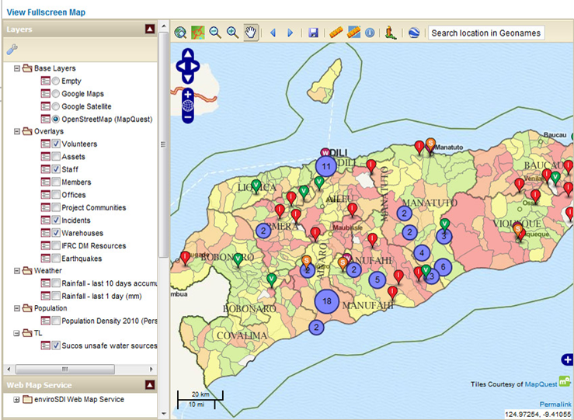
Resource Management System (RMS)
RMS is an integrated and web-based system which manages staff, volunteers, membership, warehousing and assets with geographical mapping (GIS), project tracking and vulnerability tracking features for national society and secretariat staff.
Notes:
RMS is an integrated and web-based system which manages staff, volunteers, membership, warehousing and assets with geographical mapping (GIS), project tracking and vulnerability tracking features for national society and secretariat staff. RMS enables national societies to view and analyse hazards and vulnerabilities together with their material and human resources such as volunteers, staff, offices and warehouses on a digital map to examine how well its people and resources are positioned to make a difference to the lives of vulnerable communities that suffer from natural disasters and longer-term development challenges.
Geographical Information System. The merge of cartography with statistical analysis, ex flood risk, safe water sources or other health/DM related data.

Slide 13
Purpose of RMS
RMS has been built for mainly the three following purposes:
Supporting daily management of human and material resources
Supporting long-term programming
Supporting response operations
RMS is not an IT project but a programme support tool and an OD process. Therefore the ownership of the system and information managed with it should reside in programme departments and not in the IT department

Slide 14
Benefits of RMS
Supports integrated program planning (e.g. Health, DM, WatSan, Logistics...)
Helps to prepare for and respond to disasters
Easier and faster access to resource information → saves time
Easier to share information
Information is backed up daily, no loss of data
No additional costs to national societies
Development of new features is guided on national societies’ needs and requests
Notes:
There is one central RMS server in Singapore that will be used by all the national societies that implement RMS. It is hosted in a very powerful cloud so in case there are suddenly lots of new users the system will still be able to work effectively and fast.

Slide 15
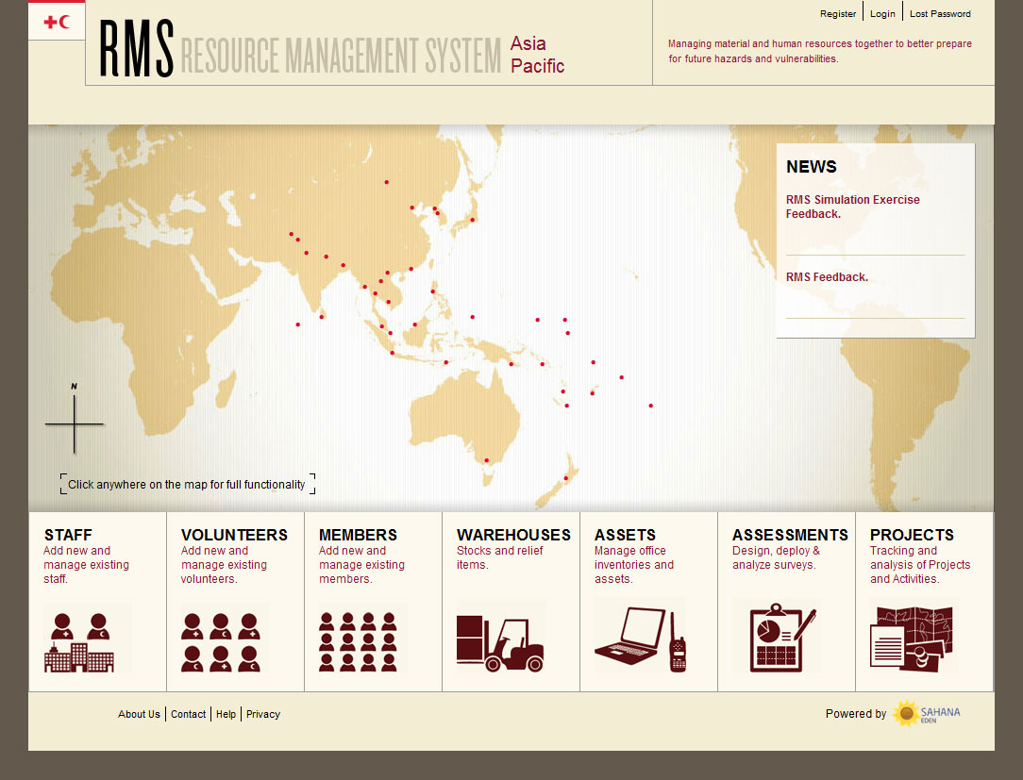
Notes:
In addition to resource management, there are two other modules that can be accessed from RMS:
Assessments and
Projects.
In assessments, users are able to add new field assessments through their web browsers or batch import assessments added to Excel spreadsheets. Place of assessments together with its accompanying information can be tagged on map.
Projects provides possibility to save and track key project information like the location, amount of beneficiaries reached, donor, funding, etc. It is not however a project management tool nor will become one. Rather one is able to see where different projects are run at and find and extract key information for e.g. reporting purposes.

Slide 16
RMS Current Status and Way Forward
Long-term commitment of IFRC to fund the development and maintenance of RMS
15 NS in AP Zone has signed agreement and begin implementation of RMS and several other NS are interested on implementing RMS.
AP WASH team is utilizing RMS for mapping Emergency WatSan resources in the zone.
Africa Zone is using RMS for its RDRT deployment management system.
American Zone : Peruvian RC is in progress of implementing RMS.
MENA Zone have already nominate a focal point for RMS implementation within the zone.
Notes:
NS signed/implemented RMS: Timor-Leste ,Philippines, China ,Maldives ,Viet Nam ,Myanmar ,Nepal ,Bangladesh ,Afghanistan ,Pakistan ,Malaysia ,Micronesia ,Fiji ,Australia and Mongolia.
Additionally Asia Pacific zone is supporting the global roll out of RMS, providing access to software development and ensuring the integrity and system operations.
****
AP Wash Mapping Project:
The primary objective of the mapping project has thus been to collect, collate and validate records of Emergency WatSan resources in the zone – with an initial focus on SE Asian National Societies, due to the greater frequency of emergency responses in the region, and the relative ease of travel in the area. The validated records would subsequently be imported to RMS, with the anticipation that the respective National Societies would subsequently take ownership of the data.
****

Slide 17
Disaster Response Preparedness Capacity
DM Coordinator in the Zone Office
Contingency Planning
Pre-disaster Meetings
Roll-out of Principles and Rules and Movement Framework
RDRT development
(as recommended in regional NS meeting Feb 2014)

Slide 18
Regional Disaster Response Teams (RDRT)
RDRT is part of an ongoing discussion among NSs in the region that have ambition to strengthen regional cooperation. Some ideas…
Common zone roster using RMS
Zone-wide induction and refresher training
Global minimum (common) mandate and induction training curriculum
Generic ToR defining scope of delivery and reporting lines
Surveys to technical level on appreciation of RDRT concept
Advocacy towards senior management and governance

Slide 19
Thank you for your kind attention!
For any questions, suggestions or complaints, please contact:
Nelson Castano, Head of DMU, APZ
Email: nelson.castano@ifrc.org
Mobile: +6012-234-6591

