Slide 1


Red Cross Red Crescent
South East Asia Youth Network (SEAYN)
By: Mohammad Zaidi
Co-Chair SEAYN
Youth Volunteer at Singapore Red Cross Society

Slide 2
Outline
SEA Youths and Volunteers
Youth role from Junior to Youth in RC
Regional Youth activities- SEAYN functions
Interesting actions - Youth Empowerment
Youth Voice-in WCDRR, AMCDRR, RC Youth Statements inclusion in DRR framework
Conclusion with a Video “Youth on the move”

Slide 3
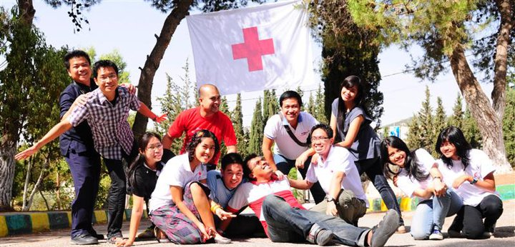
1. SEA Youths and Volunteers
Approximately 630 million people
282 million are children and youths under the age of 25 years
  Around 45 per cent
50 per cent of them are Red Cross Red Crescent (RCRC) youth volunteers

Slide 4

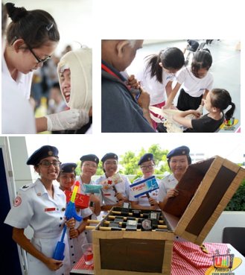
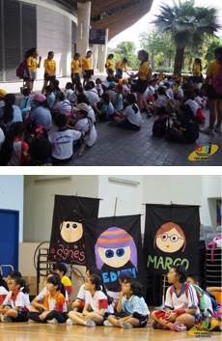
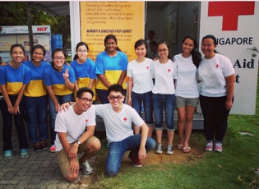
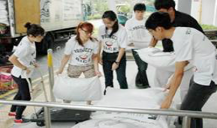
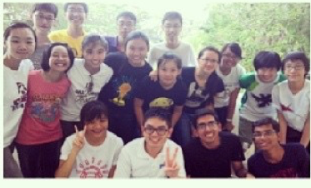
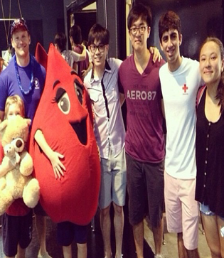
2. Youth role from Junior to Youth in RC
Singapore Red Cross Youth
Youth activities in Junior and Senior in programmes

Slide 5
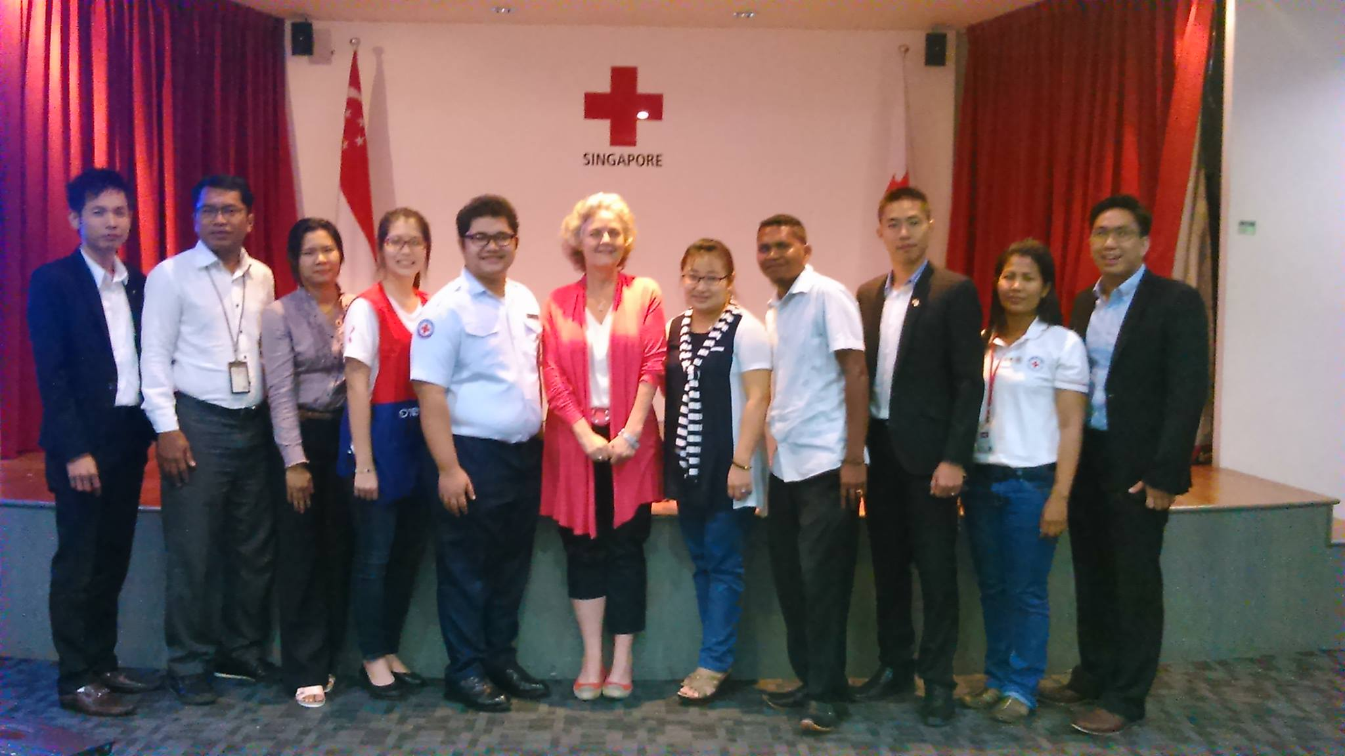
3. Regional Youth activities
- SEAYN functions
Coordination Team
  Indonesia (PMI), Lao (LRC), Philippines(PRC), 3 youth leaders (APYN SEA)
2 months basis online meeting
Activity updates: According to each team’s preparations

Slide 6
3. Regional Youth activities
- SEAYN functions
No | 4 Key Actions | Hosting National Society | CT responsible
1 | Youth champion on social media including IT initiative and advocate about SEAYN activities and best practices through webpage Newsletter, E newsletter | SEAYN | APYN SEA
2 | Healthy school safety programme, initiated and strengthened | PMI, PRC, CVTL | PMI
3 | Youth Empowerment Project (YABC) initiatives and implementation | CRC, SRC, Myanmar RC | PRC
4 | Peer support and youth exchange facilitation through events, conferences, networking, English communication skill training National Network Establishment | SRC, LRC, CRC, Myanmar, CVTL, TRC | LRC

Slide 7
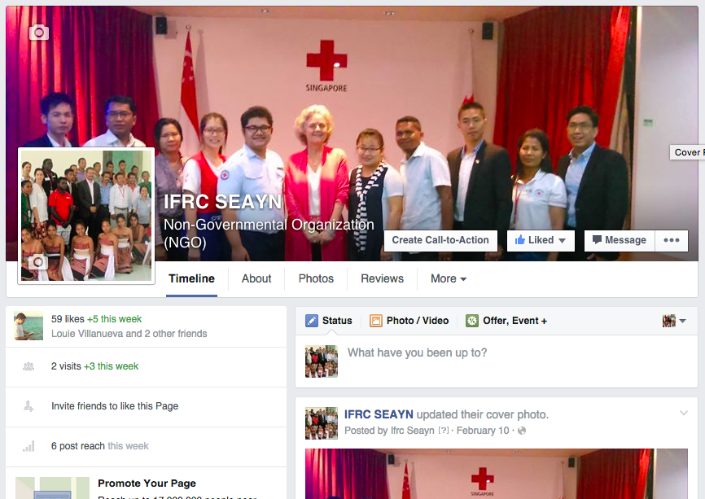
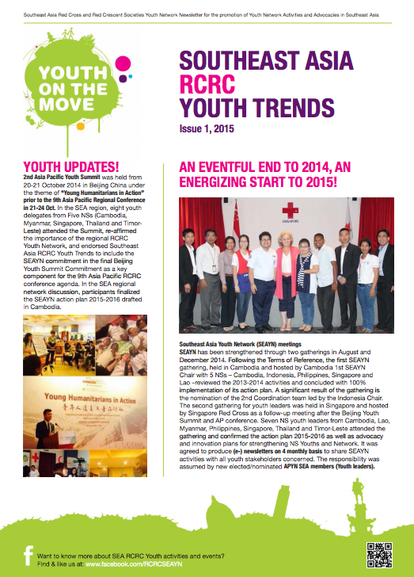
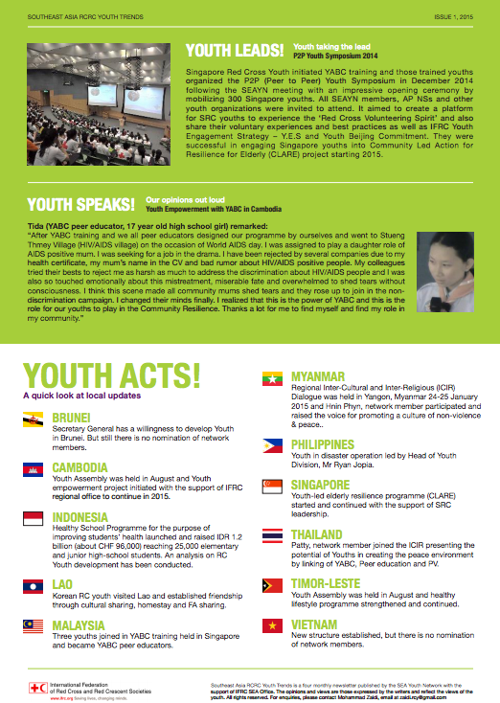
3. Regional Youth activities
- SEAYN functions
Every 4 months newsletter
Facebook social media
AP zone youth activities – APYN connection

Slide 8
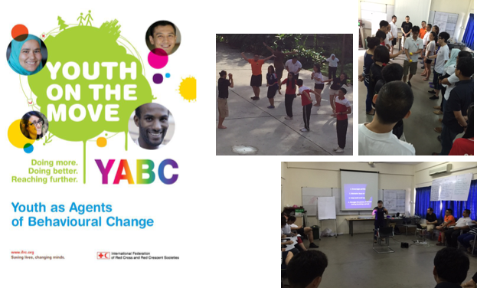
4. Interesting actions - Youth Empowerment
Youth as Agent of
Behavioral Change
(YABC)
  Understanding oneself
  Internalizing Values
  Taking Actions
  Creating the positive change
  in their community
Integration into DRR, Health, School based programme and Youth development activities (Cambodia-2014, Singapore-2014, Myanmar-2015)

Slide 9
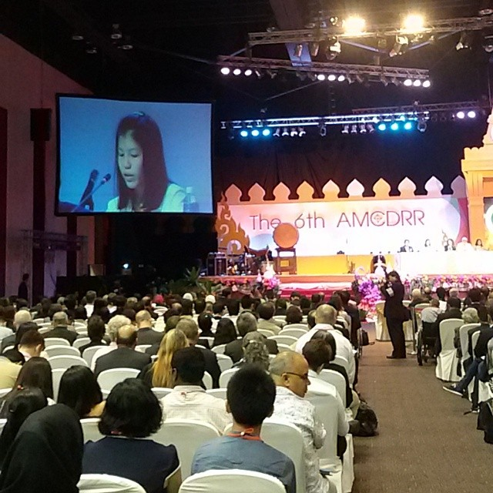
5. Youth Voice-in WCDRR, AMCDRR, RC Youth Statements inclusion in DRR framework
SEA RC youths delegates joining in:
  6th Asian Ministerial Conference on Disaster Risk Reduction
    22 to 26 June 2014, Bangkok, Thailand
    15 Thai RC youth volunteers and 2 Nepal RC participated
  3rd World Conference on Disaster Risk Reduction
    11 Youth delegates from 9 national societies
The Thai Red Cross Youth Volunteer reading out Children and Youth Statement on behalf of Stakeholders’ Group in the Final Plenary session during the 6th AMCDRR

Slide 10
5. Youth Voice-RC Youth Statements inclusion in DRR framework
As young people, we need to practice our leadership, have access to information, and be engaged at all levels of the National Society’s work. Youth engagement in the DRR must go beyond the implementation of activities; otherwise the potential of youth is untapped.
As young people, we connect with our peers easily and can therefore become effective advocates for the RCRC approaches in the DRR on the global and regional level while banking on existing or facilitating new partnerships with the Youth-led organisations, governments, and other RCRC partners. We are the best advocates for the DRR education in schools and university curricula!
As young people, we see the world interconnected and youth engagement in technical areas such as DRR need to be recognised as a cross-cutting phenomenon. You as the National Societies and the IFRC respected senior leaders can request the existing structures to amend their approaches and recognise young people as partners in creating a better world. Together, we can change the culture of working in technical youth/health/DRR/governance silos. Real life is complex and our technical experts have to think holistically.

Slide 11
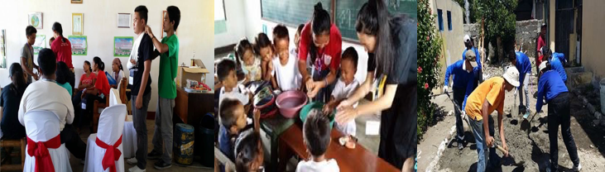
6. Conclusion
With children, adolescents, and young people meaningfully engaged as leaders, volunteers, and beneficiaries, the South East Asia Youths can do more, do better and reach further.

Slide 12
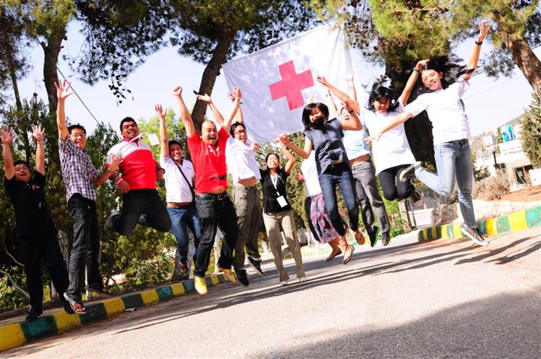
Thank You!
Let’s reach Further!

