Slide 1
IFRC Road to Resilience Global/AP Zone Update
Resilience

Slide 2
Global Community Safety and
Resilience Framework

Slide 3
The Framework for Community Resilience
PSD Offsite
15 Oct 2012
The Roadmap to Resilience
Expected characteristics:
All encompassing, sector-inclusive, multi-disciplinary
Focused on people and community empowerment
Systems approach to strengthen resilience at different levels, with community resilience as a process and (long term) goal
Determinants as a means of analysing context, identifying vulnerabilities and risk factors and targeted interventions
Recognizes the extent of our contribution and the role/contributions of many other actors.
3
Notes:
All encompassing – suggested as an explicit approach.
Re-framing that people are at the centre of our work and recognizing that we engage at the community level for reasons of scale and practicality. Communities are made up of people and our approach should include that all individuals with communities, particularly the most vulnerable, have access to our services, programmes, etc.-
Resilience at different levels
Individual level: a resilient individual is healthy, has the knowledge, skills, competencies and mind-set to adapt to new situations and improve his or her life, and those of her or his family, friends and community. A resilient person is empowered.
Family – Household level: a resilient household has members who are resilient - starting with the household head and other adults (see individual level). A household is resilient when it generates regular resources from diversified or sustainable sources, not just for basic needs but to allow for a better future - and to allow time for engagement within the broader community, e.g. volunteering for the RCRC.
Community level – Resilience at community level is more complex with the sum of resilient individuals not sufficient to say that it is a resilient community. Rather, if the community is seen as a system, then it is resilient only when it contributes to the resilience of all its members - individuals and households.
Local Government, and local governance, can either strengthen or weaken resilience at the individual, household and community levels, as it is responsible for infrastructure development, maintenance, many social services, and applying the rule of the law, including environmental regulations. In many cities for example, municipal officers exercise more power and influence than informal community leaders.
National level - Resilience at this level deals with policy, social protection systems, infrastructure, laws and governance issues. It can play a pivotal role in creating an enabling environment at the local level.
Organisations, like National Societies, including their branches and volunteers, are an integral part of the systems that strengthen resilience at all levels. National Societies’ assets include their volunteers, resources, auxiliary status to local and national authorities, reputation, credibility and connection to the global RCRC Movement and the Movement’s humanitarian culture enshrined by the Fundamental Principles. The degree to which National Societies impact resilience strengthening will depend on how well they mobilise and manage these unique assets.
Regional and Global levels impact resilience at all the other levels: the broadly felt impacts of conflicts, mass migration, economic recession, pandemics, pollution and climate change provide examples of this inter-connectedness and how it can negatively impact at the other levels. New information technologies and globalisation can also impact resilience.
And
Resilience as a process – i.e. it is a way to address underlying vulnerabilities. Resilience as a goal – the definition works here “the ability of individuals, communities, organizations or countries exposed to disasters and crises and underlying vulnerabilities to anticipate, reduce the impact of, cope with and recover from the effects of adversity without compromising their long-term prospects.”
4. Commonly used determinants drawn from academic environment as a means of understanding and analysing context.
5. RCRC makes important contributions to strengthening resilience – but individuals and their communities build resilience and there are many other actors (governments, NGOs, civil society, etc.) all who make real contributions and have valid roles and with whom partnering is a real opportunity.

Slide 4
Process Applied
Wide consultation within the Secretariat and with zones and National Societies
Zero draft circulated to all in Aug 2013 for comments
Five consultation workshops in Geneva, Amman, KL, Nairobi, Panama,
Broad consultation through multiple channels (eg. virtual, online, survey, written submissions)
Feedback informed the Draft 1 in Oct 2013
Draft 2 circulated for consultation early in 2014
Final presentation in Cali – Colombia during Resilience Forum Meeting – Nov 2014
Notes:
Wide consultation within the Secretariat and with zones and National Societies
Zero draft FCR was circulated to National Societies in Aug for comments
Draft 1 has been developed based on the feedback received from five regional consultation workshops.
The feedback from this workshop session and from National Societies will inform the revision and development of draft 2
Final discussion and approval of the framework due in Colombia in May 2014

Slide 5
Key changes in Draft 1
Describe community resilience as a bridge between humanitarian action and development
Better articulation of the phrase “being available to everyone, everywhere, always”.
Clear definition of a community and its complexity and uniqueness .
RCRC engagement with other actors and linkages with HFA and MDGs.
Inclusion of more practical guidance and tools.
Replace the determinants with characteristics
Notes:
Feedback from the 5 regional consultations has informed the development of the Draft 1. Key changes are as follows:
• Explicit recognition of the potential for community resilience to act as a bridge between humanitarian action and development
• Better articulation of the phrase “being available to everyone, everywhere, always”. Strategy 2020 recognizes that the RCRC is ”… widely perceived as a ‘public good’ – available to everyone, everywhere, to prevent and reduce human suffering”. The Draft ‘1’ FCR provides guidance on how this should be achieved.
• Clear definition of a community and the complexity and uniqueness of each community.
• Elaboration of the need for the RCRC to engage with other actors at the local and national level and the linkages between RCRC community resilience programming and the international agenda, e.g. HFA and MDGs.
• Inclusion of more practical guidance and tools.
• Replace the key determinants with the key characteristics of a safe and resilient community as a means to analyse and understand community resilience.

Slide 6
New elements in the revised Framework
Policy and operational guidance on “what” we do and “how” we do it.
IFRC’s own definition of resilience
Clarified RCRC approach to strengthening community resilience
Highlighted the key issues to be taken into account in community resilience programming
Notes:
As compared with the 2008 Framework for Community Safety and Resilience, the zero-draft has included new elements.
The zero-draft:
• Provides the policy and operational guidance on “what” we do and “how” we do it.
• Has included the IFRC’s own definition of resilience: “the ability of individuals, communities, organizations, or countries exposed to disasters and crises and underlying vulnerabilities to anticipate, reduce the impact of, cope with and recover from, the effects of adversity without compromising their long-term prospects”.
• Has clarified how we should organize ourselves to strengthen community resilience:
adopting risk-informed, holistic approaches to addressing underlying vulnerabilities;
taking a people centred approach and working to empower people and communities;
being available to everyone, everywhere.
The nature of communities’ underlying vulnerabilities is dynamic and complex as they are influenced by human, natural and physical assets as well as social, political and economic structures and processes. These factors are inter-connected and influence each other, therefore it is important to consider and understand them holistically and to select interventions that are most relevant to the community.
Strengthening community resilience is a process for the community and owned by itself. Therefore, key to strengthen community resilience is to empower people and communities through a people-centred approach.
Our strength lies in our global network of National Societies with branches and millions of volunteers. Our auxiliary role, our presence in communities; our community-based knowledge and expertise; our capacity and readiness to support those in need – all these place us in an advantageous position to strengthen community resilience.
• Has highlighted the key issues to be taken into account in community resilience programming:
reflecting the local context of each community in the nature and extent of our engagement;
taking the systems approach, considering the existing systems operating within the community and the community’s connection and interaction with other systems;
adopting community-specific interventions, allowing flexible approaches to cope with evolving circumstances.
The nature and extent of our engagement with each community depends on its specific context (underlying vulnerabilities and capacities), as well as the existing systems within the community and its connection and interaction with other systems. It is a complex and on-going process which requires the engagement of all stakeholders, comprehensive analysis, long-term planning and integrated approaches. As each community is dynamic, it is necessary to adopt flexible approaches to support resilience strengthening over time. However adapted to the specific context these approaches have a number of consistent management components involving RCRC programmes, volunteers and National Societies.

Slide 7
POSITION PAPER
The Road to Resilience – Bridging relief and development for a more sustainable future.
Notes:
PURPOSE OF THE POSITION PAPER
Communications piece that articulates the IFRC position on resilience and how we deliver it,
Document that advocates for the most vulnerable and articulates how, through strengthening community resilience, the IFRC makes a positive contribution to the circumstances of the most vulnerable,
Document that helps us all talk with one voice on resilience – providing consistency in our engagement with global and national supporters and actors whilst recognizing the unique context of each community we work with.

Slide 8
Challenges with the current version of Position Paper
While it is recognized as a very good advocacy paper there are limitations that need to be addressed:
Lack of consultation with National Societies
Not aligned with the Framework for Community Safety and Resilience
Unclear target audiences
No key messages to target audiences
Limited selection of good case studies/examples from different sectors and regions
No statistics of our contribution to community resilience
No link with reference materials
Notes:
Good advocacy paper for our key partners:
Present IFRC’s definition of resilience
Describes RCRC perspectives on resilience: levels, process, how to strengthen resilience, characteristics of resilient communities
Explains RCRC contribution to community resilience with case studies/evidence and photos
Limitations:
Lack of consultation with National Societies and zones
Not aligned with the Framework for Community Safety and Resilience
Unclear target audiences
No key messages to target audiences
Limited selection of good case studies/examples from different sectors and regions
No statistics of our contribution to community resilience
No link with reference materials

Slide 9
Issues for consideration/improvements
Align with the Framework for Community Resilience
Clarify right target audiences and their expectations
Visualize resilient communities
Include a hyperlink to reference documents
Use innovative technology to convey key messages
Choose right success stories
Statistics and evidence of RCRC contribution to community resilience
Simple language and definition
Specify resilience approaches at different levels
Examples of characteristics of resilient communities
NS capacity building as part of community resilience
Linkage with HFA2 and post-2015 development agenda

Slide 10
6th Asian Ministerial Conference on Disaster Risk Reduction (AMCDRR), Bangkok, July 2014
I
Notes:
Consultations started in March 2013, 89 events up to the Global Platform

Slide 11
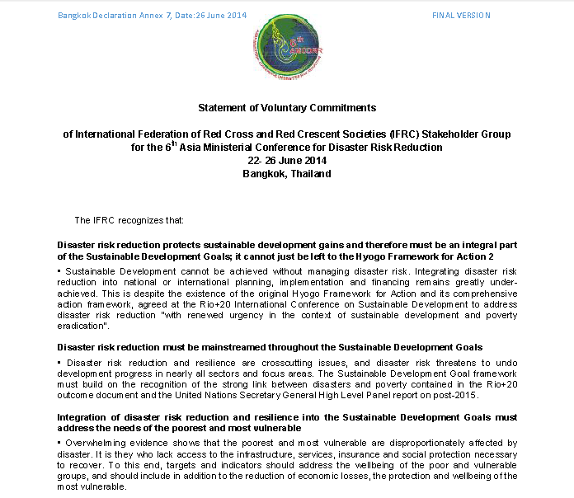
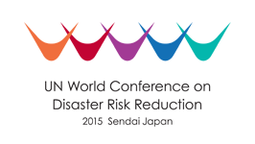
RCRC Statement of Commitments
Focus on:
Community Resilience
- Private Public Partnerships
- Improving Public Investments in DRR and sustainable development

Slide 12
Thank You

Slide 13
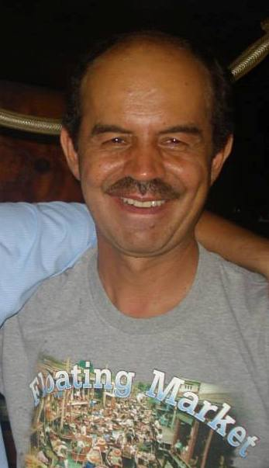
Q & A
Please contact:
Nelson Castano, Head of DM Unit in AP Zone Office
nelson.castano@ifrc.org
Mob: +60 12 234 6591

