Slide 1
SOCIAL MEDIA
The Thai Red Cross Society

Slide 2
background
Start >> 2010
for …. PR news, activities, projects of TRCS
>> One way communication <<
Notes:
Let me show you the background of the social media role in Thailand.
For Thai Red Cross, We have started using social media in 2010 (two thousand ten) for PR news, activity and project of Thai Red Cross.
At the beginning , We used it in the form of one way communication.

Slide 3
Then….
Tsunami
in Japan
Japanese
Red Cross
Thai volunteer
Tweet for fund raising
Notes:
We introduced Thai Red Cross to them, told them what we do and how to contact Thai Red Cross by social media. So, the fundraising for tsunami in Japan was sent directly form Thai Red Cross to Japanese Red Cross. Thai Red Cross’s social media became popular after that.

Slide 4
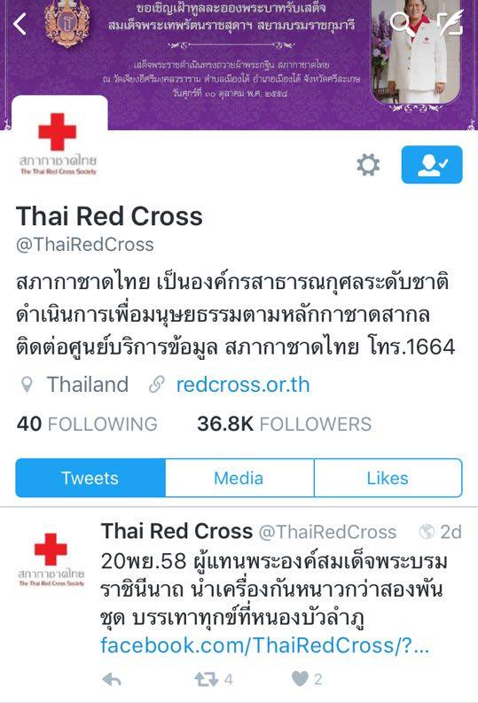
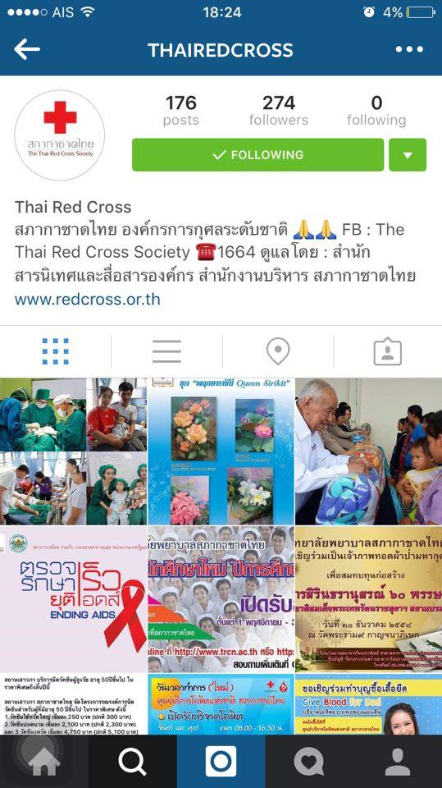
Social media Rating
The Thai Red Cross Society
PAGE LIKE > 190 K.
Thai Red Cross Reporters
PAGE LIKE > 700 pax
@ThaiRedCross
Follower 36.9 K.
thairedcross
Follower > 270 pax

Slide 5
mission
Mission in normal situation
PR for blood donation, eyes donation, organs donation
PR the activity of Thai Red Cross / IFRC / ICRC
To give healthcare service information of King Chulalongkorn Memorial Hospital and Queen Savang Vadhana Memorial Hospital
Mission in emergency situation
To be a channel for people who need help from TRCS
To follow the situation from other website, Facebook, Twitter
To request for cooperation from volunteers
To raise the money and basic necessities
To announce the helping point by co-op with Relief and Community Health Bureau

Slide 6
SOCIAL MEDIA LEARNING EXCHANGE 24-26 NOVEMBER, JAKARTA

Slide 7
1. A list of 3 specific things that you hope to learn from your colleagues during the Exchange.
The idea of social media campaign
Community engagement
Social Media strategy
How to use social media as a tool in disaster management/ disaster risk reduction from NSs experiences

Slide 8
2. Review National Society’s Facebook page.
1. Princess Sirindhorn present robes to monks at the end of Buddhist Lent at Sisaket province
2. National Blood Center invites people to donate blood continuously
3. Relief and Public Health Bureau help people who are in trouble with house fire.
https://www.facebook.com/media/set/?set=a.1073725409327788.1073741994.104937049539967&type=3
https://www.facebook.com/nbctrc/photos/a.509126809198417.1073742299.260541607390273/782615241849571/?type=3
https://www.facebook.com/ThaiRedCross/posts/1051314398235556

Slide 9
3. Choose a Facebook page for an organisation, brand, celebrity or news outlet that you like.
https://www.facebook.com/unicef/?fref=ts
•Who or what is the title of the account? UNICEF
•How many followers do they have? 5.5 M.
•How often do they post? Daily
•Do many people comment on their posts or Share their posts? Do they respond to comments? Many people comment and share. They answer every comments.
•What do they well? What do you like about their page? Nice picture & copy writer, interesting campaign, world class celebrities
•Do you think they could do better? YES
•What do you think they are trying to achieve with their Facebook page?
Raising awareness about underprivileged children and raising money to
support their campaign

Slide 10
3. Choose a Facebook page for an organisation, brand, celebrity or news outlet that you like.
https://www.facebook.com/MSFsouthafrica/
•Who or what is the title of the account? MSF south affrica
•How many followers do they have? 79 K.
•How often do they post? Daily
•Do many people comment on their posts or Share their posts? Do they respond to comments? Depend on the situation
•What do they well? What do you like about their page? The pictures and contents are touching in positive presentation
•Do you think they could do better? They could present how budget donate have done for what program are successful
•What do you think they are trying to achieve with their Facebook page? Raising awareness and money. PR their activities.

Slide 11
Challenge
No specially social media staff and limited staff.
No social media policy and social media guideline
No social media response team to manage critical comments
Sensitive issue related to the royal family
Management for effective media, Complication with plenty theme from internal bureau.

