Slide 1
Myanmar Red Cross Society
Regional Resilience Workshop
Country Advocacy and Humanitarian Diplomacy Planning

Slide 2
Objective
1. Secure more support from government and State & Regional Parliament for RC activities that will therefore support vulnerable people.

Slide 3
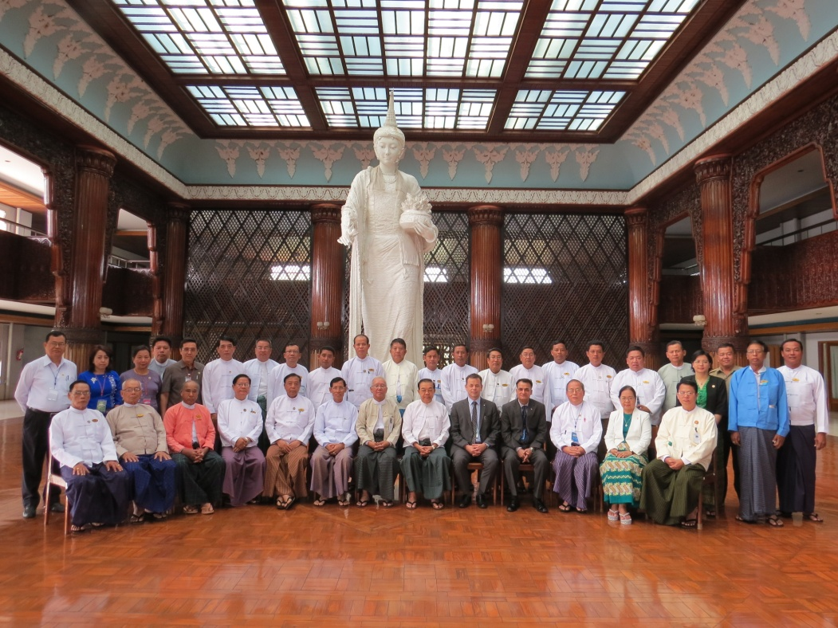
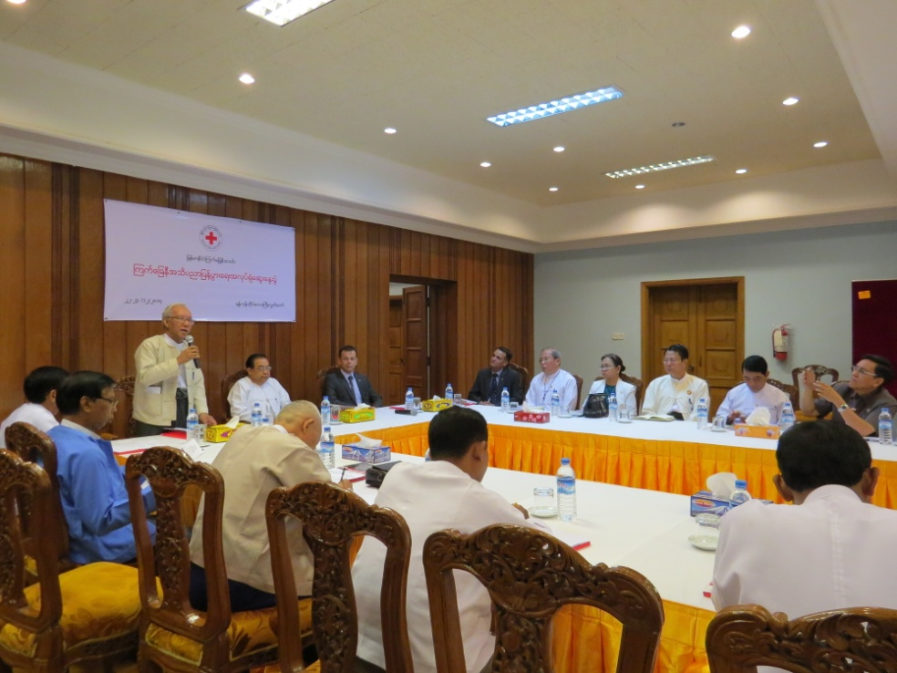
Audience
Government and State & Region Parliament

Slide 4
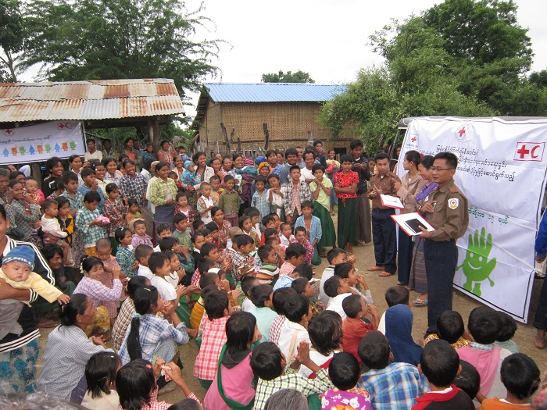
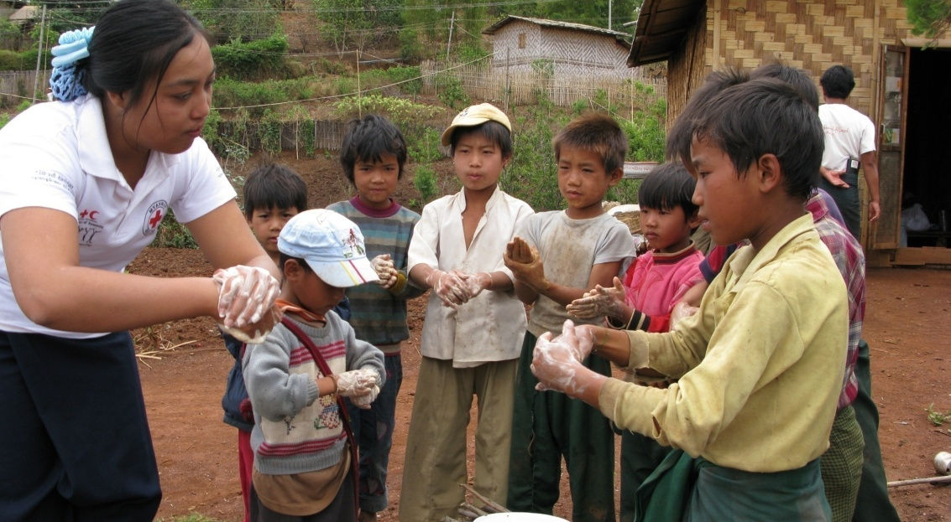
Evidence
Range of RC services and activities (not only First Aid)
Consistency of the RC (always there)
Red Cross 7 Fundamental Principles & Unique roll

Slide 5
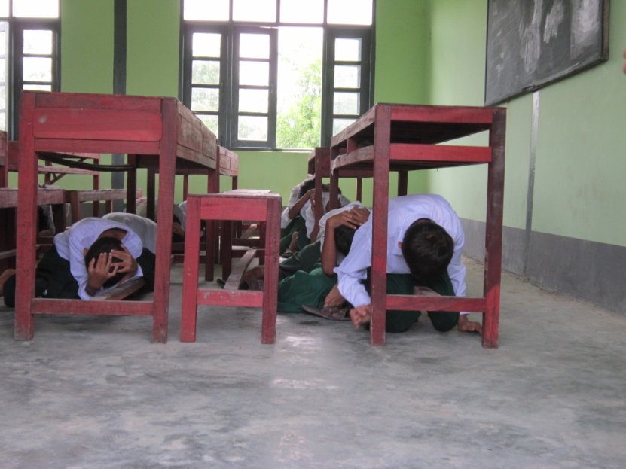
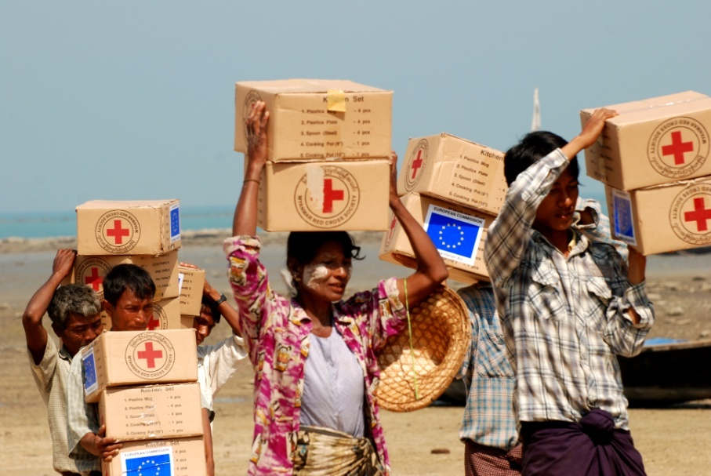
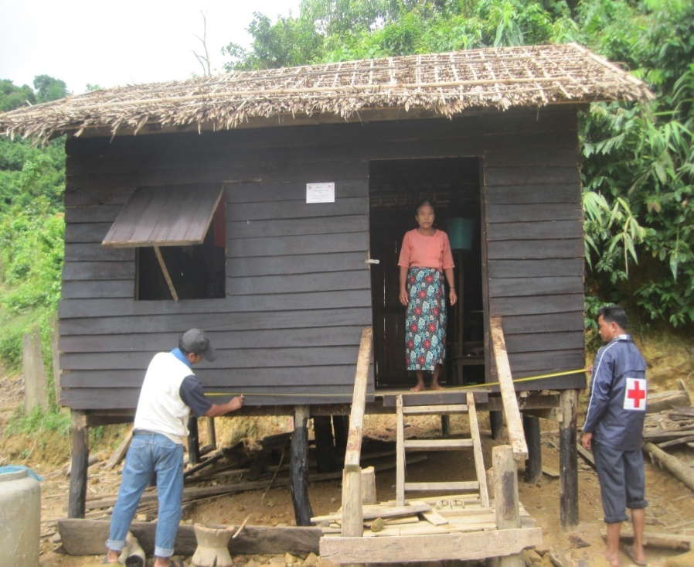
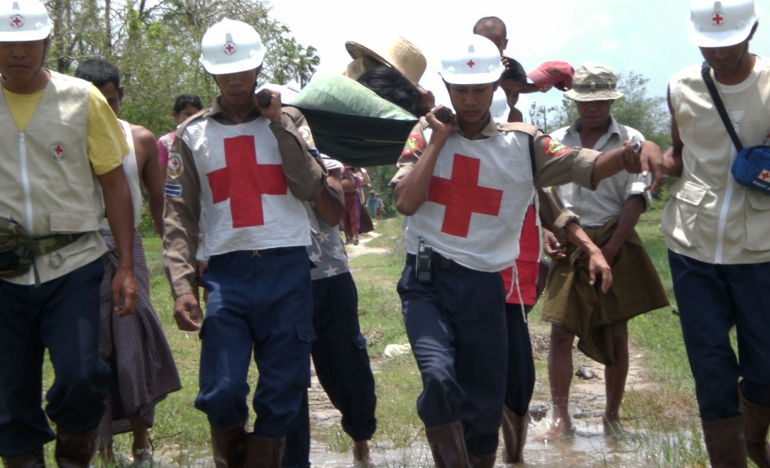
Evidence

Slide 6
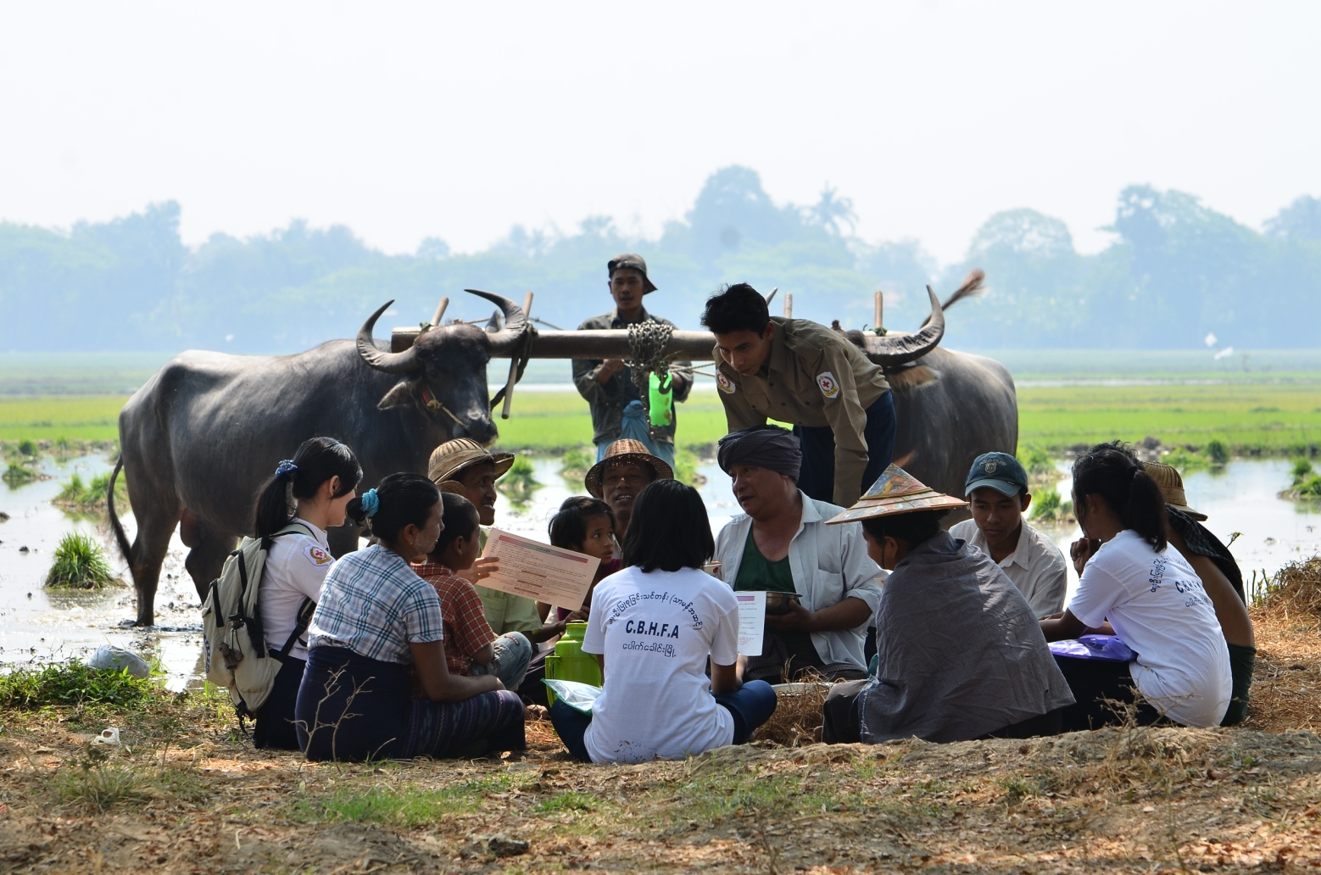
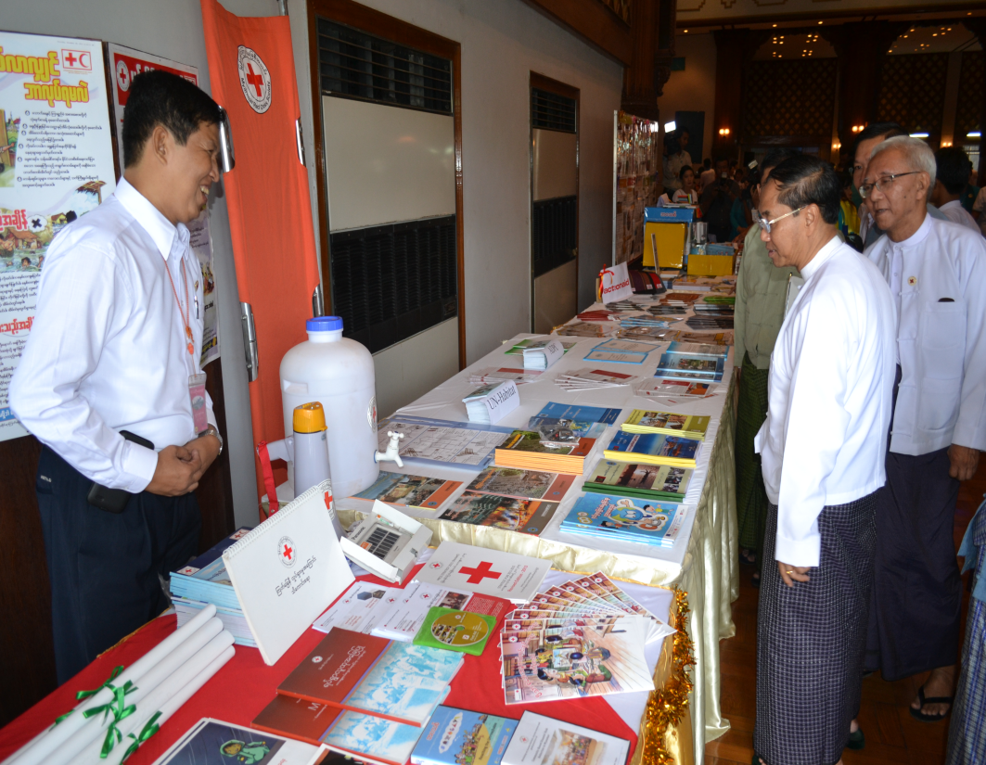
Channels
Public awareness campaign on the FPs and role of RC

Slide 7
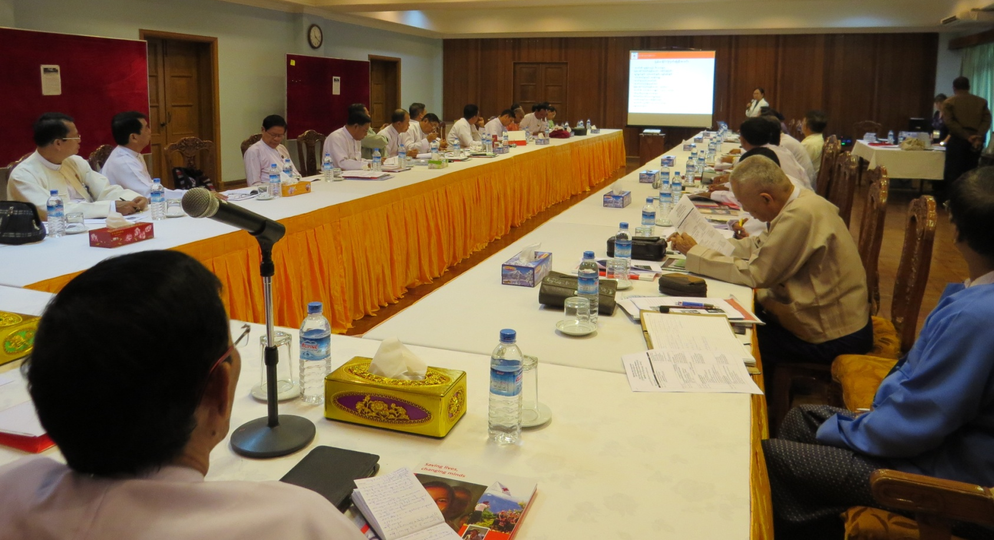
Channels
Targeted parliamentary sessions to share key message campaign & successes.

Slide 8
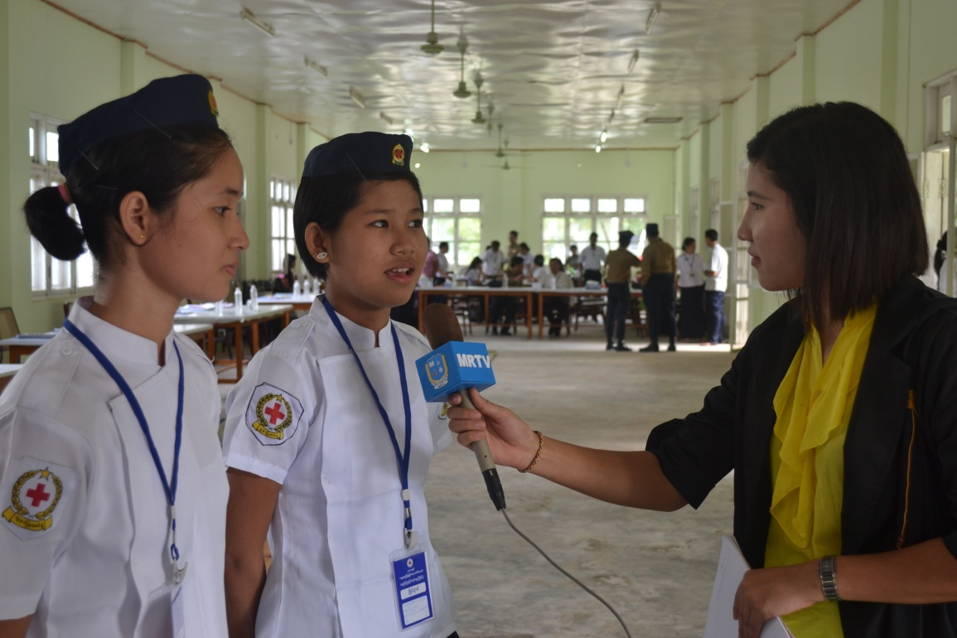
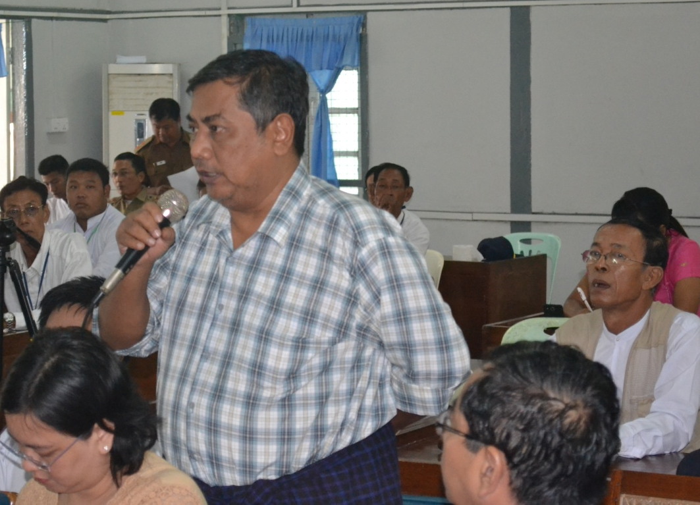
Channels
Taking community voice to the parliament (Video, in person)
Red Cross News Journals

Slide 9
Opportunities
Government, State & Region Parliament aware on Red Cross requirement of internal support
Improve auxiliary role of RC to Government.
Access to government.

Slide 10
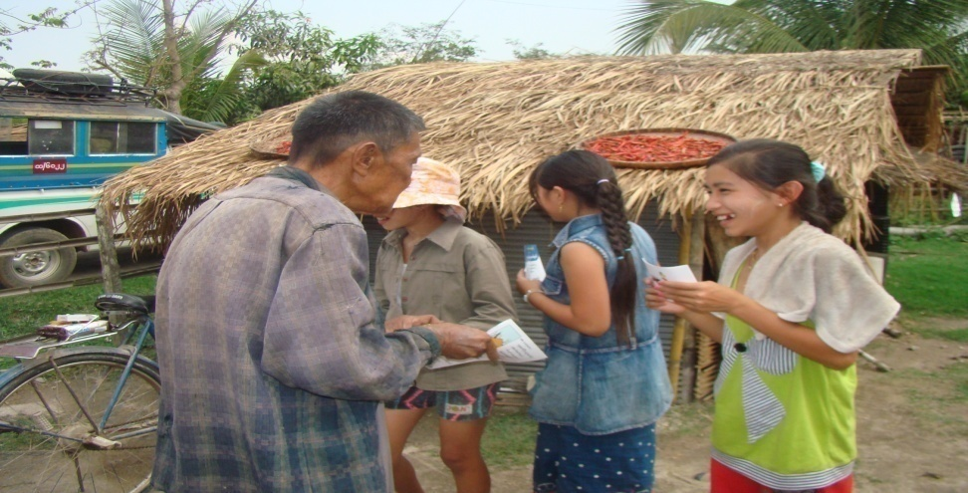
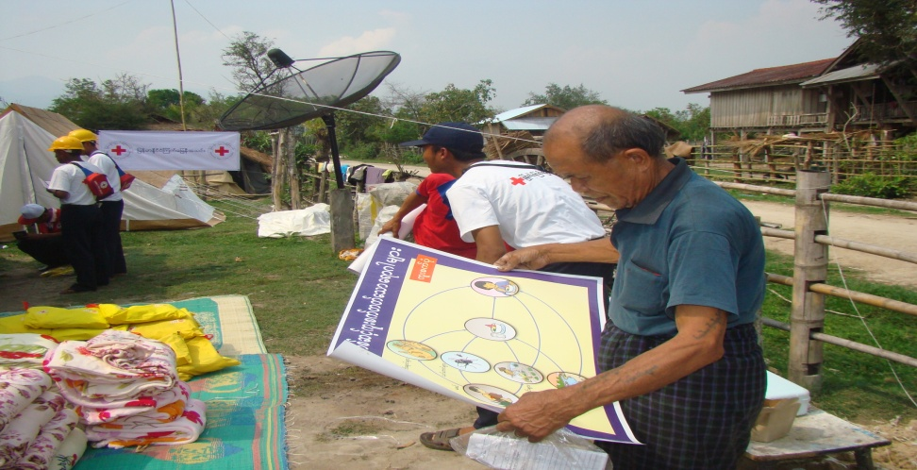
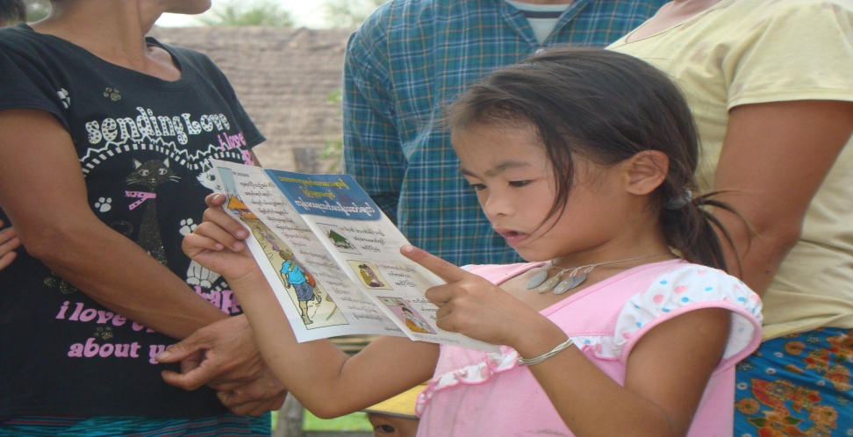
Needs
Budget for producing materials.
Social Media technical support
Partnership

Slide 11
Challenges
Time constraints of government
Different views of political parties (in Parliament)
Different capacities of RC branches can reflect Red Cross image for government and parliament.
Small mistake of single Volunteer on fundamental principle and misuse of emblem by anybody (inside or outside movement) can create big misunderstanding.
Perception that RC is only First Aid.
Incorrect use of social media-(negative impact on RC image)

Slide 12
Objectives-
2. Increase knowledge and understanding of Red Cross in the community in order to strengthen Red Cross branches to ensure sustainability of Red Cross activities in supporting needs of vulnerable people.
3. Increase partnership with private sector in order to enhance mutually supporting.
(eg. Financial support or donations from private sector and in-return for staff training, safety measures- factories, airline, business..)

Slide 13
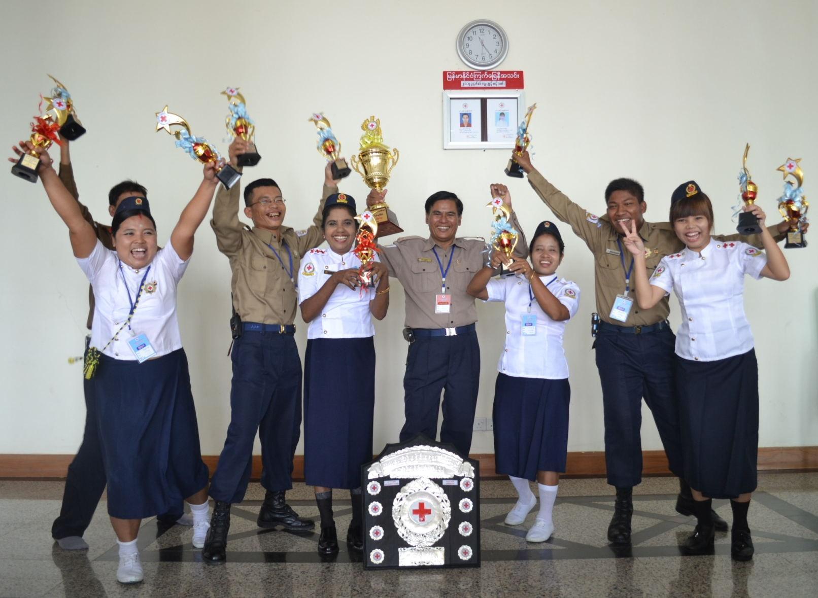
Thank for your kind attention

Slide 14
Question and answer!

