Slide 1
Lao Red Cross Malaria Prevention Project
Regional Community Safety and Resilience Forum
4-6 August 2015, Jakarta, Indonesia
Presented by : Bounma XAYASOUK
Head of Health Promotion Department,
Lao Red Cross

Slide 2
Back ground
National Strategy for Malaria Control and Prevention 2011-2015 of the MoH, Laos
Project initiative year 2013-2014(Jul-Dec annually)
Target: 2 risk provinces(03 districts/20 villages)
Funded by IFRC

Slide 3
Objective
To improve the health and well-being of people living in remote communities in Lao PDR.
Knowledge of villagers of 20 villages of 3 districts in Champassak and Sekong provinces on malaria prevention and good hygiene practice increased and behavior dramatically changed.

Slide 4
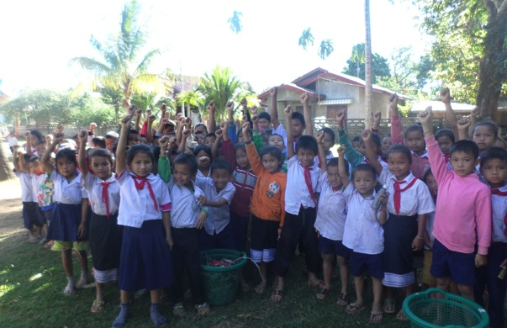
Achievements
12,069 Beneficiaries in 20 villages, 3 districts, 2 provinces.

Slide 5
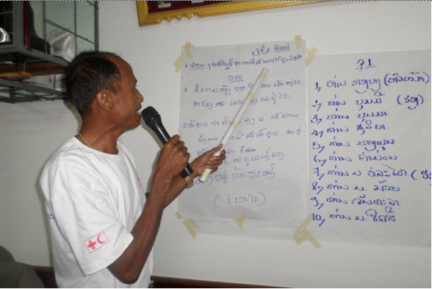
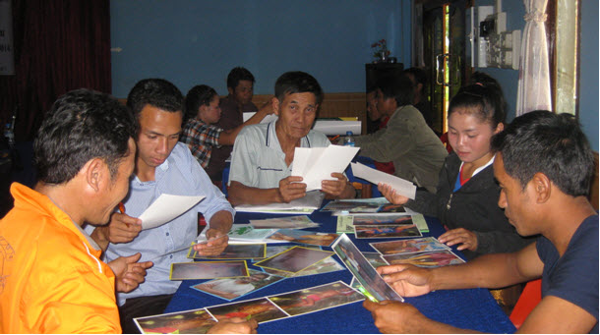
40 VHVs, 20 primary school teachers, 20 village heads trained in malaria prevention and good hygiene practice and transfer their knowledge to communities.

Slide 6
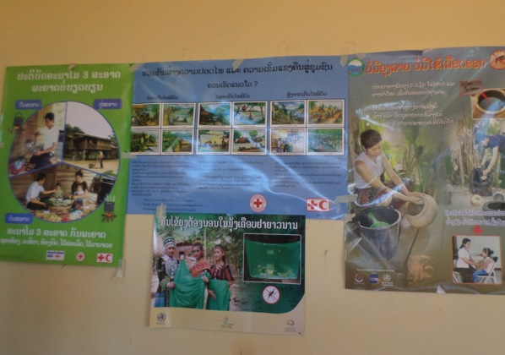
IECs were provided:
200 T-shirts,
200 posters with slogan: “ Practice of 3 hygienic principles make disease far away from”, 250 posters with slogan for dengue fever prevent
​5,000 leaflets with message “​ Pay attention to destroying mosquito breeding ground in side and around your house” ( A4 size) ​.
400 stickers with message “Thank you for killing mosquitoes and larva”.

Slide 7
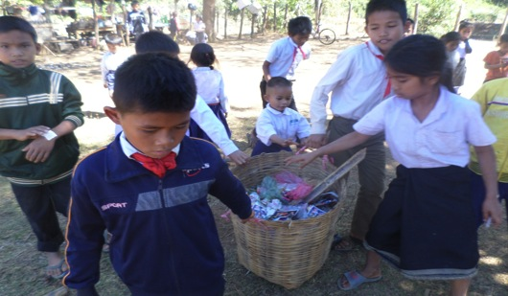
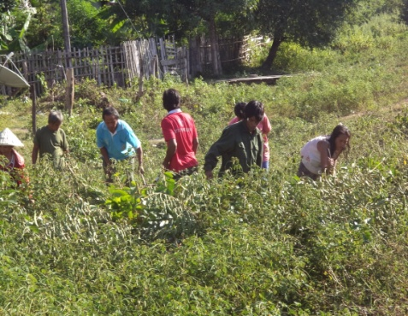
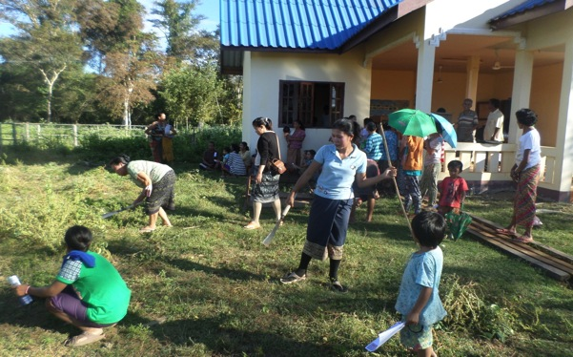
Community Cleaning Campaigns are conducted in collaboration with village and school community.
Households aware, practice malaria prevention technique, clean community surrounding areas, bed nets increasing.

Slide 8
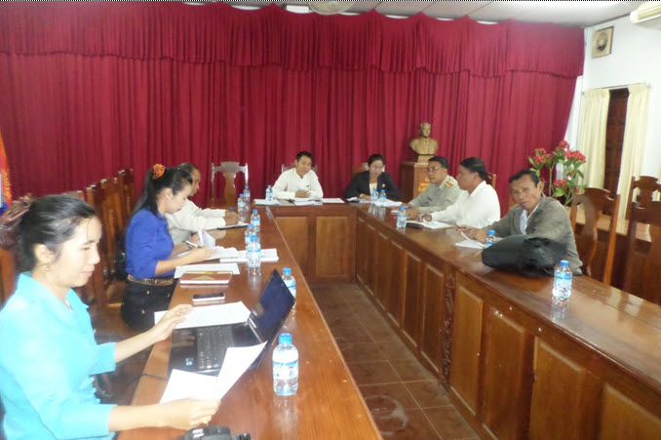
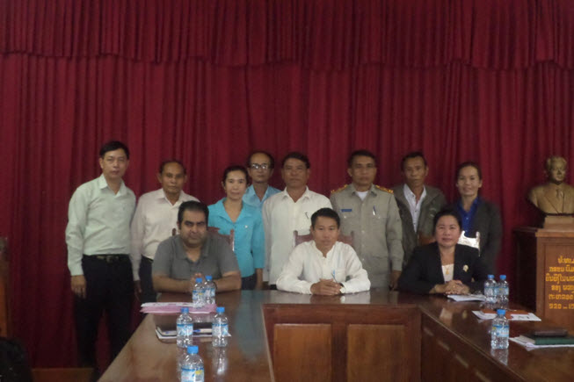
Activities
Meeting with District deputy-governor of Kaleum district
Meeting with District health committee of Pathoumphone district
Advocacy workshop in Pathoumphone District

Slide 9
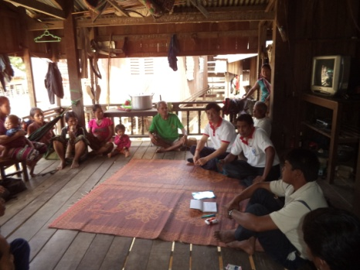
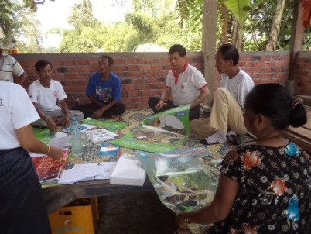
Activities
Meeting with Phalai village communitee,
Pathoumphone District
Meeting with Lakai village communitee, Kaleum District
VHV, teacher, head man training
District Red Cross is introducing IEC materials to volunteer.

Slide 10
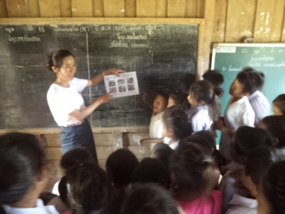
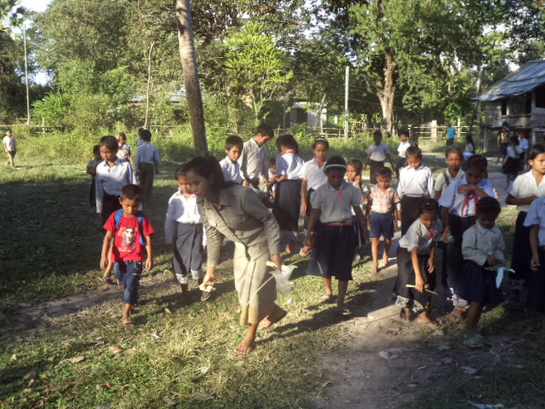
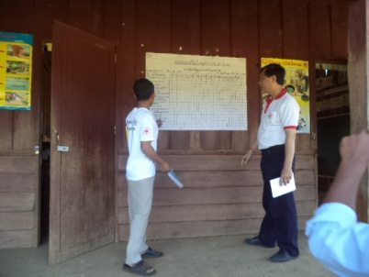
Red Cross officer is explaining how to destroy mosquito breeding ground.
Teacher is leading school children to sing a malaria prevention song
school children and student conducted cleaning campaign
Teacher is explaining school schedule for project activities

Slide 11
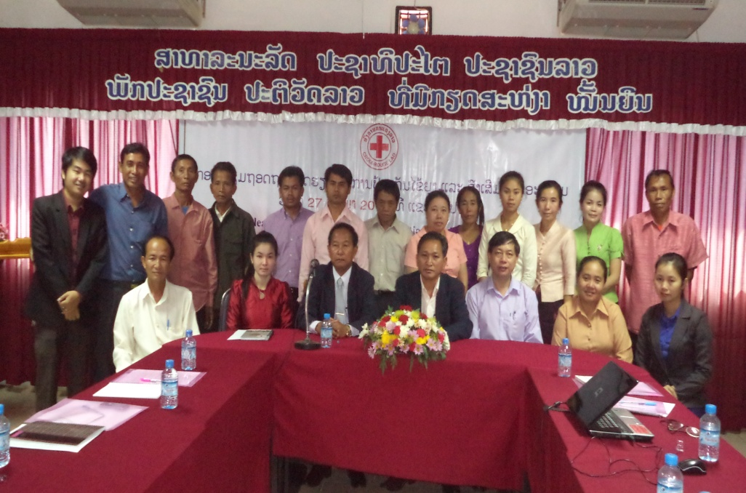
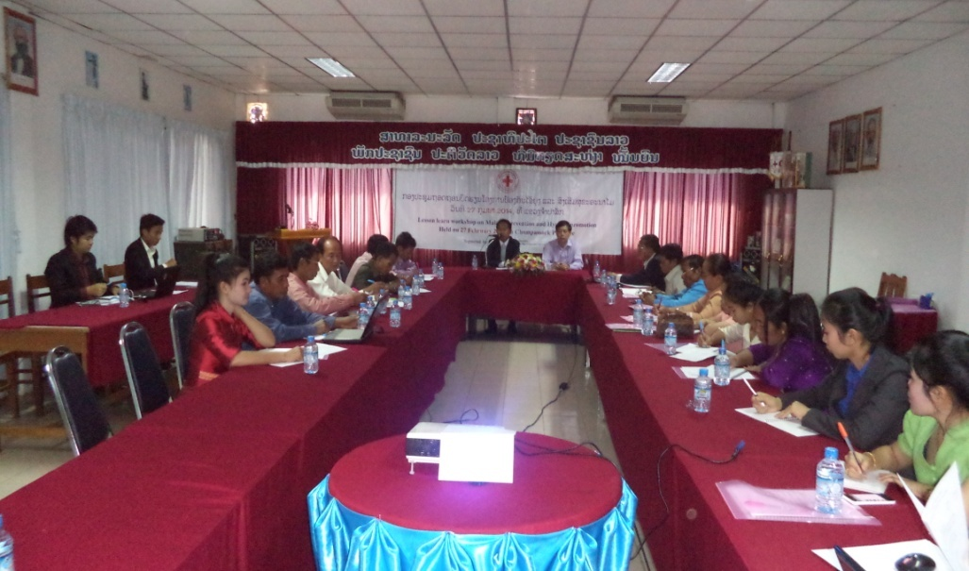
Lesson learned workshop

Slide 12
Challenges
Communication problems: local languages
Appropriate timing: access, farming season,...
The limited time, discontinuous
Limited budget
Capacity of human resource.

Slide 13
Lesson Learned
High risk of malaria prevalence was decided/ identified by district and provincial authorities.
More understanding to stakeholders to all levels
Need stronger village authority ownership.
Project period should be extended
The project should be implemented before raining season(Q2)
The training curriculum limited/ need to improve on ECV (malaria, dengue fever,...), Training should be more increased schedule at least 5days.
Increasing of household visit
More communities – schools integration
Notes:
Lao Red Cross decided to select 40 villages in the 3 districts(5 each) because these 3 districts are at high risk of malaria prevalence identified by district and provincial authorities.
Coordination at all levels, concerned parties is very necessary to start in the beginning to get effective implementation of activity; and sustainability
Village authorities must be strong in encouraging and organizing the community people to do the activities given.
The training curriculum is still limited. It should be more improved by adding the manual on ECV focussing on malaria and dengue fever. Training length should be increased from 3 days to 5 days.
Household visit is very necessary and important as it helps villagers to be able to receive enough health message and also help monitoring team know how and what to help them.
________________
Conducting these health activities in primary school is also the way to send health message to their families not only for the pupils in schools.
Project life time is too short, that is not enough time for making behaviour change in community people. Its appropriate length should be at least 1-2 years.
Reporting from all levels must be on time or faster in order to address the problem of the delay of money transfer from IFRC.
Monitoring visit needs concerned party to go together in particular health authority
As project was implemented in local ethnic areas where most of people speak their old language. So, project staff in particular at district level should know their local ethnic language for more effective communication so that the target beneficiaries can receive enough health message.
As many villages in other district in each province are malaria and dengue fever-stricken areas. Project should continue its implementation in the new areas.

Slide 14
Way forward
Continue/develop the project of LRC
Enhance and integrate to other activities of LRC: emergency cases, DRR, Climate Change…
Expanding to new targets.
Collaboration to organizations involved Malaria & Dengue fever

Slide 16
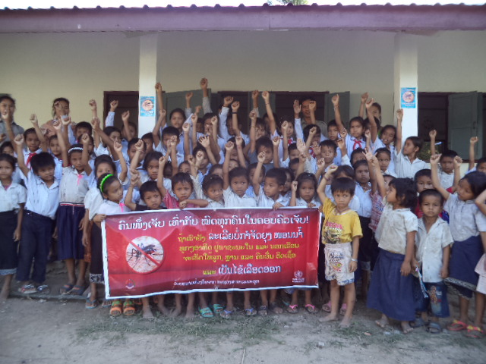
Thank you

