Slide 1
Key Components of SBDRR

Slide 2


Slide 3
Lesson I learnt from this video
Foundation or the base
Team Work
Diligent and efficient Planning
Adding star leading to bench mark

Slide 4
Let us brain storm on SBDRR Activities!
On-site Activities – Within School Campus
Off –site Activities – As an outreach plan or Joint planning
Their Expected Outcome

Slide 5
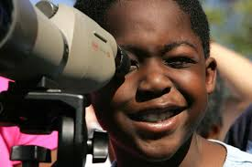
School Based Disaster Risk Reduction

Slide 6




It concerns us………we should be part of it.
Too much! I can’t hold it
Don’t you prefer to be simple?

Slide 7
School Safety Approach
Reflect
Learn
Empower

Slide 8



APPROACH
LEARN
REFLECT
EMPOWER
Small and Definitive actions
School Disaster Management Plans
Mock Drills
Short Class room exercises
Factors leading to human casualties in disasters
Recognize practices which leads to cause of disasters
Talk
Students deepen their awareness about hazards and risks
Case Studies m Movies , Workshops
Awareness
Adaptation
Actions

Slide 9
Elements of School Safety
Structural Safety
Non-Structural Safety
Education & Awareness

Slide 10
Elements to be covered under school safety
Preparedness
Awareness, training and capacity building
Collaboration with external agency
Exposure to underlying causes

Slide 11
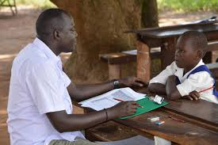
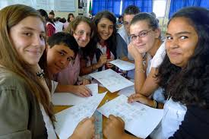
Baseline Survey and Assessment

Slide 12
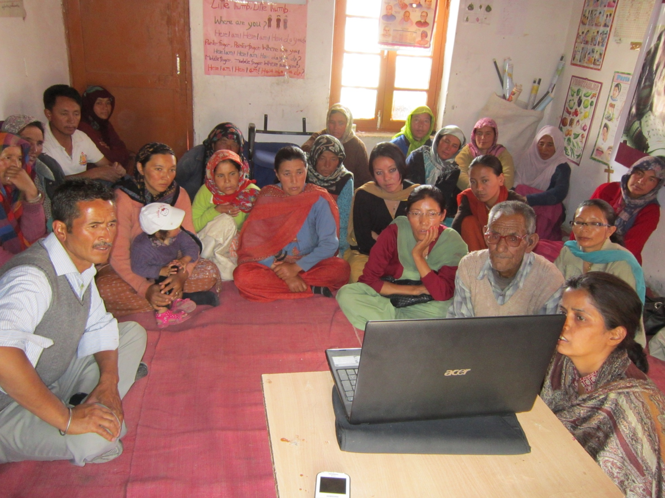
School Disaster Management Committee

Slide 13
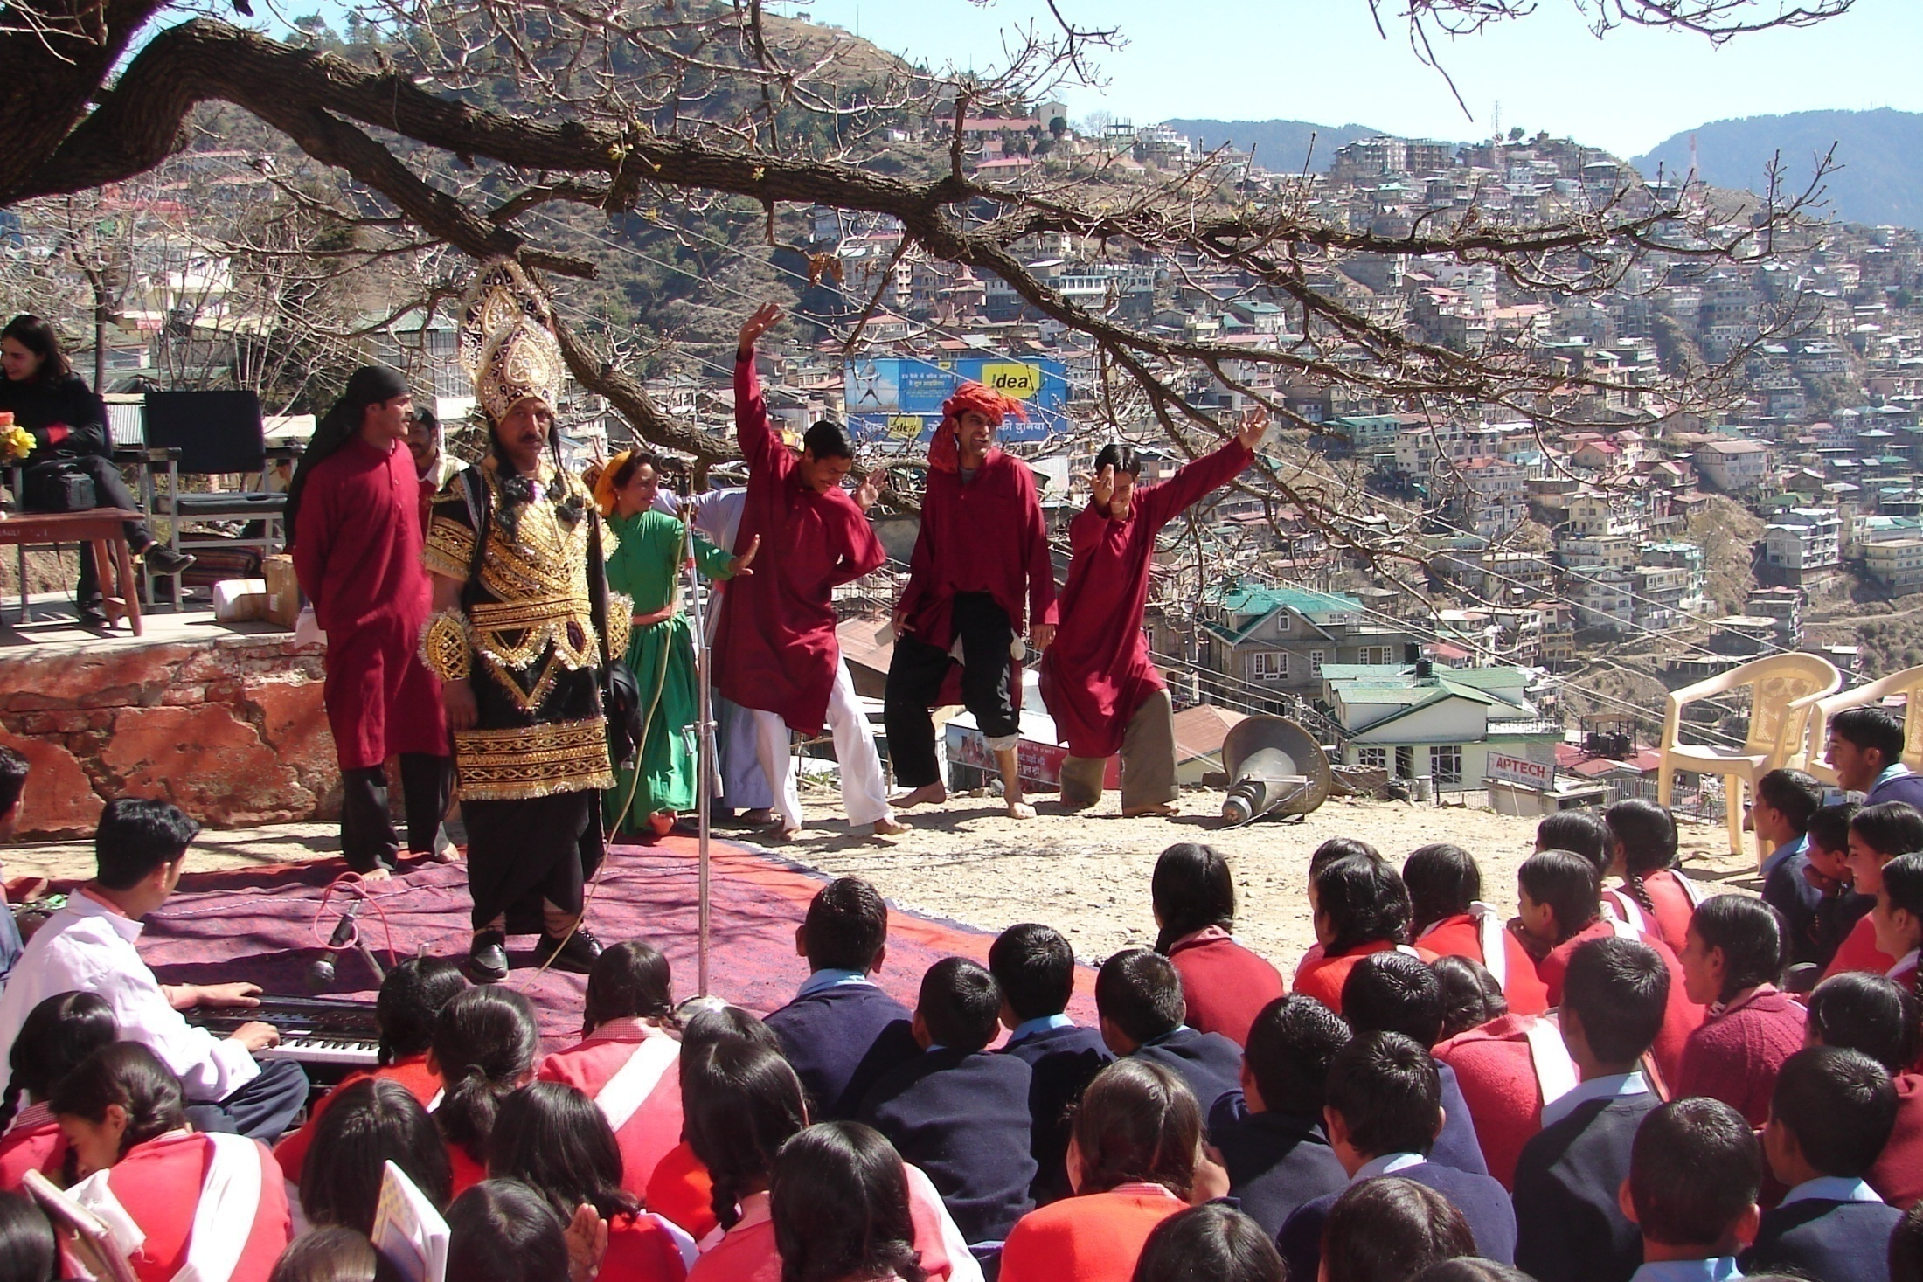
Children Club

Slide 14
Orientation Sessions

Slide 15
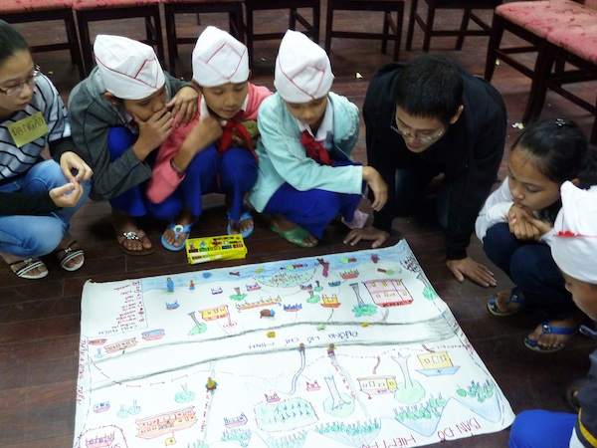
HVCRA

Slide 16
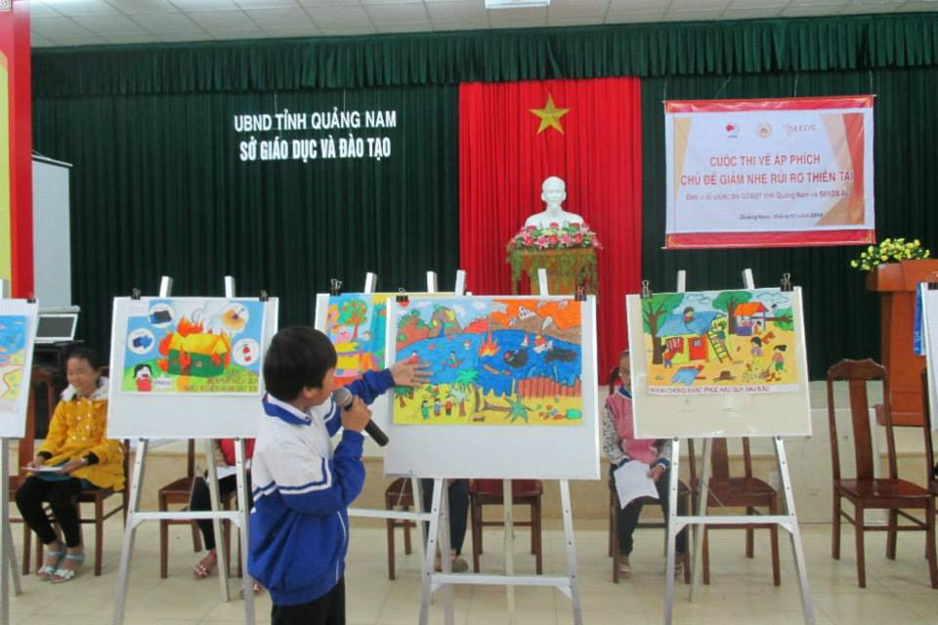
HVCRA

Slide 17
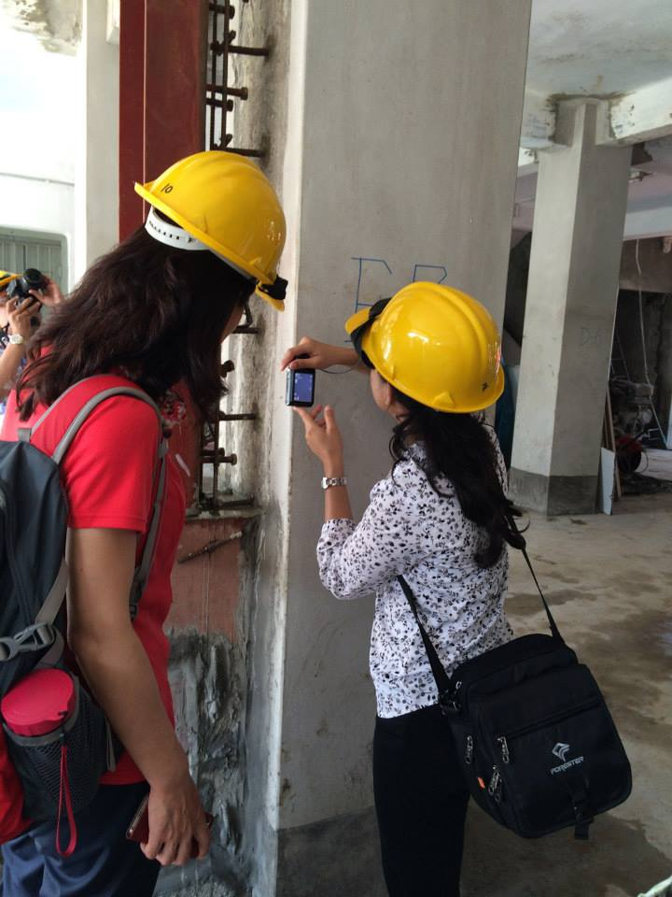
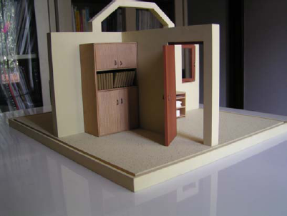
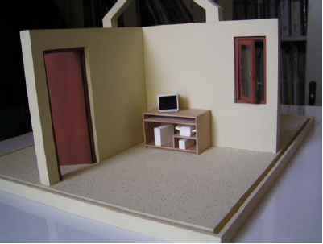
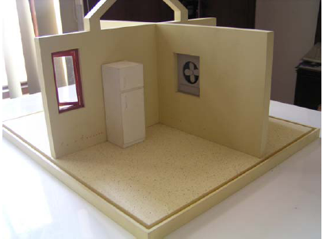
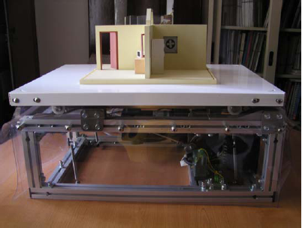
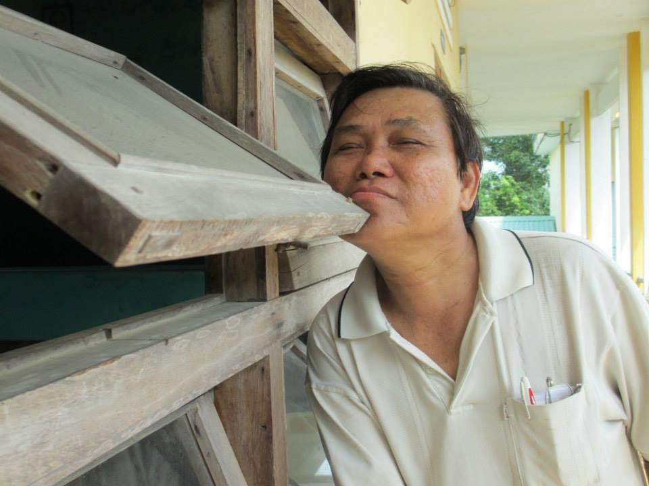
Structural and Non-structural Hazards

Slide 18
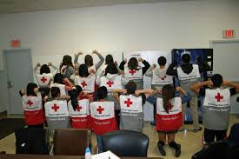
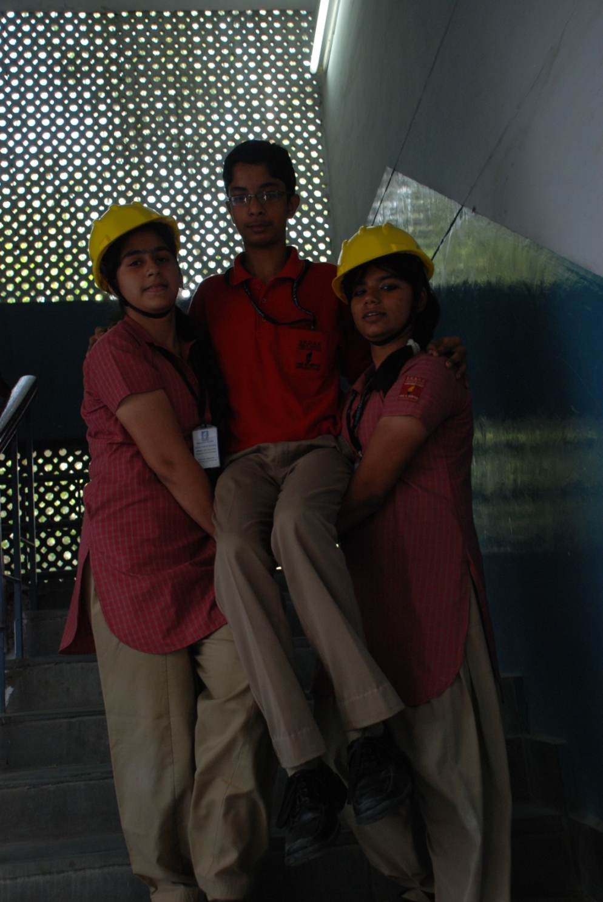
Task Forces

Slide 19

School Disaster Management Plan

Slide 20
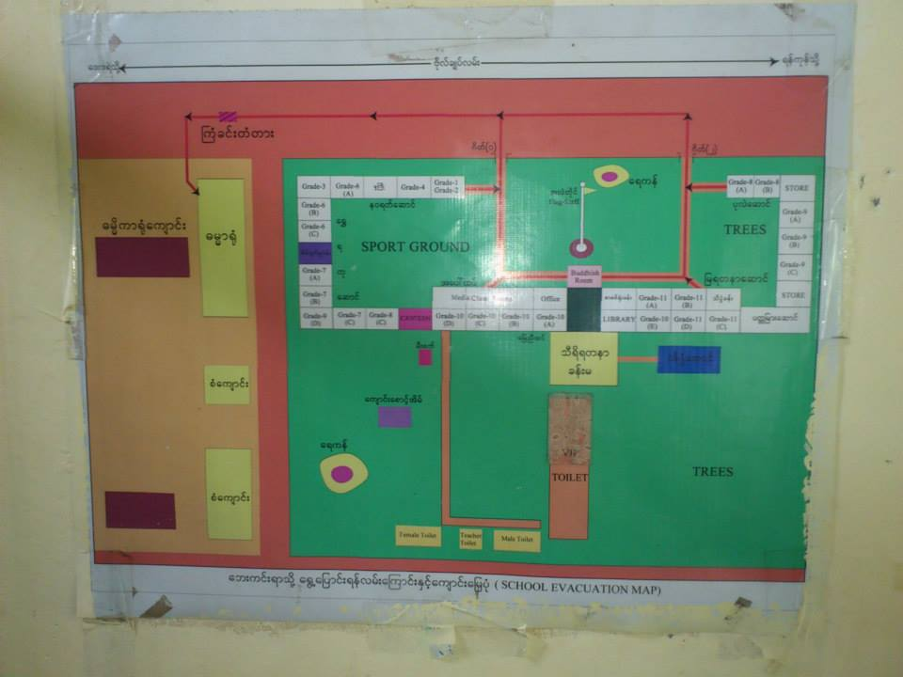
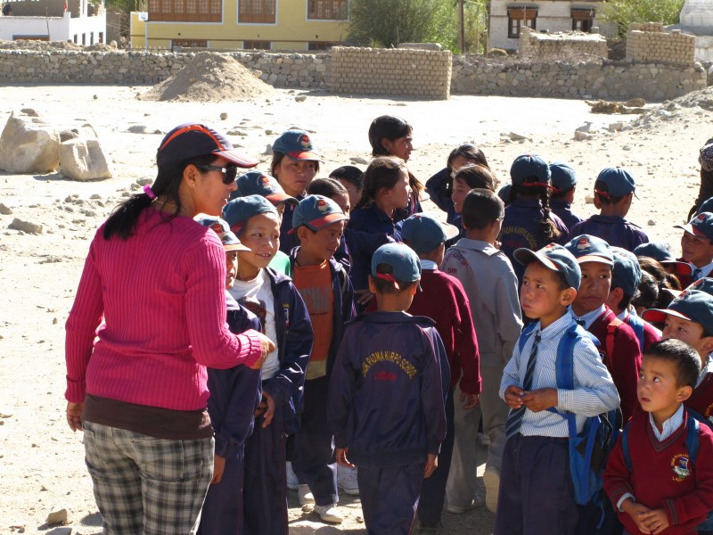
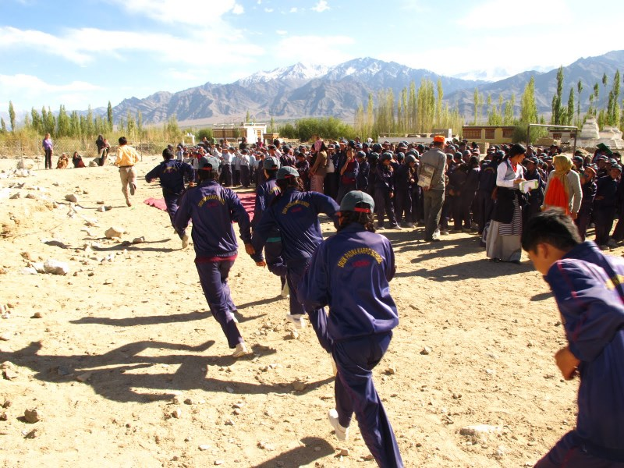
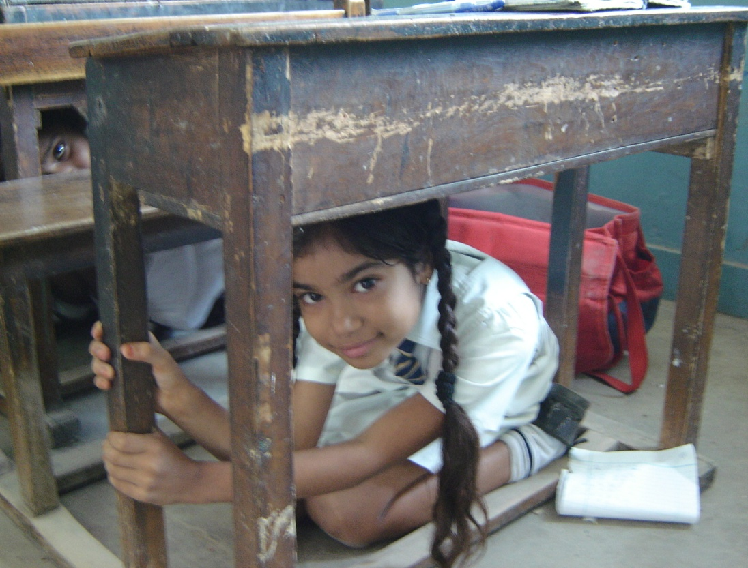
Evacuation and Mock Drill

Slide 21
