Slide 1
IFRC
contribution to SDGs
From Millennium Development Goals (MDGs) to Sustainable Development Goals (SDGs)
and
I F R C

Slide 2
Millennium Development Goals (MDGs)
- MDGs managed to mobilize support for a global development agenda
- Developed by a small group of experts and not member state driven
- Too much aid focused/donor driven and
- Overlooked the issue of inequality
- Lack of implementation of Principle 10 of Rio Commitment regarding “public participation” into the MDGs at all levels (local, national, regional, global) during various phases starting from analysis to planning, budget allocation and implementation etc…)

Slide 3
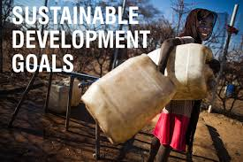
From MDGs to SDGs
- MDGs were a product / reflection of the understanding of development as ‘human development’.
- The MDGs placed great weight on social goals without considering economic development (re. sustainability)
The aid-driven improvements in and expansion of health services are noteworthy achievements in many poor countries, but without economic resources they lack sustainability

Slide 4

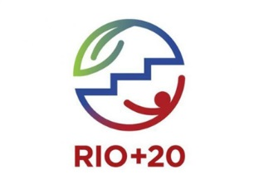
- Establishing post-2015 goals was an outcome of the Rio+20 summit in 2012, which mandated the creation of an open working group involving representative from 70 countries in consultation process for the development of SDGs.
- During consultation process, four threats to global sustainability, peace and security were identified : (a) violence (b) conflict (c) disasters (d) climate change.
- Other shortcomings of the MDGs were also addressed, especially around ownership
- The Post 2015 SDGs to go beyond aid and address three pillars of Sustainable Development: Economic, Social, Environmental

Slide 5

Outcomes from the Working Group:
17 Goals
169 Targets
If member states agree at a UN summit in New York in September, they will become applicable from January 2016. The expected deadline for the SDGs is 2030.

Slide 6
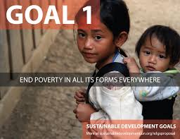
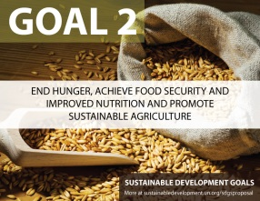
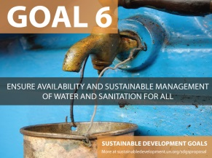
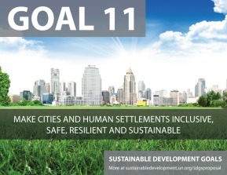
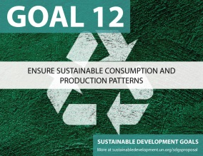
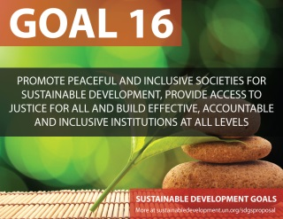
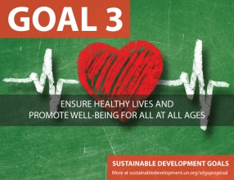
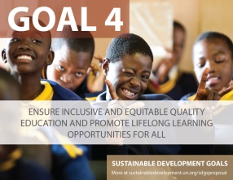
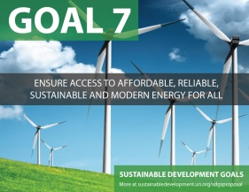
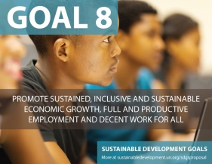
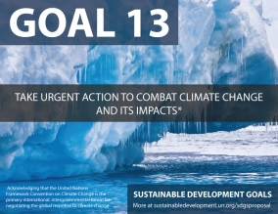
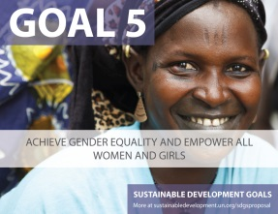
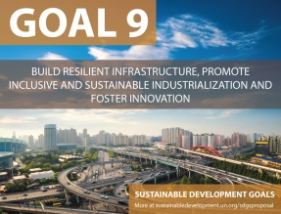
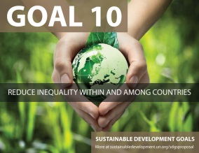
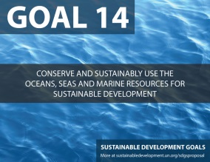
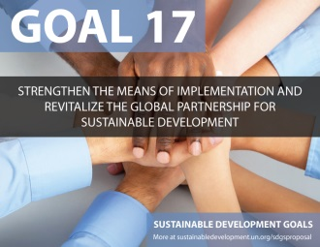
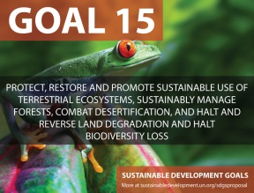
17 Sustainable Development Goals (SDGs)
Governance/ Peace
MDG’s “unfinished business”
New areas (water, settlements, urban…)
Means of Implementation, Partnerships
Green Agenda

Slide 7

IFRC contribution to Sustainable Development Goals (SDGs)
By Goal

Slide 8

Sustainable Development Goal 2:
Food Security
Livelihoods
The Cash Learning Partnership (CaLP)
Advocacy at all levels

Slide 9

Sustainable Development Goal 3:
Blood, VNRBD, First Aid
NCD, Communicable Diseases,
CBHFA, MCMH, Hygiene Promotion
Emergency Health, Pandemic and Epidemic Preparedness
Public Health Services
Advocacy all levels

Slide 10
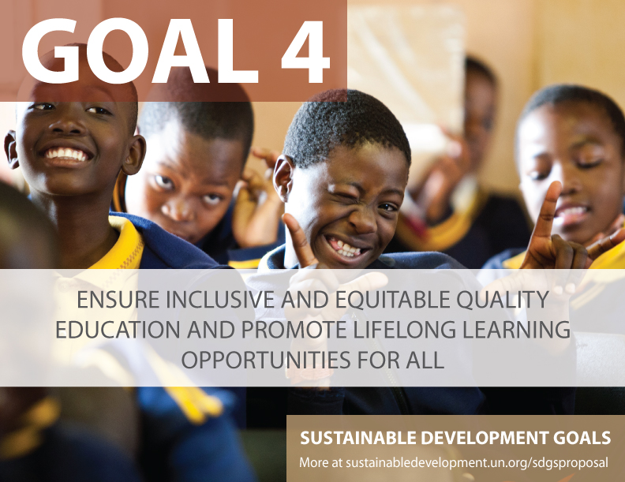
Sustainable Development Goal 4:
Through our engagement with Global and Regional Alliances for DRR and Resilience in Education and commitment to support implementation of Comprehensive Framework for School Safety at national level
Advocacy at all levels (i.e. 3rd WCDRR..)

Slide 11

Sustainable Development Goal 5:
Through our promotion of social inclusion and a culture of non-violence
Mainstreaming of gender in all our programming
Advocacy at all levels

Slide 12

Sustainable Development Goal 6:
Water and Sanitation in emergencies, recovery,
rehabilitation and
development contexts
Advocacy at all levels

Slide 13

Sustainable Development Goal 10:
Through promotion of social inclusion and a culture of non-violence (S2020-SA3) incl. migration issues
Advocacy at all levels

Slide 14

Sustainable Development Goal 11:
Through our contribution to the implementation of Sendai Framework for DRR and engagement in global campaigns on Urban Resilience. Implementation of Urban DRR & Resilience programmes at national/local levels (including response)
Advocacy at all levels

Slide 15

Sustainable Development Goal 13:
Through engagement in National Implementation Plans on Climate Change, Early Warning Early Action
Small Scale Mitigation (mangrove,
tree plantations / reforestation..)
Advocacy at all levels

Slide 16
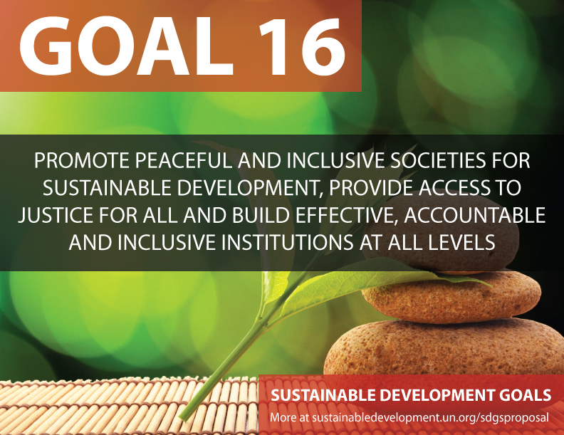
Sustainable Development Goal 16:
Through our support to the
development and Institutionalization
of legal frameworks for Disaster
Response & Disaster Risk Reduction
Advocacy at all levels

Slide 17

Sustainable Development Goal 17:
- Through strengthening of the RCRC auxiliary role to the government in development sector with focus on community resilience building
- Building new, non-traditional partnerships i.e. private sector, academia, and other stakeholders engaged in sustainable development

Slide 18
Prepared by: Indira Kulenovic, IFRC Asia Pacific Region
Thank You

