Slide 1
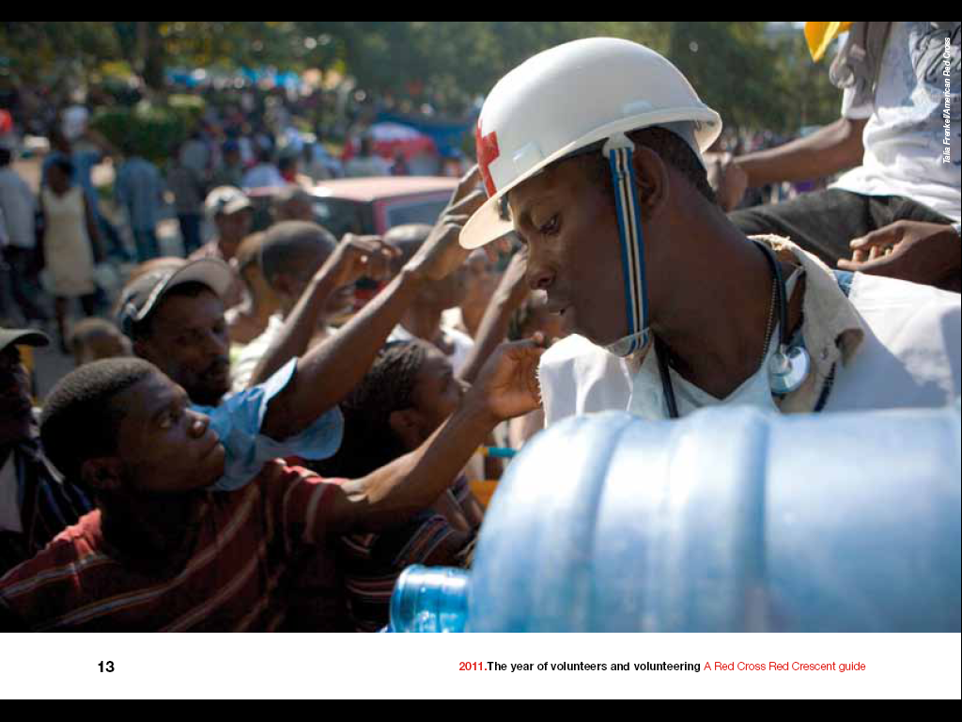
IFRC emergency response mechanisms, tools and services

Slide 2
International Red Cross and Red Crescent Movement
National Red Cross and Red Crescent Societies “National Societies”
International Federation of Red Cross
and Red Crescent Societies
“International Federation”
International Committee of the Red Cross
“ICRC”

Slide 3
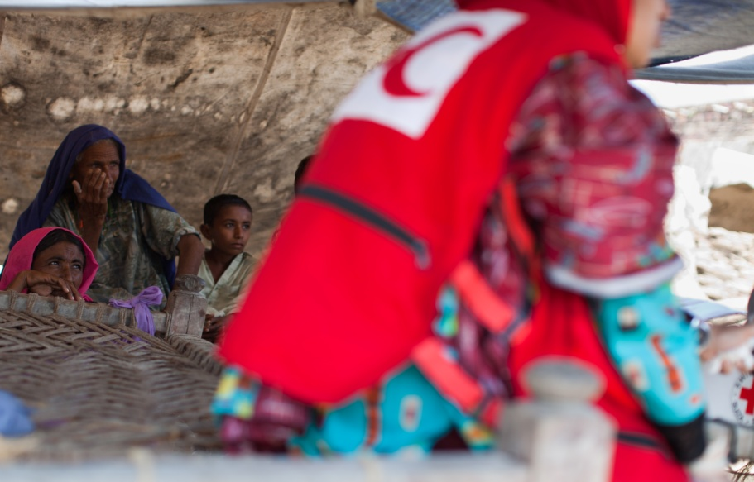
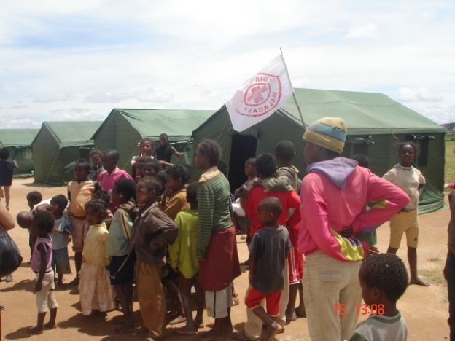
From local to global
IFRC work is to support National Society (NS) members who are auxiliary to their Governments in the field of disaster, crisis and conflict response
The work from local to global is optimising resources at each level as the scale or complexity of the disaster requires
The engagement follows agreed principles and rules where IFRC coordinates international support from other National Societies and provide assistance with global and regional tools.
The IFRC also has the task to coordinate with other actors at all levels

Slide 4



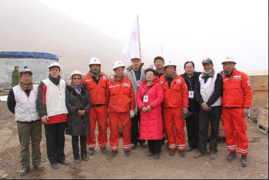
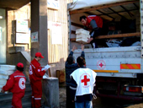



IFRC Global Disaster Response Tools
People
NDRT
RDRT
HEOps
FACT
FERST
Equipment
And People
ERU’s
Funding
DREF
EA
Information Management
DMIS

Slide 5
Disaster response & recovery tools
CASH: Cash programming in emergencies
DMIS: Disaster Management Information System
DREF: Disaster Relief Emergency Fund
EA: Emergency Appeal (marketing)
EPoA: Emergency Plan of Action
ERU: Emergency Response Unit
FACT: Field Assessment Coordination Team
HEOps: Head of Emergency Operations
IM: Information Management
RDRT: Regional Disaster Response Team
RECOVERY: Recovery assessment and planning
including household economic security (HES)
RFL: Restoring family links

Slide 6
Disaster Relief Emergency Fund (DREF)
Federation’s main mechanism for accessing immediate emergency funding
Non-earmarked funds used for start up of response in large scale disasters (loans) where Emergency Appeal (EA) is launched
Funding of small-scale disasters and preparedness for imminent disasters (grants) or DREF Operations

Slide 7
Field Assessment and Coordination Team (FACT)
Rapid international level response tool for the Red Cross / Red Crescent in disaster relief – 42 missions since 2000
Shared ownership by Federation Secretariat and 100 national Red Cross and Red Crescent Societies globally
400 people from NSs, Federation Secretariat and ICRC with range of skills have followed 2-week FACT training
Support to national Red Cross/Crescent Societies in their auxiliary role in national disaster response
Complementary to RDRT and ERU systems
International coordination (IASC clusters, PNS, donors), assessment analysis and PoA
Members are alerted via SMS and Emails
Goal is to assemble a team within 2 hours
Deploy the team within 12-24 hours
A deployment time of 2-6 weeks

Slide 8
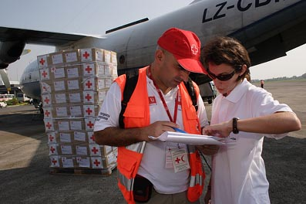
Regional Disaster Response Teams (RDRT)
Regional disaster response support system, managed by the zones
Staffed by members of national RC/RC Societies, many being volunteers
Teams trained using standard curriculum to assess and respond, coordinate with FACT and ERU, international humanitarian community
Deployment in 6-24 hours for 2-8 weeks
In Asia Pacific 275 members, predominantly in South Asia and South East Asia

Slide 9
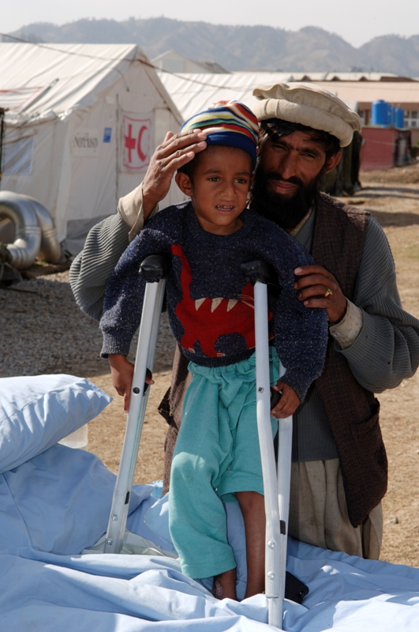
Emergency Response Units (ERU)
Standardized modular system of equipment and pre-trained teams of National Society technical specialists
Provide specific support or direct services when local facilities are either destroyed, overwhelmed by needs or do not exist
Deployment in 24-72 hours for 1-4 months, self-sufficient for 1 month
After operation, hand over to National Society trained counterparts

Slide 10
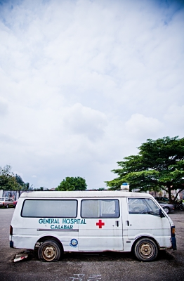
Types of ERU
    Referral hospital
    Basic Health Care
    Water treatment
    Water supply line
    Water distribution & trucking
    Specialised water
    Mass sanitation
    Telecommunication
    Relief distribution
    Base camp
The Referral Hospital has inpatient capacity of 120 - 150 beds and essential services for 250,000 people
Health Care provides curative and preventive healthcare for up to 30,000 people
WatSan treatment gives access to 225,000 litre/day for a population of 15,000 people
Water distribution 75,000 litres a day with 9 different distribution points
Basic sanitation facilities for up to 20,000 beneficiaries

Slide 11
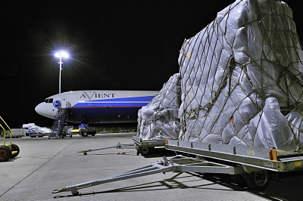
Logistics Mobilization
3 Logistics hubs (Panama, Dubai and Kuala Lumpur) and Vehicle Fleet
Base in Dubai
Framework agreements, national, regional, international
Standardized relief stocks
Standardized, donor accepted procurement procedures
Centralized procurement and dispatch of goods
Standardized systems warehousing, procurement, fleet management,
donor reporting, etc.

