Slide 1
Gender and Diversity in Disaster Management
RCRC Induction Session
AHA Centre Executive (ACE) Programme
27-29 April 2015

Slide 2
Welcome and session objectives
Presentation
Understanding of key concepts
IFRC’s approach to gender and diversity
Key issues and good practice
Role play & group exercise
Identify aspects of gender and diversity
Reflect on your own countries programmes and strategies
Discuss the importance of gender and diversity and how to further mainstream approached into DM
Notes:
Welcome everyone and introduction
Introduction of participants
Objectives for the session
Increase understanding of key concepts such as gender, diversity and vulnerability
How these concepts can be applied practically to gender-sensitive DRR and DM in preparedness planning, relief and response, and recovery and reconstruction.
Introduction to the IFRC approach to gender and diversity and into the strategies and frameworks that guide this
Roles play:
Identify aspects of diversity and understand how this links with vulnerability through practical examples
Reflect on your own country’s policies and strategies that address gender and diversity and how this could be improved reflecting on how we can improve vulnerabilities through humanitarian aid.

Slide 3
Introduction to gender and diversity
Sex: refers to the biological differences between men and women
Gender: refers to the social differences between men and women
Diversity: refers to the differences between people.
sexual orientation, age, disability, HIV status, socio-economic status, religion, nationality and ethnic origin
Notes:
Where as a person’s sex refers to the biological differences between men and women gender…..
Gender: refers to the social differences between men and women and relate to the attitudes, behaviors, roles and expectations placed on men and women as a result of being male or female
Diversity: refers to the differences between people. These differences can be physical or social and can include: gender, sexual orientation, age, disability, HIV status, socio-economic status, religion, nationality and ethnic origin
The are many interactions between gender and different aspects of diversity and these can further exacerbate a person’s vulnerabilities depending on the culture or the situation. E.g. being a women who is also HIV positive and from an ethnic minority group.

Slide 4
What characteristics do you think most describe men and women?
Notes:
Start by what you understand by a persons gender? (have a white board if possible)
What characteristics do you think of when you know someone is male or female?

Slide 5
Examples of gender stereotypes
strong
good listeners
breadwinner
emotional
well-organised
aggressive
weak
nurturing
good leaders
risk-takers
multi-tasking
Notes:
These characteristics and expectations that are put on people lead to vulnerabilities which can cause people to be marginalized within society.
Vulnerabilities can be physical, social, economic, or environmental and in times of disasters these vulnerabilities can be even more prevalent.
Put overlapping circles

Slide 6
Vulnerabilities of gender and diversity in disasters
Women, girls and boys are 14 times more likely to die during a disaster than are men
Asia Tsunami, 2004 +70% fatalities women.
Japan earthquake 65% of casualties were
/tsunami, 2011 60+
Indonesia tsunami One fifth of victims were young children
Notes:
Here are some examples of how gender or a group of people are vulnerable to a disaster…
Women, girls and boys 14 times more likely to die during a disaster than are men
More than 70% of those that died in the 2004 Asia Tsunami were women.
In three of the affected areas of the 2011 Japan earthquake/ tsunami, 65% of casualties were over the age of 60
After the tsunami in Aceh, Indonesia, 21.2% of victims were young children
Put in a chart

Slide 7
IFRC’s approach to gender and diversity
Notes:
(Add image
The IFRC ensure that gender and diversity is fundamental to all of its programmes.

Slide 8
Fundamental Principle of Impartiality
The RCRC Movement makes no discrimination as to:
Nationality
Race
Religious beliefs
Class
Political opinions.
Notes:
The IFRC’s gender and diversity work is rooted in its humanitarian mandate to prevent and alleviate human suffering without discrimination and to protect human dignity.
The Red Cross Red Crescent recognizes that women and men have different capacities, strengths, needs and vulnerabilities, which can impact resilience to disasters and crises.
The principle of impartiality - endeavors to relieve the suffering of individuals, being
guided solely by their needs, and to give priority to the most
urgent cases of distress ensures that all people will be helped equally in a humanitarian situation as well as recognizing that we cannot address everyone needs in exactly the same way without accounting how much they are suffering or how urgent their needs are – both these level of suffering and urgency of need can be impacted by their vulnerability.

Slide 9
IFRC Strategic Framework on Gender and Diversity issues
1
Systematic incorporation of gender and diversity in programs, services and tools
2
Improved gender and diversity composition
3
Active promotion of fundamental principles
Notes:
The IFRC Strategic Framework on Gender and Diversity issues (2013-2020). This provides strategic direction to the IFRC and its member National Societies by encouraging and promoting gender equality and respect for diversity.
The Strategy is in line with Strategy 2020 and the IFRC’s principles and values.
There are three key outcomes outlined in this strategy:
Outcome 1: Systematic incorporation of gender and diversity in all programmes, services and tools throughout the whole project management cycle - from assessment to planning, monitoring, evaluation and reporting.
Outcome 2: Improved gender and diversity composition at all levels e.g. governance, management, staff and volunteers.
Outcome 3: Reduced gender- and diversity-based inequality, discrimination and violence through the active promotion of fundamental principles and humanitarian values.

Slide 10
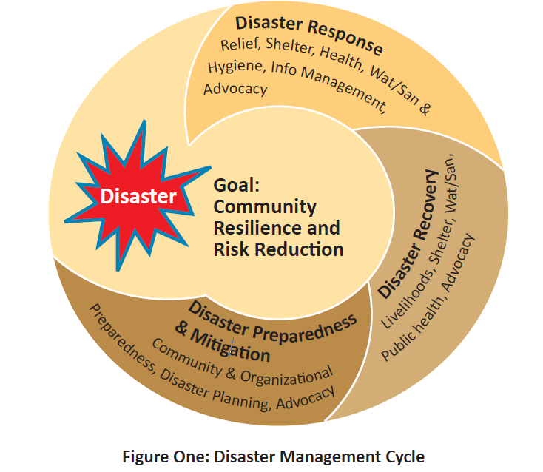
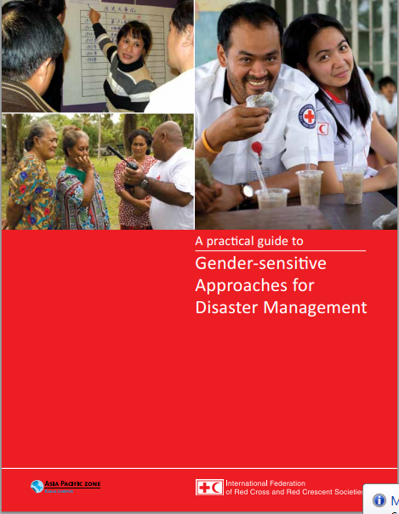
Disaster Management Cycle
Notes:
IFRC applies gender and diversity approaches to all of the work it does
In disaster management, gender and diversity needs and capacities are addressed from DRR and resilience, to response and recovery. By doing this IFRC’s support will not only benefit the groups IFRC is assisting, but it will benefit the community as a whole. Reducing overall community vulnerability and increasing community resilience. Addressing gender and diversity will have overall positive developmental outcomes as well as ensuring that they are better prepared for and to respond to future disasters.
The IFRC has developed a handbook on gender-sensitive approaches for disaster management
….

Slide 11
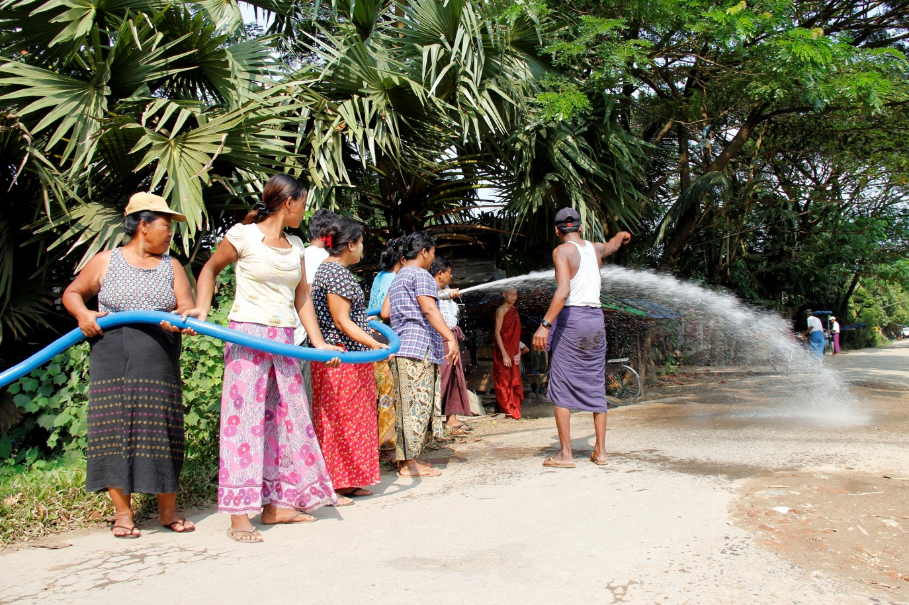
Gender- and diversity- sensitive risk reduction and resilience
Risk Factors:
Access to information
Social expectations
Opportunities for skill development
Notes:
Some of the key risk factors relating to peoples level of disaster risk and resilience and ensuring that they are prepared include:
Access to information. From a gendered perspective this relates to women and girls systematically having less opportunity for or access to education. Therefore many more women are illiterate and this put them in a vulnerable position with regards to accessing information regarding disaster preparedness systems or early warning. Also EWS are less likely to be designed to target women and ways in which women can best receive information
The death toll from the Bangladesh Cyclone (1991)was 5x higher for women than men. Part of the reason was that early warning information about the cyclone and the floods was transmitted by men to men in public spaces, rarely reaching women directly
With regards to different social groups, migrants – particularly those who are undocumented live outside of the systems designed to protect communities from disasters. As such they may be intentionally or unintentionally excluded from DRR/prepardness programmes. Another important roup of people are those with disabilities or impairments. They will have a different perception on the environment around them an may have to access information differently e.g. hearing, sight or mental or physical impairments.
It is important that when designing or planning DRR activities and prepardness programmes that all groups within a population are represented.
2) A second risk factor from a gender perspective is that because of their gender, girls and boys are not always afforded the same opportunities to learn skills such as swimming and climbing. Many women and girls will not have the opportunities to engage in these activities which could turn out to be lifesaving skills.
3) Societies expectations, for example:
Women being less able to leave the house without being accompanied by a male relative which, in sudden onset disasters, means women are unable respond to early warning information and evacuate their home immediately. (risk = building collapse or not saving elderly relatives and children)
Men and male characteristics often mean men are expected to take, and do take, more risks in the aftermath of disasters, which impacts their survival and safety. They are often less likely to seek help if they suffer from post traumatic stress for example after a disaster

Slide 12
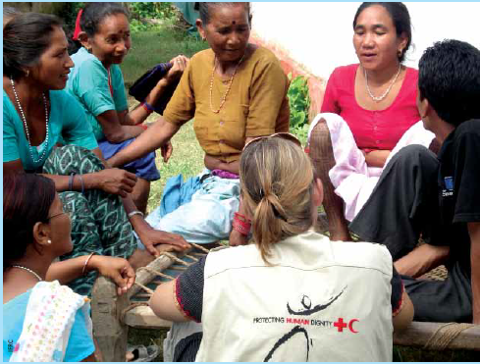
Gender- and diversity- sensitive response and recovery
Key issues:
Relief distribution
Livelihoods development
Notes:
In response and relief efforts there are many factors that can make individuals and groups vulnerable due to their gender or group to which they belong.
The distribution of relief items can inadvertently place certain groups in more vulnerable positions making the impact of the disaster even greater. An example of this is through beneficiary registration for relief distribution. Cases whereby beneficiaries are registered with the make HH or by home owners. However this can exclude groups such as FHH, widows and people who do not own property such as nomadic groups or migrants.
2) In terms of livelihoods development: Women usually have less control or ownership over assets and financial resources such as savings, loads or access to credit. Land is usually owned by the male head of the household and land rights may not be passed to the women if she is widowed after a disaster. This places her in a vulnerable situation especially if she has a family to look after. It is important that all groups in a community are included into cash for work programmes, are given a fare and equal wage to men and that flexible working hours are identifies if the women, and single male HH who also have to take care of household responsibilities.
3)

Slide 13
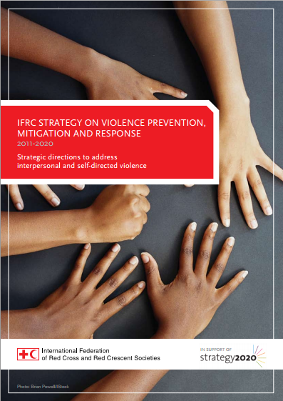
GBV following a disaster
Break down in social structures leads to reduced protection
Increased stress and increased rates of alcoholism
IDP and refugee camp environments
Notes:
Violence must also be recognised as a cross cutting issue throughout DRR and DM activities. Violence can affect women, men, boys and girls, however women and girls and men who do not conform to society’s concepts of masculinity are usually more at risk of violence as a result of their gender (gender-based violence). Gender inequality is the root cause of vulnerabilities to violence.
Following a disaster, sexual, physical and gender-based violence (GBV) is known to increase,
In times of disaster, social structures that do exist can break down and therefore people loose valuable protective networks that could have kept them safe.
Disruption to people’s social environments following disasters can also lead to increased stress within families/communities and, as a result, there can be an increased risk of violence including GBV and domestic violence. In addition, there can be increased rates of alcoholism and alcohol-related violence is frequent in disaster-affected areas.
In the after math of a disaster refugee and IDP camps are established very quickly to respond to need. However if women and men are not involved in the planning processes this can have increased security risks – particularly for women and girls. Poor lighting and lack of security (e.g. locks on latrine doors) at water and sanitation facilities can increase the risk of violence, particularly against women and girls with often no accountability for perpetrators.
IFRC works on mainstreaming violence prevention and reduction through its work – particularly with regards to its work on gender and diversity as well as One of the key ways it does this is through its youth networks and harnessing the capacity of youths to be agents of behavior change. Which you will learn a bit more about in the next session.

Slide 14
Indonesia – CBDRR after Tsunami
Indian Ocean Tsunami, 2004, 60-75% of fatalities were women
Integrated CBDRR project
Mainstreamed gender throughout operations
Vulnerability and capacity analysis for disaster mitigation planning:
Equal male and female facilitators
Gender analysis (social, environmental, economic)
Outcome: Evacuation routes were safer for women, children, the elderly and the disabled increasing overall community safety and resilience
Notes:
During the 2004 Indian Ocean tsunami women accounted for 60-75 per cent of the total number of people killed.
After the tsunami PMI committed to mainstreaming gender throughout its operations and, with the American red cross developed an integrated CBDRR project build the preparedness and response of communities.
As part of this project they conducted VCAs:
Ensured 1 male and one female facilitator.
Conducted a gender analysis – looking at social and environmental management, economic issues.
They used the results from the VCA to influence their action planning.
During disaster mitigation planning, several communities proposed constructing a stairway as part of an evacuation route to a hill they had identified as a safe location in case of a flood or tsunami. After consulting with women during the gender review, the stairway was re-designed to include a handrail and to reduce the height of the steps in order to facilitate its use by women holding babies, the elderly, children and the disabled.
These gender sensitive approaches contributed to the overall increased community safety. Made sure the project to addressed the needs and concerns of male and female community members and made them more accessible and user-friendly for women and children than they would otherwise have been

Slide 15
Myanmar – Recovery after Cyclone Nargis
Cyclone = 61% of victims were women
Gender sensitive early recovery programme
Needs assessment teams
Participation of women in FGDs
Beneficiary selection – 33% female
Inclusion of people with disabilities, the elderly, FHH, widows, landless labourers, MHH
Equal wage
Outcome: Gender-sensitive needs assessment highlighted the need for child-care facilities ensuring economic development without discrimination
Notes:
The majority of the cyclone’s victims were women – with an average of 61% but with a much higher proportion in some villages.
The MRCS with support from the IFRC responded immediately as well as helping communities transition from relief to recovery stages.
They developed a recovery programme that would also build the capacity of communities for future disasters. One of the key areas of this programme was a Cash for Work programme. Which aimed to mainstream gender throughout.
Needs assessment: The team conducting the needs assessment with both men and women team.
Women in the community were encouraged to participate in the assessment which comprised FGD, and interviews - This allowed them to find out that a particularly vulnerable group were landless female laborers had difficulty finding employment post-disaster
When they began the project:
Beneficiary selection was 33% female
Inclusion of activities that women could take part in
Equal wage payment for both men and women
Wages were paid to the actual beneficiaries rather than family members – so women received money directly
They also ensured inclusion of people with disabilities, the elderly, single headed male and female households (including widows)
One of the most significant findings came just before implementation, in the final preparations, it became clear that FFH especially those with large families found it hard to balance work and family responsibilities. As a result of this MRSC set up facilitates so that women could bring their children to work
“The project has been very useful for women like me. It has given us hope that we can recover form the disaster” – Women participant in cash-for-work programme

Slide 16
What can we do next?
Increase research and systematic collection and analysis of sex-disaggregated data
Promote women’s capacity and support their participation and leadership in disaster management
Ensure full and equal participation of women, men and marginalised groups at all stages
Review current policies, strategies, tools and programmes
Notes:
Harness the capacities of men and women and social groups within a population and ensure their equal and full participation at all stages of the DM - DRR, relief and recovery and in all stages of the programme cycle from planning, implementation, monitoring, evaluation and reporting. Ensure that it is not seen as an ‘add-on’.
Review current policies, strategies, tools and programmes and find ways to mainstream gender, diversity and gender-based violence prevention and response
Ensure the systematic collection and use of sex- and age- disaggregated data in all DRR and DM programmes. Collect qualitative and quantitative data to allow for rigorous monitoring and evaluation and more in depth understanding of gender and diversity impacts
Harness the capacity of women and support and promote their capacity to be leaders in their communities of DRR and DM

Slide 17
Thank you!
Any questions?

Slide 18
Group role play activity
Landia Case Study

Slide 19
Key issues
Situation | Groups and individuals
Land locked country | Ethnic and cultural hierarchy
Limited basic services and poor road infrastructure | People born with disabilities – often suspected of witchcraft
Recent earthquake | Urban superiority over rural
Drought causing food insecurity (agriculture) | Gender disparities- women less powerful, less decision making ability (public & private spheres)
IDPs and IDP settlements = competition for resources | Children – responsibilities but low education
Lack of latrines or water points in the informal settlements | Majority of IDP families are female-headed
 | Elderly: women – low status/ men – high status
 | Violence and social exclusion to LGBTI
 | Risk of violence/harressment travel for water
Notes:
Outline some key issues leading to vulnerability as highlighted in the group discussions from the Case Study.
It is important that we look, not only at the infrastructure and physical vulnerabilities that exist but understand and be aware of the people we are working with and how their differences can cause vulnerabilities and how this can interact with the physical world.

Slide 20
Group activity
In what ways do you currently address gender and diversity in your disaster management programming or strategies?
What are the challenges in implementing a gender and diversity-sensitive approach (perceived or experienced)?
What ways do you think you can further mainstream gender and diversity within your disaster management programming?

Slide 21
Thank you!
“...when gender equality is actively promoted, it can positively transform and enhance individual
lives as well as societies as a whole”
Notes:
What is key to remember is that women, girls and social groups that are marginalized and therefore more vulnerable have a lot to contribute and have specific capacities and strengths that can enhance overall community resilience and response to disasters.
We needs to always work in a participatory way with women, men and all groups within society to empower them to be agents of change.
Quote:
IFRC Strategic Framework on Gender and Diversity Issues
2013- 2020

