Slide 1
DEVELOPING RC MODEL Of SCHOOL BASED DRR
Prepared by: Dr. Manu Gupta
Contributions from: Ms. Shivangi Chavda & Mr. Yezdani Rahman, SEEDS

Slide 2
INCEPTION OF CSSP
Hyogo Framework of Action [ 2005 -2015] laid down the fundamentals of incorporating risk reduction in Education sector as one of the key points of actions
Children’s Charter [ Aug 2011] presented the five key points which aimed to raise awareness for the need of child centred approach to DRR and for stronger commitment from governments,donors and agencies to take appropriate steps to protect children and utilise their energy and knowledge to engage in DRR and climate change adaptation

Slide 3
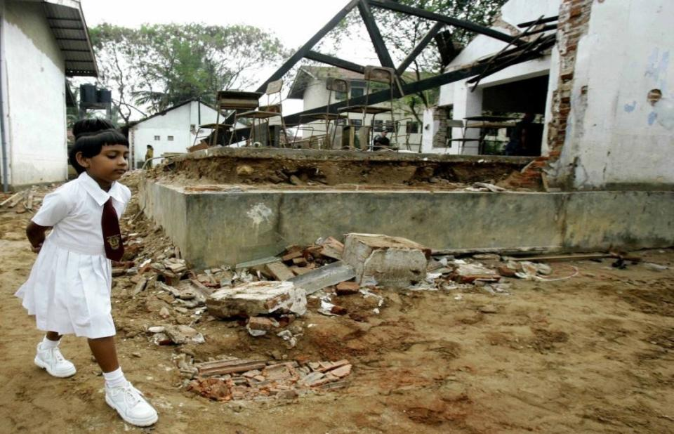
WHY SCHOOL SAFETY
Who is at fault ?

Slide 4
STORY OF SCHOOLS
“ I think that it is our right to know about earthquakes. This is because when earthquake comes everybody including our parent, teachers will try to save their own lives. At that time they may not take care of us. So we ourselves need to know what to do during earthquakes……Also it our right to have a safe school. We don’t build our school building ourselves. But if it is very weak then earthquake will destroy it and kill us. Why should children die from weakness which others create? That is not because of our fault. It is their fault who build houses. So we request all our parents, teachers to build safe school buildings for us.”
(Written by Sony, a student in Nepal)

Slide 5
LEARNING FROM PAST DISASTERS
Loss of future citizens of the country due to either structural fault of lack of planning during such events
It is also economic loss , burden to the government to set up systems again
Education discontinuity results into high drop out rates , psycho social trauma and often the children are forced into labour work after disasters and other such societal problems

Slide 6
IMPACT OF DISASTERS ON SCHOOLS
1993 : Long Beach Earthquake USA - 70 schools destroyed, 120 damaged and 41 rendered unsafe
1999 : Odisha Cyclone , India :20000 schools destroyed
2001 : Bhuj Earthquake , Gujarat , India : 1000 schools destroyed
2003 : Iran Earthquake : Schools collapsed killed 110 children
2005 : J&K Earthquake : 8000 schools destroyed , 17000 children killed , 850 teachers killed , 20000 suffered injuries
2006 : South Asia Tsunami : 1200 schools collapsed , 1000 teachers killed
2008 : China Earthquake : 7000 schools destroyed,10000 students killed , 1000 teachers killed
2008: Cyclone Nargis : 3000 schools destroyed in Myanmar, 1000 teachers killed
and it continues…Philippines 12000 schools affecting 4.4 million students..

Slide 7
WHAT IS SAFE SCHOOL?
Safe School will have strong and stable building structure which will ensure continuity of education in safe and conducive environment
Safe School will have trained human resources who have ability to cope up with the disasters or any emergencies s
Safe School has disaster management planning , with effective response , recovery and rehabilitation planning
Safe School can act as “Safe Haven” or “Emergency Shelter” for the closed community

Slide 8
Desired Outcome through our work
School based Disaster Risk Reduction Model and Framework for Red Cross National Societies
Toolkit for Master Trainer to conduct School Safety Programme.
Guidelines for Education Ministry
Notes:
It is expected from the consultancy

Slide 9
SCOPING EXERCISE based on secondary information on 5 identified parameters

Slide 10
Parameters to Evaluate School’s Resilience
Level of Preparedness
- Structure
- Non Structure
- Planning
- Integration
- Inclusion
- Resources
Level of Awareness, Training and Capacity Building
- Training & capacity building
- Awareness
- Participation
- Education- curriculum
Degree of Risk
- Losses / expected losses
- Stresses influencing children a large
- Frequency of disaster
- Severity of disaster
Exposure to Underlying Causes
- Access to basic services
- WaSH
- Health and Nutrition
- Quality Education
- Solid waste management
- Livelihood
- Other contextual factors
Collaboration with Emergency support agencies
- External Linkages
- Financial Support
- Advocacy and Network

Slide 11
Range 1 – 5:
1 – Evidence of comprehensively done. Most suited for replication and creates bench mark
2 – Evidence on great progress. Requires few improvements to achieve perfection
3 – Evidence on progress to some extent/average. Requires further Action.
4 – Evidence on limited progress. Significant intervention needed.
5 – No clear evidence of action taken. Critical intervention required.

Slide 12
Analysis
Level of Preparedness
Level of Awareness, training & capacity Building
Collaboration with External Agencies
Exposure to Underlying Causes
Risk Factor
Evidence on limited progress. Significant intervention needed.
Evidence on limited progress. Significant intervention needed.
Evidence on limited progress. Significant intervention needed.
No clear evidence of action taken. Critical intervention required
No clear evidence of action taken. Critical intervention required.

Slide 13
STRONG POINTS
Trained Volunteers
Early Warning
Policy and Regulation
Awareness
DRR & Curriculum
Coordination
Advocacy & network
Cross Participation
Awareness
Non-curricular activities
Budget Availability
Site selection
Advocacy and network
Byelaws
Integrated approach
Inclusion
Resource availability
Indonesia
Myanmar
Laos
Thailand
Linkage with Govt, Health, First Aid, Watsan are the overall major strength of RCRC

Slide 14
EMERGING MODEL OF SBDRR

Slide 15
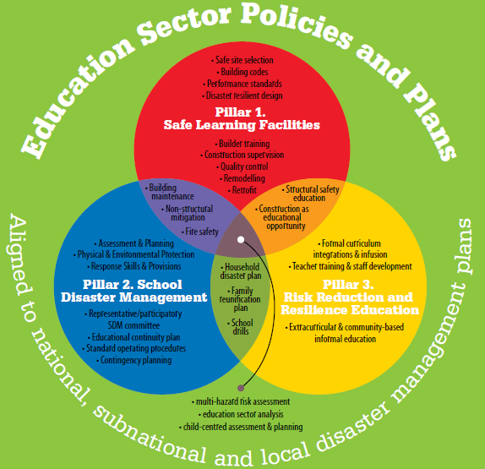
Local Government
Authorities
Networking
Service Providers
Areas require attention:
- Stresses are not adequately covered – e.g. WaSH, Protection, others
- Policy and execution at greater level required – beyond DM and Education to other line departments. Like PHED, PWD, Judiciary, Social Welfare, others.
- Accountability is to be established for all
- Networking with all stake holders as duty bearer of children is required. Strong linkages and its framework is required to be established.
Risks
Advocacy
Training &
Capacity Building
SCHOOL
Accountability
Education & Awareness
Communities
SMCs
Structural Mitigation &
Non Structural Mitigation
Resources
Citizens’ Forums
Enforcement
Advocacy
Notes:
The existing Comprehensive model on SS does not elaborate on
System Approach is required wherein external threat are actually addressed by external/line departments. Whereas in CSS model only covers education department and Disaster Management department.
Linkages with community and neighbourhood is limited to participation but a joint action is essential
Stresses only to limited extent and these threats are higher in Urban setting.
Strong monitoring mechanism to be in place and hence create accountability.
Please note: Emphasis on System approach and Citizens’ forum essential.

Slide 16
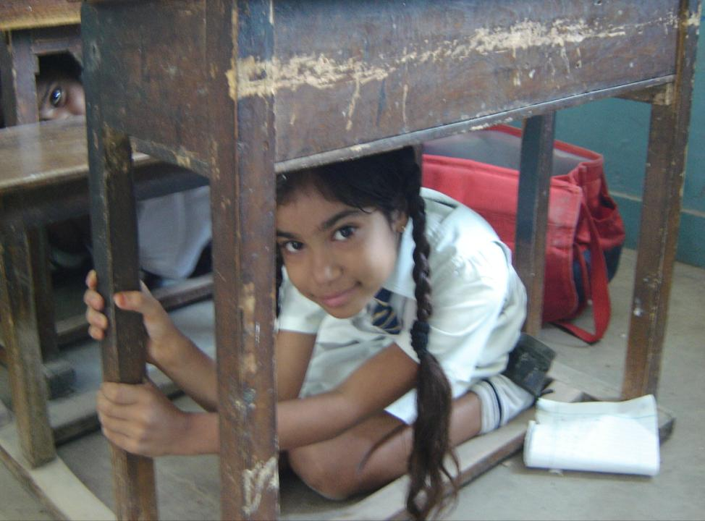
Duck, Cover, Hold
Notes:
Activities in general we do onsite.

Slide 17
Evacuation Mock Drill

Slide 18
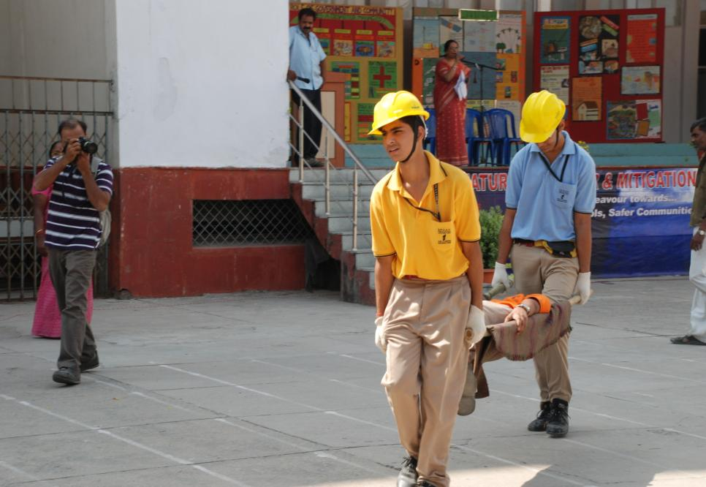
Search & Rescue Task Force Demonstration

Slide 19
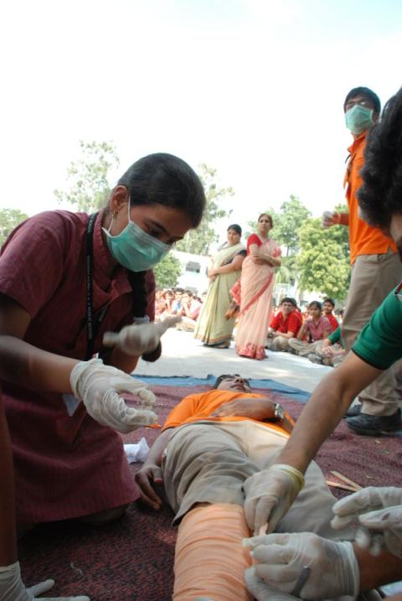
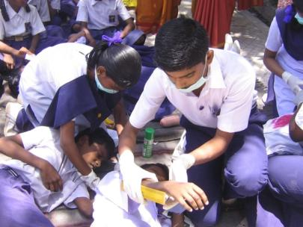
First Aid Task Force Demonstration

Slide 20
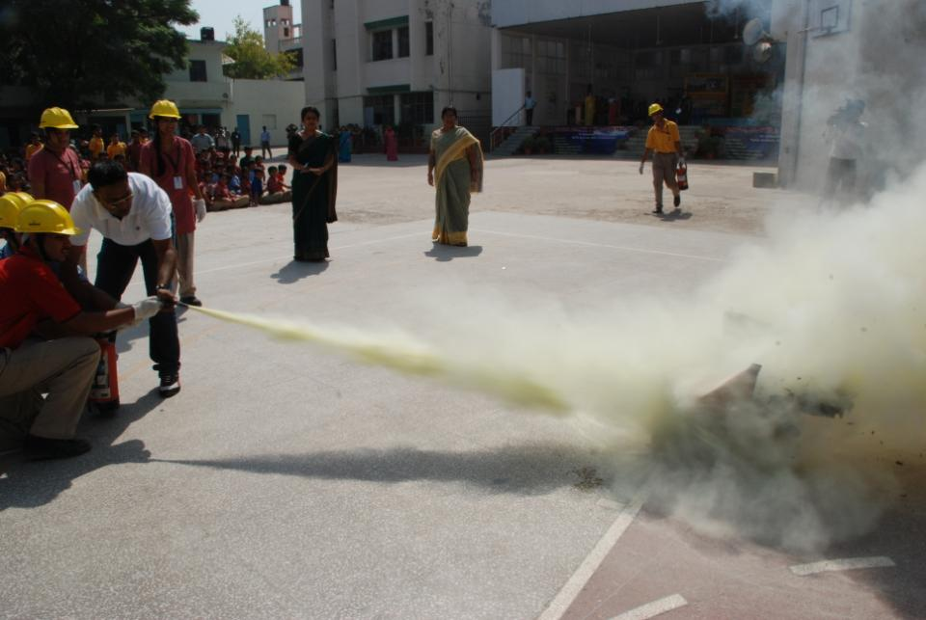
Fire Safety Task Force Demonstration

Slide 21
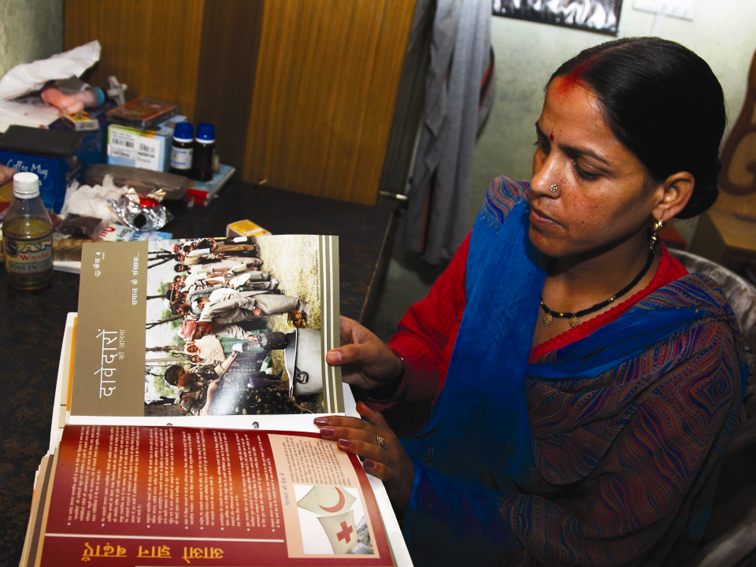
Training of Teachers

Slide 22
Notes:
It can be explained as one of the tools

Slide 23
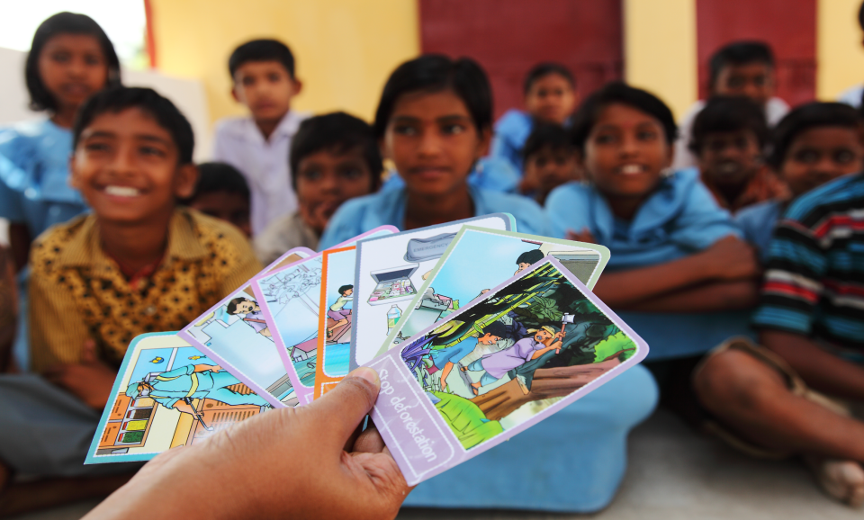
Games
Notes:
It can be explained as one of the tools

Slide 24
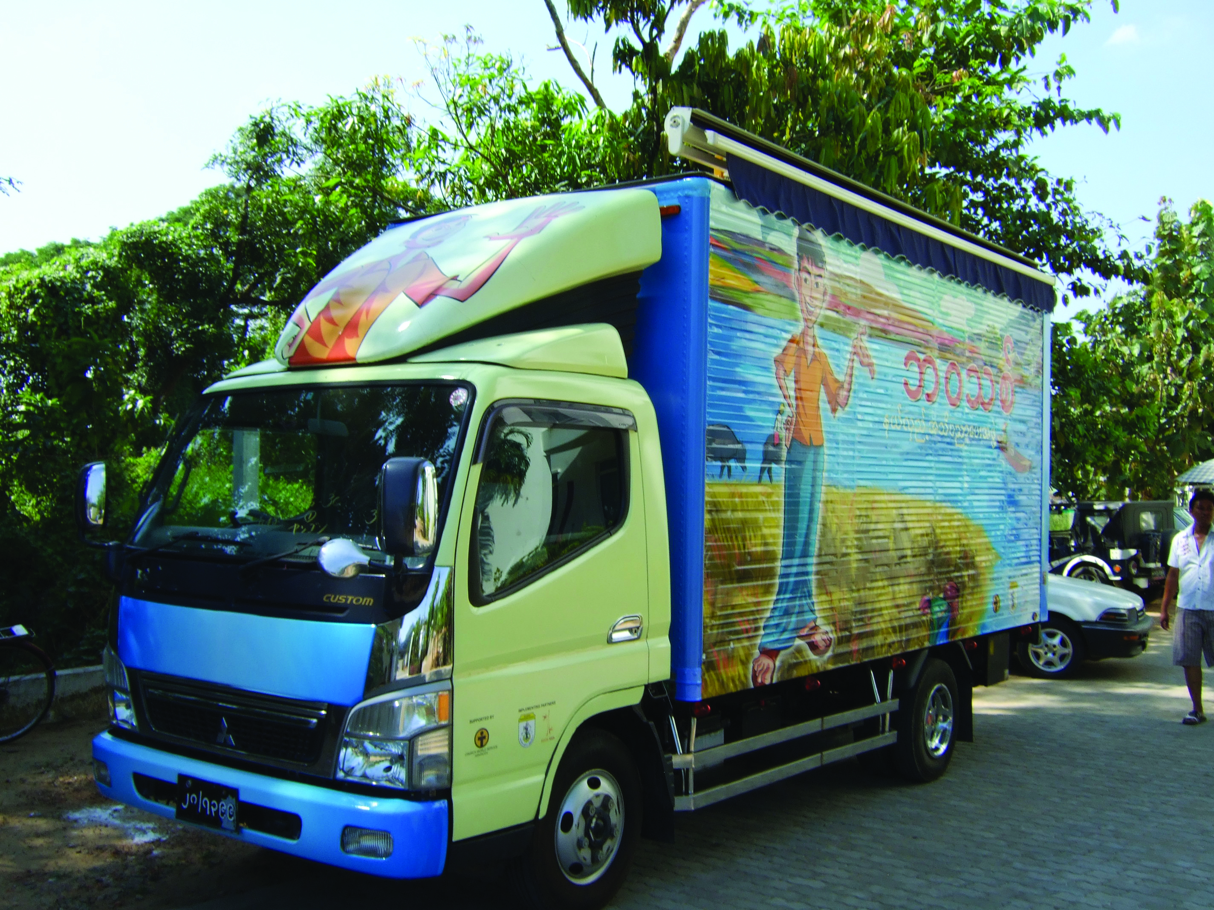
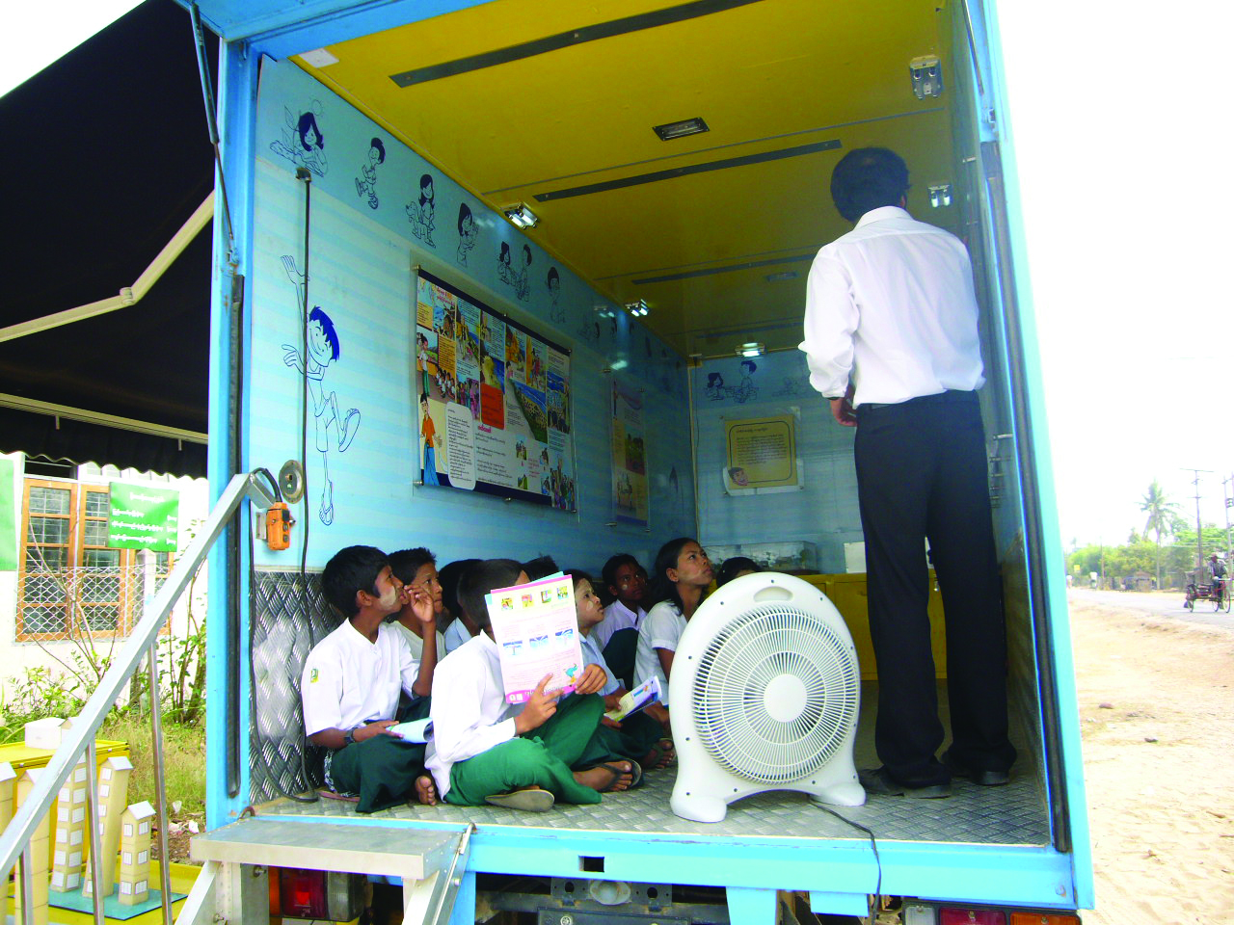
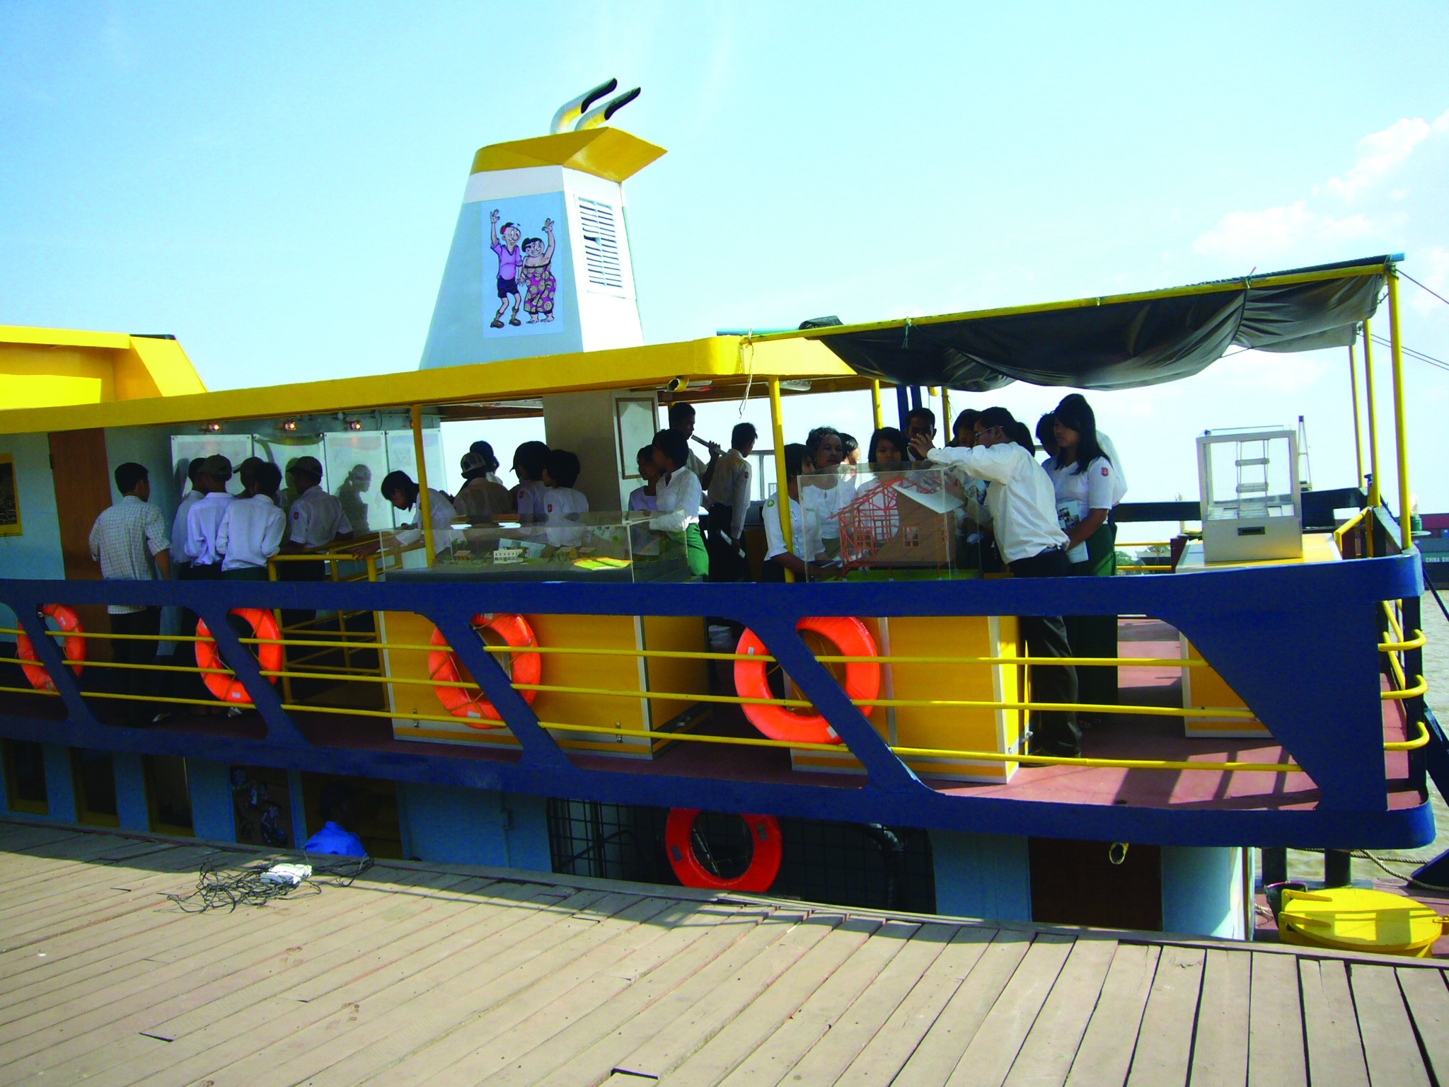
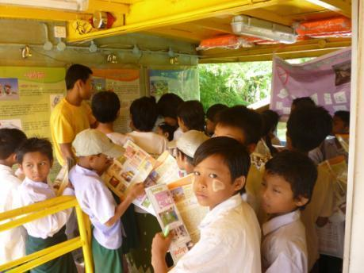
Notes:
It can be explained as one of the tools. This is on Myanmar.

Slide 25
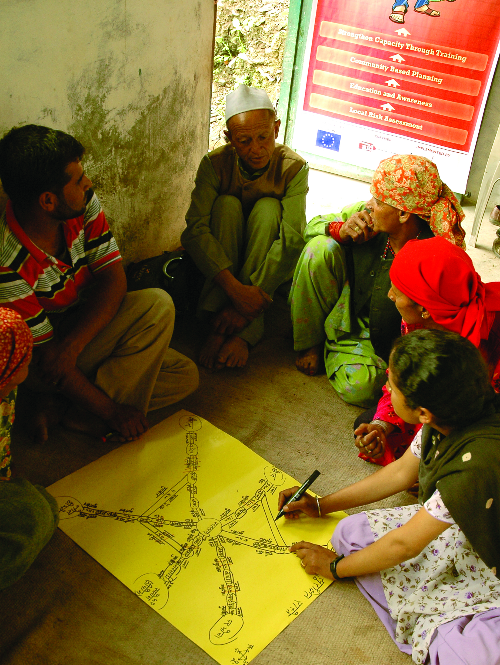
School to Community linkages
Notes:
Though participation from community is mentioned in CSSP but there is a requirement of string linkage and joint action/plan.

Slide 26
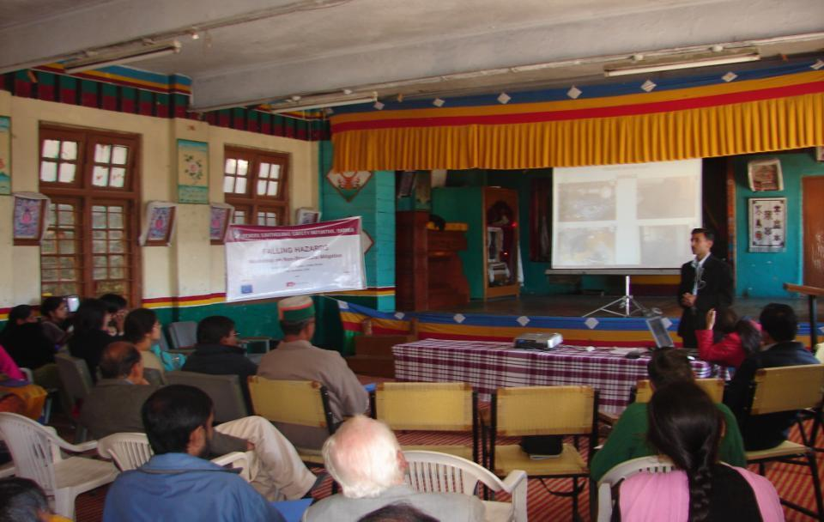
School to Parents

Slide 27
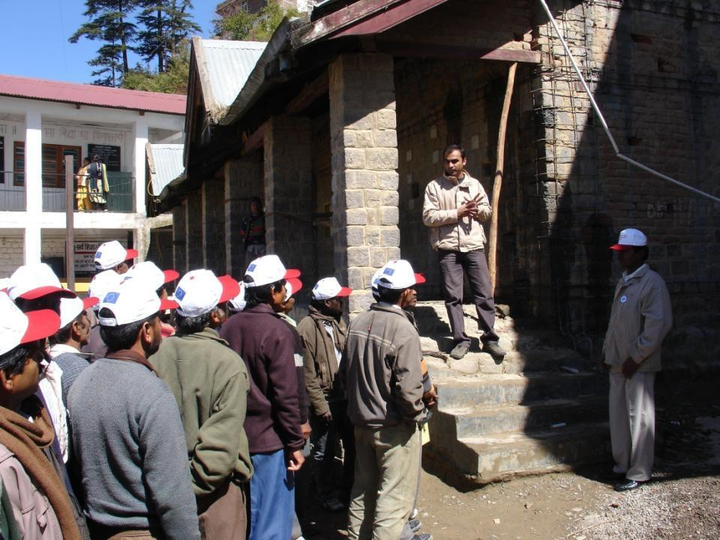
School to Masons

Slide 28
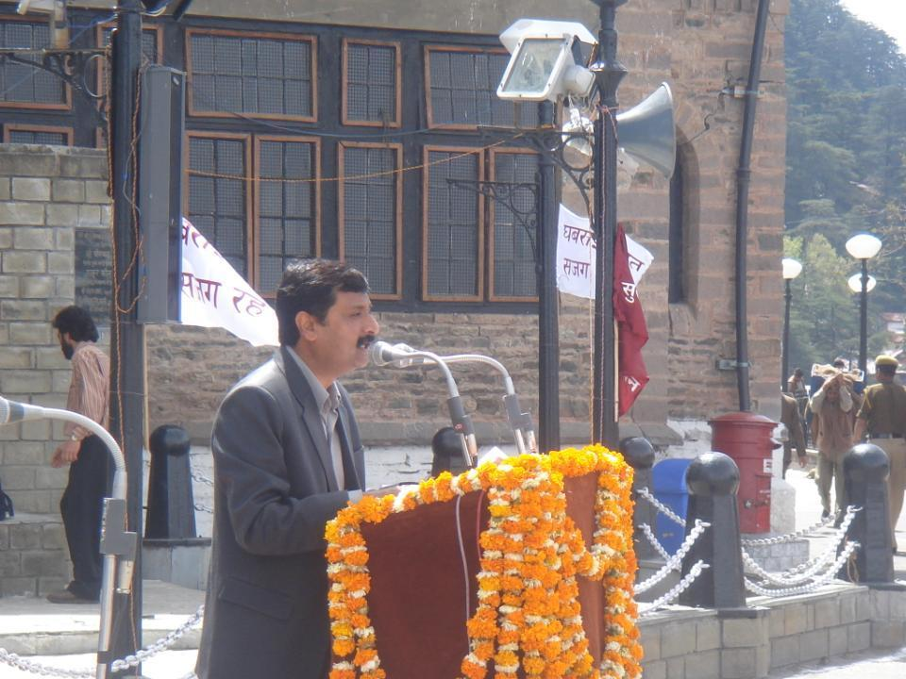
School to Government

Slide 29
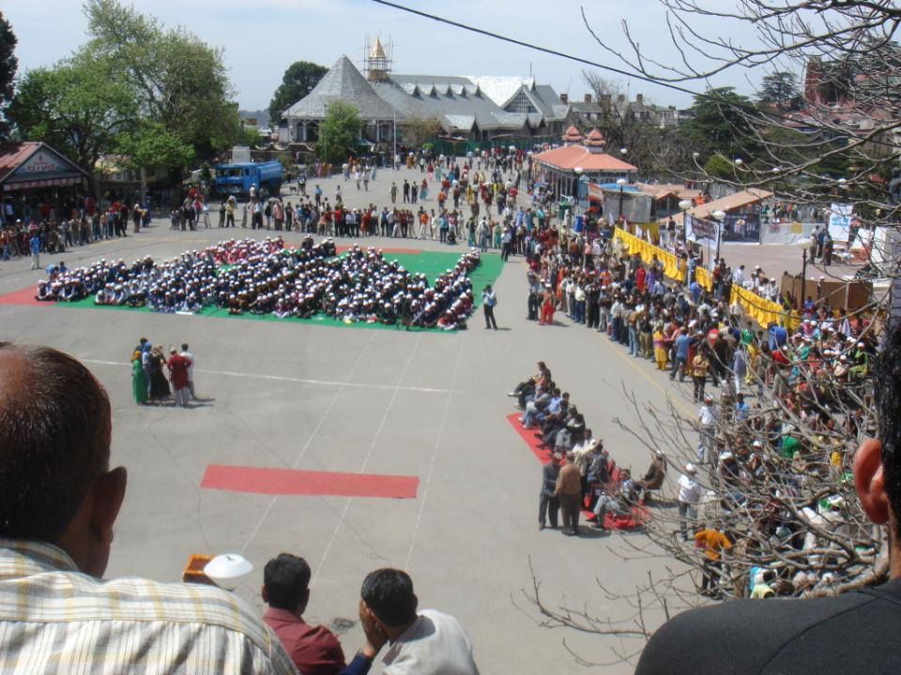
School to Neighbours

Slide 30
Generating Awareness
Stakeholders:
Care Givers, ICDS workers, Parents
Generating Awareness
Stakeholders:
Teachers, Students,
School Authorities
Generating Awareness,
Training & Capacity Building,
Stakeholders:
Teachers, Students, School Authorities
Generating Awareness,
Training & Capacity Building,
Stakeholders:
Youth Volunteers,
Community representatives, Citizen Forums
0
5
12
18
24
AGE GROUP
Non School going children
School Going Children
Primary to Higher Secondary
Youth Volunteers
Out of school Children

