Slide 1
Climate Change Adaptation in Disaster Risk Reduction Programming

Slide 2
Questions
What does Climate Change Adaptation mean?
Why Should we mainstream Climate Change Adaptation?

Slide 3
Disaster Risk Reduction
The concept and practice of reducing disaster risks through systematic efforts to analyze and manage the causal factors of disasters, including through reduced exposure to hazards, lessened vulnerability of people and property, wise management of land and the environment, and improved preparedness for adverse events

Slide 4
Climate Change Adaptation
Adjustment in natural or human systems in response to actual or expected climatic stimuli or their effects, which moderates harm or exploits beneficial opportunities
Notes:
The definition recognizes that humans can adjust to past ("actual") climate change and its impacts, or prepare for projected future ("expected") climate change and its impacts. Adaptation can include changes in behaviour, technology, institutions, policies, and other aspects of human systems. (IPCC Definition)

Slide 5
Mainstreaming CCA and DRR
Considering and addressing risks associated with disasters and climate change in all processes of policy-making, planning, budgeting, implementation, and monitoring.
Notes:
The definition recognizes that humans can adjust to past ("actual") climate change and its impacts, or prepare for projected future ("expected") climate change and its impacts. Adaptation can include changes in behaviour, technology, institutions, policies, and other aspects of human systems. (IPCC Definition)

Slide 6
Exercise
Divide Participants into 5 groups :
Group 1 : Geophysical Hazards
Group 2 : Rainfall
Group 3 : Storm
Group 4 : Sea Level Rise
Group 5 : Raise of the Temperature

Slide 7
Exercise (cont.)
Identify Its Consequences
Identify its Possible Impact on People and Society
Identify the actions to prepare to and reduce its impact

Slide 8
Overlap between DRR and CCA
changes in average
climactic conditions,
including sea level
rise, biodiversity loss
and spread of climate
sensitive disease.
geophysical hazards,
including volcanic
eruptions, earthquakes
and tsunamis.
hydro-meteorological
hazards, including
droughts, cyclones and
tropical storms.
Notes:
8
8

Slide 9
Overlap between DRR and CCA
Climate Change Impact
Disaster Impact
(geophysical hazards)
Disaster Impact - hydro-meteorological
hazards
Notes:
9
9

Slide 10
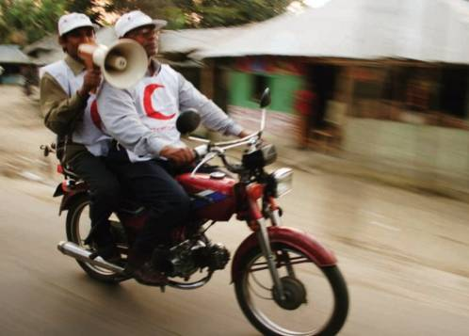
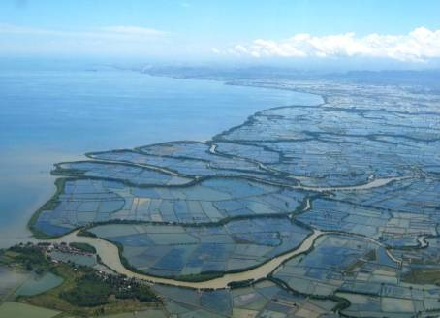
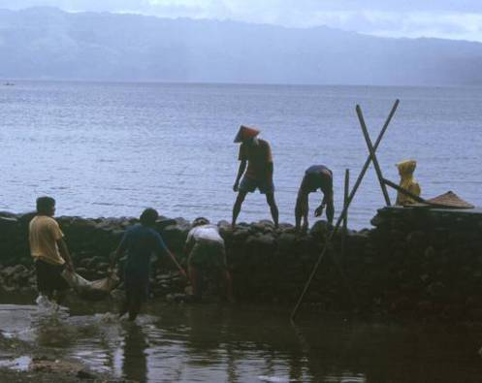
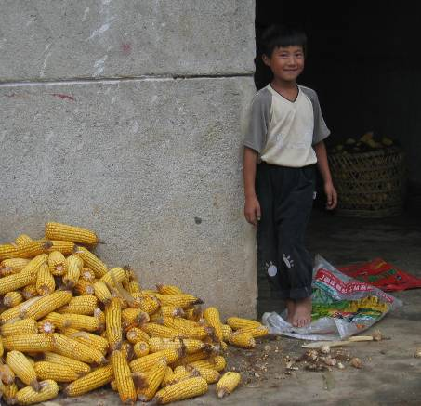
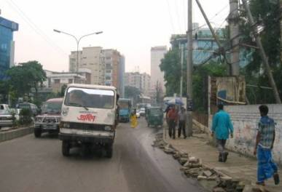
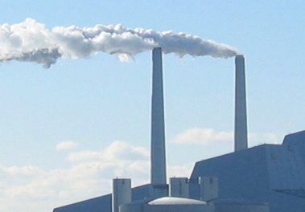
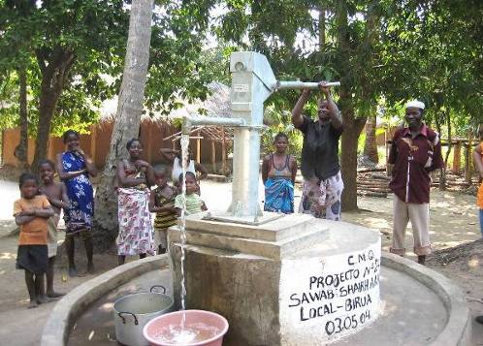
Overlap between DRR and CCA
adaptation to climate change
adaptation to climate change
Long-term adjustment to changing average climate conditions (incl. benefits)
Climate risk management
(including weather extremes)
DRR central in CCA – by addressing current climate risks
Risk management of geophysical (and industrial/man-made) hazards
disaster risk reduction
disaster risk reduction
Based on Mitchell & van Aalst 2008
Photos: Danish Red Cross
Notes:
10
10
This diagram illustrates that there is a broad area of overlap in the fields of DRR and CCA, although some fundamental differences remain.
Difference include, for example, that DRR addresses geo-physical hazards such as earthquakes and volcanoes – and man-made hazards (including conflict, traffic accidents and, possibly, industrial/pollution) while climate change adaptation doesn’t.
On the other hand, CCA tends to focus on long term changes to average conditions such as temperature and sea level rise – and the associated risks (e.g. sea level rise may cause flooding, erosion and salt intrusion into low-lying areas, glacier melt may change water availability on medium to long time scales) as well as benefits (e.g. new crop types may be cultivated in some areas). DRR however tends to be more focused on extreme weather events.
The main overlap between the two is the management of hydro-meteorological hazards.
And this large overlap – Climate Risk Management – is what the Red Cross Red Crescent Movement already has a vast experience in.
So the well-known approaches and tools of ‘traditional DRR’, including the VCA (see separate module) and practical early warning systems, flood prevention measures and protecting wells etc. mainly need to be a little better planned, designed and placed – and make better use of weather/climate information – in order to also become ‘climate-smart DRR’. And they need to be scaled-up to reach more communities affected by increasing climate risk.
IPCC’s AR5: Adaptation is fundamentally about risk management

Slide 11
Climate risk management builds on existing capacities and knowledge
Notes:
11
The range of protection mechanisms (“soft” as well as “hard” measures) invented over millenia to protect assets against effects of natural hazards are still relevant.
But with climate change the existing knowledge and design may be overwhelmed by changes in climate, such as unprecedented extreme events. Our old dykes (a metaphor, of course, for all sorts of protective measures) may no longer be good enough to protect us.

Slide 12
Climate risk management is an add-on to existing programmes and projects
Notes:
12
Again metaphorically, we may need to build our dikes higher.
So we do not necessarily invent new measures to counter the effects of climate change, but need to plan for a worse future and design our existing strategies to changes in climate, including more extreme weather events.
Also in Red Cross Red Crescent work, climate risk management can be considered an ‘add-on’ to further strengthen our programmes and activities.

Slide 13
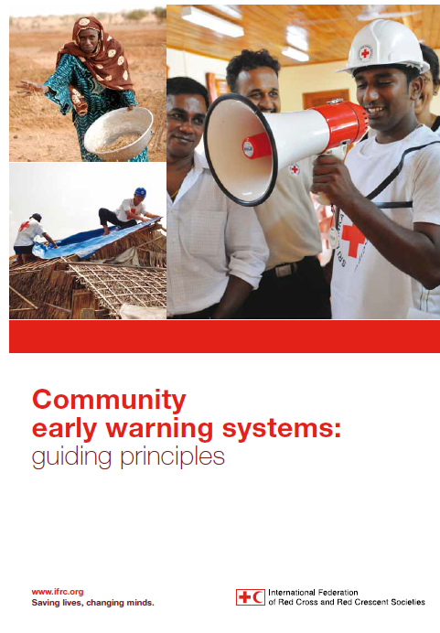
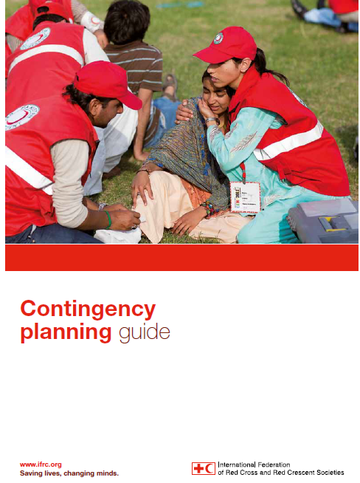
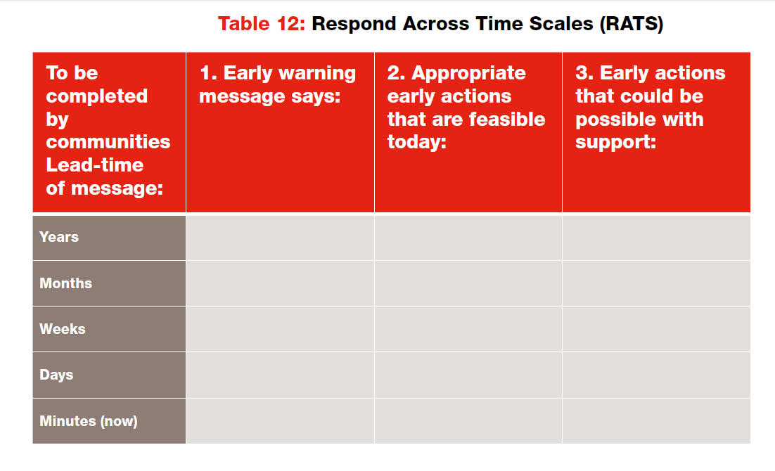
New good IFRC guides
Accommodate multiple timescales
”...we respond to warnings, not disasters”
Account for evolving risk and
rising uncertainty

Slide 14
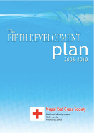
Enhancing existing work – integration, not stand-alone programmes!
Photo: NASA
Climate lens
Notes:
14
Addressing climate variability and climate change should not be done in a stand alone programme or project. It needs to be considered amongst much of the work we already do. For Disaster Management the types of actions we take – such as community-early-warning systems and mobilising networks of volunteers - remain largely the same, however the process to design these actions needs to be different, for example information we gather may help determine the scale, when and where, certain actions occur. What follows are some steps for considering climate and weather information to further enhance your DM work….

Slide 15
CCA a cross-cutting issue – so may involve most departments / programmes
Disaster Management
Health and Care
CLIMATE (CHANGE) RISKS
Water and Sanitation
Food Security
etc....
Notes:
Although climate change is often perceived as most relevant in relation to disaster management, it is a highly relevant issue for most departments or programmes in a National Society.
See the Climate Training Kit modules on Health, and Community Climate Risk for further examples of how climate change can be addressed.
15

Slide 16
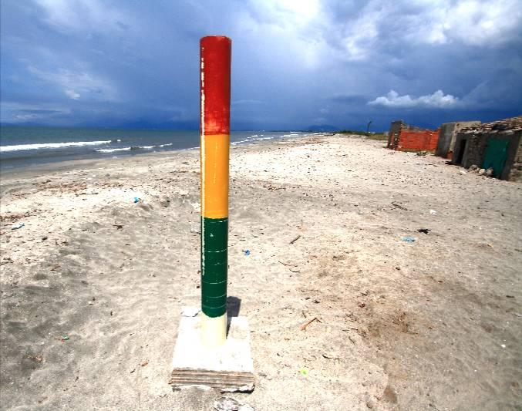
General steps
Assess your National Society plans and work areas in light of climate information and establish priorities:
What are the current risks – and how will they be affected by climate variability and change?
What needs to be done differently?
Where do we want to focus?
Photo: Alex Wynter/Netherlands Red Cross
Notes:
16
16
The picture shows a sea-level warning mast in the village of Tasajera, on Colombia’s Caribbean coast, installed by Colombian Red cross volunteers as part a DRR project.
Tasajera and other villages are exposed to storm surges from the sea and floods originating inland as rivers. The mast pictured is painted in standard traffic-light colours of red, yellow and green, giving villagers a clear idea of what to do when a seaborne disaster threatens; the precise levels for the painted bands were initially established by environmental experts from the local authorities. Red means evacuate – to designated sites.

Slide 17
1.Preparedness for response
climate
and weather information with different lead times
4.Recovery
2.Disaster Risk Reduction
3.Food Security
Notes:
We believe that many Disaster Management interventions could benefit from the use of climate and weather information. This information might include information relating to climate change, such as changing trends in rainfall, and also climate variability, such as the El Nino/La Nina phenomenon. We will walk through some of them in the next slides.

Slide 18
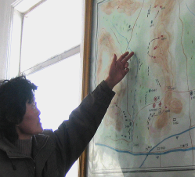
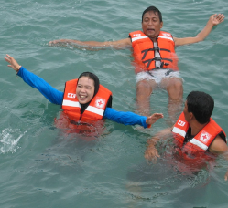
Enhancing preparedness for response
Accounting for new and rising risks due to climate change, for example:
Contingency planning including pre-emptive actions based on climate and weather information
Reviewing location of relief warehouses and distribution channels, evacuation centres etc.
Mobilisation and training of a sufficiently large volunteer base ready to assist in impending disasters
Can you think of other potential actions?
Photos: Danish Red Cross
Notes:
18
When it comes to ‘preparedness for response’, the following actions are very relevant:
Contingency planning: eg can your Meteorological office send you automatic updates on how long the intense rainfall or drought is likely to last? What preparedness could be taken based on certain scenarios – such as information that an El Nino event is occurring? Does your contingency plan contain elements such as this?
If you get a warning for extreme weather in the coming days, there is no chance to reposition stocks. If you get a warning over a longer period of time (seasonal warning) could you still supply warehouses in the likely affected areas with enough stock? Will you mobilize your volunteers ahead of time in those areas and can they warn vulnerable people who have no access to this warning? Which other actions could you think of, ahead of time? (evacuations based on early warnings, radio warnings, set up of a whistle warning system run by volunteers in remote areas, etc)
On a longer time scale: would the National Society (and Governmetn parterns) need to reconsider if warehouses are in safe locations even for unprecedented extreme events?

Slide 19
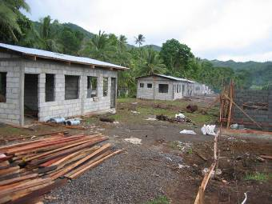
Enhancing Recovery
“Don’t rebuild risk”:
Long term safe areas need to be identified before shelters are built or beneficiaries are relocated; e.g. are shelters on higher ground in flood prone coastal areas?
Photos: Danish Red Cross
Notes:
19
In the post-disaster recovery there are huge opportunities for “building back safer”. Collaboration with land use planners and climate scientists may help identify safer areas than those devastated by the recent disaster – i.e. the site selection must be based not only on historical disaster events, but also based on trends and long-term forecasts for sea level rise and new extreme rain and flood level events.
Of course such land use planning may be controversial. But rebuilding without somehow considering the future risk scenarios should not be an option.

Slide 20
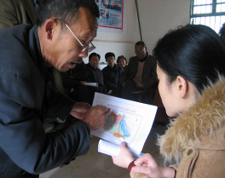
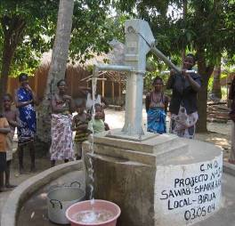
Monitoring and documenting impact
Include indicators to verify DM programmes are ‘climate-smart’ and contribute to ‘adaptation’, e.g.:
Are DM Standard Operating Procedures (SOPs) and contingency plans adjusted to monitor seasonal forecasts and react to them?
Are there plans to ensure emergency response infrastructure and stocks are positioned in safe locations in case of more extreme events?
Are community risk reduction plans designed to handle more extreme events?
Do at-risk communities have access to early warning information (and can they react)?
Photos: Danish Red Cross
Notes:
20
20
In line with IFRC ‘Project/programme monitoring and evaluation (M&E) guide’ 2011
see http://www.ifrc.org/Global/Publications/monitoring/IFRC-ME-Guide-8-2011.pdf
Ensure there are relevant parameters and baseline data to verify that DM and DRR programmes are being adjusted properly to handle a changing climate.
There is no fixed list of ‘climate indicators’ but the design of any program plan and/or logframe needs to pay due attention to specific indicators that can help gauge if the efforts lead to more climate smart planning and behaviour.
A key point is to document the final impact – in case studies etc. and share such ‘good practices’ to stimulate up-scaling. Please visit the communication module for more guidance on communication.

Slide 21
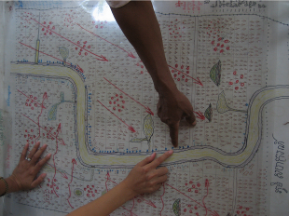
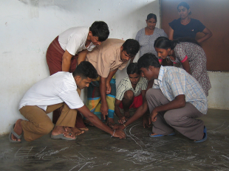
Community Assessments
Consider how climate and weather-related hazards adds to community risks by using the Vulnerability and Capacity Assessment (VCA)
Climate change should be considered amongst the many factors that affect risk – and addressed in the VCA and ‘community risk reduction plans’ (“Plan of Actions”)
Photos: Danish Red Cross
Notes:
21
21
The first people to respond to disasters are the community people themselves. They already have existing knowledge of how weather and climate affects them. As you can see in the Community Climate Risk module, VCAs can easily extract information on climate risks, and help to stimulate relevant discussions with community members about possible solutions to those risks. Feeding this information on climate risks, and community level solutions, into Disaster Management planning is important.
If you like to learn more about how to consider climate risks into the VCA, please read our guidance note in relevant reading section of the Community Climate Risk module.

Slide 22
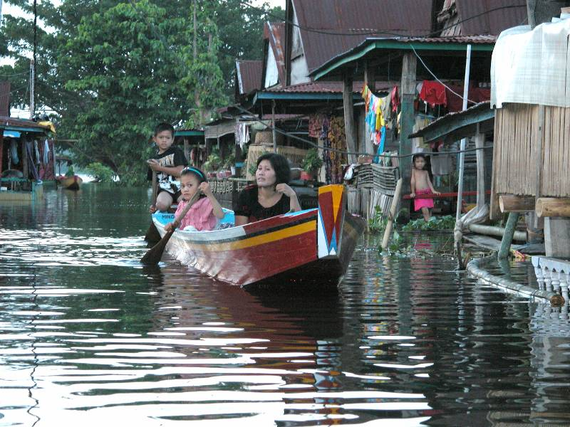
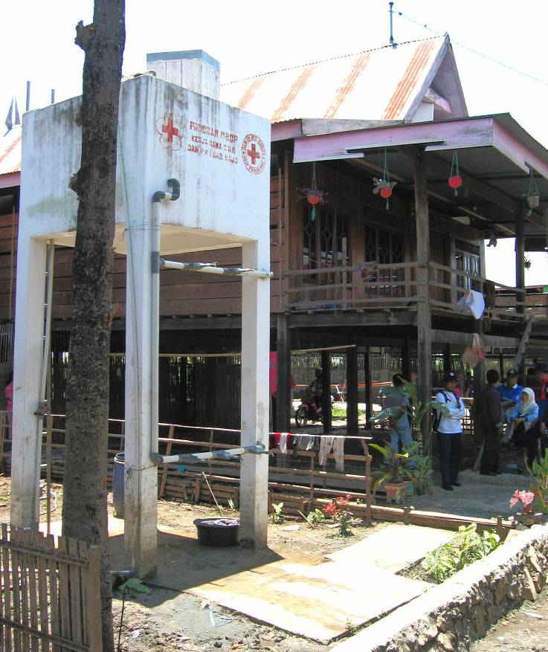
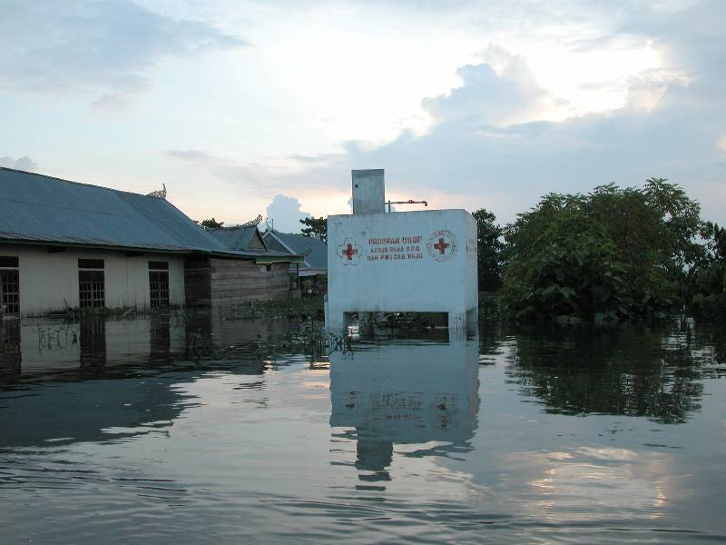
Climate-smart DRR/CCA?
Photos: Danish Red Cross
Notes:
22
An example from Indonesia: Indonesia Red Cross (PMI) programme supported by Danish Red Cross; the programme was planned 2002, i.e. before CC was high enough on the agenda to be well incorporated into the community-based programmes.
Situation:
A community-based programme
A community at the edge of a lake that every year swells and expands in the rainy season
People are used to the annual floods and are prepared by having houses on stilts, and boats for transportation during the flood season
In the DRR programme, the community (via VCA) identified one of their primary risks: the lack of clean drinking water in wet season – causing many water-borne diseases, especially diahorrea
The DRR Programme supported (among other things) construction of water towers to ensure access to clean water year round: they have taps at ground level for access in dry season – and taps at 3m level for safe access by boat in wet season (see picture)
But since the planning of the design of water towers (and the houses too) was based on local experience and historical evidence of flood levels, the design did not prepare for un-precedented flood levels – which could be expected due to changes in rainfall patterns as a consequence of climate change.
So at a flood some years later, even the upper taps were flooded - as were the floor levels in most houses (see picture).
Future programmes could help raise the houses to a higher level, and new water towers should be built higher – which would make the DRR programme”climate-smart” and promoting CC adaptation. This kind of thinking and adjustments to DRR plans is what now makes PMI one of the Indonesian agencies capable of implementing community-based CCA programmes.
How much higher should houses and water tanks be buildt? This is the type of question to be discussed during consultations with local knowledge centres (Universities, local planners and others) – and not just ’guesswork’ by local people, NGOs or the Red Cross staff/volunteers etc.

Slide 23
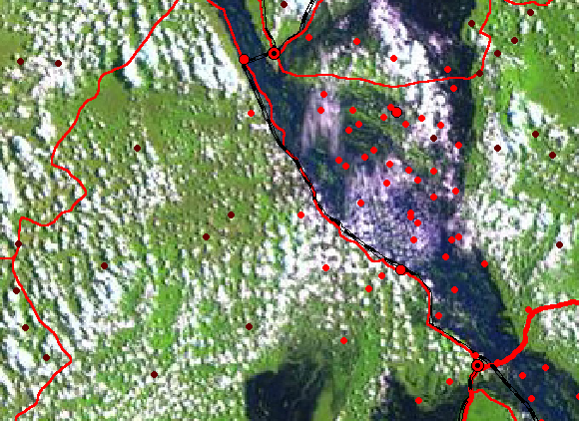
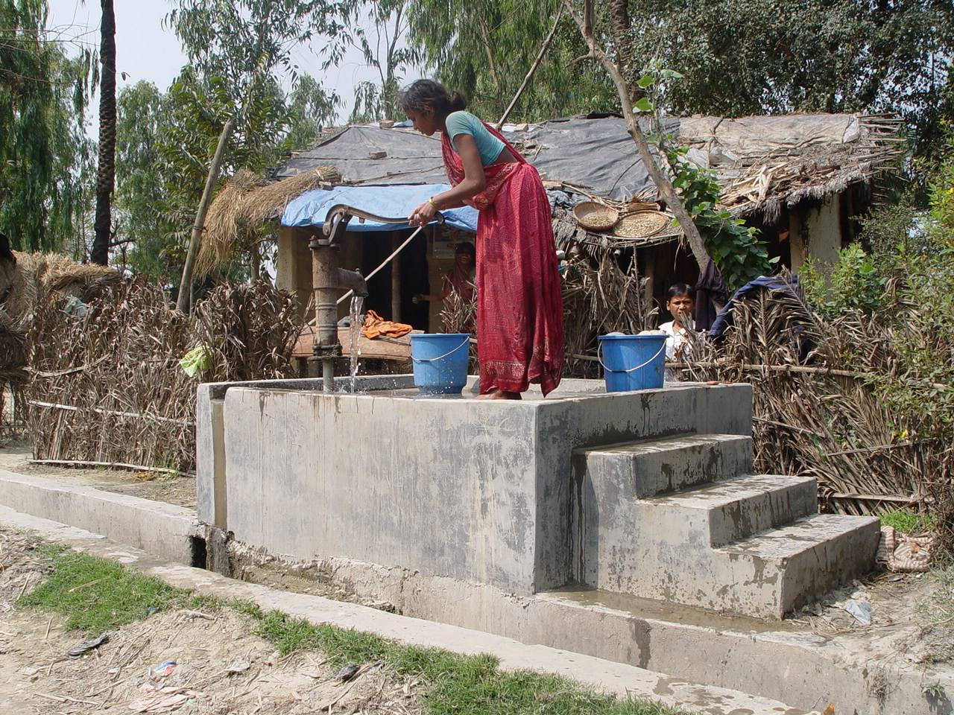
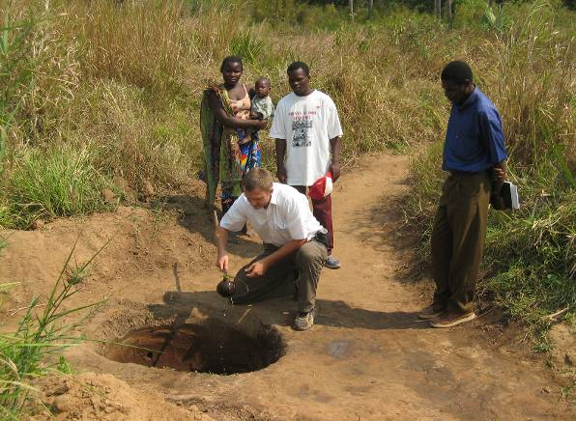
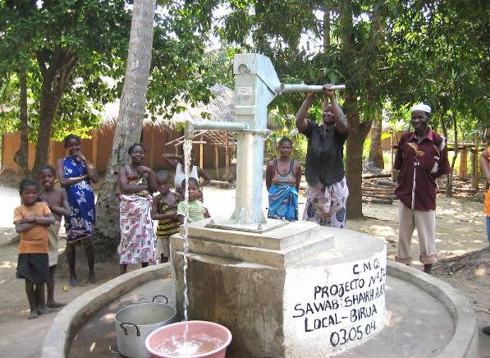
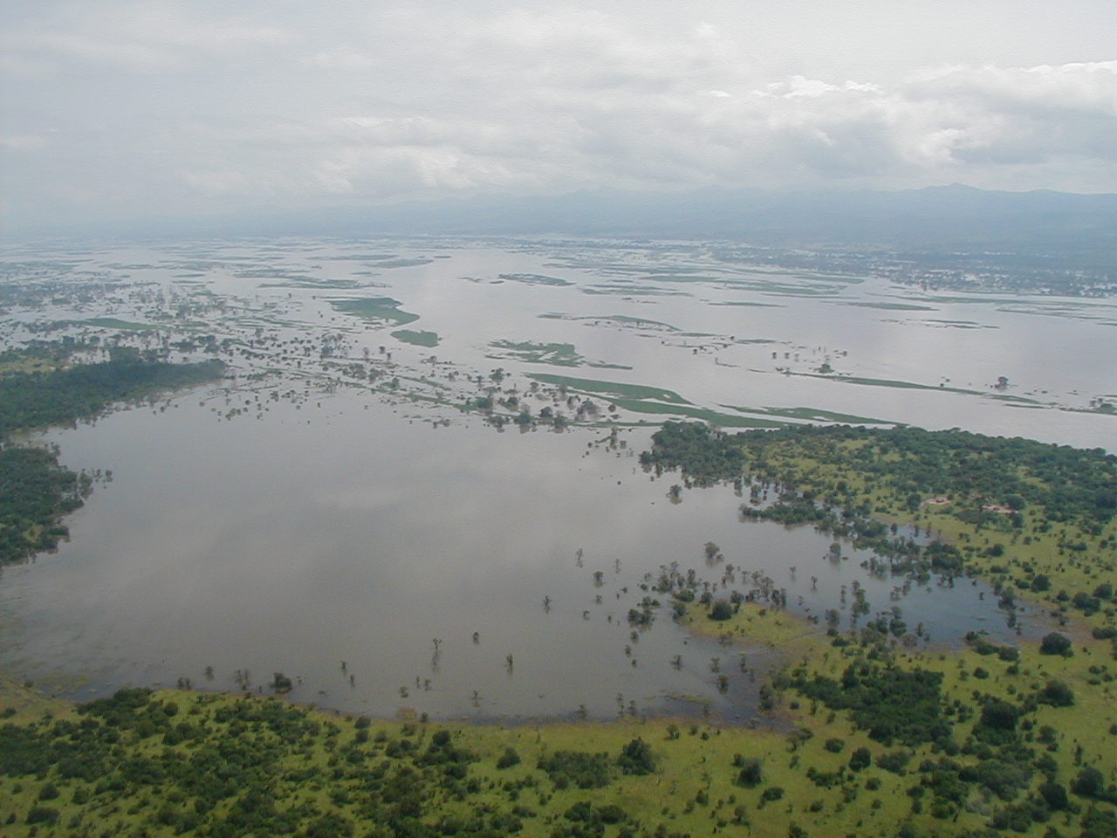
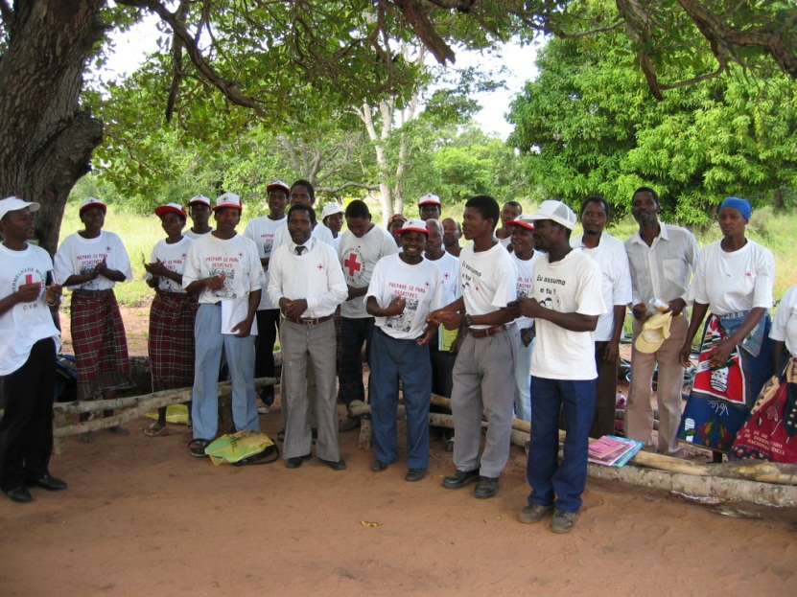
Small-scale risk reduction & adaptation examples - Mozambique
Community-based programmes: warning and evacuation plans + Wat/San
Notes:
Satellite view of 2000 floods – the red dots are villages, the blue/black water, and the green ’dry land’
In the middle of the flooded areas, relatively little communities can do physically protect themselves, but:
Improving warning and evacuation systems, incl. Ways to protect assets are among the means
Protecting wells (especially at margins of expected flood areas, helps prevent disease outbreaks during and after floods

Slide 24
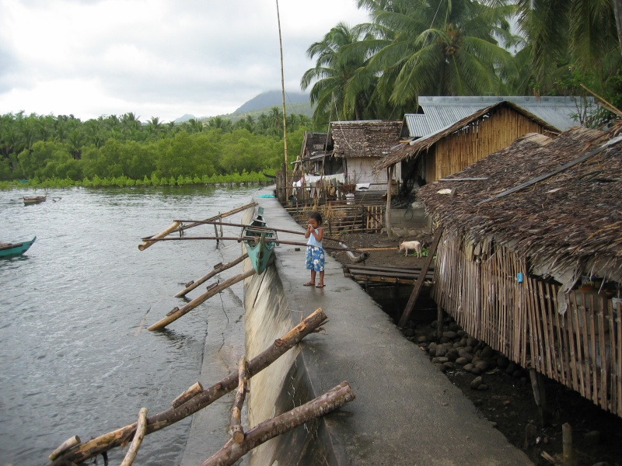
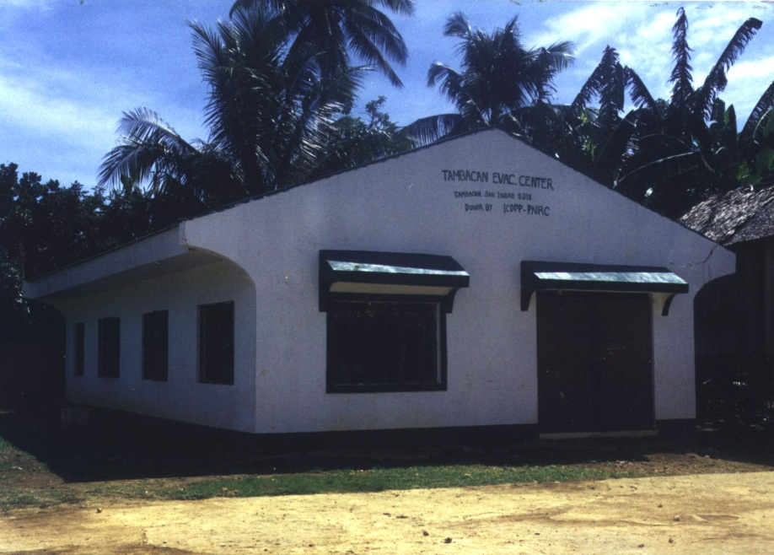
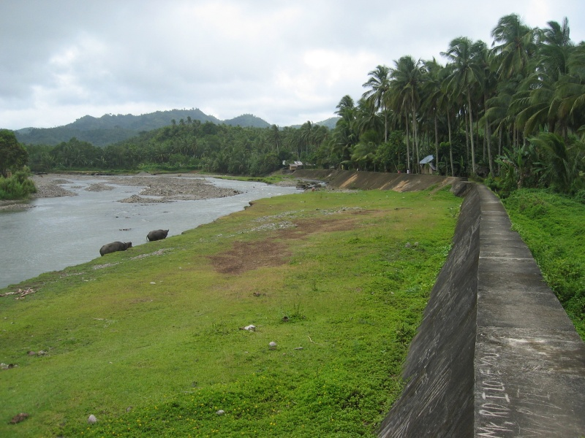
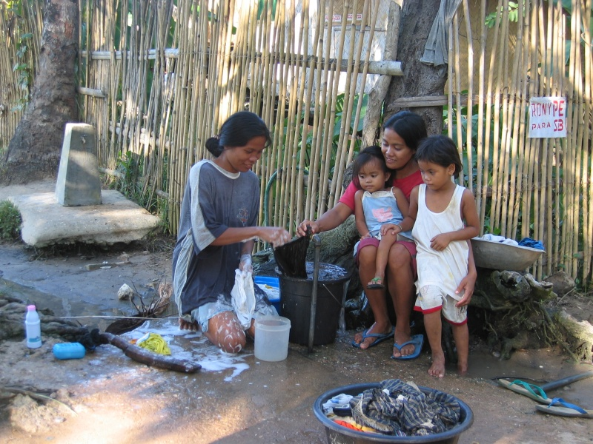
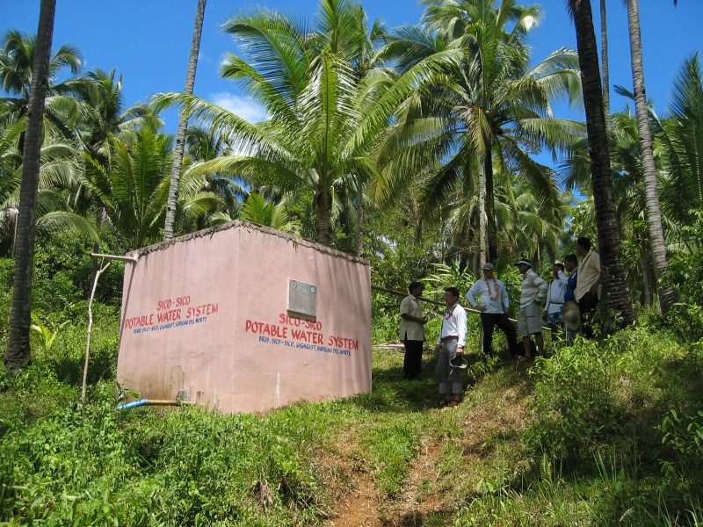
Small-scale risk reduction & adaptation – examples - Philippines
Notes:
Local risk reduction microprojects – examples of efforts that could be designed/placed with a chenging climate in mind – thereby incorporating the adapation element into measures addressing immediate risks:
Coast wave breaker protecting landless fisher-families’ households from wave destruction
River erosion wall
School & health care building moved to safer ground (from low-lying flood area w/ schistosomiasis)
Protecting water sources – cleaning/storage tank on hill side + taps in village below

Slide 25
Key message
Assess: what are the current risks – and how will they be affected by climate variability and change?
Plan accordingly
This applies to all levels – from HQ to community planning
Photo: Alex Wynter/Netherlands Red Cross
Notes:
25
25
The picture shows a sea-level warning mast in the village of Tasajera, on Colombia’s Caribbean coast, installed by Colombian Red cross volunteers as part a DRR project.
Tasajera and other villages are exposed to storm surges from the sea and floods originating inland as rivers. The mast pictured is painted in standard traffic-light colours of red, yellow and green, giving villagers a clear idea of what to do when a seaborne disaster threatens; the precise levels for the painted bands were initially established by environmental experts from the local authorities. Red means evacuate – to designated sites.

