Slide 1
Early Warning, Early Action

Slide 2
Weather Reports From The Future
UN Climate Summit 2014: Catalyzing Action
How will climate change impact our weather in the year 2050? Watch “weather reports from the future”
If humanity’s GHG emissions continue to increase, the average temperature of the Earth’s lower atmosphere could rise more than 4 degrees celcius by the end of the 21st century. But what does a global average temperature rise really mean? How would we experience it on a daily basis?
Weather report from the year 2050 – TV weather presenters present possible scenarios (NOT TRUE FORECASTS).
But they are based on the most-up-to-date climate science and they paint a compelling picture of what life could be like on a warmer planet.
THESE WORST CASE FUTURES DO NOT NEED TO HAPPEN!
http://www.youtube.com/watch?v=Hbne3q9Xers&feature=youtu.be

Slide 3
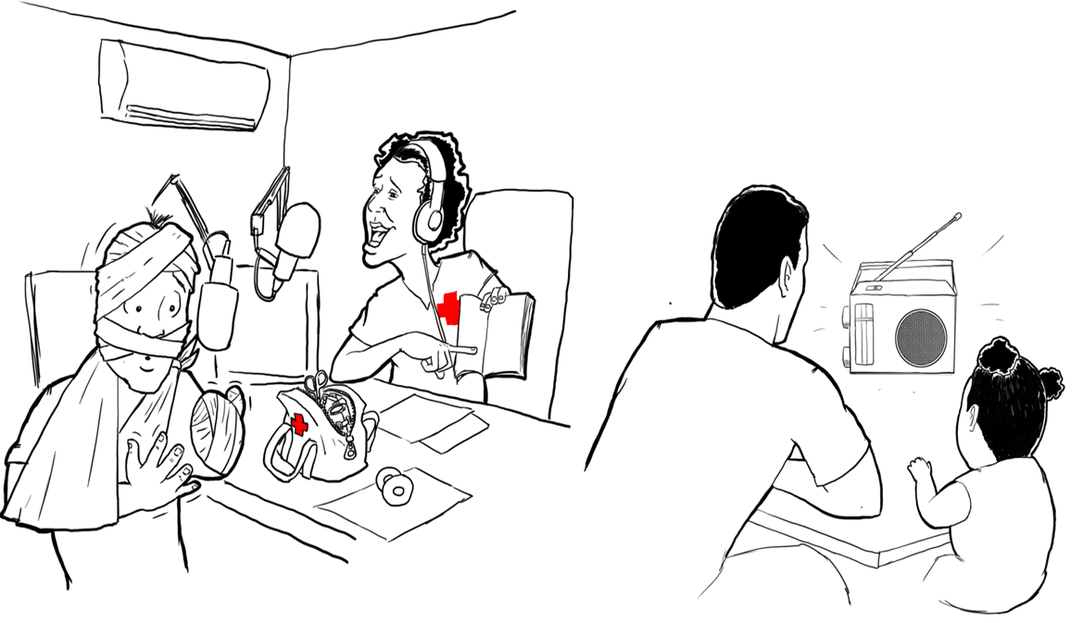
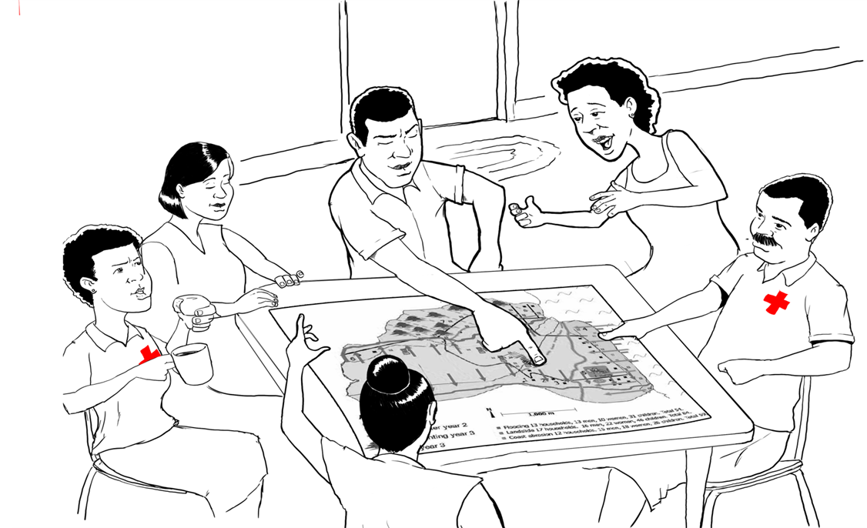
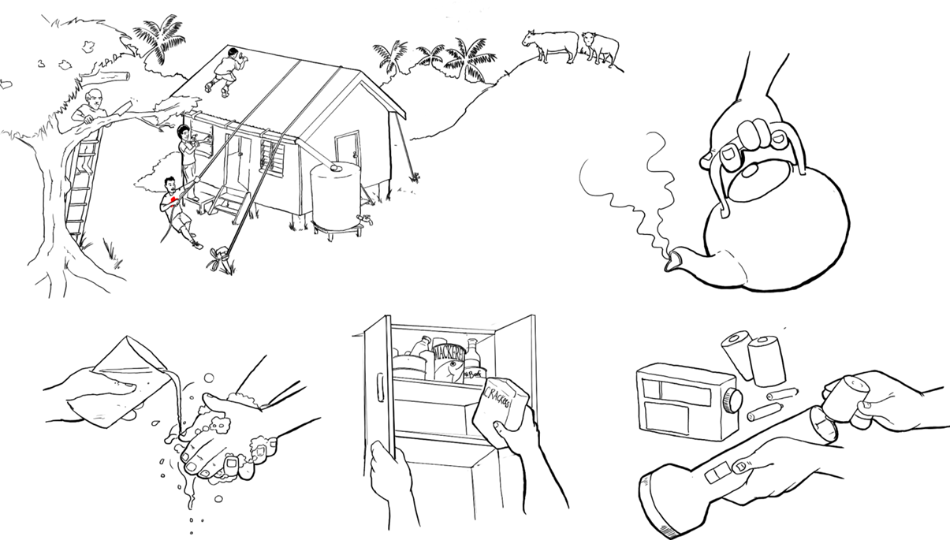
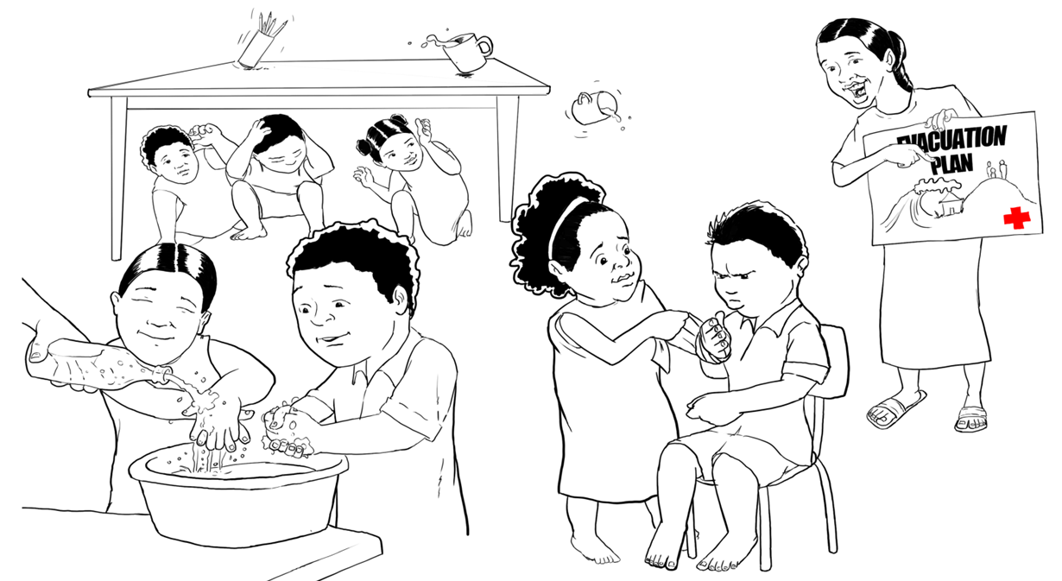
Understanding and Using Weather and
Climate Information – Early Warning Action

Slide 4
Early Warning, Early Action

Slide 5
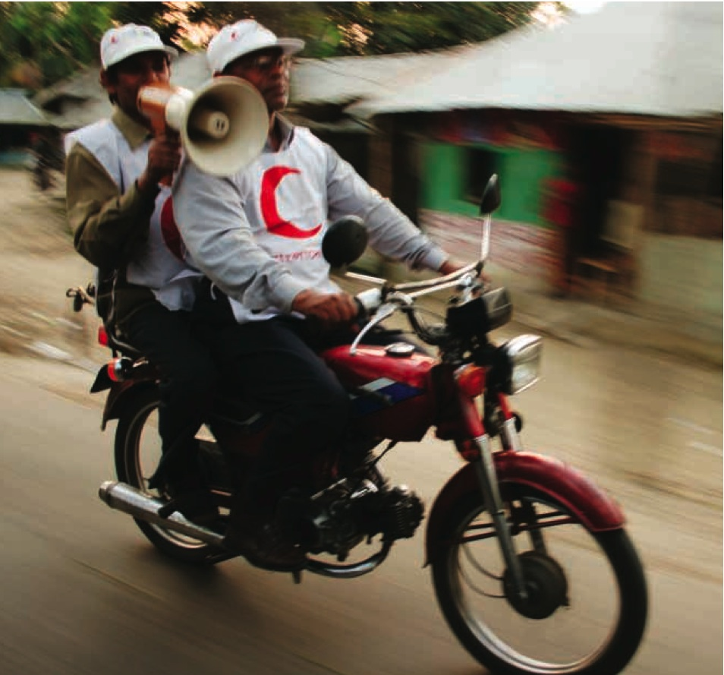
Early Warning, Early Action means
Routinely taking humanitarian action before a disaster or health emergency happens, making full use of scientific information on all timescales.
Using climate and weather information to take action before a disaster strikes, in order to reduce negative impacts.
Notes:
To the left on the slide you’ll find the formal definition, but to put it simply: making use of climate and weather information before a disaster strikes and act sooner than you would do without this information. This concept will explain itself better in the coming slides.

Slide 6
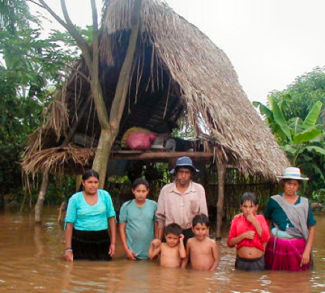
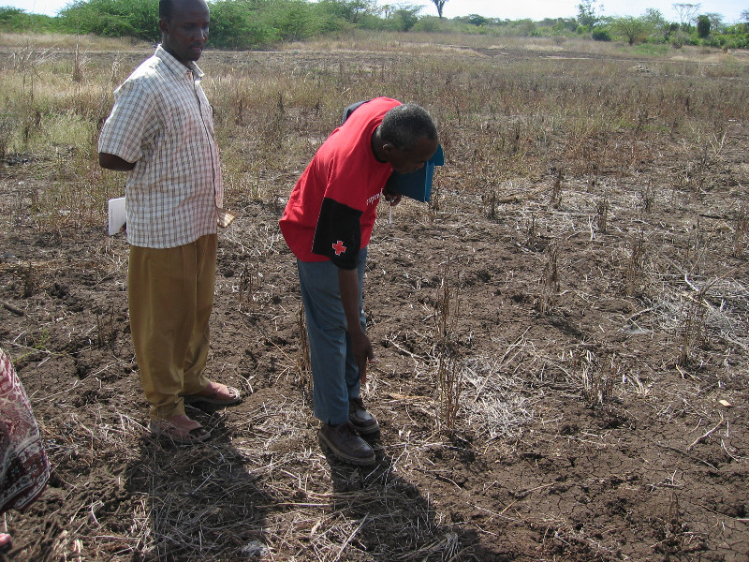
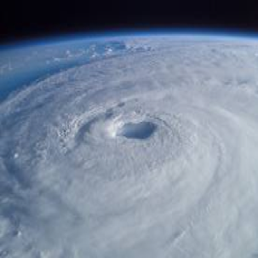
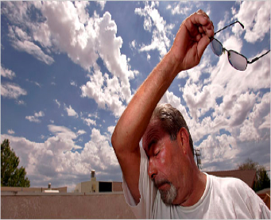
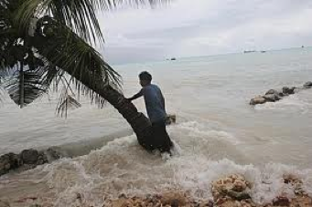
As the climate changes, we can expect more extreme weather events, more often
Photo: Danish Red Cross
Photo: NASA
Notes:
These events can have implications for safety, health, livelihoods, food security, water and sanitation, etc.

Slide 7

Traditional Approach
Disaster
Response
Notes:
In the standard approach, humanitarian organizations are reactive: they start emergency relief operations once the disasters have struck and assistance is needed.

Slide 8


Disaster
Enhanced approach
Early Warning
Early Action
Response
Notes:
But usually – at least in relation to weather-related hazards – we often have some information ahead of the upcoming disaster event, and that information can be interpreted and used to prepare the emergency operation better.
So in the ‘Early Warning, Early Action’ approach we make full use of climate information, and we act in a way that prepares us better as a whole, but also with a more strategic approach to disaster response.

Slide 9
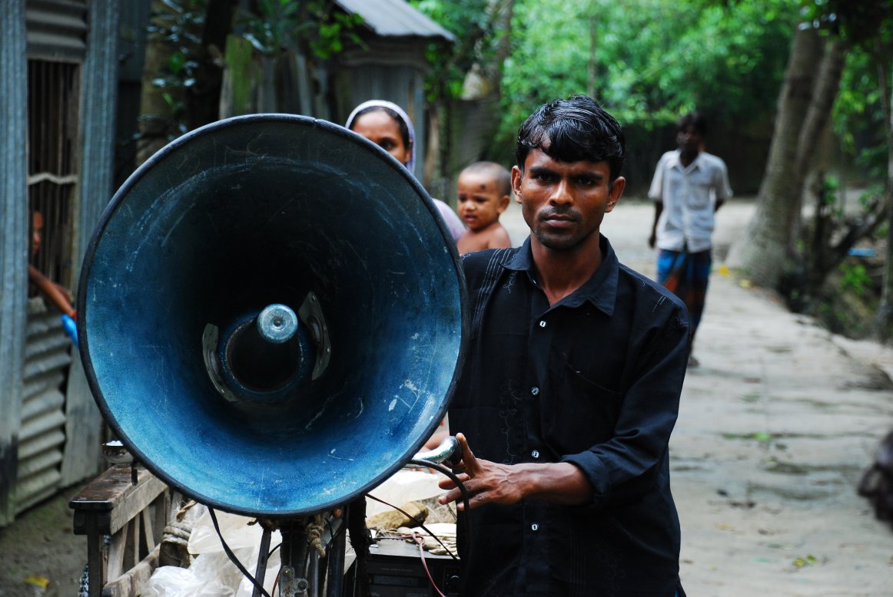

Why Early Warning, Early Action?
Extreme events have implications for health, livelihoods, water, food security, and others.
Climate and weather information can help anticipate and prepare for changing risks.
Notes:
We will dive deeper into early warnings and early actions in the next slides, but in brief:
* Using relevant warning climate and weather information (at all timescales) comes down to establishing good working relationships with partners and stakeholders (such as meteorological offices and knowledge centres) in your country. Through this partnership the National Society can develop a systematic and comprehensive flow of relevant information on upcoming extreme weather events.
* Alerts can be given at different timescales – from decades, to seasons, weeks and hours ahead – and provide opportunities to take early action. Then it comes down to making the right decisions after a warning is issued, improving response time and quality by acting in advance.

Slide 10
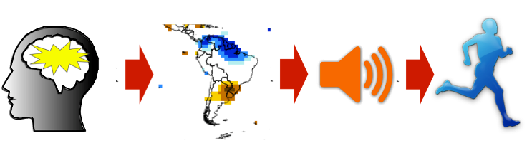
The elements of
Early Warning, Early Action
Knowledge: Collecting data to understand risks
Monitoring: Collaboration with hazard monitoring services
Communication: Sharing information about hazards
Action: building response capability Preparing for pending hazards.
Notes:
Now, let’s consider early warning, the trickier side of Early Warning, Early action. Questions to consider when designing an Early Warning, Early Action Plan:
Risk knowledge:
Are hazards and vulnerabilities well known?
What are their patterns and trends?
Are risks maps and data available?
Monitoring:
Are the right indicators of the hazard being monitored?
Can accurate and timely warnings be issued?
Communication:
Do warnings reach everyone?
Is warning information clear and usable?
Action:
Are people at risk prepared and trained in reacting on the warnings?
Are proper facilities in place to protect people – evacuation centres, potected/safe water?

Slide 11
Risk Knowledge
Key questions to consider when designing EW-EA Plan
Are hazards and vulnerabilities well known?
What are their patterns and trends?
Are risks maps and data available?
Notes:
Now, let’s go back to the beginning and take the steps in order. To implement the most effective Early Warning, Early Action plans, it is important to have in-depth risk knowledge.
Are hazards and vulnerabilities well known?
What are their patterns and trends?
Are risks maps and data available?
Risks could be at regional, national, sub-national and local levels.
For help incorporating climate information into a Vulnerability and Capacity Assessment, please see the Climate Centre’s “VCA and Climate Change: A summary for practitioners.”
Map source: Yusuf and Francisco, 2009, Climate change vulnerability mapping for Southeast Asia.

Slide 12
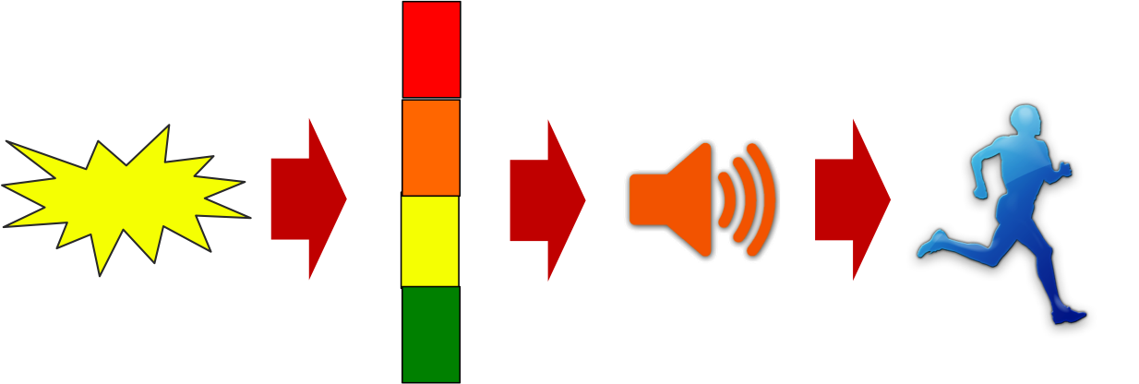
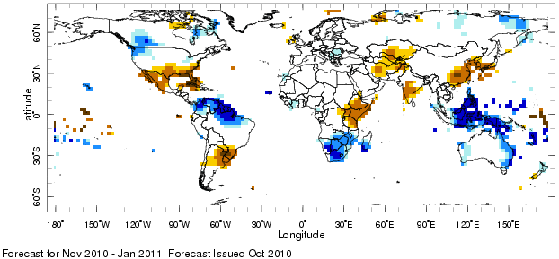
Monitoring (The trickier side of Early Warning, Early Action)
Hazard monitoring can include, for example, river gauges for floods and scientific forecasts for extreme rain or drought
Forecasts issued for days, weeks and months in advance
Collaboration with national meteorological service is a good add on to access information
Notes:
Questions to consider when designing an Early Warning Early Action Plan:
Are the right indicators of the hazard being monitored?
Can accurate and timely warnings be issued?
Collaboration is crucial. While National Society disaster managers should have a basic understanding of forecasts, in order for the most efficient and effective results strong collaboration with information centers such as the national meteorological services and national disaster management offices is crucial.

Slide 13

Communication
Key questions to consider
when designing EW-EA Plan
Do warnings reach all of those at risk?
Are the risks and the warnings well understood?
Is the warning information clear and usable?

Slide 14
Early Warning, Early Action means
Using climate and weather information to take action before a disaster strikes, in order to reduce negative impacts
Notes:
To the left on the slide you’ll find the formal definition, but to put it simply: making use of climate and weather information before a disaster strikes and act sooner than you would do without this information. This concept will explain itself better in the coming slides.

Slide 15
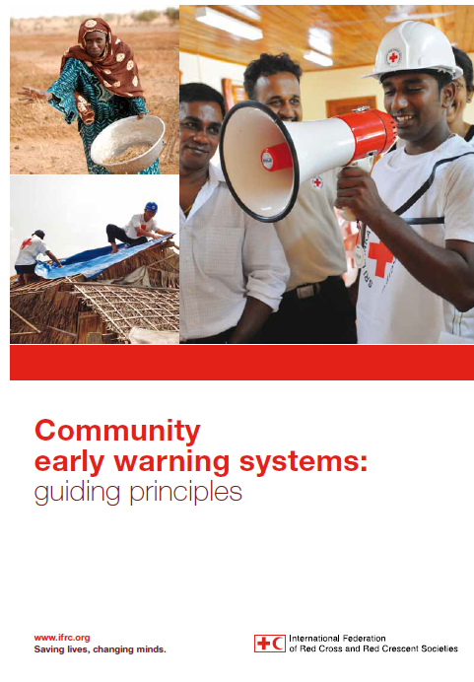
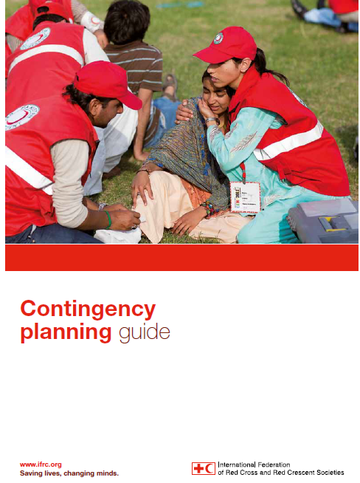
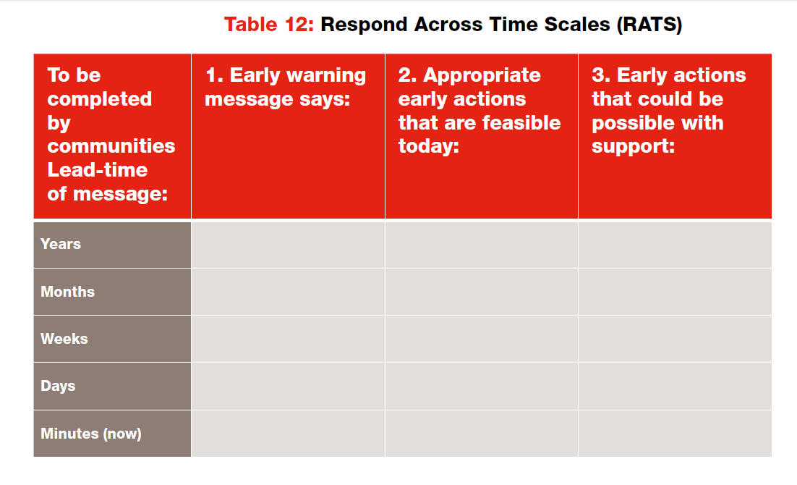
New good IFRC guides
Accommodate multiple timescales
”...we respond to warnings, not disasters”
Account for evolving risk and
rising uncertainty

Slide 16
Early warning, early action
Bridging time scales
Climate change
Rising risks, trends, more surprises
More specific information
Seasonal forecasts
Level of risk in coming months
More time to reduce risk
“Regular” forecasts
Impending hazard
Notes:
16

Slide 17

Forecast Caveats
(time to take action versus specificity)
3–10 day forecasts (short lead time, very specific)
Notes:
When considering forecast information, it is important to understand the benefits and limitations of forecasts in order to manage our own expectations and inform our decision-making.
Forecasts on 3-, 7- and 10-day timescales are examples of ‘short’ lead-time forecasts, but they are very specific in terms of location and predicted outcomes, such as amount or duration of rainfall.

Slide 18
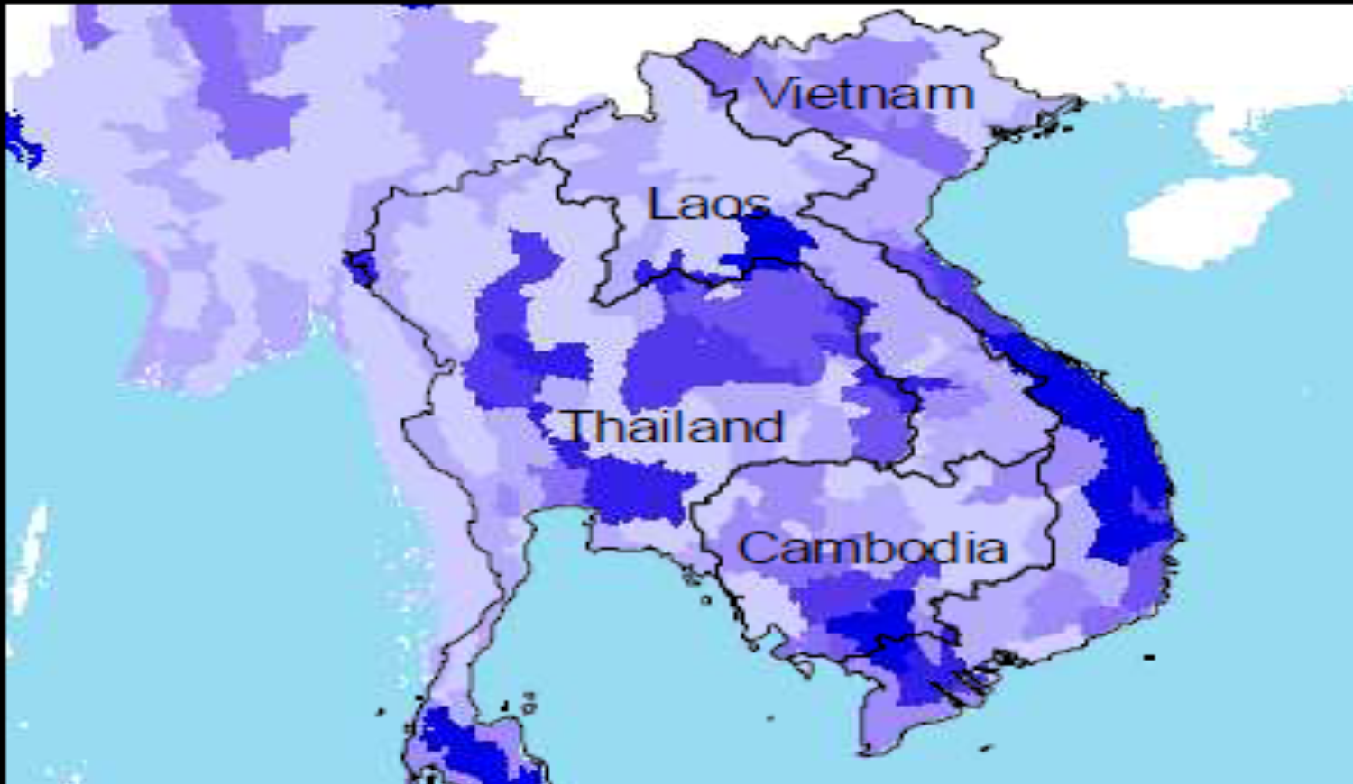
Forecast Caveats
(time to take action versus specificity)
Monthly and seasonal forecasts
(more lead time, less specific)
Notes:
Monthly and seasonal forecasts are longer lead time forecasts that have the benefit of providing more time to take early action. But they are less specific in terms of location – possibly covering regions of a country or regions of multiple countries as shown – and they are also less specific in terms of outcome.
They can predict that an area is more likely to have extra rain over a season, but not specifically say how much or which exact locations in the region will receive extra rainfall. This information is still very useful in helping to manage risks.
When seasonal forecasts project a likely change in the normal (like more rain or drought), they are also an incentive to pay more attention to shorter-term weather forecasts (weeks/days), alerting us to upcoming hazardous events like emerging and approaching strong cyclones and associated rainfall and storm surges.

Slide 19

Forecast Caveats
(time to take action versus specificity)
Climate change predictions (even more lead time, even less specific)
Notes:
Climate change projections provide the longest lead time, but they are very general, often covering wide regions including many countries. They can say if a region is likely to receive more rain over the course of years, but not give specific information regarding exact locations, year-to-year fluctuations, or how much more rain is likely.

Slide 20
Long lead-time forecasts can’t say it all about the future
Long-term forecasts are not precise. They can only tell what is more likely to happen over a large area.
We need to also monitor shorter-term weather forecasts to better anticipate when, where or how severe.
Notes:
Climate change gradually increases the risks to weather-related disasters over long time scales, but it is difficult to predict exactly where, how and how much.
Long-term forecasts are not precise – they can only tell what is more likely to happen in general. But long-term forecasts can help preparing for contingency planning for more extreme events and prepare for long-term changes in health risks etc.
So we still need to pay attention to shorter-term weather forecasts (weeks/days) alerting us to upcoming hazardous events like emerging and approaching strong cyclones and associated rainfall and storm surges.

Slide 21
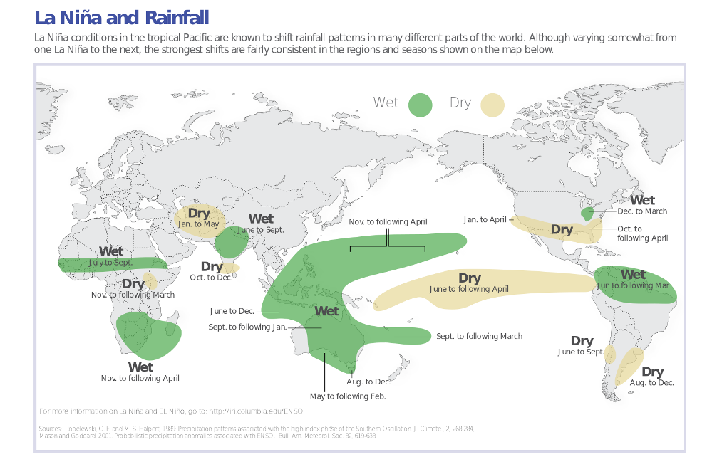

Slide 22
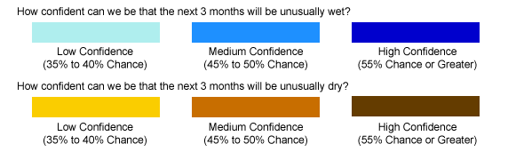
Seasonal rainfall forecast issued October 2010 for upcoming November-January
Notes:
2010 was a La Nina year. This forecast from October predicts that the blue areas are likely to have above-normal rainfall, and the brown/yellow areas are likely have below-normal rainfall over the November-January season.
Send to IFRC every month

Slide 23
Areas that experienced flooding or drought that November-January
Notes:
In many of these places, above-normal or below-normal rainfall did occur, and this was important for Red Cross Red Crescent work around the world. In several of the below-normal rainfall areas there were droughts (for example, the East Africa drought was linked to famine in Somalia), and in several of the above-normal areas, there were floods. You can see all those areas circled here in red.
From the rainfall forecast in October, we knew we could anticipate heightened flood risk in northern South America, South Africa, South-East Asia and Australia.
Note: this slide indicates where disasters occurred, not where early action was taken.

Slide 24
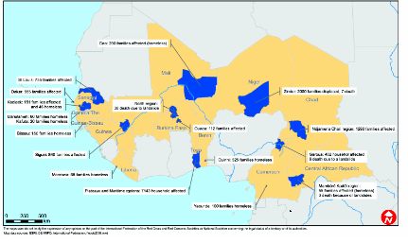
Early Action Paid Off:
Faster response: 1-2 days rather than 40 in 2007
Fewer victims (30 instead of hundreds)
Lower cost per beneficiary (30%)
Example: Red Cross
volunteers in Ghana saving lives by alerting Volta fishermen that the Bagre dam would be spilled.

Slide 25
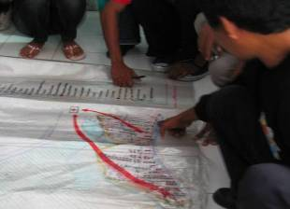
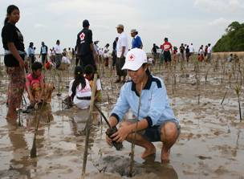
Which forecasts are useful for humanitarian decisions?
What kind of early actions should be taken in the…
short term?
medium term?
long term?
Notes:
25
This is the intro to the ”scenario exercise” based on the separate word file with four scenarios
Matching the early warnings (at all timescales) with appropriate early actions (at all timescales) is the crux of an efficient Early warning, Early Action approach. For example, it does not make sense to plant trees against landslides when there is a short term cyclone warning, nor to evacuate today a low lying region because of warnings of rises in sea levels. The next slide will give some concrete examples.

Slide 26
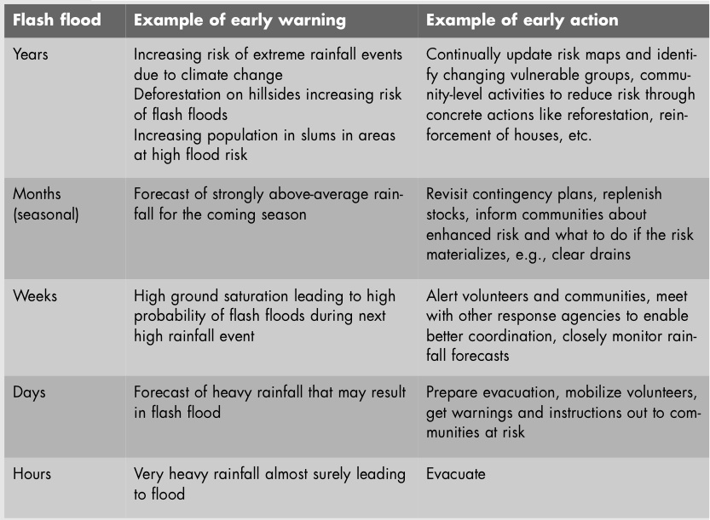
Different actions are appropriate at different timescales
Notes:
Early actions, when forecast uncertainty is still high, should be low-cost but beneficial, even if a particular disaster does not happen (‘no- or low-regrets options). These actions lay the groundwork for enhanced preparedness and response, which can be scaled up/intensified according to forecasts on shorter timescales.
(Table source: 2009 World Disasters Report)

Slide 27
you risk missing critical information in the short term.
Long term vs Short term
If you only monitor the long term,
And, if you only monitor the short term…
…you risk missing critical information
in the long term.
Notes:
It’s important to monitor forecasts across timescales (i.e. with each category of time to take action as well as specificity). Focusing only on the long term is like focusing on reaching your home during a long drive while failing to see the potholes immediately in front of you. Failing to see the potholes can cause damage to the car and prevent you from reaching home!
Similarly, preparing only for medium- or long-term projections for more drought in an area can cause you to miss heavy rains and flooding that can occur in between. Preparing only for the short term means we will fail to adapt to the increasing extremes hazards and changing risks of the future.
The best strategies will find balance between the needs of the present and the needs of the future, without neglecting either.

Slide 28
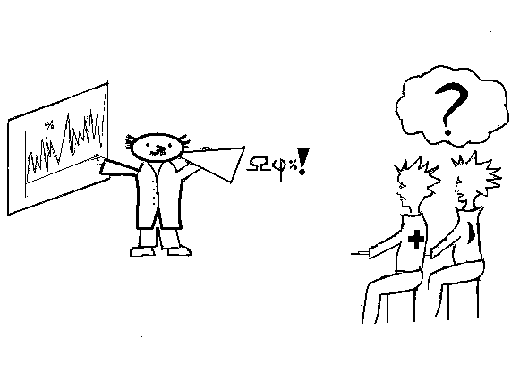
For monitoring, partnerships with information centers are crucial, but….
Can we understand what the
met office is telling us?
Notes:
Partnerships are critical, as the Red Cross Red Crescent Movement our strength lies in mobilizing communities and taking action. While it is important to have a basic understanding of forecasts, it is equally if not more important, to work with local knowledge and information centres, such as the national meteorological service, to help in monitoring and interpreting forecast information.
We need to work on partnerships with meteorological offices to improve the communication of complex climate and weather information so that end users can better understand – and are able to act on – the early warning messages issued.
It will be key to explain to the met offices what you do and don’t understand. There is no such thing as a silly question! Remember: having a dialogue with your met office should be ongoing. Building the foundation for a flow of relevant information takes time, and is difficult to do once a crisis situation is underway.
It requires an investment form both ends to make sure you understand each others needs and language. Quite often met offices want to show their complex data sets and assume everybody will understand it. This is absolutely not the case. You have to explain them what you need and how you would like to have it communicated. For a list of sample questions that you can ask your met office, please visit the relevant reading section of the Networks and Partnership module of the CTK.

Slide 29
Defining triggers
Defining triggers for action that are…
LOW-COST
NO-REGRETS
BENEFICIAL
Not Easy!
Notes:
Even if the disaster never comes, take actions that will still benefit the community or the organization
(This would be a good time to run the exercise that helps participants brainstorm which actions they would take based on higher and lower certainty.)

Slide 30
Establishing triggers
Draw on past knowledge of disasters
Establish and document triggers well before
a hazard arrives
Ensure internal support and external partnerships are in place – especially with the government.
Focus on low-cost, no-regrets, beneficial solutions.
Notes:
Triggers can be a percentage chance of heavy rain similar to the previous slide; they need to be decided and documented well before a hazard is pending. It is critical to be sure that internal support and external partnerships are in place so that early action can be taken immediately.
Actions need to focus on low-cost, no-regrets, beneficial solutions that are tailored to the likelihood of the pending hazard. It is important to draw on past knowledge of when disasters have struck to inform early action decision making, and for everyone involved to understand and accept the risks of taking action, if a hazard does not materialize. If well planned and discussed however, these risks should be far less than failing to take action when a hazard does materialize.
This is not an easy process, please feel free to reach out to the Climate Centre for more guidance and support.
NOTE: if actions include warnings to communities, it must be for the government to issues those warnings.

Slide 31
Taking Action, Establishing Triggers
Tailor actions to likelihood of hazard.
Understand and accept the risks of taking action if a hazard does not materialize.
Understand and accept the risks of not taking action if a hazard materializes.
Notes:
This is not an easy process, please feel free to reach out to the Climate Centre for more guidance and support.
NOTE: if actions include warnings to communities, it must be for the government to issues those warnings.

Slide 32
Putting it all together
Examples of Early Warning Early Action
Early Warning: In 2007, the Bangladesh Red Crescent received early warning indicators of Cyclone Sidr approaching their coast.
Early Action: Working with the government 5,000 volunteers with megaphones alerted and evacuated at risk residents.
As result 4,500 people died compared to 138,000 in 1991.
Notes:
The Bangladesh Red Crescent worked with the government using megaphones to issue evacuation warnings to communities in preparation for a pending cyclone. As a result 4,500 people died compared to 138,000 deaths during a similar cyclone in 1991.

Slide 33
Early Warning, Early Action pays off
The case of West Africa
Most countries got supplies just days after flooding in 2008.
(In 2007, flood operations were an estimated 40 days late).
Faster arrival of relief saved lives, minimized health impacts, protected livelihoods and enabled communities to recover.
In 2007 an emergency dam spillage cost 30 lives. In 2008, dam release times were scheduled, allowing Red Cross volunteers to warn communities ahead of time. This time only two lives were lost.
Resources were used more efficiently: 33 per cent less spent per beneficiary in 2008 than in two previous years.
Notes:
33

Slide 34
Low-cost actions beneficial, even if floods hadn’t materialized
Updating contingency plans
Training of trainers and increase of volunteer capacity
Paperwork for border crossing and health insurance handled in advance for relief teams
Relief items strategically placed in three regional warehouses, (instead of depending on supplies from Dubai)
Shorter-term early warning systems established and checked
Relationships formed with forecasting agencies, so the Red Cross Red Crescent received timely warnings
Relationships formed with government authorities to allow for early actions.
Notes:
34

Slide 35


Questions?
Climate change trends and projections
Interpretation of seasonal and shorter-term forecasts and guidance on appropriate action
Recommendations of national/regional forecast and climate information providers
Whether observed changes can be attributed to climate change or natural climate variability.
E-mail: ifrc@iri.columbia.edu

Slide 36

Early warning is
a chain of people linked to
a chain of actions
that make it work!

