Slide 1
Red Cross Red Crescent Policies, Strategies, Tools and Guidelines related to
Climate Change
Notes:
This week we are not here to tinker with the definition as there is a global working group on that and we can separately feed into that process (Terhi, Susil and Nelson are well connected to that group)
- at the end of the day resilience is the goal and it's far more about mindset and approach than our structures - it's about our people (ie in NS as well!) who want to make an integrated difference in people's lives at local levels and can forget their egos and protective approaches to budgets and skill sets and make them available for collective impact
- it's about donor education and advocacy if we find others only willing to resource silo approaches
- that's why our agenda starts again at exploring what inspiring experiences we have found at community level to try and emulate them elsewhere, and then to reflect on how the way we work helps or hinders those examples of excellence we have come across and need to better celebrate at community levels where people have been working on their resilience for hundreds of years!
- But first - - My presentation will focus on current discussions on the concept of resilience and the discussions around putting the concept of resilience in to practice.

Slide 2

International Conference 2007
Together for Humanity (Resolution 1), Governments and National Societies acknowledged the threats posed in humanitarian terms by environmental degradation and climate change.
https://fednet.ifrc.org/en/newsevents/events/ifrc-events/international-conference/30th-international-conference-november-2007/reports-adopted-declaration-and-resolutions

Slide 3
The Red Cross / Red Crescent commitments
Commitments were made to address climate change in the following ways:
raise awareness on climate change
provide humanitarian assistance
improve capacity to respond
decrease vulnerability of communities most strongly affected
integrate climate risk management into policies and plans
mobilise human and financial resources, giving priority to actions for the most vulnerable

Slide 4
Strategy 2020 emphasizes on tackling climate change
IFRC’s mission of building safer and resilient communities and addressing climate change is clearly stated as a priority under the Strategic Aim 2 of the IFRC Strategy 2020 “Enable Healthy and Safe Living”.
Notes:
Trigger question: How many of you are aware of IFRC strategy 2020?
The strategic aims of Strategy 2020 are:
1. Save lives, protect livelihoods, and strengthen recovery from disasters and crises
2. Enable healthy and safe living
3. Promote social inclusion and a culture of non-violence and peace

Slide 5
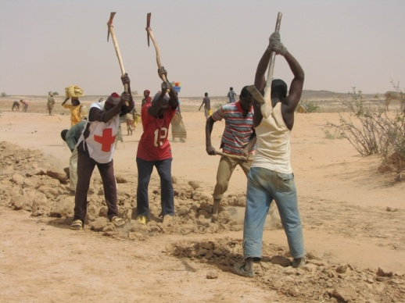
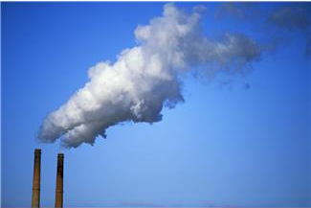
‘Mitigation’ and ‘Adaptation’
Adaptation: adjusting and preparing for change
Mitigation: tackling the causes of climate change
Photo: IFRC
Main focus for
humanitarian work
Strategy 2020
“We also contribute to mitigating the progression of climate change
through advocacy and social mobilization to promote sustainable community development that optimizes communities’ carbon footprints”
Strategy 2020
“Our climate change adaptation work is through scaling up disaster risk reduction measures and strengthening traditional methods of coping with disasters that are relevant in particular environmental contexts”
Notes:
5
5
Trigger question: 1. IFRC strategy focuses on adaptation or mitigation?
2. Does IFRC strategy 2020 focus on CCM or not? Answer: Yes
Climate change commitments are also included in the International Federation’s Strategy 2020. Although the Strategy 2020 mentions the obligation to contribute to reducing the Movement’s carbon footprint , it is important to highlight that as an organization we focus mostly on the humanitarian aspects of climate change and strive to reduce vulnerability – i.e. a focus on ‘adaptation’.
A large part of the Red Cross Red Crescent specialises in disaster management, health, water & sanitation, so our main task is to integrate the increasing climate risk into our existing expertise.
Climate change Mitigation is not our main focus – many other organisations have a large amount of focus on this. We do not have the expertise or mandate to enter the intricate international debate on emissions targets. However we underline the necessity of this agenda and align with the statements made in the latest IPCC report. Sometimes the two agendas (mitigation and adaptation) combine for win-win solutions. For example: a reforestation initiative to prevent landslides will result in new trees that absorb carbon dioxide. Our main target remains to prevent the landslide from happening and protect the most vulnerable.
NOTE the different meanings of ‘mitigation’: in disaster risk reduction work ‘mitigation’ often refers to ‘disaster mitigation’ or measures to reduce the impact of disasters, but in the climate change context it means halting global warming by reducing emissions of greenhouse gasses.

Slide 6
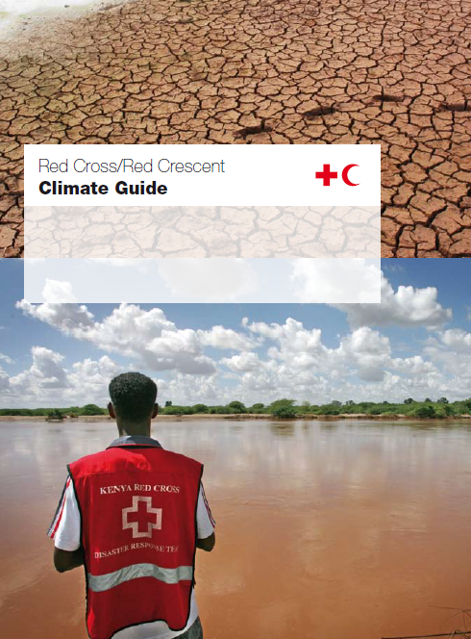
RCRC Climate Guide
Climate change basics
Dialogues
Communications
Disaster Management
Community Risk Reduction
Health and Care

Slide 7
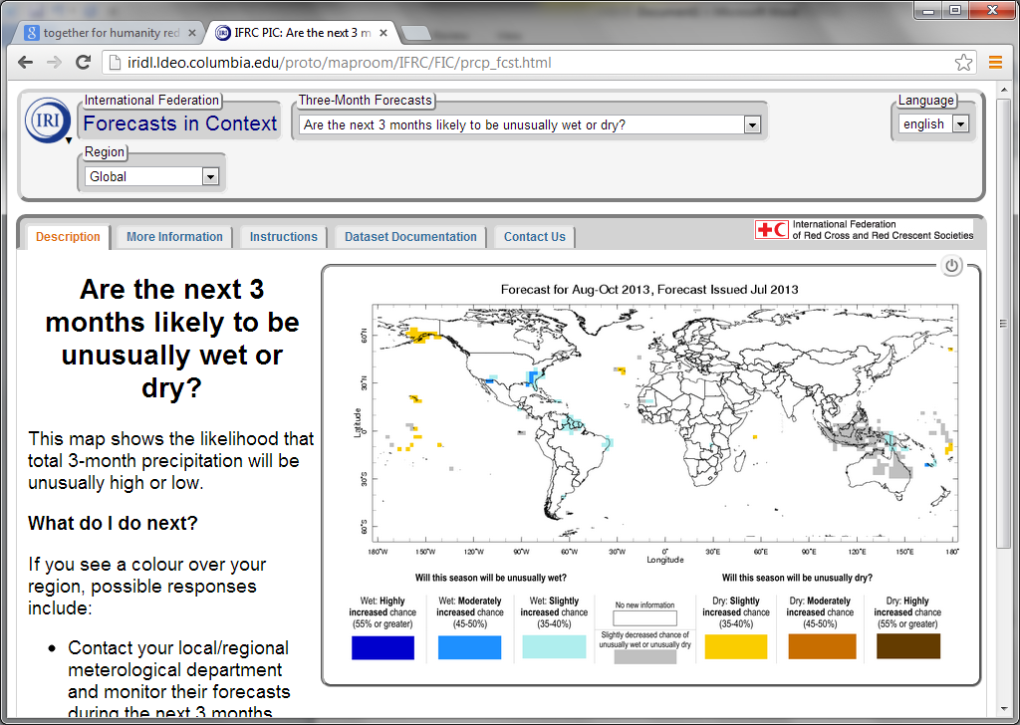
IRI-IFRC partnership: IFRC Map room http://iridl.ldeo.columbia.edu/proto/maproom/IFRC/FIC/prcp_fcst.html
Collection of maps provides information for humanitarian decision-making around the world.
types of early action that can be taken based on these maps.
-Six-Day forecasts, Three-Month Forecasts, Past Conditions, Recent Climate Trends, Vulnerability Indicators…..

Slide 8
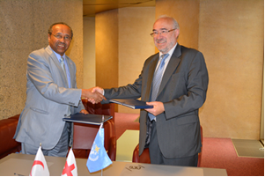
IFRC-WMO partnership
WMO and IFRC signed an agreement to strengthen cooperation on tackling climate risks
The memorandum reflects the importance of making science-based climate information and prediction accessible and understandable to local actors and communities to reduce the risk of climate-related disasters
Notes:
WMO = World Meteorological Organization
WMO and IFRC sign agreement to strengthen cooperation on tackling climate risks in 2013

Slide 9
VCA in the context of urban and climate risks
CORE PRINCIPLES OF A SUCCESSFUL VCA PROCESS
CLIMATE CHANGE IMPACTS AND HOW TO ADDRESS THEM IN THE VCA PROCESS
VULNERABILITY AND CAPACITY ASSESSMENT IN URBAN AREAS
COMPLEMENT the VCA TOOLBOX – ANALYSING ISSUES RELATED CLIMATE CHANGE AND URBAN RISK
What needs to be done differently in the different VCA tools
Review of the VCA tools in the context of climate change and how to use them to asses climatic risk condition at community level.
Notes:
Trigger Question: How many of you have conducted VCA in your job?

Slide 10
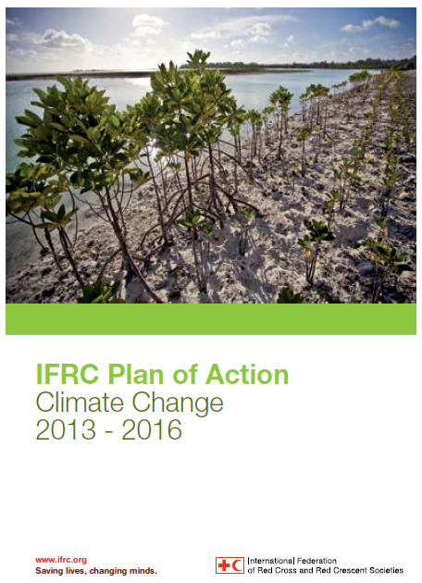
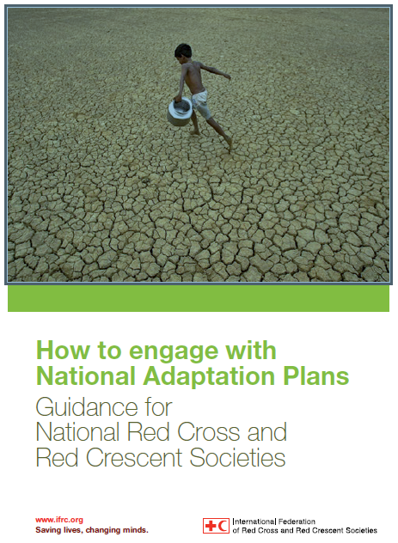
Guidelines

Slide 11
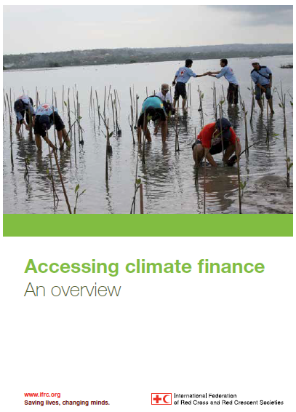
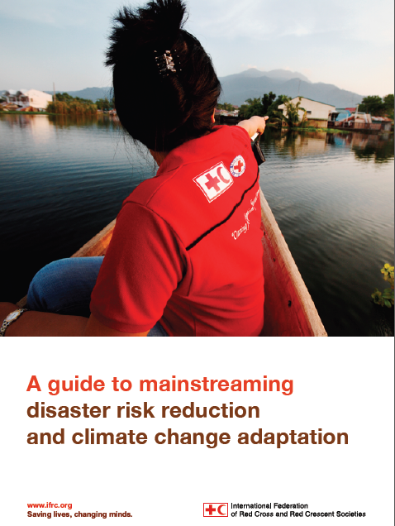
Guidelines

Slide 12
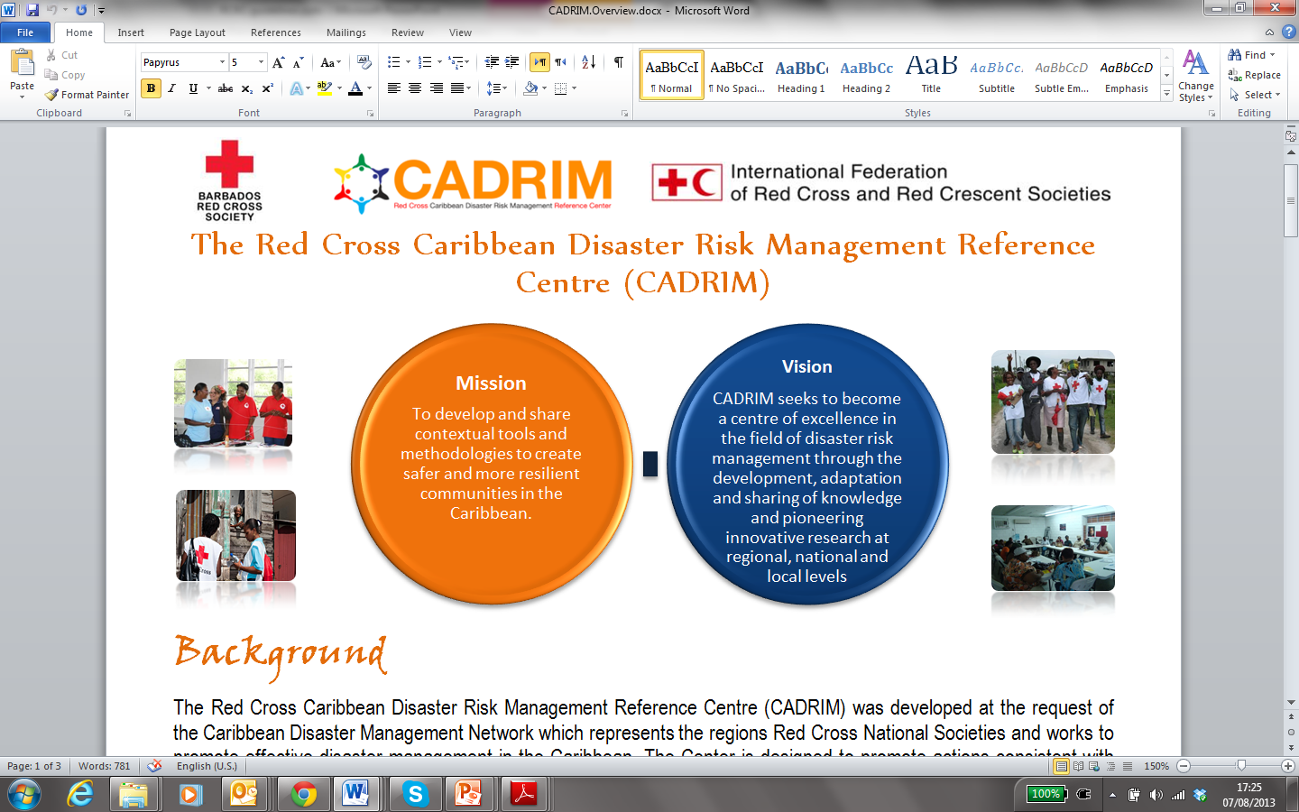
RCRC reference centres related to climate change

Slide 13

www.climatecentre.org
Notes:
13

Slide 14
Formation of the RC/RC
Climate Centre in 2002
The RC/RC Climate Centre is the reference centre on climate change of the RC/RC family
Supports the RC/RC Movement to understand and address the humanitarian consequences of climate change and extreme weather events
Notes:
14

Slide 15
Formation of the RC/RC
Climate Centre in 2002
Main approach:
  Raise awareness on the topic climate change
  Advocate for climate change adaptation and disaster risk reduction (within and outside the RC/RC Movement)
  Analyze relevant forecast information on all timescales
  Integrate knowledge of climate risks into RC/RC strategies, plans and activities
Notes:
15

Slide 16
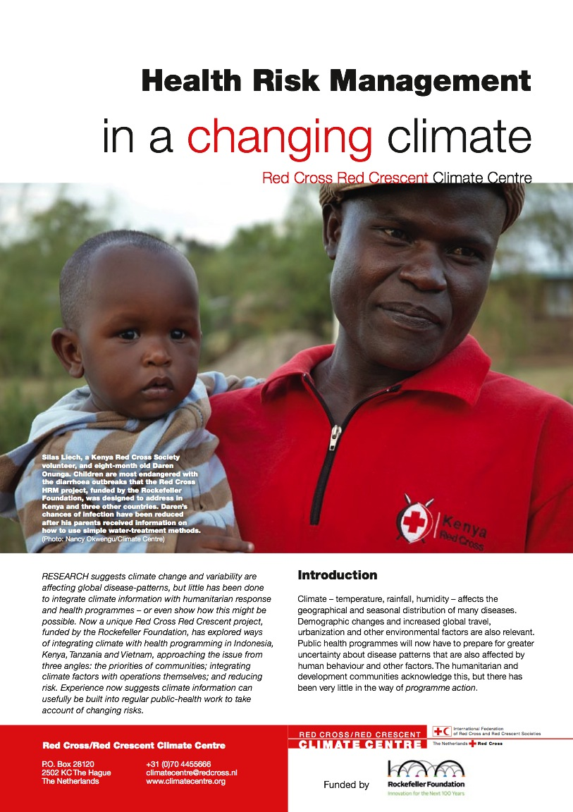
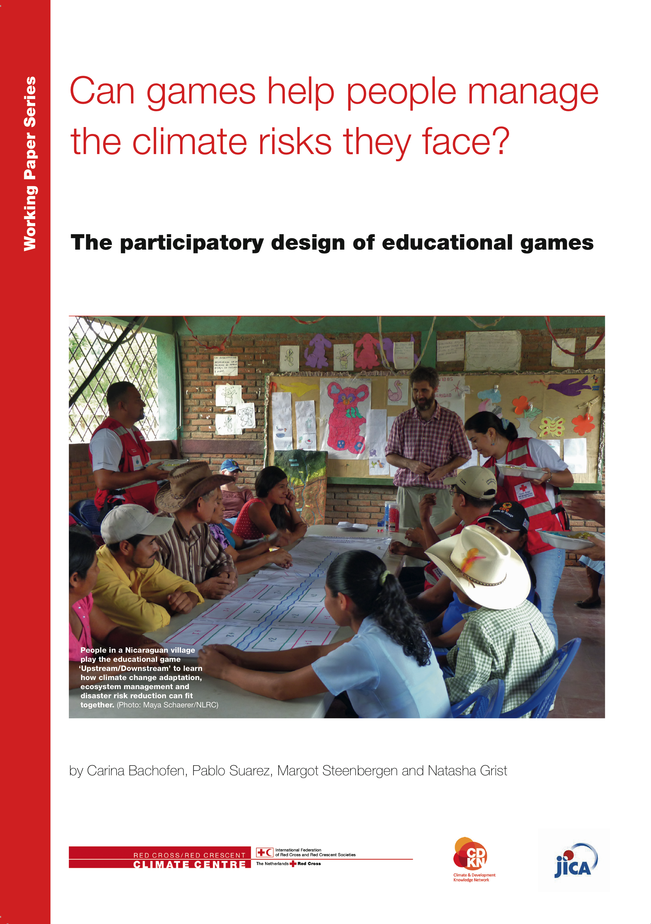
Raise awareness
Help people and institutions learn about climate change and its humanitarian consequences
Notes:
III Raising awareness
One important role of the Red Cross Red Crescent is to help people and institutions learn about climate change and its humanitarian consequences, and most importantly solutions to address it, both through community-based activities and public-awareness campaigns. Up to 60 National Societies have prepared materials for awareness campaigns. For a more extensive overview catalogue: please have a look at the communication module in this climate training KIT, under the section ‘experience of other National Societies’.

Slide 17



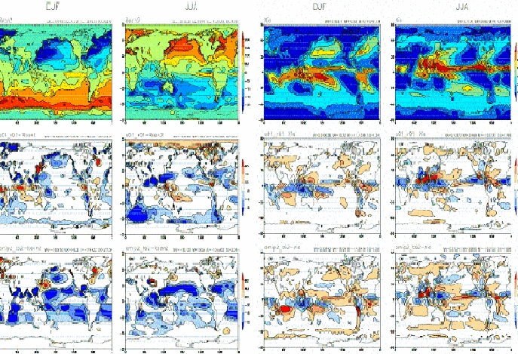
Paying for Predictions
A game on information, decisions and consequences
  GFDRR CG, November 2012
  Maarten van Aalst
Notes:
Clicks:
Start by introducing the Red Cross Red Crescent Movement
Wouldn’t it be great if the Movement had a crystal ball and could know in advance if a disaster was going to happen?
?
Actually, it is currently possible to have early warning of climate-related disasters! Scientists can make predictions about many things, including rainfall, up to months ahead, that can actually help us make decisions about how to prepare for potential disasters. However, if you show a Red Cross employee this map, you might as well be showing them
This!
We have developed games to help explain this, but expect confusion.

Slide 19
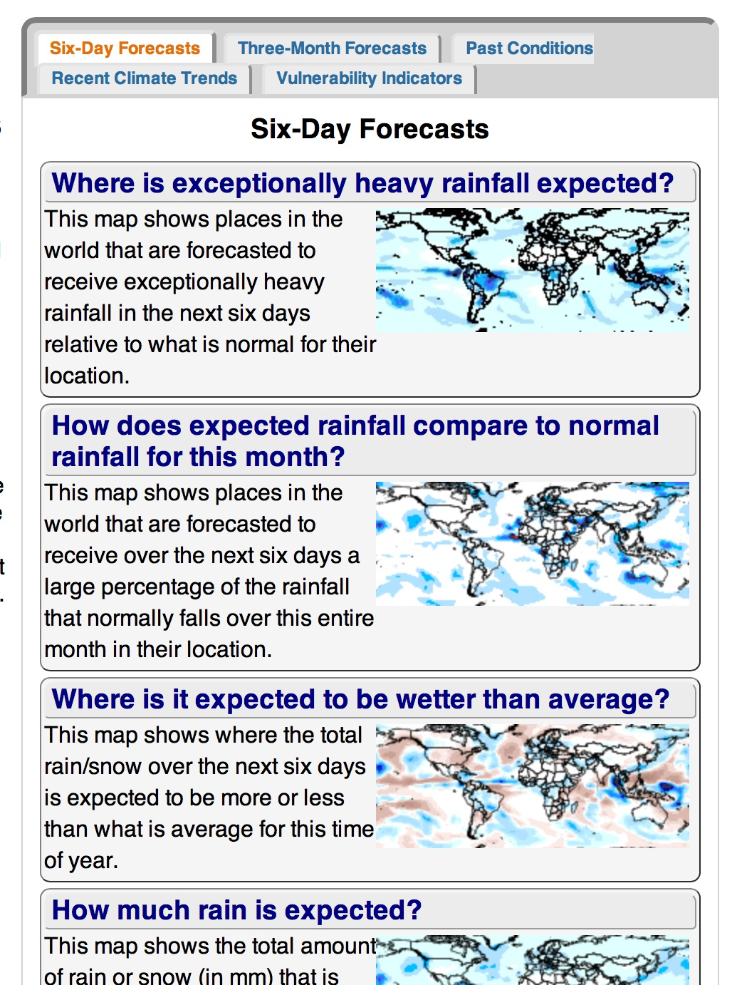
More tailored forecasts at IFRC maproom: iri.columbia.edu/maproom/IFRC
Notes:
If these forecasts can be useful, how can we access them?
The Red Cross Red Crescent Climate Centre has a “maproom” where you can find forecasts of seasonal rainfall, like the one you just saw, and also find forecasts of heavy rainfall in the next few days (shown here).
All of these maps are global, and although you can zoom in on your region of interest, they do not provided detailed country-level information.
For this, we recommend partnering with your local meteorological office to obtain their local forecasts of what to expect in the coming days. If you check the global map and see that your country is in either blue or brown for the next few months, then we highly suggest that you make this contact and check their local forecast every day, for more information about when rainfall events might arrive.

Slide 20

Establish and enhance partnerships
Addressing climate change requires partnerships with for example: meteorological office, government agencies and NGOs etc.
Notes:
IV Establishing and enhancing partnerships
Addressing climate change cannot be done in isolation. Risk assessments require inputs from climate experts (for instance, from the national meteorological office). Risk reduction often requires partnerships with governments, NGOs, businesses, and others. National Societies’ local reach puts them in a strong position to help bridge the gaps between national and local stakeholders.

Slide 21
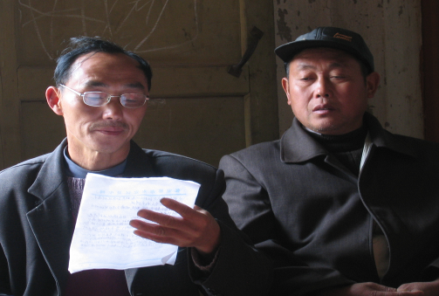

Advocacy and policy dialogue
at the local, national as well as international level, the RC can influence people/ policies!
Photo: Danish Red Cross
Notes:
V Advocacy and policy dialogue
Red Cross/ Red Crescent can advocate/ open dialogues for the most vulnerable people, and ensure that we are included in the global response to climate change. We have the opportunity to call on all governments to address the problem and to show that we have an approach that can address the problems of the most vulnerable people. By strengthening our approach at different levels: national, local and international we are uniquely positioned to make clear statements on what is needed for climate change adaptation.

Slide 22
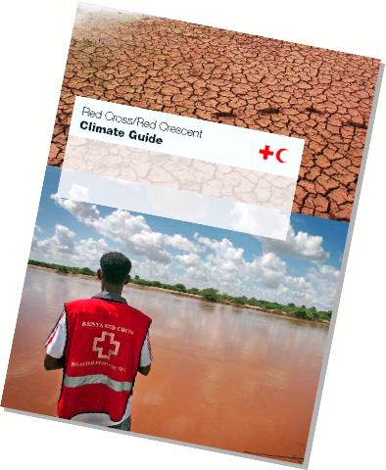
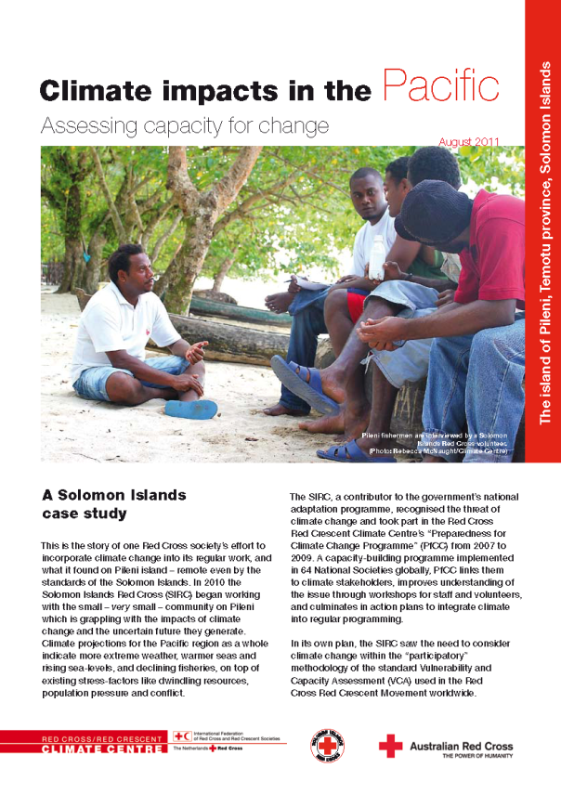
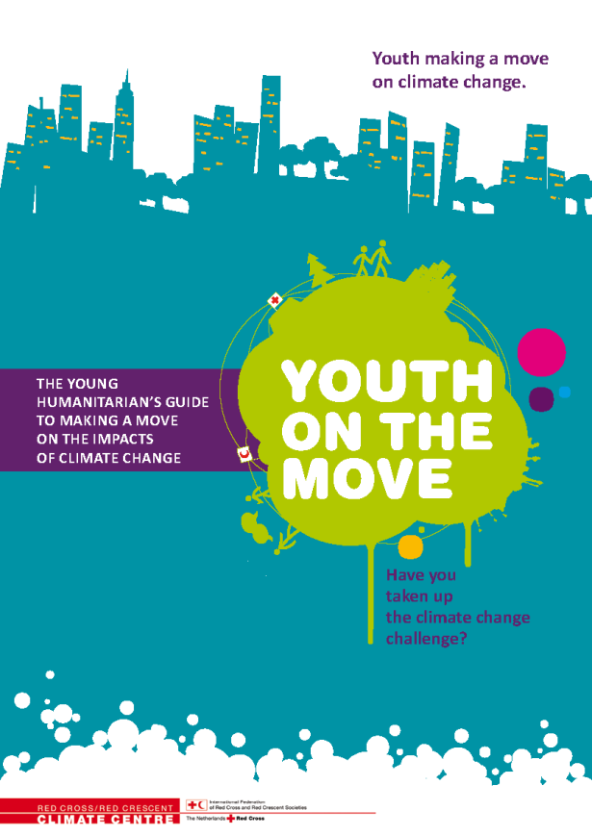
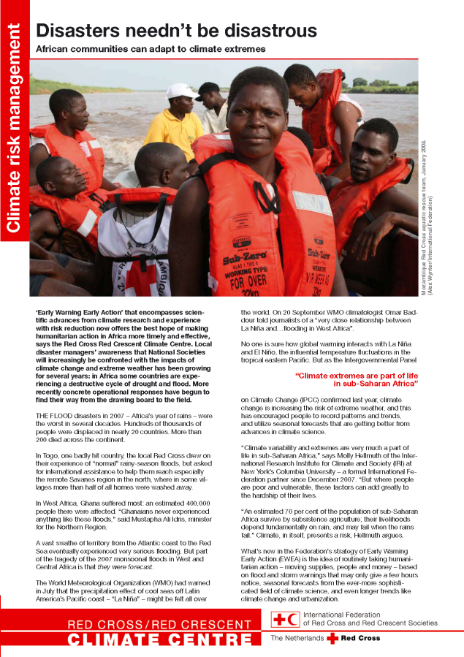
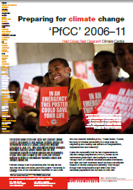
Document and share experiences and information
Photos: Danish Red Cross
Notes:
VI Documenting and sharing experiences and information
We are only just starting to address the rising risks, and there is much to learn. By sharing an experience you can promote the fact that your National Society has an approach that can actually help the most vulnerable people. It can motivate or inspire others!
22

Slide 23
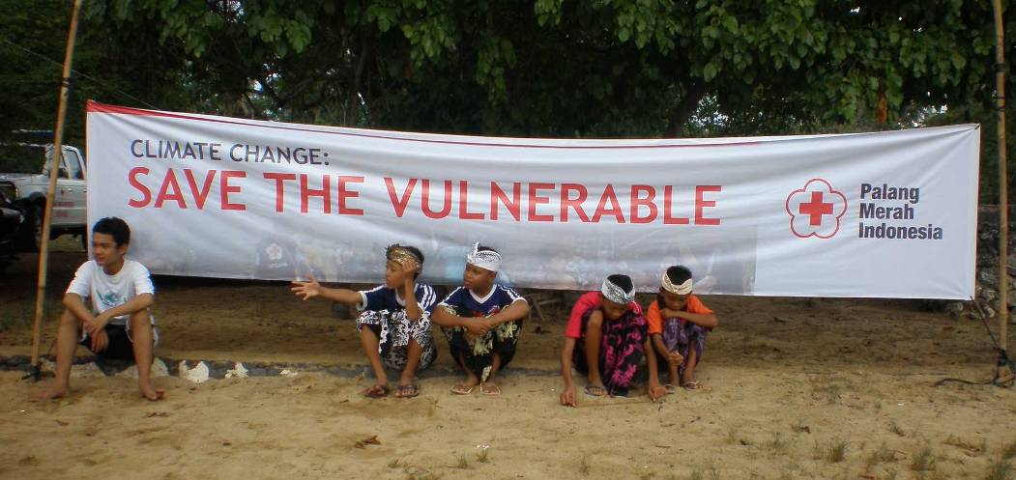
Photo: IFRC
Notes:
23
The rest of the Climate Training Kit modules will help with dealing with increasing climate risk in the regular programmes of the Red Cross Red Crescent Movement.

Slide 24
Thank you

