Slide 1
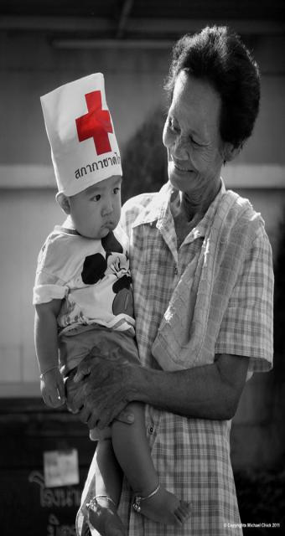
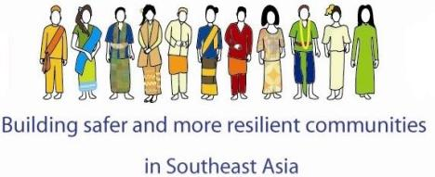
Community Safety and Resilience Unit (CSRU), Southeast Asia regional Delegation, Bangkok, Thailand
Regional Health and CBHFA Meeting
5-9 November, Bangkok
Prepared by: Indira Kulenovic

Slide 2
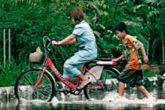
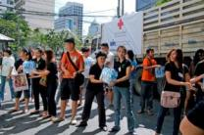
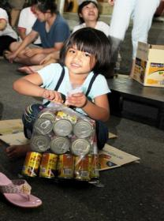
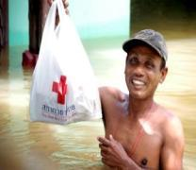
WHAT has changed?
WHO is the most exposed?
WHAT can be done?
HOW do we move forward?
Notes:
This presentation consists of three parts:
Current status quo on scientific knowledge on climate change: what do we know with enough certainty?
Impacts of climate change on hazards and human vulnerability: how is it affecting us?
Red Cross Disaster risk reduction activities to reduce the negative impact of climate change: what can we do as an organization?

Slide 3
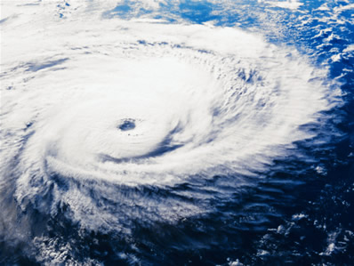
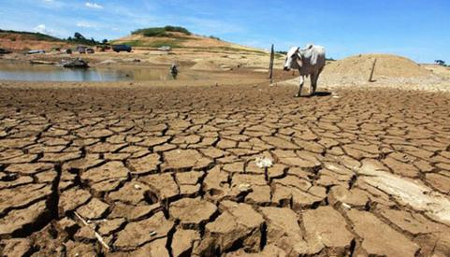
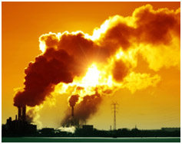
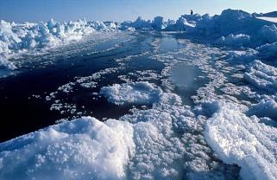
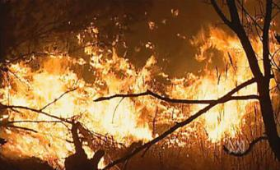
What
A changing climate led to changes in extreme weather and climate events
2

Slide 4
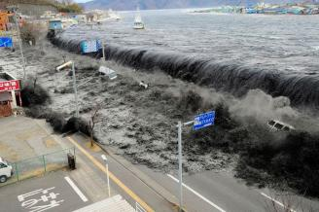
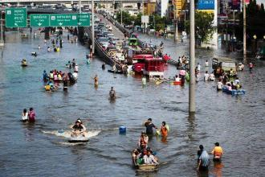
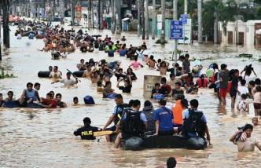
Biggest, largest, ever recorded, unprecedented, most expensive, most devastating etc ……
Japan
Most devastating Tsunami ever recorded (Indian Ocean and Japan)
Unprecedented floods – the worst in 100 years (Thailand)
Biggest number of natural disasters ever recorded in one year – 33 (Philippines)
Biggest earthquake ever recorded (Pakistan, Haiti) – (although non CC related)
Thailand
Manila

Slide 5
Where is SEA in terms of risk

Slide 6
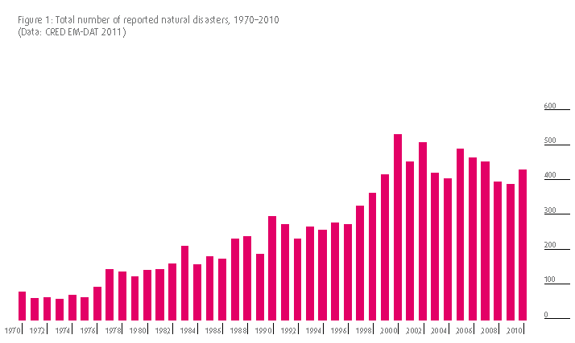
Statistics
1970-2010
Notes:
increase small- and medium-scale disasters,
more uncertainties

Slide 7
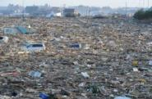
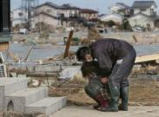
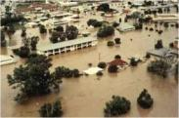
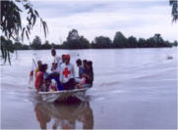
Impacts in 2011…

Slide 8
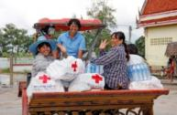
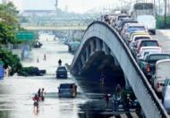
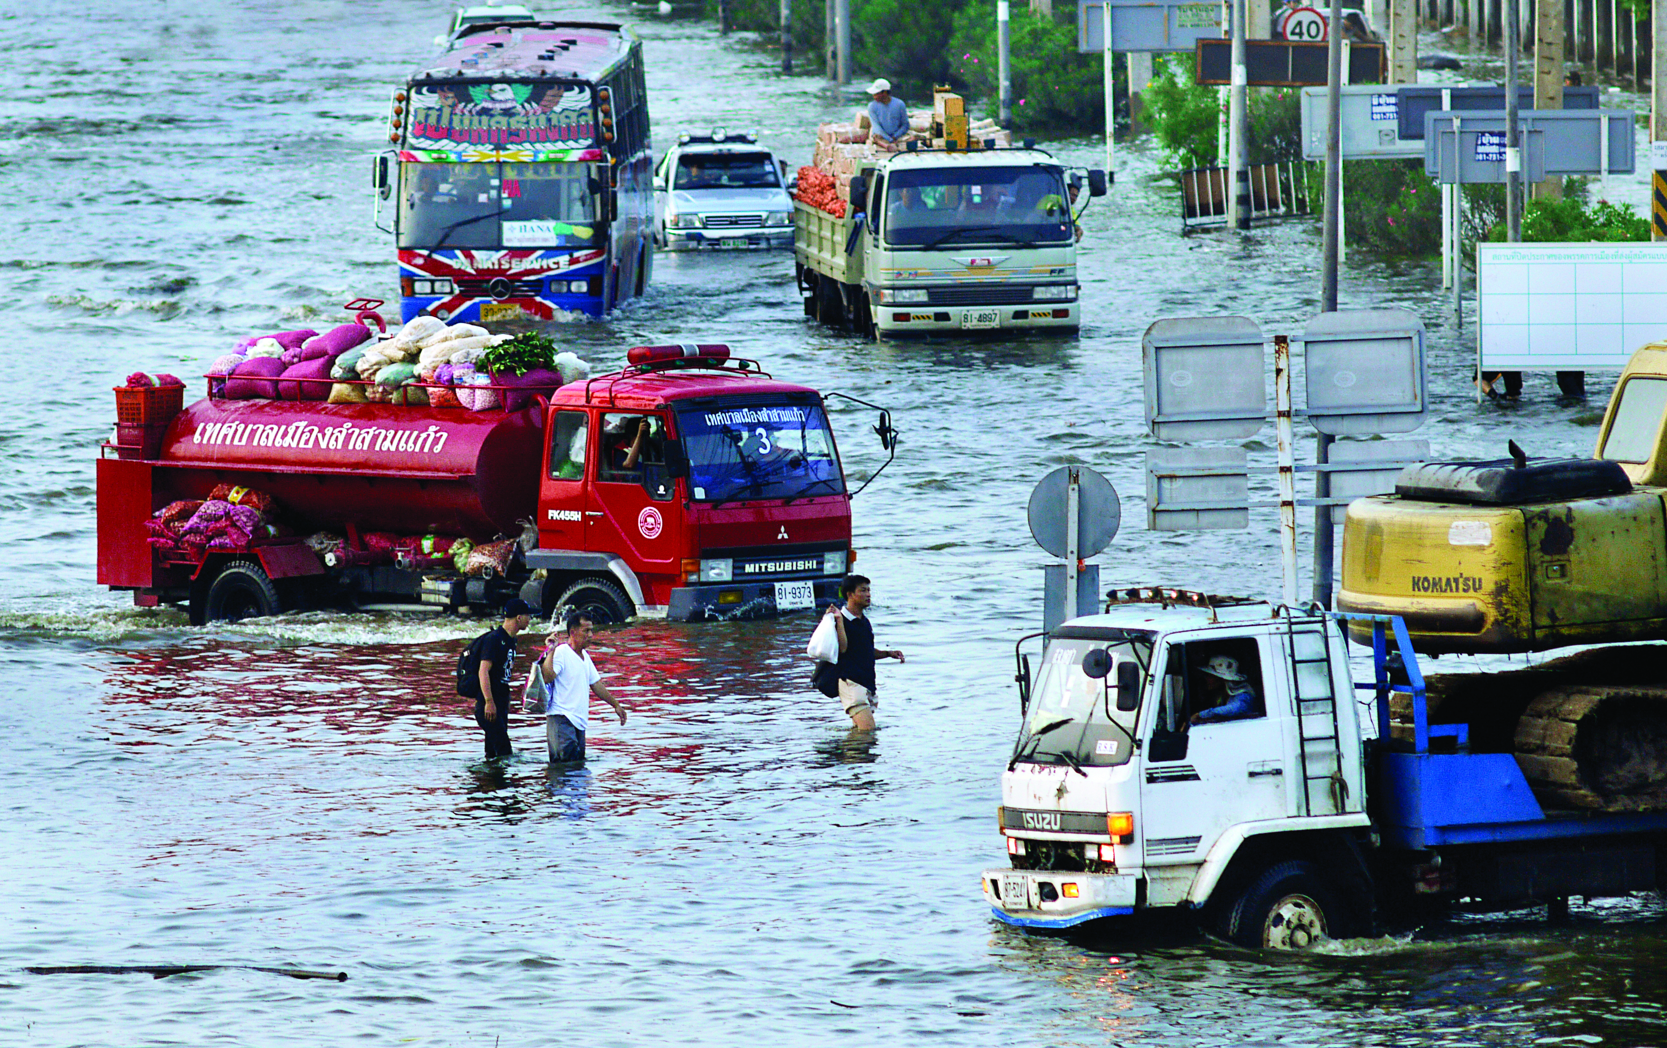
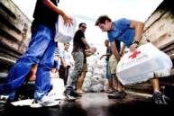
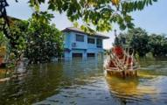
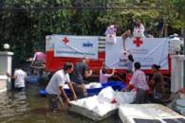
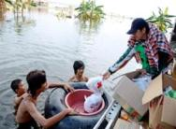
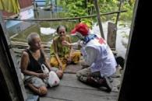
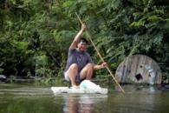
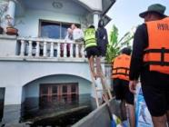
Impacts of climate
change
“If we fail to prepare
We are preparing to fail”
Notes:
Entering the second part of the presentation, we will discuss the changing disaster patterns and its impact on human livelihoods and vulnerability

Slide 9
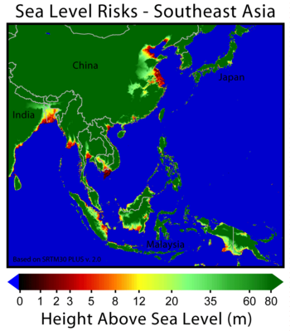
Sea Level Rise
Large coastal areas at risk
Salt water intrusion threatens water supply and food security
Migration

Slide 10
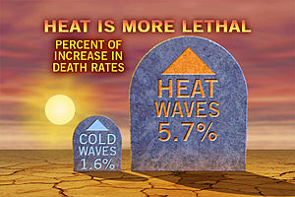
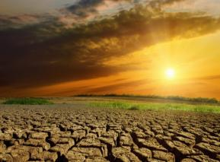
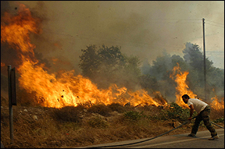
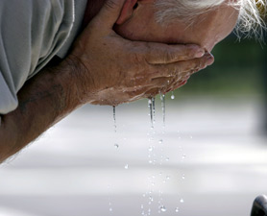
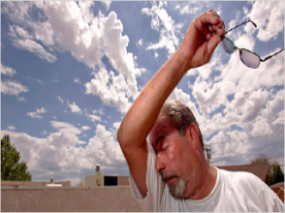
Increasing Temperature
More warm days and more heat waves
Higher death toll amongst the elderly and disabled
Increasing risk of forest fires

Slide 11
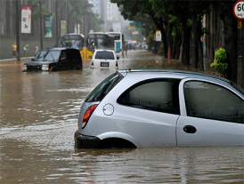
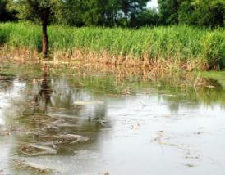
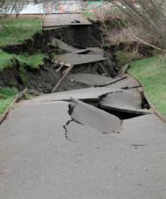
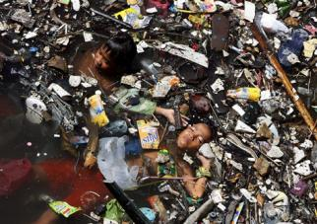
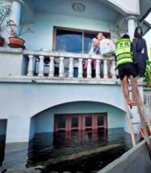
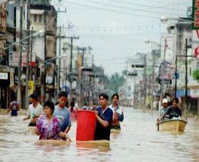
More intense rainfall
more floods, landslides
pollution of water
destroyed harvests, destroyed industries

Slide 12
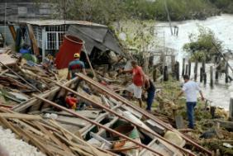
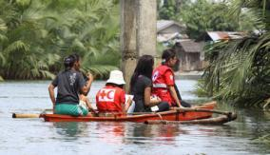
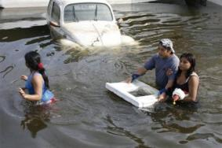
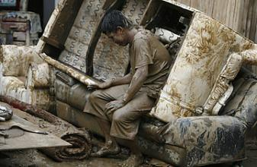
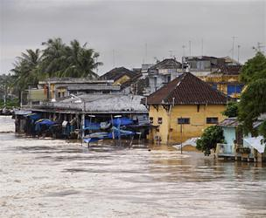
More intense tropical storms:
higher wind speed and more rainfall

Slide 13
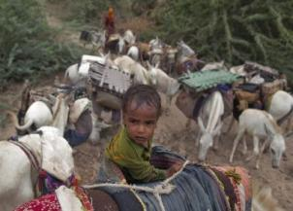
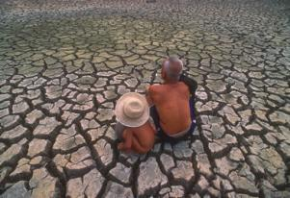
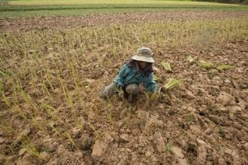
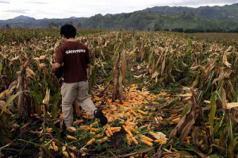
More droughts,
more often:
too little drinking water
food security threatened
potential impact on conflict and migration

Slide 14
Humanitarian and Development Impacts….

Slide 15
Impacts…
Increased human and material damages
Increased/more intense floods, tropical storms/cyclones and droughts
Decreased water availability and water quality
Potential conflicts over water availability…(i.e. Mekong River Basin countries….
Environmental refugees (by 2050 150 Million)
Increased incidence of waterborne diseases such as diarrhea, malaria, dengue, cholera diseases etc
Decreased agricultural productivity (food shortages)

Slide 16
Coping Capacities
Disaster risk is lower in high development countries than in low development countries.
Development processes intervene in the translation of physical exposure to hazards into disaster risk
For example: the United States was hit by more natural disasters than any country except China (in 2007: 26, compared with China's 35). But if you rank countries by the number of people killed or affected per 100,000 inhabitants, the U.S. hardly even figures.

Slide 17
Impacts on development...
Average GDP losses = 2-3 % in developed countries and up to 15% in non-developed countries
Due to meteorological disasters:
Thailand lost 2.5% of GDP for 2011
Japan lost 3% of GDP in 2011
Bangladesh loses 5.21% of GDP annually *
China loses 5% of GDP annually
- India loses 2 % of GDP annually due to same
Economic losses
16
600
Losses as % of GDP
12
400
Losses as % of GDP
Billion Dollars
8
200
4
0
0
Richest Nations
Poorest Nations

Slide 18
RCRC response to
challenges faced

Slide 19
Move from Emergency to Development
Resilience Approach
Relief
Recovery
&
Rehabilitation
Development

Slide 20
What is Resilience?
Intern “An ability to prepare for, adapt to, withstand and recover from external and internal shocks as well as have the capacity to cope with social, political and economic disparities that contribute to vulnerability”
Photo: IFRC
Notes:
20
20
Of course, any humanitarian organisation will have to consider how it will adapt to changes in the occurrence of disaster events and risk patterns and prepare for “more work and challenges.”
The Red Cross Movement has raised the issue at the highest level: The International Conference, which brings together the world’s largest humanitarian network and the world’s governments in a conference to debate major humanitarian challenges. It is attended by the ICRC, the International Federation and the186 national Red Cross and Red Crescent societies; on the government side, all 194 States that are party to the Geneva Conventions attend.
The International Conferences (IC) normally take place every 4th year, and in 2007 Climate change was one of the four main subjects of this conference, and in 2011 “Humanitarian consequences of climate change” was the theme for one of the 8 “workshops” at the IC.
In 2007, workshops were very well visited and Secretary Generals kept bringing forward their experiences of erratic weather in their countries. With the final Declaration and the commitment of the NSs, ICRC, the Federation and governments, climate change now needs to be fully implemented in the policy plans and programs of all NS.
Commitments were made to address climate change in the following ways (see slide):
raise awareness on climate change
provide humanitarian assistance
improve capacity to respond
decrease vulnerability of communities most strongly affected
integrate climate risk management into policies and plans
mobilise human and financial resources, giving priority to actions for the most vulnerable

Slide 21
Characteristics
A Safe and Resilient community...
1. … is knowledgeable and healthy. It has the ability to assess, manage, and monitor its risks. It can learn new skills and build on past experiences.
2. …is organized. It has the capacity to identify problems, establish priorities, and act.
3. … is connected. It has relationships with external actors (family friends, faith groups, government) who provide a wider supportive environment, and supply goods and services when needed.
4. … has infrastructure and services. It has strong housing, transport, power, water, and sanitation systems. It has the ability to maintain, repair, and renovate them.
5. … has economic opportunities. It has a diverse range of employment opportunities, income and financial services. It is flexible, resourceful and has the capacity to accept uncertainty and respond (proactively) to change.
6. … can manage its natural assets. It recognizes their value and has the ability to protect, enhance and maintain them.

Slide 22
Characteristics
The diagram shows the six characteristics
of resilient communities highlighting the
fundamental importance of knowledge and health
as the foundations of resilience at an individual level.

Slide 23
Important to remember:
There is no community with ZERO resilience as there is no community with ABSOLUTE resilience
Resilience is not the end of the road or outcome but the ongoing PROCESS
Resilience approach is an attempt to PROTECT development gains in longer term and to reduce dramatic RECLINE in development that disasters and crisis often cause
Meeting basic needs (food, water, shelter, health) is a prerequisite to building resilient communities. Communities who are unable to meet their basic needs, whose day-to-day focus remains survival, do not have the capacity to build resilience.

Slide 24
A Global Road to Resilience….
When did it start?
What are our Global commitments?
How do we fit in?
Way forward

Slide 25
Millennium Development Goals - MDGs
Hyogo Framework for Action - HFA
“Building the resilience of nations and communities to disasters”
Strategic goals
More effective integration of Disaster Risk consideration into sustainable development policies, planning and programming at all levels – with emphasis on disaster prevention, mitigation, preparedness and vulnerability reduction
Development/Strengthening of institutions (especially at community level) to build resilience to hazards .
Systematic incorporation of RR approaches into design and implementation of emergency preparedness, response and recovery programs
Notes:
The Yokohama Strategy for Safer World: Guidelines for Natural Disaster Prevention, Preparedness and Mitigation and its PoA (Yokohama Strategy) adopted in 1994 provides landmark guidance on reducing disaster risk and the impact of disasters
De facto ECHO-DIPECHO approach/orientation in DRR is in line with Strategic Goals 2 and 3

Slide 26
Five Priority Areas for Action
Ensure that DRR is a national and local priority
Identify, assess and monitor disaster risk and enhance early warning
Use knowledge, innovation and education to build a culture of safety and resilience at all levels
Reducing underlying risk factors.
Strengthen disaster preparedness for effective response
Notes:
Training: first aid, search and rescue teams, provision of equipment, drills, …
Awareness campaigns with the population (i.e: at schools) to recognise disaster risks & necessary measures.
Early warning systems (hydrological studies, communication systems, awareness signs, etc…),
Risk mapping (mapping of villages/risks/existing structures,…).
Institutional strengthening : training of institutions, facilitation of coordination, information sharing networks
Mitigation - To limit/minimise the averse impact of natural, environmental, technological hazards by reducing the physical vulnerability of the existing sites / infrastructures. : costal reforestation, construction of protection walls along water streams, building of elevated platforms for key village assets (i.e: water points) to face flooding, reinforcement of bridges to allow quick evacuation of people, …
Prevention- : Includes: planning (i.e site planning) legal measures (i.e : construction
codes) infrastructure works (i.e: dams, retrofitting,…), etc.

Slide 27
1. Make DRR a Priority
HFA
Ensure that DRR is a National and a Local priority with strong institutional basis for implementation
Creating effective, multi-sector national platforms to provide policy guidance and to coordinate activities
Integrating DRR into development policies and planning such as Poverty Reduction Strategies
Ensuring community participation, so that local needs are met
Global RCRC commitment to Resilience, operationalisation in progress with primary focus on communities
National DRR platforms in Indonesia and Philippines, DRR Forum in Vietnam– RC/RC active members
Community participation in DRR programming from assessment stage to implementation

Slide 28
HFA
2. Know the Risk and Take Action
Identify, assess and monitor disaster risks – and enhance early warning
RC/RC Climate Centre
EWEA
VCA / CBHFA / PASSA / PRA /PHAST

Slide 29
HFA
3. Build Understanding and Awareness
Use knowledge, innovation and education to build a culture of safety and resilience at all levels
Awareness raising through various Information, Education, Communication (IEC) materials
CBDRR, ICBRR, CBHFA (Involvement of beneficiaries during assessment, designing, implementation and monitoring).
International Day on DRR and other national events
Cross-regional learning, Peer-to-Peer
School Safety (DRR interactive games for children, DRR Comic books, Posters etc)

Slide 30
HFA
4. Reduce Risk
Reduce underlying risk factors
Small scale mitigation (Mangrove plantations, re-forestation, river protection walls etc…)
Building back better (Do no rebuild risk)- mainstreaming DRR
Awareness raising / Public awareness
Community preparedness / Capacity building (DRR mapping, OCAC, WPNS etc)
Partnership with key stakeholders (joint interventions)

Slide 31
HFA
4. Reduce Risk
Reduce underlying risk factors
Small scale mitigation (Mangrove plantations, re-forestation, river protection walls etc…)
Building back better (Do no rebuild risk)- mainstreaming DRR
Awareness raising / Public awareness
Community preparedness / Capacity building (DRR mapping, OCAC, WPNS etc)
Partnership with key stakeholders (joint interventions)

Slide 32
5. Be Prepared and Ready to Act
Strengthen disaster preparedness for effective response at all levels
Early Warning Early Action
CBDRR, CPP, CBDRM, CBHFA
Preparedness for Response, Contingency Plans, Pre-disaster meetings, Emergency stocks/Prepositioning
Simulation exercises / Evacuation drills
Disaster Emergency Funds
RDRT, NDRT, BDRT

Slide 33
A Road to Resilience in
Southeast Asia…

Slide 34
How to strengthen resilience
PEOPLE FIRST: A people and community centred approach. We can facilitate and assist individuals and their households and communities in their own efforts to strengthening their resilience.
LOCAL OWNERSHIP: Focus on building local ownership, assets and capacity, do not foster dependency or substitution.
COMPREHENSIVE APPROACH: Understand the diverse underlying causes of vulnerability and disaster and crisis risks simultaneously. This requires holistic assessments and interventions which take into account a variety of shocks and underlying causes of vulnerability.
ACKNOWLEDGING INTERDEPENDENCIES: address underlying causes of vulnerability and prepare for and respond to disasters and crises throughout the overlapping phases of disaster management and linking closely to developmental programming.

Slide 35
How to strengthen Resilience Cont.…
LONG TERM PERSPECTIVE: Engage and invest in the long term.
WORKING IN PARTNERSHIP: Create and broker relevant partnerships or advocate for support especially in areas which are not in the core of Red Cross and Red Crescent expertise or mandate but relevant to the individuals and communities we work with. Resilient communities cannot be achieved solely with IFRC support. The Red Cross and Red Crescent needs to facilitate support from a range of stakeholders who contribute to strengthening and sustaining resilience.
KNOW THE LIMITS: Acknowledge that strengthening and sustaining resilience is not possible in all contexts at all times

Slide 36
How did we operate so far?
Silo Approach
Migration
Gender
DM
Advocacy
&
Communication
Health
PwD
Climate Change
Coordination & Cooperation
OD
Children

Slide 37
What has been done so far?
WDR focusing on community resilience in 2004 (other resilience related approaches even before this)
Community Safety and Resilience Framework, focus on DRR in 2007-2008
Strategy 2020 references to resilience
Health Strategic Operational Framework 2011-2015 – resilience approach
“Characteristics of Resilient Communities” – DRR study 2011
Development and Disaster and Crisis Management Position Papers 2011
Workshop on Community Resilience at the GA 2011
Resilience teams/units – e.g. Bangkok Regional Delegation preparedness and resilience unit
NS work on resilience programmes

Slide 38
SEA Regional Community Safety and Resilience Unit - CSRU
Since Aug 2011
Community Safety and Resilience Unit
Health
Disaster Management

Slide 39
SEA CSR Team
SEARD CSRU Team
Country Delegations
Team
DM Delegate in Myanmar
CSR Coordinator in Jakarta
CSR Coordinator in Manila
CSR Coordinator in Hanoi

Slide 40
CSRU Objective
.. is to provide National Society focused technical advisory support in three priority areas:
1) Improve preparedness for response capacities through strengthening local, national and regional capacities to respond to health emergencies, disasters and crises;
2) Strengthening community safety and resilience through promotion and development of an integrated risk reduction community based programs that incorporate all cross cutting issues such as climate change, gender, migration, people with disabilities, psycho-social-support and other relevant issues and,
3) Reducing the burden of public health issues through strengthening National Society capacities in their auxiliary role to government.

Slide 41
Integration
Advocacy
&
Communication
Disaster
Management
Health
Resilience Approach
Cross–Cutting
National Society Development
Coordination & Cooperation
Integrated Risk Reduction Programming

Slide 42
Mainstreaming
CBDRR
CBHFA
IEC
Preparedness for Response
Response (RDRT)
Beneficiary Communication
iCBRR
Water & Sanitation
Advocacy
&
Communication
Disaster
Management
PSP
Comms in emergencies
Health
Recovery /
Rehabilitation
NCD
MCH
Children
KIM
GRSP
Migration
Regional
Forums DM/DRR & Health
Cross–Cutting
Peer-to-peer
exchange
National Society Development
Gender
Coordination & Cooperation
Logistics
People
With
Disabilities
- PwD
Knowledge sharing
ASEAN,
ACDM, APG, RCC, IAP
Volunteer Management
Climate
Change
RCY
Mainstreaming Cross Cutting Issues

Slide 43
How do we take Resilience Approach forward
Way forward
Communities must be at the centre of our risk reduction efforts. This requires ensuring their engagement and participation at all stages of risk reduction programming cycle and supporting them to be the decision-makers (owners of programs) in the design and implementation of their own risk reduction activities.
Strengthening advocacy strategies and skills of National Societies with external partners and governments to engage with communities and support planning, implementation and sustainability of Risk Reduction activities with ownership by the communities.
Develop a standardized Community Based Risk Reduction methodology, including community selection criteria, which can be applied at scale, yet allows sufficient flexibility to respond to the needs of specific communities.

Slide 44
Increase RCRC capacity in the facilitation of a multi-sector VCA process and the ability to respond to the priorities identified in the VCA (in any sector). Do we need to develop a multi-sectoral assessment tool that would also include key cross –cutting issues…..
Involve local government throughout CBDRR programs and advocate for the incorporation of DRR and CBDRR into local and national government policies and investment programmes.
It is NOT structural integration but integration of cross –sectoral planning into ONE risk reduction plan.

Slide 45
Some practical ideas for Integrated programming….
Multi-sectoral assessments and community planning – Community Assessment Field School, use of participatory techniques/tools for community assessments and planning
Understand mutual interests and priorities; identify areas for integration in planning and implementation;
Agree on conceptual, operational models, share models/tools whenever applicable/possible
Joint action: planning, implementation, review and evaluation of activities/initiatives
Assembling indicators from both DM and Health that will translate the needs of communities and be easily measurable
Disaster
Management
Health

Slide 46
Integrated planning: DM and HEALTH – more suggestion for further discussion…..
Strengthening the emergency preparedness, planning capacities and response to disasters/shocks
Identification of risks from hazards and assessment of community vulnerabilities
Improving preparedness for response such as development of evacuation plans or improving epidemic preparedness and response mechanisms at community levels
Promoting better integration of risk reduction activities across health and other sectors – strengthening coordination mechanisms (both preparedness and response)

Slide 47
Integrated Risk Reduction Programming:
Is not a short term but long term process
Will depend on commitment of all sectors / technical experts to work together in the process of planning, implementation, monitoring and evaluation of such programs/initiatives.
Should also open new funding opportunities especially for programs that were facing difficulties in securing necessary funds
Should also enable access to longer term donor mechanisms

Slide 48
We have started our journey but it requires a team work to travel on a Road to Resilience
T
ogether
E
verybody
A
chieves
M
ore

Slide 49
Thank You

