Slide 1
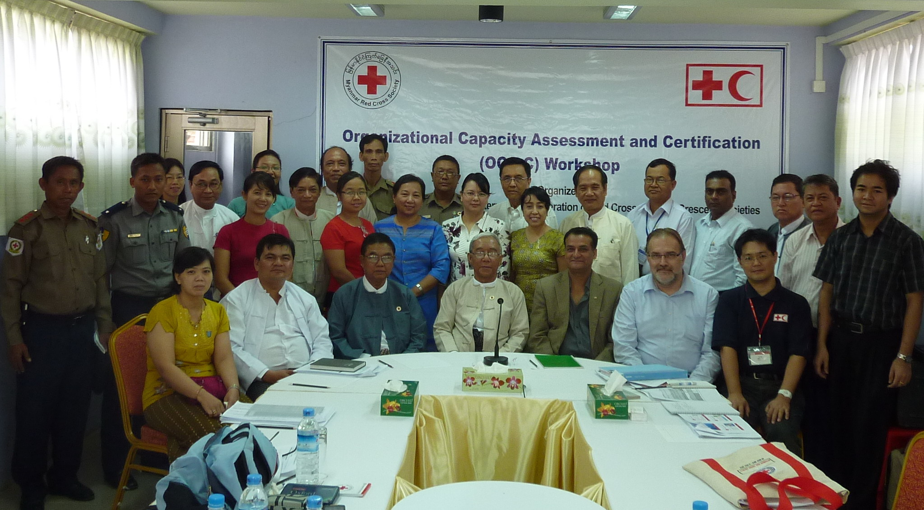
MRCS Perspective and Feedback on OCAC
In November 2012 ( 15 participants with 2 Facilitators )

Slide 2
Objectives of OCAC Internal self assessment
Organisational Capacity Assessment
to assess ourselves against defined
international standards
to develop and implement a tailor-made development Plan
Certification by the IFRC Governing Board

Slide 3
Critical conditions - looked into for sustained performance
Capacity to exist
Capacity to organize
Capacity to relate and to mobilize
Capacity to perform
Capacity to grow

Slide 4
Phase I - How did we measure?
Core capacities
Attributes
Indicators
A
B
C
D
E
Strategic Plan
A | B | C | D | E | A - E | 1 - 4
 | The NS has Statutes that are available at all levels of the NS. | The Statutes have been revised less than 10 years ago. | The NS Statutes meet the requirements of the guidance document. | The NS regularly discusses and disseminates its Statutes. It involves all levels of the NS in this process.
Notes:
Note:
The organizational context adjusts the benchmarks for indicators in SOME attributes only.

Slide 5
According to 5 core capacity areas, 63 Attributes positioning in A and B score, were needed to tackle urgently.

Slide 6

How did we use OCAC results?
Identified “What are the critical capacity
deficits of MRCS?”
prioritized actions for MRCS’s Development Plan.
Planned “How MRCS should do to fulfil these deficits “
  2013 Development plan
  2014-2015 Development plan

Slide 7
Phase I - How did we prioritize ?
Core capacities
Attributes
Indicators
A-E
Prioritize
1 - 4
A
B
C
D
E
A or B
A: The NS has no statistics related to volunteer involvement
PRIORITIZE
1- Not relevant
2 – Relevant but not Urgent
3 – Relevant and Urgent
4 – Critical ( Law revise, Emblem, state/region /branch capacity build)

Slide 8
Pie chart diagram showed that MRCS has only 4.35% of attributions represented highest and great satisfied level Vs 31.52% of attributions are worst level needed to be improved or urgent needed to be changed in organizational development process.

Slide 9
Priorities according to OCAC findings;
Institutional matters (highest)
Legal tools (highest)
Security and safety awareness (highest)-
Resource mobilization (highest)-
Identity (2nd )
Protection of image and reputation (2nd )
Communication (2nd )
Learning from others (3rd )

Slide 10
Planned “How MRCS should do to fulfil these deficits “
Developed -
  2013 Development plan
  2014-2015 Development plan

Slide 11
based on 63 Attributes positioning in A and B,
42 actions were planned to tackle in urgent in 2013,
19 actions have been done at the end of 2013 (45%)

Slide 12
MRCS’s
Development Plan For 2014-2015
23 Actions are needed to address in 2014-2015 (55%)

Slide 13
Institutional matters and Legal tools
2013 | 2014-2015
Scaling up Community based programmes Selection of pilot branches and coverage of community based Program in country in line with OD recommendation Develop clear roles of senior management level development of Communication Policy Law and statutes revision Waiting for approved new Law. | Scaling up Community based programmes Selection of pilot branches and coverage of community based Program in country in line with OD recommendation Regular review and update of Branch development model clear boundary between governance and management. Improve communication & Information capacity and system Statutes revision Develop Emblem law within one year after approved new Law. Establish common PMER system at all levels.

Slide 14
Security and safety awareness
2013 | 2014-2015
Developed and followed “code of conduct”. Continue Volunteer insurance and practice. Awareness on internal reporting system regarding violence/abuse of power for staff and volunteers Undertake humanitarian diplomacy to support vulnerable people in Myanmar. | Develop and operate “Staff and Volunteer safety and security guideline” and provide related supports Continue Volunteer insurance and practice. Provide basic security training for staff and safer access session to all staff/RCVs with effective monitoring system. Develop internal reporting system regarding violence/abuse of power for staff and volunteers Undertake humanitarian diplomacy to support vulnerable people in Myanmar.

Slide 15
Resource mobilization
2013 | 2014-2015
Developed HR policy and regulation, Child Protection Policy, staff- orientation/Induction Info; booklet.etc. Determined core structure and core budget covering to 30% or less of total budget. Initiated Development of core service policy Support to have RC branch office at 40% of branches by the end of 2015. Volunteer mobilization at IDP camps/remote areas ( deployment of RCVs, invest capacity building trainings and recovery operation) | Development and initiate CAS strategy Develop Membership policies and regulation. implement the approved cost recovery model Recruit at least one paid staff per state/region under core structure. Support to have RC branch office at 40% of branches by the end of 2015. Volunteer mobilization at IDP camps/remote areas ( deployment of RCVs, invest capacity building trainings and recovery operation)

Slide 16
Resource mobilization
2013 | 2014-2015
Upgrade current Finance management system at all levels(Navision software + trainings) Standard reporting template and information tool.(Finance, branch level) Up grade RM unit to RM division to develop RM strategy and identify target group of fundraising activities. Market MRCS First Aid and Safety services trainings to commercial customers. | Upgrade current Finance management system at all levels Start Resource Management System and assign volunteer data base focal person in Nhq. Market MRCS First Aid and Safety services trainings to commercial customers. Strengthens RC youth development Programme to support MRCS community based programme.

Slide 17
Follow up Actions in 2013-2014
OCAC-report , after assessment
Shared OCAC report to all movement partners, Central council members, and management staff
Reviewed and revised MRCS’s Strategic Plan 2015 regarding to OCAC deficits and shared revised SP 2015 to all PNSs
Priority Core Areas and actions and POA.
Disseminated “ Priority Core Areas and actions” to PNS meeting in Oct 2013.
Developed 2014-2015 Operational Plans in line with OCAC report and revised SP -2015

Slide 18
Benefits of O-CAC process
4 E – outstanding efforts ->> inspire mark for MRCS
63- Deficits- >> Opportunity for MRCS’s tailor-made Development Plan
Common understanding >>>Where MRCS is and what we have done and what we need to tackle in urgent.
pledge and committed << Governance and Management level
Transparency – Partners- >> building trust
>>increased # of Donor
interest and support of Donor – particular areas
Self confidence - All Departments/Unit- in development of yearly operational plan
Notes:
Proud for having received 4 “E” grade.
Deficits- Opportunity for NS’s tailor made Development Plan
MRCS realized that where we are, which areas are highest need to develop urgently, eg. Legal base revision, RC/RC image in public are very important issues for NS and RM is urgent issue to implement for capacity to grow etc.
MRCS senior mgt; staff are getting more committed to fulfill the OCAC ‘s deficits.
MRCS got trust building among partners through transparency and dissemination of OCAC report sharing.
So that Partners and donors are more enthusiastic to support NS.
MRCS Management staff have getting more self confidences to do yearly operational plan inline with Strategic plan.

Slide 19
Challenges
Long term support ( more than 3 year)
support of Union of Government
Workload of Senior Management staffs –
higher turn over rate

Slide 20
Lesson learned and need support from Donors
Continuous OCAC assessment annually.
Next Strategic Plan 2016-2020 should be in line with the deficits of OCAC assessment and Indicators/attributes.
Both short-term and Long term Development plan
legal base development and dissemination to all staff, members and the public must be regular and continuous.
Humanitarian Diplomacy is very impartant
Annual progress reports should be made with the help of PMER support.
CAS strategy is needed to support OCAC based implementation plans.
Any NS should do the OCAC Internal assessment.

Slide 21
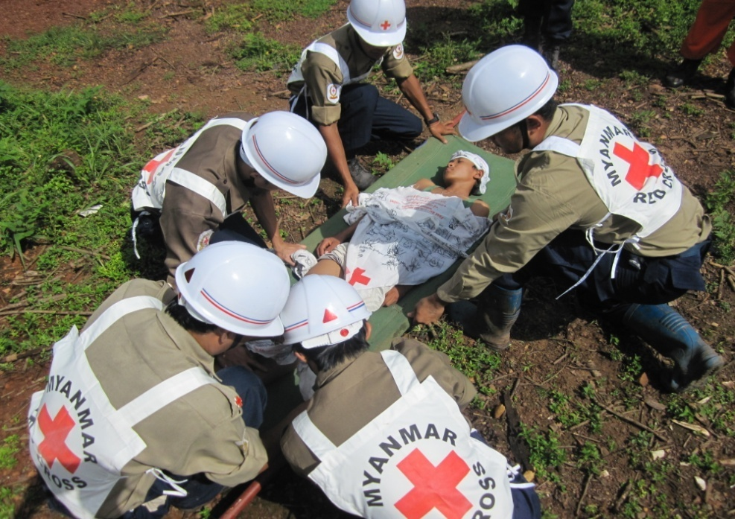
Thank you

