Slide 1
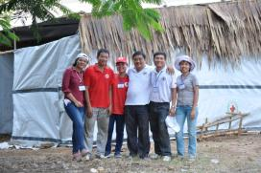
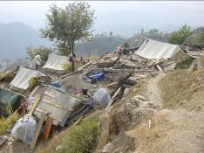
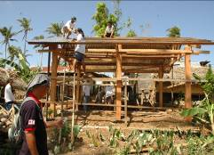
What is a shelter?
Notes:
Here are the contents of the session:
Introduction of the participants and the trainers – with ice-breaker (15 minutes)
Objectives of the training + specific objectives
The day’s themes and the overall agenda for the training
Contents of the folder given to participants
General information on the organization of the session
Look at the expectations of the participants
Questions?

Slide 2
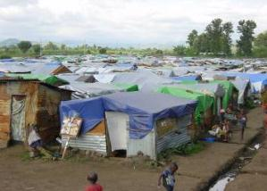
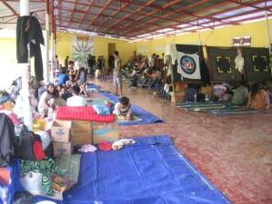
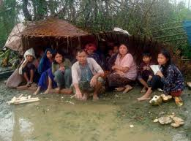
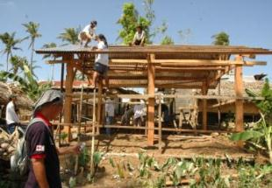
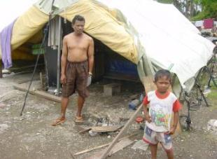
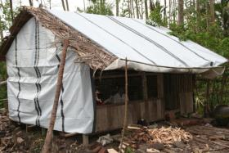
How do we define “shelter”
Notes:
Time allowed: 10 minutes approximately
Ask the participants!
Write on the board or the flip-chart all the answers given.
It could be interesting to note the translation of the word « shelter » in different languages or dialects (ex.: hut, lean-to, etc.)
Start with a discussion on what does ‘shelter’ mean in different languages – observation that often it means safety, protection but usually limited in timeframe/temporary in nature – important for us to remember that to our beneficiaries shelter is usually their home.
Sometimes the only support that they will receive, will be the one that we can give to them….
KEY MESSAGES to convey:
Is the word they use for “shelter” the same they use for “home”?
Summarize the discussion saying that the way we understand shelter in the department does not necessarily correspond with the dictionary definition. It covers all the aspects described and many more. Probably a better word would be “HOME”.
Useful to capture some of the meanings in a flipchart.

Slide 3
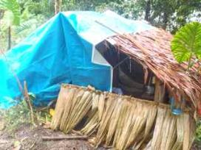
Shelter: why, what’s it for?
Protection - health
Security – feeling safer
Privacy & Dignity
Livelihoods Essential activities?
Others….
“A habitable covered living space, providing a secure, healthy living environment with privacy and dignity to those within it” (Corsellis & Vitale 2004)

Slide 4
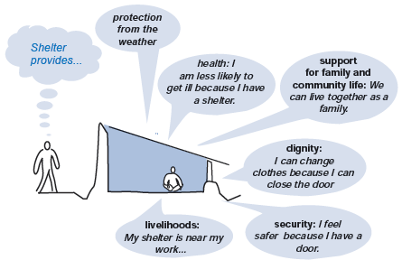
Some of the functions of appropriate emergency shelter:

Slide 5
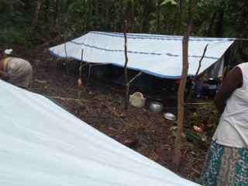
Dictionary definition
Shelter: ‘a place giving temporary protection from bad weather or danger’

Slide 6
Shelter as a Human Right
The ‘Universal Declaration of Human Rights’ provides the basis for materials planning in four different areas
security of person: “everyone has the right to life, liberty and security of person”
privacy: “no one shall be subjected to arbitrary interference with his privacy, family, home or correspondence”
peaceful enjoyment of possession: “everyone has the right to own property… no one shall be arbitrarily deprived of his property”
adequate housing: “everyone has the right to a standard of living adequate for the health and well-being of himself and of his family”
download from
un.org/rights
These need to be implemented through understandings of age, gender and diversity
Notes:
RE-DO DIAGRAM

Slide 7
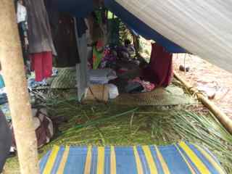
Shelter: What is it?
Clothing, blankets
Shelter (roof)
Mattress
Wind proofing
Insulation - warm room
Stoves & fuel
Sanitation?

Slide 8
Shelter: who, when, how?
Who needs shelter?
Varying needs, age, gender, disability etc
Protection issues - location, construction?
When?
How will shelter needs change?
Seasons?
How will it be provided?
And what is our role (as Cluster Leads) in this?

Slide 9
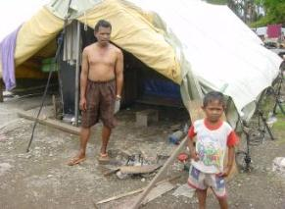
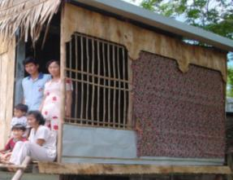
Some things to consider
Lifespan of the shelter
Climate – hot, cold, rain, wind, etc
Space/privacy – for family size, women/children
Security – for families and possessions
Hazards - winds, flooding rivers
Culturally appropriate
Healthy – vector control, draught proof, cooking smoke
Accessibility – aged, disabled
Notes:
Explain each answer:
Protection from the climate: rain, cold, snow but also the heat, sun, wind, etc.
Security and protection of the private space: 1 family per shelter, men and women separated if necessary
Health: a shelter to reduce the risk of falling ill
Support for the family unit and communal space: a place to live, prepare food, sleep, care for children….
Support for the resumption of subsistence activities: a place where one can take up or continue an economic activity (e.g., sell items, sew, raise chickens…)

Slide 10
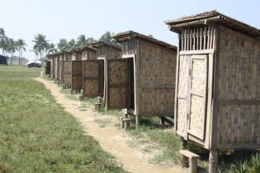
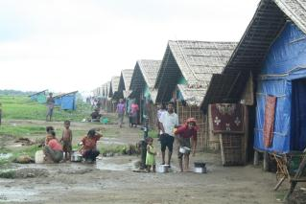
Some things to consider
Water supply – to wash, clean and drink, drainage
Sanitation and laundry facilities
Consider the environment
Use local advice, traditional construction.
Participation of affected households in the design and construction
Allow upgrade at a later stage by the people who use it
What worked locally when the last disaster struck and what didn’t

Slide 11
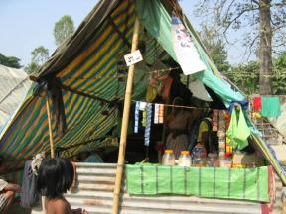
Some things to consider
Access to livelihood opportunities – access to markets
Access to community facilities – health facilities, schools
Access to transport links
Support social networks, family and friends

Slide 12
Understand what do the Red Cross Red Crescent do in shelter
Red Cross and Red Crescent National Societies are usually the first responders after a disaster delivering emergency relief – food, NFI’s and first aid support.
As part of the emergency relief National Societies implement a wide range shelter responses including tents, tarpaulins and household NFI.
Often National Societies are also part of longer term recovery programmes which include repairing and rebuilding permanent houses.
Notes:
KEY MESSAGES to convey:
There will be high expectations on IFRC programme because it has committed to lead shelter.
Role for the shelter FACT in the cluster is to attend to the meetings.
Although shelter has been an activity of the RC since Solferino (Henry Dunant used host family and collective shelter ;-) the good practice and guidance has not been systematized.
ADDITIONAL background information:
The “cluster” approach is a method of coordinating and strengthening the effectiveness of disaster response operations, in support of the host country’s government. It is part of the Humanitarian Reform process that was developed by the IASC Working Group, a body comprised of the Red Cross Red Crescent Movement, various NGOs and the United Nations. At the 2005 General Assembly, the IFRC committed to convening the Shelter Cluster in disaster response operations.
Humanitarian reform. Cluster system. IFRC as convener shelter cluster after a natural disaster during the emergency phase - UNHCR on operation related with conflict situation.
RCRC movement (NS, IFRC & ICRC) have been implemented shelter programmes for quite time ago but shelter department was created in IFRC after to take the decision of become shelter cluster convener.
At the same time that the FACT team is deployed, a shelter cluster coordination team SCCT will be deployed too. They’ll coordinate the general shelter response in the country including RC/RC Movement, UN agencies, NGO/INGOs. They’ll not be involve on the implementation of the RC/RC response. They’ll be in depended but it will be important to have a close collaboration.

Slide 13
Some shelter achievements…
66 million – people with houses damaged by 2007 Asia floods (Nepal, Bangladesh, Pakistan, China, DPRK, Vietnam, India)
1.8 million – homes destroyed or damaged in Pakistan by the last Floods in 2010
47.9% - housing as a percentage of total cost of tsunami damage in Indonesia
CHF 100 million - IFRC spend on Aceh transitional shelter programme
140,000 HH helped by RCRC in Haiti with Emergency Shelter (covering kit, tents & STK)
100,000 families supported by RCRC in Philippines in response to Typhoon Hiayan with shelter relief
Notes:
Quick glance to put in perspective SCALE of shelter on disaster response:
KEY MESSAGES to convey:
Shelter is about scale: meeting the needs of many people (points 1-2)
It is a very expensive activity (points 3-5)
There are different approaches and solutions with different range of costs. Since they will be multiplied by many HH, the choice of the approach/solution has huge cost implications (points 6-9)

Slide 14
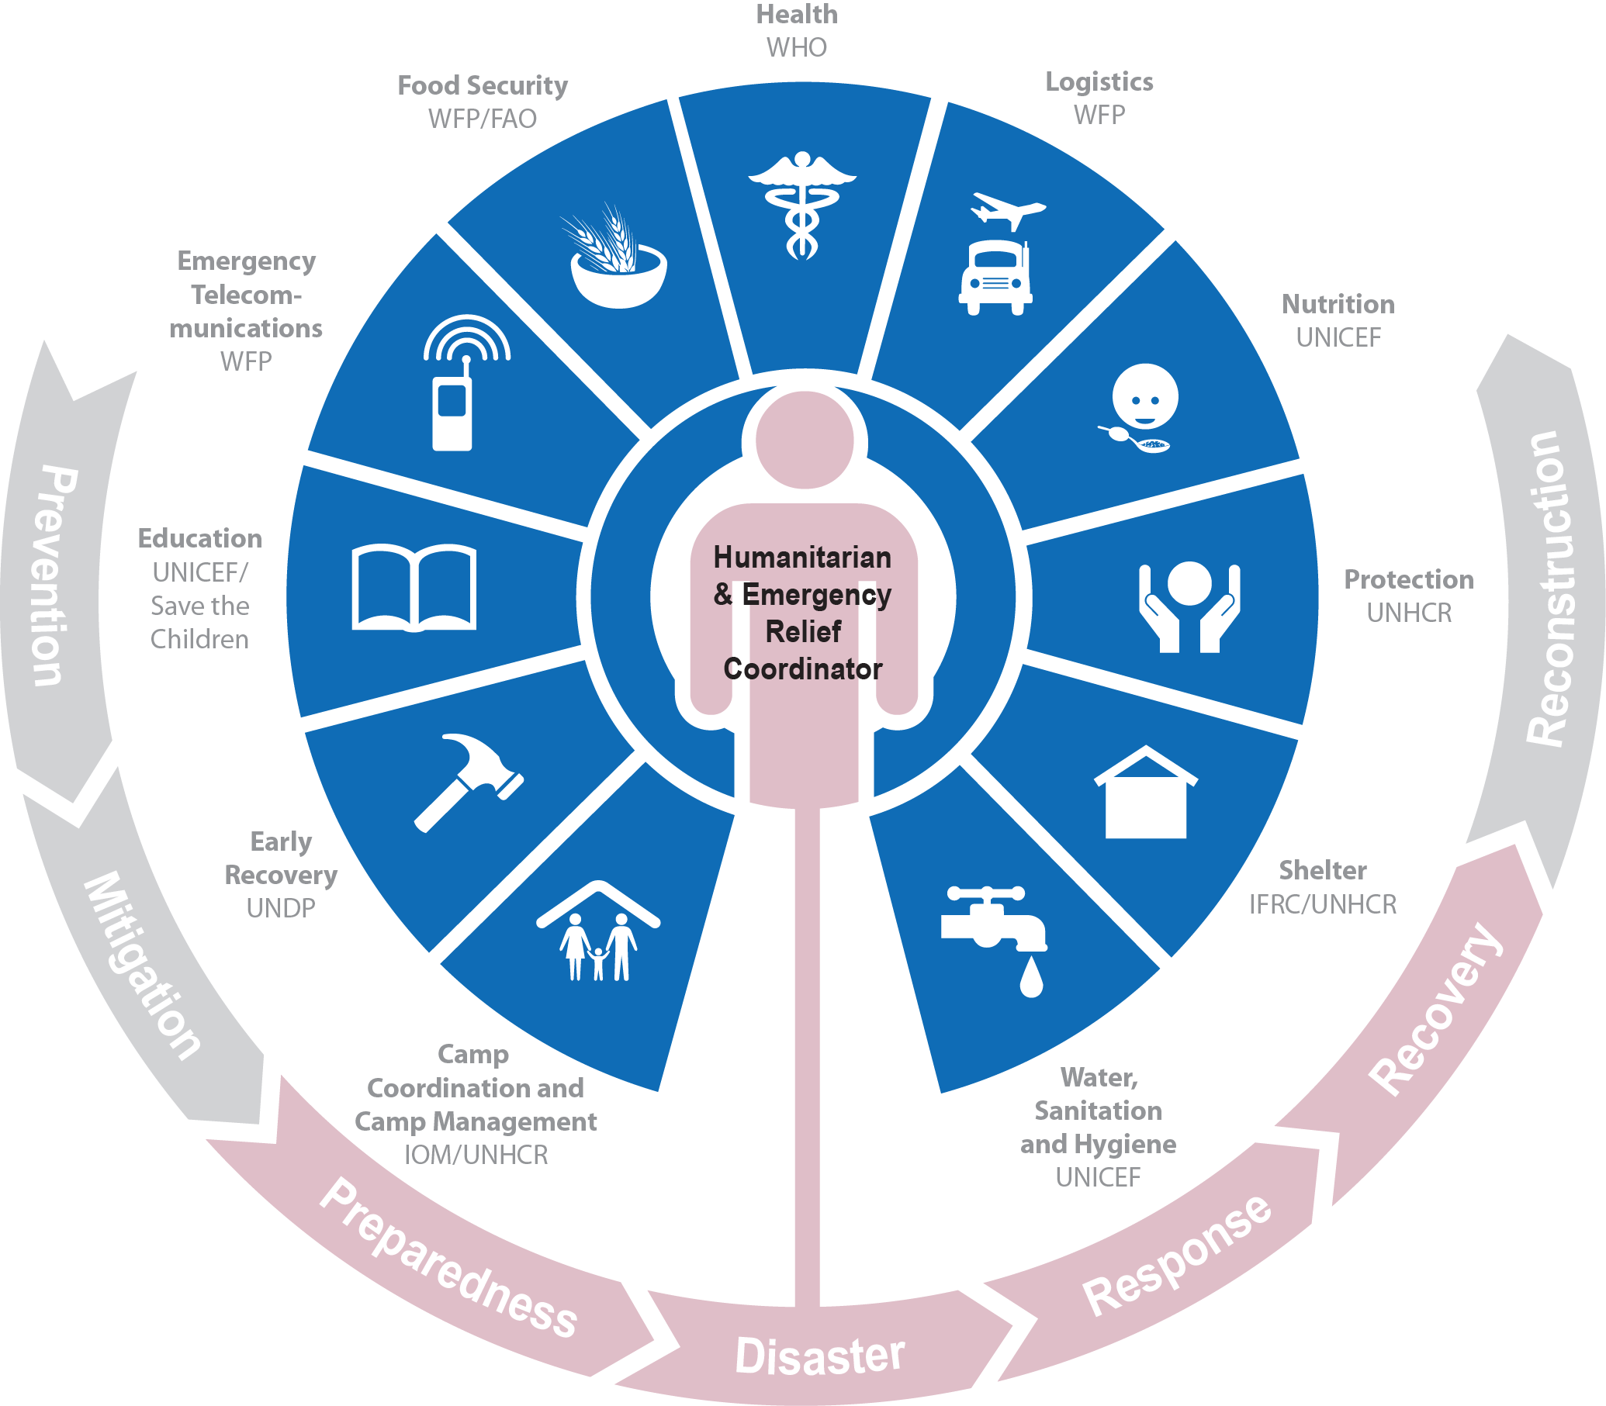
IFRC are the lead agency for shelter in the IASC (for natural disasters in non conflict areas)
Inter agency standing committee

Slide 15
IFRC and shelter cluster…
For many years the IFRC has been a leading agency in the shelter sector for natural disasters– and few other agencies have shelter in their mandate
At the 2005 General Assembly, the IFRC committed to convening the Shelter Cluster in disaster response operations in non conflict areas.
IFRC subsequently signed an MOU with OCHA.
National Societies implement a wide range of emergency, transitional and permanent housing.
IFRC have had a dedicated shelter and settlements unit in Geneva and the zone offices from 2006.
Notes:
KEY MESSAGES to convey:
There will be high expectations on IFRC programme because it has committed to lead shelter.
Role for the shelter FACT in the cluster is to attend to the meetings.
Although shelter has been an activity of the RC since Solferino (Henry Dunant used host family and collective shelter ;-) the good practice and guidance has not been systematized.
ADDITIONAL background information:
The “cluster” approach is a method of coordinating and strengthening the effectiveness of disaster response operations, in support of the host country’s government. It is part of the Humanitarian Reform process that was developed by the IASC Working Group, a body comprised of the Red Cross Red Crescent Movement, various NGOs and the United Nations. At the 2005 General Assembly, the IFRC committed to convening the Shelter Cluster in disaster response operations.
Humanitarian reform. Cluster system. IFRC as convener shelter cluster after a natural disaster during the emergency phase - UNHCR on operation related with conflict situation.
RCRC movement (NS, IFRC & ICRC) have been implemented shelter programmes for quite time ago but shelter department was created in IFRC after to take the decision of become shelter cluster convener.
At the same time that the FACT team is deployed, a shelter cluster coordination team SCCT will be deployed too. They’ll coordinate the general shelter response in the country including RC/RC Movement, UN agencies, NGO/INGOs. They’ll not be involve on the implementation of the RC/RC response. They’ll be in depended but it will be important to have a close collaboration.

Slide 16
Special role of the IFRC as Shelter Cluster “convener”
Not accountable to the HC/ERC because of independence and neutrality of the Red Cross Red Crescent Movement
Not a “provider of last resort”
IFRC does not receive money from the CERF – UN funding mechanisms

Slide 17
Coordination and the cluster approach
The people who survive a disaster are the first to provide emergency assistance to their family and community.
But when the disaster is large and overwhelms a countries own capacity to respond a range of regional and international organisations may send money, goods and workers to their aid.
Whether the response is local, national or international coordination between those involved is needed.

Slide 18
But coordination can be difficult
What organisations are already here?
Who needs assistance?
What standard do we use?
Who is doing what, where and when?
Where do people need assistance?
Where can I get information?
How can I get funds?
What is the government doing?

Slide 19
There is a lot to coordinate.
Local knowledge
Technical advice

Slide 20
Many agencies
IOM
Caritas
Shelter Box
Save the Children
Care
Nepal Red Cross
Govt
Samoa
Red Cross
ADRA
WV!
Oxfam
HfH
Many agencies.
Some familiar to Govt, some not.
Working in different locations.

Slide 21
With coordination …..
Shelter individual agencies
Individual agencies with different objectives and different standards reporting to the Govt
Shelter Cluster
Cluster of individual agencies with common objectives and common standards reporting to the Govt

Slide 22
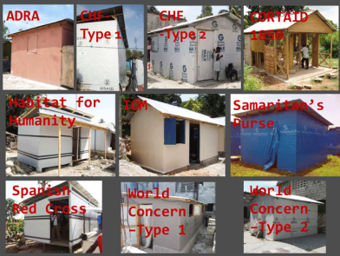
We find many different standards of response …..
Too many agencies with no clear focus.
Doing their own thing where they wanted because they got there first.
Too many different standards in the response – unequitable responses.
Not enough accountability and transparency.
There was a need for better coordination to provide a needs-based, rather than capacity-driven, response.
To ensure a coherent and complementary approach, identifying ways to work together for better collective results for the affected populations

Slide 23
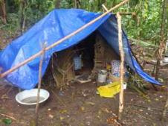
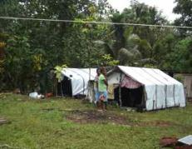
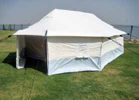
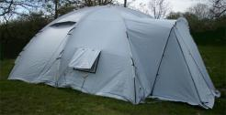
We try to avoid different standards….with coordination
Different tarpaulins
IFRC/UNHCR standard 6x4
Rolls of plastic sheeting
Different tents
IFRC/UNHCR tent
Shelter Box tent
Different repair kits
One agency gives 10pcs CGI, 8x2’, Ga 28
One agency gives 16pcs, CGI, 10x3’, Ga26

Slide 24
We agree technical standards….with coordination
We all agree the tarpaulins with be this quality
xyz, $
We all agree the tent will be this quality
xyz, $
We all agree the repair kit will contain this and cost about that
xyz, $
We all agree the minimum design standards for a new house

Slide 25
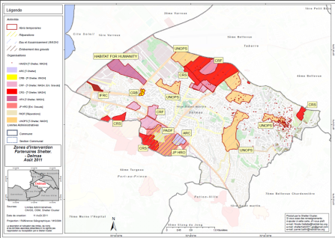
We agree common information management……with coordination
We all agree what locations we will work in
We all agree how we will report our facts and figures – who, what, where, when
We all agree to cover gaps

Slide 26
We agree common assessment indicators ……with coordination
Definitions of damage
Vulnerabilities

Slide 27
Humanitarian Response Review
In 2005 the UN Emergency Relief Coordinator commissioned the Humanitarian Response Review.
The Review identified a 4 key areas to improve coordination in humanitarian emergencies:
Adequate capacity and predictable leadership in all sectors – (cluster approach)
Effective leadership and coordination through the UN Humanitarian Coordinators role.
Adequate, timely and flexible humanitarian financing.
Strong partnership between UN and non-UN agencies.
The Review was implemented by the Inter Agency Standing Committee (IASC) - comprised of UN agencies, RCRC Movement and the primary NGO consortia bodies

Slide 28
The aims of the Cluster approach
Joint strategic and operational planning:
The formal process of coordination within and between Clusters enhances efficiency while improving effectiveness.
Enhanced predictability:
Sector and thematic responsibilities are now clearer, and formal mechanisms exist to clarify those areas where they are not, both at national and international level.
Increased transparency and accountability:
Greater transparency in resource allocation, co-leadership, and operational performance leads to greater accountability.
Engagement with national and local authorities:
Inclusion of affected communities:
Tools and services developed through the Cluster ensures that those who know the most appropriate solutions to their problems be engaged in formulating the response.
Having a single person to call speeds up the resolution of issues, and allows greater access for the non-governmental community to government and UN decision-makers.
Where the Clusters, singly or collectively, speak with one voice on issues of common concern, including those affecting groups who are not normally heard.
More effective advocacy:

Slide 29
National Governments and cluster
Governments remain responsible for assistance to people.
The planning and coordination of emergency response remain the legal responsibility of the host government.
Hence clusters aim to support the work of the host government and of national and local government authorities

Slide 30
UN vs IASC
The Cluster approach is NOT a UN (only) coordination mechanism.
However, the majority of global cluster leads are UN agencies

Slide 31
What does the shelter cluster do?
The shelter cluster coordinates the work of organisations involved in the provision of shelter and household NFI’s.
Following major natural or technological disasters to which there is an international response, the IFRC normally leads the shelter cluster.

Slide 32
What does the shelter cluster do?
The aim of the shelter cluster is to enable partner agencies to take a strategic approach to collective response.
It aims to ensure that:
Overall response by agencies delivering shelter and NFI’s is adequate, effective, coherent and coordinated.
Gaps and duplication in the provision of shelter and NFI’s are minimal
Assistance is given in accordance with humanitarian principles, standards and guidelines

Slide 33
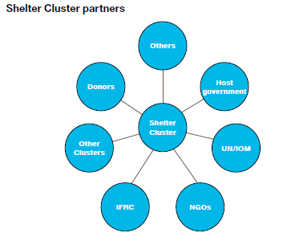
Which agencies are partners in the shelter cluster?
Any organisation involved in fulfilling rights to humanitarian shelter and NFI’s can become a shelter cluster partners
Partners include organisations that have different mandates, perspectives, roles and priorities within the response.
Partners include: Govt, RCRC, NGO’s/INGO’s, UN agencies, etc.
However, the overall objectives of the clusters work is humanitarian; the cluster and its work are governed by the principles, standards and practice of the humanitarian sector.

Slide 34
How long does the cluster be active?
The IFRC usually lead the shelter cluster for at least 6 weeks to 3 months.
But this varies greatly depending on the scale of the disaster and response and the country context.
Largest scale and response so far by IFRC:
18 people in Haiti, 2010, 10 months
13 people in Philipines Haiyan, 2013-14, 1 year
Small scale, 1 person for a few weeks to few months.

Slide 35
Phases….and handover
Preparedness: an appropriately placed UN agency or NGO can lead the cluster.
Emergency response: The IFRC for disasters caused by natural events in non conflict areas.
Recovery: the IFRC normally hands the cluster to an appropriately placed agency such as UN-HABITAT, UNDP, or an INGO.
preparedness
IFRC or others
emergency
IFRC
recovery
IFRC or others

Slide 36
Clusters and Cluster Leads
Not all Clusters are activated in each emergency
Clusters can be combined (for example Shelter and CCCM)
Global Cluster leads and local Cluster leads don‘t have to be identical.
New thinking: train national NGOs in coordination so they can lead Clusters
Global Cluster leads are accountable to the Emergency Response Coordinator (ERC). Exception: IFRC

Slide 37
The Cluster Functions

Slide 38
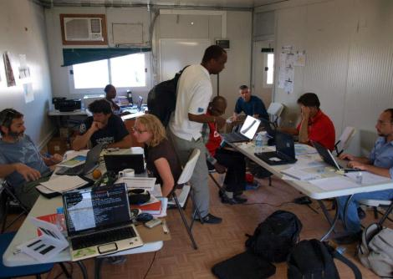
What does the shelter cluster coordination team do
Contributes to the effective provision of emergency shelter and NFI’s.
Through timely and efficient coordination of partners.
Support the host government in its humanitarian role.

Slide 39
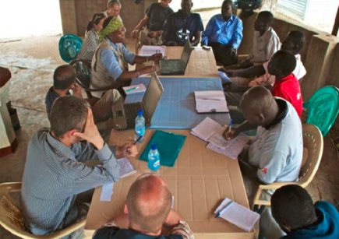
Cluster Coordination
The shelter cluster coordination team provides the table where all cluster members (including Govt) can sit down to develop “strategic field level coordination.”
Photo: João Almeida

Slide 40
There are 7 core functions of coordination in the cluster
Support service delivery
Informing HC/HCT strategic decision-making
Planning and strategy development
Advocacy
Monitoring and reporting
Contingency planning and preparedness
Accountability to affected population

Slide 41
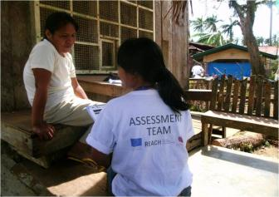
Basic outputs from the shelter cluster
Cluster Response Plan – the strategic framework - which covers inputs to the appeals (CERF/FLASH/HAP)
Technical guidelines/standards
Needs assessment reports
WWW and gap analyses
Factsheets, website updates

Slide 42
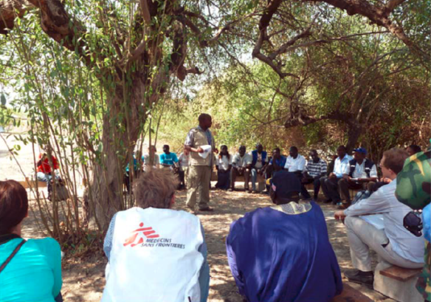
Shelter coordination team

Slide 43
Shelter coordination team
Technical coordinator
Coordinator
Information manager

Slide 44
Typical shelter cluster structure
Coordinator:
From Red Cross Red Crescent
Team leader responsible for cluster coordination
Information Manager
Can be from cluster partners
Collecting, analysing and distribution of data (4W’s)
Includes working with REACH
Technical Coordinator
Can be from cluster partners (CARE, OXFAM…)
Familiar with local context

Slide 45
The size of the coordination team depends on the context
For example in Philippines for the Typhoon Haiyan response now we have 13 people working in the cluster for 12 months.
But sometimes its only one person deployed to support tier Govt counterpart for 4 weeks to 6 months.
In Nepal we have IFRC/NRC who provide shelter cluster coordination – Sanjeev and Ramesh
But whatever the team the basic function are the same. Only the scale changes to be appropriate to the context.
Coordination
Information management
Technical coordination

Slide 46
Shelter cluster extended coordinator team
Land rights
Environment
Mapping/GIS
Remote support
Contingency planning
Dept./Hub coordinators
Tech
Coord
IM
Debris
Media
Logistics
Gov. liaison
Urban settlement
Community liaison

Slide 47
We have JD’s and TOR’s for all these positions

Slide 48
What's the role of the shelter cluster coordinator
Provides coordination services to the cluster agencies.
Ensures the shelter response is guided by relevant policy, guidelines and technical standards.
Over seas the transition from emergency to recovery phase, or hands over to other agencies.
Identifies key partners and acts as the focal point with government, inter cluster coordination, NGO’s, UN agenise and UN RC/HC.
Advocates for the best interests of the shelter cluster and shelter beneficiaries.
Takes a lead in the compilation of appeal documentation and is a direct liaison with the donor community and supports fund raising initiatives.

Slide 49
Main activities
Coordination
Coordinating provision of shelter assistance to the affected community – to achieve equality, efficiently and effective response.
Critical linkage in coordination between all partners: Govt, agencies, donors, community.
Links partners together to provide solutions and avoid gaps and duplication
Supports building capacity in Govt and agencies.
National shelter cluster and hub meetings
These meetings are an integral part of the cluster activities.
The coordinator supports the Govt representative to chair or co chair the meetings.

Slide 50
Main activities
Advocacy
For both shelter cluster partners and affected community.
Responds to inquiries from Govt, represents shelter agencies with external partners to provide one voice for the sector.
Advocates, sometimes defends, the polices, mandates and capacities of cluster partners.
Advocates with donors to ensure requirements are aligned with the humanitarian response and needs of the beneficiaries
The Strategic Advisory Group – see later
Reporting and monitoring performance
Reporting monitoring performance ensures the shelter response is effective and aligned to global and national objectives as well as technical standards.

Slide 51
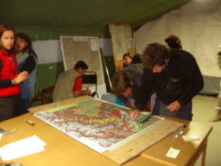
What’s the role of Information Manager (IM)
Provides timely, consistent and compatible data and information
Supports inter cluster IM
Ensures dissemination and adaptation of IM tools - WWW, gaps, maps, graphics
Ensure links with all stakeholders for risk mapping and gap identification
Maintain cluster partner lists
Supports assessments
Updated the website
Notes:
From ToRs

Slide 52
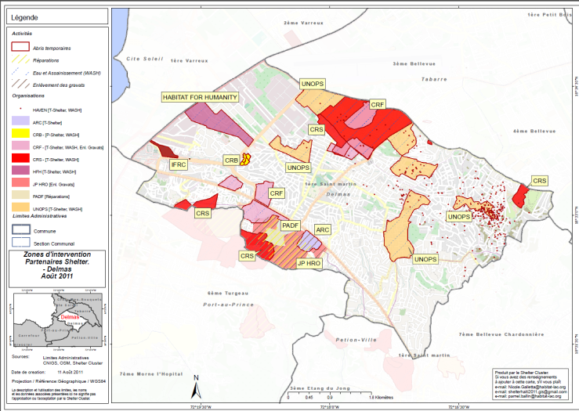
IM products - maps

Slide 53
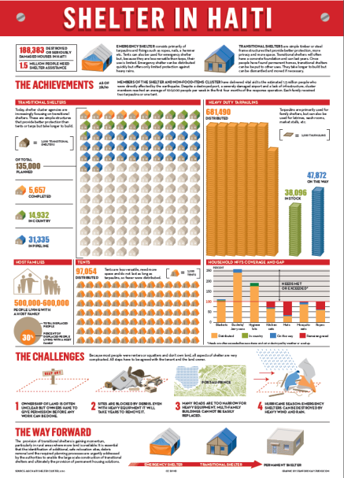
IM products – fact sheets

Slide 54
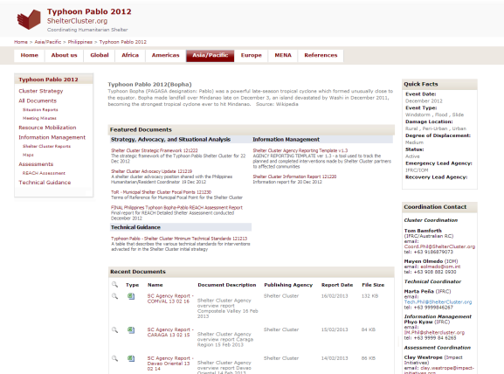
www.sheltercluster.org

Slide 55
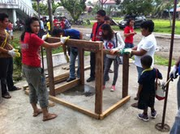
What’s the role of the Technical Coordinator
Provides:
Technical guidance
Facilitates Technical Working Groups
Supports advocacy and resource mobilisation
Technical capacity building
Assessment and monitoring

Slide 56
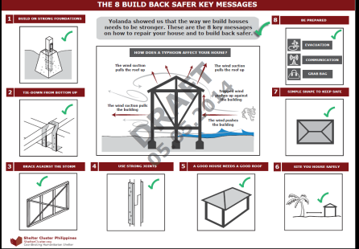
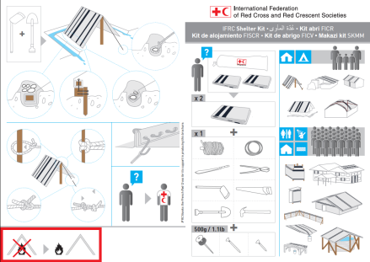
Technical guidance

Slide 57
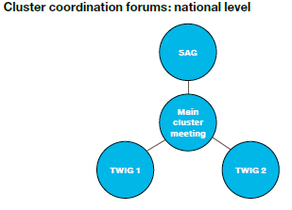
Shelter cluster structures
The cluster can meet via 3 forums
Main Shelter Cluster meeting: Everyone: Govt, INGO’s, NGO’s UN, RCRC, donors, etc.
Strategic Advisory Group: Max 15 key operational partners. Develops the overall strategy and provides strategic oversight. Vets proposal for Flash appeal etc.
Technical Working Groups: Specific, short-term. For example: Drainage, Temporary shelter design, Unaccompanied/seperated minors ...

Slide 58
Main shelter cluster meeting
Usually attracts the largest number of participants, especially at the start of a response.
The cluster coordinator convenes the meeting chaired by or along with the Government counterpart.
The meeting is open to all national and international agencies involved in the shelter response.
Partners have an equal voice.
Some will be implementing shelter and NFI’s others will be related to rights issues, e.g. protection, etc.
Its important to make sure there is representation from national NGO’s and local partners.

Slide 59
Main shelter cluster meeting
The coordinator reports to the meeting on:
General situation.
Situation reports/assessments from Govt and inter cluster agencies.
Updates from other clusters
Updates from OCHA
Government plans and priorities.
Updates on funding
Any output form the SAG and TWIG.
Cross cutting issues

