Slide 1

HEALTH and DM UPDATE
Regional Community Safety and Resilience Forum
Bangkok, 16th September, 2014
Lt.Gen.Amnat Barlee, M.D.
Director of Relief and Community Health Bureau,
The Thai Red Cross Society
Chair of Regional RCRC CSR Forum for SEA

Slide 2

Major Achievement against Road map and Resilience House
Regional Community Safety and Resilience Forum, Bangkok, 16th September, 2014
Health and DM achievement should be highlighted.
Strengthening the capacity of Vulnerable Coastal Communities to Address the Risk of Climate Change and Extreme Weather Events – (INCA Project - UNDP)
Community resilience building and analysis through Community Based Disaster Risk Reduction – (CBDRR Project - Canadian Red Cross)

Slide 3







Regional Community Safety and Resilience Forum, Bangkok, 16th September, 2014
Strengthening the capacity of Vulnerable Coastal Communities to Address the Risk of Climate Change and Extreme Weather Events – (INCA Project - UNDP)
INCA Project was implemented by RCHB, TRCS in partnership with Sustainable Development Foundation (SDF), DDPM and SEA-START, Chulalongkorn University, with the supporting from UNDP and funding from Special Climate Change Fund (SCCF), Global Environment Facility (GEF).
The implementations of INCA Project cover a period of 3 years during 2011 – 2013 in 6 sub-districts of 3 southern provinces.
Tha Sala and Talumphuk sub-districts, Nakhon Si Thammarat Province
Tha Chiet Watershed: Tamod, Chong Thanon, and Na Pakho sub-districts, Phatthalung Province
Ko Libong Sub-district, Trang Province

Slide 4
Strengthening the capacity of Vulnerable Coastal Communities to Address the Risk of Climate Change and Extreme Weather Events – (INCA Project - UNDP)
Four main outcomes;
Outcome 1: Increased knowledge and awareness of climate-related risks and impacts in vulnerable coastal communities
Outcome 2: Increased climate risk management and disaster preparedness capacity in vulnerable coastal communities
Outcome 3: Integration of climate change adaptation into provincial development plans and sector policies
Outcome 4: Project knowledge captured, disseminated and replicated through dedicated follow-up activities
Vulnerable Communities
Disaster have become more frequent and severe
livelihoods and immediate wellbeing are most directly dependent on coastal and marine resources
Communities do not generally participate actively in decisions concerning coastal zone management and development
Increasing directly damage to the environment and natural resources

Slide 5
Strengthening the capacity of Vulnerable Coastal Communities to Address the Risk of Climate Change and Extreme Weather Events – (INCA Project - UNDP)
Knowledge & Awareness of Climate Change : VCA
Key public service providers and decision-makers at the provincial, sub-district and village levels have increased the knowledge and ability on climate change adaptation through the variety of mechanism with particular emphasis on cross-community and cross-sector learning.
The project approach using the climate change Vulnerability and Capacity Assessment (VCA) to systematically analyze and document the vulnerabilities and adaptation options of 10 target communities through participatory and gender dimension.
VCA was set to bring together local knowledge with related to climate change and risk reduction and/or adaptation knowledge in order to help community identify their climate change problems and develop the potential community-based adaptation measure namely Community Climate Risk Reduction Action Plan (CRR Action Plan).
CRR Action Plan were designed from the process of VCA, community physical survey and factors related to risk caused by present and future climate extremes.

Slide 6
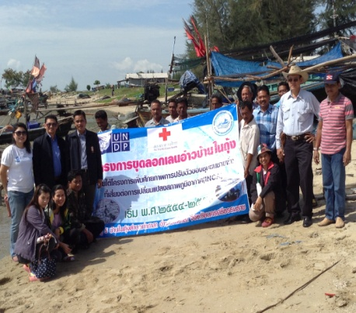
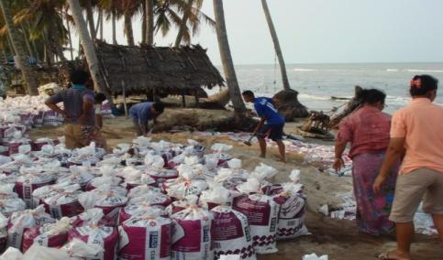
Strengthening the capacity of Vulnerable Coastal Communities to Address the Risk of Climate Change and Extreme Weather Events – (INCA Project - UNDP)
Climate risk management and adaptation capacity
in vulnerable coastal communities
10 target communities have provided the 28 small-scale adaptation grants to demonstrate priority climate risk reduction measures identified in their Climate Risk Reduction Action Plans. The effectiveness and appropriate of 2 community-based adaptation approach in target coastal sub-districts systematically be applied and disseminated.
Community-based Disaster Risk Reduction
integrated to Climate Change Adaptation
(CBDRR to CCA)
Ecosystem-based Adaptation :
Watershed management;
Upstream – Midstream – downstream

Slide 7
Strengthening the capacity of Vulnerable Coastal Communities to Address the Risk of Climate Change and Extreme Weather Events – (INCA Project - UNDP)
Integration of climate change adaptation
Integration of CCA to local and provincial development plans
Integration of CCA to sector policies
Systematically project Knowledge and lessons learn captured, disseminated
Lessons learned and adaptation knowledge generated through the project systematically analyzed and documented in two knowledge management reports of
1) INCA project’s process and lessons-learned on the mainstreaming of climate change adaptation into development planning;
2) Guideline in using GIS to support the vulnerability and capacity assessment process.
Awareness of climate change risks and community-based adaptation options and experiences was exchanged and disseminated both nationally and internationally through a variety of mechanisms, with particular emphasis on cross-community and cross-sector learning.

Slide 8
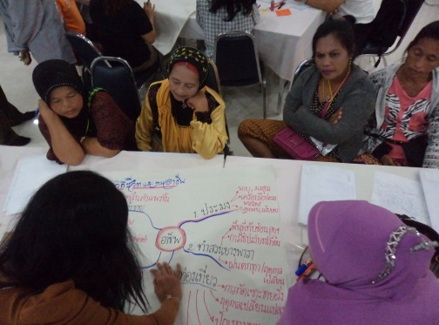
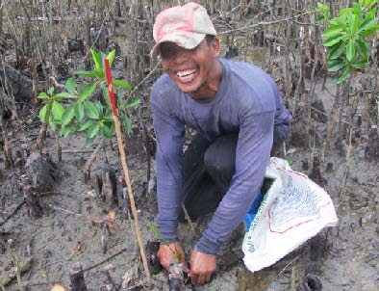
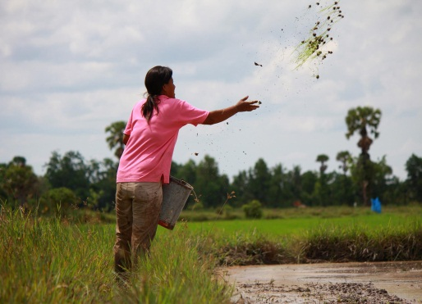
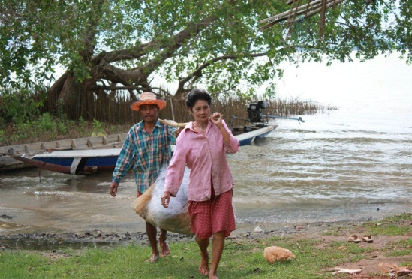
Strengthening the capacity of Vulnerable Coastal Communities to Address the Risk of Climate Change and Extreme Weather Events – (INCA Project - UNDP)
Good Practices
Utilized local experience of NGOs in the region.
Implementation modality had certain advantages, particularly with respect to strengthening community level capacities.
Facilitated strengthening the role of women in some of the target communities.
Training in management and financial accounting is empowering for the community groups.

Slide 9
Strengthening the capacity of Vulnerable Coastal Communities to Address the Risk of Climate Change and Extreme Weather Events – (INCA Project - UNDP)
Lessons learned
Expecting provincial level planning results requires concerted involvement from government agencies.
Community level development activities are typically recurrent or small-scale one-off measures.
Working with three different provinces was probably too expansive.
The performance management system mandate by the government influences stakeholder involvement on issues outside their core responsibilities.
To inform and have impact on national level policy, grounded project experiences need to be systematically consolidated and documented.
Indicators for such projects should also capture intangible benefits realized.
Certain groups are sensitized to receiving free, unconditional assistance.

Slide 10
Regional Community Safety and Resilience Forum, Bangkok, 16th September, 2014
Community resilience building and analysis through Community Based Disaster Risk Reduction –
(CBDRR Project - Canadian Red Cross)
Cooperation Project between IFRC [Canadian Red Cross] and RCHB, TRCS
MOU signing on September 15, 2011
Thai Red Cross aims to encourage targeted communities living in disaster prone areas to take part in the CBDRR program to increase community capacity and resilience. This way, the impact of disasters can be reduced.
CBDRR Project cover a period of 3 years during 2012 – 2014
in 20 Communities of 5 provinces ; Surin [2], Buriram [3],
Chiang Mai [5], Ubon Ratchathani [5] and Phetchabun [5]

Slide 11
Community resilience building and analysis through Community Based Disaster Risk Reduction –
(CBDRR Project - Canadian Red Cross)
CBDRR Process (8 steps)
There are eight steps; some of these steps can be worked in parallel with other steps.
Step 1 : Community Selection
Step 2 : Program orientation and establish relationship with targeted
communities
Step 3 : Conduct VCA training for Communities leaders/volunteers.
Step 4 : Set up communities committees
Step 5 : Vulnerability Capacity analysis and develop DRR plan/ CP/DP
Step 6 : Capacity Building for the community
Step 7 : Table Top Exercise and Communities Drills
Step 8 : Project evaluation and hand over with a set of mutual agreement
with local authority to ensure sustainability of the project

Slide 12
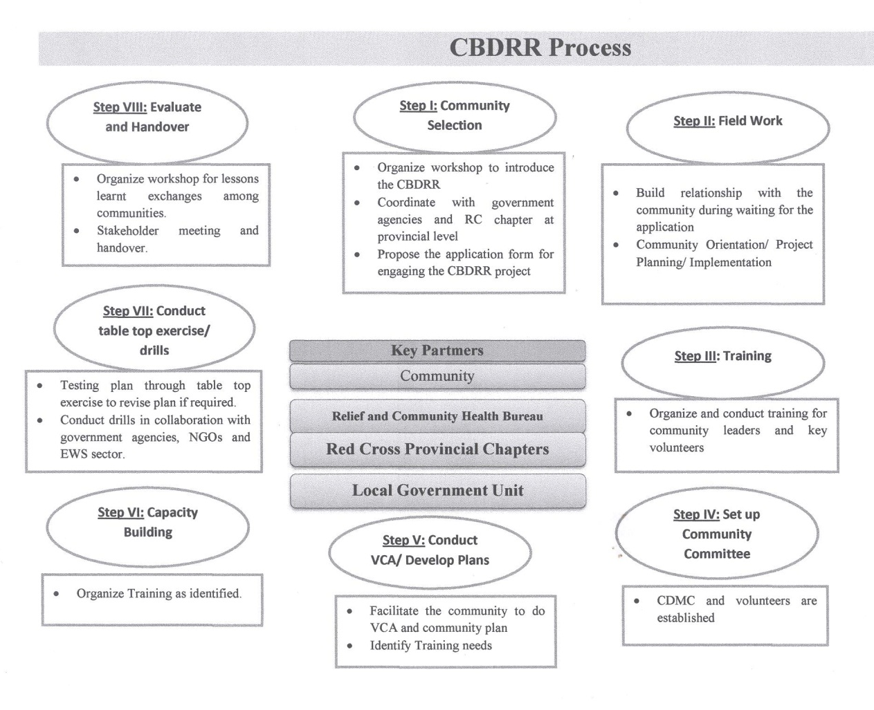
Community resilience building and analysis through Community Based Disaster Risk Reduction –
(CBDRR Project - Canadian Red Cross)

Slide 13
Community resilience building and analysis through Community Based Disaster Risk Reduction –
(CBDRR Project - Canadian Red Cross)
Assessment Criteria for CBDRR Program that based on the standard of The Thai Red Cross Society
1. Communities set up its committee to implement planned activities.
2. Communities conduct the evacuation/drill at least once a year.
3. Local authority provides funding and supporting community’s plan and
implementation on CBDRR.
4. Conduct CSR activity at least once a year on the topic of disaster or
environment.
5. Increase disaster management capability for community leaders and/or
community volunteers.
6. The communities have effective EWS and monitoring system.
Communities that received assessment scores of 60 percent or higher pass the criteria for CBDRR program.
Communities that received assessment scores of 80 percent or higher pass the criteria to be “model” communities for CBDRR program.

Slide 14
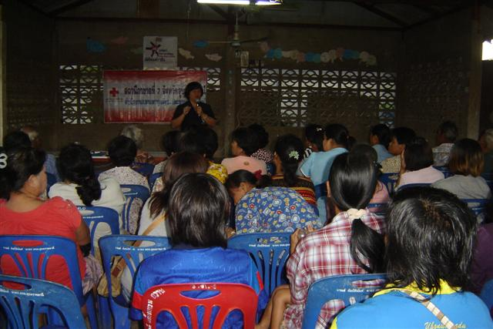
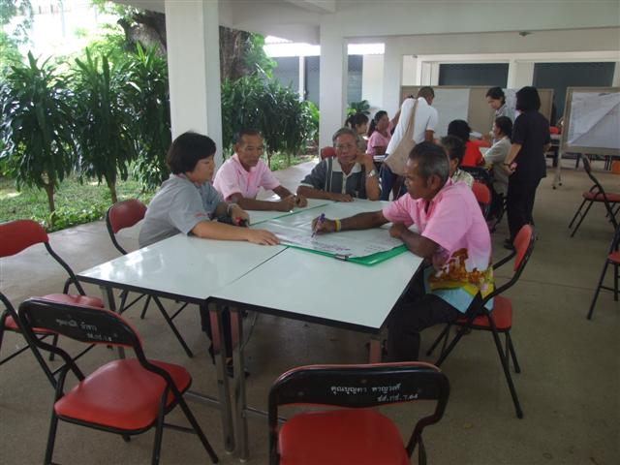
Community resilience building and analysis through Community Based Disaster Risk Reduction –
(CBDRR Project - Canadian Red Cross)
Don Ngio, Warinchamrab District, Ubonratchatani
Community Selection
Training for Communities leaders

Slide 15
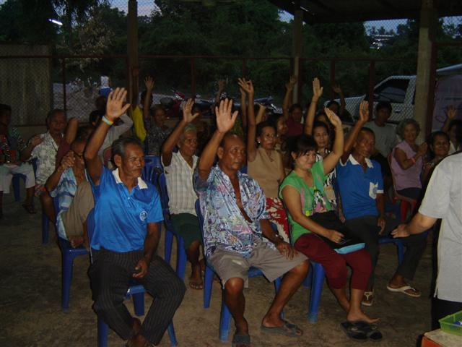
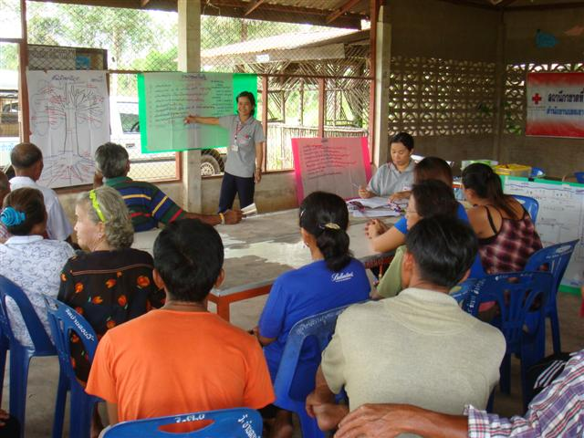
Community resilience building and analysis through Community Based Disaster Risk Reduction –
(CBDRR Project - Canadian Red Cross)
Don Ngio, Warinchamrab District, Ubonratchatani
Set up communities committees
Vulnerability capacity analysis

Slide 16
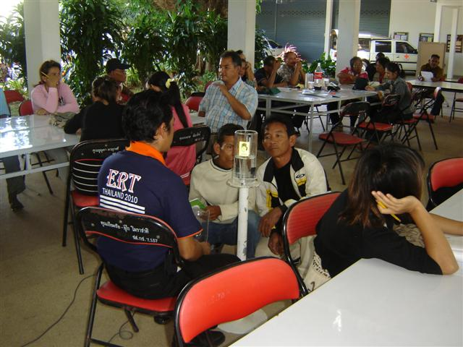
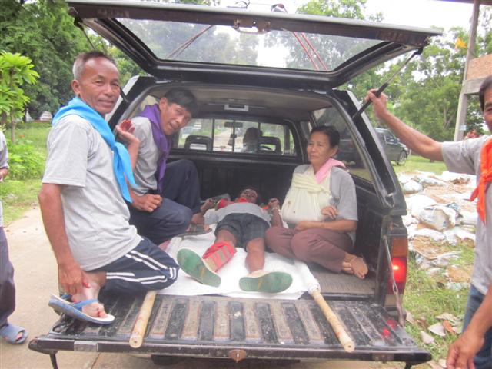
Community resilience building and analysis through Community Based Disaster Risk Reduction –
(CBDRR Project - Canadian Red Cross)
Don Ngio, Warinchamrab District, Ubonratchatani
Capacity Building for the community
Table Top Exercise & Communities Drills

Slide 17
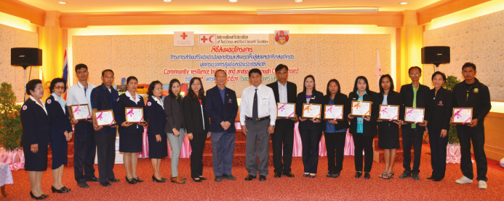
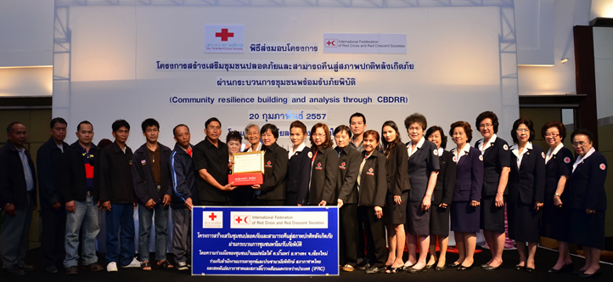
Community resilience building and analysis through Community Based Disaster Risk Reduction –
(CBDRR Project - Canadian Red Cross)
Project evaluation and hand over with a set of mutual agreement with local authority to ensure sustainability of the project

Slide 18
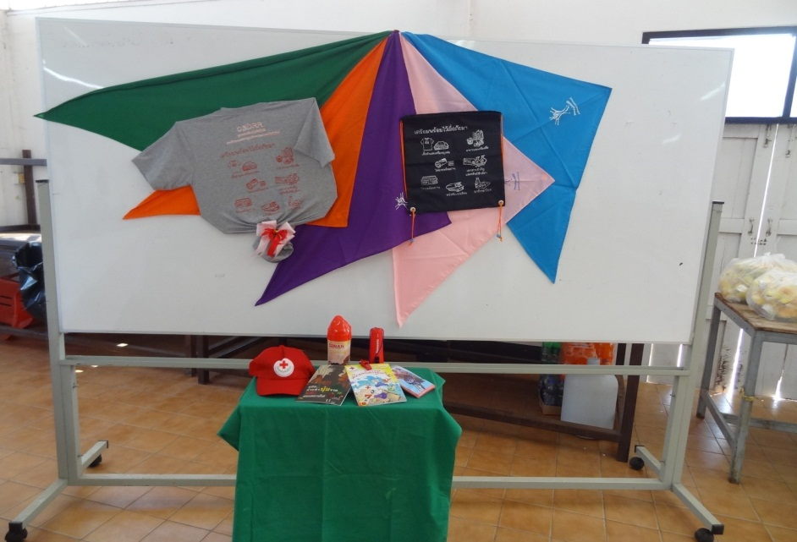
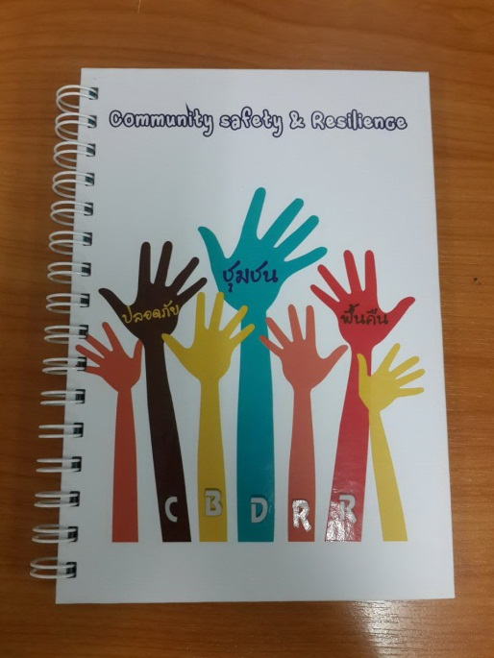
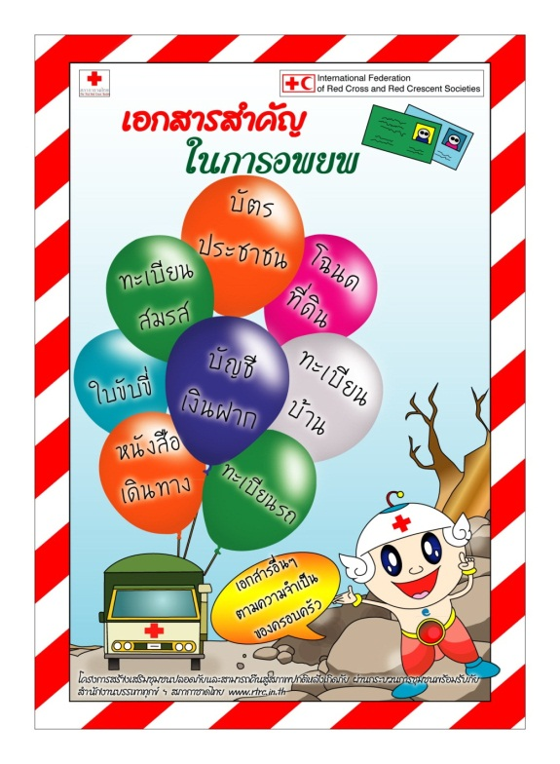
Community resilience building and analysis through Community Based Disaster Risk Reduction –
(CBDRR Project - Canadian Red Cross)
IEC Materials

Slide 19
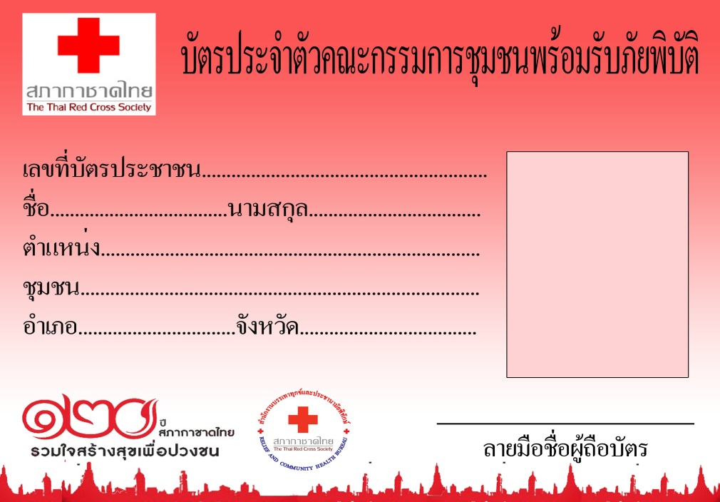
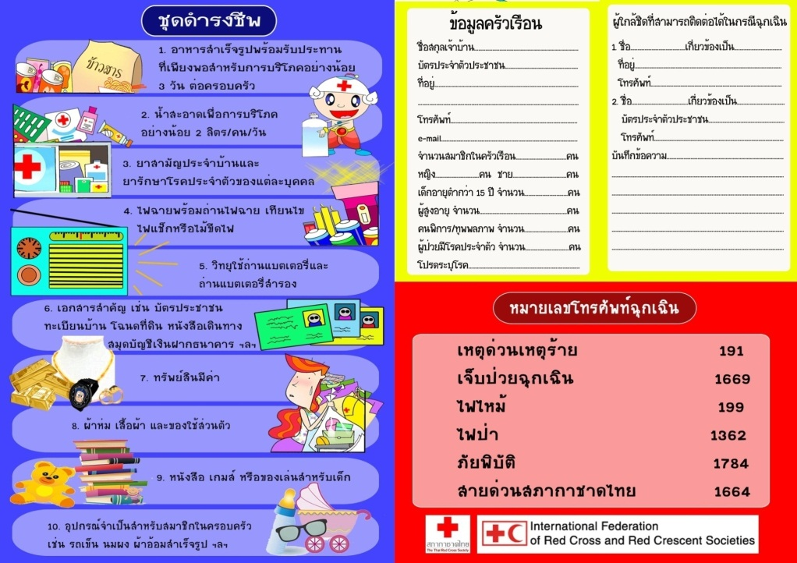
Community resilience building and analysis through Community Based Disaster Risk Reduction –
(CBDRR Project - Canadian Red Cross)
IEC Materials

Slide 20

New Initiative and new partners
Regional Community Safety and Resilience Forum, Bangkok, 16th September, 2014
Agency
Bangkok Hospital
Queen Sawangwattana Memorial Hospital
Migration
Thai Red Cross College of Nursing
Facilitator
Doha
Qatar RC

Slide 21
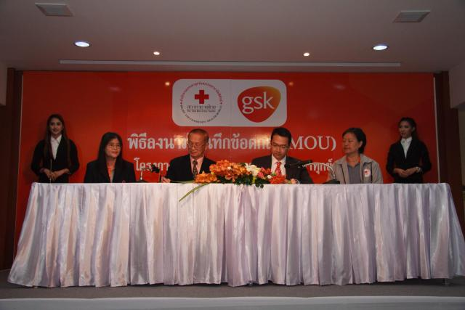
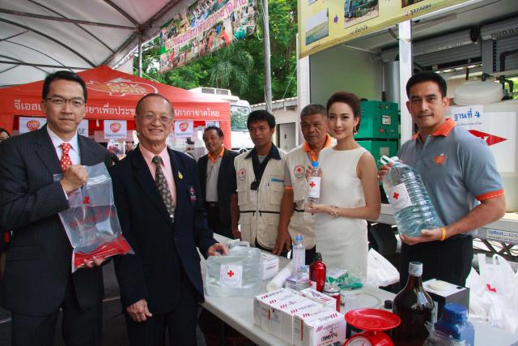
New Initiative and new partners
Regional Community Safety and Resilience Forum, Bangkok, 16th September, 2014
GSK [GlaxoSmithKline]

Slide 22
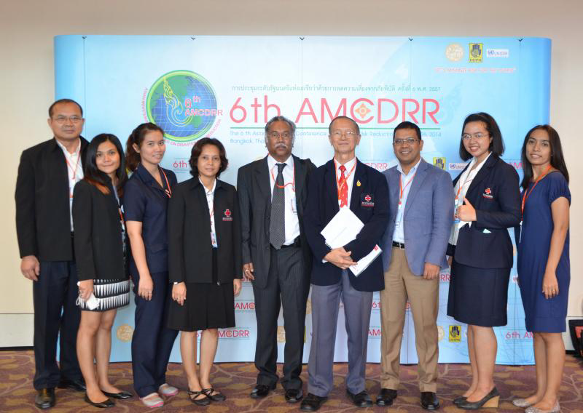
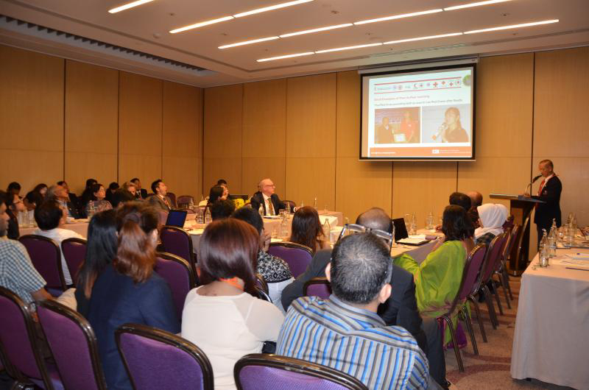

New Initiative and new partners
Regional Community Safety and Resilience Forum, Bangkok, 16th September, 2014
6th AMCDRR
DDPM
- ASEAN Day for Disaster Management (ADDM)
- The International Day for Disaster Reduction (IDDR)
- ICC Day
DOW

Slide 23
Challenges to operationalize Resilience approach/ implementing road map
Regional Community Safety and Resilience Forum, Bangkok, 16th September, 2014
Internal Challenges :
Policy +-
System +- Awareness / Understanding
Operation +
Unpredictable (Climate Change)
Earthquake
Flood
Landslide Vulnerable Settles, Livelihood
Strom Surge Deforest, Development, Road block water way etc.
Typhoon / Cyclone

Slide 24
Challenges to operationalize Resilience approach/ implementing road map
Regional Community Safety and Resilience Forum, Bangkok, 16th September, 2014
External Challenges :
CSR
DM / Health / OD
Key Stakeholder
Materials
Entry Point - NS
SOP
RDRT
National / NS :
- Gov. – DDPM
- NGO
- Private Sector
Regional
- ASEAN / IFRC / Zone Facilitate Coordinate
- Asia Pacific
Internal Global
- America
- Europe
Money
- Donor
- TRC : Relief
Silo Mentality Practice

Slide 25
Opportunities to operationalize Resilience approach/ implementing road map
Regional Community Safety and Resilience Forum, Bangkok, 16th September, 2014
Man : M.D. / Nurse / RDRT / DMERT / Logistic / Communication
Materials : Tool / WATSAN / Trucks / Boats / Relief Kits etc.
Money : Fundraising – AP Fundraising Forum
Training : WATSAN / Warehouse / CBDRR / Mobile Kitchen
Cooperate
- Air force : C130
- Navy : Ship
- Army : Truck / Boat / Water
Private : Company / Foundation; Coca Cola Foundation, DOW, GSK, BANPU, Toyota
AADMER - ADPC

Slide 26
Specific expectations from IFRC in 2015
Regional Community Safety and Resilience Forum, Bangkok, 16th September, 2014
Respect Agreement and/or MOU
Open dialogue more closely

Slide 27
The Thai Red Cross Society
LT. Gen. Amnat Barlee, M.D.
Director of Relief and Community Health Bureau
Tel. +662 2517853-6
Email : abarlee@redcross.or.th
Date : 10 September 2014

