Slide 1
18TH REGIONAL CSR FORUM
16 – 19 September 2014, Bangkok - Thailand

Slide 2
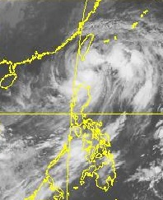
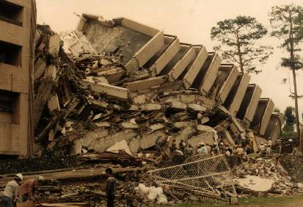
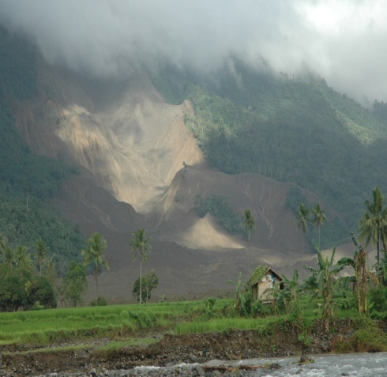
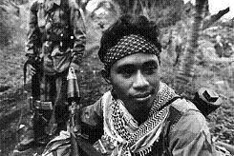
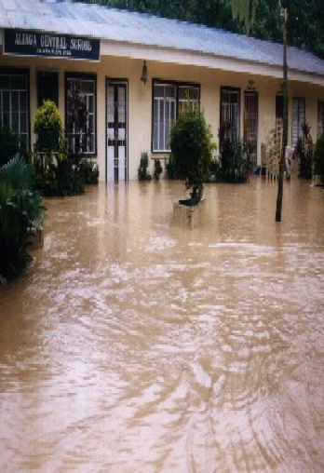
For the past two years, the Philippines suffered tremendous disaster events of various magnitudes.
Although this is not new but only it is above the normal conditions that we all experienced.

Slide 3
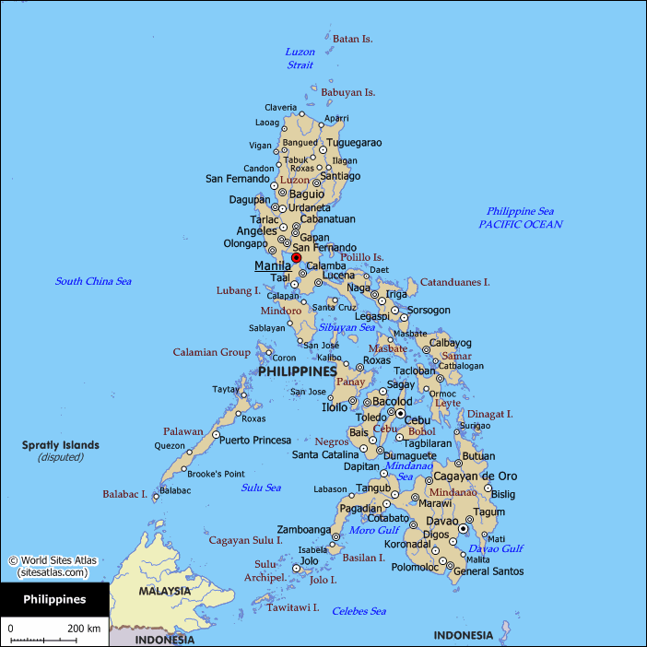
DISASTER EVENTS
August to December 2013
TYPHOON LABUYO (Utor)
09 August 2013
Central Luzon
TYPHOON ODETTE (Usagi)
and EPIDEMIC – LEPTOSPIROSIS
16 September 2013
Central Luzon
TYPHOON SANTI (Nari)
13 October 2013
Central Luzon
EARTHQUAKE
7.2 M; 15 October 2013
Bohol
HABAGAT – TYPHOON MARING (Trami)
18 August 2013
NCR and Central Luzon
SEA MISHAP
August 16, 2014
Cebu, Visayas
SUPER TYPHOON YOLANDA (Haiyan)
08 November 2013
Central Visayas
ZAMBOANGA CITY – INSURGENCY RELATED INCIDENT AND FLOODS
09 September 2013
Zamboanga City

Slide 4
DISASTER EVENTS
January to August 2014
TYPHOON LUIS (KALMAEGI)
September 14 – 15, 2014
Northern Luzon
TYPHOON GLENDA (RAMANSUN)
July 2014
Southern Luzon and NCR
TROPICAL STORM BASYANG (KAGIKI)
January 2014
Central Visayas
SINKING SEA – PASSENGER VESSEL
September 14, 2014
Surigao del Norte, Mindanao
Cholera Epidemic
May 2014
Kidapawan - North Cotabato, Mindanao
TROPICAL STORM AGATON (LINLING)
January 2014
CARAGA Region, Mindanao

Slide 5
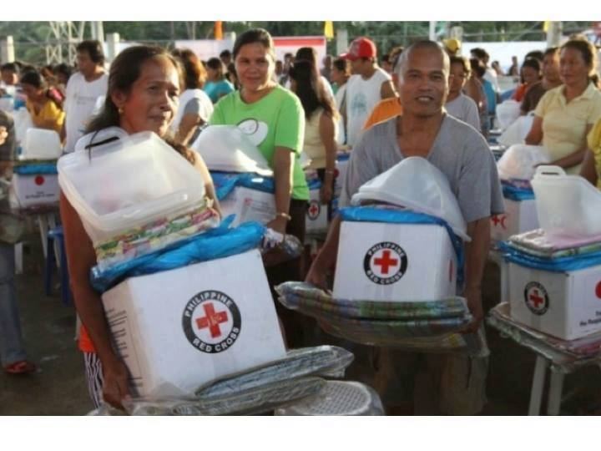
Inspite of the overwhelming odd, we continue to keep the spirit of the “Humanitarian Services” high .

Slide 6
PRC DISASTER MANAGEMENT AND HEALTH
Highlight of Activities from July 2013 to September 2014

Slide 7
DISASTER RISK REDUCTION
On-going various community based disaster risk reduction and
management (DRRM) program in 239 communities funded by
Partners (mostly will end by December 2016):
Netherland Red Cross
Finnish Red Cross
German Red Cross
Spanish Red Cross
Australian Red Cross
On-going various school based disaster risk reduction and
management (DRRM) program in 196 schools funded by Partners
mostly will end by December 2015):
Netherland Red Cross
Finnish Red Cross
German Red Cross
Spanish Red Cross
Australian Red Cross

Slide 8
DISASTER RISK REDUCTION
One (1) TOT VCA conducted last February 2014;
Five (5) TOT DRRM Conducted last 2013 (three sessions) and 2014
(two sessions from February and May 2014;
Two (4) PRC – DMS National Field Representative attended the
Urban Disaster Workshop funded by British Red Cross in Nepal last
May 2014;
PRC DM Manager participated in the 6th ACMDRR Forum last July
2014 held in Bangkok, Thailand;
Hosted the IFRC AP Urban DM Workshop last 19 – 21 August 2014
held in Manila;

Slide 9
Four (4) PRC staff (DMS and Health) attended the VCA TOT in
Phuket, Thailand last 01 – 06 September 2014; and
Roll out activities for the dissemination of the playbook for the
RC 143 training at the community and school levels.
Approximately 1.3M volunteers recruited and trained on health
(CBHFA, WASH, Nutrition, HIV, Maternal and Child, and
Disaster Nursing) program nationwide

Slide 10
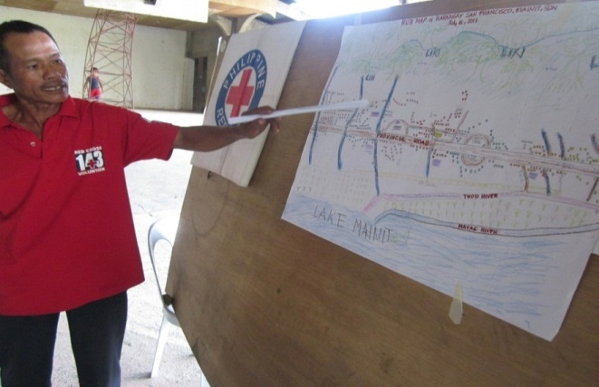
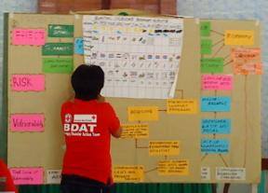
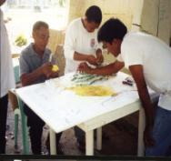
PRC STRATEGIES ON DISASTER RISK REDUCTION AND MANAGEMENT (DRRM)
Empowering the communities, school, and workplace – participatory approach and ownership driven DRR project.

Slide 11
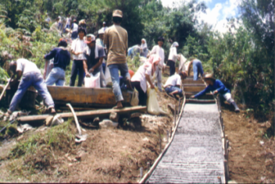
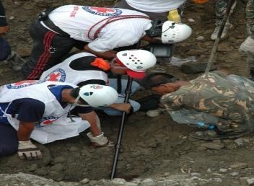
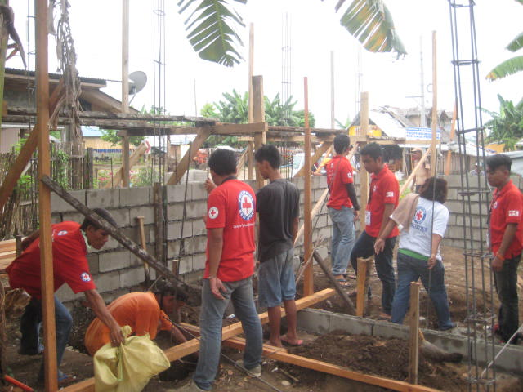
PRC STRATEGIES ON DISASTER RISK REDUCTION AND MANAGEMENT (DRRM)
Mobilization of volunteers in DRR – before, during and after disaster (specially in urban context)
Hazard and Risk Analysis,
and VCA
Mitigation
Recovery Program
Response Activities

Slide 12
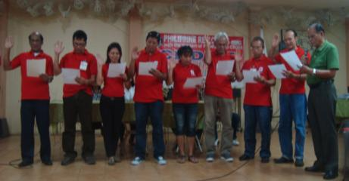
PRC STRATEGIES ON DISASTER RISK REDUCTION AND MANAGEMENT (DRRM)
Promote volunteerism thru Red Cross 143 in the community, schools, and workplaces (specially in urban context)
Predict hazards
Plan to lessen vulnerability and increase your organization’s capability
Prepare the equipment and the people
Constantly Practice so when the challenges come they can cope
Cope/Mitigate + 3 R’s (Retrieve, Relief, Recovery)

Slide 13
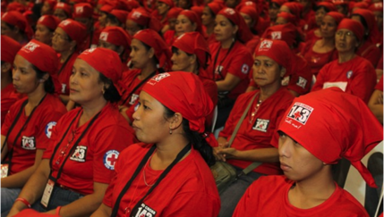
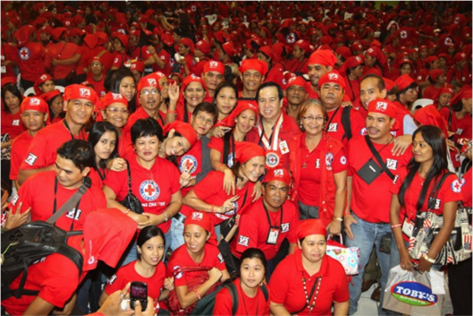
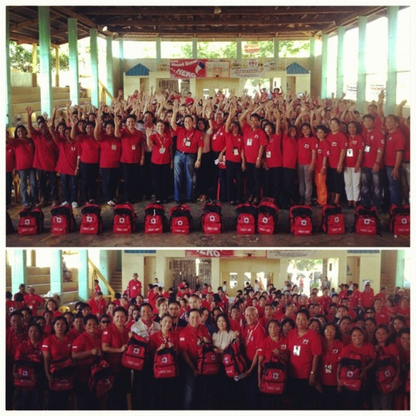
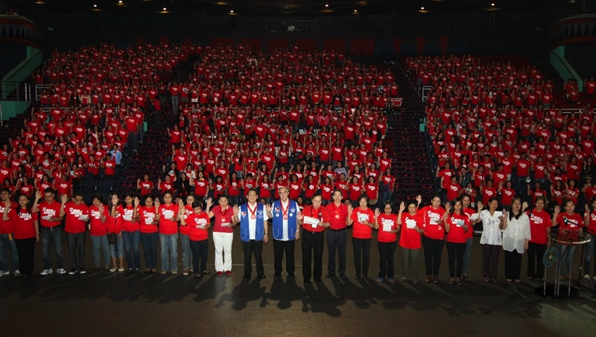
RED CROSS 143 VOLUNTEERS

Slide 14
Roles of 143 Volunteers
To build resilient communities
To be the early warning agents
To conduct local risk assessment (Vulnerability and Capacity Assessment)
Chapter Level: Pre-disaster history and
assessment
To be the first responders and reporters
To assist in the relief and rehabilitation process

Slide 15
Red Cross143 Organization
OUT OF 11:
1= Tracing & Social
1= IHL
1= Communication
2= Safety
2= DMS/ERU
2= Blood 2= Health
11
11
11
11
= 44
MINIMUM
Notes:
----- Meeting Notes (7/27/12 14:35) -----
2- Tracing should be part of the blood/ social
2 safety-CPR, First aid, in the neighborhood
2- commiunity health (CHNS)
2- DMS
Communication(1)-getting the data
flooding- must be reported
MINIMUM OF $$
----- Meeting Notes (10/17/12 14:35) -----
Tracing -> Social

Slide 16
Successful and Effective Disaster Response
Volunteers + Logistics + Information Technology
=
Always First, Always Ready,
Always There…

Slide 17
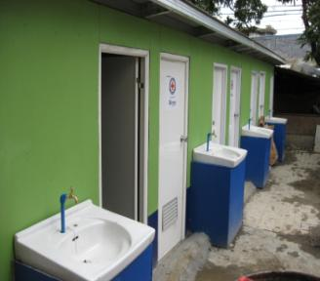
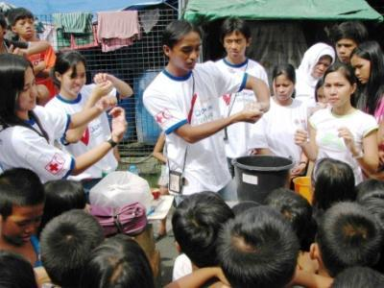
PRC STRATEGIES ON DISASTER RISK REDUCTION AND MANAGEMENT (DRRM)
Chapters conduct VCA + DRR Plan + Budget
Integration of Health and Disaster Management in Disaster Risk Reduction
Health and Sanitation

Slide 18
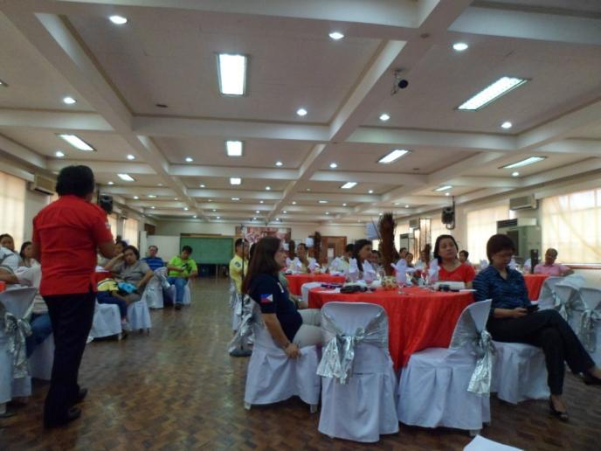
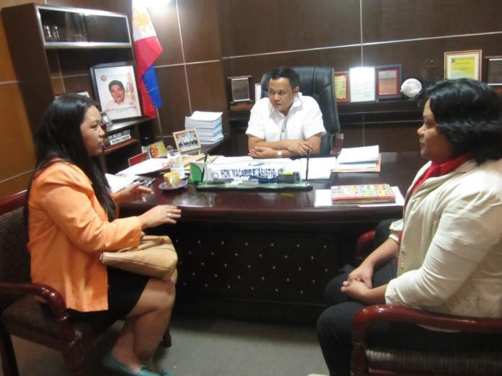
PRC STRATEGIES ON DISASTER RISK REDUCTION AND MANAGEMENT (DRRM)
Partnership for Resilience with private sectors and civil society organizations (cso), and strengthen partnership with local government units
Private and CSO
Government

Slide 19
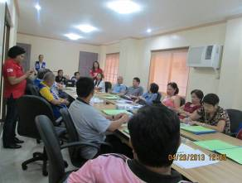
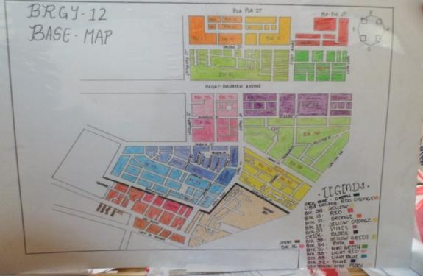
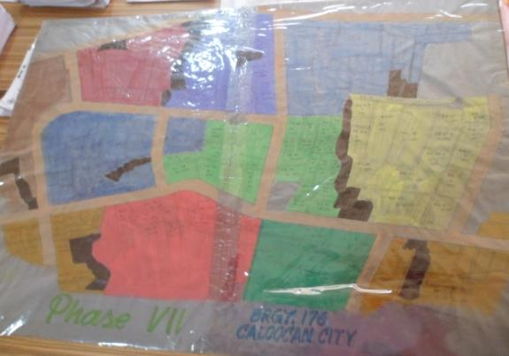
PRC STRATEGIES ON DISASTER RISK REDUCTION AND MANAGEMENT (DRRM)
Advocate with local governments and community leaders to include disaster risk reduction into their Sustainability Development Plan (SDP)
Baseline Map

Slide 20
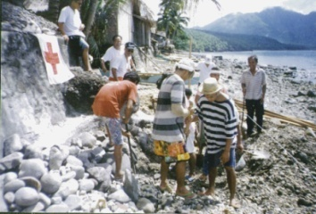
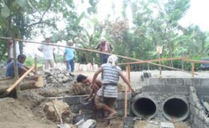
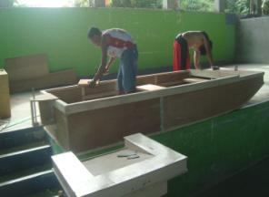
PRC STRATEGIES ON DISASTER RISK REDUCTION AND MANAGEMENT (DRRM)
Mitigation measures should focus on development and reducing risks

Slide 21
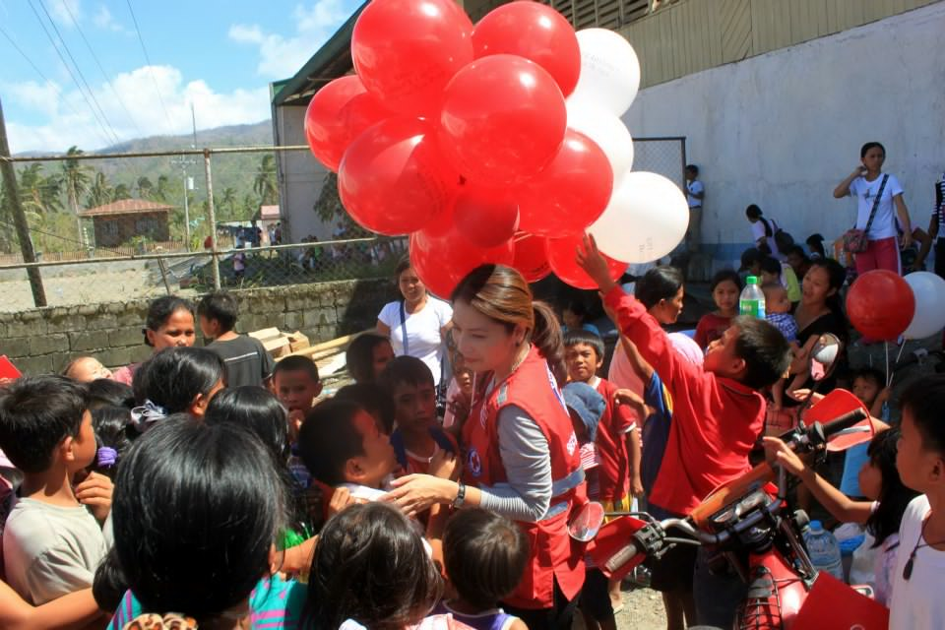
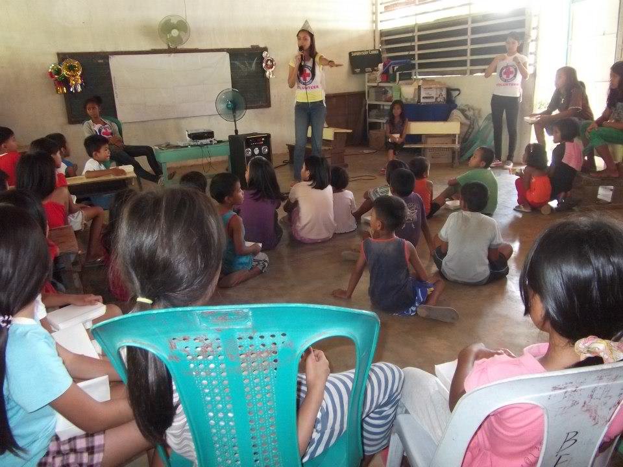
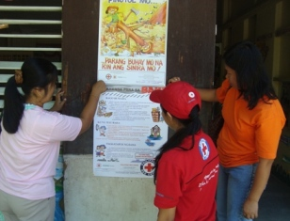
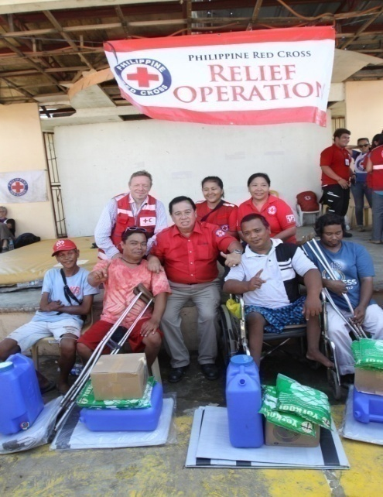
PRC STRATEGIES ON DISASTER RISK REDUCTION AND MANAGEMENT (DRRM)
Inclusion of thematic issues on DRRM such as gender balance, person with disability, climate change, livelihood, child protection, and eco-system management and restoration

Slide 22
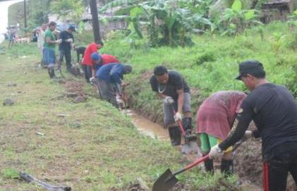
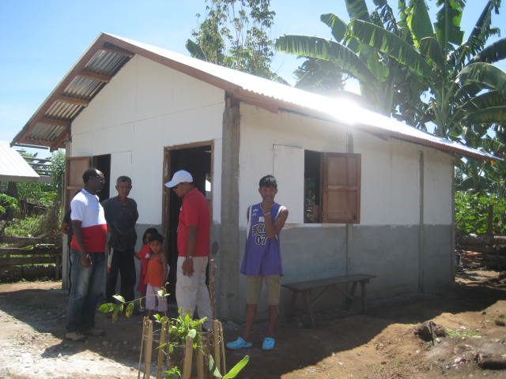
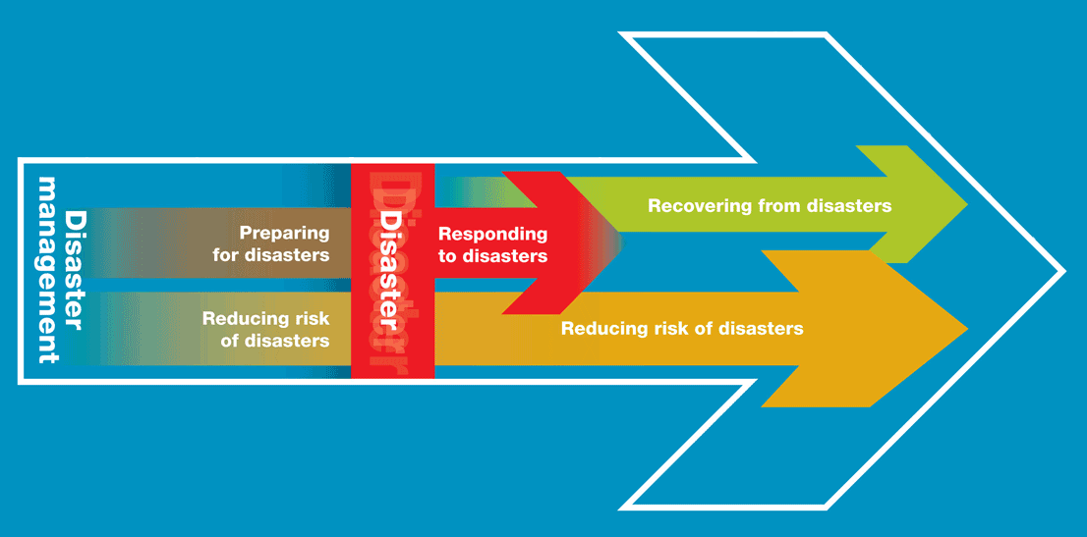
PRC STRATEGIES ON DISASTER RISK REDUCTION AND MANAGEMENT (DRRM)
Integrate resilience to disaster
recovery
Rehabilitation Project – DRR Community activity
Recovery - Safe Shelter

Slide 23
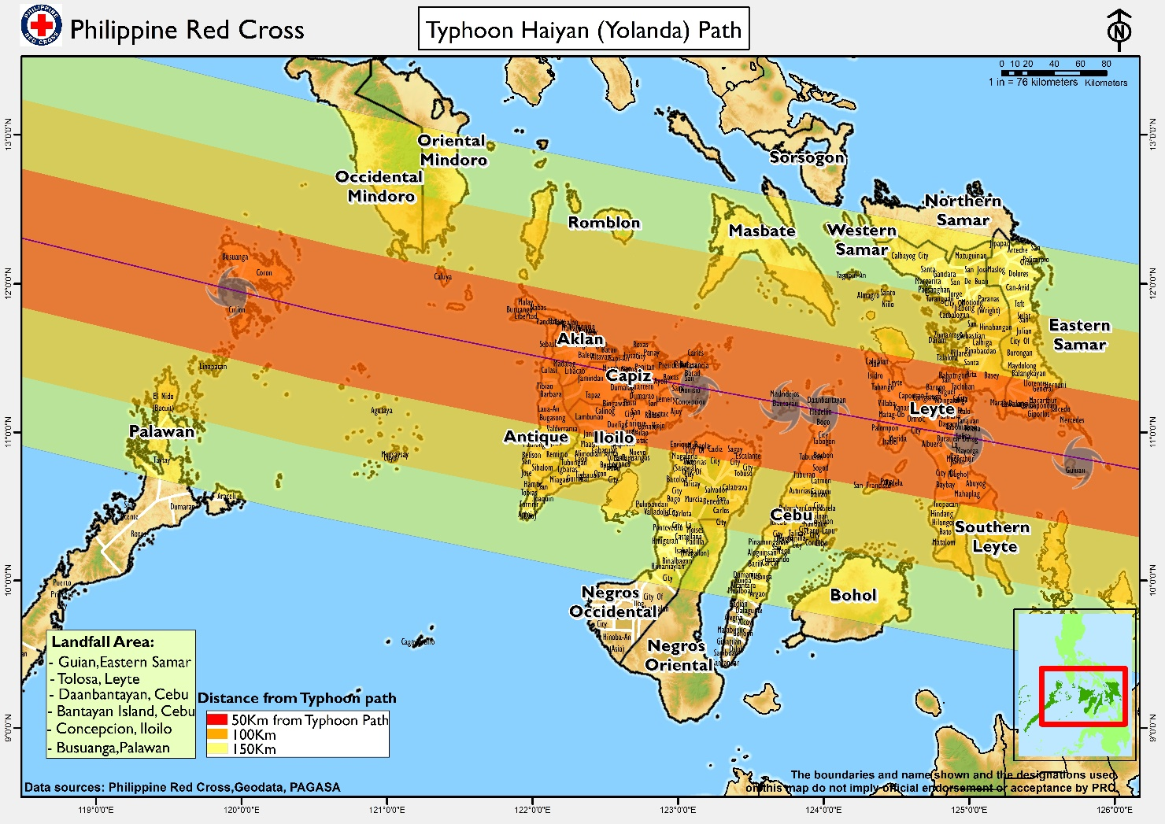
As an End-to-End recovery approach, include DRR program within the
Recovery program as part of the community capacity building (also
include school-based and workplace)

Slide 24
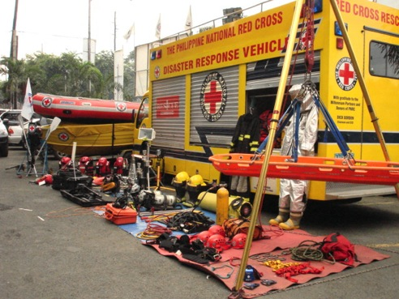
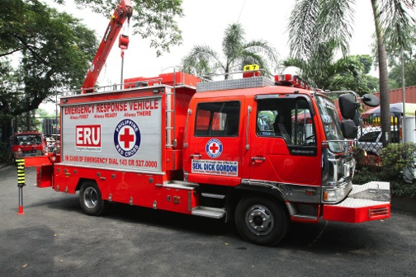
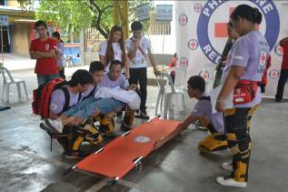
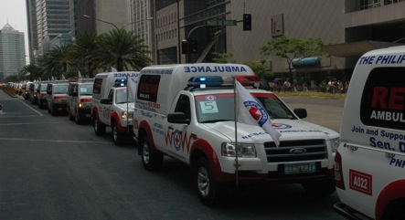
PRC STRATEGIES ON DISASTER RISK REDUCTION AND MANAGEMENT (DRRM)
Strengthen the PRC Chapter Capacity on Disaster Preparedness for Response

Slide 25
DISASTER RISK REDUCTION
On Process:
Finalization of the updated DRRM Curriculum by end of October
2014;
Completion of the mapping to identify priority areas for 2016 (35
provinces and 11 urban highly disaster prone) by end of
September 2014;
Finalization of the VCA Manual by end of October 2014;
Finalization of the framework model on DRRM and DP; and
Finalization of the PRC Capacity Building proposal for disaster
management covering 2015 to 2016 of the PRC Strategic
Direction 2012 - 2016

Slide 26
CHAPTER DISASTER PREPAREDNESS – FRAMEWORK MODEL
RESILIENCE
Disaster Preparedness for Response
PRC NHQ
Local
Partners
Community
(RC 143 Volunteers)
Local
Government
CHAPTER
Response Tool
(RCAT)
Focal Person
Contingency Plan & SOPs
Basic DR Equipment
Emergency Funds
VCA and Hazard & Risk Analysis
Capacity Building on Technical Expertise
RC 143
(community, School, workplace)
Communication Center
Rapid Assessment and Planning

Slide 27
DISASTER PREPAREDNESS
Organize and training of Red Cross Action Teams (RCAT)
57 Chapters with RCAT
45 Chapters still to support for 2015 - 2016
RCAT includes training of 35 members (DM, Health, Safety, IHL,
Social – Welfare), and equipage funded by the IFRC and ICRC;
Training of ERU - WASAR at NHQ and Chapter levels;
Procurement of additional equipment such as water tankers and
fire – rescue truck;
Participation to the joint “Balikatan Exercise” together with the US
– Hawaii National Guard in the conduct of Search and Rescue
training and exercise together with different SAR organizations
(i.e. Armed Forces of the Philippines, MMDA, and local
government units).

Slide 28
DISASTER PREPAREDNESS
Still on-going the Implementation of the Disaster Response and
Contingency Plan for Metro Manila Earthquake Impact Reduction or
in anticipation of a “Big One” earthquake that could affect the Metro
Manila;
Strengthen the Red Cross 143 volunteers;
Maintain stockpile of non-food items at the Central and Regional
Warehouses;
On-going construction for the PRC Academy and Regional DM and
Logistics Hub in Subic, Zambales; and
Review of the existing Disaster Operation Manual.

Slide 29
DISASTER RESPONSE AND RECOVERY
On-going disaster recovery operations:
Recovery Shelter Project Typhoon Ketsana in Iba, Zambales for 363
families completion date October 2014 funded by the Singapore Red
Cross and Hongkong Red Cross;
Recovery Shelter, Health, and Livelihood Project Typhoon Bohpa in
Davao Oriental and Compostela Valley for 400 families . Completion date
October 2014 funded by the IFRC;
Recovery Project (includes Shelter, Livelihood, Health & Watsan, and
Schools) Bohol Earthquake for 1,500 families completion date by March
2015 funded by IFRC; and
Recovery Project (includes Shelter, Watsan, Health, Livelihood,
Education, and DRRM) Typhoon Haiyan for 100,000 families in ten (10)
provinces completion date by 2016 (or more) various funding support from
the RC/RC Movement and Private Sectors.

Slide 30
DISASTER RESPONSE AND RECOVERY
Zamboanga City Siege Recovery Activities focus on Health, Water
and Sanitation, Hygiene and Sanitation Promotion, Cash-for-work,
and Livelihood in various existing evacuation centers.

Slide 31
THANK YOU!!!

