Slide 1
HEALTH and DM UPDATE
Myanmar Red Cross Society
Myanmar Red Cross Society
Bangkok, 16th September, 2014.

Slide 2
Major Achievement against Road map and Resilience House
Myanmar Red Cross Society
Contingency Planning workshop ( March )
DM, Health, FA&SS, HV&Com, Finance, OD Directors and staff attended, discussed and drafted CP (Integration)
Pre-Disaster meeting in August with the participation of Health, Watsan, OD, FA&SS, HV&Com, RFL, Logistics
PHAST training for CBDRR program was conducted with the coordination of Watsan team. (Also FA, PSS, PHiE, Watsan..)
Water supply system at UDRR Program area.
Township Branch Assessment at Program area 10 townships with the coordination of DM and OD
Capacity building of RCVs and branch development activities are for all CBDRR, UDRR program areas

Slide 3
Myanmar Red Cross Society
Model of Resilience House and its thematic

Slide 4
Major Achievement against Road map and Resilience House
Myanmar Red Cross Society
( a ) CBHD Projects ( 2014 )
Projects…CBHFA , CBHR , CBHD-MNCH ( total- 18 tsp. }
Community need assessment done by V .Committee ( Multi-sectoral Approach)
Tsp branch development activities ( OD + Health ) ( 10 tsp ).
WASH Training including PHAST Step 1 to 7 ( Health + Watsan ) ( 14 tsp )
Learning by doing activities (13 tsp )
Community Initiative activities (CIA) against Comm. PoA ( 18 tsp )
School Hygiene promotion activities ( 13 tsp )
IG activities ( Health + RM + OD + Finance ) ( 18 tsp )
DRR Training and DRR mitigation activities ( Health + DM ) ( 17 tsp )
BFA Training for all CVs by township branch ( Health + Branch ) ( 18 tsp. )
Financial procedure training ( Health + Finance ) ( 18 tsp. )
-

Slide 5
Myanmar Red Cross Society
CBHFA ( Malaria and NCD )
Malaria project ( 25000 CHF ) ( Aug.-Dec ) is integrated into two townships
of Shan State focused on prevention and environmental sanitation only.
Now we are starting the NCD tools translation, follow giving trainings and
apply tools in 5 villages of one tsp. as a pilot. ( 5000 CHF ) ( Sept- Dec )

Slide 6
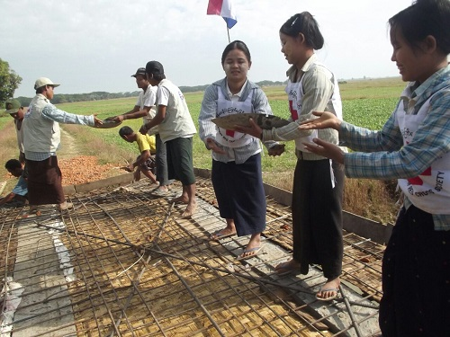
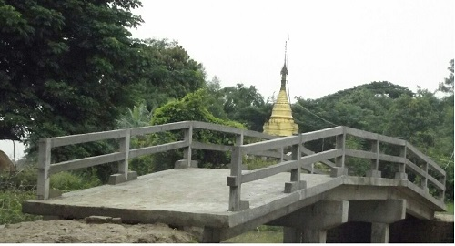
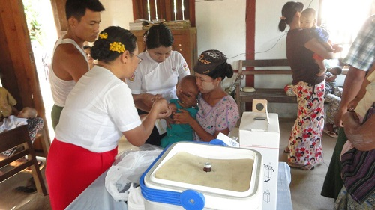
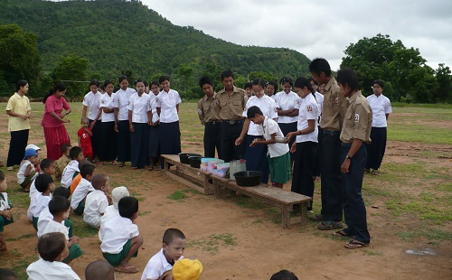
Myanmar Red Cross Society

Slide 7
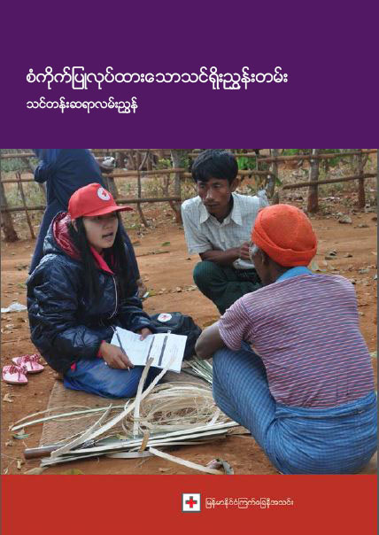
( b ) Emergency health and WASH
Myanmar Red Cross Society
Project…Epidemic preparedness and CB-WASH
CBHFA – ECV tool kits ( HKRC ) was adapted into Myanmar Context and implemented in Lewei township.
Epidemic Control for Volunteers
Toolkit
- and -
Training
Manual
One suspected case of
Ebola infection was
found on ( 19.8.2014 ),
who came from
Africa country and
finally diagnose
as Malaria. Our RCVs
were working together with Health staff in surveillance activities.

Slide 8
Myanmar Red Cross Society
WASH PROJECTS
Emergency WASH ( IFRC – Norcross )
Predisposing Water Plant units in risky 9 States and Regions
Forming local ERT team, conducting ERT training focused on simulation
exercise
Developed SOP and standard HP box.
Resource Mobilization System developed
CB-WASH (IFRC – Austria.)
Implemented in 2 townships
Hardware and software (PHAST training) were conducted by RCVs
Developed new water sources and 3000 gal storage tanks by MRCS and
HHs to HHs pipe-line system by community contribution.

Slide 9
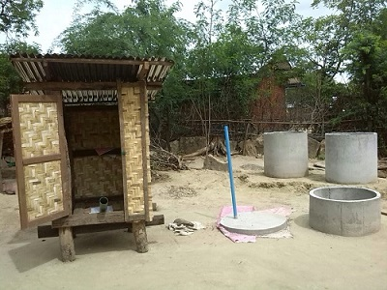
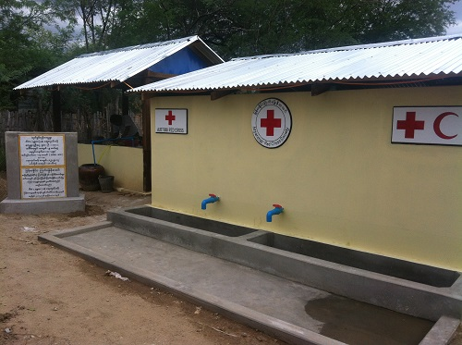
Myanmar Red Cross Society

Slide 10
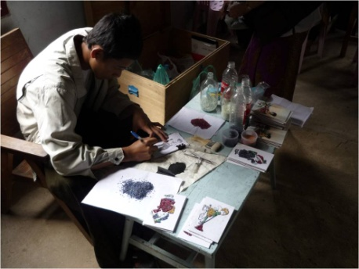
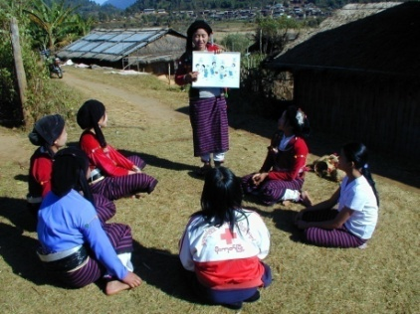
Myanmar Red Cross Society
( c ) Blood services and HIV
Blood
MRCS was only done the VBDRP in 17 tsp of 6 States and Regions,
during Jan. to June 2014.
HIV
Training of 30 RCVs, 17 SHG ( PLHIV ) and HH members in
prevention ,care and support.
Develop and Adaptation of SHG curriculum for SHG members.
Support for SHG income generation activities.
HIV Prevention
Income Generation

Slide 11
Partners
Myanmar Red Cross Society
CBHFA - SRC and FRC through IFRC
CBHR - Australia RC ( Bilateral )
CBHD-MNCH - 3 MDG- Consortium (Bilateral )
CBDH-MNCH - EU – Consortium ( Bilateral )
CBHD-HIV - DRC ( Bilateral )
CB-WASH - Austria RC through IFRC
Em-WASH - Nor cross through IFRC
CBHFA-Epidemic Preparedness - HKRC through IFRC ( Jan. to May )
VBDRP - Canadian RC through IFRC

Slide 12
New Initiative and new partners-
Myanmar Red Cross Society
CBDRR Framework with 9 step was developed (with the coordination and collaboration of MRCS, IFRC, FRC, AmRC )
OREDOO Phone Operator (donated for Relief items)
Panasonic Co donated (Solar Lantern ..)
Mobile Application (with Phone Operator Co.)
EOC (RRD, DMH)
International Disaster Law dissemination (with RRD & relevant Depts)
DRR Working Group (Steering Committee.)
Royal Thai Embassy and Thai Companies in Myanmar
Strategic Research into National and Local Capacity Building for Disaster Risk Management

Slide 13
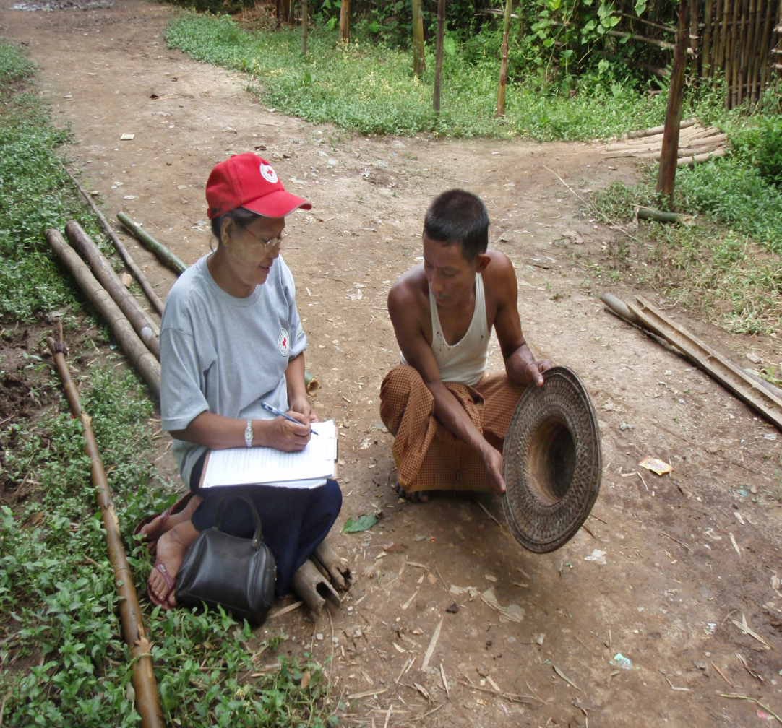
New Initiative and new partners-
Myanmar Red Cross Society
CBDRR Practice Case Study -3
CBDRR Practice Case Study-1
Identification and selection of Community at-Risk Project Site
Baseline and end-line studies

Slide 14
New Initiative and new partners-
Myanmar Red Cross Society
Myanmar Red Cross Society
Manual
On Disaster Risk Reduction
Myanmar Red Cross Society
Manual
on Community-Based Disaster Risk Reduction

Slide 15
New Initiative and new partners-
Myanmar Red Cross Society
Success story of UDRR Program

Slide 16
Challenges to operationalize Resilience approach/ implementing road map
Myanmar Red Cross Society
Wider definition of Resilience and MRCS Capacity
Internal Coordination for integration (Roadmap)
To work with (family friends, faith groups, government) who provide a wider supportive environment.
To enhance strong housing and infrastructure based on the economy of country and community.
Economic opportunity for the vulnerable community is big challenge.
Income generation of most vulnerable community deeply rely on natural environment.

Slide 17
Challenges to operationalize Resilience approach/ implementing road map
Myanmar Red Cross Society
Capacity of Community were still low for implementing CSR.
Internal Coordination and Planning for integration are still weak as per Roadmap.
Only 3 years of CB project duration is very limited to get sustainable.
Supporting the livelihood sector is essential in CSR program
Lack of fund and resources mobilization and need to increase IG fund
Lack of Resources Mobilization System of all departments in NS.
Inadequate collection of information from beneficiary document
is a big challenge.
New emerging communicable epidemic diseases are facing ( eg.Ebola )

Slide 18
Opportunities to operationalize Resilience approach/ implementing road map
Myanmar Red Cross Society
New Guideline of Union President to organize 500 RCVs per township.
New Leadership of MRCS after 11th National Assembly
CBDRR, SBDRR, CBHFA, CBHD, CBDP etc. can reach to communities and new RCVs at communities are organized and trained.
Organizing the whole school to become Red Cross is progress in Yangon and some state/region.
Local Government of the states and regions appreciate the Red Cross activities as a result of advocacy .

Slide 19
Opportunities to operationalize Resilience approach/ implementing road map
Myanmar Red Cross Society
Getting Guide Lines from RCRC Leadership meeting regularly
Most of the health projects are based on CBHFA approach.
All health projects done advocacy at all levels down to the grass roots deeply.
Need assessment , select the priorities problems, PoA and implementing by themselves.{ owner ship )
Integrated with all related depts and good coordination with stake holders
Implement School HP activities and some projects can organize School RC.
Capacity building were done in RCVs , village committee and CVs.
Information sharing by bulletins from Regional and AP zone regularly

Slide 20
NS engagement to strengthen the coordination and cooperation at National level
Myanmar Red Cross Society
Internal
External
Health, DM, HV&Com, FA&SS, OD working with close coordination (Program, CP, PDM etc)
Branch Development is the main factor for the success of program & sustainability.
Support activities, Finance, Logistics, HR, RM is also working hermoniously.
Focal Ministry MoH gives support for smooth working.
Working closing with RRD, DMH and other relevant depts.
Steering Committee of DRRWG, which organized UN agencies, INGOs & NGOs.
Working together for MAPDRR (Gov, UN, INGOs, NGOs..)

Slide 21
NS engagement to strengthen the coordination and cooperation at National level
Myanmar Red Cross Society
Country Coordination Mechanism member ( CCM )
National Health Committee member
Health System Strengthening working group member
Technical Working group member of Malaria, TB, HIV
National Social Protection Committee member
Myanmar Women Affair Committee member
Central Scout Committee member
National Human Right Committee member
Civil Society Working group Committee member

Slide 22
Specific expectations from IFRC in 2015
Myanmar Red Cross Society
Long term program and commitment
Exchange visit between NSs and also with IFRC
Technical and financial support for specialize areas (Climate Change, CSR, EWEA etc..)
To support for Regional cooperation
Staff Loan or internship training
RDRT training and deployment in case of emergency
Priority area for intervention (Specialize areas to be identified and innovative activities to get Leadership role..)

