Slide 1
Overview of Red Cross Red Crescent in South-East Asia
Anne E. Leclerc
IFRC Head of Regional Delegation

Slide 2
South-East Asia context and emerging humanitarian challenges
Accelerated vulnerability to disasters
Significant flows of migration (legal and illegal /internal and external flows)
Rapid urbanisation
Community adaptation to climate change Emerging Health threats (Pandemic, Malaria, Dengue, NCD, etc.)

Slide 3
National Society context
The region is changing, so do its National Societies illustrating the successful dynamism of SEA, the will of NS to be in a better lead and self reliance
NS are becoming stronger, growing in competencies, in confidence both at domestic level but increasingly at regional and international level.

Slide 4
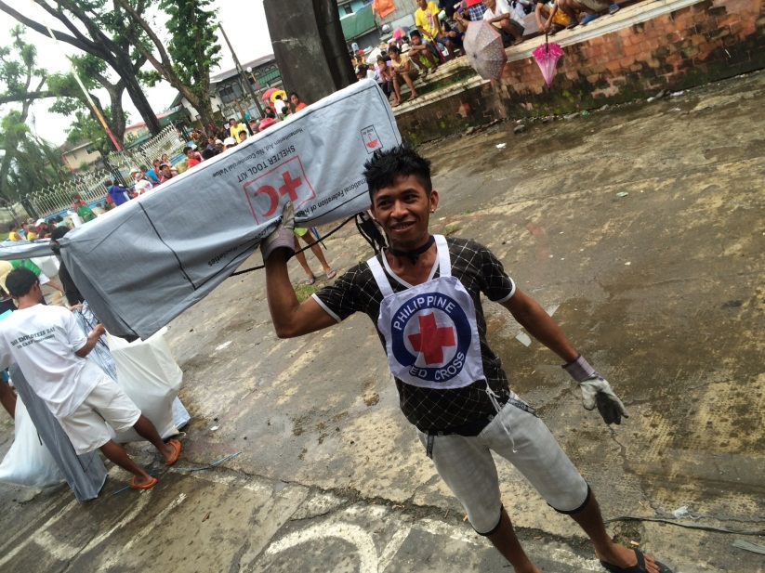
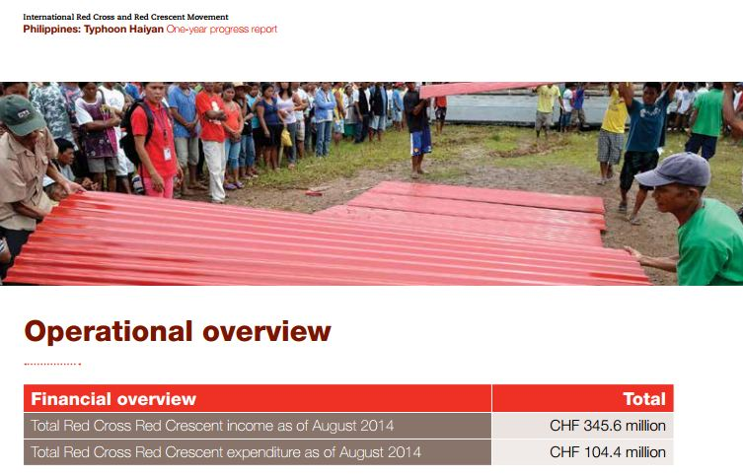
Our members are best known for their response activities…

Slide 5
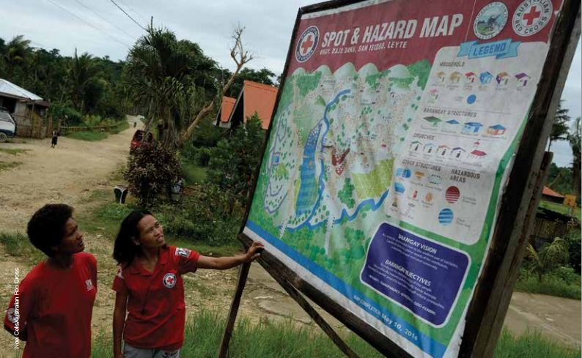
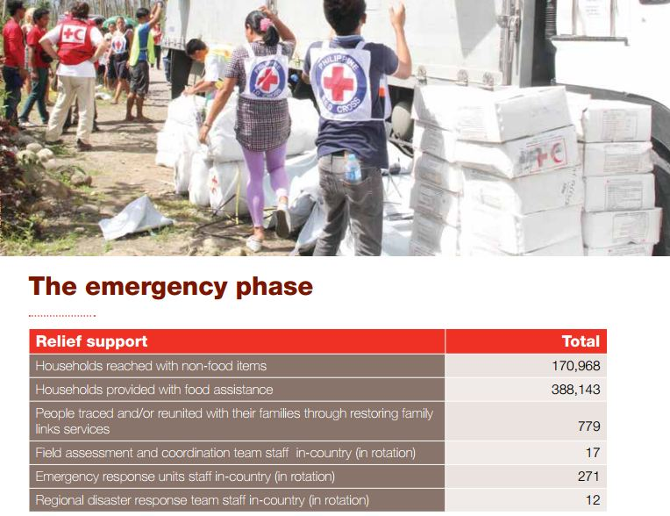
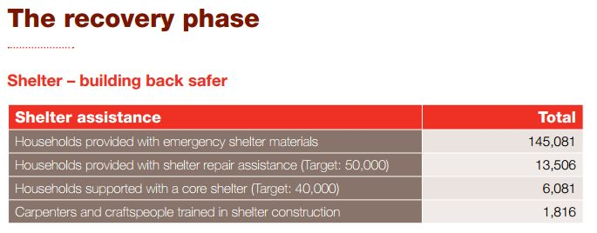
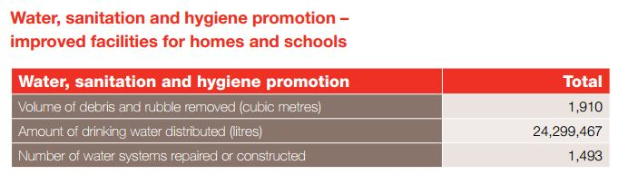
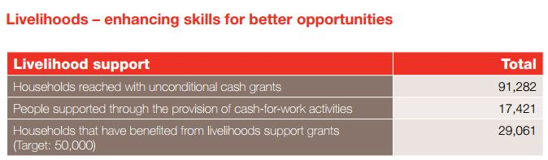
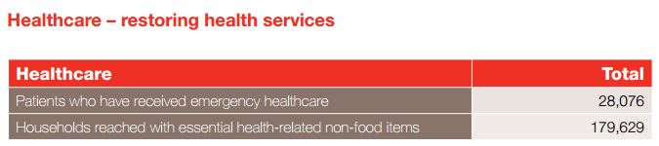
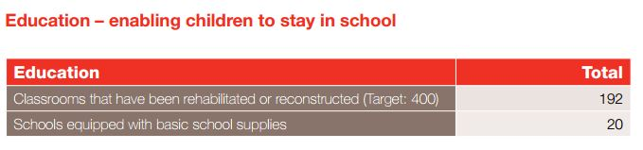
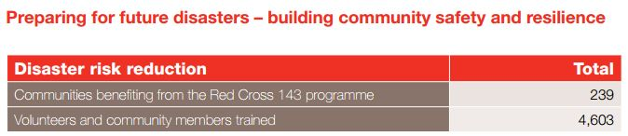
From initial response to recovery, rebuilding lives…

Slide 6
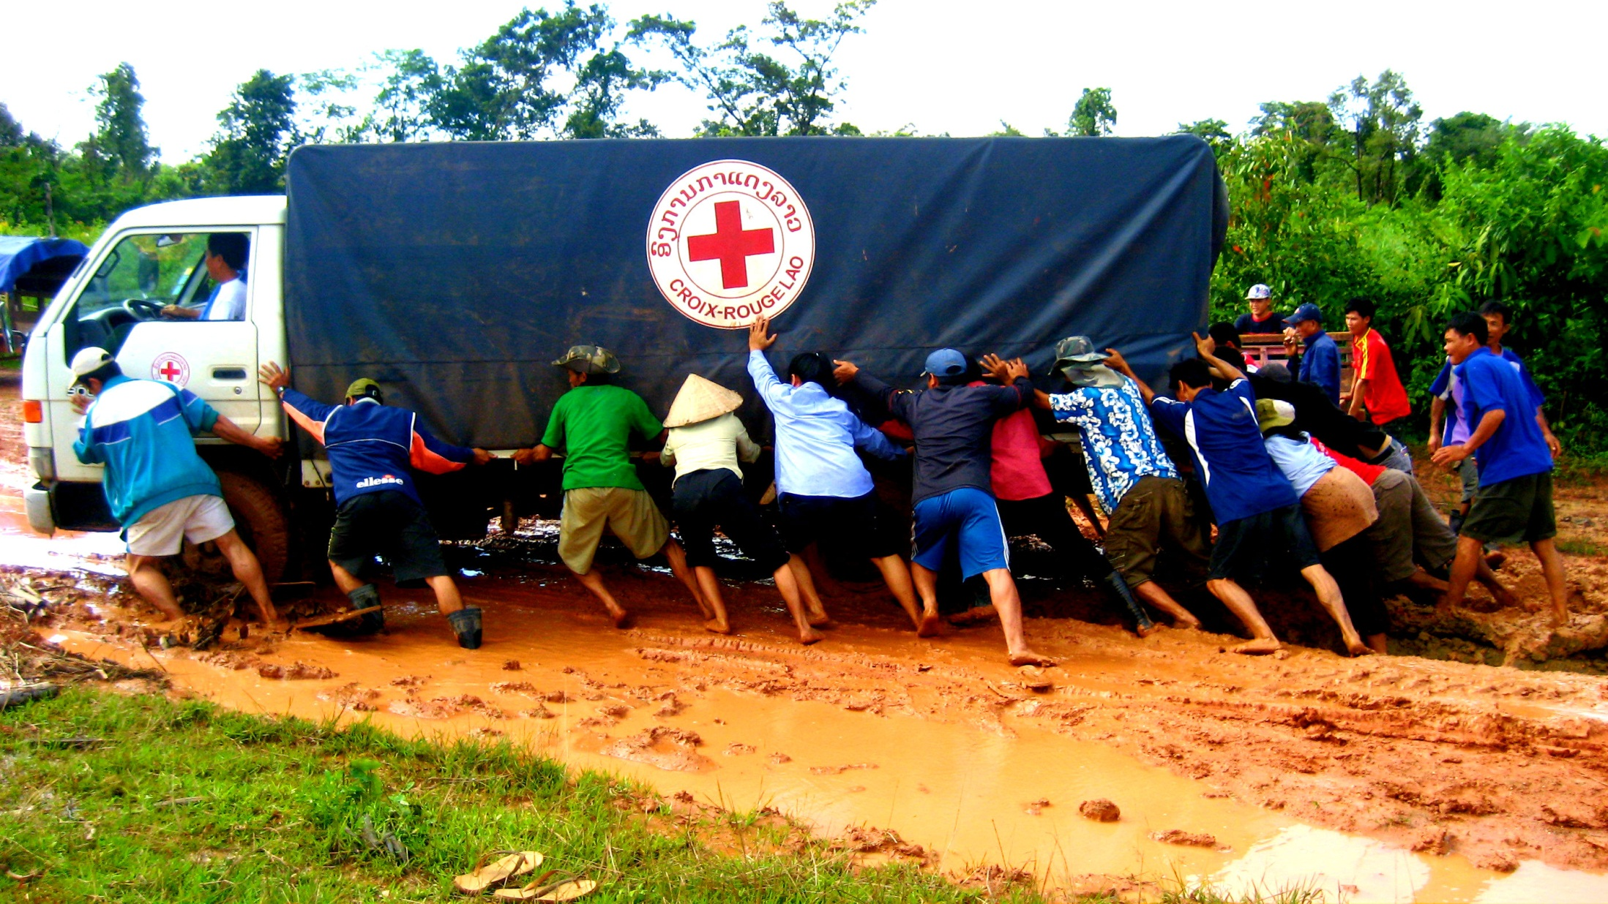
In sometimes difficult environments…

Slide 7
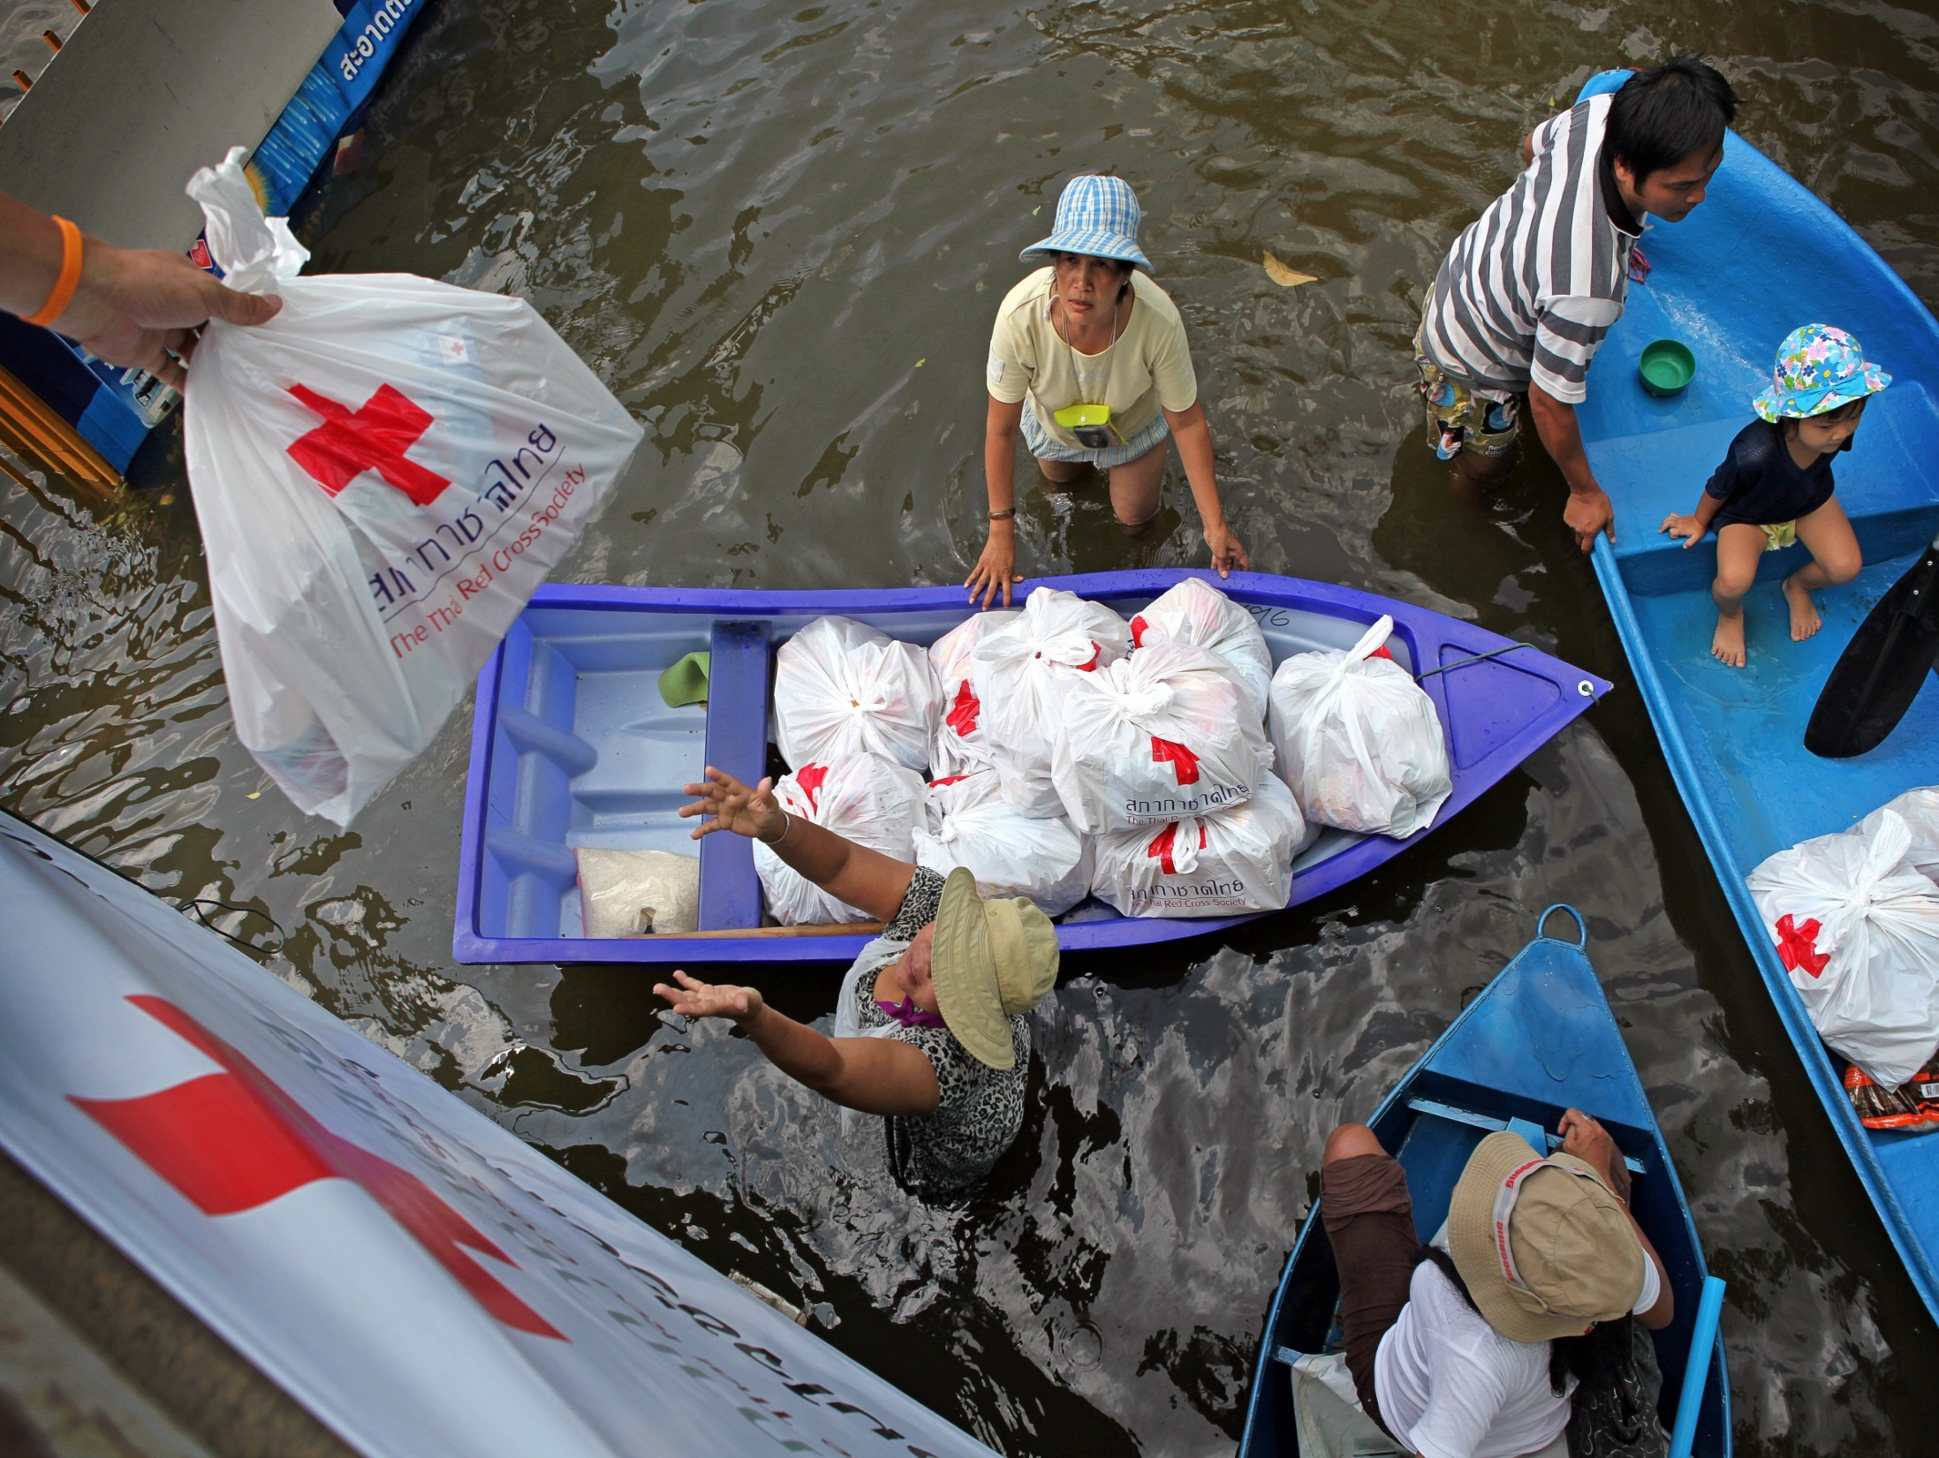

Slide 8
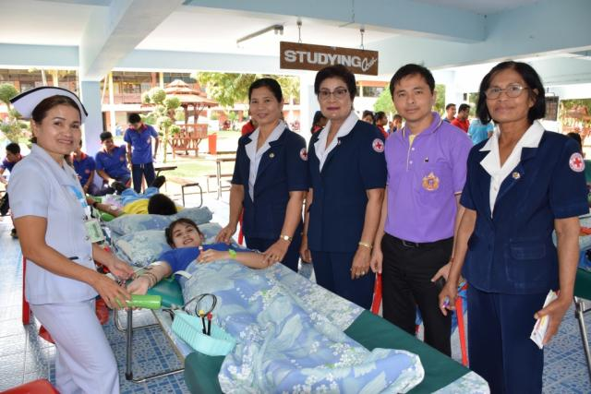

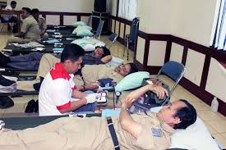

Blood services with health ministries…

Slide 9

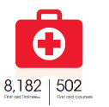

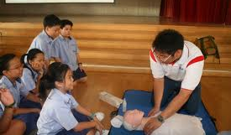
First aid, a core activities in all countries
Singapore, in 2013…

Slide 10
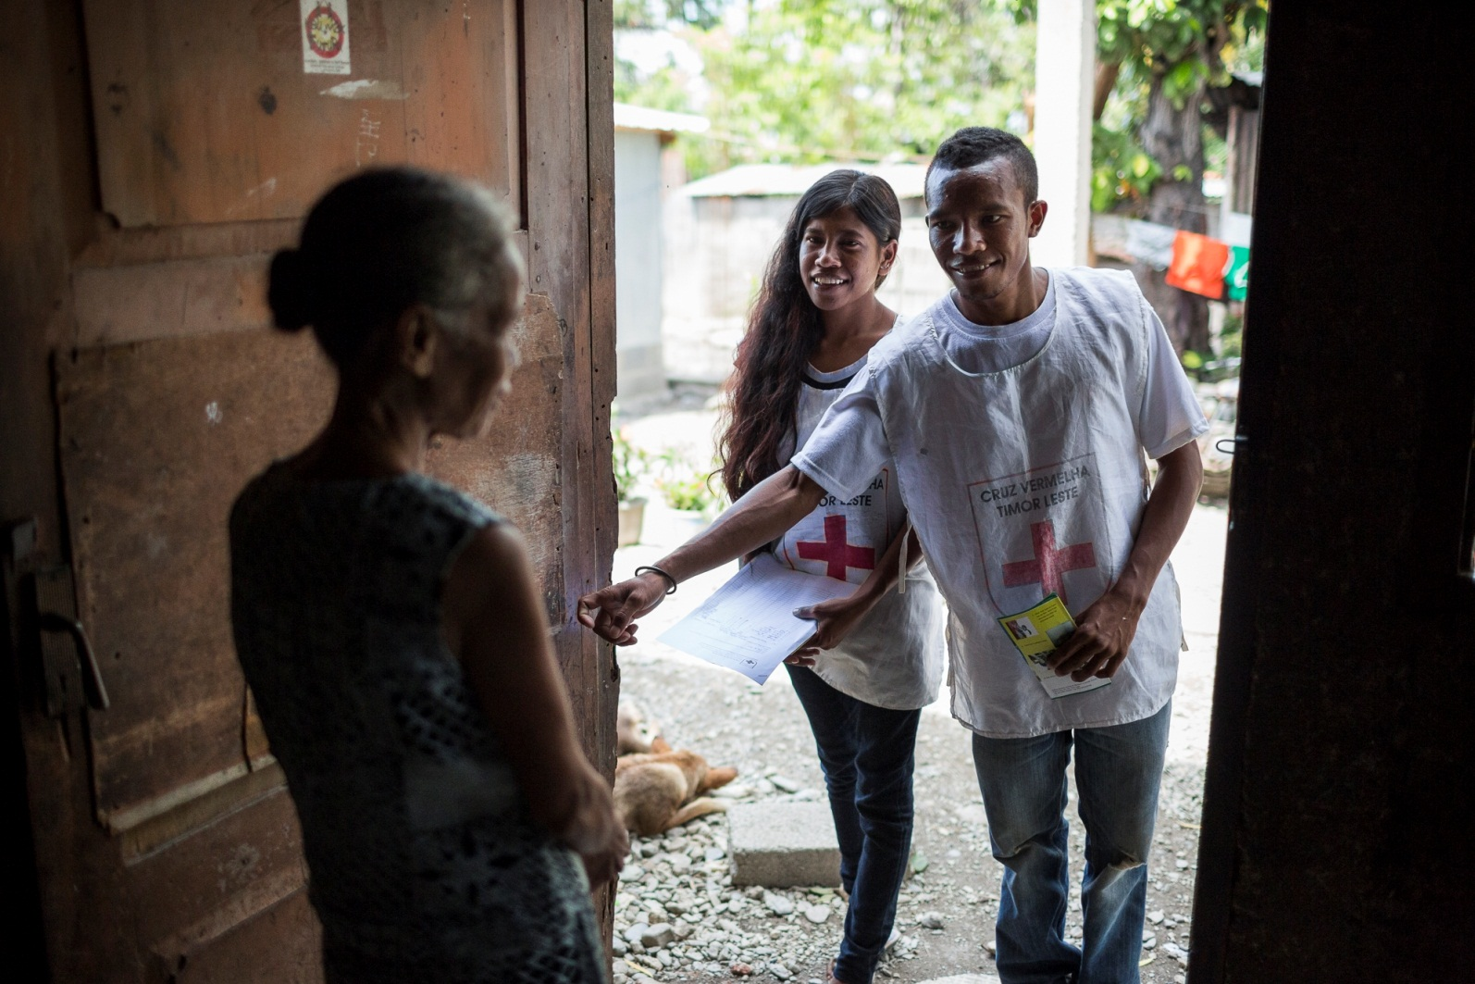
Their action spread all over the countries

Slide 11
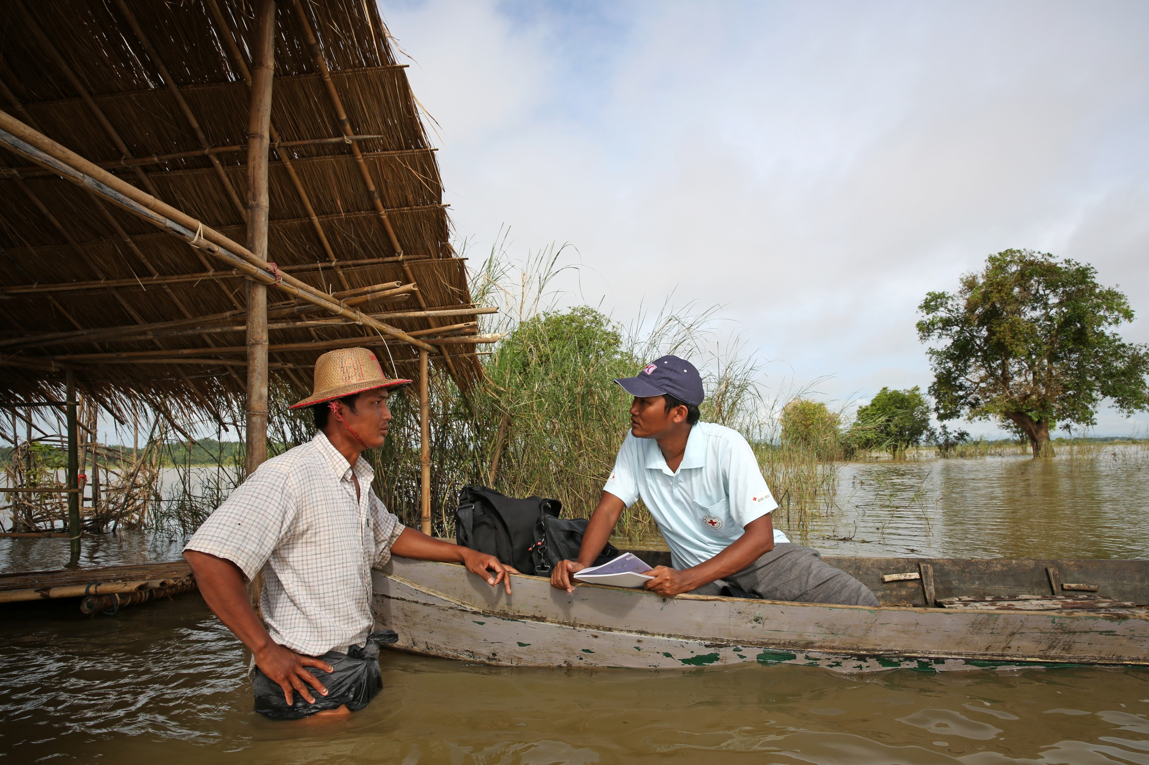
Myanmar

Slide 12
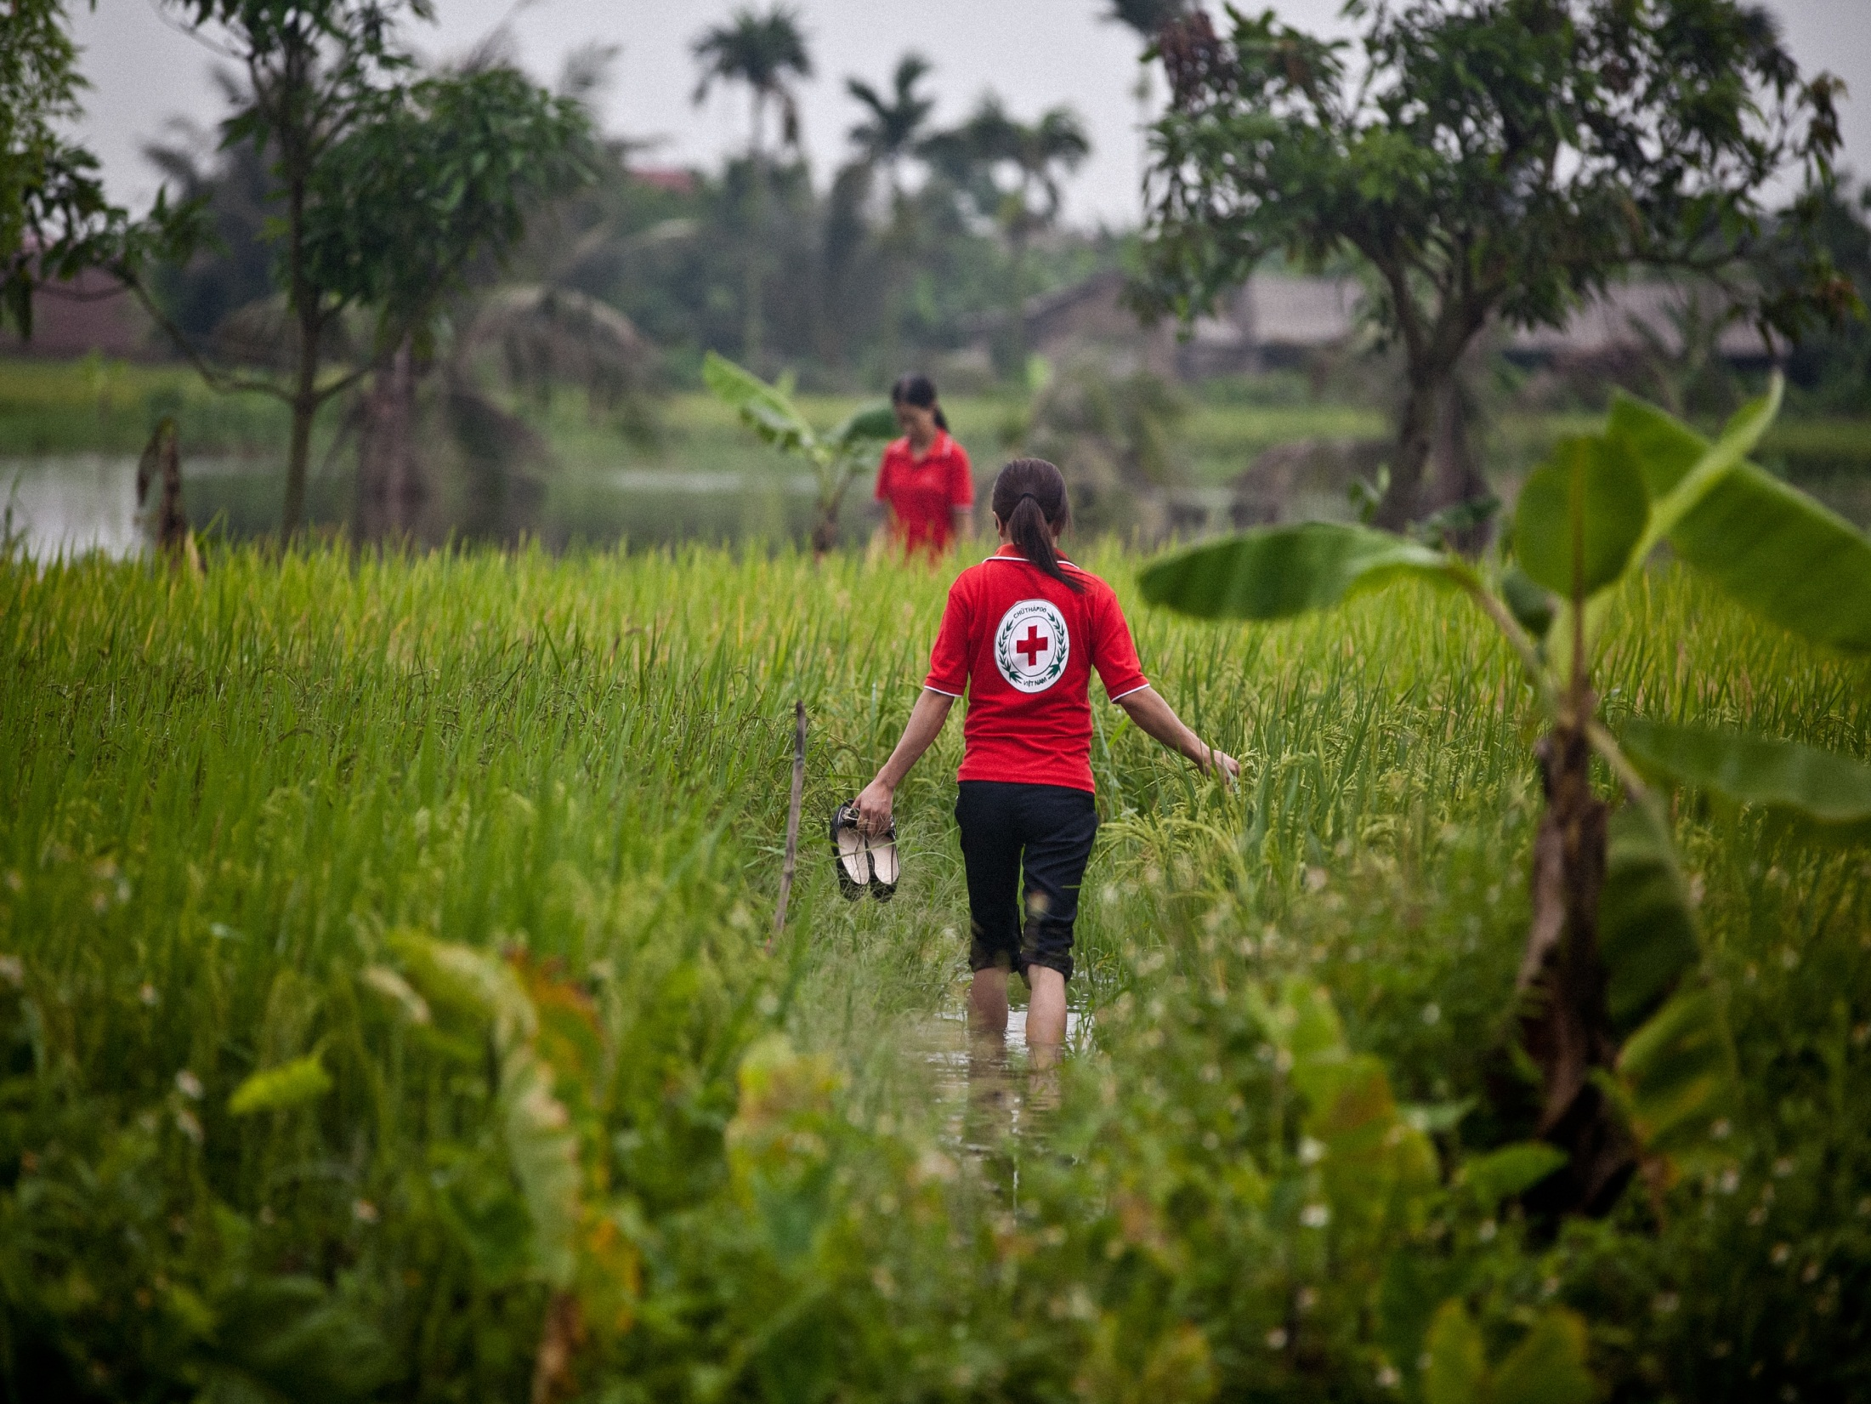
Vietnam

Slide 13
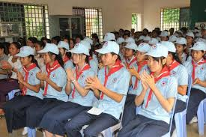
Youths and volunteers
Cambodia

Slide 14


Slide 15
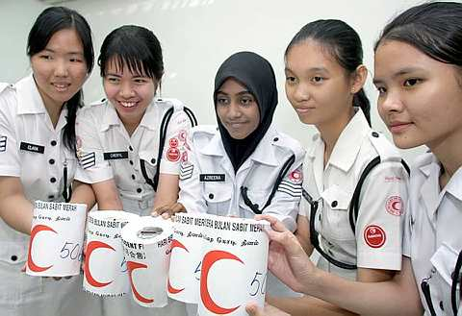

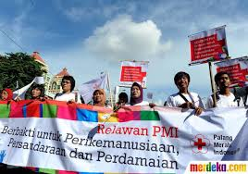

Malaysia
Brunei

Slide 16
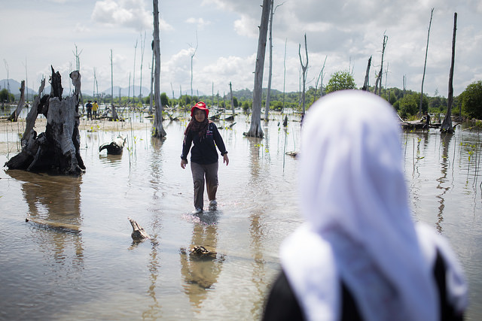
Engagement in communities and schools
Planting mangrove in Indonesia

Slide 17
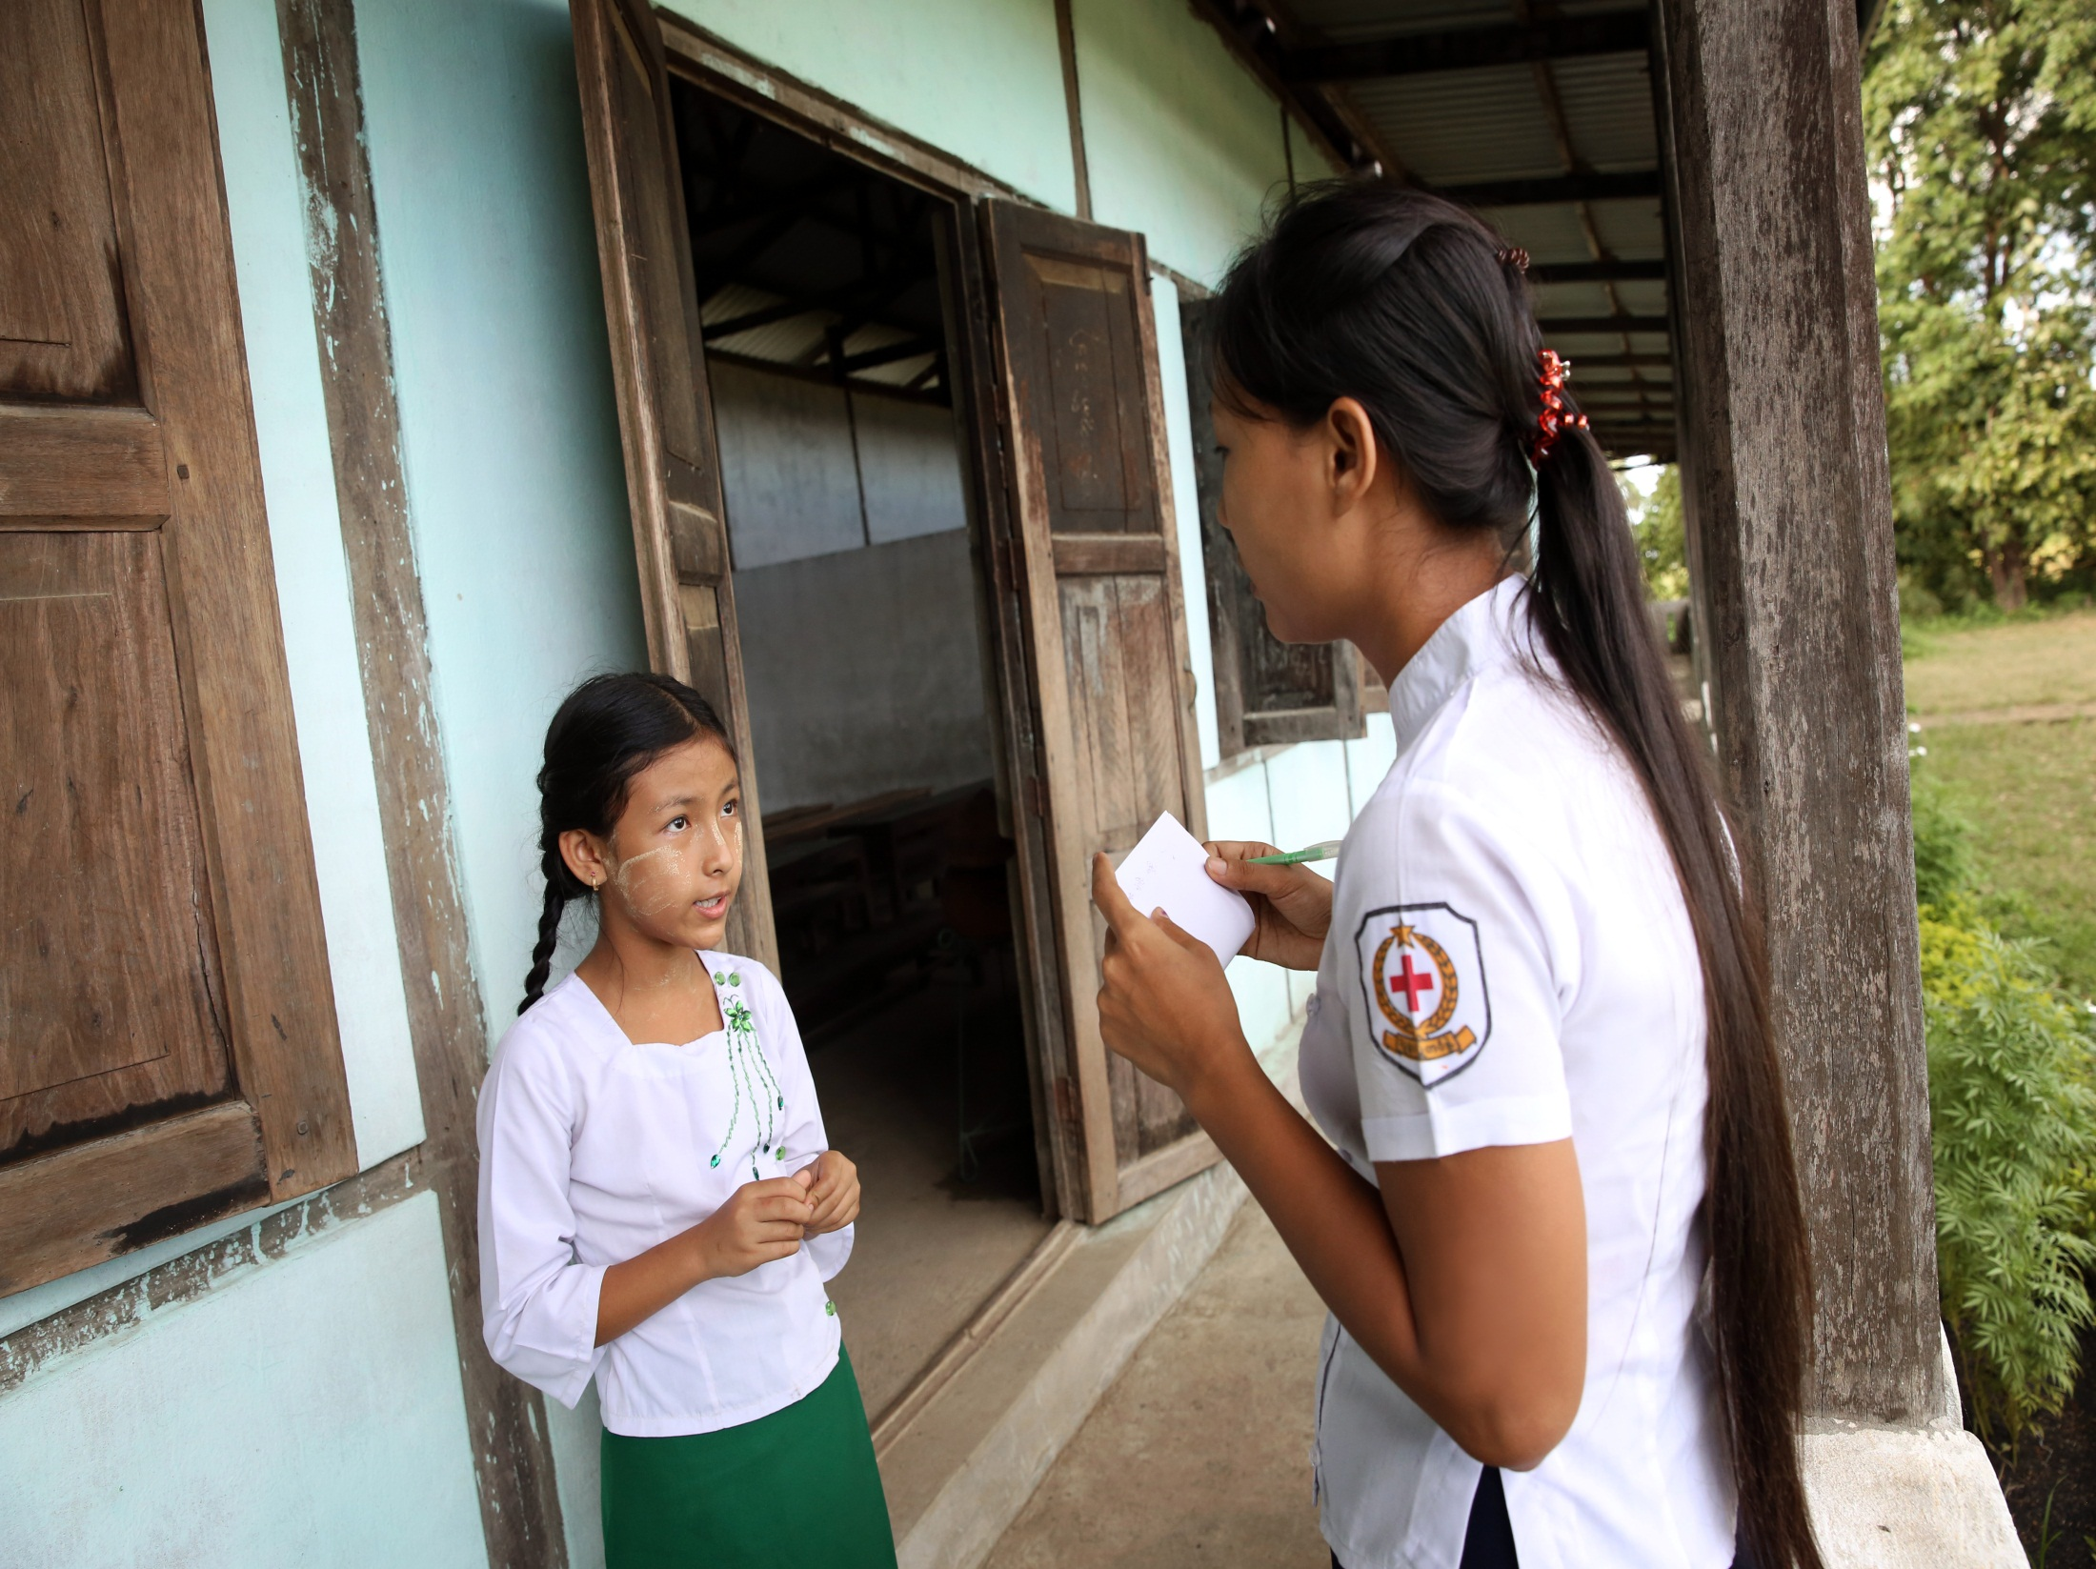
School awareness, Myanmar

Slide 18
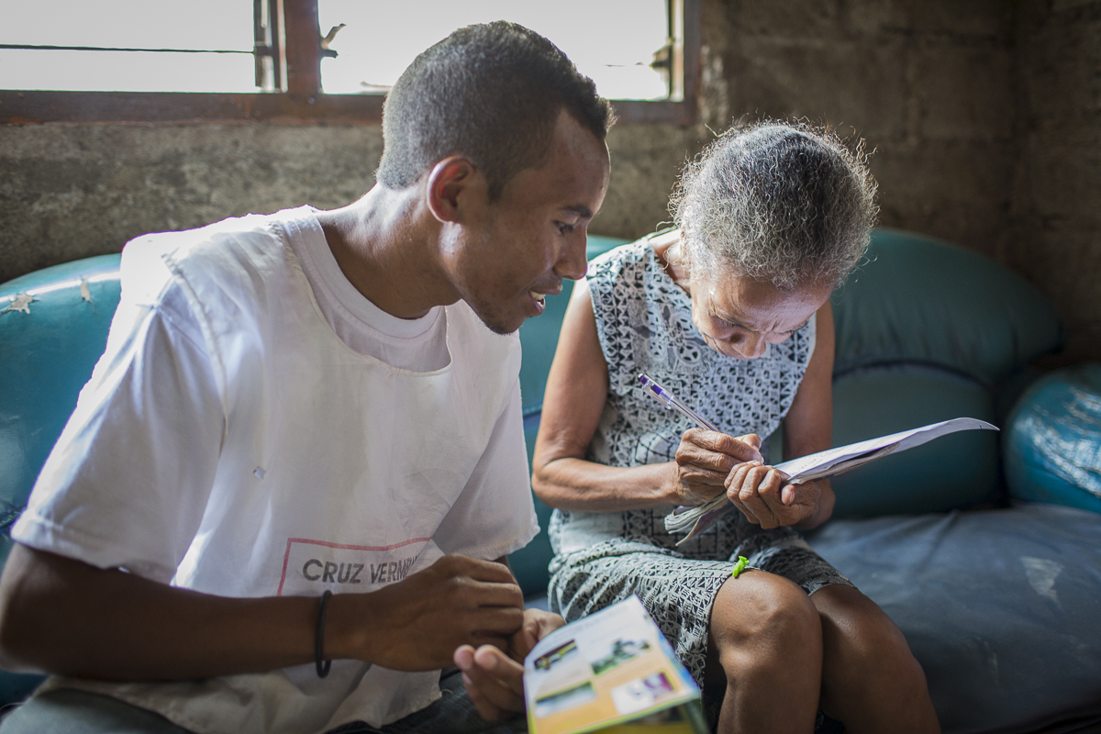
Dengue prevention, Timor Leste

Slide 19
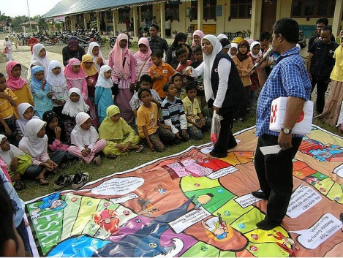
Disaster Preparedness in Indonesia

Slide 20
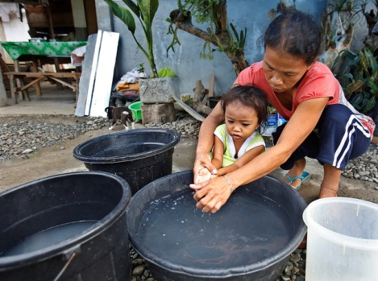
Hygiene promotion in the Philippines

Slide 21
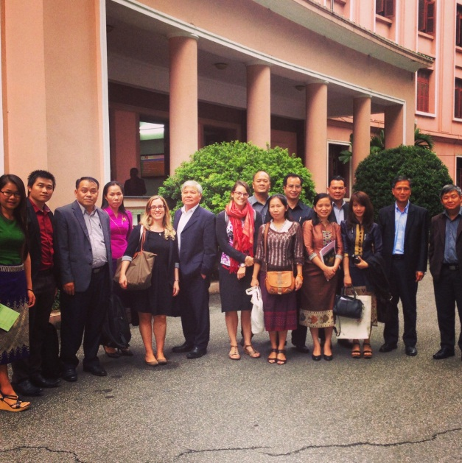
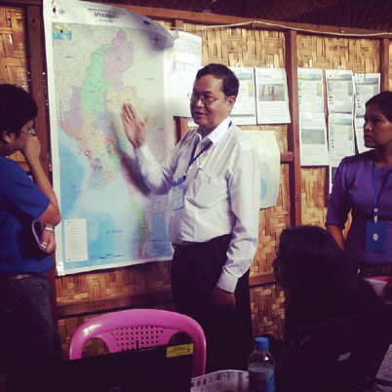
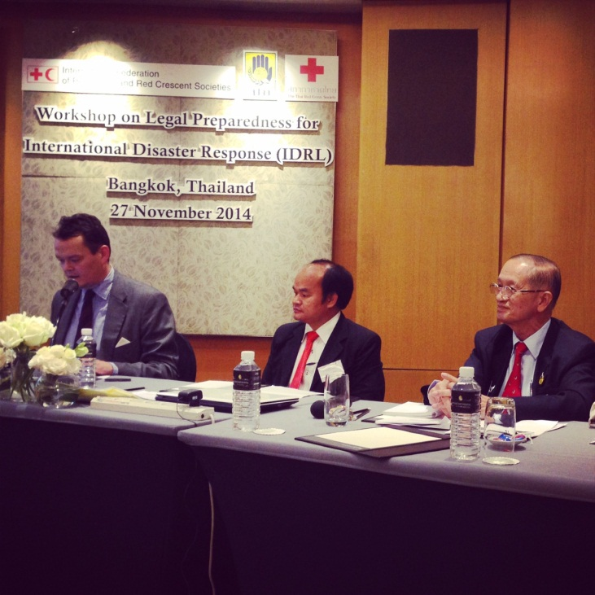
Working with governments…
Vietnam – Lao exchange on Disaster Law
Simulation exercise in Myanmar
Disaster Law workshop, Thailand

Slide 22
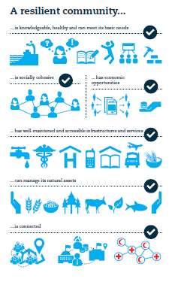
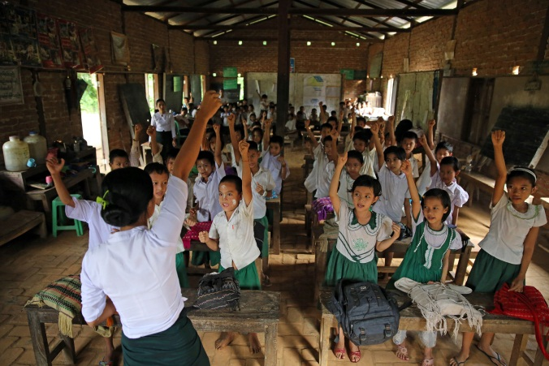
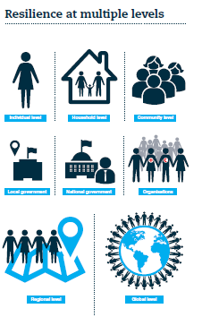
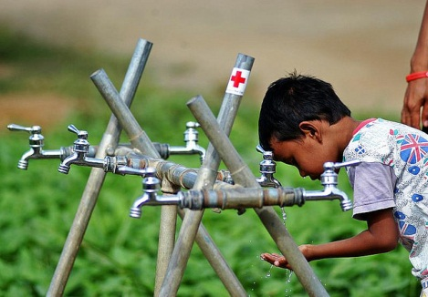
Community resilience…

Slide 23
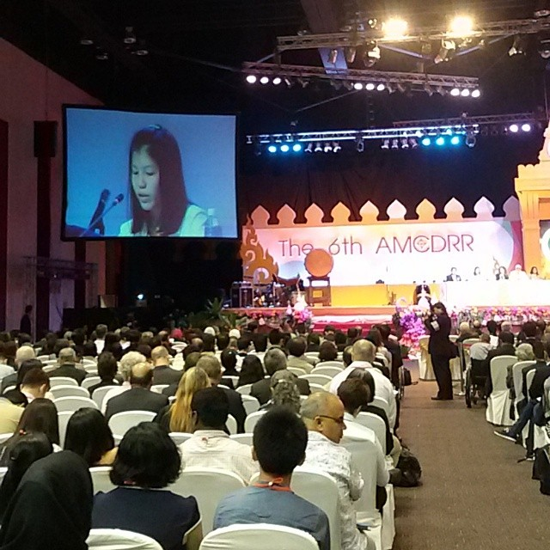
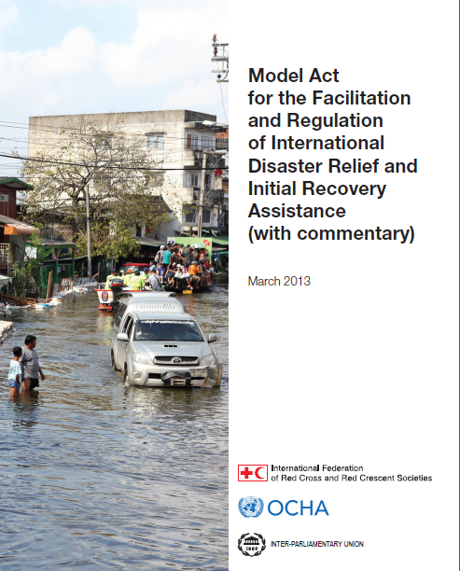
Humanitarian Diplomacy

Slide 24
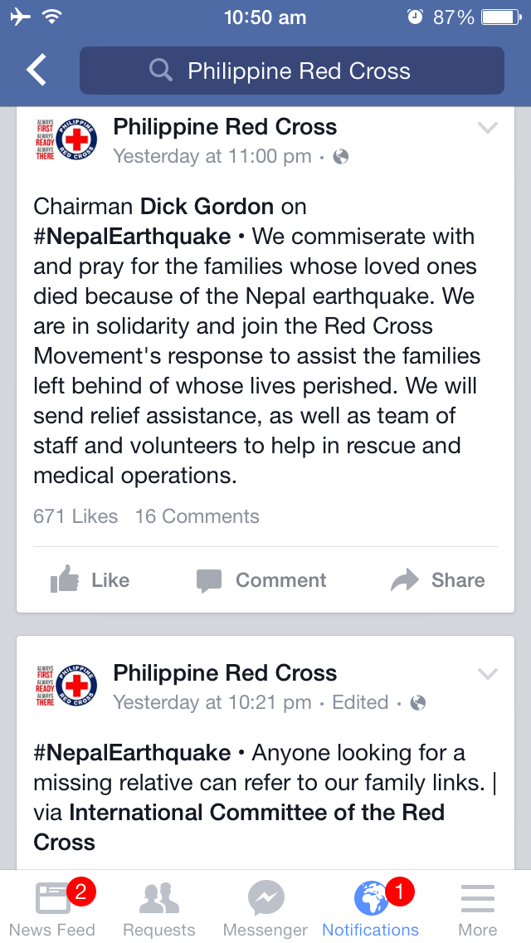

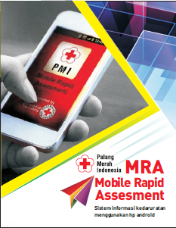
Beneficiary communications
Notes:
PMI on Facebook: another roles (building community, emergency request from public, etc.)

Slide 25
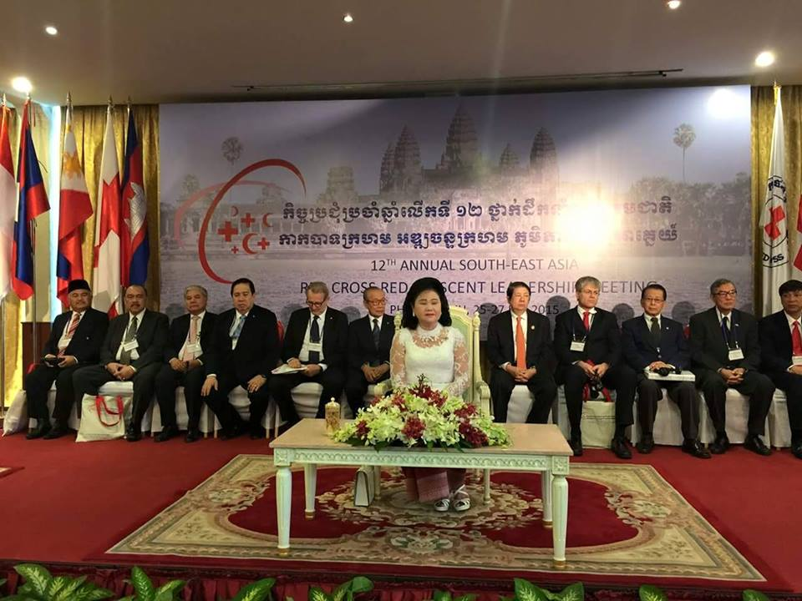

Slide 26
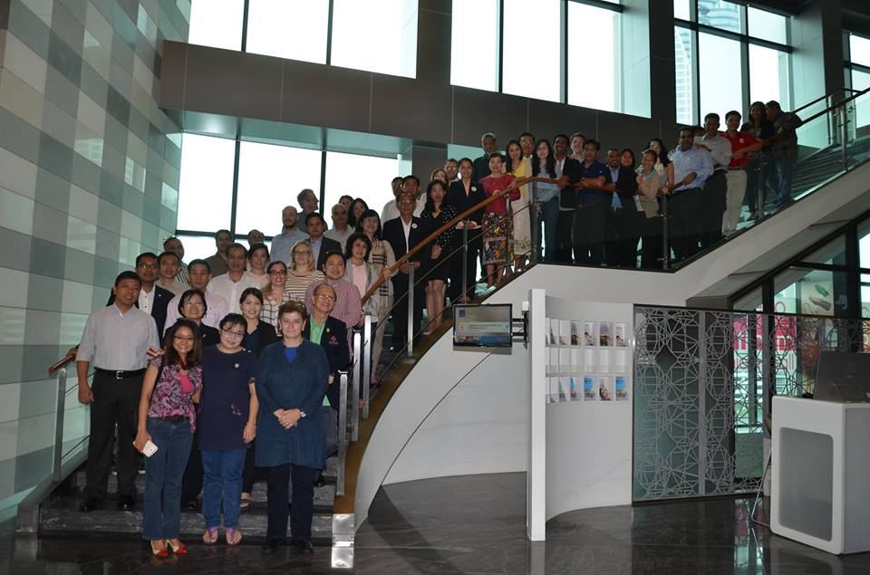
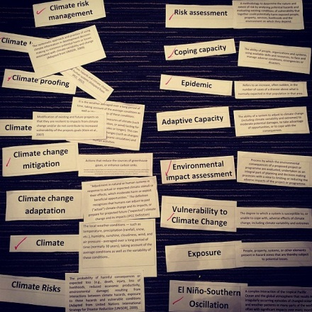
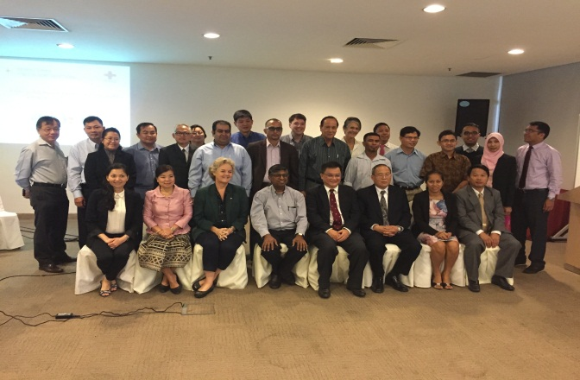
Regional cooperation – among NSs
Community Safety and Resilience Forum
Pandemic Preparedness and Public Health Emergency
Climate Masters Training
Notes:
CSR Forum
Climate Change
Pandemics / 17-20 Nov / DFATD / Jacob at last day
RDRT technical meeting (October)
Peer to peer (PMI-CVTL, TRCS-LRC…)

Slide 27
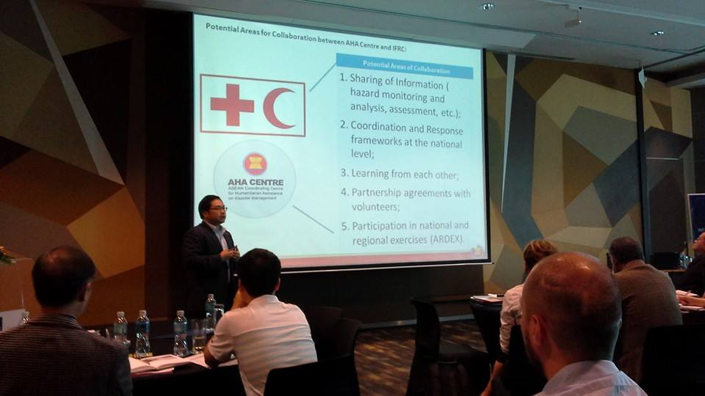
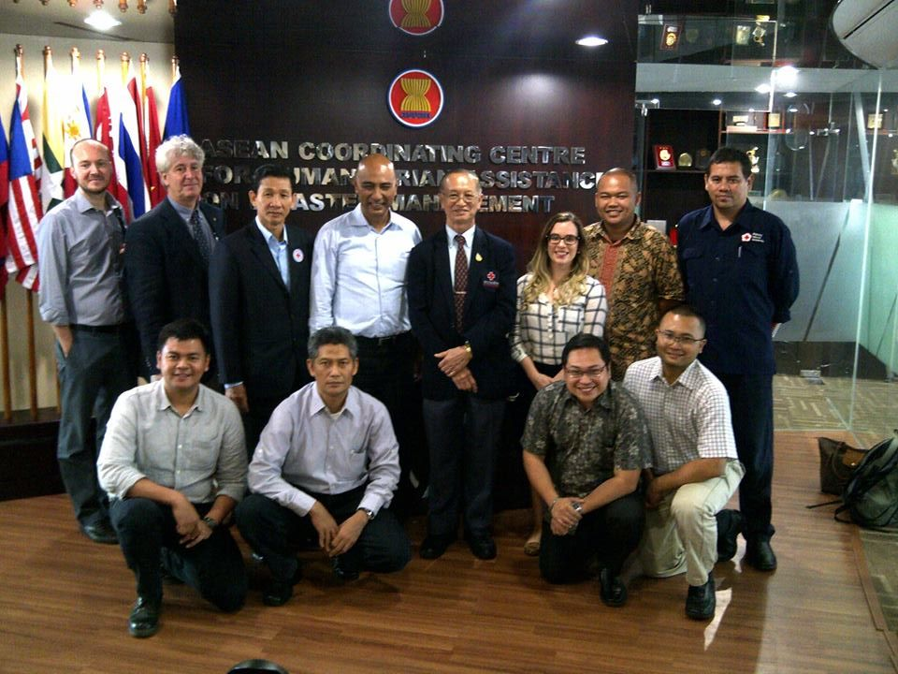
Regional cooperation with ASEAN
Joint Action Plan with AHA Centre – ACE Programme
Alignment of School Safety activities with ASSI
Contribution to AADMER reporting and future planning
Health: potential joint efforts in pandemic preparedness and NCD
Notes:
AHA Centre / Joint action plan / ACE
ASSI / APCSS
AADMER / mapping initiated
ASEAN / pandemics
ASEAN / NCD / Dengue (RRI)

