Slide 1
The International
Red Cross and Red Crescent Movement
Presentation to
Participants to 2nd batch of ACE training
by AHA Centre

Slide 2
Video imagine

Slide 3
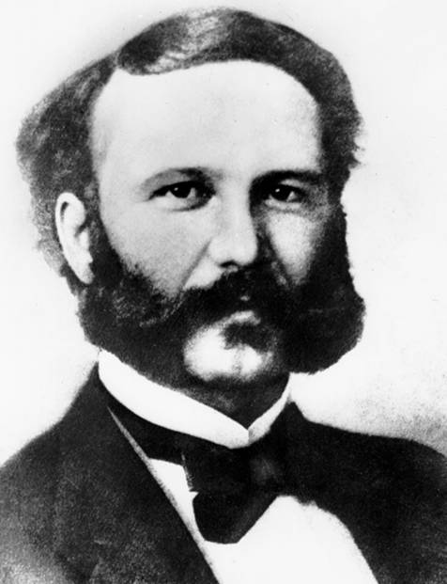
Birth of the Red Cross and
Red Crescent Movement
1859
- battle of Solferino - Henry Dunant
1863
- International Committee for Relief of the
Wounded (later the International Committee
of the Red Cross)
- first International Conference (Geneva)
- creation of National Committees for Relief
to Wounded Soldiers
1864
  - First Geneva Convention
1919
- Henry Davison initiated founding of the League
of Red Cross Societies to improve the health
of populations after World War I
- since 1991 International Federation of
Red Cross and Red Crescent Societies
Henry Dunant
Notes:
The history of the Movement predates the Federation by six decades. The beginnings can be traced back to 1859 when a Swiss businessman called Henry Dunant was travelling through northern Italy and witnessed large-scale human suffering at the battle of Solferino, which involved 300,000 troops and caused more than 40,000 casualties.
Horrified by the scale of casualties, Dunant organized local residents to care for the war wounded, regardless of nationality.
Dunant's experiences and subsequent book inspired five Geneva citizens to set up the founding committee – known as the International Committee for Relief of the Wounded, later to become known as the ICRC – in 1863. The first international conference was held in that year in Geneva and National Committees for Relief to Wounded Soldiers were created.
The principle was to protect those wounded on the battlefield and those taken as prisoners of war. This was later incorporated into international law through the first Geneva Convention in 1949.
In 1919, after World War I the chairman of the American Red Cross War Council, Henry Davison, called for the creation of the League of Red Cross Societies to focus on the needs of post-war Europe and to act as an organ of permanent cooperation.
The League began with five National Societies and continued to grow to the 185 that exist today. In 1991, the network was renamed the International Federation of the Red Cross and Red Crescent Societies.

Slide 4
Video birth of an idea

Slide 5
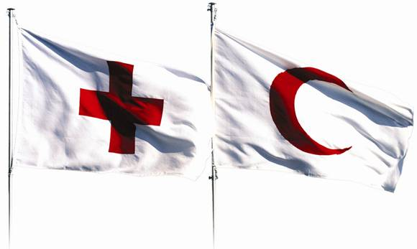
The Fundamental Principles
Humanity
Impartiality
Neutrality
Independence
Voluntary service
Unity
Universality

Slide 6
The Fundamental Principles
Humanity
The International Red Cross and Red Crescent Movement, born of a desire to bring assistance without discrimination to the wounded on the battlefield, endeavours, in its international and national capacity, to prevent and alleviate human suffering wherever it may be found. Its purpose is to protect life and health and to ensure respect for the human being. It promotes mutual understanding, friendship, cooperation and lasting peace amongst all peoples.
Impartiality
It makes no discrimination as to nationality, race, religious beliefs, class or political opinions. It endeavours to relieve the suffering of individuals, being guided solely by their needs, and to give priority to the most urgent cases of distress.
Neutrality
In order to enjoy the confidence of all, the Movement may not take sides in hostilities or engage at any time in controversies of a political, racial, religious or ideological nature.
Independence
The Movement is independent. The National Societies, while auxiliaries in the humanitarian services of their governments and subject to the laws of their respective countries, must always maintain their autonomy so that they may be able at all times to act in accordance with the principles of the Movement.
Voluntary service
It is a voluntary relief movement not prompted in any manner by desire for gain.
Unity
There can be only one Red Cross or Red Crescent Society in any one country. It must be open to all. It must carry on its humanitarian work throughout its territory.
Universality
The International Red Cross and Red Crescent Movement, in which all societies have equal status and share equal responsibilities and duties in helping each other, is worldwide.

Slide 7
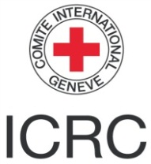
The International Red Cross and Red Crescent Movement
189 National Red Cross and Red Crescent Societies worldwide
founded in 1919
International Committee of the Red Cross
(ICRC), founded in 1863
Notes:
The world’s largest humanitarian network
The International Federation of Red Cross and Red Crescent Societies (IFRC), 189 National Societies and the International Committee of the Red Cross (ICRC) together form the International Red Cross and Red Crescent Movement. The Movement works in cooperation with governments, donors and other aid organizations to assist vulnerable people affected by natural and manmade disasters, as well as by conflicts around the world. As partners, the different members of the Movement also support communities in becoming stronger and safer through a variety of development projects and humanitarian activities.
The work of National Societies is carried out by millions of local Red Cross and Red Crescent volunteers and members around the world. These committed individuals are on the front line, delivering humanitarian assistance and supporting vulnerable communities to become stronger and more resilient. National Societies support their public authorities as independent auxiliaries to government in the humanitarian field. In wartime, National Societies also assist affected civilian populations and support army medical services, where appropriate.
The Red Cross, Red Crescent and Red Crystal are protective, indicative emblems enshrined in the Geneva Conventions.
A brief history:
1859 - Henry Dunant witnesses the aftermath of the Battle of Solferino in northern Italy
1863 - International Committee for Relief of the Wounded (later ICRC) formed, National Committees for Relief of Wounded Soldiers established, the 1st International Conference held.
1919 - League of Red Cross Societies (renamed IFRC in 1991) founded in Paris to improve public health following the First World War.
1949 - The 4 Geneva Conventions were adopted covering wounded and sick, prisoners of war and civilians in enemy territories.

Slide 8
Movement components & their mandates
ICRC
(1863)
Neutral, independent humanitarian organisation with international legal mandate
Protects and assists victims of armed conflicts & OSV
Guardian of IHL
Cooperation with all Movement members
189
National
Societies
(1863 onwards)
International
Federation
(1919)
Autonomous national organizations
National legal identity
Organize emergency relief operations for victims of conflict, natural disasters & other emergencies
Assist victims internationally
International membership organization
Inspires, encourages, facilitates and promotes NS's humanitarian activities
Strengthens NS
Brings relief to all disaster victims
Notes:
Just as the activities of the components overlap, so do their mandates.
National Societies primarily have a NATIONAL mandate for ASSISTANCE to victims affected by ALL KINDS OF EMERGENCIES (conflict, natural disaster, other).
The ICRC brings assistance & protection to all victims of ARMED CONFLICT. Therefore its mandate is INTERNATIONAL in scope and although it shares assistance activities to conflict victims with NS, its specific PROTECTION mandate is unique in the Movement.
The International Federation's primary goal is to support National Societies so they can better deliver their mandated activities. Since it comprises all NS, its scope is INTERNATIONAL. It does have a specific responsibility for bringing relief to DISASTER victims. Because it has a mandate to support NS in all their activities, its operations can and do go beyond natural disasters.

Slide 9
The emblems
The red cross and the red crescent are two of the most recognized symbols in the world. But they are more than just that. They are protective emblems and their use is enshrined in international humanitarian law.
Notes:
The International Federation uses as its "logo" two globally recognized emblems - the red cross and the red crescent - set on a white background within a red rectangle.
The emblems go back a long way. The red cross was formally adopted in the first Geneva Convention of 1864. The red crescent was adopted by the Ottoman Empire in 1876 during the war with Russia. It was recognized in the 1929 Geneva Convention along with the red lion and sun of Persia. For National Societies, the emblem serves two purposes; it is "indicative" and it is “protective”.
The protective use of the emblem is related to its essential purpose: in times of conflict, to constitute the visible sign of protection conferred by the Geneva Conventions. It is meant to show combatants that personnel; medical units and means of transport are protected by the Geneva Conventions and their Additional Protocols. The emblem, when used as a protective device, must arouse a reflex among combatants – one of restraint and respect.
The indicative use of the emblem is designed to show, mainly in peacetime, that a person or object is linked to the Movement. The emblem also serves as a reminder that the Red Cross and Red Crescent works in accordance with the Movement's Fundamental Principles.

Slide 10

The emblems
The emblems
The red crystal was created by States at the Diplomatic Conference in 2005.
It stands alongside the red cross and red crescent, with equal status.
The red lion was used by Iran from 1929 to 1980.
Notes:
With the adoption of the Third Additional Protocol in December 2005, the red crystal is now also a recognized distinctive sign under international law, with the same status as the red cross and red crescent. By mid July 2006, 72 States had signed the Protocol, two had ratified it and several other governments were well advanced with their parliamentary ratification processes. The Protocol will formally enter into force, therefore, in January 2007.
The emblems are used in more than 190 countries in the world to protect medical personnel, buildings and equipment in time of armed conflict and to identify national Red Cross and Red Crescent societies, the International Committee of the Red Cross (ICRC) and the International Federation of Red Cross and Red Crescent Societies.
Unfortunately, the red cross and red crescent emblems have sometimes been wrongly perceived as having religious, cultural or political connotations. This has affected respect for the emblems and has diminished the protection the emblems offer to victims and to humanitarian and medical personnel. The debate that led to the adoption of the Third Additional Protocol recognized the need to provide protection in cases where neither the red cross nor the red crescent is respected as neutral.
The debate also considered the needs of those National Societies that were unable to join the Movement because of their inability to use either the red cross or the red crescent. The adoption of the Third Protocol and the incorporation of the red crystal into the Statutes of the Movement makes it possible for those Societies to use the red crystal without endangering their own traditions.

Slide 11
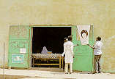
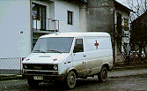

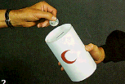
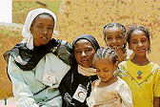
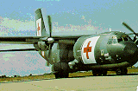
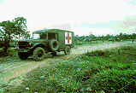
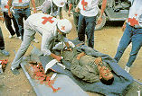
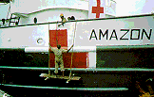
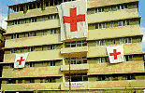
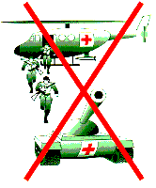


Indicative use (small dimension)
Protective use (large dimension)
Misuse
or abuse

Slide 12
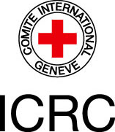
The ICRC

Slide 13
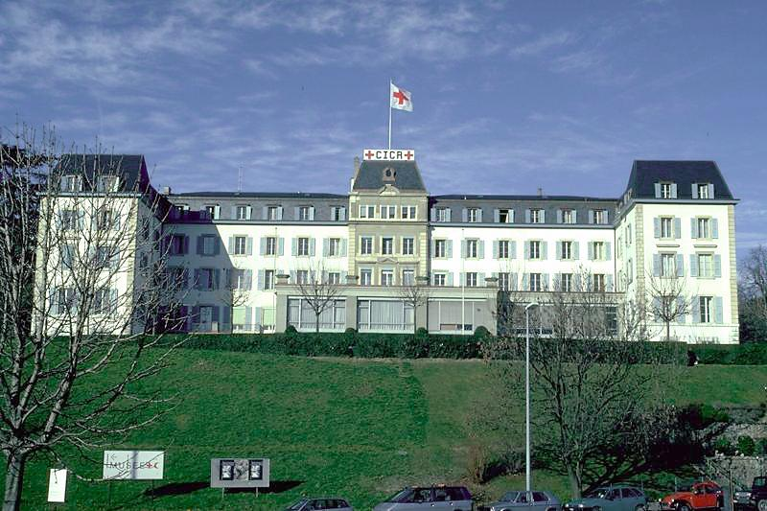
Introduction to the International Committee of the Red Cross

Slide 14
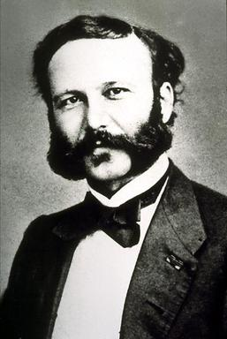
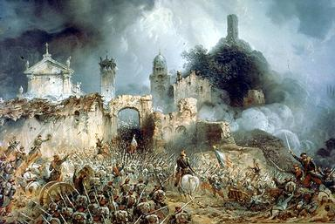
THE ORIGINS OF THE ICRC
1859: Battle of Solferino
    24 June – France against Austria
    16 hours of fighting for 40'000 casualities
1863: Creation of the Committee of Geneva (10 articles signed by 16 States)
1864: First Geneva Convention
1864: Establishment of the first National Societies.

Slide 15
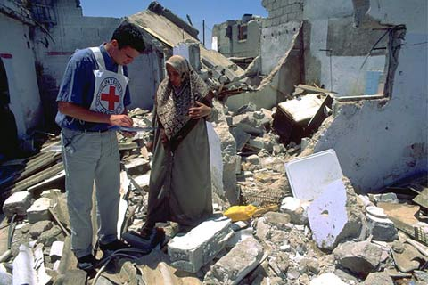
Mission
The ICRC has a mandate conferred by the communitiy of States to:
provide protection and assistance for civilian and military victims of armed conflicts and internal violence,
by acting in a strictly neutral and impartial way.

Slide 16
WHAT THE ICRC DOES…
Protect the victims of armed conflict with any action designed "to ensure respect for life, health and dignity of persons in the power of their enemy"
Assist those victims
Protect persons deprived of freedom
Restore and maintain family links
Support health services, provide water and other services
Prevention Action: remind all parties of their obligation to respect IHL

Slide 17
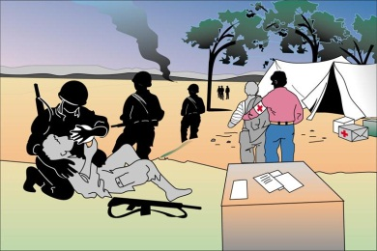
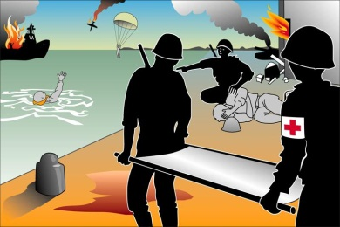
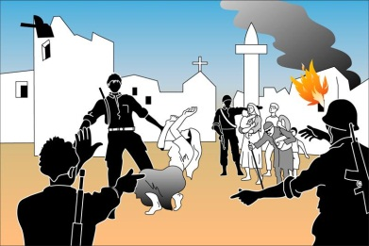
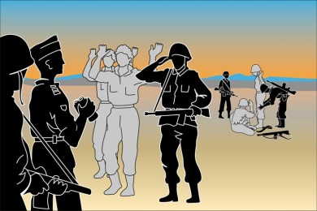
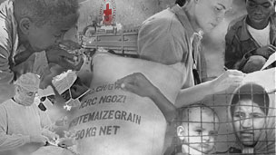
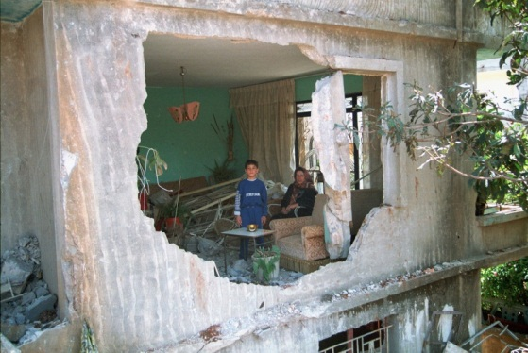
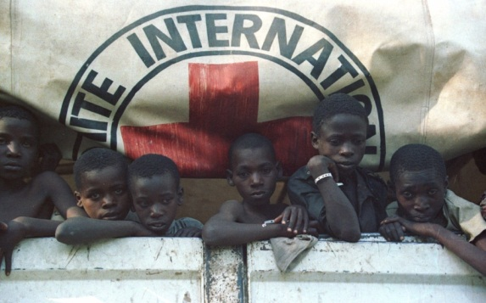
International Humanitarian Law
Protection
Limit to the effects of armed conflict.
Protection to persons who are not or are no longer participating.
Spreading knowledge of International Humanitarian Law.
Carrying out practical activities to protect and assist people in need.
Civilians not taking part in the fighting must on no
account be the object of attack and must be spared
and protected.
Notes:
International humanitarian law (IHL) in brief
International humanitarian law is a set of rules which seek, for humanitarian reasons, to limit the effects of armed conflict. It protects persons who are not or are no longer participating in the hostilities and restricts the means and methods of warfare. International humanitarian law is also known as the law of war or the law of armed conflict.
International humanitarian law and human rights
International humanitarian law and international human rights law are complementary. Both seek to protect the individual, though they do so in different circumstances and in different ways. Humanitarian law applies in situations of armed conflict, whereas human rights, or at least some of them, protect the individual at all times, in war and peace alike. While the purpose of humanitarian law is to protect victims by endeavouring to limit the suffering caused by war, human rights seek to protect the individual and further his development.
Basic rules of international humanitarian law in armed conflicts(*)
Persons hors de combat and those who do not take a direct part in hostilities are entitled to respect for their lives and their moral and physical integrity. They shall in all circumstances be protected and treated humanely without any adverse distinction.
It is forbidden to kill or injure an enemy who surrenders or who is hors de combat.
The wounded and sick shall be collected and cared for by the party to the conflict which has them in its power. Protection also covers medical personnel, establishments, transports and equipment. The emblem of the red cross or the red crescent is the sign of such protection and must be respected.
Captured combatants and civilians under the authority of an adverse party are entitled to respect for their lives,dignity, personal rights and convictions. They shall be protected against all acts of violence and reprisals. They shall have the right to correspond with their families and to receive relief.
Everyone shall be entitled to benefit from fundamental judicial guarantees. No one shall be held responsible for an act he has not committed. No one shall be subjected to physical or mental torture, corporal punishment or cruel or degrading treatment.
Parties to a conflict and members of their armed forces do not have an unlimited choice of methods and means of warfare. It is prohibited to employ weapons or methods of warfare of a nature to cause unnecessary losses or excessive suffering.
Parties to a conflict shall at all times distinguish between the civilian population and combatants in order to spare civilian population and property. Neither the civilian population as such nor civilian persons shall be the object of attack. Attacks shall be directed solely against military objectives.
* This text constitutes the quintessence of the provisions of international humanitarian law. It does not have the force of an international legal instrument and is in no way intended to replace the treaties in force. It is designed, to facilitate dissemination of international humanitarian law.

Slide 18

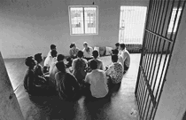

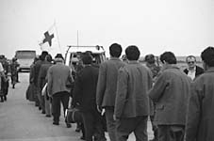
Visiting people deprived of their liberty
Detention
Preventive action and dialogue with the detaining authorities with
a view to ensuring that people they hold are treated humanely.
Notes:
Purpose
The aim of ICRC visits is to take preventive action and initiate a dialogue with the detaining authorities with a view to ensuring that people they hold are treated humanely.
Visits to prisoners of war, civilian internees and any other individuals imprisoned on security grounds in a crisis situation constitute an important aspect of what is known as the ICRC's protection work. The purpose of ICRC visits is purely humanitarian: it is to preserve the physical and moral integrity of detainees, to prevent any abuse to which they may be subjected and to make certain that they enjoy decent material conditions of detention. The ICRC never questions the reason for a person's arrest.
It should be emphasized, however, that it is up to the detaining authorities to ensure the protection of the people they take into custody and that they can be held accountable if they fail to do so.
Conditions for ICRC visits
Whatever the circumstances, the ICRC visits people deprived of their freedom only if the authorities allow it:
to see all prisoners who come within its mandate and to have access to all places at which they are held;
to speak with prisoners in private, without any third parties being present;
to draw up a list of prisoners during its visit whom it considers to come within its mandate, or to receive such a list from the authorities and to check and supplement it if necessary;
to repeat its visits to all prisoners of its choice if it considers that the situation so warrants, and to do so as often as it wishes.
The ICRC regularly provides the national authorities with a summary report on its findings over a given period or in a specific category of places of detention, which covers not only the problems identified but also any improvements observed or steps taken.
Dialogue with the authorities, and not the systematic denunciation of violations of international law and the humanitarian principles, is the course of action adopted by the ICRC.

Slide 19
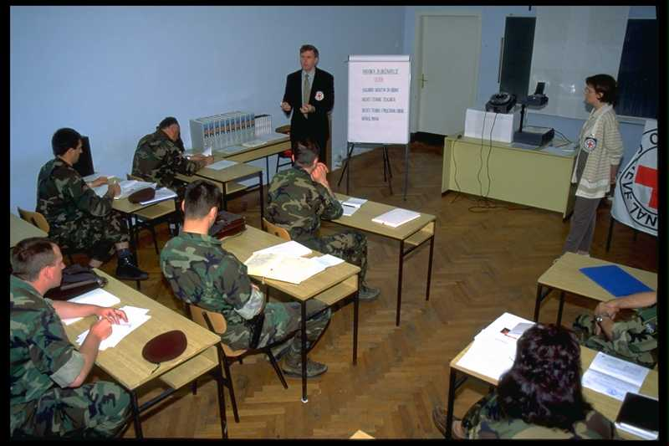
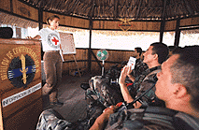
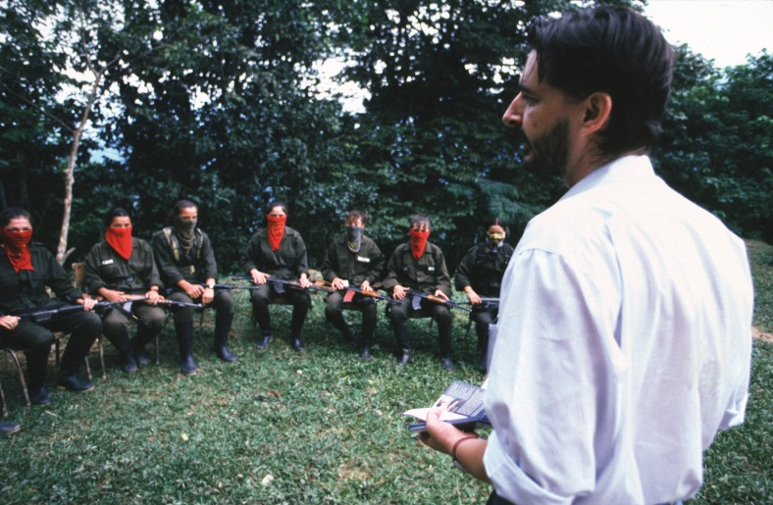
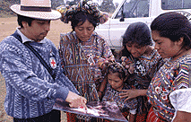
Promotion of humanitarian law
Promotion of IHL
Target audience: armed forces, police, security forces and other weapons
bearers, decision-makers and opinion-leaders at local and international
level and, with an eye to the future, teenagers, students and their teachers.
Notes:
Promotion of humanitarian law
The ICRC's preventive work is designed to contain the harmful effects of conflict and keep them to a minimum. The very spirit of international humanitarian law is to use force with restraint and in proportion to the objectives. The organization therefore seeks to promote the whole range of humanitarian principles so as to prevent — or at the very least to limit — the worst excesses of war.
In its prevention programmes, the ICRC targets in particular those people and groups who determine the fate of victims of armed conflict or who can obstruct or facilitate ICRC action. These groups include armed forces, police, security forces and other weapons bearers, decision-makers and opinion-leaders at local and international level and, with an eye to the future, teenagers, students and their teachers.
The strategy behind these activities comprises three levels:
awareness-building;
promotion of humanitarian law through teaching and training;
integration of humanitarian law into official legal, educational and operational curricula.
The ultimate aim is to influence people's attitudes and behaviour so as to improve the protection of civilians and other victims in times of armed conflict, facilitate access to the victims and improve the security of humanitarian action.

Slide 20
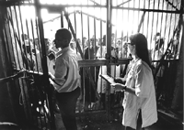
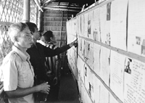
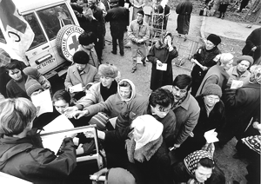

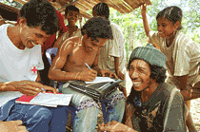
Restoring family links
Re-establishing family links
Preservation of the family unit is a universal right guaranteed by law.
The ICRC does everything possible to reunite people separated by conflict
Notes:
Restoring family links
The ICRC's Central Tracing Agency works to restore family links in all situations of armed conflict or internal violence. Each year, hundreds of thousands of new cases of people being sought by their relatives are opened, whether they concern displaced people, refugees, detainees or missing persons.
When war breaks out families are torn apart, entire populations are displaced or forced into exile, children become separated from their parents, and soldiers are wounded, taken prisoner, reported missing or killed in action. The ICRC and the National Red Cross and Red Crescent Societies work, often together with other humanitarian agencies, to alleviate the human suffering arising from these situations - distributing Red Cross messages, organizing family reunifications, issuing temporary travel documents and capture cards, visiting persons deprived of their freedom, drawing up certificates of captivity and death certificates, and so on.
Preservation of the family unit is a universal right guaranteed by law. The ICRC does everything possible to reunite people separated by conflict, by establishing their whereabouts and reuniting them with their families. Special attention is given to particularly vulnerable groups, such as unaccompanied children or elderly people.

Slide 21

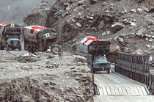
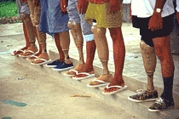
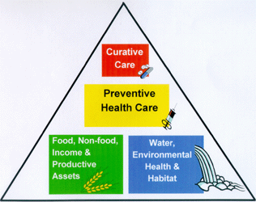
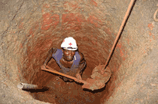
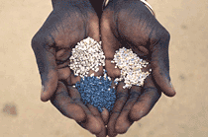
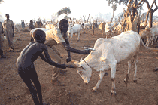
Assistance
Assistance
To protect conflict victims' lives and health, to ease their plight and to ensure that the consequences of conflict do not jeopardize their future.
Keeping sight of the ultimate aim of restoring people's ability to provide for themselves.
Notes:
Assistance
The primary aim of ICRC assistance is to protect victims' lives and health, to ease their plight and to ensure that the consequences of conflict — disease, injury, hunger or exposure to the elements — do not jeopardize their future. While emergency assistance saves lives and mitigates the worst effects of conflict, the ICRC tries always to keep sight of the ultimate aim of restoring people's ability to provide for themselves.
Assistance may take a variety of forms, depending on the region and the nature of the crisis. It may include the provision of food and/or medicine, but usually builds on the capacity to deliver essential services, such as the construction or repair of water-supply systems or medical facilities and the training of primary health care staff, surgeons and orthopaedic technicians.

Slide 22
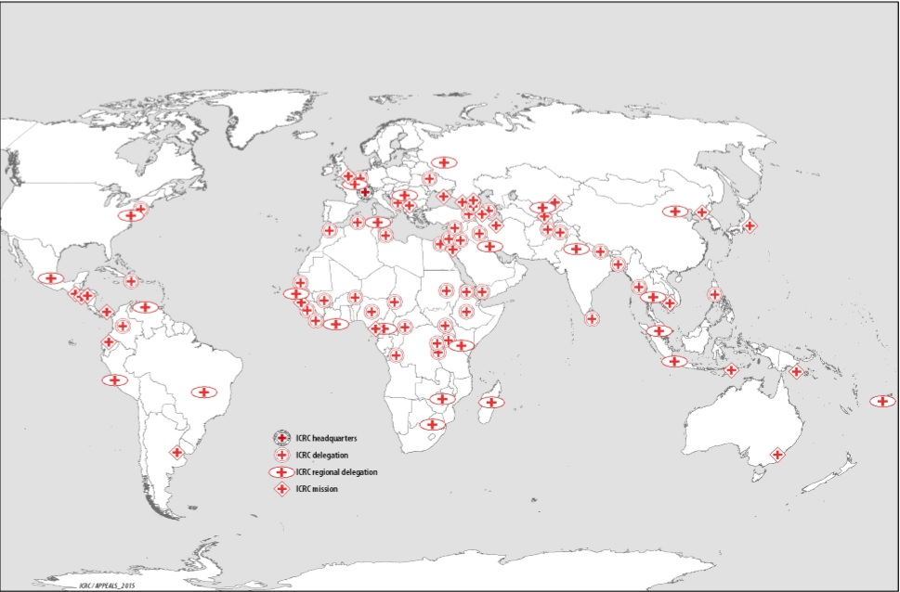

Slide 23
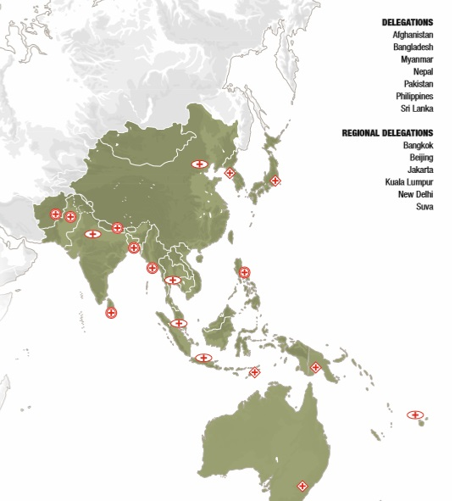

Slide 24
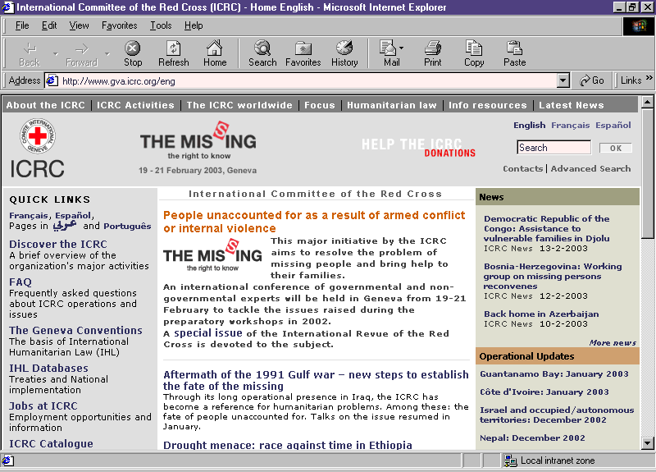
More information
www.icrc.org
Notes:
More and updated version maybe find on ICRC web-site, available in English, French and Spanish.

Slide 25
The IFRC

Slide 26
Video
We are the Federation.mp4

Slide 27
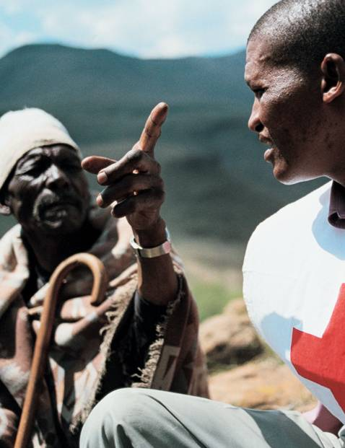
A membership organisation
189 Red Cross or Red Crescent National Societies
A secretariat that provides support to and linkages between our 189 member National Societies
International coordination services in response to large-scale disasters and health emergencies
International representation, resource mobilization and humanitarian diplomacy

Slide 28
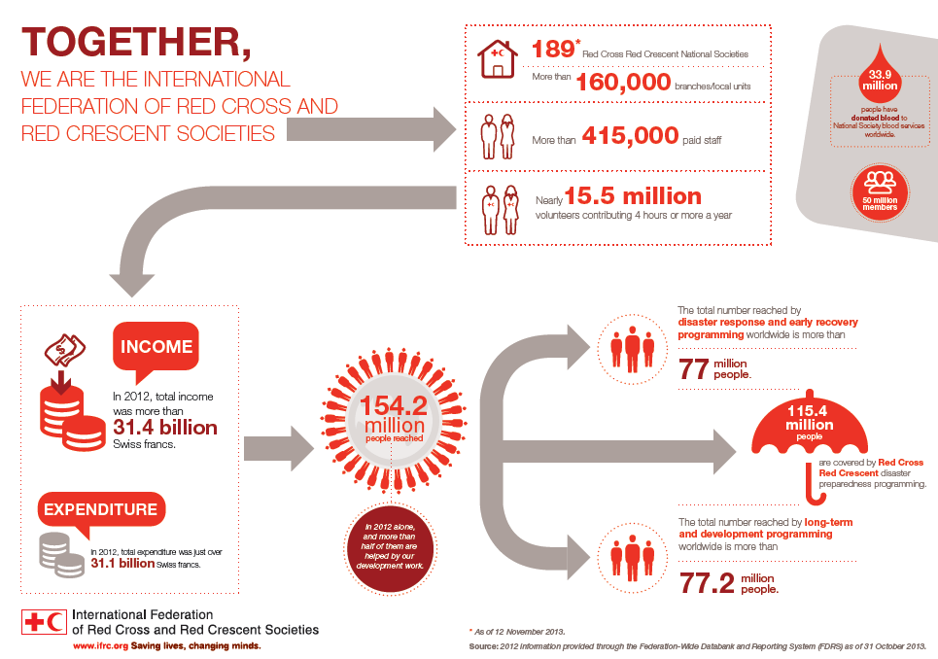
The International Federation of Red Cross and Red Crescent Societies (IFRC)

Slide 29
IFRC Governance
Sets direction, decides strategy and policy, supervises management
IFRC Management
Translates strategy and policy into cost-effective results, decides use of resources, reports to governance
President
Secretary General
Governing Board (20 members, 4 Vice Presidents,1 ex-officio)
Elect
Decide, approve
Africa
Asia Pacific
MENA
Europe
Americas
Geneva Team
General Assembly of the IFRC
Reg. office
189 NSs
Country delegation
NSS
…
NSS
Supports a NS

Slide 30
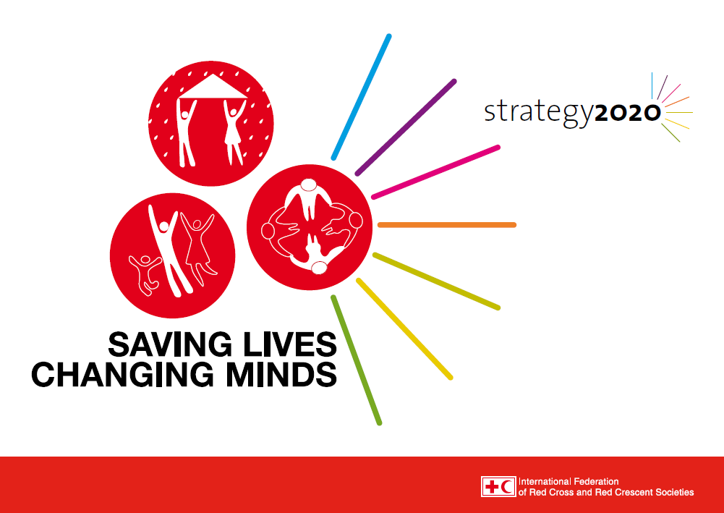
Notes:
4. About our vision
We think that the IFRC, as a whole, should set our common vision – this is taken straight from the Constitution adopted in 2007, while each National Society or RCRC centre should set its specific mission within its own context and selected priorities.

Slide 31
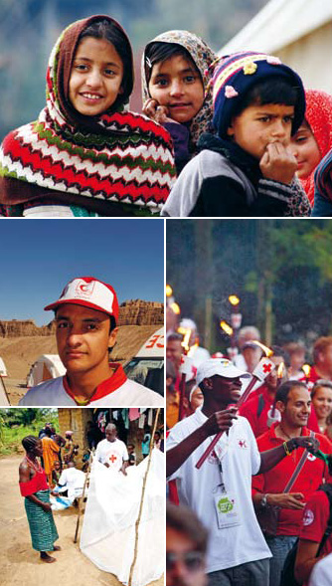
Vision 2020
To inspire, encourage, facilitate, and promote at all times all forms of humanitarian activities by National Societies, with a view to preventing and alleviating human suffering, and thereby contributing to the maintenance and promotion of human dignity and peace in the world.
(Article 4, IFRC Constitution)
Notes:
4. About our vision
We think that the IFRC, as a whole, should set our common vision – this is taken straight from the Constitution adopted in 2007, while each National Society or RCRC centre should set its specific mission within its own context and selected priorities.

Slide 32
Strategy 2020
Vision 2020
Strategic Aim 1
Save lives, protect livelihoods, and strengthen recovery from disasters and crises
Strategic Aim 2
Enable healthy
and safe living
Strategic Aim 3
Promote social inclusion and a culture of non-violence and peace
Enabling Action 2
Pursue humanitarian diplomacy to prevent and reduce vulnerability in a globalised world
Enabling Action 3
Function effectively as the IFRC
Enabling Action 1
Build strong National Red Cross and Red Crescent Societies

Slide 33
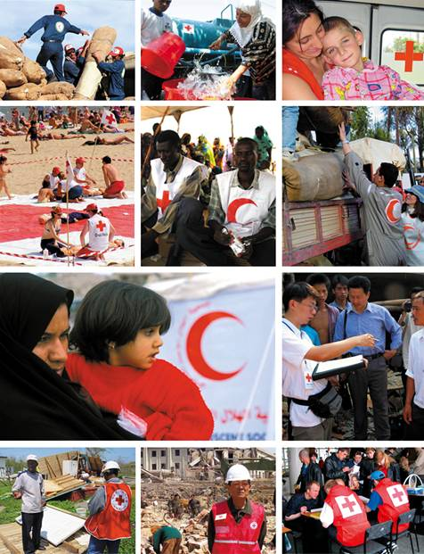
National Societies
National Societies act as auxiliaries to the public authorities of their own countries in the humanitarian field.
They provide a range of services including disaster relief, health and social programmes, and assistance to people affected
by war.
Notes:
The promotion of humanitarian values is an intrinsic part of all Red Cross and Red Crescent activities. National Societies conduct campaigns and speak on behalf of vulnerable people in their own countries. They also promote awareness of international humanitarian law and advocate internationally through the Federation and with the International Committee of the Red Cross.
National Societies build and mobilize their network of volunteers through a nationwide branch structure, which can reach communities at greatest risk. Their programmes and services address both immediate and long-term needs of the beneficiaries and include:
• emergency shelter, food and medicine
• water and sanitation
• restoring family contact for disaster victims
• disaster preparedness
• community-based health and care
• first aid training and activities
• control and prevention of diseases
• HIV/AIDS prevention and awareness
• blood donor recruitment, collection and supply
• youth and volunteer activities

Slide 34
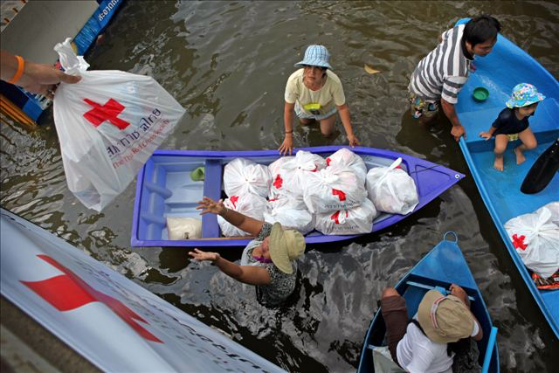
National Societies provide services like:
Disaster response and recovery –
to save lives and protect
livelihoods
Emergency shelter
Food, relief supplies and clean water
Restoring family links

Slide 35

National Societies provide services like:
Enabling healthy and
safe living
Disaster risk reduction and resilience building
Community-based health
and care
First aid training
Water, sanitation and hygiene
promotion
Climate change adaptation

Slide 36

National Societies provide services like:
Promoting social inclusion
and peace
Promotion of the practical application of the Fundamental Principles
Integration of disadvantaged people into their communities
Migrant and refugee services

Slide 37


Slide 38

Notes:
The IFRC’s zone office in Kuala Lumpur supports the humanitarian and development work of National Societies in 37 countries across the Asia Pacific region. The zone offices oversees the four regional IFRC offices based in Beijing, New Delhi, Bangkok and Suva and 14 country based offices.

Slide 39
Video where the streets have no name

Slide 40

www.ifrc.org www.icrc.org www.pmi.or.id www.standcom.ch giorgio.ferrario@ifrc.org
If you want to know more:

Slide 41
Thank you
© International Federation of Red Cross and Red Crescent Societies, Geneva, 2014.
Any part of this presentation may be cited, copied, translated into other languages or adapted to meet local needs without prior permission from the International Federation of Red Cross and Red Crescent Societies, provided that the source is clearly stated. Requests for commercial reproduction should be directed to the IFRC Secretariat at secretariat@ifrc.org
All photos used in this presentation are copyright of the IFRC unless otherwise indicated.
This presentation was written and developed by Giorgio Ferrario and produced in January 2015
Relevant resources are available on FedNet at fednet.ifrc.org
For further information, please contact giorgio.ferrario@ifrc.org

