Slide 1
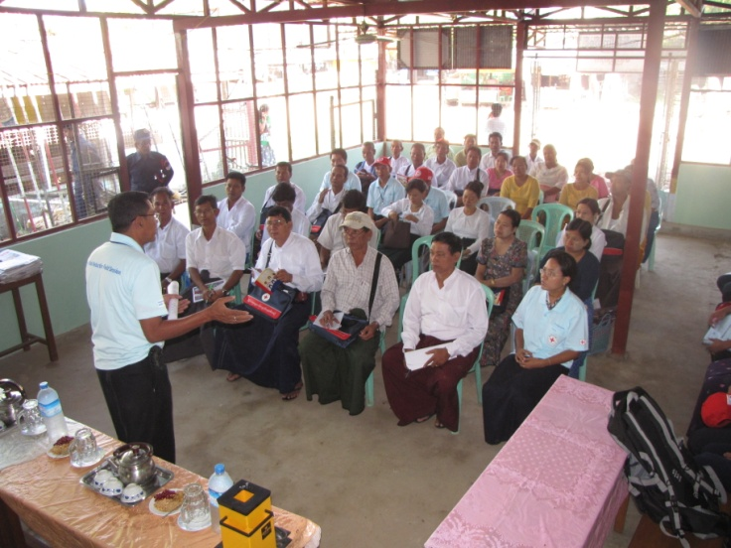
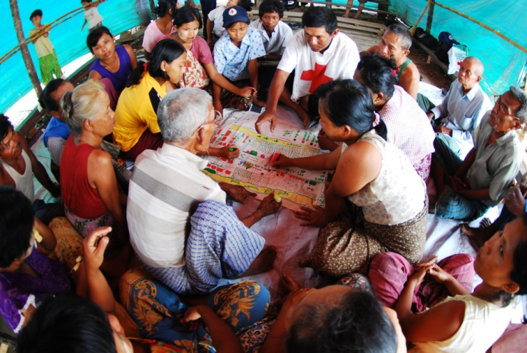
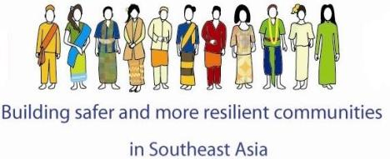
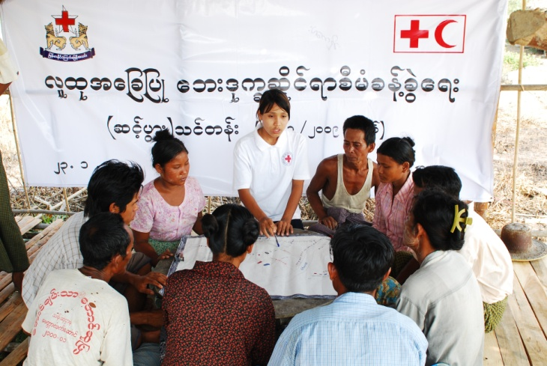
Resilience Approach

Slide 2
What is Resilience?
For the IFRC, it is defined as:
The ability of individuals, communities, organisations, or countries exposed to disasters and crises and underlying vulnerabilities to:
anticipate,
reduce the impact of,
cope with,
and recover from the effects of adversity without compromising their long-term prospects.
Photo: IFRC
Notes:
2
2

Slide 3
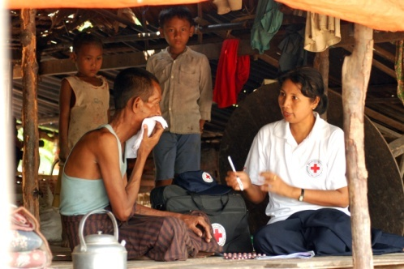
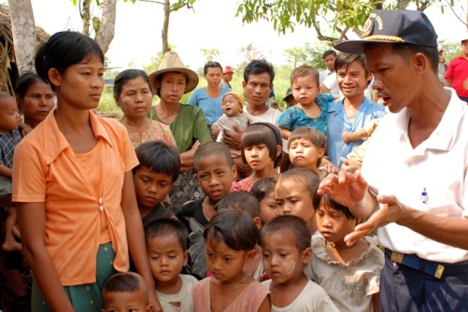
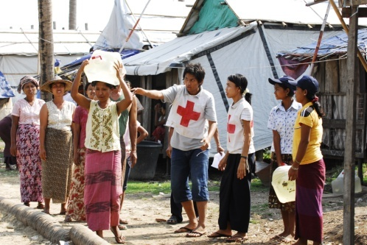
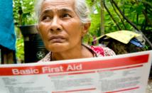
Key to resilience
PEOPLE FIRST: A people and community centred approach. We can facilitate and assist individuals and their households and communities in their own efforts to strengthening their resilience.
LOCAL OWNERSHIP: Focus on building local ownership, assets and capacity, do not foster dependency or substitution.
COMPREHENSIVE APPROACH: Understand the diverse underlying causes of vulnerability and disaster and crisis risks simultaneously. This requires holistic assessments and interventions which take into account a variety of shocks and underlying causes of vulnerability.
LONG TERM PERSPECTIVE: strengthening resilience does not happen overnight and requires long-term investment and engagement.

Slide 4
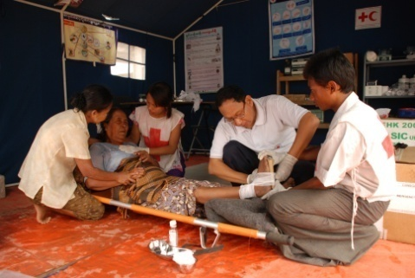
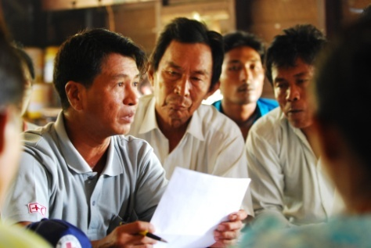
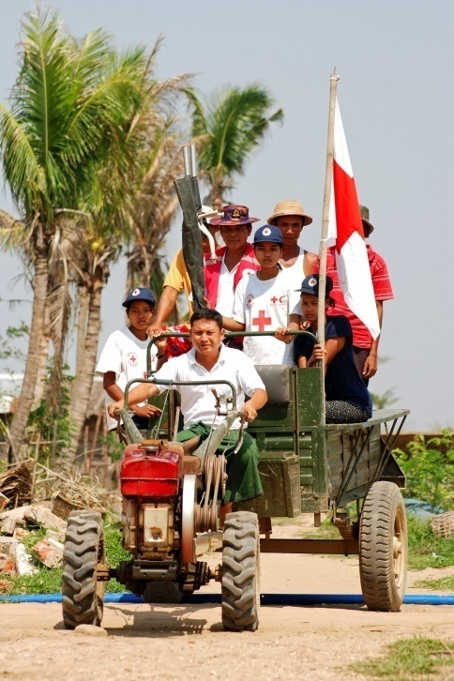
Key to Resilience
WORKING IN PARTNERSHIP: Resilient communities cannot be achieved solely with RCRC support. The RCRC needs to facilitate support from a range of stakeholders who contribute to strengthening and sustaining resilience.
KNOW THE LIMITS: Acknowledge that strengthening and sustaining resilience is not possible in all contexts at all times
STRENGTHEN LAWS AND POLICIES: Legal framework and policies on building resilience should further assist vulnerable people and communities.

Slide 5
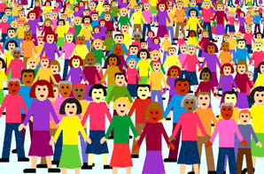
We can make a better impact if we work together at community level….?
DM
Health
Livelihood
OD
Watsan
………
Appropriate Shelter
People
Notes:
If we can find a way to plan and implement community projects together, we can make a much bigger impacts and communities can become more resilient as a result.

Slide 6
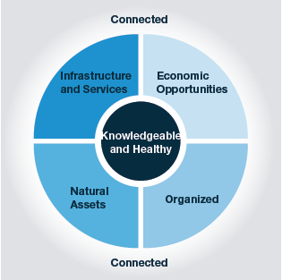
What Characteristics does a community need to have to be resilient ?
The diagram shows characteristics
of resilient communities highlighting the
fundamental importance of knowledge and health
as the foundations of resilience at an individual level.
Notes:
1. … is knowledgeable and healthy. It has the ability to assess, manage, and monitor its risks. It can learn new skills and build on past experiences.
2. …is organized. It has the capacity to identify problems, establish priorities, and act.
3. … is engaged in the development of local policy for reducing risks
4. …is connected. It has relationships with external actors, who provide a wider supportive environment, and supply goods and services when needed.
5. … has infrastructure and services. It has strong housing, transport, power, water, and sanitation systems. It has the ability to maintain, repair, and renovate them.
6. … has economic opportunities. It has a diverse range of employment opportunities, income and financial services. It is flexible, resourceful and has the capacity to accept uncertainty and respond (proactively) to change.
7. … can manage its natural assets. It recognizes their value and has the ability to protect, enhance and maintain them.
Let us now look what does a community should have to be more resilient. Research done by us has identified 7 broad characteristics that a community should have to be resilient.

Slide 7
Important to remember:
There is no community with ZERO resilience as there is no community with ABSOLUTE resilience
Resilience is not the end of the road or outcome but an ongoing PROCESS
Meeting basic needs (food, water, shelter, health) is a precondition to building resilient communities.

Slide 8
How do we operationalize it?
  Build on existing good practices/experiences
  Cross Sectoral Program Integration (CBRR, CBHFA, SBRR etc)
  Mainstreaming Cross-cutting issues into integrated Risk Reduction Programming
  Harmonization of tools (multisectoral assessment tool, integrated community based programming tool etc)

Slide 9
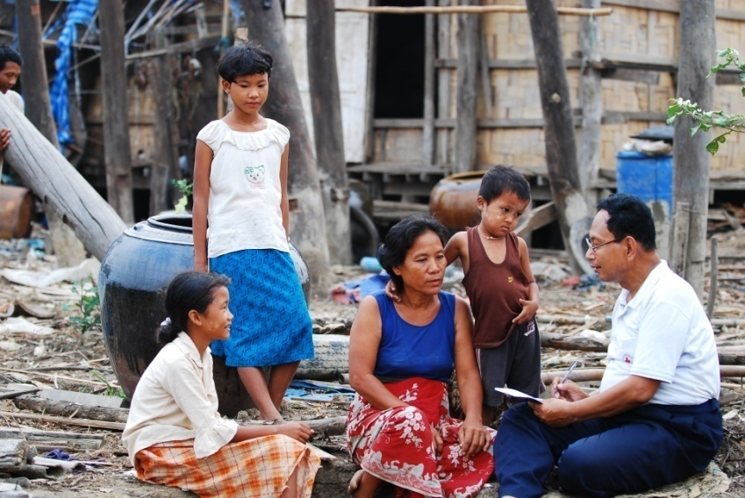
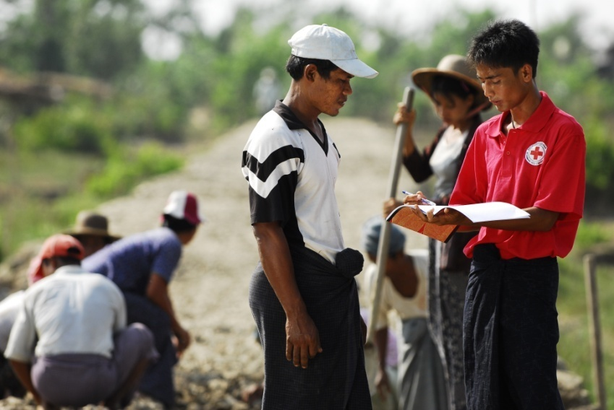
Thank You
“If we fail to prepare
We are preparing to fail”

