Slide 1
Training Skills and Adult Learning
5/10/15

Slide 2
Session Aim & Objectives
Aim: To introduce participants to how adults learn and the training cycle.
Objectives:
By the end of the session, participants will be able to:
    Articulate how adults learn and three learning styles
    Identify the four stages of the training cycle
    Formulate better training objectives

Slide 3

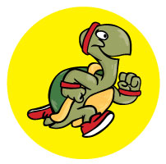

How do people learn? Learning Styles
Visual learners – see it
Kinaesthetic learners – do it
Auditory learners – hear it

Slide 4
Activity – page 3 of Handbook
Activity:
What type of learner do you think you are? Why?
Match the activities to the type of learner.
Activity | Activity
Posters Sing songs Dancing Role plays Watching a DVD Brainstorm Writing on a whiteboard | Radio interview Clay modelling Drawing Listen to music Take notes Look at a diagram Graphs Reading to the group

Slide 5
The Training Cycle
Jigsaw activity
(Divide into 4 groups)
For your part of the training cycle jigsaw:
What do you think this part of the training cycle covers?

Slide 6
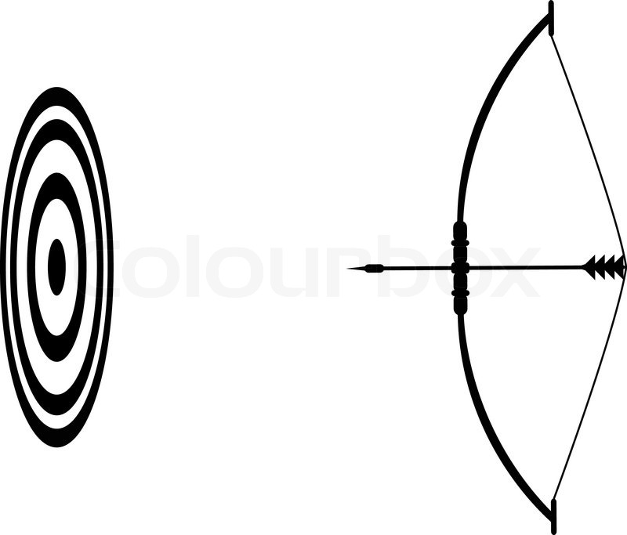

Setting Aims & Objectives

