Slide 1
Module 1: Implementing the Program
CBDRR Framework Training - Myanmar Red Cross Society
Session 1. Program Socialization

Slide 2
Session Objectives
At the end of this session, the participants will be able to
  Describe the socialization process that is carried out at the beginning of each CBDRR program

Slide 3
What is Program Socialization?
serves as an initial advocacy process to raise the awareness of the stakeholders about MRCS and its works in general and about the specific program interventions in particular
main aim: to ensure the support of the relevant authorities at that level for the particular CBDRR program that is going to be implemented in their location

Slide 4
Benefits of CBDRR Socialization
Respective authorities and Red Cross Branch personnel are informed from the outset what is to be taken place within their area
Official endorsement is obtained
Unique opportunity for analyzing existing capacities
Target community selection process is expedited
Invaluable information and nuances for potential target areas can be gathered, which assist in the selection of target community

Slide 5
Socialization Meetings at State/Regional Level
Expected output | Info to be shared | Info to be collected
Approval of state/region authorities Coordination and collaboration by state/region authorities and other partners | General information of MRCS – misson, vision, goal, objective, strategy, key areas of work, etc. Short program profile (objective, expected outcomes and outputs, target beneficiaries, time frame, detailed activities, exit strategy, M&E, etc.) | Most disaster vulnerable townships within the state/region (hazard and risk information) Existing DRR activities (by both government and non-government agencies) in the state/region DRR gaps and needs in general

Slide 6
Keep in Mind…
During the program socialization briefing meetings and orientation sessions, it is imperative to emphasize on the positive aspects of CBDRR process, focusing on both economic advantage: pro-activeness can help reduce rehabilitation and recovery costs, and life-saving properties, to gain buy-in and contribution especially of the authorities.
There is always the possibility that some delays might occur during the selection and socialization processes triggered by government red tape and bureaucratic procedures such as hold-up in issuing of official letters or postponement of program activities because of the unavailability of government officials. A potential solution is to keep the number of official meetings at a minimum.

Slide 7
Socialization Meetings at Township Level
Expected output | Info to be shared | Info to be collected
Official support of township authorities Coordination and collaboration by the township authorities and other partners | General information of the implementing agency (MRCS misson, vision, goal, objective, strategy, key areas of work, etc.) Short program profile Expected commitment from the stakeholders | DRR needs and gaps at the township level including capacity requirement of township branch Most vulnerable villages/ village tracts/ wards in the township (hazard and risk information) Number of schools located in the most vulnerable village/ village tract/ ward Contact list of community leaders/ leading community members Existing DRR activities (by both government and non-government agencies) in the township

Slide 8
Keep in Mind…
Begin prepping the local stakeholders for their ultimate expected role: to take over the management of CBDRR activities on the ground at the end of program period. The socialization meetings and sessions provide a great opportunity to acquaint the key stakeholders with roles and responsibilities they are expected to assume. It is very important to share detailed timeframe of the program activities with them so that they can prepare themselves.

Slide 9
Socialization Meetings at Village Level
Expected output | Info to be shared | Info to be collected
Official support of local authorities Coordination and close collaboration by the local authorities and other partners | General information of the implementing agency (MRCS – misson, vision, goal, objective, strategy, key areas of work, etc.) Short program profile Detailed expected commitment from the stakeholders | DRR needs and gaps on the ground Existing DRR activities (by both government and non-government agencies) in the community Contact list of community leaders/ leading community members Any other concerns with regards to poverty and environmental issues

Slide 10
Keep in Mind…
As a reference, you can consult the ‘Village Level Advocacy Guidelines’ prepared and published by MRCS for the socialization process.
Socialization events at the community level (village/ ward or school) need to make sure the most vulnerable groups are included in process. Hence, the envoys of groups or associations representing the most vulnerable population (women, aged, physically challenged, PwDs, ethnic minorities, and children) should be unequivocally invited to the orientation sessions.

Slide 11
Socialization Meetings at School Level
Expected output | Info to be shared | Info to be collected
Official support and coordination/ collaboration of school authorities | General information of the implementing agency (MRCS misson, vision, goal, objective, strategy, key areas of work, etc.) Short program profile Detailed expected commitment from the stakeholders | DRR needs and gaps Potential human resources (students, teachers)
Especially in schools, it is important to get the support of parents during the socialization meetings. It should be ensured that parents know about the upcoming program activities and are engaged in the planning and implementation phase to ensure that

Slide 12

Any Questions?

Slide 13
Module 2: Implementing the Program
CBDRR Framework Training - Myanmar Red Cross Society
Session 2. Program Site Selection

Slide 14
Session Objectives
At the end of this session, the participants will be able to
  Understand the process of selecting the target community using suitable criteria at different levels: state/region, township and village/ village tract/ ward.
  Describe the main linkage between the socialization process and the program site selection process.

Slide 15
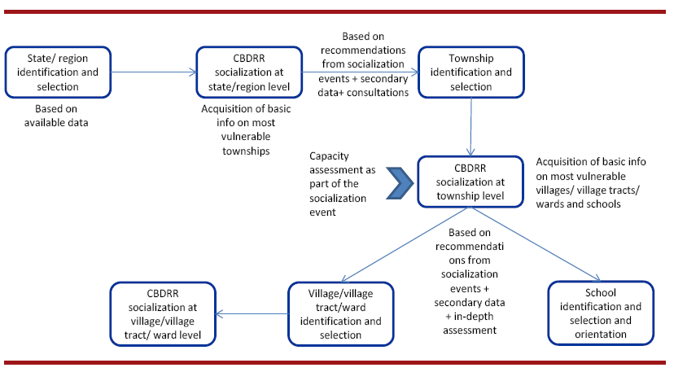
Linkages between Socialization and Selection Process

Slide 16
Keep in Mind…
1. In selecting the most vulnerable community, there needs to be general consensus among the responsible parties.
2. Community selection process, first and foremost, has to be impartial: solely placing the evaluation and conclusion on risk and vulnerability factors, and transparent so that no illicit activities or favouritism are involved.
3. There are always multiple-stakeholders in any development or DRR program. When negotiating access to the communities, it is important to know the interests of the various stakeholders so as to maintain independence and neutrality with the organizations represented (ADPC, 2004).

Slide 17
Group Exercise – Role Play

Slide 18
Any Questions?

Slide 19
Module 2: Implementing the Program
CBDRR Framework Training - Myanmar Red Cross Society
Session 3. Mobilizing the Community and RCVs

Slide 20
Session Objectives
At the end of this session, the participants will be able to
  Understand the benefits of community mobilization function.
  Mobilize the community by organizing them into functional entity like disaster management committees
  Identify capacity building needs of the newly formed disaster management committees and design and deliver the appropriate training activities.

Slide 21
What is Community Mobilization?
MRCS’ Definition
Organizing key stakeholders on the ground such as RCVs, community members, teachers and students in such a way that they are actively involved in assessing their own risks and capacities, planning and implementation of the risk reduction measures along with key program personnel and authorities at different levels. Functional groups can be formed, under the umbrella of village/ township disaster management committee, each assigned specific area of tasks such as relief, search and rescue, awareness, preparedness, early warning, mitigation, preparedness, etc.

Slide 22
Why is Community Mobilization Important?
Motivates the community
Builds capacities
Raises awareness
Promotes good leadership
Creates new generations of DRR communicators and practitioners
Building trust and rapport is the key to facilitate community participation

Slide 23
Key CBDRR Stakeholders at Community Level
Village leader
School teacher
Local business leader
Elderly
Students
Single mother
Monk
…….

Slide 24
Establishment of DMCs in the Community
Available resources
Existence of community level structure
Opinions of the community

Slide 25
Using Existing Institutions/Groups
Advantages | Disadvantages
Avoidance of delays in start-up Group cohesion Trust Altruism | Inflexibility Dependence on incentives Dysfunctional structure Unequal structures

Slide 26
Formation of VDMC
1. Situation Analysis
Examine the various organizational arrangements & leaderships structures
2. Development of ToR
3. Selection of DMC Members
4. Confirmation of Members
5. Orienting the VDMC on the ToR
6. Informing the Community
Comprises program profile & duties and responsibilities of the DMC members
Number and composition of members are determined by the nature of the program, the available resources as well as the already existing committees
DMC members need to confirm their participation in the DMC
Orientation meeting for all VDMC members
Selection of chair, co-chair, secretariat
Official introduction of the VDMC to the community

Slide 27
Key Characteristics of a Functional DMC
Members agree on common goals and objectives
Members should include representatives of most vulnerable groups
Elected officers and committees/task forces/working groups formed perform disaster risk management functions
Members of the community-based organizations have agreed on the CBDRR Plan, policies and procedures
Have agreed on how to pool resources for preparedness and mitigation activities
Have identified and networked with government and non-government agencies to tap financial and technical supports
Well informed about developments affecting the community
Commitment and leadership in mobilizing the community-at large in implementation of the Plan

Slide 28
Formation of a SDMC
Consultations with target school authorities
Identification of potential members of the SDMC
Confirmation of nominated members
Official acceptance of SDMC membership
Announcement of SDMC
SDMC members are introduced to school as well as community

Slide 29
Capacity Building for CBDRR
Capacity building at this stage focuses mainly on improving the CBDRR knowledge and know-how of the DMCs as well as the RCVs in the target communities and schools.

Slide 30
TNA Activities
TNA
Distinguishing what DRR related trainings have been offered in the target area
Organizing consultation meetings with key target recipients
Creating catalogue of trainings to be provided
Developing a training calendar

Slide 31
Group Exercise
Based on your experience from the field what are the two most important characteristics of a DMC?
2. What kind of training is most important to ensure a functional DMC?
3. What challenges do you face in organizing the trainings, and what are the solutions?

Slide 32
Any Questions?

Slide 33
Module 2: Implementing the Program
CBDRR Framework Training - Myanmar Red Cross Society
Session 4. Identification of Community Needs

Slide 34
Session Objectives
At the end of this session, the participants will be able to:
  Understand the key activities to be carried out in identifying the community DRR needs
  Explain different assessment tools
  Determine which assessment tool can be employed in which assessment to ensure the optimum results
  Undertake Multi-Sector Assessment to determine the community disaster risk reduction needs

Slide 35
What is a Multi-Sector Assessment?
A Multi-Sector Assessment takes the form of a participatory vulnerability and capacity assessment with the involvement of Red Cross volunteers (RCV), community members and the government representatives from the existing disaster management entities at the local level (from various related departments and sectors) within the target program area.

Slide 36
Establish and Train a MSA Team
Provides an opportunity for the program team to involve more community members into the planning and implementation of the program
Before the process is started, it has to be ensured that the DMCs as well as local authorities are informed about the plans

Slide 37
Establish & Train a MSA Team - Process
Development of information package
Information on specific objectives, timeframe, required data, focal persons, tasks involved, resources needed
Engaging VDMC
Solicit the involvement of VDMC in MSA exercise
Approval from local authorities
Approval and commitment should be obtained with the support of the VDMC
Formation of MSA Team
Mixture of RCVs, community members, VDMC members & subject specialists
Training the MSA team
Field Session including field exercise to gather data

Slide 38
Conducting the Multi-Sector Assessment
To simplify data collection, the MSA team could be divided into different groups
A variety of sources should be used in collecting the information to ensure varied views and opinions are captured
Before the data collection, a Field Plan of Action should be prepared that describes all activities during the assessment

Slide 39
Keep in Mind…
The target community need to be informed from the outset the expected immediate results so that no false hopes are created as they might think this assessment may help solve all the problems.
For facilitators it is important to stress that their role is to urge and motivate the community participants to talk, discuss and identify their own problems and not to assert their wills.

Slide 40
Possible Assessment Tools
Risk mapping
Seasonal calendar
Historical profile
Focus group discussions
Transect walk
Observation
Ranking

Slide 41
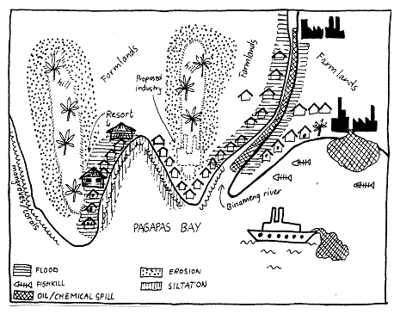
Risk Mapping
WHAT: Make spatial overview of the area’s main features

Slide 42
Risk Mapping cont’d
WHY: Maps facilitate communication and stimulate discussions on important issues in the community. Maps can be drawn for many topics:
  Spatial arrangement of houses, fields, roads, rivers, and other land uses
  Hazard map,
  Elements at Risk (vulnerability)
  Resource map showing local capacities
  Mobility map
WHEN: In initial phase of community risk assessment
WHO: Community members
HOW: 1. Decide about the type of map to be drawn
2. Find men, women who know the area, and willing to share experiences
3. Choose a suitable place (ground, floor, paper) and medium (stick, stones, seeds, pencils, chalk) for the map
4. Help the people get started but let them draw the map by themselves
5. Use questions to facilitate development of map

Slide 43
Seasonal Calendar
WHAT: Making a calendar showing different events, experiences, activities, conditions throughout the annual cycle

Slide 44
Seasonal Calendar
WHY:
Identify periods of stress, hazards, diseases, hunger, vulnerability, etc.
Identify what people do in these periods, how they diversify sources of livelihood, when do they have savings, when do they have time for community activities, what are their coping strategies;
Identify gender specific division of work, in times of disasters and in normal times
WHO: Team and community members; have separate sessions for men and women

Slide 45
Seasonal Calendar
HOW:
1) Use ‘blackboard’ or craft paper, mark off the months of the year on the horizontal axis. Ask people to list sources of livelihood, events, conditions, etc., and arrange these along the vertical axis.
2) Ask people to enumerate all the work they do (e.g. Ploughing, planting, weeding, etc.) for each source of livelihood / income by marking months and duration, adding gender and age.
3) Facilitate analysis by linking the different aspects of the calendar: how do disasters affect sources of livelihood? when is workload heaviest? Ask for seasonal food intake; period of food shortage, out-migration, etc.
4) You can continue the discussion on coping strategies, change in gender roles and responsibilities during times of disasters, or other issues you think are relevant.

Slide 46
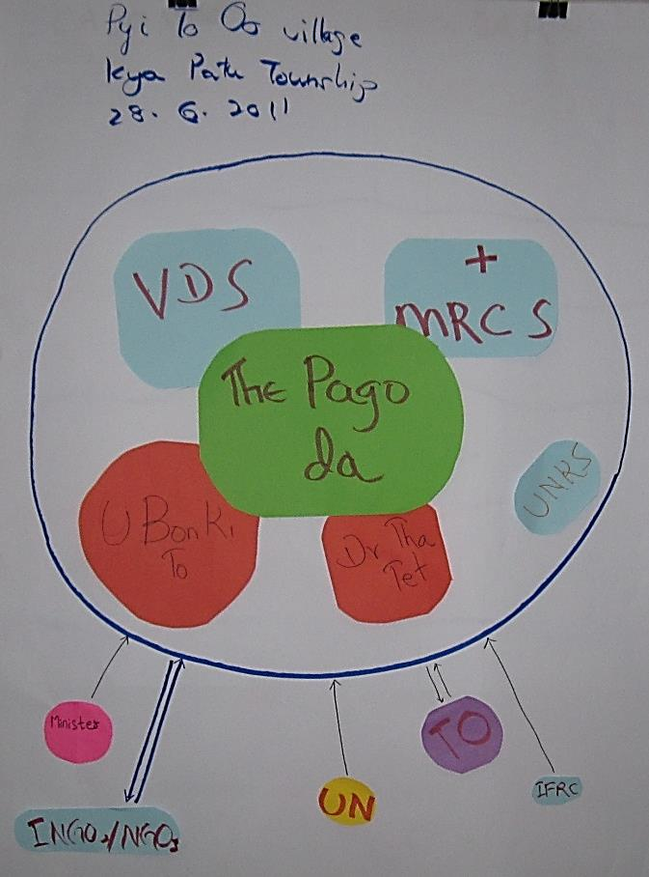
Institutional & Social Network Analysis Through Venn Diagram
WHAT:
Making a diagram that shows key-organizations,
groups and individuals in a community & nature
of relationship and level of importance
WHY:
Identify organizations (local & outside), their role/importance, and perceptions that people
have about them;
Identify stakeholders in community-based
disaster risk management
WHO:
Team and community members

Slide 47
Institutional & Social Network Analysis
HOW:
Know in advance, names of organizations
Ask group to determine criteria for importance of an organization or individual
Ask group about level & type of linkages amongst organizations
Draw circles to represent each institution, group or individual.
Distance & overlap shows level of interaction amongst
organizations
Continue discussion by asking questions on:
- history
- actions taken by organization
- coordination amongst them
- people’s perception of organizations
- which one can be relied upon during disasters.

Slide 48
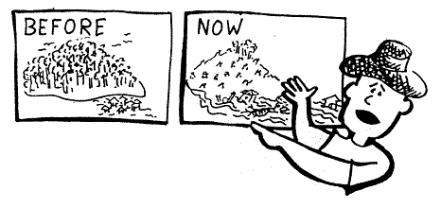
Historical Profile
WHAT:
Gathering information about what happened in the past
WHY:
To get insight in past hazards,
changes in their nature, intensity and behavior;
Understand present situation in community (causal link) between hazards and vulnerabilities;
To make-people aware of changes
WHEN:
In initial phase

Slide 49
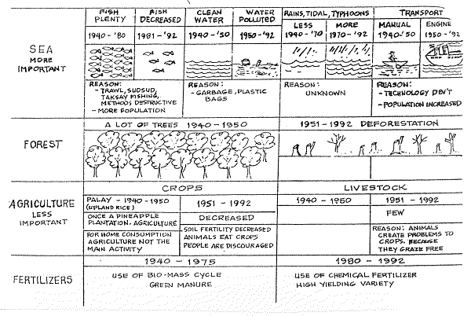
Historical Profile

Slide 50
Historical Profile
HOW:
Plan a group discussion and ensure that key-informants (old people, leaders, teachers) are present. Invite as much people as possible, especially the young ones,
for them to hear the history of their community
2) Ask people if they can recall major events in the community, such as:
    Major hazards and their effects
    Changes in land use (crops, forest cover, etc.)
    Changes in land tenure
    Changes in food security and nutrition
    Changes in administration and organization
    Major political events

Slide 51
Historical Profile
The facilitator can write the stories down on
a blackboard or craft paper in chronological order
Life Histories: another method is to ask individual informants to give a detailed account of their life or regarding a specific issue from a historical perspective
History Tracing: asking individuals or group to begin with current experiences and to go back in time. Purpose to find reasons / causes which contributed to the occurrence of the certain experience.

Slide 52
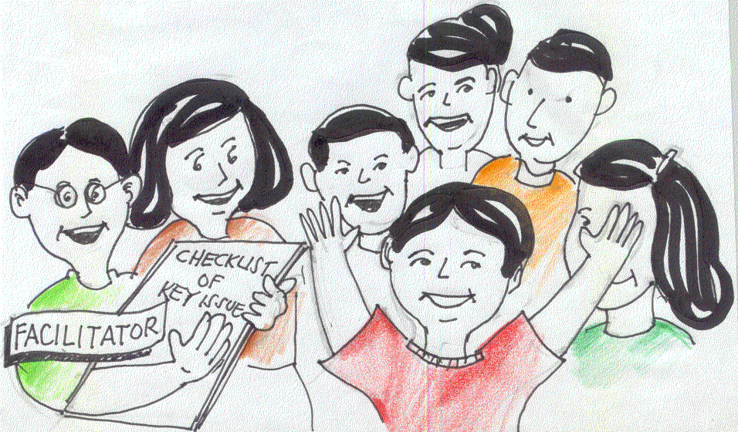
Semi-structured Interviews (SSI)
WHAT: SSI are discussions in an informal and conversational way. SSI do not use formal questionnaire but at the most a checklist of questions as a flexible guide. There are different type of SSI:
1) Group Interview
2) Focus Group Discussion
3) Individual Interview
4) Key Informant Interview
WHY: To get info (general and specific), to analyze problems, vulnerabilities, capacities and perceptions, to discuss plans

Slide 53
Semi-structured Interviews (SSI)
Group Interview: to obtain community level information, to have access to a large body of knowledge, not useful for sensitive issues
Individual Interview: to obtain representative, personal info. May reveal differences/ conflicts within community
Key-Informant Interview: to obtain special knowledge about a particular topic; you interview a nurse if you want to know more about epidemics, a farmer about cropping practices, a village leader about procedures and policies.
Focus Group Discussion: to discuss specific topics in detail with a small group of persons who are knowledgeable or who are interested to in topic. People can also be grouped according to gender, age, owners of resources

Slide 54
Semi-structured Interviews (SSI)
WHO:
Team of 2-4 people
HOW:
Prepare key issues in advance
Select one person to lead the interview
Ask questions in an open-ended way (what, why, who, when, how, how do you mean, anything else?)
Ask for concrete information and examples
Try to involve different people (if present)
Pay attention to group dynamics
Ask new (lines) of questions, arising from answer given
Make notes in a discreet way

Slide 55
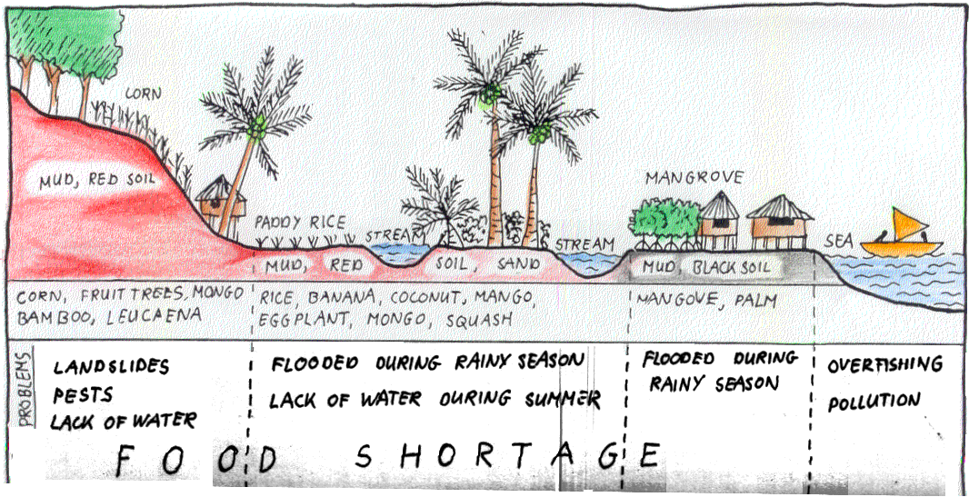
Transect Walk

Slide 56
Transect Walk
WHAT:
Systematic walk with key-informants through
the community to explore spatial differences
or land use zones by observing, asking,
Listening & producing a transect diagram
WHY:
Visualizes interactions between physical
environment & human activities over
space & time;
Identifies danger zones, evacuation sites,
local resources used during emergency
periods, land use zones, etc.;
3) Seeks problems and opportunities

Slide 57
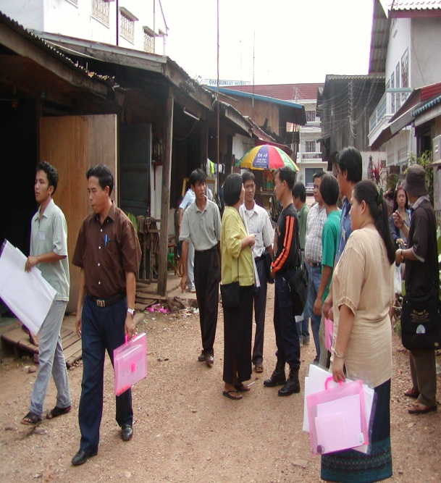
Direct Observation
WHAT:
Systematically observing objects, people,
events, relationships, participation, and
recording these observations.
WHY:
To get a better picture of the situation,
especially of things that are difficult to verbalize
To cross-check verbal information. Observations
are analyzed afterwards, women participate in
community meetings
WHO: Everybody
HOW: Think about the purpose of why you are in the community,
and identify indicators, which you can assess through direct
observation these will make up your checklist

Slide 58
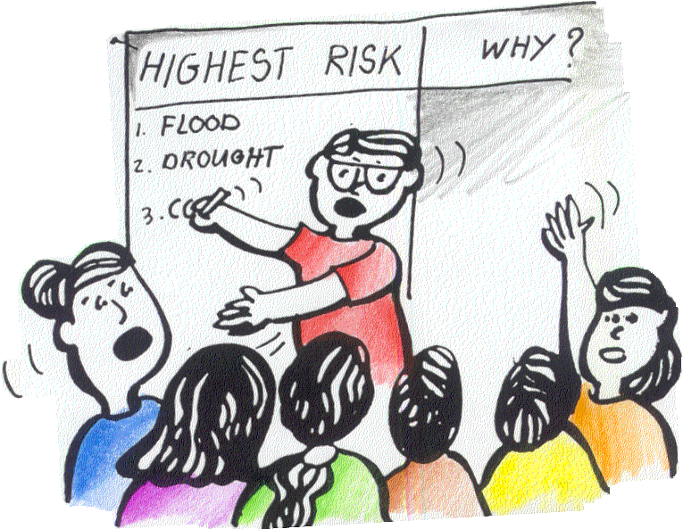
Ranking
WHAT:
Tool to facilitate prioritizing issues & concerns
WHY:
Problems, risks, solutions concerns might
not be common for the entire community.
Perceptions differ according to class,
gender religion, ethnicity, etc.
WHO:
Team facilitates community meeting (ranking can be done in sub-groups)

Slide 59
Ranking
HOW:
  Criteria or characteristics for comparing items are listed by the community members
  Criteria used are put on one side of the matrix or table (y-axis)
  Items being compared are put on the x-axis
  Points are given by putting stones, seeds, etc.

Slide 60
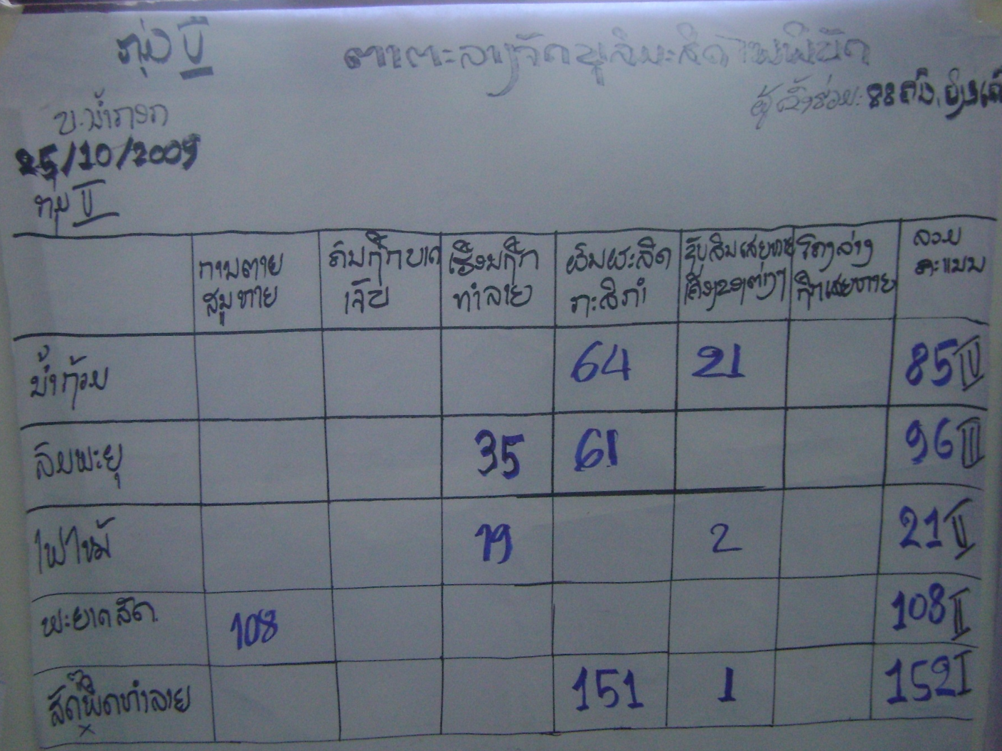
Table of Ranking Disasters
Group members: 88
Affected House
Agr. Products
Asset Loss
Affected Infra.
Dead/Loss
Injured
TOTAL
Flood
Storm
Fire
Disease
Pest
Group members given 5 stones each and asked to place in the table, according to their concerns.

Slide 61
Analysis of Assessment Findings
Collate and cross-check data at the end of each assessment day!
Systematize all data (hazards/threats, risks/impacts, elements at risk, vulnerability and capacity)
Identify a problem statement
Identify indirect and root causes
Develop a problem tree and transform it into an objective tree
Identify possible interventions to reach the objectives

Slide 62
Presentation of Assessment Findings
The findings can best be presented in the combination of the following three formats:
  Final assessment narrative report
  Risk maps
  Tabular arrangements
All reports need to be shared with the community for verification purposes as well as to maintain their interest

Slide 63
Exercise: Getting Everybody’s Views
What kind of information can be collected from that person?
How do you make sure that this person is included in the MSA process?

Slide 64
Any Questions?

Slide 65
Module 2: Implementing the Program
CBDRR Framework Training - Myanmar Red Cross Society
Session 5. Action Plan Development

Slide 66
Session Objectives
At the end of this session, the participants will be able to
  Oversee the development of community-based disaster risk reduction plans based on the results of the MSA
  Employ participatory planning approach in formulating the essential risk reduction measures

Slide 67
Community Action Plan
Starts with the desire to create a safer environment for the family and individuals living in it
Based on the problems and objectives identified in the MSA
Road map for the community to achieve more resilience and to sustain development accomplishments

Slide 68
Key Aspects in Community Action Planning
Purpose of plan needs to be clear
Resources and time to carry out the plan need to be available
Technical support and expertise should be in place
Involvement of stakeholders (men, women, boys, girls, elderly and people with disability)

Slide 69
Process of Participatory Action Planning
Engaging the community in the action planning process
Formulation of objectives of the plan
Formation of sub-teams/groups
Devising of risk reduction measures
Determination of required resources
Assigning roles & responsibilities
Finalizing the plan
Defining the timeline
Development of operational procedures
Identification of opposing elements

Slide 70
Engaging the Community in the Action Planning Process
Who should be involved in making the community action plan?
  Influential people from all groups affected
  People directly involved in the problem or issue
  Members of grassroot organizations or NGOs working in the community
  Members of ethnic and cultural groups of the community

Slide 71
Engaging the Community in Action Planning Process
Throughout the entire planning process, it needs to make sure that the local authorities’ involvement is encouraged through constant information sharing and consultation, who in turn can help lobby for greater community engagement and resource commitment.
Similarly, the community should also be kept informed of the progress in the planning process.
To keep the interests of the community going strong, the planning consultative meetings should be made lively with social activities.

Slide 72
Formulation of Action Plan Objectives
Objectives should be based on the MSA
Should reflect the aspirations of the community
Community representatives should be involved in the process

Slide 73
Formation of Sub-Teams
Involved stakeholders could be divided in different teams (e.g. preparedness & mitigation, relief & response, recovery & rehabilitation, shelter, health care, psychosocial support, M&E)
DMC should be in charge of overall implementation process

Slide 74
Devising of Risk Reduction Measures
The community action plan should contain measures on how the community can:
  Avoid loss rather than replace loss
  Avoid local dislocation
  Protect assets of households, community, government
  Protect community safety nets & equity of access to support
  Ensure the needs of vulnerable people are adequately addressed

Slide 75
Keep in Mind…
A common pitfall many community action plan face is the lack of or poorly planned M&E procedures and its supporting budget. As one of the key activities to ensure the successful realization of the action plan, M&E should be prominently featured in the list of activities with its own timeframe and adequate budget.
Subject specialists of cross cutting issues such as climate change and environmental management need to be consulted as well to ensure the planned activities cover these topics as well.

Slide 76
Determination of Required Resources
For all planned activities the required resources needs to be determined:
  Estimated budget
  Resources available in the community
  Resources available at local level
  Resources that could be requested to the program
  Additional resources that need to be requested from outside

Slide 77
Finalizing the Plan
Identify a lead person/group for each activity
Prepare a time-line/implementation schedule for each activity
Development operational procedures and policies
Identification of possible challenges
Finalize the plan and share it with all stakeholders

Slide 78
Key Components of a DRR Action Plan
Objectives & targets of the action plan
Validity
Description of key agency responsible for AP
Brief description of the community
Community disaster situation
Strategies & activities for risk reduction
Roles & responsibilities
Schedule of activities
Review and upate of the plan
Contact numbers
Annexes

Slide 79
Important Aspects
Final plan has to be updated regularly and shared with local authorities and community members
There should be a strong linkage between the school-based action planning and the community-based action planning

Slide 80
Any Questions?

Slide 81
Module 2: Implementing the Program
CBDRR Framework Training - Myanmar Red Cross Society
Session 6. Implementation of Action Plans

Slide 82
Session Objectives
At the end of this session, the participants will be able to
  Describe the guiding principles behind the participatory implementation process.
  Manage the implementation of the developed community action plan with the involvement of all stakeholders.
  Identify and mobilize resources as and when necessary.

Slide 83

Guiding Principles for a Participatory Implementation Process
Participation of all stakeholders
Dialogue among stakeholders
Sequential process
Cyclic process
Systematic analysis
Cross-cultural sensitivity
Transparency
Consensus orientation

Slide 84
Benefits of Participatory Implementation
increases the prospect of success and sustainability of risk reduction measures in the community;
help build self-reliance and overall risk reduction capacities of the community stakeholders;
enable the community to learn to manage resources and time constraints and to mobilize addition resources when needs arise;
create a platform for all stakeholders; and
lead to greater tolerance and harmonization among different social groups, providing them a united front to counter the negative impacts of disasters.

Slide 85
Participatory Implementation Activities
Assignment of Tasks
Mobiliza-tion of Resources
Implemen-tation of Activities
Capacity Building
M&E
Formulation of Corrective Actions

Slide 86
Assignment of Tasks
Each of the sub-groups established in the last step have to assign the respective tasks among themselves
  Leadership
  Management
  Technical support
  Financial management
  Administration
  Social mobilization

Slide 87
Capacity Building
Need for specific technical skills for action plan implementation
If the program has limited resources or timeframe, partner agencies should be approached and request for assistance

Slide 88
Example Trainings
Type of training | Disaster preparedness and response | Disaster risk reduction | Organizational management & development
Training courses that can be offered again as ‘Refresher Course’ | Search and rescue Medical first aid Relief coordination, distribution Emergency shelter management Evacuation management | Orientation on disaster reduction Risk communication (awareness raising) Early warning systems Structural mitigation Livelihood sustainability | Leadership (facilitation) Negotiation, conflict management and resolution Community mobilization Budgeting and financial management Proposal and report writing Facilitating a meeting or training Documentation
Subject specific new courses |  | Disaster risk reduction and education Disaster risk reduction and health Water and sanitation Climate change Environmental management Gender and disaster risk reduction | Resource mobilization Coordination Monitoring and evaluation

Slide 89
Mobilization of Resources
4 different kinds of resources
  Those available in the community
  Those available at local level
  Those that could be requested to the program
  Those that need to be obtained from outside the program
DMC needs to organize meeting with respective stakeholders to discuss resources

Slide 90
Mobilization of Resources – cont’d
Make an inventory of the local and community resources
People (skills, time, materials, labor or cash)
Organizations (list of organizations and purpose, resources and activities)
Informal Social Networks and Communications (learning about important developments in the community)
Local Institutions (NGOs, businesses, schools, health centers, etc).
Local government (Government legislation, policies and programs that cover the objectives and activities of Action Plan)

Slide 91
Mobilization of Resources – cont’d
2. Establish resource requirements to implement Action Plan
SN | List of resources | List of activities
 |  | Pre-Disaster | Emergency phase | Post disaster risk reduction phase
1 | Human/manpower, labor
2 | Skills, knowledge, technology
3 | Materials and supplies: first aid kits, megaphone, cement, stones, seedlings,
4 | Equipment: communications & transportation
5 | Facilities: warehouse or go down, evacuation center or shelter, bridge etc
6 | Organization and leadership
7 | Financial resources

Slide 92
Mobilization of Resources – cont’d
3. Compare Existing Resources with Resource Requirements in Action Plan
Identifying resource gaps
Identify who owns or control resources
Availability for the community’s particular risk reduction activities at pre-disaster, emergency, and post disaster phase
4. Use the Resource Analysis Matrix or Table
Planned CBDRR Measures/Activities | Resources needed | Existing resources | Resource gap
1.
2.
3.
4.
Table-1: Resource Analysis Matrix
92

Slide 93
Mobilization of Resources – cont’d
Key Risk Reduction Measures/ Activities | Resources needed | Time when needed | Existing Resources & Location/ Ownership/ Control |  | Actions needed to make existing resources accessible. | How long will it take to make these available?
 |  |  | Accessible | Not Accessible & why
1.
2.
3.
4.
Table-2: Detail of Resource Analysis Matrix
93

Slide 94
Implementation of Planned Activities
Activities that have been proposed in the community are finally put into action!
Implementation schedule?
Roles of participating agencies?
Beneficary participation?
Incentive and reward system?
Financial tracking system?
Coordination and communication system?
Standard operating procedures and policies?
M&E system?
Reporting system?

Slide 95
Examples of Implementation Problems
Poor scheduling of programs
Misallocation of funds
Lack of accountability and transparency
Bureaucracy in decision-making
Weak monitoring and evaluation
Lack of team work
Lack of incentives for implementers

Slide 96
Keep in Mind…
There has to exist some flexibility in allowing fundamental changes as and when required based on the changing needs on the ground
Community organizing techniques need to consider the cultural and religious contexts of the groups and only the methods acceptable to the community should be applied
In schools, parents should be invited to be active partners in the implementation of school risk reduction plans
In dealing with multiple stakeholders, transparency is one key element that could prevent conflicts

Slide 97
Participatory M&E
A process of self-assessment, knowledge generation and collective action in which stakeholders in a program collaboratively define the evaluation issues, collect and analyze data, and take action as a result of what they learned through this process.

Slide 98
Principles of Participatory M&E
Participation
Learning
Negotiation
Flexibility

Slide 99
PME in Practice
A M&E framework should be in place from the very beginning of an intervention and should include:
  A log-frame
  A draft schedule for periodic review
  Manpower
  Key aspects to be considered
  Final proposed format of the report
Process monitoring vs. Effect monitoring
M&E can be done for the whole program in the same way as it is done for the DRR Action Plan

Slide 100
Formulation of Indicators
Indicators serve as benchmarks or measurement tools against progress and effectiveness of interventions
Process indicators (inputs & outputs) and effect indicators (outcomes)
Indicators should be linked to overall M&E indicators of the program

Slide 101
Determining the Methodology
What methods will be used to gather the information, who will do it and when will it be done?
  Example tools: structured surveys, review of existing records, in-depth interviews, community meetings, focus group discussions, direct observations
Who will do it?
  Depending on the kind of M&E the DMC, the program team or external evaluation teams
When will it be done?
  M&E cycles should coincide with program reporting timetable to save resources and time

Slide 102
Selecting Analysis Tools & Reporting Format
At community level, simple and descriptive summaries of changes are sufficient while more sophisticated statistical analysis should be carried out during the overall M&E of the program
M&E reports are normally internal reports, but at community level they should be shared with all concerned stakeholders
Emphasis of the report should be on the progress made under the community action plan
The reports have to be clear, concise and conclusions easily comprehensible for use by the program coordinator, concerned officials at the headquarters level and other stakeholders including local government officials and community members to make necessary decisions. It should also avoid using too many technical jargons.

Slide 103
Realizing the PME
PME plan needs to be employed in cyclic pattern of periodic data collection, analysis and report preparation
Information sharing is of utmost importance
M&E should be matched with regular reporting schedule
1. Regular information sharing is the key in PME
2.Ensure greater participation of the most vulnerable groups in the PME through use of unconventional means of communication

Slide 104
Formulation and Implementation of Corrective Actions
Based on findings of the PME reports, adjustments may be required in different aspects of the program: performance, operational procedures, activities, objectives, timeframes, etc.

Slide 105
Any Questions?

