Slide 1
Module 1: Understanding the Basics
CBDRR Framework Training - Myanmar Red Cross Society
Session 1. Introduction to the CBDRR Manual

Slide 2
Session Objectives
To familiarize the participants with the CBDRR Manual

Slide 3
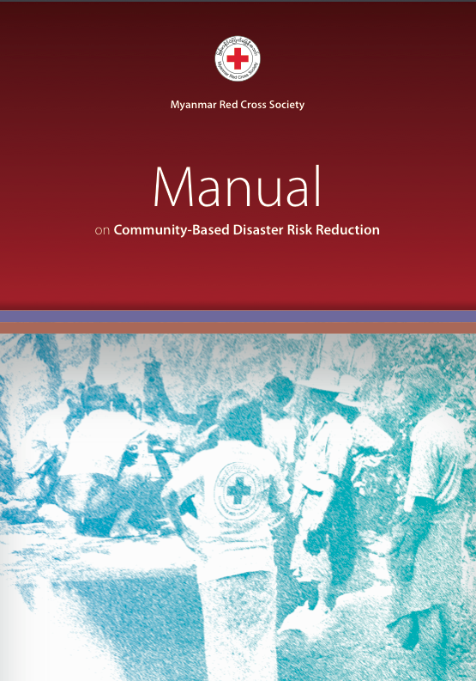

Slide 4
What is the CBDRR Manual?
The CBDRR Manual is a practical how-to-guide for Red Cross Volunteers trained in CBDRR, MRCS programstaff as well as any other CBDRR practitioner in Myanmar. Together with the CBDRR Awareness Tool Box, the CBDRR Manual provides guidance and support to the implementation of community-based programs in Myanmar by explaining each of the implementation steps as well as the tools used.

Slide 5
Icons used in the CBDRR Manual
Checklist
A set of statements that need to be re-evaluated by the CBDRR practitioner to assure adherence to the procedures, rules, benchmarks and requirements under each step of the CBDRR process. They needed to be referred to from time to time to guarantee completeness and consistency.
Example Step 2: Program Site Selection
Selection criteria have been chosen and agreed upon
Data has been collected from different sources and organized in a systematical way
A shortlist of possible state/regions has been prepared and validated by MRCS governance
State/region RCEC have been consulted and an informed decision about the program state/region has been made based on the consultation meetings as well as the selection criteria defined earlier

Slide 6
Icons used in the CBDRR Manual
Challenges
that are likely to be faced when implementing CBDRR programs. By paying attention to the information next to this icon, CBDRR practitioners will be able to prepare themselves for certain challenges in the field and come up with counter measures.
Example Step 2: Program Site Selection
There is always the possibility that some delays might occur during the selection processes.

Slide 7
Icons used in the CBDRR Manual
Attention
The points to ponder raise attention to aspects that should be included in the program planning to ensure that the program can be successful implemented.
Example Step 1: Program Socialization
During the program socialization briefing meetings and orientation sessions, it is imperative to emphasize on the positive aspects of CBDRR process, focusing on both economic advantage: pro-activeness can help reduce rehabilitation and recovery costs, and life-saving properties, to gain buy-in and contribution especially of the authorities

Slide 8
Icons used in the CBDRR Manual
Additional References
Reference materials that could be consulted for more in-depth information.
Check Information
Information has already been given in a different part of the CBDRR Manual.

Slide 9
Cross-Cutting Issues

Slide 10
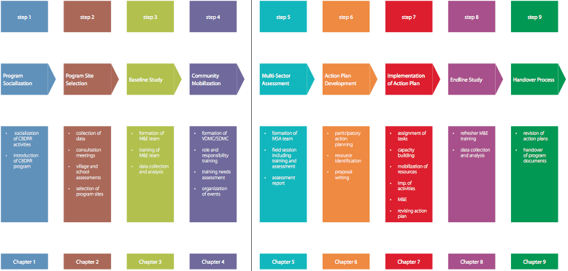
Chapter Overview

Slide 11

Any Questions?

Slide 12
Module 1: Understanding the Basics
CBDRR Framework Training - Myanmar Red Cross Society
Session 2. CBDRR in Myanmar

Slide 13
Session Objectives
At the end of the session, the participants will be able to:
  Explain the essential elements and benefits of CBDRR as well as its fundamental process;
  Understand why CBDRR is relevant for Myanmar;
  Understand the existing natural disaster risks and vulnerability in Myanmar;
  Discuss the current disaster risk reduction institutional and policy arrangements in Myanmar;
  Define the different CBDRR stakeholders in Myanmar; and
  Examine challenges and opportunities in Myanmar with regards to advocating for wide-spread adoption of CBDRR.

Slide 14
Key Elements of CBDRR
What does the term “community” mean?
  Who are the first to be affected by a disaster?
  Who are the first to respond to emergencies?
  Who understands the local situation?
  Who can effectively plan for/ prepare for/ respond to disaster? Why?

Slide 15
Key Elements of CBDRR
Participatory process and content
Responsive
Integrated
Proactive
Comprehensive
Multi-sectoral and multi-disciplinary
Empowering
Developmental

Slide 16
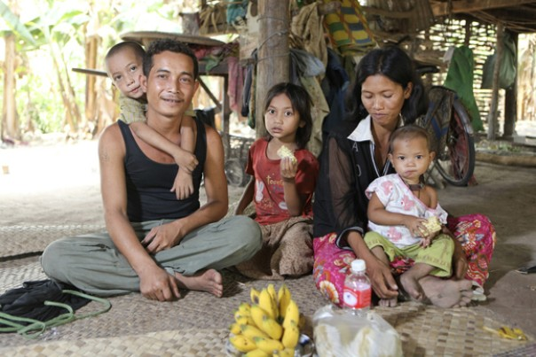
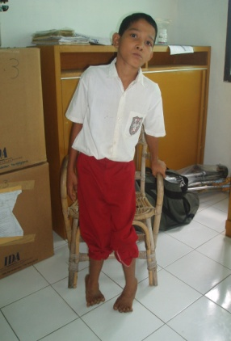
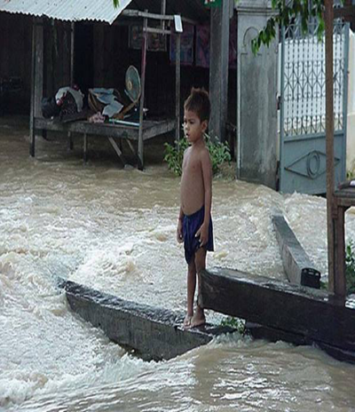
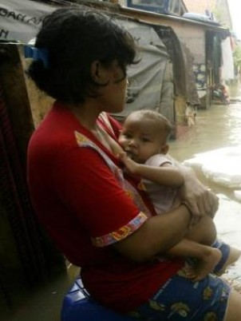
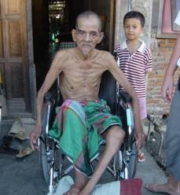
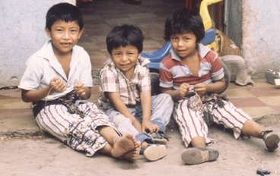
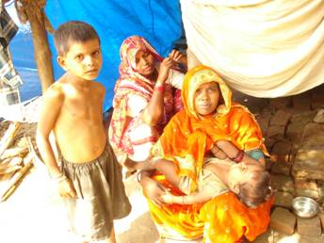
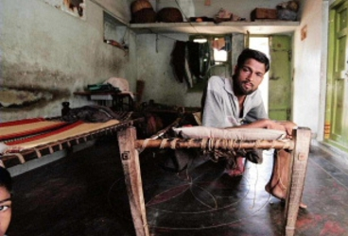
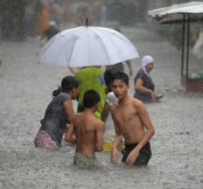
Participatory Process
Involvement of vulnerable groups in the whole process of CBDRR.

Slide 17
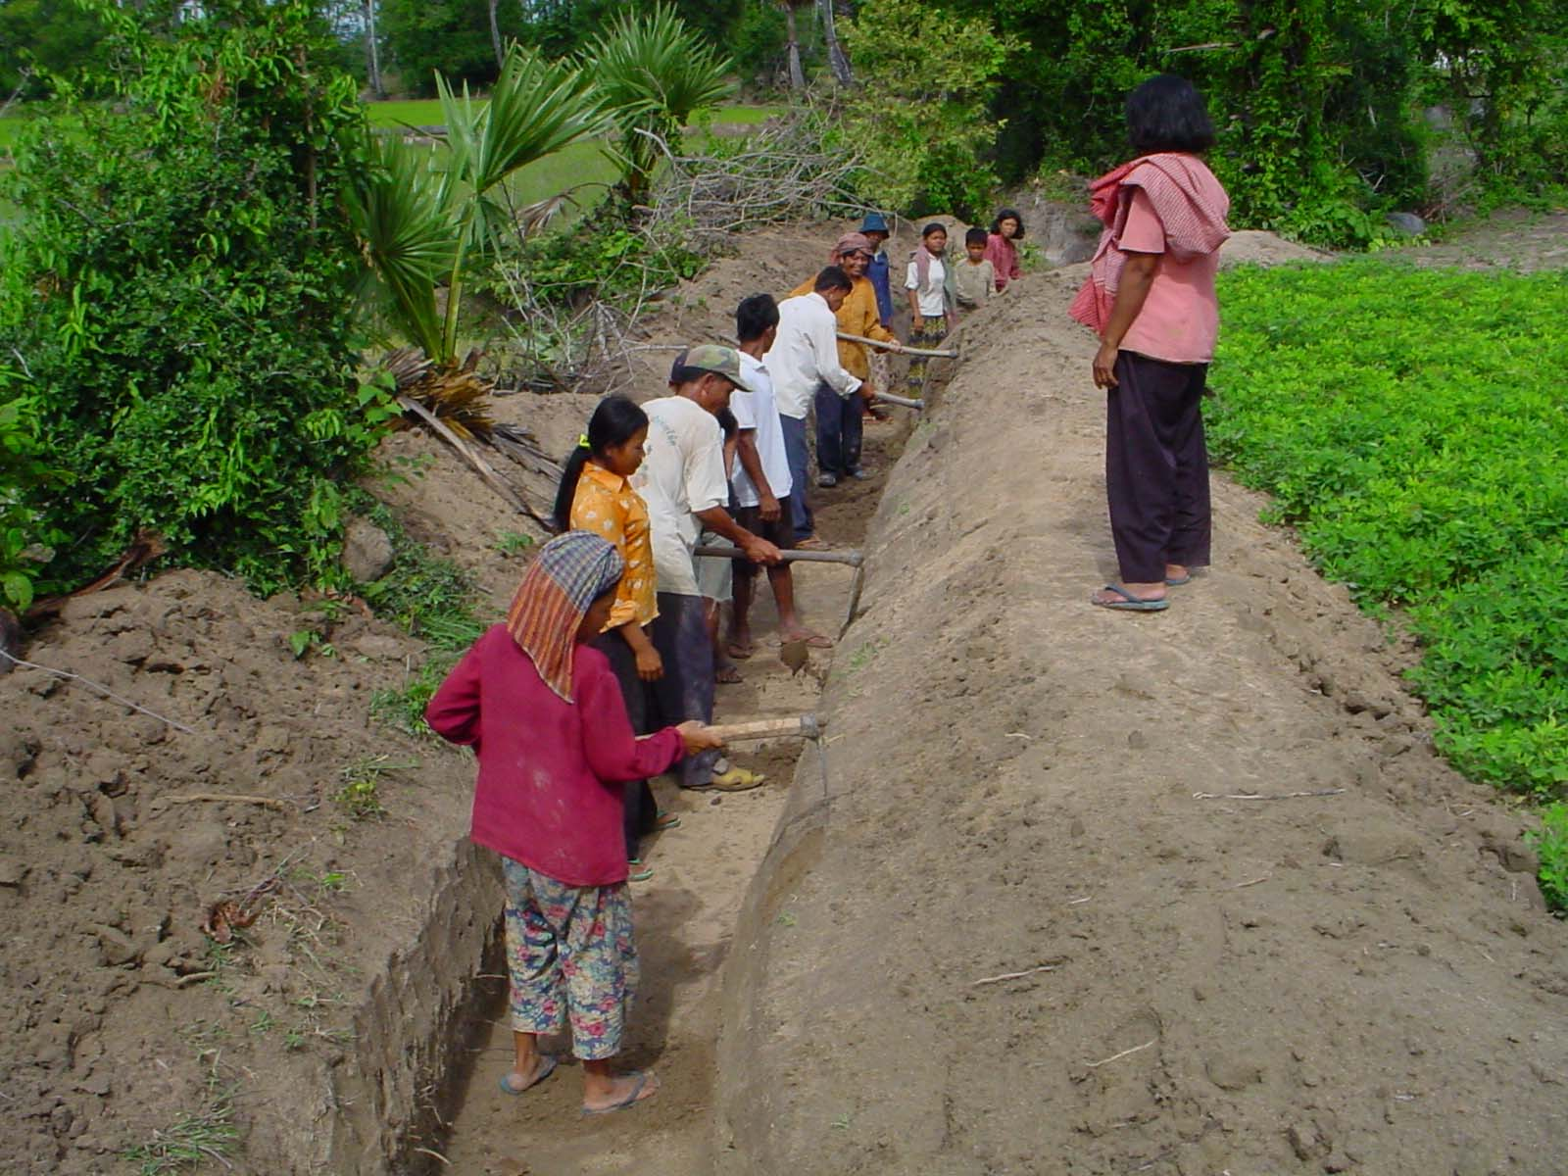
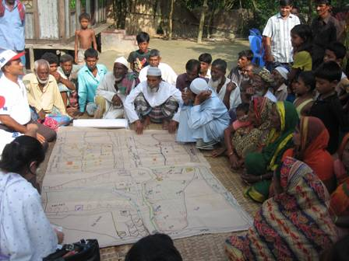
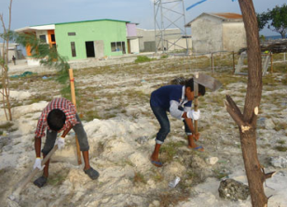
Responsive
Community involvement lead to actions and ownerships

Slide 18
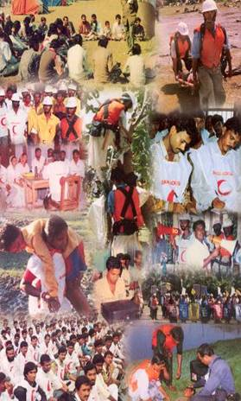
Integrated
Pre, during and post disaster measures are planned and implemented by the community. Link to communities, and stakeholders to get external support.

Slide 19
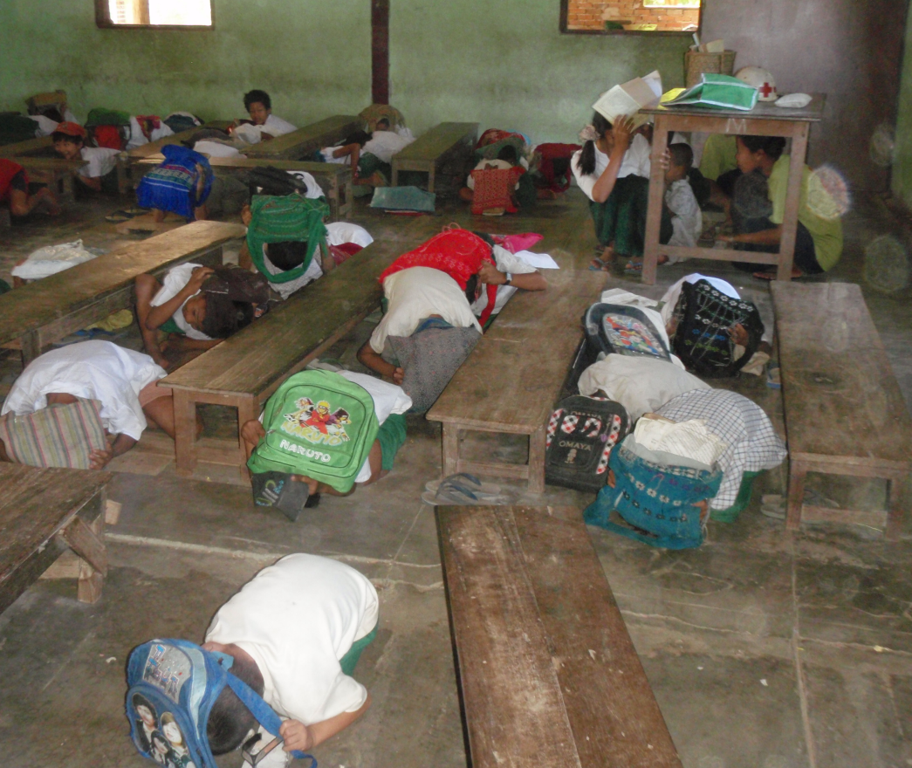
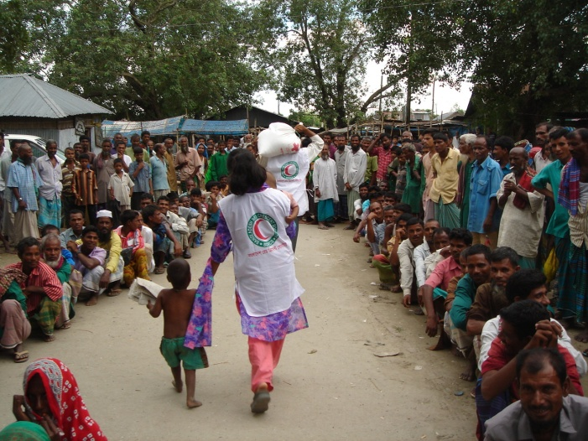
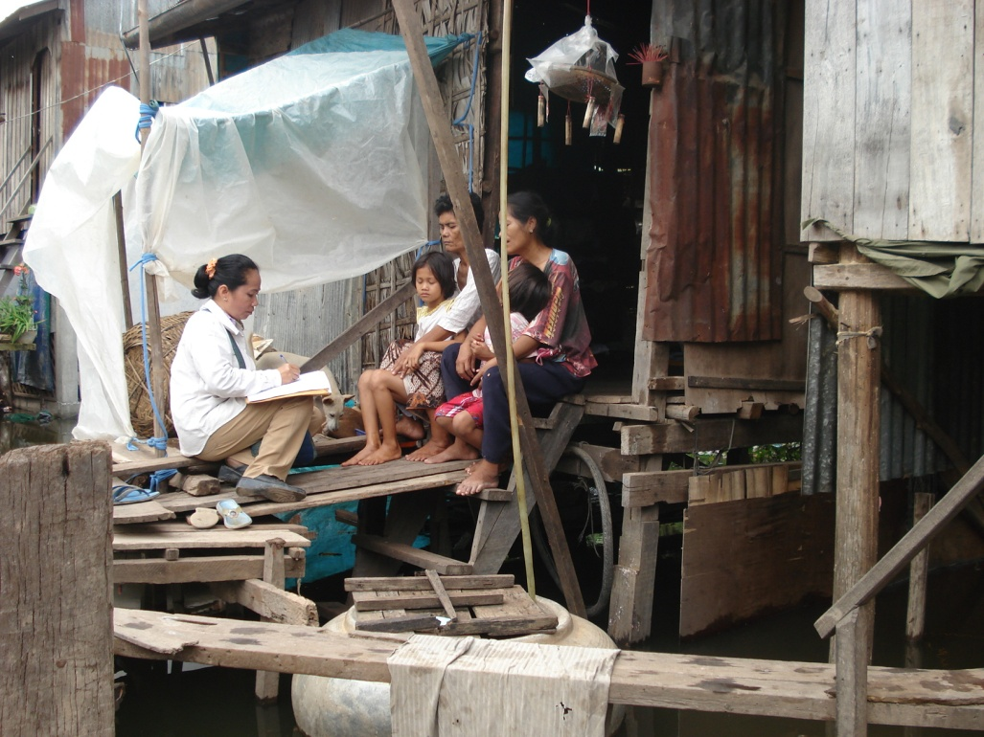
Proactive
Stress on pre-disaster measures of prevention, mitigation and preparedness

Slide 20
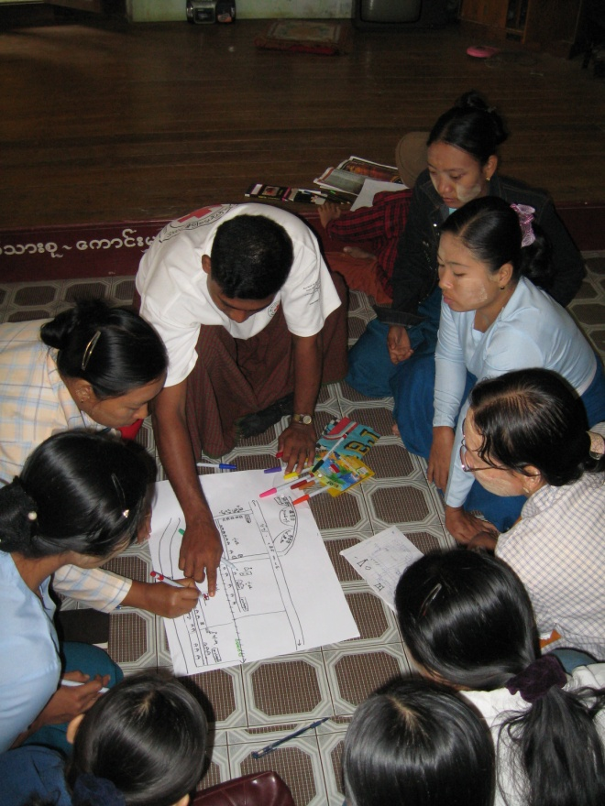
Structural and non-structural preparedness and mitigation measures are undertaken; short-, medium- term and long-term measures to address vulnerabilities
Comprehensive

Slide 21
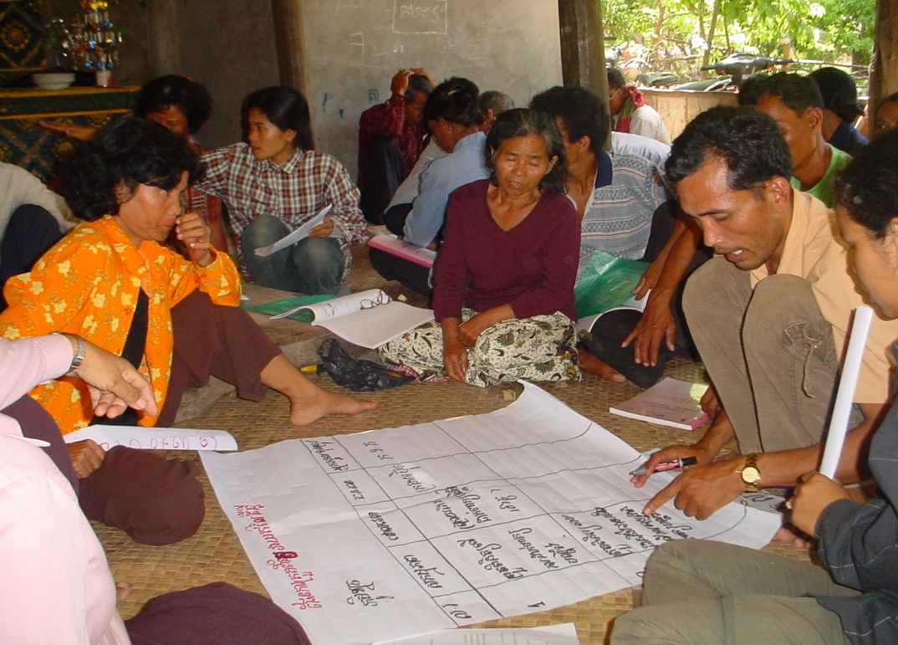
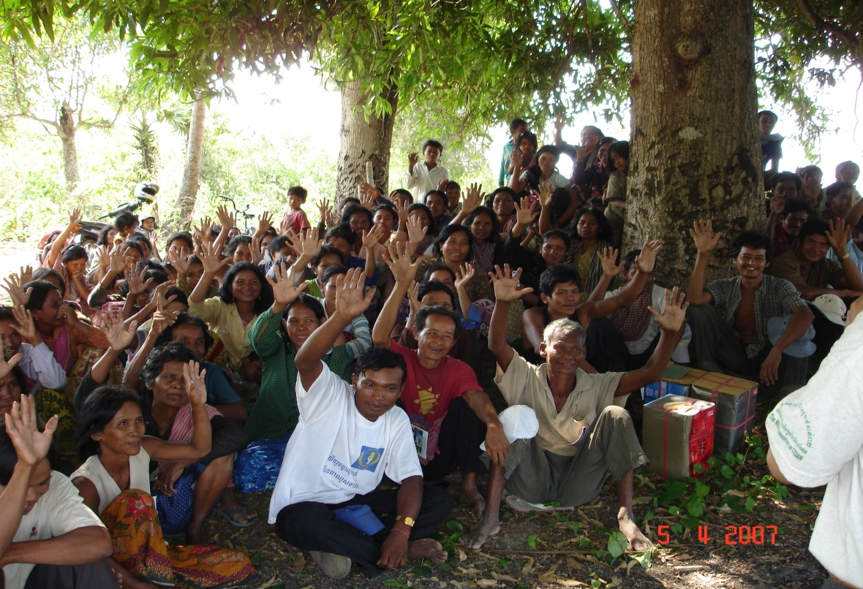
Multi-sectoral and Multi-disciplinary
Consider roles and participation of all stakeholders in the community

Slide 22
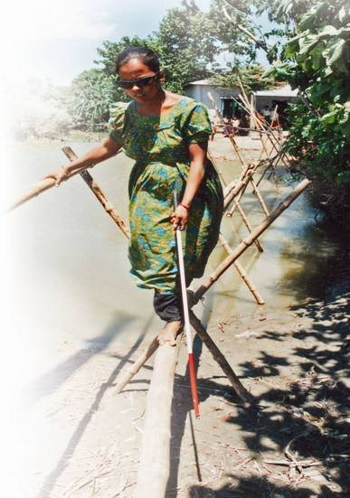
Empowering
People’s options and capacities are increased; more access to and control of resources and basic social services. More meaningful participation in decision making.

Slide 23
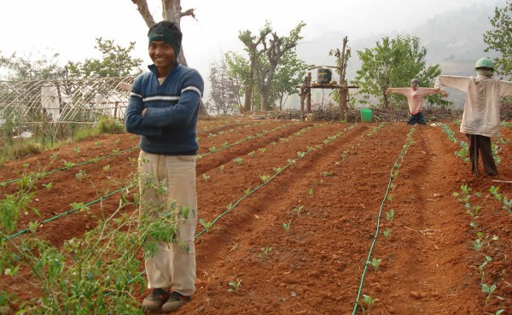
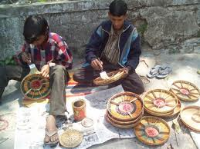
Contributes to addressing and reducing the complex relation of conditions, factors and processes of vulnerabilities present in society, including poverty, social inequity and environmental resources depletion and degradation
Developmental

Slide 24
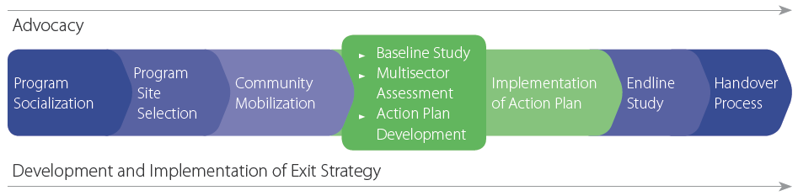
Process of CBDRR

Slide 25
Challenges and Opportunities
Challenges | Opportunities
Lack of political support Poverty Existing DRR capacity on the ground Weak social and physical infrastructure Inadequate DRR information Socio-cultural issue Unequal involvement of stakeholders | Existence of national level DRR framework Presence of existing guidelines Increased awareness on DRR Availability of resources Existence of CBDRR advocates

Slide 26
Any Questions?

Slide 27
Module 1: Understanding the Basics
CBDRR Framework Training - Myanmar Red Cross Society
Session 3. Key Concepts and Terminology

Slide 28
Session Objectives
At the end of this session, the participants will be able to
  Explain basic terms and concepts related to community based disaster risk reduction (CBDRR)

Slide 29
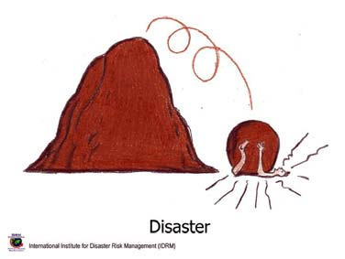
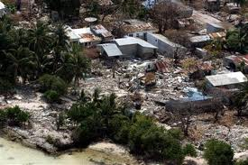
Disaster
The serious disruption of the functioning of society, causing widespread human, material or environmental losses, which exceed the ability of the affected people to cope using their own resources.
An event, either human-induced or natural, sudden or progressive, causing widespread human, material or environmental losses.

Slide 30
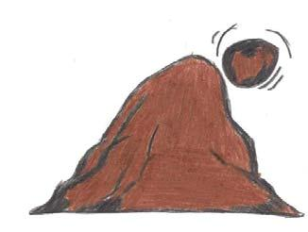

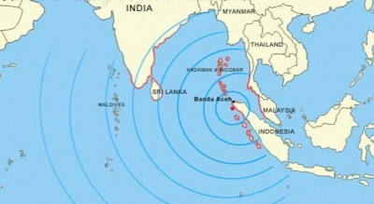
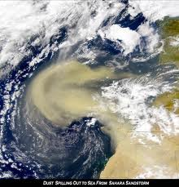
Hazard
A dangerous phenomenon, substance, human activity or condition that may cause loss of life, injury or other health impacts, property damage, loss of livelihoods and services, social and economic disruption, or environmental damage.
(UNISDR 2009)
There is a potential for occurrence of an event
Biological Hazards
Hydrometeorological Hazards
Geological Hazards

Slide 31
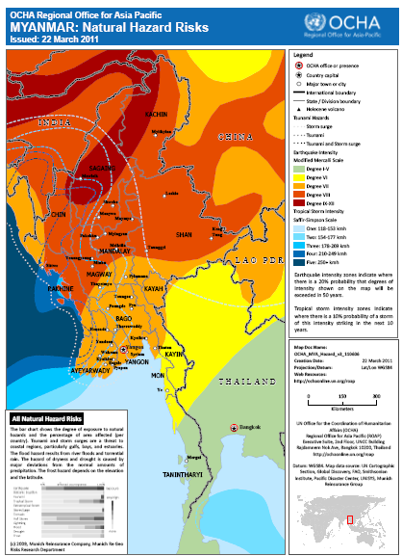
Potential Hazards in Myanmar
OCHA, March 2011

Slide 32

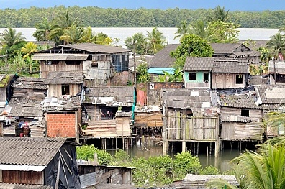
Vulnerability
The characteristics and circumstances of a community, system or asset that make it susceptible to the damaging effects of a hazard.
(UNISDR 2009)
There are many aspects of vulnerability, arising from various physical, social, economic, and environmental factors.

Slide 33
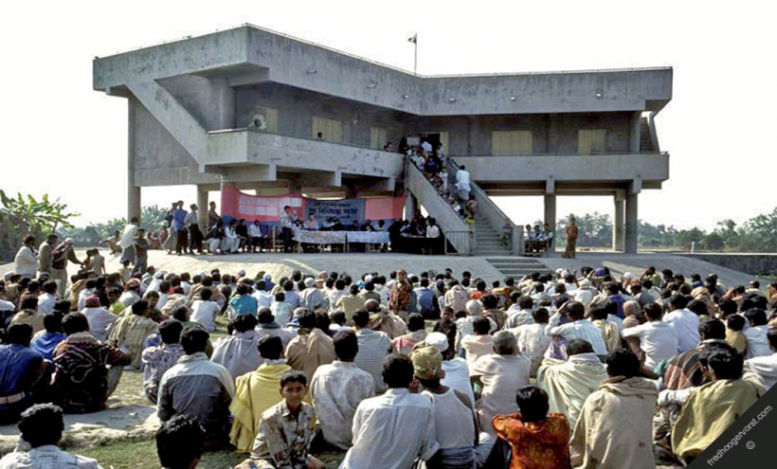
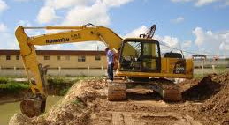
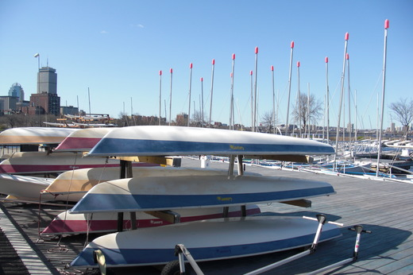
Capacities
Those positive condition or abilities which increase a community’s ability to deal with hazards.

Slide 34
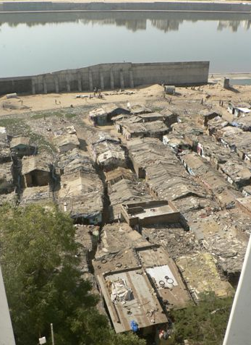
Exposure of Elements At-Risk
People, property, systems, or other elements exposed to known hazard, which are likely to be adversely affected by the impact of the hazard.
Riverfront slums, Ahmedabad, February, 2010
http://affordablehousinginstitute.org/blogs/us/2010/02/a-snapshot-of-indias-housing-situation-part-2-the-opportunities.html

Slide 35
Risk
The probability of harmful consequences, or expected losses (deaths, injuries, property, livelihoods, economic activity disrupted or environment damaged) resulting from interactions between natural or human-induced hazards and vulnerable conditions.
Disaster Risk = Hazard x Vulnerability x Exposure
      Capacity

Slide 36
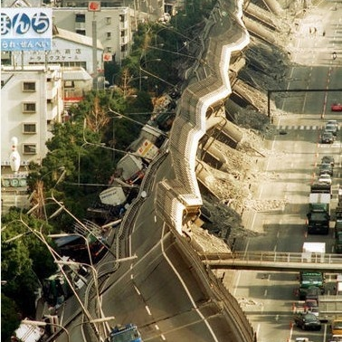
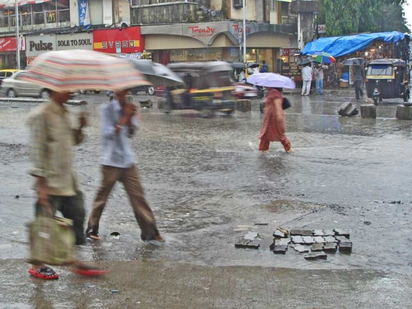
Intensive and Extensive Risk
Extensive risk
Risk of low severity, high frequency disasters
Mainly associated with highly localized hazards
Intensive risk
Risk of high severity, low frequency disasters
Mainly associated with major hazards

Slide 37
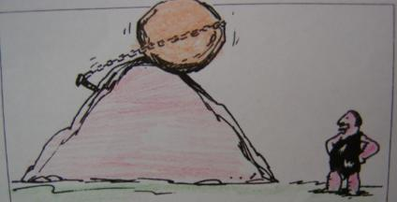
Prevention
The outright avoidance of adverse impacts of hazards and related disasters (ISDR, 2009).

Slide 38
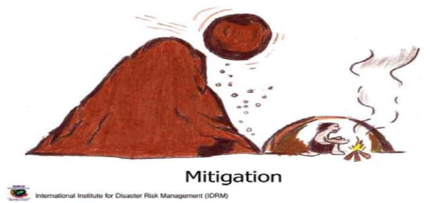
Mitigation
The lessening or limitation of the adverse impacts of hazards and related disasters (ISDR, 2009).

Slide 39
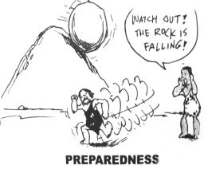
Preparedness
The knowledge and capacities developed by governments, professional response and recovery organizations, communities and individuals to effectively anticipate, respond to, and recover from, the impacts of likely, imminent or current hazard events or conditions (ISDR, 2009).

Slide 40
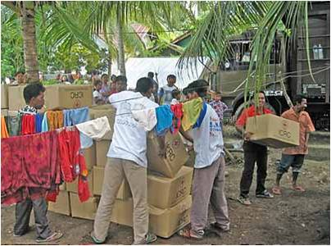
Response/Relief
The provision of emergency services and public assistance during or immediately after a disaster in order to save lives, reduce health impacts, ensure public safety and meet the basic subsistence needs of the people affected. (ISDR, 2009)
  Focused on immediate and short-term needs and is sometimes called “disaster relief”
  Division between the response stage and the subsequent recovery stage is not clear-cut
  Response actions, such as the supply of temporary housing and water supplies, may extend well into the recovery stage
Post Tsunami food, water and shelter provisions Banda Aceh, Indonesia source: FAO 2005

Slide 41

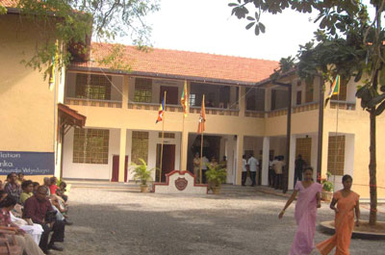
Recovery
The restoration, and improvement where appropriate, of facilities, livelihoods and living conditions of disaster-affected communities, including efforts to reduce disaster risk factors.

Slide 42
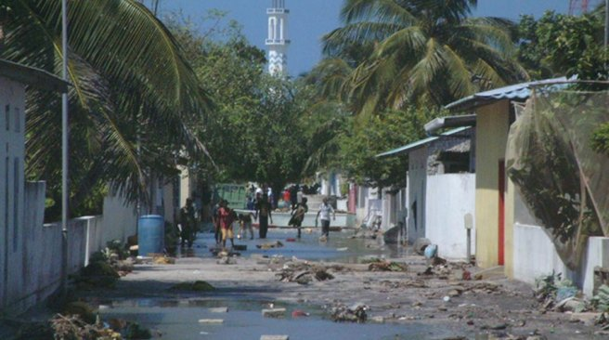
Underlying Risk Drivers
Development-related processes such as badly planned and managed urban and regional development, environmental degradation and poverty, which shape risk patterns and trends
The destruction caused to Baa Atoll Eydhafushi by the Tsunami in 2004. FILE PHOTO

Slide 43
Disaster Risk Reduction
The concept and practice of reducing disaster risks through systematic efforts to analyze and manage the causal factors of disasters, including through reduced exposure to hazards, lessened vulnerability of people and property, wise management of land and the environment, and improved preparedness for adverse events (ISDR, 2009).

Slide 44

Prospective, corrective and compensatory risk management
Prospective risk management
Designed to avoid the construction of new risks, i.e. better planning
Corrective risk management
Designed to address pre-existing risks
Compensatory risk management
Designed to avoid disaster losses spilling over into poverty and other outcomes, i.e. insurance and risk transfer

Slide 45
Community-Based Disaster Risk Reduction
A process of disaster risk reduction in which at-risk communities are actively engaged in the
identification
analysis
treatment
monitoring and evaluation
of disaster risks in order to reduce their vulnerabilities and enhance their capacities.
This means that people are at the heart of decision making and implementation of disaster risk reduction activities.

Slide 46
Group Work
Tagging
Divide into groups of 4-7 members.
Each group is provided with a drawing
Each group has 10 minutes to discuss to identify Hazard, Vulnerability and Capacity in the drawing
Then, list down in the table below and present to other groups
Hazard | Vulnerability | Capacity

Slide 47
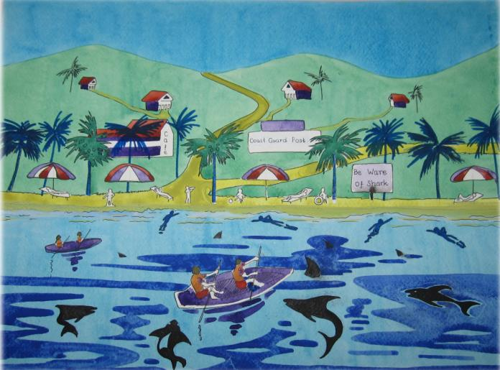

Slide 48
Any Questions?

